Slide 1

11. AI Across Civil and Architectural Engineering
The big picture
Week 11 · CE/ARCE 2XX AI Literacy for Civil and Architectural Engineering
Notes:
Today we zoom out. After ten weeks of methods, we tour where AI is used across the whole life of infrastructure and buildings, in every CE and ARCE sub-discipline. We use real Arizona bridge data to see why engineering data is hard, and you will practice analyzing a case. This week's lab on Arizona bridges is a template for your project; proposals are due Sunday.

Slide 2
Agenda
Today's plan
1
Quiz on Week 10 (AI agents)
2
Where AI fits in the life cycle of an asset
3
A tour by sub-discipline: seven examples
4
Digital twins, and combining physics with data
5
Why CE and ARCE data is hard
6
Case-study jigsaw
7
Lab 11 preview and your project proposal
Notes:
Timing guide (75 min): quiz on Week 10, 6; recap and objectives, 3; life cycle and task types, 6; tour, 18 (about 2 min per example; the geotechnical and water slides are pre-reading, so give them 30 seconds each); digital twins and physics + data, 9; why the data is hard, 8; jigsaw, 16; lab preview, proposal, wrap-up, 5; buffer, 4. If you run late, shorten the share-out and the physics-informed ML slide. Reminder: the project proposal (two-page canvas) and the team charter are due Sunday at 11:59 pm.

Slide 3
Recap
Last week in 60 seconds: AI agents
Model + tools + memory + loop
Tool calling
1
2
Observe → think → act → observe, until done or a step limit stops it.
The model writes a JSON request; your code checks it and runs the tool.
Risks
Guardrails
3
4
Compounding errors, wrong inputs, prompt injection, unsafe actions, cost.
Least privilege, human approval, limits, logs, tests — and use the simplest tool that works.
Notes:
Ask one student to explain the agent loop in their own words, and another what went wrong in their Lab 10 test tasks. Today's applications include several where an agent would be overkill — keep asking 'what is the simplest tool that works?'

Slide 4
Learning objectives
By the end of today, you can…
Place AI applications on the life cycle: plan, design, build, operate, maintain, renew
✓
For an application, name its input data, AI task type, and output
✓
Explain digital twins, surrogate models, and physics-informed ML
✓
Explain why CE/ARCE data is hard — and why accuracy misleads for rare failures
✓
Analyze a case study and judge whether AI fits the task
✓
Notes:
These map to CLO6 (identify AI applications across CE/ARCE and evaluate them) and support CLO8 (the project). The input → task → output habit is the main skill today.

Slide 5
01
The life cycle
AI can help in every phase of an asset's life
Notes:
Section 1, about 6 minutes.

Slide 6
The life cycle
AI shows up in every phase of an asset's life
Design
surrogates · generative design · code checks
Plan
forecast demand · screen sites
Build
safety video · progress · scheduling
Decades of service
Bridges are often designed for 75 years
Renew
rank bridges and pipes for repair
Operate
energy forecasts · HVAC and signal control
Maintain
crack detection · health monitoring
Notes:
Walk around the cycle. Plan: forecast demand (traffic, water, energy) and screen sites. Design: fast surrogate models and generative design explore options; code checking. Build: site-safety video, progress tracking against the model, scheduling. Operate: energy forecasts, HVAC and traffic-signal control. Maintain: crack detection and structural health monitoring. Renew: rank which bridges or pipes to repair or replace. Then the cycle repeats. Key idea: assets last decades — U.S. bridge design specifications (AASHTO LRFD) use a 75-year design life — so data collected in one phase is used in the next.

Slide 7
The life cycle
Six task types cover most engineering AI
WEEKS 3–5
WEEKS 4–6
WEEK 6
Regression
Classification
Detection
Predict a number. Heating load (kWh/m²) from building shape.
Pick a category. Cracked or not; poor deck or not.
Find where things are in an image: hard hats, potholes, spalls.
WEEK 6
WEEK 1 MAP
WEEKS 7–8
Forecasting
Optimization
Generation
Predict future values in a time series: traffic next hour, river level tonight.
Choose the best option under limits: repairs within a budget, HVAC setpoints.
Create new content: reports, code, images, design options.
Notes:
This vocabulary is the lens for the tour. For every example, ask: what goes in, which of these six tasks is it, and what comes out? Anomaly detection — learning 'normal' and flagging the rest — is a close cousin of classification that we meet in structural health monitoring. Many real systems chain two types: predict, then optimize.

Slide 8
02
A tour by sub-discipline
Seven examples: input data → AI task → output
Notes:
Section 2: the tour takes about 18 minutes, not counting the opening quiz. Keep each example to about 2 minutes; the geotechnical and water slides are assigned as pre-reading. These are typical, real-world-style applications described generically; details vary by agency and vendor.

Slide 9
Structural
Health monitoring learns “normal” and flags the unusual
INPUT DATA
Who uses it
Acceleration and strain time series from sensors on a bridge or tall building, plus air temperature
Owners of long-span bridges, tall buildings, and stadiums; researchers
Watch out
AI TASK · ANOMALY DETECTION
Learn the normal vibration pattern (e.g., natural frequencies) from a healthy period; flag departures
Temperature and traffic also shift frequencies → false alarms. Few or no “damaged” examples.
Also in this field
OUTPUT
Crack and spall detection in photos (Week 6); fast surrogate models for design (later today)
An alert with the time and sensor location → an engineer inspects
Notes:
Structural health monitoring (SHM) uses sensors permanently installed on a structure. Damage such as a loss of stiffness changes how a structure vibrates, for example its natural frequencies. Because damaged-structure data is rare, models usually learn what 'normal' looks like and flag anything unusual — unsupervised learning from Week 2. Researchers have shown that temperature can change natural frequencies by a few percent, which is the same order as some damage, so the model must account for it.

Slide 10
Geotechnical · pre-reading
Mapping where slopes are likely to fail
INPUT DATA
Who uses it
Map layers per grid cell: slope angle, geology, soil, rainfall, land cover, distance to roads and streams — plus past landslides
Geological surveys, state departments of transportation (DOTs), and planners
Watch out
AI TASK · CLASSIFICATION
Landslide or not, for every cell, as a probability — often logistic regression or a random forest (many decision trees that vote)
Inventories miss small or old slides. Nearby cells look alike, so test on a separate region.
Also in this field
OUTPUT
Soil classification from cone penetration tests (a cone pushed into the ground measures resistance)
A susceptibility map (low → very high) for routing roads and pipelines
Notes:
Pre-reading slide (required reading in the README): in class, spend about 30 seconds — ask one student for the input → task → output. Landslide susceptibility mapping is one of the most studied ML applications in geotechnical and engineering geology work. Each map cell is one example; the label comes from an inventory of past landslides. The 'watch out' is important and general: when examples are spatially close, a random train/test split leaks information, and the test score looks better than it will be in a new area. The same problem appears in our bridge data.

Slide 11
Transportation
Forecasting how many vehicles are coming
INPUT DATA
Who uses it
Hourly counts from road sensors or cameras, time of day, day of week, holidays, weather (like Lab 06's I-94 data)
State DOTs and city traffic operations centers
Watch out
AI TASK · FORECASTING
A sliding window of recent hours predicts the next hour's volume (vehicles/h)
Crashes, events, and new roads break past patterns. Always beat a naive baseline.
Also in this field
OUTPUT
Pavement cracks and potholes from vehicle cameras (detection); adaptive signals; automated vehicles
Predicted vehicles/h per road segment → signal timing, ramp meters, work-zone schedules
Notes:
This is the optional bonus from Lab 06. A naive baseline such as 'same hour last week' is surprisingly hard to beat for traffic, so any model must be compared against it. Pavement condition from images is another common application: cameras on vehicles, a CNN finds cracks, and a pavement condition index is computed for maintenance planning.

Slide 12
Water and environment · pre-reading
Forecasting river levels hours ahead
INPUT DATA
Who uses it
Rain gauges and radar, upstream stream gauges (level and flow), soil moisture, weather forecasts
Flood control districts, forecasters, and water utilities
Watch out
AI TASK · FORECASTING
Predict water level or flow 1–24 h ahead — often an LSTM (Week 6) or a hybrid with a hydrologic model
The biggest floods are the rarest in the record. Gauges can fail in the very storms you care about.
Also in this field
OUTPUT
Leak detection from pressure and acoustic sensors in water mains; water quality; stormwater
A forecast hydrograph (level over time) + a warning when a threshold is crossed → close crossings
Notes:
Pre-reading slide (required reading in the README), and the background for jigsaw expert group B (flash-flood warning); in class, spend about 30 seconds. A hydrograph is a plot of water level or flow over time. Researchers have shown that LSTM networks can forecast streamflow well, especially when trained on many watersheds. In Arizona the summer monsoon brings flash floods to dry washes and low-water road crossings, so short-range forecasts matter. Ask: what is the cost of a missed warning versus a false alarm? That trade-off returns in the bridge example.

Slide 13
Construction
Spotting missing hard hats in site video
INPUT DATA
Who uses it
Frames from site cameras or drones, labeled with boxes around workers, hard hats, and vests
General contractors and safety managers
Watch out
AI TASK · OBJECT DETECTION
A CNN-based detector finds each worker and checks for PPE (personal protective equipment: hard hat, vest)
Worker privacy. Misses at night, in rain, or when people are partly hidden. Not a replacement for a competent person.
Also in this field
OUTPUT
Progress tracking (site scans vs the BIM model); schedule risk; cost estimating from past bids (regression)
Boxes on the image + an alert to the safety manager; weekly trend reports
Notes:
Object detection is the Week 6 CNN idea extended to drawing boxes around objects. PPE means personal protective equipment. In OSHA rules a 'competent person' is someone able to identify hazards who has authority to fix them — a camera system does not have that authority. Privacy returns in Week 13. Cost estimating is a regression problem: predict a bid price from project features and past bids.

Slide 14
Building systems (ARCE)
Predict building energy use, then control it
INPUT DATA
Who uses it
Geometry and envelope, schedules, weather, smart-meter and building-automation trend data
Energy engineers, facility managers, and early-stage designers
Watch out
AI TASK · REGRESSION → OPTIMIZATION
Predict heating, cooling, or hourly energy (as in Lab 05); then search setpoints that cut energy within comfort limits
Models trained on one climate or building type transfer poorly (Phoenix is not Belgium). Enforce comfort and safety limits.
Also in this field
OUTPUT
Fault detection; occupant comfort; daylighting; generative design of layouts and façades; BIM queries
Energy forecasts, recommended setpoints and schedules, fault alerts (e.g., a stuck damper)
Notes:
This chains two task types: a regression model predicts energy, and an optimizer searches for the settings that minimize it while keeping comfort. The house energy dataset in our data folder comes from a low-energy house in Belgium, a very different climate from Phoenix — a reminder about distribution shift (Week 13). A damper is a plate in a duct that controls airflow; a stuck damper wastes energy quietly for months.

Slide 15
Asset management
Which bridges need attention first?
INPUT DATA
Who uses it
Inventory and inspection records: age, material, design type, traffic, truck share, past ratings (the National Bridge Inventory)
State DOTs, counties, and cities
Watch out
AI TASK · CLASSIFICATION + OPTIMIZATION
Predict which decks will be rated poor; then choose repairs that cut the most risk within the budget
Poor decks are rare — about 1% in Arizona. Ratings are human judgments. A model never replaces an inspection.
Also in this field
OUTPUT
Deterioration models predict condition years ahead; pavement and pipe management work the same way
A risk-ranked list of bridges for inspection or repair → engineers decide
Notes:
This is exactly this week's lab. The National Bridge Inventory (NBI) is the Federal Highway Administration's database of U.S. highway bridges, updated from routine inspections: at most every 24 months by default, at most every 12 months if any component is rated 3 or less, and up to 48 months for qualifying bridges rated 6 or better (23 CFR 650.311). Inspectors rate the deck, superstructure, and substructure from 0 (failed) to 9 (excellent). The next two slides use the real 2024 Arizona file.

Slide 16
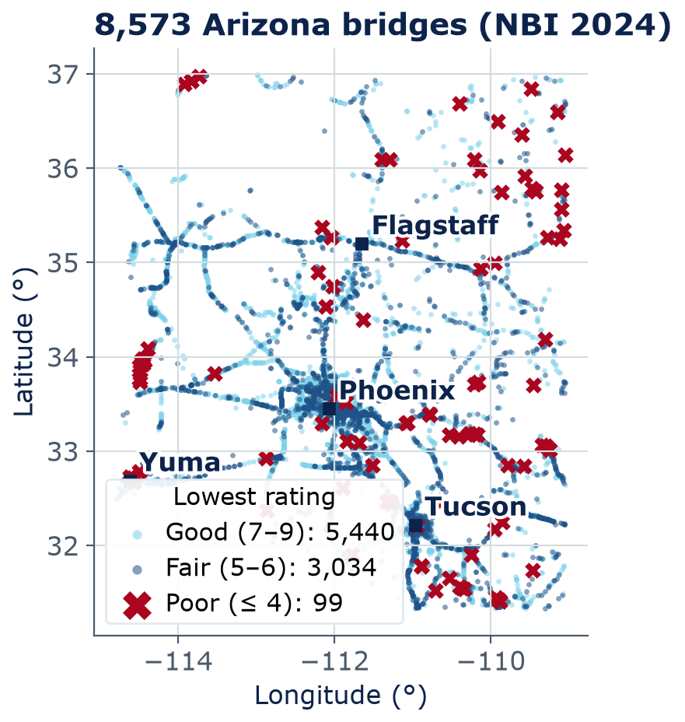
Asset management
8,573 Arizona bridges: most are fair or good
All 8,573 structures, by lowest component rating: good 5,440 (63%) · fair 3,034 (35%) · poor bridges 99 (1.2%) (any component ≤ 4)
Poor bridges are not spread evenly: 44 of the 99 are owned by tribes or the Bureau of Indian Affairs (BIA) — 11% of those 388 bridges
Their repair is funded through a separate federal program (23 CFR 661): an infrastructure-investment question
56% of the rows are culverts, which get a culvert rating instead of a deck rating
Source: FHWA National Bridge Inventory, Arizona 2024
Notes:
Each dot is one bridge; together they trace the highway network. Color AND marker shape show condition by the FHWA rule, using the lowest of the deck, superstructure, substructure, or culvert rating: good 7 or more, fair 5-6, poor 4 or less. These 99 are poor BRIDGES (any component, all 8,573 structures); slide 26 counts the 41 poor DECKS among the 3,762 bridges that have a deck rating, so the two numbers measure different things. Ask: where are the poor bridges? They are not spread evenly: 44 of the 99 are owned by tribal governments or the Bureau of Indian Affairs (BIA) — 11% of those 388 bridges, compared with 19 of 4,877 state-owned bridges (0.4%). Context (federal regulations): BIA- and tribally owned bridges are inspected to the federal standards, with reports reviewed by the BIA Division of Transportation (25 CFR 170.513-170.514), and their repair or replacement competes for a dedicated federal set-aside, the Tribal Transportation Facility Bridge Program for bridges in poor condition (23 U.S.C. 202(d); 23 CFR 661). INSTRUCTOR NOTE: frame this as an infrastructure-investment question — how bridge funding and inspection are organized and resourced — never as a judgment of tribal agencies or communities. The data cannot tell us why. Do not call on any student to speak for a group because of their identity. We return to whose infrastructure is in the data in Week 13. Also note that 56% of the rows are culverts.

Slide 17
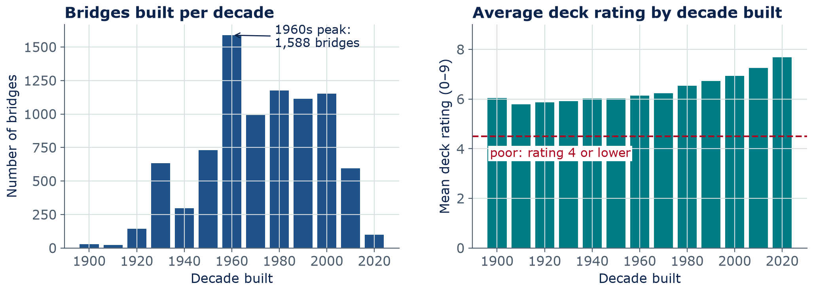
Asset management
Older Arizona bridges have lower deck ratings
Left: all 8,573 bridges. Right: the 3,762 bridges with a deck rating. Source: FHWA NBI, Arizona 2024.
Notes:
Left: many bridges were built in the 1960s, the era of Interstate construction, so a large group is now about 60 years old. Right: decks on older bridges have lower average ratings. The 41 poor decks average about 74 years old, versus about 44 for the rest. Careful: this is a correlation. Age is a useful feature, but traffic, climate, materials, and repairs also matter — and some old bridges were rebuilt. In this week's lab you will test how well age and other features predict a poor deck.

Slide 18
Concept check
Which task type is it?
A DOT has a risk score for every bridge and must choose which repairs to fund this year to cut the most risk within a fixed budget. Which task type is the choosing step?
Regression
Classification
A
B
Optimization
Generation
C
D
Notes:
Thirty seconds, then vote. Some will say classification because the risk scores came from a classifier — that is the step before. Real systems often chain predict-then-optimize, as in the building-energy example.
Answer: C. Choosing the best set of actions under a limit (the budget) is optimization; the risk scores came from classification.

Slide 19
Concept check
Which task type is it? — answer
A DOT has a risk score for every bridge and must choose which repairs to fund this year to cut the most risk within a fixed budget. Which task type is the choosing step?
Regression
Classification
A
B
Optimization
Generation
C
D
Choosing the best set of actions under a limit (the budget) is optimization; the risk scores came from classification.
Notes:
Answer: C. Choosing the best set of actions under a limit (the budget) is optimization; the risk scores came from classification.

Slide 20
03
Digital twins, physics + data
Models that stay connected to the real asset
Notes:
Section 3, about 10 minutes.

Slide 21
Digital twins
A digital twin stays connected to the real asset
Physical asset
Digital twin
data streams in
A specific bridge, building, or water network
Sensors: strain, vibration, temperature, flow, energy meters
BIM: geometry and components
Physics model (finite element, energy, hydraulic)
decisions go back: inspect, repair, adjust controls
ML models: forecasts, anomalies
Digital model
no automatic data link
Digital shadow
data flows in, one way
Digital twin
data in, decisions out
Notes:
A digital twin is a digital model of a specific physical asset that is updated with data from that asset and is used to make decisions about it. The bottom strip gives a useful distinction from the manufacturing literature (Kritzinger et al., 2018): a digital model has no automatic data link; a digital shadow receives data automatically one way; a digital twin also sends decisions back. Many products called 'digital twins' are really shadows, and that is fine — ask which one it is. The 2024 National Academies report on digital twins is in the readings.

Slide 22
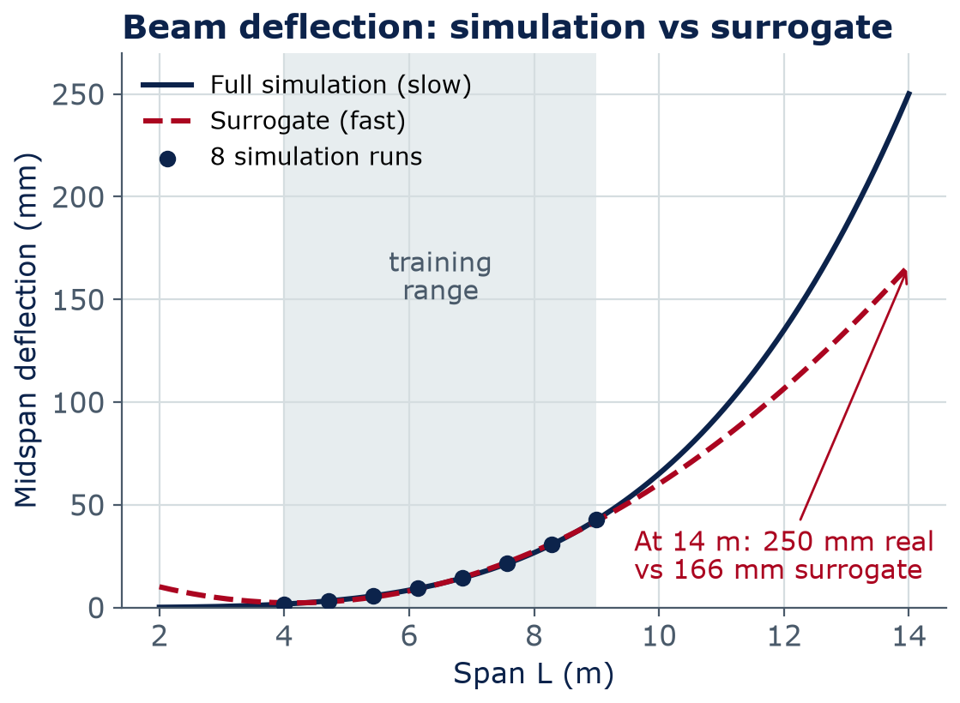
Physics + data
Surrogate models: fast, but only inside their range
A surrogate is a fast ML model trained on runs of a slow physics model (e.g., finite-element analysis)
Explore thousands of design options in seconds — then check the best few with the full model
Inside the training range it can be very close…
…outside, it can be badly wrong: here it under-predicts deflection by a third at 14 m — the unsafe direction
This beam fails L/360 at 14 m anyway (250 mm ≈ L/56); a surrogate only screens options
Notes:
Finite-element (FE) analysis can take minutes to hours per run, so engineers train a fast model on a few hundred runs and use it to search designs. Here, to keep it transparent, the 'slow simulation' is the beam formula 5wL^4/(384EI) for w = 15 kN/m, E = 200 GPa, I = 1.5x10^8 mm^4, and the surrogate is a quadratic fitted to 8 runs between 4 and 9 m. Inside that range it is within about 1 mm. At 14 m it predicts 166 mm instead of 250 mm: unconservative. Rule: always know a surrogate's training range, and verify the final design with the full model. Note that this one section fails the L/360 deflection limit at 14 m by about 6 times (250 mm is about L/56), so no engineer would pick it there: the surrogate's job is only to screen options quickly; a real design would also vary the section (I) as an input.

Slide 23

Physics + data
Physics-informed ML adds a physics penalty
J_data
error against measurements — the cost from Week 3
J_physics
how badly predictions break physics (e.g., mass balance)
λ
a weight you choose: how much to trust physics vs data
Example: a water-network model penalized whenever flow into a junction ≠ flow out
Notes:
Same recipe as Weeks 3-5: minimize a cost with gradient descent. Physics-informed ML adds a second term that penalizes predictions that break a known equation, so the model needs less data and behaves more sensibly between and beyond the data points. Physics-informed neural networks (PINNs) were popularized by Raissi, Perdikaris and Karniadakis (Journal of Computational Physics, 2019). Example: a pipe-network model that must conserve mass at every junction. It helps most when data is scarce — which, as we will see next, is usual in CE and ARCE.

Slide 24
04
Why CE and ARCE data is hard
Small, rare, long-lived, and safety-critical
Notes:
Section 4, about 10 minutes.

Slide 25
Why the data is hard
Six reasons engineering data is harder than web data
Small data
Rare failures
Long lifespans
1
2
3
Hundreds of bridges or test cylinders, not millions of photos. Every sample costs money.
Collapses and big floods are rare, so models see few examples of what matters most.
Assets last 50–100 years; climate, loads, codes, and sensors change meanwhile.
Safety-critical
Codes and liability
Messy records
4
5
6
A wrong answer can hurt people. “Usually right” is not good enough.
Designs must meet codes, and a licensed engineer is responsible for the result.
In our bridge file: 13 rebuild years coded 9999; a 9.8 m culvert listed as 990.6 m wide.
Notes:
Contrast with web-scale AI: image and language models train on billions of examples; a state DOT has thousands of bridges and a handful of failures. Card 6 is real: in the 2024 Arizona NBI file, 13 bridges have a reconstruction year of 9999 (a placeholder), and one 9.8-m-long culvert has a deck width of 990.6 m — almost certainly a data-entry error. Cleaning data is real engineering work; in lab you will meet these values.

Slide 26
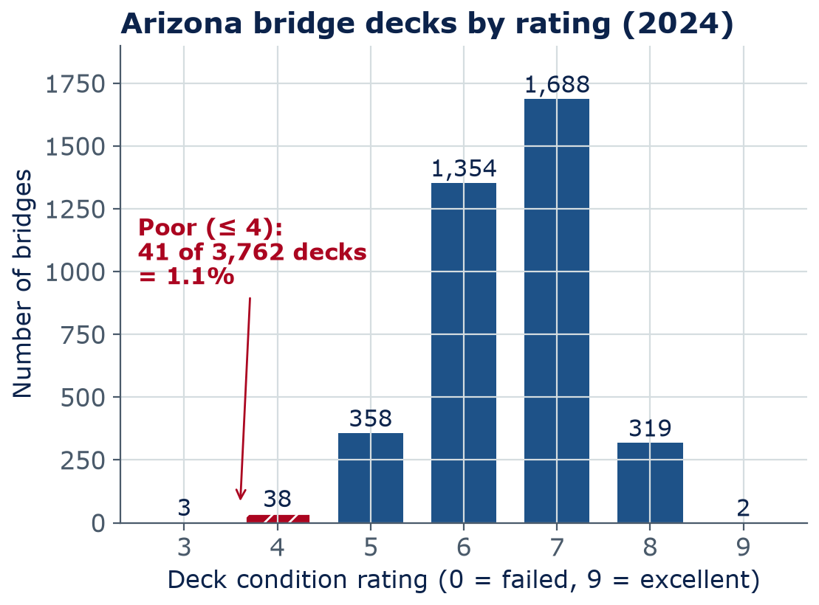
Why the data is hard
Rare failures make accuracy misleading
Of 3,762 rated Arizona decks, only 41 are poor (≤ 4): 1.1%
A “model” that always says “not poor” is 98.9% accurate…
…and finds 0 of the 41 poor decks
Recall = poor decks found ÷ all poor decks. For rare failures, report recall, not just accuracy
Notes:
This is called class imbalance. The poor class is about 1 in 90. A useless model that never predicts 'poor' scores 98.9% accuracy, because 3,721 of 3,762 answers are right. That is why this week's lab compares accuracy with recall for the poor class. (In Week 13 we switch to 'low = rating 5 or less', 399 decks, because 41 is too few to compare subgroups.) Ask: for a bridge owner, which is worse — a false alarm (an extra inspection) or a missed poor deck? Usually the miss, so recall matters most, while keeping false alarms manageable.

Slide 27
Concept check
Recall or precision?
A model flags 90 decks as poor: 30 of them really are poor, and it misses the other 11 of the 41 poor decks. What is its recall for poor decks?
About 33%
About 73%
A
B
About 98%
About 1%
C
D
Notes:
Students may compute 30/90 — that is precision, the share of alarms that were real. Recall asks: of all the poor decks that exist, how many did we catch? Both matter; for safety, missing a poor deck is usually the costlier error.
Answer: B. Recall = 30 ÷ 41 ≈ 73%. (30 ÷ 90 ≈ 33% is precision: the share of flags that were right.)

Slide 28
Concept check
Recall or precision? — answer
A model flags 90 decks as poor: 30 of them really are poor, and it misses the other 11 of the 41 poor decks. What is its recall for poor decks?
About 33%
About 73%
A
B
About 98%
About 1%
C
D
Recall = 30 ÷ 41 ≈ 73%. (30 ÷ 90 ≈ 33% is precision: the share of flags that were right.)
Notes:
Answer: B. Recall = 30 ÷ 41 ≈ 73%. (30 ÷ 90 ≈ 33% is precision: the share of flags that were right.)

Slide 29
05
Case-study jigsaw
Become an expert on one case, then teach your group
Notes:
Section 5, about 16 minutes. Before class, print or post the six case cards (next-but-one slide). Count off students into six expert groups (A-F).

Slide 30
Case-study jigsaw
Jigsaw: one case per group, then teach each other
Expert groups (6 min): each group takes one case (A–F) and fills in the template below
Home groups (8 min): one expert per case; each teaches their case in 1 minute
As a home group, pick the case most ready to deploy and the least ready, with one reason each
Share-out (2 min): two home groups report
16
min
Jigsaw
Template: input data → AI task type → output and who uses it → success metric and baseline → what could go wrong, and who is accountable?
Notes:
Jigsaw logistics: number students 1-6 for expert groups A-F; after 6 minutes, re-form home groups so each has one member from each expert group (for small classes, use 3-4 cases). Walk around and push for specific answers: what exactly are the labels, where do they come from, what is the baseline? Expected debate: the energy forecast (D) and the bridge triage (A) are most ready because outputs are reviewed by people; the code-check agent (F) is least ready because errors are hard to catch and the design professional of record still owns code compliance whatever the agent says.

Slide 31
Case-study jigsaw
Six cases for the expert groups
A · ASSET MANAGEMENT
B · WATER
C · CONSTRUCTION
Bridge deck triage
Flash-flood warning
Hard-hat alerts
A state DOT wants to flag decks likely to be rated poor at the next inspection.
A county wants 1-hour flood warnings at low-water crossings from rain and stream gauges.
A contractor wants camera alerts when someone lacks PPE (hard hat, vest).
D · BUILDING SYSTEMS
E · TRANSPORTATION
F · BUILDING CODES
Campus energy
Street pavement survey
Code-check agent
Facilities wants next-day electricity forecasts for 20 buildings and HVAC fault alerts.
A city wants to rate every street's pavement from city-vehicle dash-camera images.
A design firm wants an LLM agent to check drawings against accessibility rules.
Notes:
These are generic scenarios, not specific real projects. Each maps to a project track: A, B, D are Predict; C and E are See; F is Assist (and testing it would be Evaluate). Encourage teams to reuse their jigsaw analysis in their project proposal.

Slide 32
Lab 11
Lab day: end-to-end ML on Arizona bridges
Frame the question: which bridge decks are rated poor (≤ 4)?
Explore 8,573 bridges: map by latitude and longitude, age vs condition
Build features; compare a baseline (always “not poor”) with logistic regression and a random forest
Accuracy vs recall for the rare poor class; feature importance
Write a 5-sentence engineering memo with caveats — your project template
LAB
11
Bring a charged laptop
Open the notebook from the course GitHub page
Notes:
Lab 11 walks through a complete project in one sitting: question, data, baseline, models, metrics, interpretation, and a memo with limits. Teams doing a Predict project should copy its structure. The lab is AI-Assisted with the usual acknowledgment cell.

Slide 33
Final project
Proposal due Sunday: a two-page project canvas
Due Sunday 11:59 pm with your team charter · one per team · 10% of the project grade
Problem and users
Data and its limits
Method and baseline
Evaluation
Who has the problem? What decision does your work support?
Source, size, labels, license, what is missing.
Your track, your model, and the simple thing to beat.
Which metrics, and what counts as good enough?
Verification
Risks and accountability
Plan and roles
AI-use plan
How you will check results: hand calcs, known answers, tests.
Failure modes, bias, who is responsible.
Who does what; the check-in target; a backup plan.
Which AI tools you will use, for what, and how you will document them.
Notes:
The template is project/templates/proposal-canvas.md on the course GitHub (12 short sections; this slide groups them into 8). The canvas mirrors the jigsaw template and Lab 11's structure, so you have practiced every box. Upload the team charter (project/templates/team-charter.md) with the proposal. Feedback comes back in Week 12; the progress check-in (end of Lab 12 or in Lab 13, in two waves) expects data loaded and a baseline running.

Slide 34
Wrap-up
Key takeaways
AI appears in every life-cycle phase: plan, design, build, operate, maintain, renew
1
Describe any application as input data → task type → output, and ask who acts on it
2
Digital twins stay linked to the real asset; surrogates and physics-informed ML combine physics and data
3
CE/ARCE data is small, imbalanced, long-lived, and safety-critical — check recall, not just accuracy
4
AI ranks, flags, and forecasts; engineers inspect, decide, and stay accountable
5
Notes:
Recap. Next week: AI tools for engineers — how to choose them, use them, and verify their output. Proposal due Sunday.

Slide 35
Learn more
Readings and resources
Google ML Crash Course: accuracy, precision, recall — required: the metrics behind this week's lab (20 min)
FHWA National Bridge Inventory — required: where our Arizona data comes from (10 min)
National Academies (2024): Foundational Research Gaps and Future Directions for Digital Twins — optional: free PDF; the summary (20 min)
Raissi, Perdikaris & Karniadakis (2019): Physics-informed neural networks — the PINN paper — skim the introduction (optional)
Notes:
Required reading (about 35 min, listed in the README): the ML Crash Course page, the NBI page, and the geotechnical and water slides in this deck. The digital twin report and the PINN paper are optional.

