Slide 1

12. AI Tools for Engineers
Choosing, using, and verifying
Week 12 · CE/ARCE 2XX AI Literacy for Civil and Architectural Engineering
Notes:
Welcome back. Today is about the AI tools you will actually use as students, interns, and engineers: what kinds exist, how to pick one, and — most important — how to check what they give you. Start with the 6-minute quiz on Week 11.

Slide 2
Agenda
Today's plan
1
Quiz on last week (Week 11)
2
The AI tool landscape for engineers
3
Choosing a tool: fit, accuracy, privacy, cost, licensing
4
Trust, but verify: the 5-check workflow
5
AI for coding, and documenting AI use
6
Lab 12 preview, HW5, and project feedback
Notes:
Timing guide (75 min): quiz 7 min; landscape 10; choosing a tool 15; the 5-check workflow with two worked examples 25; coding and documentation 12; wrap-up 6. The 5-check workflow is the core of today: Lab 12 and HW5 use exactly the same five names.

Slide 3
Last week in 60 seconds
Week 11 recap: AI across CE and ARCE
1
Every life-cycle stage
2
Every sub-discipline
Plan, design, build, operate, maintain, renew — AI shows up in each one.
From structural health monitoring to flood forecasting, site safety, and HVAC fault detection.
3
Our data is hard
4
Lab 11 lesson
Small data sets, rare failures, long lifespans, safety-critical decisions, codes and liability.
On imbalanced bridge data, accuracy misleads. Check recall for the class you care about.
Notes:
Quick recap, one minute. Last week was the tour: where AI is used across the life cycle and the sub-disciplines. Two lessons carry into today: engineering data is hard, and a single headline number such as accuracy can hide the errors that matter. Today we move from 'where is AI used' to 'how do I, personally, use AI tools well and check them'.

Slide 4
Learning objectives
By the end of today, you can…
Describe the main categories of AI tools and what each is good and bad at
✓
Choose a tool using task fit, accuracy, privacy, cost, and licensing
✓
Apply the 5-check verification workflow to an AI answer and catch its errors
✓
Test AI-written code with known cases and assert before trusting it
✓
Write a clear AI-use acknowledgment statement
✓
Notes:
Read the objectives. Point out that the third one is the heart of the lecture and of Lab 12: you will leave with a five-step checklist you can apply to any AI answer, in any class or job.

Slide 5
01
The landscape
Kinds of AI tools — categories, not brands
Notes:
Section 1, about 10 minutes. Products change every few months; categories change slowly. Learn the categories and the questions to ask, and you can evaluate any new product.

Slide 6
The landscape
Eight kinds of AI tools engineers meet (as of 2026)
Many products combine several of these — and features change fast
General chat assistants
Coding assistants
Research & search assistants
Document & spreadsheet AI
Explain, draft, brainstorm, summarize, do quick math (verify it).
Write, explain, and debug code inside an editor or notebook.
Search the web or papers and answer with citations — which you must open.
Summarize PDFs, draft reports, write formulas inside office software.
Image & visual tools
Domain tools
Local & open models
Agents
Generate concept images; read photos, sketches, and charts.
AI features inside BIM, CAD, structural, and energy software.
Run on your own computer: data stays local, but small models make more mistakes.
Tools that browse, run code, or edit files on their own (Week 10).
Notes:
Walk the eight categories. Examples, alphabetical, not endorsements, and as of fall 2026 (check current versions): general chat assistants such as ChatGPT, Claude, Gemini, and Microsoft Copilot; coding assistants built into editors and into Colab; research assistants that cite sources; AI inside word processors and spreadsheets; image generators; AI features inside BIM, CAD, structural and energy software from the major vendors; open-weight models such as the Qwen model we run in the labs; and agent modes that act on their own. Do not memorize products. Ask: what category is it, what data does it see, and how will I check it?

Slide 7
The landscape
Match the task to the category — and what to check
Task | Category | What to check
Explain hydraulic radius before a quiz | Chat assistant | Compare with your textbook
Write Python to plot traffic counts | Coding assistant | Read it, run it, test with known values
Find studies on cool pavements in Phoenix | Research assistant | Open every citation; does it say that?
Summarize a 150-page geotechnical report | Document AI | Spot-check pages; is the report confidential?
Concept images for a studio pin-up | Image tool | A mood picture, not a design; usage rights
Auto-tag rooms in a BIM model | Domain tool | Vendor documentation; review a sample of tags
Notes:
Each row pairs a realistic student or intern task with a category and the main thing to verify. Notice the last column is never empty: every category needs checking, just different checking. Ask the class for one more task from their own courses and fill in the three columns together.

Slide 8
02
Choosing a tool
Five questions before you start
Notes:
Section 2, about 15 minutes. Five questions, then a closer look at the one students most often get wrong: what data they may paste where.

Slide 9
Choosing a tool
Five questions to ask before you use an AI tool
Task fit
Accuracy
Privacy
Cost
Licensing & IP
Is this the right kind of tool? A spreadsheet or a formula may be better.
How good is it on YOUR kind of problem? Test it on cases you know.
What data will it see, store, or train on? Is the tool approved for that data?
Subscription or per-use fees — plus your time to check the output.
Terms of use, who may use the output, open-model licenses, image rights.
Notes:
Task fit: if a calculation has a known formula, a spreadsheet is exact and auditable; an LLM is not. Accuracy: vendor benchmarks are not your task; keep a small set of problems you know the answers to and try them. Privacy is next slide. Cost includes verification time, which is often the biggest cost. Licensing: read the terms — whether inputs are used for training, who may use outputs commercially, and that some 'open' model licenses restrict use. As of 2026 the U.S. Copyright Office's position is that purely AI-generated material is not protected by copyright without human authorship; we return to IP in Week 14.

Slide 10
Choosing a tool
Classify the data before you paste it
Examples
Where it may go
Public
Published codes, textbook problems, course datasets, public reports
Most tools are fine — still verify
Internal
Your drafts, unpublished class or firm work, internal notes
University- or firm-approved tools only
Confidential (client)
Client drawings, reports under an NDA, bid prices
Only if the contract and policy allow; often: don't
Restricted
Personal data (student or worker records, health) and security-sensitive infrastructure details
Do not paste. Follow policy
Notes:
Most universities and firms sort data into levels like these; use your organization's actual scheme. Public data, like this course's datasets or a textbook problem, can go into most tools. Internal data needs a tool your university or employer has approved — those agreements usually limit storage and training on your data; free consumer accounts may not. Confidential (client) data under a contract or NDA: the contract decides, and often the answer is no. Restricted data — personal information and security-sensitive details of critical infrastructure: do not paste. This course uses one scheme everywhere: Public, Internal, Confidential (client), Restricted. As of 2026, check the University of Arizona's current guidance on approved AI tools before using one for coursework or research.

Slide 11
Choosing a tool
Concept check: the NDA report
Your internship firm has a client's geotechnical report under an NDA. You want a quick summary. What should you do first?
Paste it into a free chatbot — a summary is harmless
Delete the client's name, then paste it into any tool
A
B
Check the firm's AI policy and the NDA; use only an approved tool — or summarize it yourself
Ask the chatbot to promise to keep the report confidential
C
D
Notes:
Give 60 seconds, then a show of hands for A–D. Discuss why B is tempting: the report's site address, boring locations, and project name still identify the client. D: a chatbot's promise means nothing; the provider's terms and your firm's agreement are what count.
Answer: C. Removing a name does not remove the obligation — location and project details still identify the client. The contract and the firm's policy decide.

Slide 12
Choosing a tool
Concept check: the NDA report — answer
Your internship firm has a client's geotechnical report under an NDA. You want a quick summary. What should you do first?
Paste it into a free chatbot — a summary is harmless
Delete the client's name, then paste it into any tool
A
B
Check the firm's AI policy and the NDA; use only an approved tool — or summarize it yourself
Ask the chatbot to promise to keep the report confidential
C
D
Removing a name does not remove the obligation — location and project details still identify the client. The contract and the firm's policy decide.
Notes:
Answer: C. Removing a name does not remove the obligation — location and project details still identify the client. The contract and the firm's policy decide.

Slide 13
Choosing a tool
Match how much you rely on AI to the risk
Cost of an undetected error ↑
High cost · hard to check
High cost · easy to check
Avoid, or only with expert review
Use it, then verify every result
e.g., Final foundation design; code-compliance sign-off
e.g., Beam calc you can redo by hand; code with tests
Low cost · hard to check
Low cost · easy to check
Use with care; label it a draft
Use freely; spot-check
e.g., Background summary of a research area
e.g., Report outline; plotting code for a class chart
How easy is it to check? →
Notes:
A simple way to decide how much to rely on AI. Vertical axis: what happens if an error slips through. Horizontal axis: how easy it is for you to check the output. Low cost and easy to check: use it freely and spot-check. High cost but easy to check: use it, then verify every number — beam calcs, code with tests. Low cost but hard to check: label it a draft. High cost and hard to check: avoid AI or require expert review. Ask students to place two tasks from the previous table on this grid.

Slide 14
Choosing a tool
Pick the category, the data level, and the check
(a) Summarize a city's published stormwater manual for a class project
(b) Fix a bug in your Lab 11 notebook
(c) Draft an email to a client about a delayed submittal, quoting the contract
(d) Estimate HVAC loads for a real building your internship firm is designing
5
min
Think · Pair · Share
For each: which tool category? What data level (Public, Internal, Confidential, Restricted)? Which check matters most?
Notes:
Five minutes: two alone, two in pairs, one to share. Suggested answers: (a) document AI or chat assistant; public; open the manual to confirm key numbers. (b) coding assistant; your own work is internal but fine in an approved tool; read the fix and rerun the tests. (c) chat or document AI; confidential — use only the firm's approved tool or write it yourself; check every quoted clause word-for-word. (d) a domain energy tool used by a qualified engineer; confidential; independent check and review by the engineer in charge — a chatbot estimate is not a load calculation.

Slide 15
03
Trust, but verify
The 5-check verification workflow
Notes:
Section 3, about 25 minutes: the core of today. Recall Week 7: an LLM predicts plausible text, not verified facts. Plausible and correct are different things, and engineering needs correct.

Slide 16
Trust, but verify
AI makes a few kinds of errors again and again
Kind of error | Engineering example | Check that catches it
Wrong problem or assumption | Cantilever formula used for a simply supported beam | 1 · Restate
Unit or decimal slip | Slope of 0.5 % entered as 0.5 | 2 · Units & magnitude
Arithmetic or formula slip | 9.81 × 2 × 1000 reported as 1,962 Pa | 3 · Independent check
Invented or misquoted source | “OSHA allows 1:1 slopes in Type C soil” | 4 · Sources
Buggy code | Manning function uses R^(3/2) instead of R^(2/3) | 5 · Test & document
Notes:
These five error types cover most of what students will meet in Lab 12 and HW5. Each one maps to one check in our workflow — though in practice several checks often catch the same error. Note the pressure example: the correct value is about 19,600 pascals, ten times larger. The buggy-code row is exactly the bug you will catch in Lab 12, Part 4.

Slide 17
Trust, but verify
The 5-check verification workflow
1
Restate
Restate the problem, inputs, and assumptions. Did the AI solve your problem?
2
Units & magnitude
Check units at every step, and whether the size of the answer is reasonable.
3
Independent check
Redo it by hand, in Python, or with a different method. Do the answers agree?
4
Sources
Confirm that cited codes and papers exist — and actually say that.
5
Test & document
Test generated code with known cases, and document your AI use.
Use these five names in Lab 12, HW5, and your project
Notes:
This is the canonical workflow for the rest of the course; Lab 12, HW5, and the project rubric use exactly these names. Restate: write the problem in your own words, with inputs, units, and assumptions, and compare with what the AI solved. Units and magnitude: carry units and ask whether the size makes physical sense. Independent check: a hand calculation, a Python calculation, or a different method — not asking the same chatbot again. Sources: open every cited code or paper. Test and document: test code against known answers, and write down how you used AI.

Slide 18
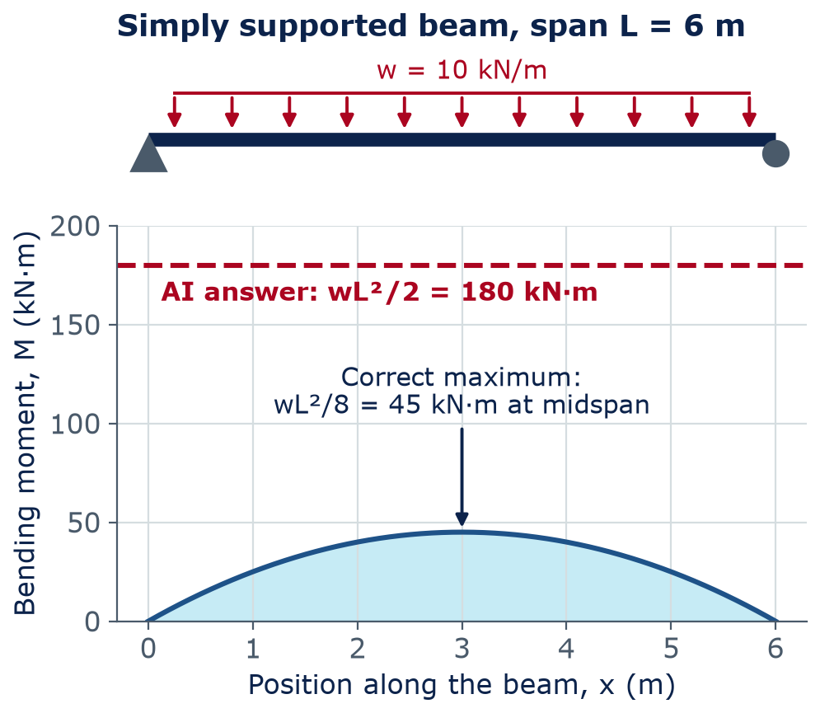
Worked example 1
A confident answer with the wrong formula
Problem: simply supported beam, span 6 m, uniform load w = 10 kN/m. Maximum moment?
AI answer: M = wL²/2 = 10 × 6²/2 = 180 kN·m
Check 1 · Restate: “simply supported” — but wL²/2 is the cantilever formula.
Check 3 · Independent check (statics):
R = wL/2 = 30 kN; M(3 m) = 30×3 − 10×3×1.5 = 45 kN·m = wL²/8
Notes:
Read the problem. The AI's answer looks professional: a formula, numbers, units. Check 1, Restate: the problem says simply supported, but wL²/2 is the maximum moment of a cantilever with a uniform load. Check 3, Independent check: each reaction is wL/2 = 30 kN; cut at midspan, M = 30 × 3 − 10 × 3 × 1.5 = 90 − 45 = 45 kN·m, which equals wL²/8. The AI's answer is 4 times too large. Here the error is conservative, but the same slip in the other direction — say, using wL²/8 for a cantilever — would be unsafe by a factor of 4.

Slide 19
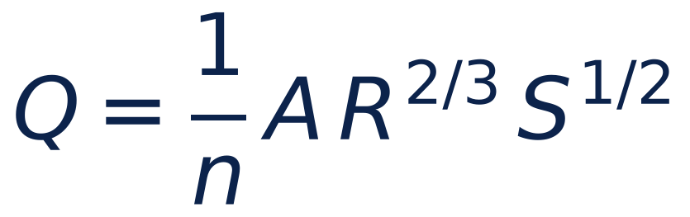
Worked example 2
Manning's equation gives open-channel flow
Q
flow rate (m³/s)
n
Manning roughness — about 0.013 for finished concrete
A
flow area (m²)
R
hydraulic radius = A / wetted perimeter P (m)
S
channel slope (m/m) — a decimal, not a percent
Notes:
Equation (for screen readers): Q = (1/n) × A × R^(2/3) × S^(1/2). Manning's equation in SI units, which you will meet in hydraulics. The 1/n form is for SI; in U.S. customary units the coefficient is 1.49 instead of 1. Stress the slope: it is a ratio, meters of drop per meter of length. A slope of 0.5 % is 0.005. That one detail is where the next AI answer goes wrong.

Slide 20
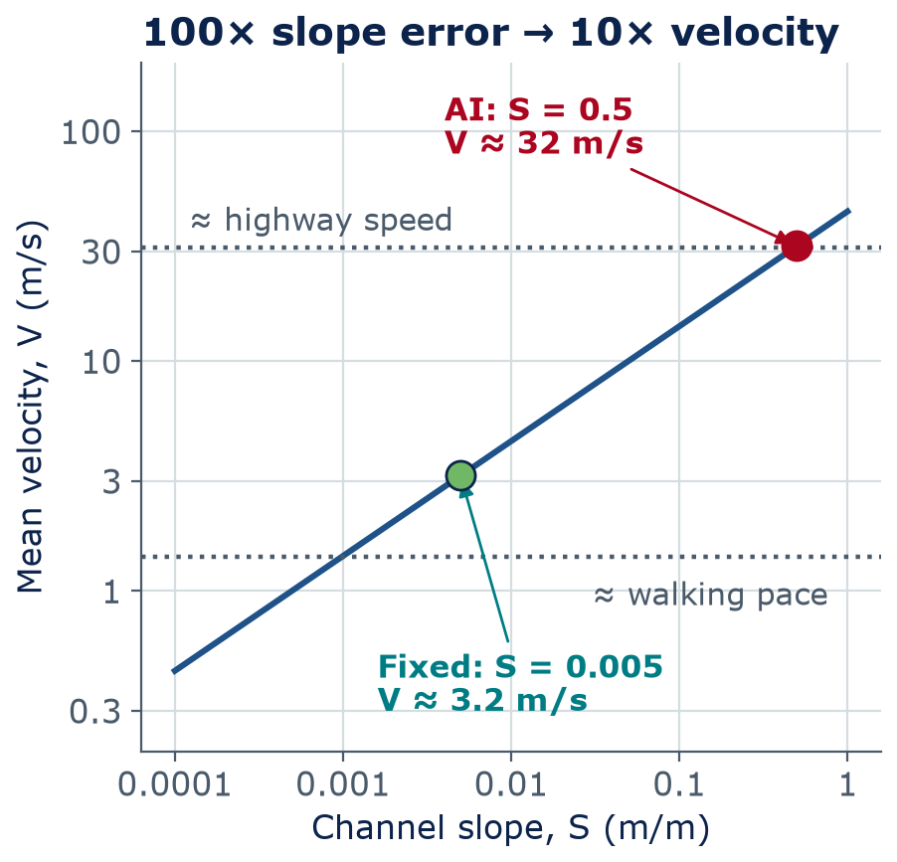
Worked example 2
A percent slipped in as a decimal
Problem: rectangular concrete channel, 2.0 m wide, flow depth 0.8 m, n = 0.013, slope 0.5 %. Find Q.
AI answer: A = 1.6 m², R = 0.444 m, S = 0.5 → Q ≈ 51 m³/s
Check 2 · Units & magnitude:
V = Q/A = 51 / 1.6 ≈ 32 m/s (≈ 114 km/h) — highway speed in a small channel? No.
Fix: 0.5 % = 0.005 → Q ≈ 5.1 m³/s, V ≈ 3.2 m/s
Notes:
Hydraulic radius R = 1.6 / 3.6 = 0.444 m. With S = 0.005 the flow is about 5.1 m³/s. The AI used S = 0.5, which makes the flow 10 times too big, because Q grows with the square root of S. The answer looks reasonable on its own — 50 m³/s is just a number. Check 2, Units & magnitude, exposes it: velocity = Q/A = 31.7 m/s, about 114 km/h, highway speed, in a 2 m concrete channel. The corrected velocity, about 3.2 m/s, is plausible. Lesson: compute a second, intuitive quantity (velocity, weight, cost per m²) and ask if it makes sense.

Slide 21
Trust, but verify
Concept check: which check catches it?
An AI says: “For Type C soil in a 12 ft deep excavation, OSHA allows a maximum slope of 1:1 (45°).” Which check catches this most directly?
1 · Restate
2 · Units & magnitude
A
B
4 · Sources
5 · Test & document
C
D
Notes:
Poll the room. The units are fine and the magnitude is plausible, which is exactly why this error is dangerous: only opening the source catches it. A 1:1 slope in Type C soil is steeper than allowed — a cave-in risk for workers. Lab 08 used this same table; Lab 12 asks the question again.
Answer: C. Table B-1 (29 CFR 1926 Subpart P, App. B) gives 1½H:1V (34°) for Type C. 1:1 is the Type B value — a real number attached to the wrong soil.

Slide 22
Trust, but verify
Concept check: which check catches it? — answer
An AI says: “For Type C soil in a 12 ft deep excavation, OSHA allows a maximum slope of 1:1 (45°).” Which check catches this most directly?
1 · Restate
2 · Units & magnitude
A
B
4 · Sources
5 · Test & document
C
D
Table B-1 (29 CFR 1926 Subpart P, App. B) gives 1½H:1V (34°) for Type C. 1:1 is the Type B value — a real number attached to the wrong soil.
Notes:
Answer: C. Table B-1 (29 CFR 1926 Subpart P, App. B) gives 1½H:1V (34°) for Type C. 1:1 is the Type B value — a real number attached to the wrong soil.

Slide 23
Trust, but verify
Check 4, Sources: four questions for every citation
Does it exist?
Right version?
Does it say that?
Primary source?
1
2
3
4
Find it yourself: library, publisher, eCFR. Invented citations look real.
Codes change by edition (ASCE 7-16 vs 7-22), and adoption varies by city.
Read the section. AI often attaches a real source to a wrong claim.
Prefer the code, standard, or paper over a blog or summary.
Notes:
Four questions for every citation. An invented citation can have real-looking authors, a real journal, and a plausible title; search for it yourself instead of clicking an AI's link. Codes come in editions, and a city may adopt an older edition, so 'the code says' always needs an edition. Most common in practice: a real source that does not say what the AI claims, as in the OSHA example. Research assistants that show citations make checking faster, not unnecessary.

Slide 24
Trust, but verify
Quick check: catch the slips
AI answer 1: a slab 10 m × 8 m × 150 mm thick needs 1,200 m³ of concrete
AI answer 2: water pressure at the bottom of a 2 m deep tank is 2 kPa
Which check flags each one? What is the right answer?
3
min
Quick calculation
Hint: about how many truckloads is 1,200 m³? How many kPa per meter of water depth?
Notes:
Three minutes, calculators out. Answer 1: 10 × 8 × 0.15 = 12 m³. The AI used 150 instead of 0.15 m. 1,200 m³ would be well over 100 mixer-truck loads for one slab — Units & magnitude flags it. Answer 2: p = ρgh = 1000 × 9.81 × 2 ≈ 19.6 kPa; rule of thumb, about 10 kPa per meter of water. Units & magnitude flags it, and an Independent check confirms. Point out that both errors are factors of 10 or 100: unit slips rarely produce small errors.

Slide 25
04
AI for coding, and documenting AI use
Read before you run; test before you trust
Notes:
Section 4, about 12 minutes. Coding assistants are among the most useful AI tools for engineers — and their bugs look just like working code.

Slide 26
AI for coding
Read before you run
1
Read every line
2
Check units and inputs
Can you explain what each line does? If not, ask — then check the explanation.
Names, units, and assumptions should be stated in comments and docstrings.
3
Never paste secrets
4
Check the imports
No passwords, API keys, or client data in prompts or shared code.
AI sometimes names packages that do not exist; attackers have registered such names.
Notes:
Run AI code in a sandbox such as Colab, not on a machine with important files. Read it first. Package names: researchers have documented that code assistants sometimes suggest package names that do not exist, and attackers can publish malicious packages under those names. Install only packages you can find on the official package index with real documentation and history. And never paste a key or password into a prompt.

Slide 27
AI for coding (lecture-only example)
Test generated code with known cases
# AI-written: peak runoff, rational method (SI)
def peak_runoff(C, i_mm_per_h, area_ha):
"""Peak flow Q in m^3/s."""
return C * i_mm_per_h * area_ha / 3600
# Known case by hand: C=0.9, i=50 mm/h, A=2 ha
# gives Q = 0.25 m^3/s
assert abs(peak_runoff(0.9, 50, 2) - 0.25) < 1e-6
# -> AssertionError: it returns 0.025
# Edge case: no area, no runoff
assert peak_runoff(0.9, 50, 0) == 0
assert stops the program if the condition is false
Units: 1 mm/h on 1 ha = 10 m³/h = 1/360 m³/s
3600 looks right (seconds per hour) but skips mm → m and ha → m²
Fix: divide by 360 — and keep the test
Lecture-only example. Lab 12, Part 4 tests a different AI-written function (Manning's equation).
Notes:
Lecture-only example: Lab 12 does not use this function. In Lab 12, Part 4, you test an AI-written Manning function (manning_velocity_ai) the same way, and catch an exponent bug that a test with R = 1 m misses. Here, the function looks professional: a clear name, a docstring, units in the argument names. The bug is a plausible-looking constant. Work the unit math on the board: 1 mm/h is 0.001 m/h; 1 ha is 10,000 m²; their product is 10 m³/h, and dividing by 3600 s/h gives 1/360 m³/s. So Q = CiA/360. The test, worked by hand, fails immediately and points to a factor of 10. Tests are cheap; keep them so the bug cannot come back.

Slide 28
Live demo
Same tool, same question — two workflows
Copy-paste workflow
Verify workflow
Paste the question with no context
Copy the first answer
Trust the confident tone
Submit — no record of AI use
Restate the problem with inputs, units, assumptions
Ask for steps, units, and stated assumptions
Run the 5 checks; fix and re-ask
Record tool, prompts, and what you checked
vs
The tool is the same. The workflow decides whether the answer is usable.
Notes:
LIVE DEMO, about 5 minutes. Use any chat assistant approved for class use. Ask: 'Peak runoff for a 2 ha parking lot, C = 0.9, rainfall intensity 50 mm/h?' First, copy-paste: read out the answer and ask the class if they would submit it. Then the verify workflow: restate the inputs and units, ask the tool to show unit conversions, check magnitude (0.25 m³/s is about 9 cfs — cubic feet per second — an 18–21 in storm drain, not a river), and do the hand check from the previous slide. If the tool gets it right, point out you only know that because you checked. Backup if there is no internet: walk through the slide.

Slide 29
Documenting AI use
An AI-use acknowledgment says what you used and how you checked it
Tool and version
Specific use
Prompts
How you checked
Which tool, which version
What you used it for
Paste or summarize them
What you verified, and how
Example (Lab 12, Part 4)
“I acknowledge the use of [tool and version] to draft the manning_velocity function in Part 4. Prompts I used included “Write a Python function for Manning's equation in SI units.” I checked the output by writing two assert tests against hand calculations; they caught an exponent error (R^(3/2) instead of R^(2/3)) that a test with R = 1 m had missed, and I fixed it.”
Notes:
Required on every AI-Assisted item in this course (labs: part of completion; homework: a missing acknowledgment costs 5 points), and increasingly expected at firms and in publications. Use the one course template, from the AI-use guide in the resources folder: tool and version, the specific use, the prompts, and how you checked the output. Vague statements like 'I used AI' do not count. Write it as you work, not at the end from memory. Whatever the tool did, you remain responsible for what you submit.

Slide 30
Lab 12
Lab day: Trust but Verify
Ask a small LLM eight CE/ARCE questions: beam moment, unit conversions, Manning, wall heat loss Q = U·A·ΔT, w/c ratio, OSHA slope, trip generation, rational method
Check every answer in Python with the 5 checks; tabulate correct vs incorrect by problem type
Part 4: catch the bug in an AI-written Manning function with assert tests
Exit ticket: 3 short questions you answer alone, without AI, in the last 10 minutes
Project check-in, wave 1: half the teams, last 25 minutes
LAB
12
Bring a charged laptop
Open the notebook from the course GitHub page
Notes:
The lab is today's lecture in practice. Students get real answers from a small open model, which will make plenty of mistakes; the goal is not to grade the model but to practice catching errors systematically. The lab is AI-Assisted and ends with an AI-use acknowledgment. Project check-ins run in two waves: half the teams in the last 25 minutes of this lab, the rest in Lab 13; post the wave list in advance. Lab due Sunday 11:59 pm (Arizona time) of this week, on Brightspace.

Slide 31
This week
HW5 is posted; project feedback is back
DUE END OF WEEK 14
PROPOSAL FEEDBACK RETURNED
HW5 — Responsible AI in Practice
Final project
A (AI-Free): find the errors in an AI-generated engineering calculation
B (AI-Assisted): audit a model for data shift and subgroup error
C (AI-Assisted + acknowledgment): memo — should a firm adopt AI tool X for task Y?
Read the feedback with your team; revise your canvas
Check-in (Lab 12 or Lab 13 — see your wave): data loaded and a baseline running
Use the 5 checks on your own results — verification is in the rubric
Notes:
HW5 is due Sunday at 11:59 pm at the end of Week 14. Part A uses today's 5 checks; Part B uses next week's reliability and bias tools; Part C uses Week 13's NIST AI RMF and Week 14's ethics. Project teams: proposal feedback is on Brightspace this week. Check-ins run in two waves — half the teams in the last 25 minutes of this week's lab, the rest in Lab 13. Upload the check-in form and a link to your notebook on Brightspace before your check-in. A baseline is the simplest reasonable model (for example, always predicting the most common class) that a real model must beat.

Slide 32
Wrap-up
Key takeaways
Think in tool categories, not brands — products change fast; the questions don't
1
Classify data before you paste; Confidential and Restricted data need approved tools or none
2
Restate → Units & magnitude → Independent check → Sources → Test & document
3
AI-written code is a draft: read it, test it with known cases, then use it
4
Document AI use — tool and version, use, prompts, how you checked. You remain responsible.
5
Notes:
Five takeaways. If students remember one thing: the five checks. Next week: what can go wrong even when a model scores well on its test set — reliability, bias, and transparency.

Slide 33
Learn more
Readings and resources
OSHA excavation rules, 29 CFR 1926 Subpart P (eCFR) — the primary source behind Table B-1
Python documentation: the assert statement — 2-minute read
NIST AI 600-1: Generative AI Profile (2024) — skim Section 2, its list of 12 generative-AI risks (preview of next week)
U.S. Copyright Office: Copyright and Artificial Intelligence — current U.S. guidance on who can own AI-assisted work (it changes — check the date)
AI-use guide (course resources folder) — the acknowledgment template and the 5 checks
Lab 12 notebook (course labs folder) — open it in Colab on lab day
Notes:
The eCFR link is the official current OSHA text. The NIST profile is a preview of next week's responsible-AI lecture; the risk list is readable in 20 minutes.

