Slide 1
From Scores to Observable Urban Operations
Hong Kong MATSim progress report
MONETIZED
PHYSICALIZED
AUDITABLE
Private-car costs · PT fares · Taxi
School bus · household car · finite fleet
Routes · events · ledgers · hashes
SCHEME B · ENGLISH EDITION
25 AUG 2026
Notes:
This report focuses on what has changed in the Hong Kong multimodal MATSim model during the latest development period. The central point is not that several parameters were added. The model now brings monetary costs, scarce physical vehicles, signal control, and event-level audits into one coherent operating framework. The eight evidence plates that follow move between territory-wide patterns and cases resolved to a named person, vehicle, link, or second. The deck reports completed implementation and validation evidence only; it contains no outlook section.

Slide 2
BASELINE · ONE SLIDE ONLY
Multimodal, but Still Abstract
PERSON
TRANSPORT
SCORE-BASED
PLANS
SUPPLY
CHOICE
NOT YET EXPLICIT
Private-car HKD · experienced PT fares · physical school buses
household vehicle continuity · finite Taxi operations
This report shows what became observable after those layers were introduced.
02
Notes:
This single slide defines the comparison baseline. The original model already had activity plans, road and public-transport supply, and score-based mode choice, so the essential demand, supply, and selection structure was in place. Four important layers were still abstract: private-car energy, toll, and parking could not be audited in Hong Kong dollars; experienced PT fares were absent from mode costs; school-bus access and boarding lacked event-level verification; and a household car was not yet represented as a physical resource with ownership and temporal continuity. The remaining slides focus on how those gaps became observable.

Slide 3
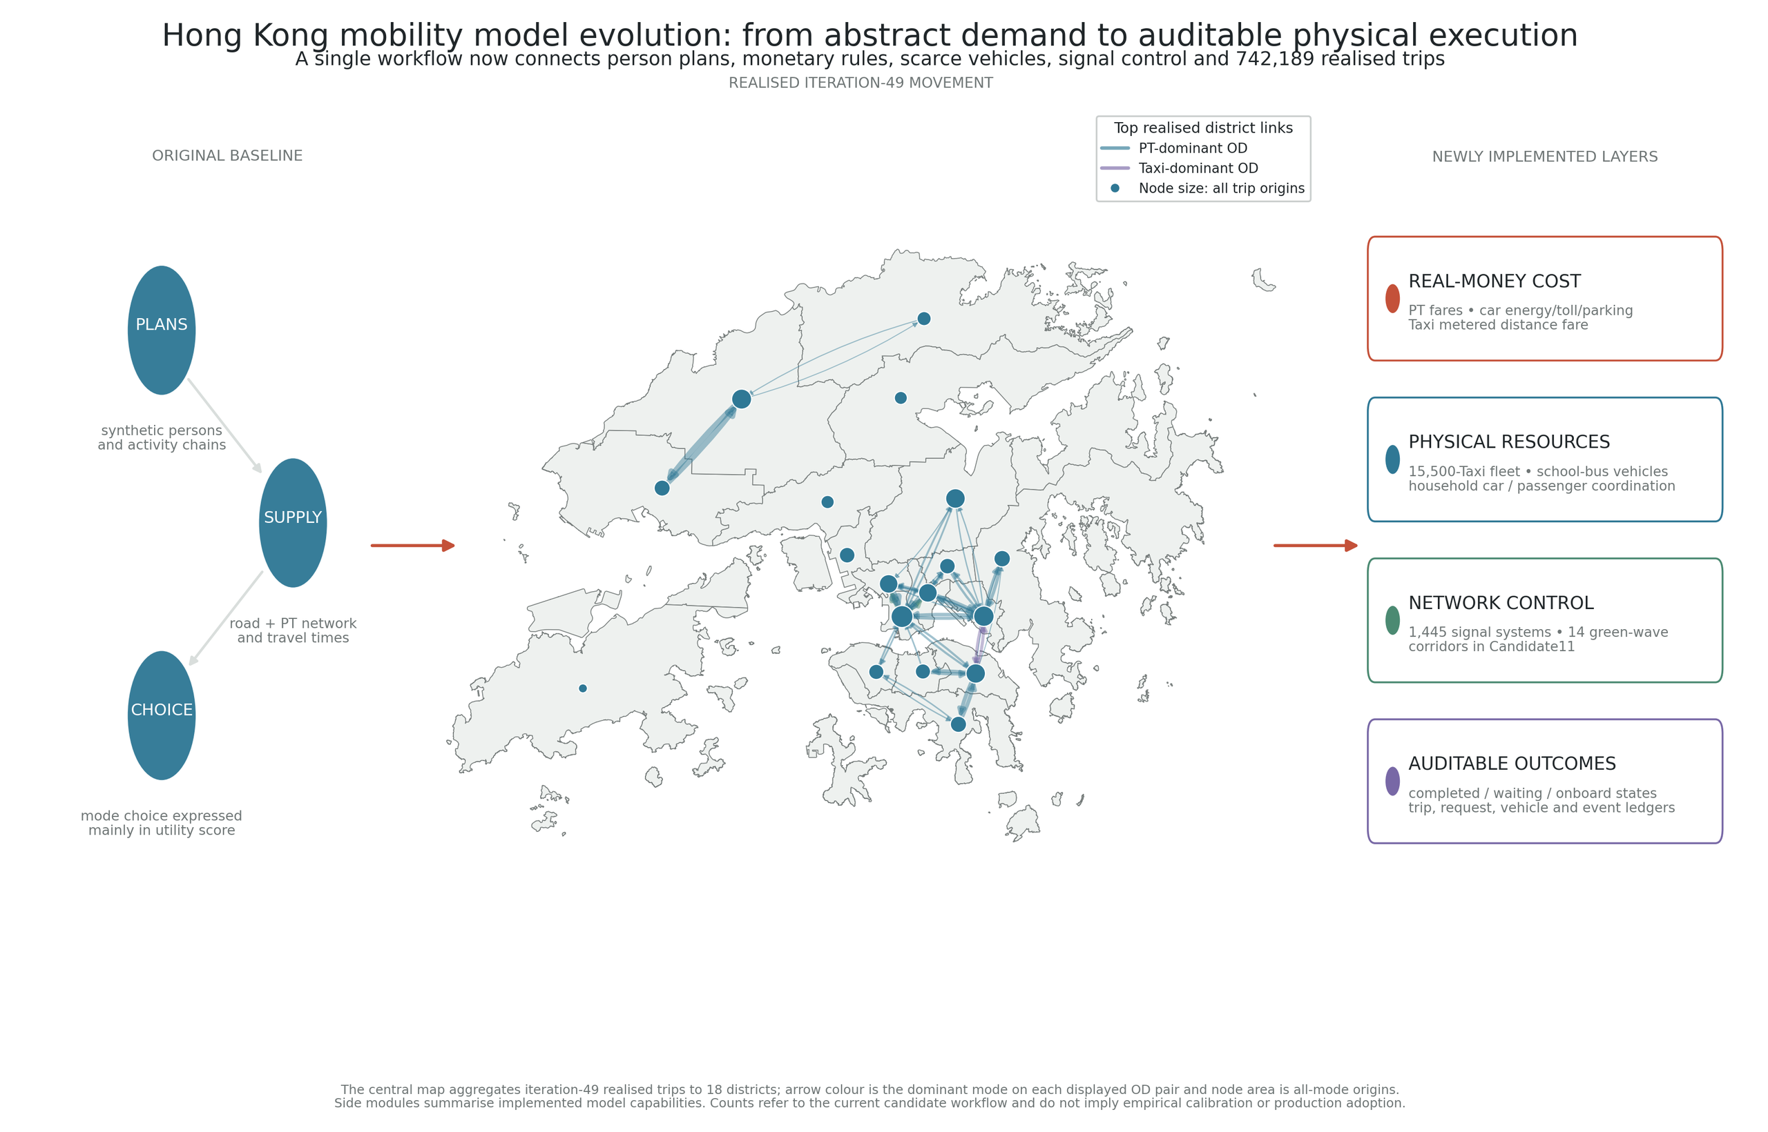
MODEL EVOLUTION
Choice now
connects to
operations.
742,189
realised trips
18 districts
Money · resources
signals · audits
Candidate / validation evidence · not a redefinition of the adopted production run
03
Notes:
This figure places the recent work within the full model architecture. The central map aggregates 742,189 realised iteration-49 trips across all 18 districts, giving the cost, vehicle, and control layers a shared simulation context. Four connected additions now sit on the original plan-and-supply foundation: real-money costs for car, PT, and Taxi; physical resources including household cars, school buses, and a finite Taxi fleet; signal systems and corridor offsets; and audit records based on named entities, event times, and explicit missing-value rules. These are candidate or validation results and do not redefine the adopted production scenario.

Slide 4
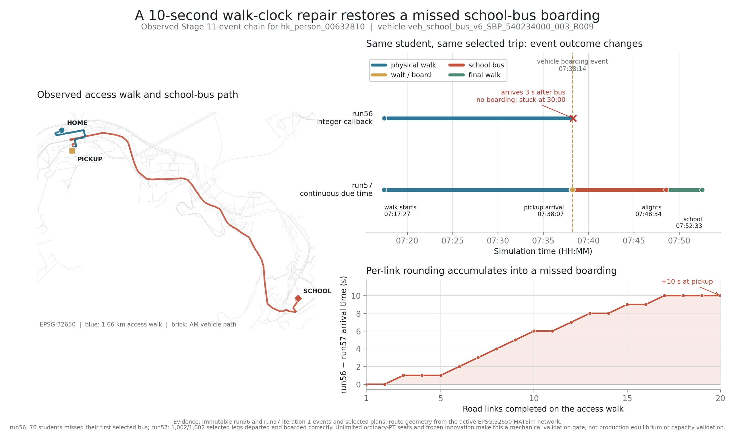
EVENT-TIME REPAIR
Ten Seconds Determined Whether a Student Boarded
RUN56
07:38:17
arrival
3 s late
RUN57
07:38:07
arrival
boarding restored
10-second error
across 20 links
Continuous due-time scheduling prevents per-link integer-rounding accumulation.
04
Notes:
The school-bus case shows how a small timing implementation detail can change interaction with a physical vehicle. For student hk_person_00632810, integer rounding on each walk link placed arrival at 07:38:17 in run56, while the vehicle boarding event occurred at 07:38:14. The student therefore arrived three seconds late. Scheduling the next link from the previous continuous due time moved arrival to 07:38:07 in run57 and restored boarding. The lower panel traces how ten seconds of error accumulated over twenty walk links, so the repair addresses a reproducible mechanical cause rather than manually changing the selected plan.

Slide 5
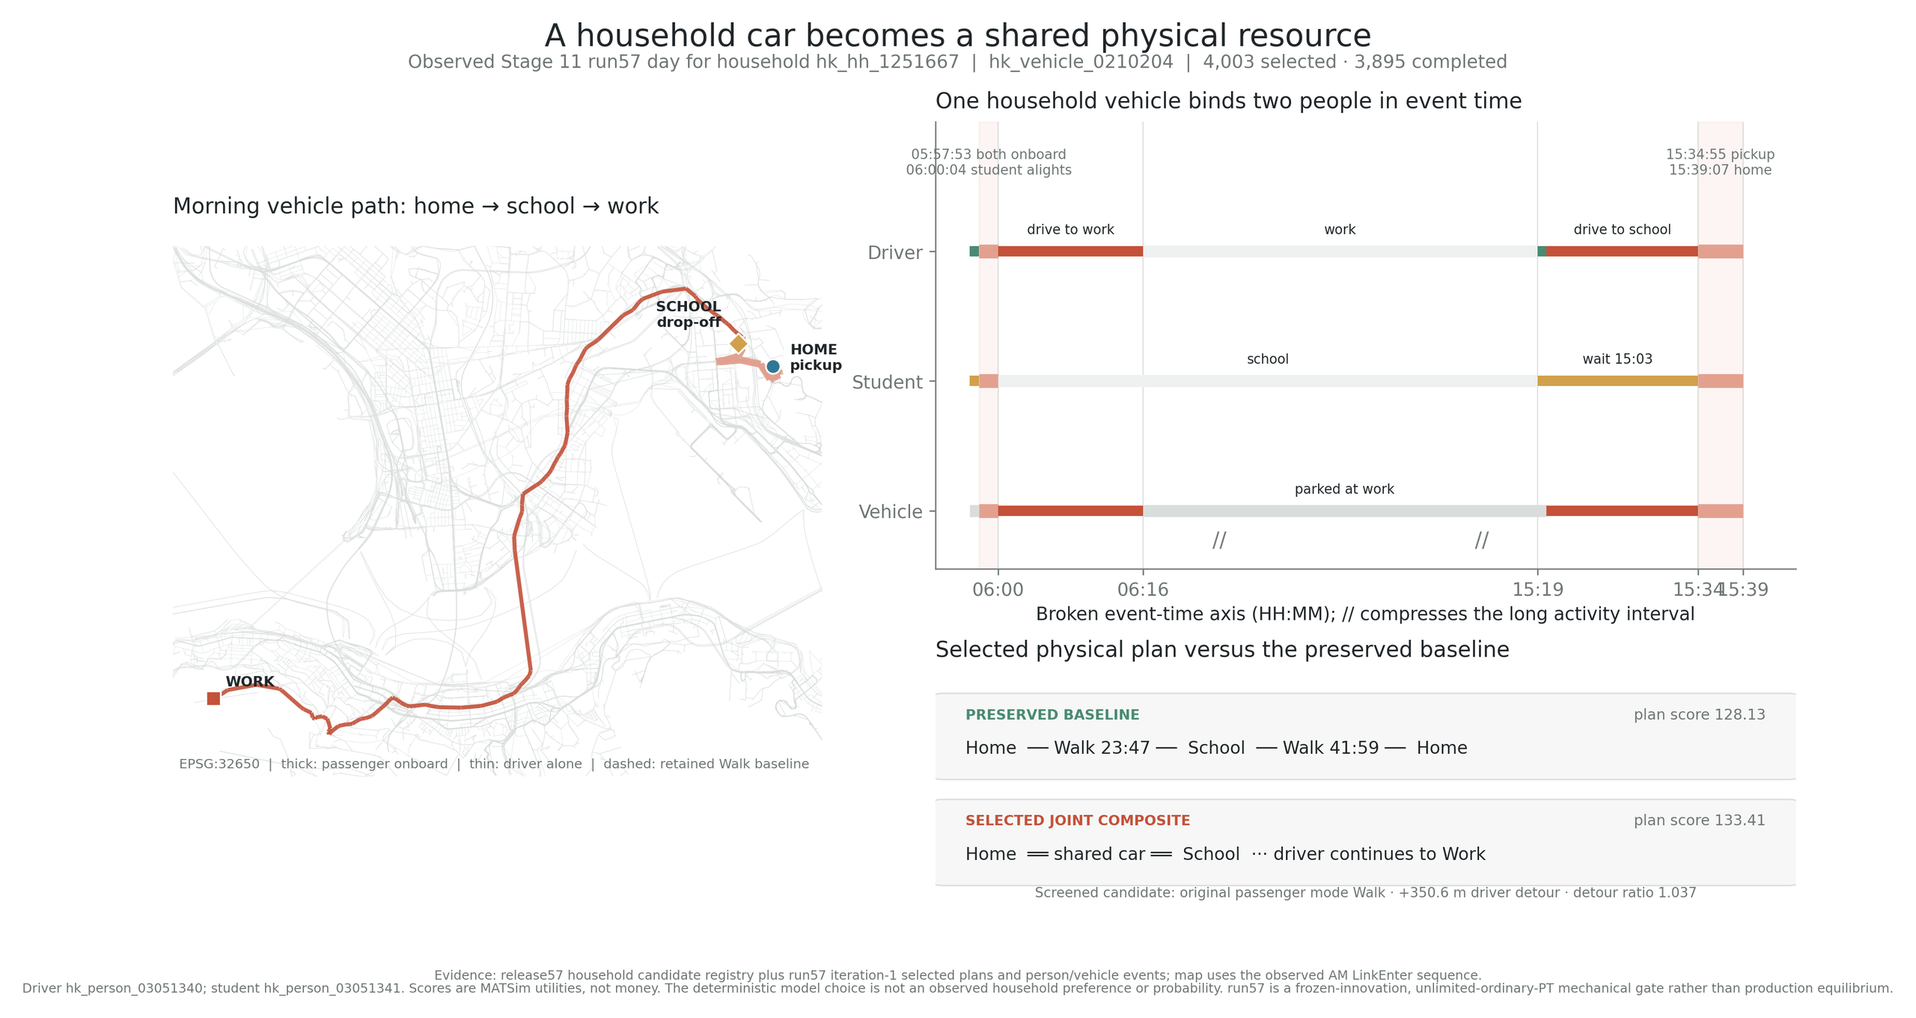
One Household, One Car, One Coordinated Day
PHYSICAL IDENTITY
HOUSEHOLD
hk_hh_1251667
DRIVER
03051340
STUDENT
03051341
VEHICLE
0210204
Scores shown in the figure are utility—not money and not observed preferences.
05
Notes:
Here the private car is no longer a mode label that can be selected independently for every leg. It is a household resource with a continuous day. The example follows household hk_hh_1251667, driver hk_person_03051340, student hk_person_03051341, and vehicle hk_vehicle_0210204. The realised events show the same car completing the school drop-off, continuing to work, returning for the afternoon pickup, and carrying the household home. Vehicle location, occupancy, and availability therefore constrain the joint plan. The retained Walk plan is a comparison alternative; the MATSim scores in the figure are utilities, not Hong Kong dollars and not observed household preferences.

Slide 6
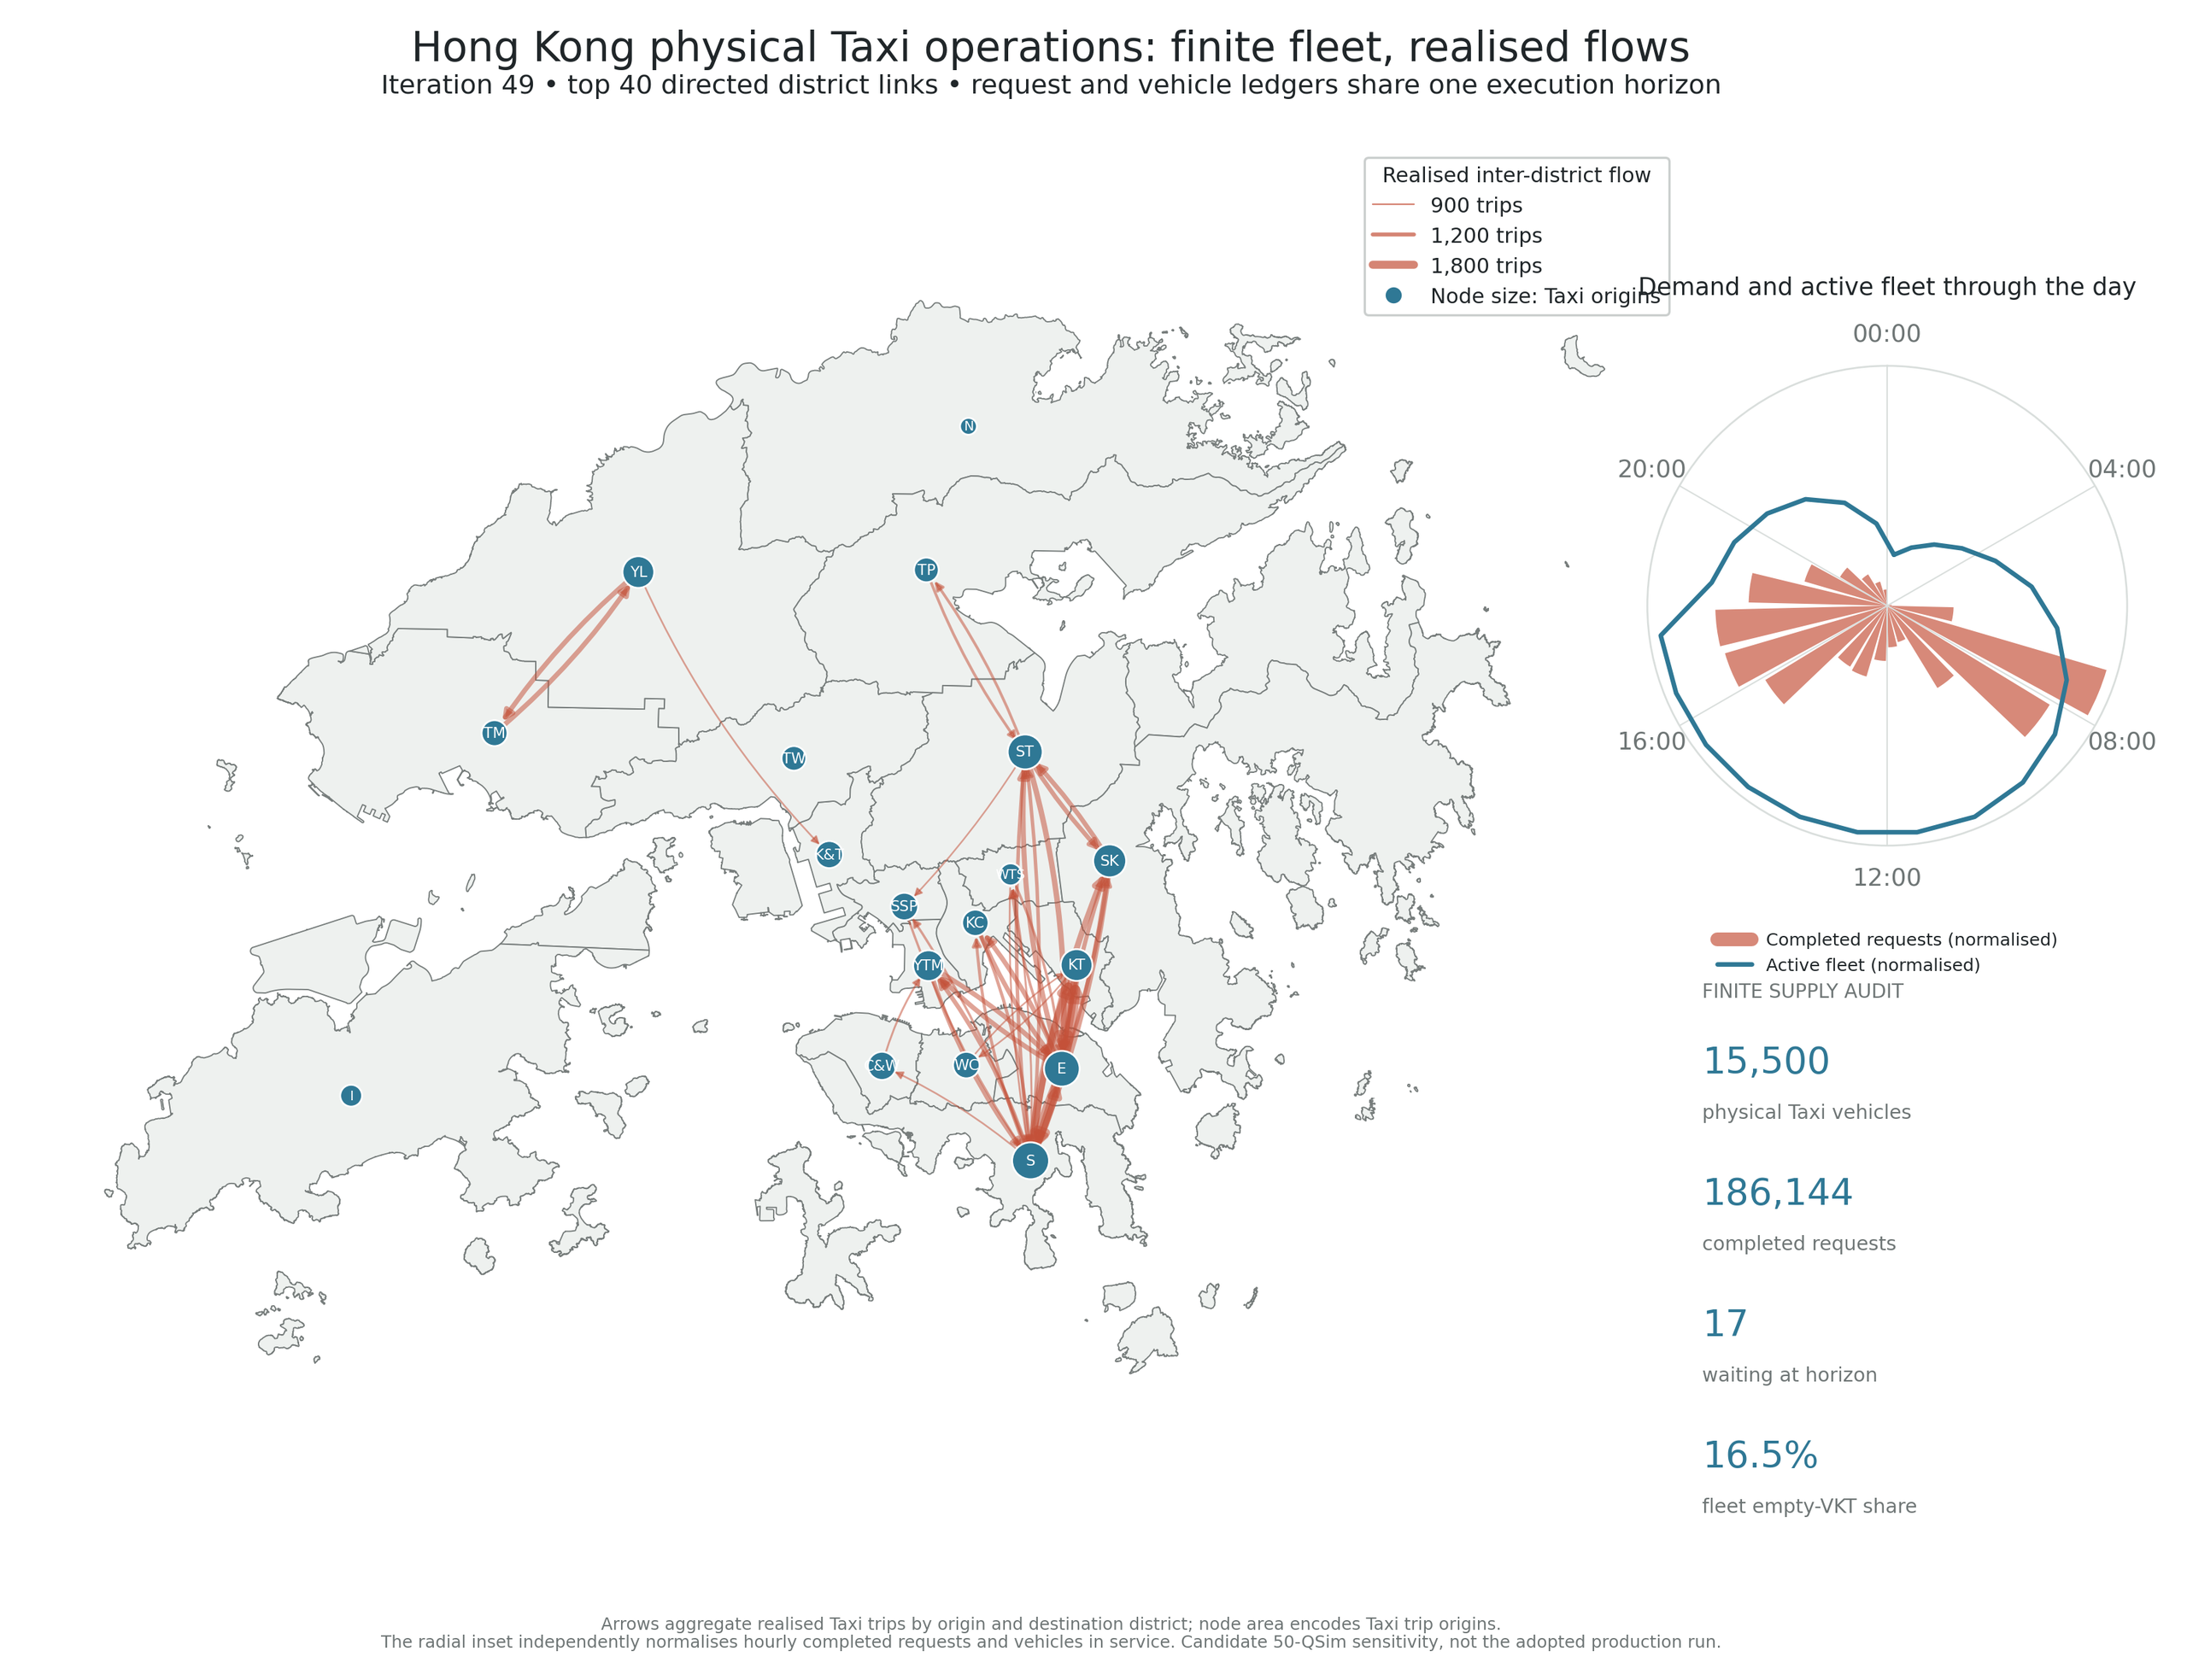
FINITE TAXI OPERATIONS
A fleet,
not a shortcut.
15,500
physical taxis
186,144
completed requests
16.5%
empty-VKT share
17 waiting
at the horizon
Distance-only Taxi cost · waiting disutility is not converted to HKD.
06
Notes:
The key Taxi change is the move from an abstract or teleported mode to a finite, reusable operating fleet with an explicit request ledger. The result contains 15,500 physical taxis, 186,144 completed requests, 17 requests still waiting at the simulation horizon, and a 16.5 percent empty-VKT share. The district flow map and the radial request-versus-active-fleet view come from the same execution result, so geography, hourly activity, and fleet utilisation can be read together. The monetary boundary is separate: Taxi cost elsewhere in the deck is based on realised occupied distance, while waiting disutility is not converted into Hong Kong dollars.

Slide 7
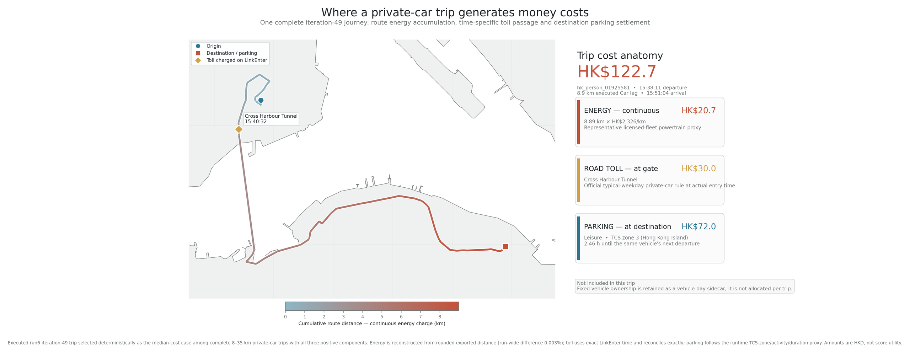
EXECUTED PRIVATE-CAR TRIP
HK$122.7
A Car Trip Can Be Read in Real HKD
HK$20.7 energy
+
HK$30.0 tunnel toll
+
HK$72.0 parking
Fixed ownership remains a vehicle-day sidecar and is not allocated to this trip.
07
Notes:
This page shows an executed private-car trip, not a generic score penalty. The selected trip for hk_person_01925581 costs HK$122.7. HK$20.7 comes from route energy, HK$30.0 from entering the Cross-Harbour Tunnel at the actual LinkEnter time, and HK$72.0 from settled destination parking. Each component can be traced back through events and explicit model rules, making the final amount explainable. Fixed ownership cost remains in a vehicle-day sidecar and has deliberately not been allocated to this trip.

Slide 8
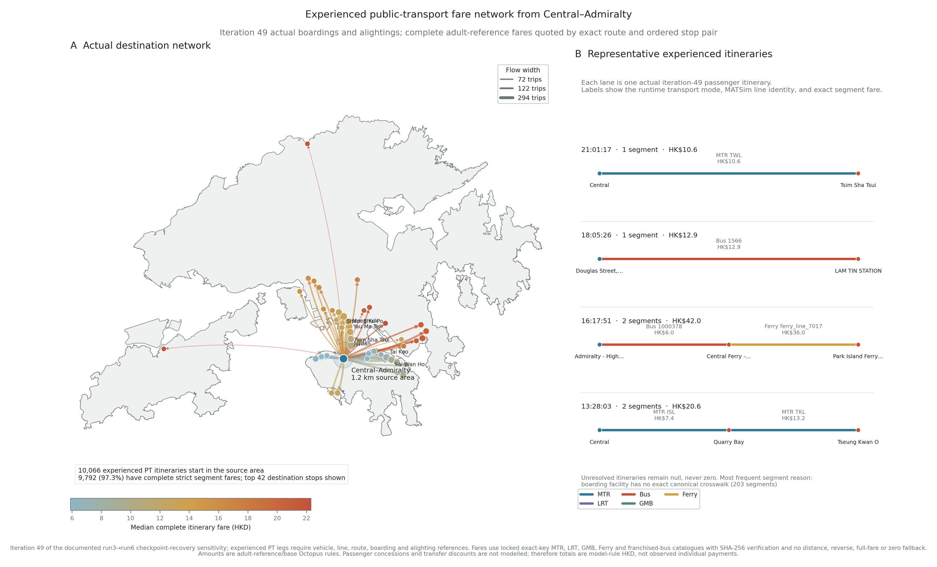
EXPERIENCED FARE
Exact chains,
not distance
proxies.
10,066
itineraries
97.28%
fully resolved
42 stops
four actual examples
Adult-reference / base-Octopus rules · no distance, reverse-order, full-route, or zero fallback
08
Notes:
Public-transport fare is resolved from the passenger’s experienced boarding, alighting, and transfer chain rather than approximated from straight-line or route distance. From the 1.2-kilometre Central–Admiralty source area, the iteration-49 result contains 10,066 experienced itineraries. Of these, 9,792, or 97.28 percent, have a fully resolved strict fare, reaching 42 leading destination stops. Four actual itineraries expose segment-level MTR, bus, ferry, and transfer-chain amounts. Ten fare tables and crosswalks are verified by SHA256. The logic uses no distance, reverse-order, full-route, or zero-value fallback; unresolved chains remain missing. Amounts represent adult-reference and base-Octopus rules, without individual concessions or transfer discounts.

Slide 9
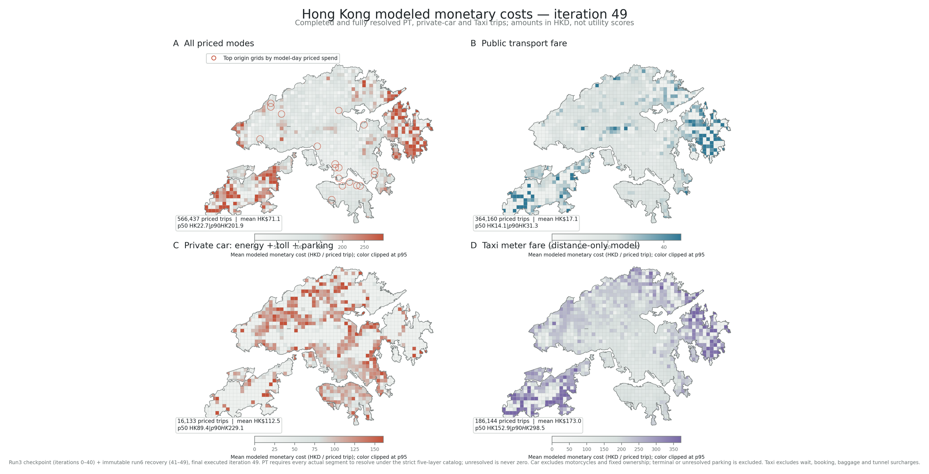
566,437
priced trips now have a monetary geography
TOTAL · PT · CAR · TAXI
364,160 PT · 16,133 car · 186,144 Taxi · unresolved PT chains remain null, never zero
09
Notes:
Once individual trip costs are auditable, they can be aggregated into a monetary geography for Hong Kong. The priced universe contains 566,437 trips: 364,160 fully resolved PT trips, 16,133 complete private-car trips, and 186,144 completed Taxi trips. The four maps compare total, PT, car, and Taxi mean model-rule costs across the fixed-link grid. The distinction between null and zero remains essential: unresolved PT chains stay null and are never silently counted as zero cost. The figure notes also retain the specific inclusion and exclusion scope for car and Taxi.

Slide 10
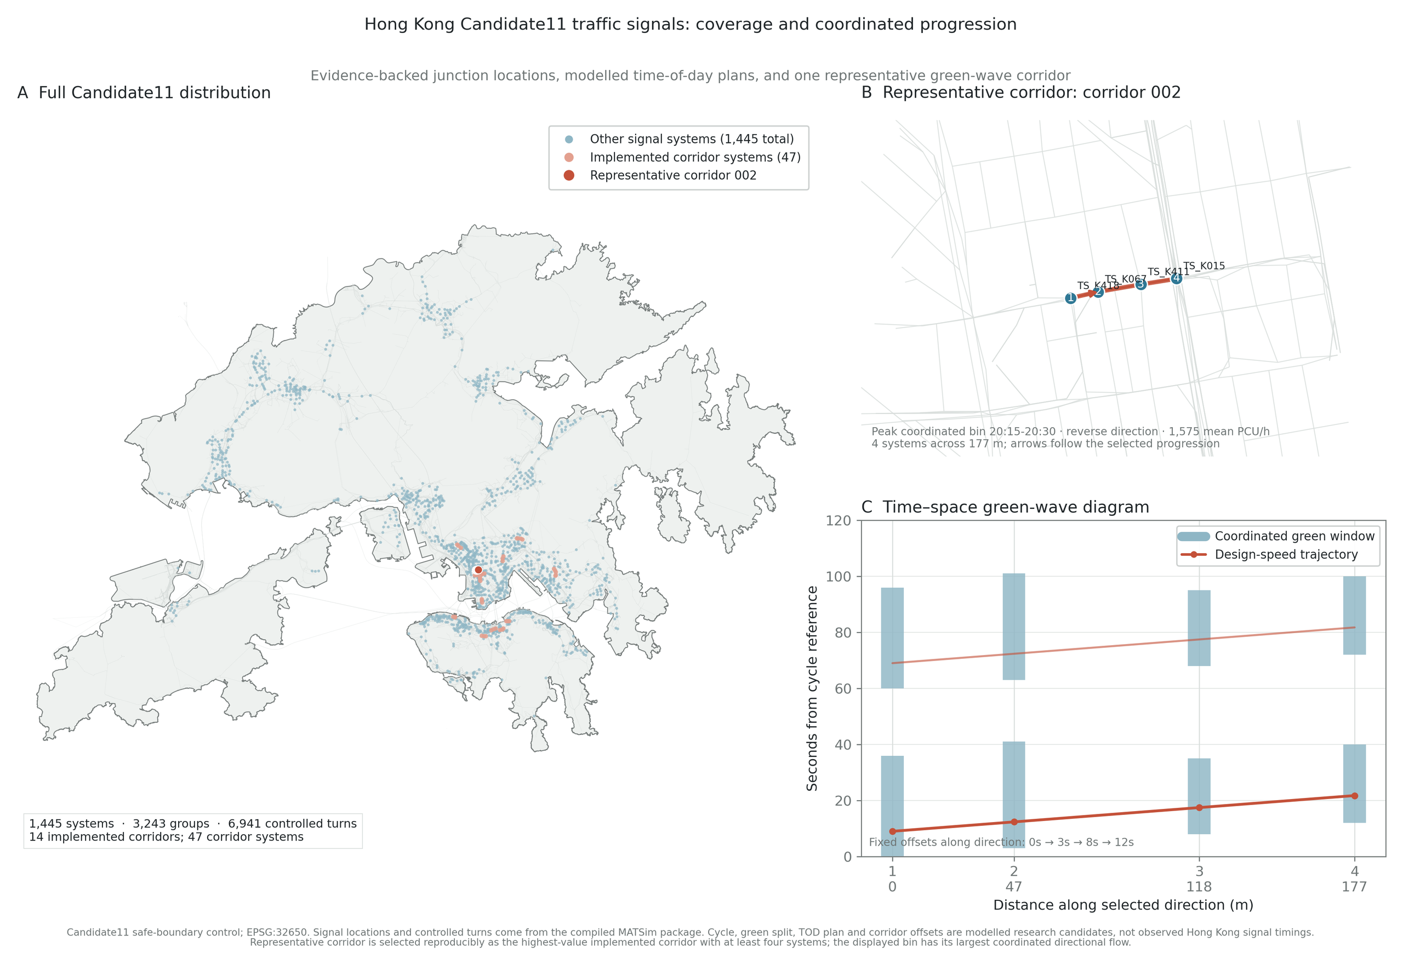
CANDIDATE
Signals add
network
coordination.
1,445
signal systems
6,941
controlled turns
14 corridors
47 distinct systems
Offsets: 0 · 3 · 8 · 12 s
Modelled cycle plans and offsets · not observed Hong Kong signal timings
10
Notes:
The Candidate11 package extends road supply from static capacity to explicit traffic control. It contains 1,445 signal systems, 3,243 groups, and 6,941 controlled turns. Fourteen implemented corridors include 47 distinct corridor systems. The representative reverse direction of corridor_002 uses fixed offsets of zero, three, eight, and twelve seconds, displayed for the 20:15 to 20:30 coordination bin. The territory-wide distribution, local controlled-turn view, and time-space diagram all use the same compiled definitions. The signal cycles and corridor offsets remain modelled research candidates, not observations of Hong Kong signal timing.

Slide 11
PROGRESS SYNTHESIS
Three Capabilities Now Work Together
MONETIZED
PHYSICALIZED
AUDITABLE
Car, PT, and Taxi costs
School bus, household car,
Routes, ledgers, events,
are expressed in real
and Taxi now have continuity
hashes, and null rules keep
model-rule HKD.
and scarcity.
outcomes inspectable.
A more interpretable urban simulation—
with candidate and production boundaries kept visible.
11
Notes:
Taken together, the evidence supports three conclusions. First, the model is monetized: private-car cost components, strict PT fares, and Taxi distance costs can be expressed in real model-rule Hong Kong dollars. Second, it is physicalized: household cars, school-bus boarding, and the finite Taxi fleet introduce ownership, continuity, and scarcity. Third, it is auditable: people, vehicles, routes, events, fare-table hashes, signal systems, offsets, null values, and exclusions remain traceable. The practical advance is from a model that can run to a model that can explain critical operational outcomes, while keeping candidate and production boundaries visible.

