Slide 1
Tank War
陳璽安 林天翼 邱筱晴

Slide 2
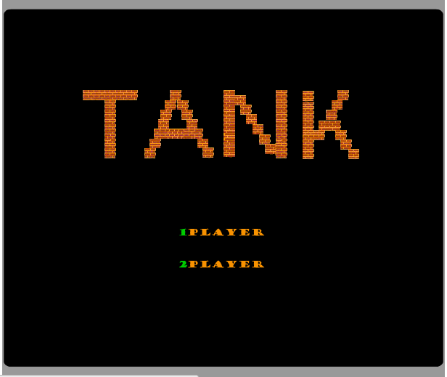
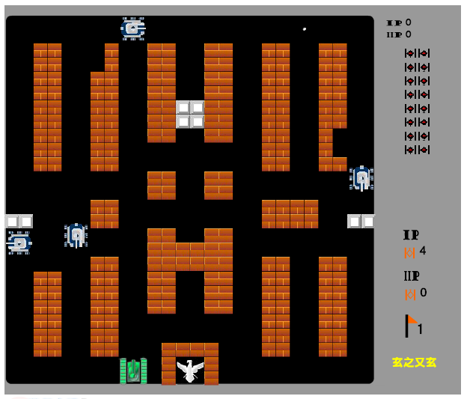
Motivaiton
經典坦克大戰

Slide 3
Introduction
坦克大戰
雖然Jack 破破 的，VM 慢慢 的，但還是 試著做了每個人的童年回憶－－坦克大 戰遊戲！！！
特色
精緻的圖片繪製，讓你看不出這是用 Jack寫出來的！

Slide 4
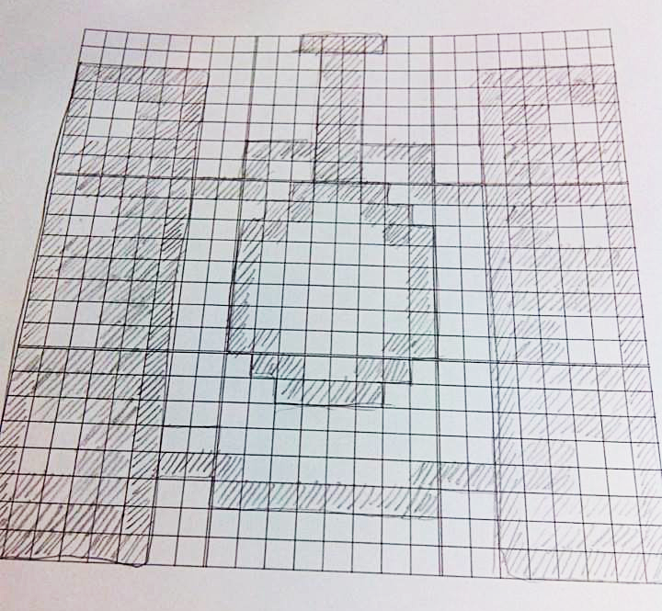
Start with Tank

Slide 5
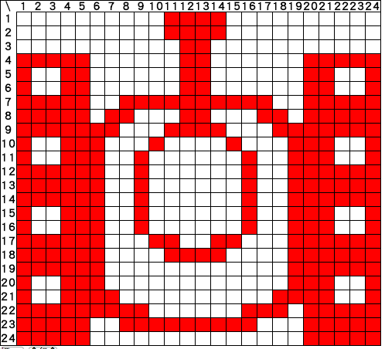
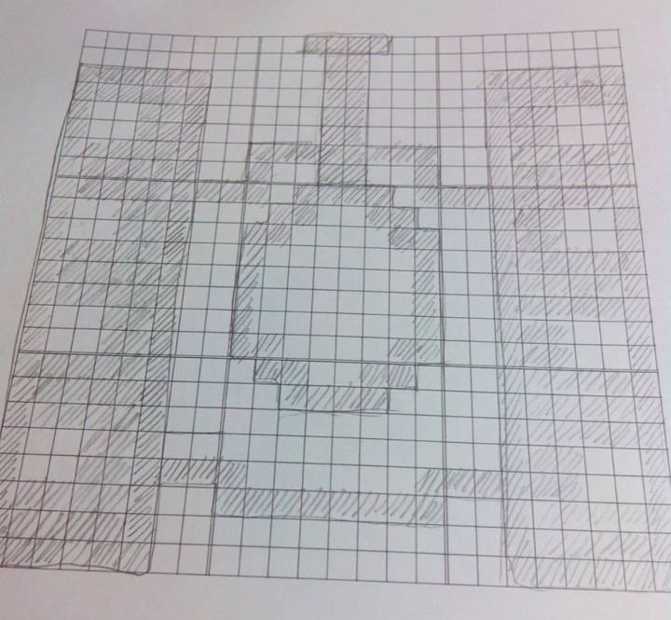
Start with Tank

Slide 6
Start with Tank
我方坦克 compeleted!

Slide 7
Start with Tank
敵方坦克 compeleted!

Slide 8

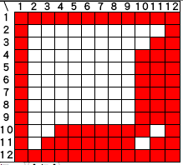
Other objects

Slide 9

Hard Brick
Compeleted!

Slide 10
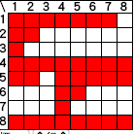

Other objects

Slide 11

Soft Brick
Compeleted!

Slide 12

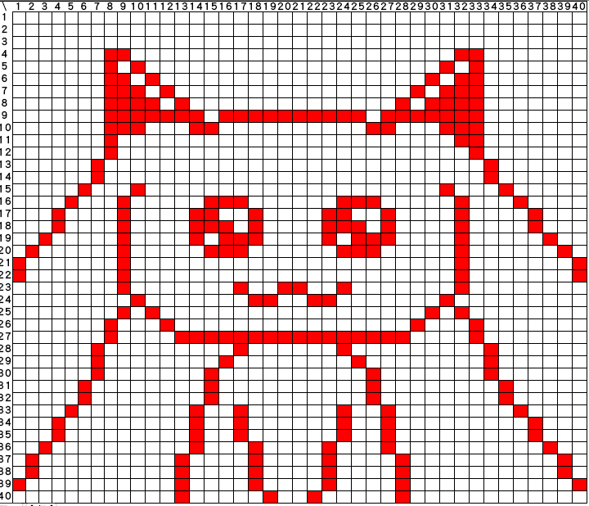
QB

Slide 13
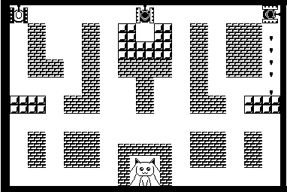
Map

Slide 14
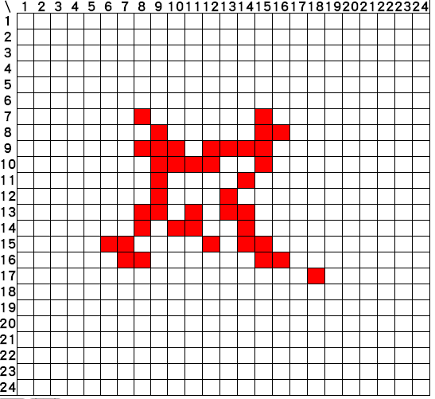
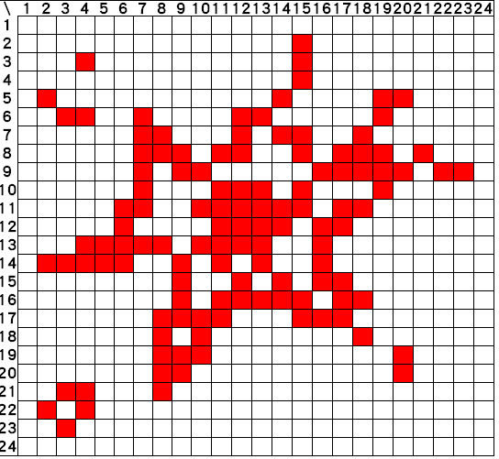
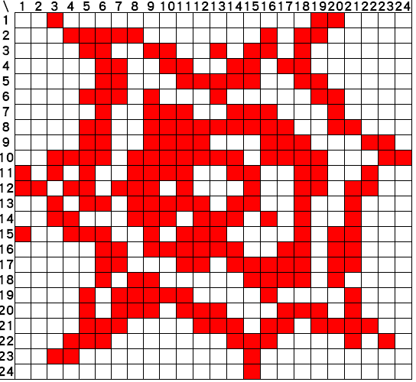
If the tank die

Slide 15

Painter

Slide 16
Map

Slide 17
Screen Arrangement
512 pixel(s)
360 pixel(s)
Statement
Map

Slide 18

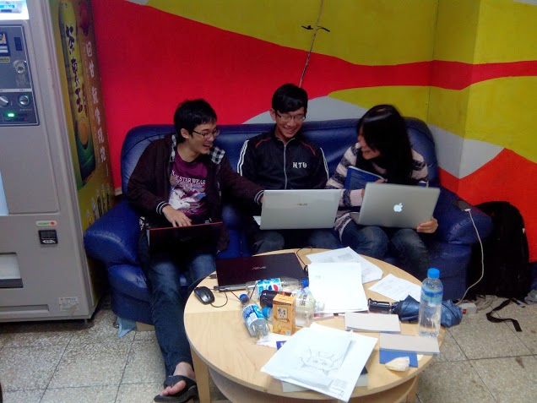
Start Coding

Slide 19
Class
Main
Game
Menu
Album
Image
Scalable
Book
Map
Statement
Label
Tank
Bullet
AI
Player
Bomb
List
Node
Rand
C*******e
C????

Slide 20
List
class List{
method void reset()
method boolean end()
method boolean next()
method int get()
method void insert(int data)
method void delete()
}

Slide 21
Random
function int rand()
{
let a = a*a+t/16&127;
let t = t+1;
return a;
}

Slide 22
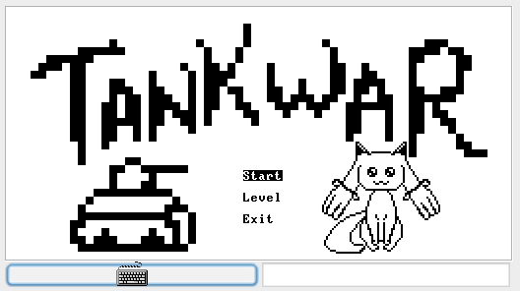
Menu

Slide 23
Album
Contain Images
TANK1 (I)
TANK2 (E)
Bricks (H)
Bricks (S)
QB
Bullet
Bomb

Slide 24
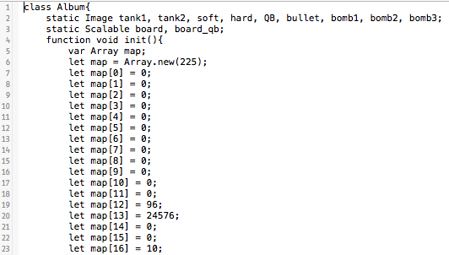
Album

Slide 25
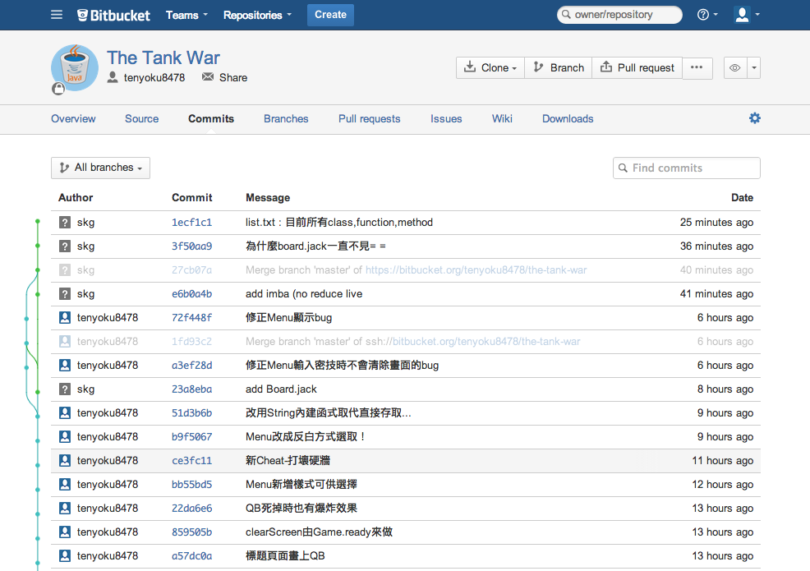
Git in bitbucket

Slide 26
Statistic
Class : 20
Function : 45
Method : 45
Constructor : 13
Commit : 80
Time Consumption : 30 hr
Code (with & without Album) : 2853 / 1364 lines

Slide 27
Demo Time!!!!!

Slide 28
Q&A

Slide 29
Thanks for Your Attention

