Slide 1
Tank War
陳璽安 林天翼 邱筱晴

Slide 2
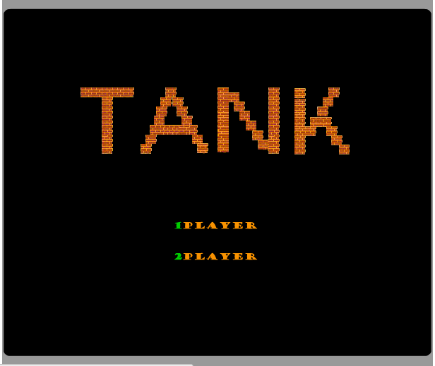
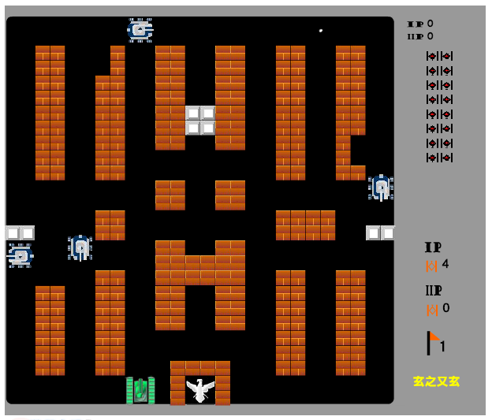
Motivaiton
經典坦克大戰

Slide 3
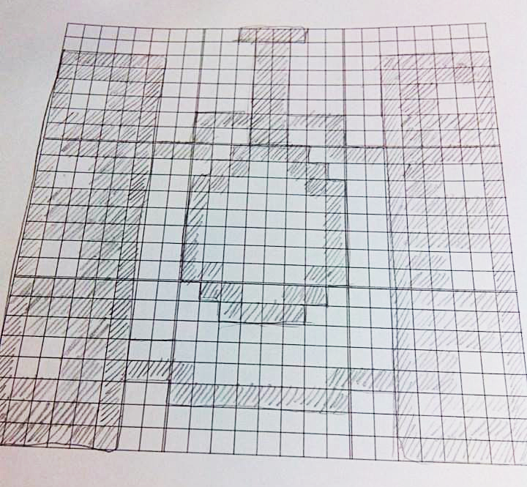
Start with Tank

Slide 4
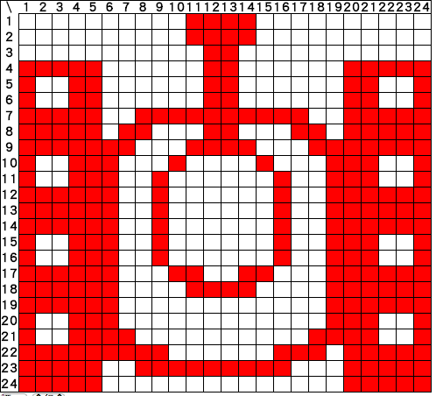
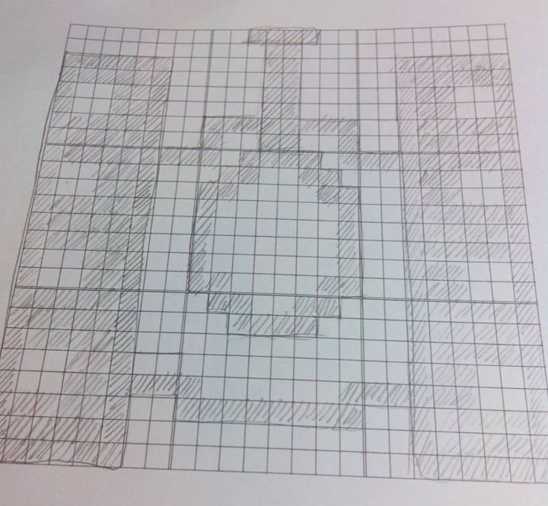
Start with Tank

Slide 5
Start with Tank
我方坦克 compeleted!

Slide 6
Start with Tank
敵方坦克 compeleted!

Slide 7

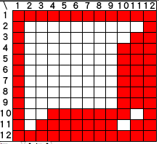
Other objects

Slide 8

Hard Brick
Compeleted!

Slide 9
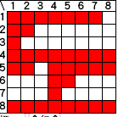

Other objects

Slide 10

Soft Brick
Compeleted!

Slide 11

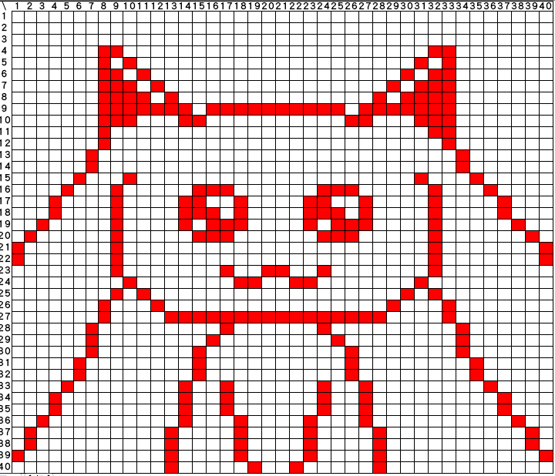
QB

Slide 12
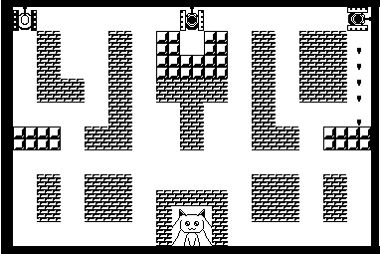
Map

Slide 13
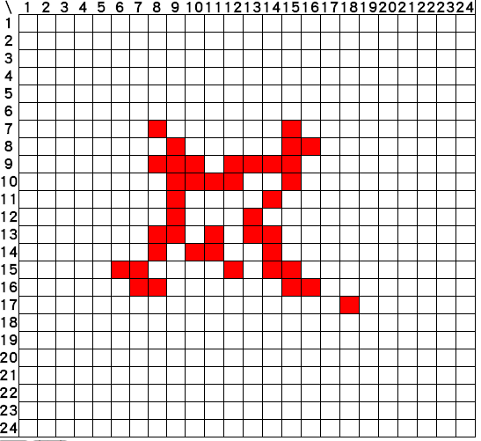
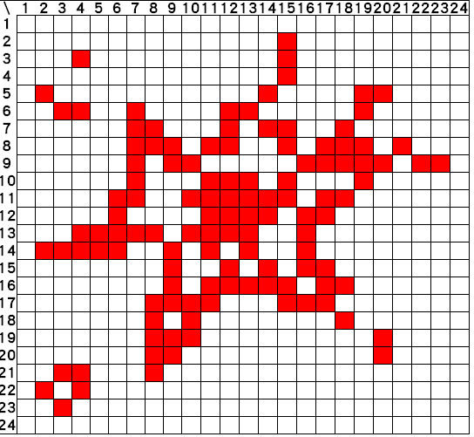
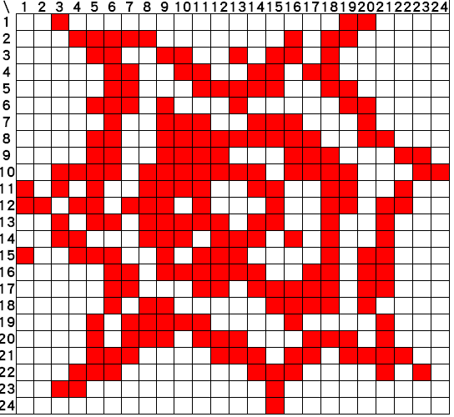
If the tank die

Slide 14
Painter

Slide 15
Map

Slide 16
Screen Arrangement
512 pixel(s)
360 pixel(s)
Statement
Map

Slide 17

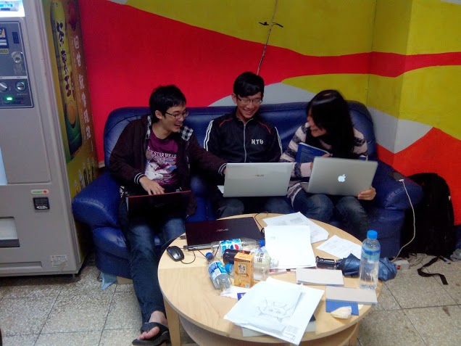
Start Coding

Slide 18
Class
Main
Game
Menu
Album
Image
Scalable
Book
Map
Statement
Label
Tank
Bullet
AI
Player
Bomb
List
Node
Rand
C*******e
C????

Slide 19
List
class List{
method void reset()
method boolean end()
method boolean next()
method int get()
method void insert(int data)
method void delete()
}

Slide 20
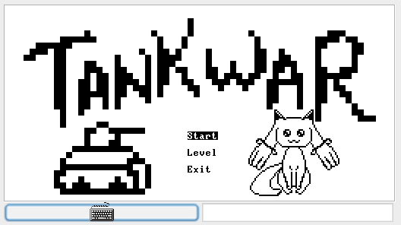
Menu

Slide 21
Album
Contain Images
TANK1 (I)
TANK2 (E)
Bricks (H)
Bricks (S)
QB
Bullet
Bomb

Slide 22
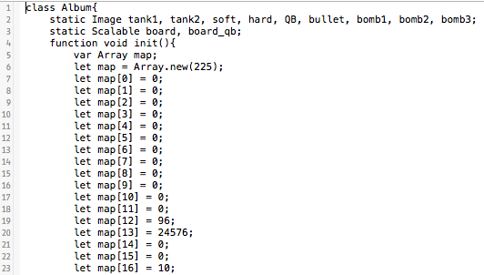
Album

Slide 23
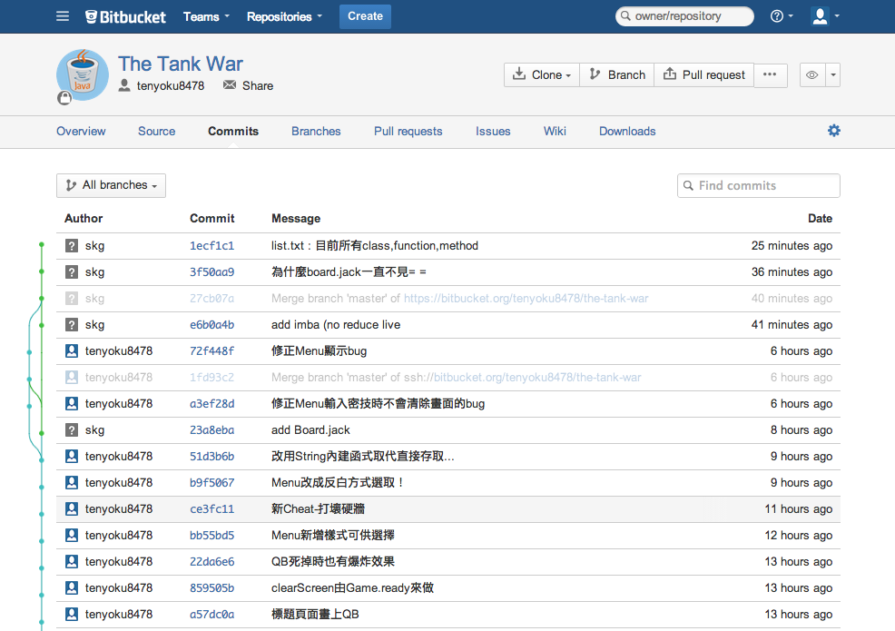
Git in bitbucket

Slide 24
Statistic
Class : 20
Function : 45
Method : 45
Constructor : 13
Commit : 80
Time Consumption : 30 hr
Code (with & without Album) : 2853 / 1364 lines

Slide 25
Demo Time!!!!!

Slide 26
Q&A

Slide 27

Thanks for Your Attention

