Slide 1


Slide 2

contents
Introduction
Causes of Hemophilia.
Classification
Symptoms
Treatment

Slide 3
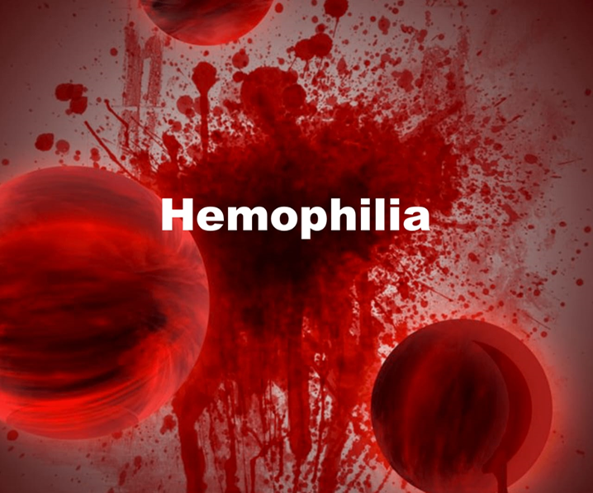
INTRODUCTION
Hemophilia is a rare disorder in which the blood does not clot normally . It is usually inherited and its usually occur in male. Hemophilia also called royal disease.
If you have Hemophilia, you have little or no clotting factor. Clotting factor is a protein needed for normal blood clotting and without it, you may bleed for a long time after injury or accident.

Slide 4
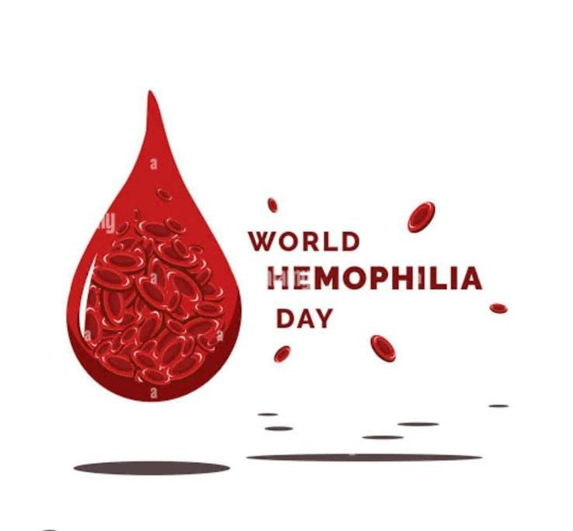
WORLD HEMOPHILIA DAY
World Hemophilia Day was started in 1989 by the World Federation of Hemophilia (WFH), which chose 17 April as the day to bring the community together in honour of WFH founder Frank Schnabel's birthday.
In 2024 the international theme is Equitable access for all: recognizing all bleeding disorders.

Slide 5
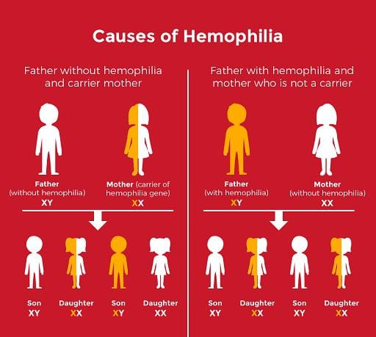
CAUSES of hemophilia
The genetic change that causes hemophilia is a recessive change in the X chromosome. Males have one copy of the genes in the X chromosome, and females have two copies.As a result, males have a 50%Trusted Source chance of developing hemophilia if their biological mother is a carrier of the gene.
Example:

Slide 6
CLASSIFICATION
Hemophilia is classified as severe, moderate or mild depending on the missing clotting factor. The level of factor VIII or factor IX in the blood is measured by a specialist laboratory
There are several types of Hemophilia
Hemophilia A : is a most common types about 80% of case .It is severe types due to factor VIII deficiency.
Hemophilia B: It is also known as Christmas disease because first diagnosed 1952 in a patient with the name of Stephen Christmas. It is moderate types due to factor IX.
Hemophilia C: It is mild type due to factor XI deficiency.

Slide 7
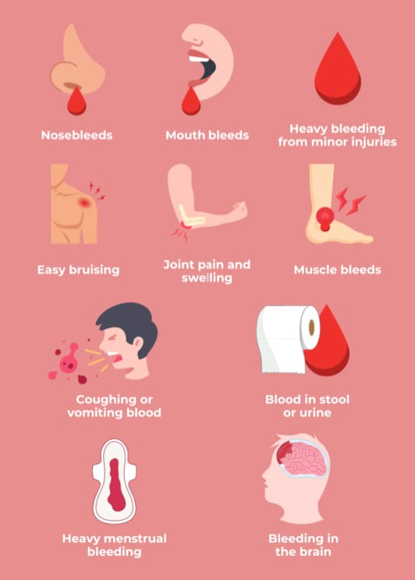
SYMPTOMS
The main symptoms of hemophilia are
Excessive bleeding or bruises.
Blood in urine .
More bleeding for a normal cuts or injury.
Excessive bleeding in tooth gums.

Slide 8
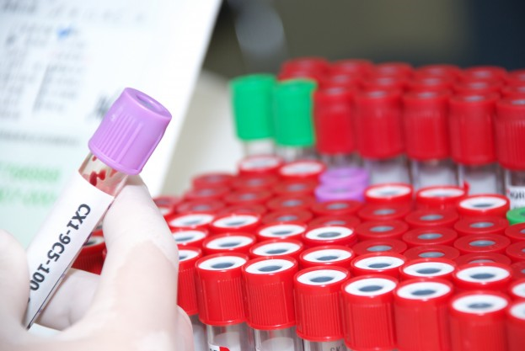
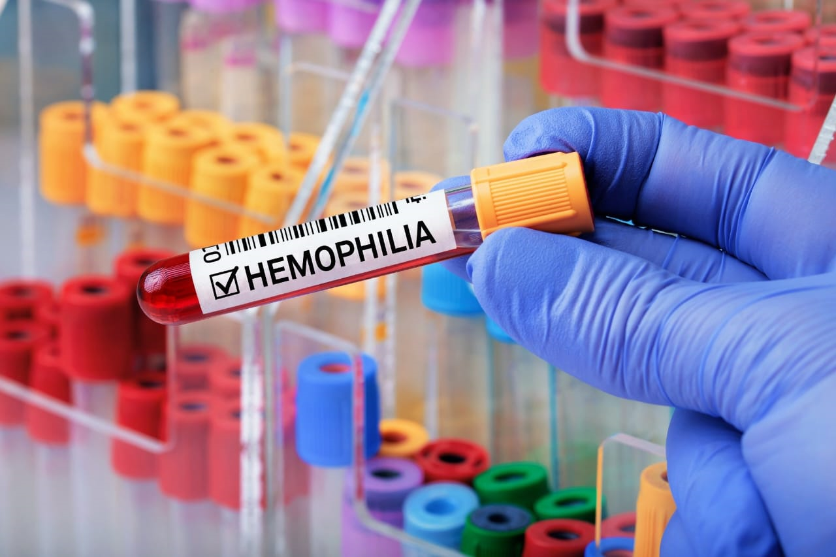
DIAGNOSTIC EVALUATION
A typical a PTT value is 30 to 40 seconds-prolonged
Bleeding time is between 2 – 7 minutes – normal
Clotting time in a person is between 8 – 15 minutes – prolonged
Normal ranges for factor VIII activity level is less than 50%, you may have hemophilia A.
The reference range for factor IX is between 60% to 140% of normal values.

Slide 9
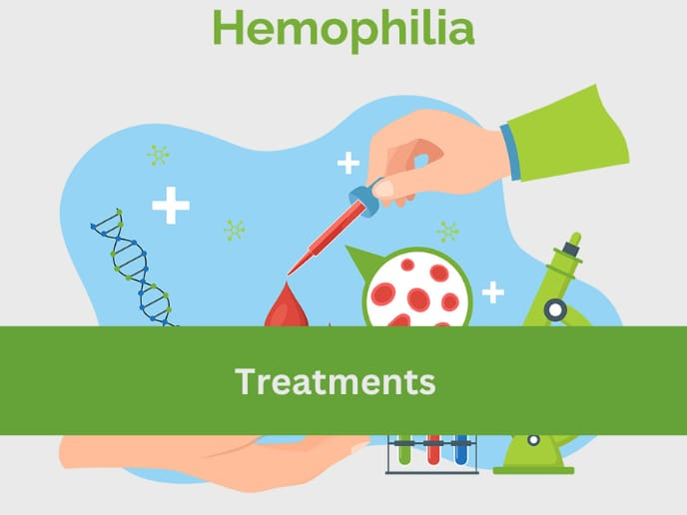
TREATMENT
If Hemophilia mild or moderate the treat with Desmopressin.
Desmopressin (DDAVP) is a synthetic drug that can help treat bleeding in patients with hemophilia A or von Willebrand disease.
In case of severe bleeding immediately transfuse missing factor if not available use cryoprecipitate.
Cryoprecipitate is a portion of plasma that's rich in clotting factors, which can help stop or slow bleeding.

Slide 10

THANK
YOU

