Slide 1

DAYANANDA SAGAR UNIVERSITY DEPARTMENT OF COMPUTER SCIENCE & ENGINEERING SCHOOL OF ENGINEERING KUDLU GATE, BANGALORE – 560068
IOT PROJECT
ON
HOME AUTOMATION
PREPARED BY
SANGMESH R B { ENG16EC0070}
SUNNY DEB { ENG16EC0084}
TENZIN GYALPO {ENG16EC0090}
VISHWESH TIWARI {ENG16EC0096

Slide 2
INTRODUCTION
A home automation system is an automating the bulk of electronic and electrical tasks within a home. It uses a combination of hardware and software to enable control and management over appliances and devices within a home.
Home automation not only refers to reduce human efforts but also energy efficiency and time saving. Here we are performing home automation by using ESP8266 – WiFi SoC and Blynk Playstore App.

Slide 3
OBJECTIVE
The goal of this project is to develop a home automation system that gives the user complete control over light and fan, all remotely controllable aspects of his or her home.
The automation system will have the ability to be controlled from a central host PC, the Internet, and also remotely accessed via a Pocket PC with a Windows Mobile based application.
The System will also sense the Accidental Gas leakage , water level and will notify the user by SMS.

Slide 4
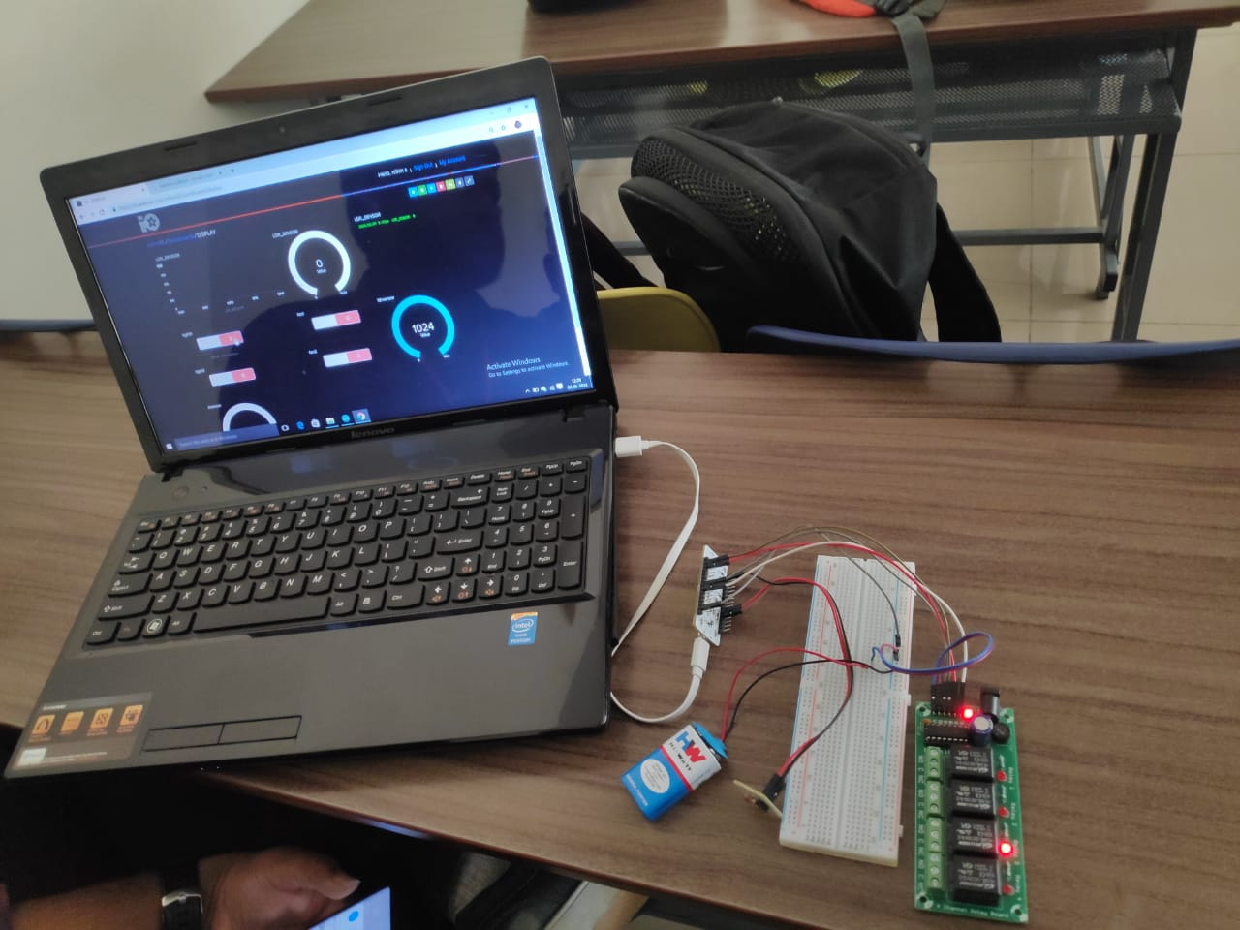
IMAGE OF PROJECT

Slide 5
APPLICATION
Leak detection, smoke and CO detectors
Indoor positioning systems (IPS).
Home automation for the elderly and disabled
Pet and Baby Care, for example tracking the pets and babies' movements and controlling pet access rights
Air quality control. For example, Air Quality Egg is used by people at home to monitor the air quality and pollution level in the city and create a pollution map
Smart Kitchen and Connected Cooking. Using Voice control devices like Amazon Alexa, Google Home or mobile applications to manage coffee machines, ovens, fridge and multi cooker, as Instant Pot or robotic kitchen

Slide 6
NOVELTY
Check on Your Home From Wherever, Whenever
Save Money
Increase Accessibility
Relax at anytime

