Slide 1
DAYANANDA SAGAR UNIVERSITY
SCHOOL OF ENGINEERING
DEPARTMENT OF COMPUTERE APPLICATIONS
PROJECT REVIEW
TITLE
Forecasting on Stock Market Time Series
Data using Data Mining Technique
TEAM MEMBERS
C PAVAN KUMAR REDDY(ENG16CA0001)
SHAO YUZHOU(ENG16CA0003)
TENZIN RABYANG(ENG16CA0006)
GUIDE:
DR VASANTHI KUMARI P

Slide 2
content
Objective and goal
Introduction
Need for the project
Scope and Strength of the project
Literature survey
System Design
Methodology
Result
Conclusion
References

Slide 3
2. Objective and goal
The main objective of this project is to forecast and plot the predicted value of Close price which is correlated to other samples in data set like Volume Price. In other words we try to predicts the Close price based on Volume price. In which way these prediction values can help investors to invest on stock to gain profit.

Slide 4
Introduction
As we all know, data is like the fuel that today's world can't run without it. Every startup or company that exists now almost very much depends on the data, produced by the user like feedback, rating, and opinion, in order to improve their product or services.
There is two major fields that we have used in this project that is Time Series data and Data Mining, however, we have concentrated more on data mining since we have used support vector regression technique. If someone asks "What is data mining?" and the simplest or general reply one can give is Data mining is the process of discovering patterns and information's in the large dataset which involves different methods like machine learning, statistics, and a database system.
In this project, as mentioned above, we have used data mining techniques, Support Vector Regression (SVR), with the help of Principal Component Analysis (PCA) to reduce the dimension and finding the optimal parameter of kernel function to produce more accurate prediction. But before we go into how SVR and PCA works, it’s important to understand individually. Regression in support vector regression is a powerful statistical method that allows you to examine the relationship between two or more variables. As in this project, we examine the relation between Volume samples with Close samples and try to predict Close price.

Slide 5
3. Need for the project
Data mining is very useful in this field. Many of the investment company is following data mining technique since it produces accuracy result. These days, due to the increasing volume of data at a high rate especially in the stock market. This kind of data is very difficult to handle by human and we require some algorithms to able to process such data and give accurate output to people to understand those data.
As compare to the early days, today we have a greater number of people who are joining the stock market and investing in some. Hence it's very important for people to understand or have little knowledge about the stock market and how they can invest.
This project can help and assist the people if the stock which they want to invest will give profits or losses. Base on the output reading people can easily interpret the graph and will know if that stock is good enough to invest in them. Hence this project basically tells people if their interested stock has a high or low chance of profit base on the past data of its volume.

Slide 6
4. Scope and Strength of the project
This project can predict the future data of the stock market by processing its old data using the data mining technique. It can also help an individual person or an organization to assist or help them where and which stock to invest money.
The main basic purpose of creating such algorithm is to help investor to where they should and when they should invest on something. With these algorithms and software, investor can not only gain profit out of it but more trust and respect that might lead your business high.

Slide 7
5. Literature Survey
S/NO | TITLE | YEAR | DISADVANTAGE | SOLUTION
1. | Forecasting Stock Price Trend Using Data Mining Techniques, (International Journal of Innovative Technology and Exploring Engineering (IJITEE)) | 2019 | This paper can’t predict long term because they use technical analysis such as Typical Price (TP), Bollinger Bands, Relative Strength Index (RSI) and Moving Average (MA). | We can use fundamental analysis which include social data like twitter for long term prediction of stock price
2. | A Hybrid Algorithm for Forecasting Financial Time Series Data Based on DBSCAN and SVR, (State Key Laboratory of Marine Resource Utilization in South China Sea, Hainan University) | 2019 | The running time of the HOS(higher-order statistics) algorithm compared to traditional SVR and SOFM algorithms is much larger than DBSCAN | Instead of loading all data together, we can divide the data and selecting the data in the form of random sampling to improve the data processing like HIVE in Hadoop.
3. | Stock Price Prediction using Artificial Neural Model: An Application of Big Data, (Washington University in Saint Louis, MIR department) | 2019 | The data which they extract is from social media, Twitter, which is less reliable as compare to news headlines | We can extract data from news where it is more accurate data and helps to improve the prediction result.

Slide 8
6. System design
Here, System Design, we mainly discussed how actual the algorithm works and showing the algorithm process in block diagram for easier and better understanding of the project.
Firstly, we will extract Microsoft stock data from yahoo finance using R as input raw data and filter the data by removing unwanted parameters and tacking a single parameter (Close column). Then close column will split into training and testing set, follow by scaling the data value. After features scaling is done on a Close column, the new data on a Close column will act as input to the next process stage that is, support vector regression.

Slide 9
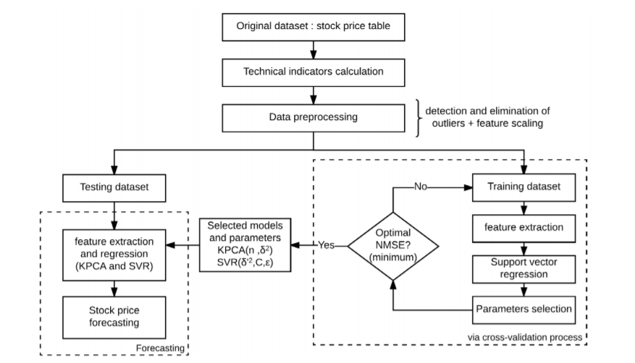
Fig: system design of stock prediction

Slide 10

a) Module design In this part, we are divide the system design into three modules as discuss below to understand more deeply on how the process works on each module.
i)Principal Component Analysis
The basic idea of PCA is a technique used for identification of a smaller number of uncorrelated variables known as principal components from a larger set of data by simply reduce the number of those variables in a dataset and producing lower dimension of dataset. Steps for Principal Component Analysis algorithm:
Step 1: Firstly we import the data as follow using R;
We notice that the data is saved in variable MSFT and we import the dataset using read_csv() function which is available in library “readr”.
Step 2: Standardize the data by using scale and apply “prcomp” function;
Step 3: Choose the principal components with highest variances using summary() function;

Slide 11

We got the following result:
If we look at the Proportion of Variance, PC1 has the maximum variance of 66.9% while PC2 has the second highest variance of 32.9% but we choose any one since we already reduced the dimension of three samples that we want to predict and scaling1 is the new data set that has lower dimension as compare to MSFT.

Slide 12
Training data set
MSFT_train
Scaling of
MSFT_train
Highest variance of PCs
Summary()
New dataset
scaling1
PCA
Fig: Block Diagram for Principal Component Analysis

Slide 13

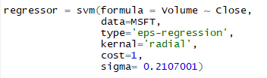
ii) Support Vector Regression
The second module is the Support Vector Regression which is often used in data mining and machine learning process which helps in classification of data base on the relationship among the variables like Volume and close and analyze the data with dependent variable with independent variables.
Step 1: Load all the necessary library into R script:
Library(e1071) contain the Support Vector Machine function, while library(caret) and library(lattice) are used to analyze the data, library(ggplot2) is used to plot the data in graphical format and library(kernlab) contains the different kernels like Gaussian and polynomial kernel.
Step 2: Execute SVR function with default parameter value:

Slide 14
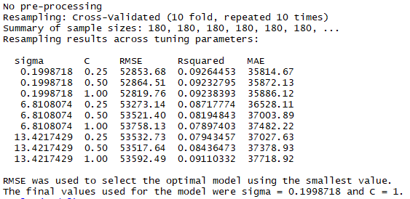
Step 3: Cross Validation of SVR parameters using trainControl() function:
Here using trainControl() function, method is ‘repeatedcv’ for validating the data repeatedly for 10 times. And we got the following result:
If we look at the figure above, we got the sigma value 0.1998718 and Cost value as 1. Now use these value in SVR function again.

Slide 15
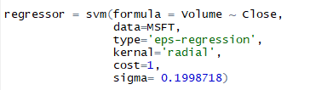
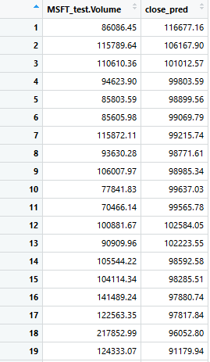
Step 4: Run SVR function again with optimized parameters values:
Step 5: Predict Close value based on Volume using predict() function:
We saved the prediction data in new variable “close_pred” and try to display the prediction value in tabular form as below:

Slide 16
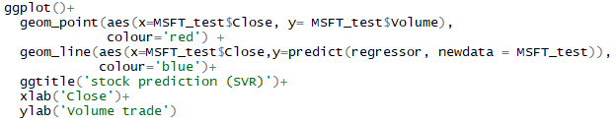
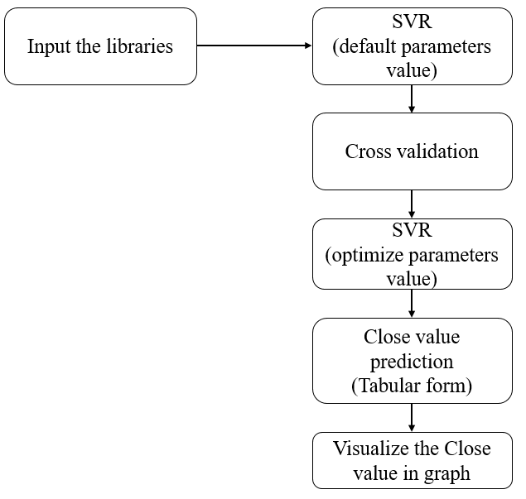
Step 6: Visualize the tabular result of Close value in Graphical format using ggplot() function:
Fig. Block Diagram
Of Support Vector Regression

Slide 17
iii) Parameter selection a. Radial Basis Function(RBF):
A radial basis function (RBF) is a term that describes any real valued function whose output depends exclusively on the distance of its input from some origin.
When training an SVM with the Radial Basis Function (RBF) kernel, two parameters must be considered: C and gamma.
The parameter C, common to all SVM kernels, trades off misclassification of training examples against simplicity of the decision surface. A low C makes the decision surface smooth, while a high C aims at classifying all training examples correctly.
Gamma defines how much influence a single training example has. The larger gamma is, the closer other examples must be to be affected.

Slide 18
b. Kernel Parameters(σ)
For classification problems, the optimal σ can be computed on the basis of Fisher discrimination. And for regression problems, based on scale space theory, we demonstrate the existence of a certain range of σ, within which the generalization performance is stable. An appropriate σ within the range can be achieved via dynamic evaluation. In addition, the lower bound of iterating step size of σ is given.

Slide 19
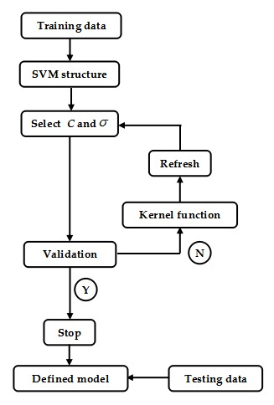
Fig: Block diagram of Parameter C and σ Selection

Slide 20
7. Methodology Here we have discuss on the tools and algorithms on which we have implemented on for this project.
R Language
R is a programming language and free software environment for statistical computing and graphics supported by the R Foundation for Statistical Computing.
The R language is widely used among statisticians and data miners for developing statistical software and data analysis.
R Programming is the best mechanism for statistics, data analysis, and machine learning. It is more than a statistical package; it's a programming language so that you can create your objects, functions, and packages that can be re-use again and again.

Slide 21
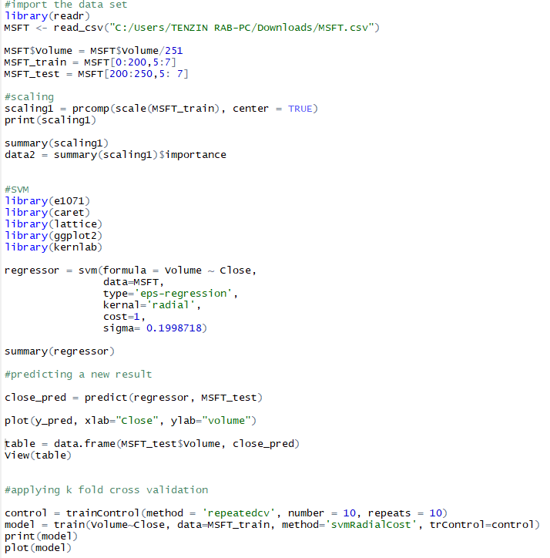

Slide 22
b) RStudio
RStudio is a free and open-source integrated development environment for R, a programming language for statistical computing and graphics. RStudio was founded by JJ Allaire, creator of the programming language ColdFusion. Hadley Wickham is the Chief Scientist at RStudio.
One of the best advantages of Rstudio is it will give you on Spot result like graph on adjacent plot window so that user can understand while writing the code.
It consist of four different window as script window for writing and saving the code, console window is where we can write code but can’t be saved, environment window which it display all the saved variable during coding and plot window which display the output like graph.

Slide 23
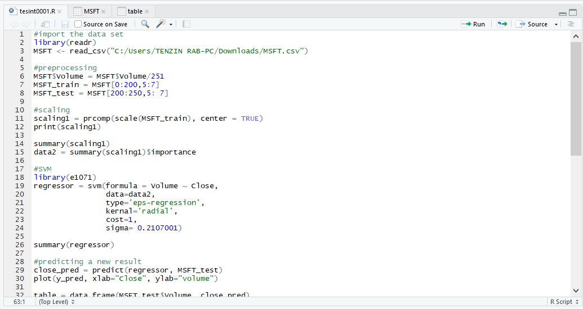
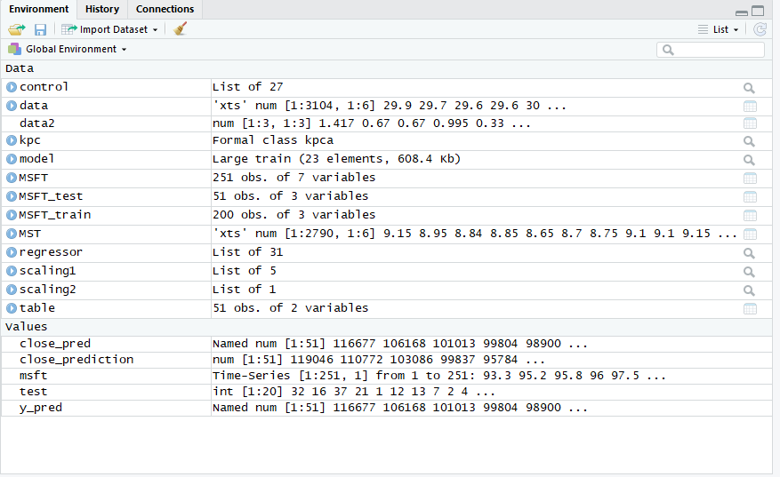
Script Window
Environment Window

Slide 24
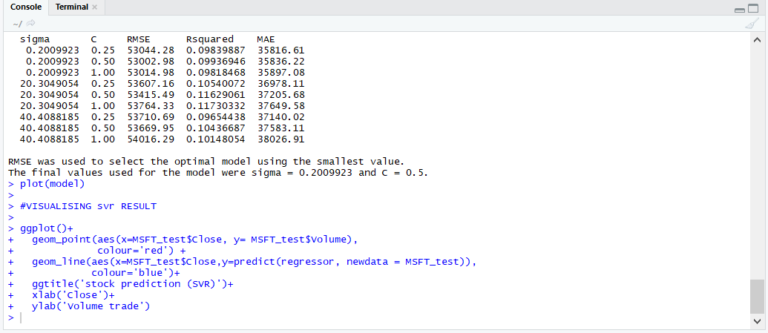
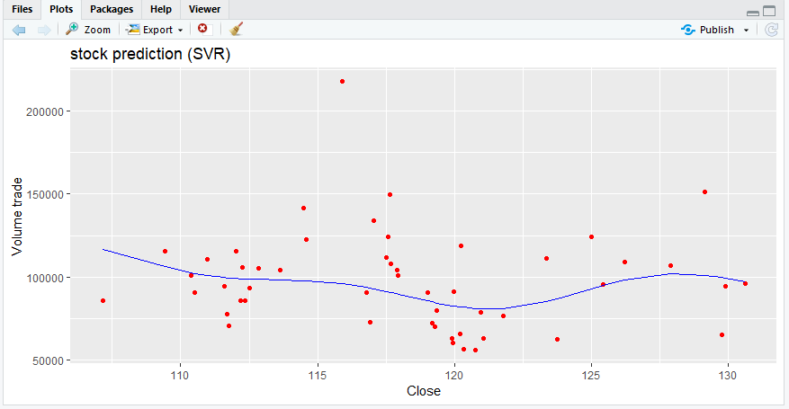
Console Window
Plot Window

Slide 25
c) Principal Component Analysis
The basic idea of PCA is a technique used for identification of a smaller number of uncorrelated variables known as principal components from a larger set of data by simply reduce the number of those variables in a dataset and producing lower dimension of dataset. Steps for Principal Component Analysis algorithm:
Step 1: Firstly we import the data as follow using R;
We notice that the data is saved in variable MSFT and we import the dataset using read_csv() function which is available in library “readr”.
Step 2: Standardize the data by using scale and apply “prcomp” function;
Step 3: Choose the principal components with highest variances using summary() function;

Slide 26
We got the following result:
If we look at the Proportion of Variance, PC1 has the maximum variance of 66.9% while PC2 has the second highest variance of 32.9% but we choose any one since we already reduced the dimension of three samples that we want to predict and scaling1 is the new data set that has lower dimension as compare to MSFT.

Slide 27
d) Support Vector Regression
The second module is the Support Vector Regression which is often used in data mining and machine learning process which helps in classification of data base on the relationship among the variables like Volume and close and analyze the data with dependent variable with independent variables.
Step 1: Load all the necessary library into R script:
Library(e1071) contain the Support Vector Machine function, while library(caret) and library(lattice) are used to analyze the data, library(ggplot2) is used to plot the data in graphical format and library(kernlab) contains the different kernels like Gaussian and polynomial kernel.
Step 2: Execute SVR function with default parameter value:

Slide 28
Step 3: Cross Validation of SVR parameters using trainControl() function:
Here using trainControl() function, method is ‘repeatecv’ for validating the data repeatedly for 10 times. And we got the following result:
If we look at the figure above, we got the sigma value 0.1998718 and Cost value as 1. Now use these value in SVR function again.

Slide 29
Step 4: Run SVR function again with optimized parameters values:
Step 5: Predict Close value based on Volume using predict() function:
We saved the prediction data in new variable “close_pred” and try to display the prediction value in tabular form as below:

Slide 30
Step 6: Visualize the tabular result of Close value in Graphical format using ggplot() function:

Slide 31
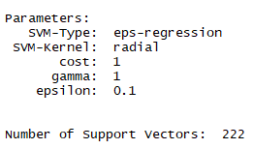
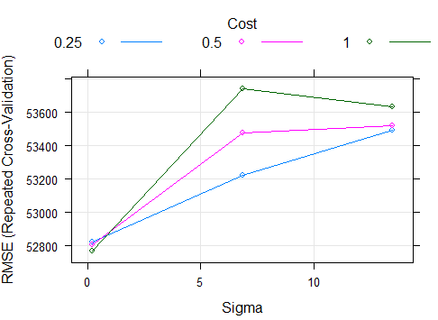
8. Result
We have to import the CVS data set file containing one year stock data of Microsoft around 251 observations and 7 samples. Then we split the data into testing and training.
Then process those data into SVR function producing values for cost, gamma and epsilon.
But we run through cross validation to
find the best or optimal value of sigma with
the help of RMSE value. We got,

Slide 32
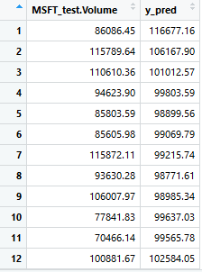
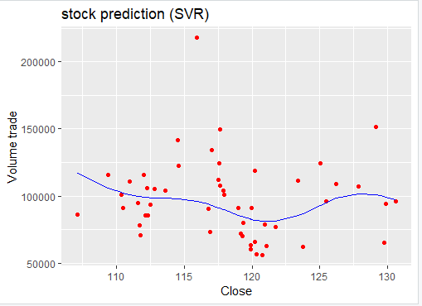
We can also show the data in tabular form and we got the optimal sigma value as 0.2232 at cost 1.
Then again we assign sigma value in SVR function and try to predict the close base on volume and show it on table form;
Then we try to visualize this table data into graphical form as we got;
As we can see, red dots are the volume at close price
and blue line try to predict at what volume, the value of
cost will be. But in most cases it ignore the far away
points.

Slide 33
9. Conclusion
In this project we use KPCA as dimension reduction and preprocessing, the output which get act as input to SVR model. SVR model able to show the predictive value of closing price relating to its volume value.
With the help of cross validation, with optimal parameters, we get the most accuracy and accurate result. But this system can be improve using machine learning technique such as neural network for better and can improve the system performance.
9.1. Futures Scope:
As for the futures scope we can also integrated the project with other machine learning algorithm and neural network algorithm like linear regression and k-nearest neighbor (k-NN). With the help of such deep learning algorithm we can predict the data for long and short term also.

Slide 34
10. References
Short-term stock price forecasting using kernel principal component analysis and support vector machines: the case of Casablanca stock exchange Anass Nahila,∗ , Abdelouahid Lyhyaouia (aLaboratory of Innovative Technologies, Abdelmalek Essaadi University, Tangier 90000, Morocco)
Predicting Stock Market Price Using Support Vector Regression (Phayung Meesad Faculty of Information Technology King Mongkut’s University of Technology North Bangkok)(Risul Islam Rasel Dept of Computer Science & Engineering University of Chittagong, Bangladesh 4000 )
Kernel principal component analysis and support vector machines for stock price prediction Huseyin Ince Gebze Technical University and Theodore B. Trafalis University of Oklahoma
Stock Prediction using Support Vector Regression and Neural Networks Lekhani Ray lekhaniray@gmail.com Vellore Institute of Technology, Vellore, Tamil Nadu
Forecasting Stock Price Trend Using Data Mining Techniques International Journal of Innovative Technology and Exploring Engineering (IJITEE) ISSN: 2278-3075, Volume-8 Issue-5 March, 2019
A Hybrid Algorithm for Forecasting Financial Time Series Data Based on DBSCAN and SVR State Key Laboratory of Marine Resource Utilization in South China Sea, Hainan University, Haikou 570228,

