Slide 1

Banking Management System (BMS)
A DBMS-powered full-stack web application that simulates core banking operations — creating and managing customer accounts, processing deposits and withdrawals, and storing a complete, auditable transaction history in a relational MySQL database.
Author: [Your Name] · Course: Database Management Systems · Tech stack: MySQL · Node.js · React.js

Slide 2
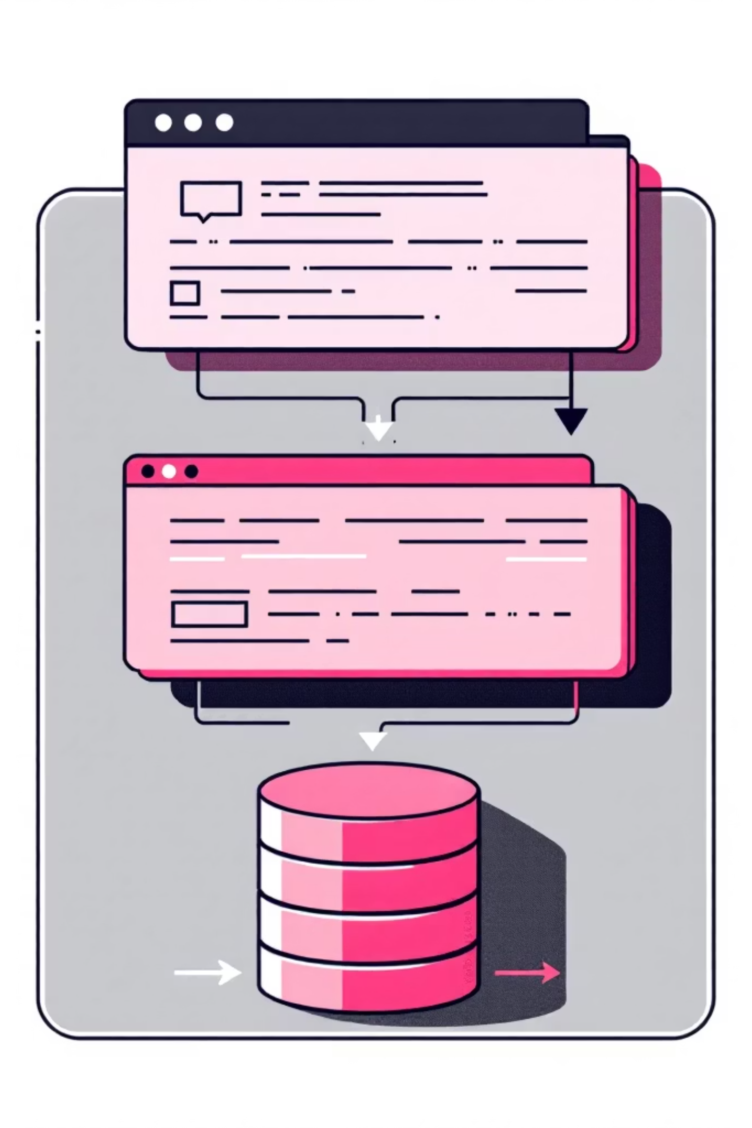
Project Overview — What is BMS?
BMS is a realistic banking simulator intended for learning DBMS-backed web applications. It models account lifecycle and transaction workflows backed by a relational database with strong constraints and ACID-safe operations. The app uses a three-tier architecture:
Frontend — React.js
Backend — Node.js / Express
Interactive UI for account management, transaction forms, and activity timelines.
RESTful API endpoints, business logic, transaction orchestration, and validation.
Database — MySQL
Relational storage with constraints, indexes, and transactional guarantees.

Slide 3
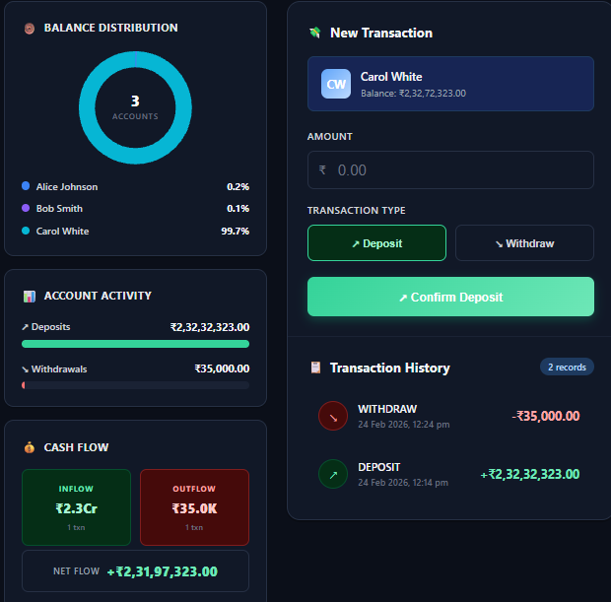
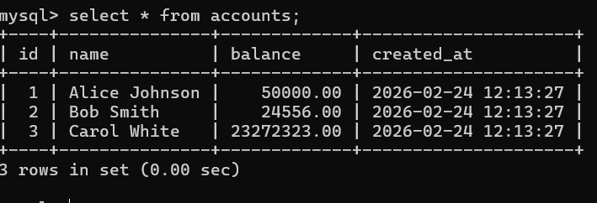
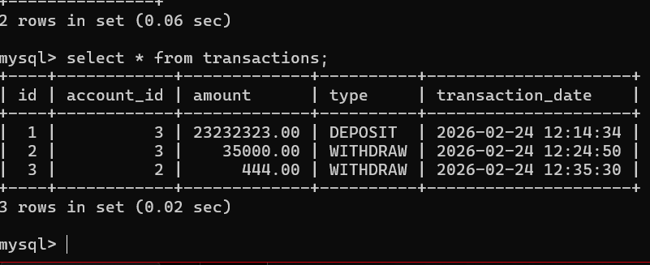
Database Design — Core Schema
The bms database centres around two core tables. The schema is compact, explicit, and designed for data
integrity and performant joins.
transactions
Append-only ledger recording every deposit or withdrawal. Key columns: id (PK), account_id (FK), amount, type, transaction_date.
Relationship: transactions.account_id → accounts.id (foreign key). This design keeps transactional data separate
from account metadata for clarity and normalization.

Slide 4

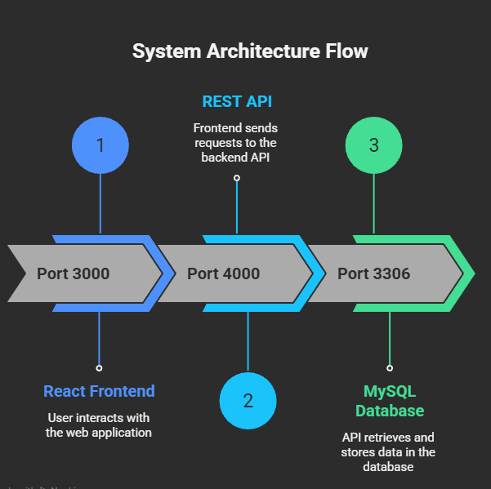
System Architecture & API Contract
The system exposes a small, well-documented REST surface. Ports shown are examples used in development and testing.
Frontend
1
React (port 3000) — account views, transaction forms, validation UI.
API
2
Node.js / Express (port 4000) — endpoints below implement business logic and orchestrate DB transactions.
Database
3
MySQL (port 3306) — schema, constraints, and transaction engine.
Key endpoints: GET /api/accounts → fetch all accounts GET /api/accounts/transactions/:id → fetch transaction history for an account POST /api/accounts/transaction → perform deposit or withdrawal (server validates and executes DB transaction)

Slide 5

Keys & Constraints — Protecting Data Integrity
Constraints enforce business rules at the DB level so the application can rely on correct state even under concurrent operations.
1
Primary Keys
id columns are PRIMARY KEY with AUTO_INCREMENT to uniquely identify rows and simplify joins.
2
Foreign Key
transactions.account_id REFERENCES accounts.id with ON DELETE CASCADE — removing an account removes its transactions.
3
NOT NULL & DEFAULT
Critical columns (name, amount, type) marked NOT NULL. balance default = 0.00; timestamps default to CURRENT_TIMESTAMP.
4
ENUM Constraint
type ENUM('DEPOSIT','WITHDRAW') prevents invalid transaction types at the schema level.

Slide 6

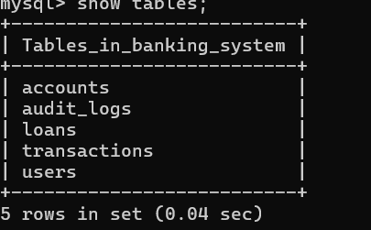
SQL Patterns Used — Select, Insert, Update
The backend uses parameterised SQL to interact with MySQL. Examples below represent the canonical queries used across the API.
SELECT
SELECT * FROM accounts ORDER BY id ASC; and SELECT * FROM transactions WHERE account_id = ? ORDER BY transaction_date DESC;
INSERT
INSERT INTO transactions (account_id, amount, type, transaction_date) VALUES (?, ?, ?, NOW()); — parameterised to prevent injection.
UPDATE
UPDATE accounts SET balance = ? WHERE id = ?; — performed inside transactions to maintain consistency.

Slide 7
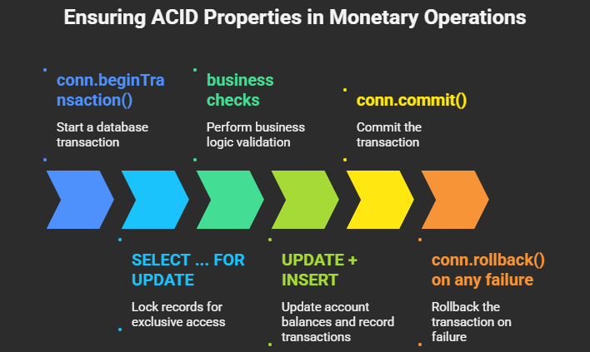
All monetary operations are wrapped in a DB transaction to guarantee ACID properties. Caption: this diagram illustrates the
ordered steps and decision points used to atomically update account balances and record transactions.
Code pattern: conn.beginTransaction() → SELECT ... FOR UPDATE → business checks → UPDATE + INSERT → conn.commit()
(or conn.rollback() on any failure).

Slide 8
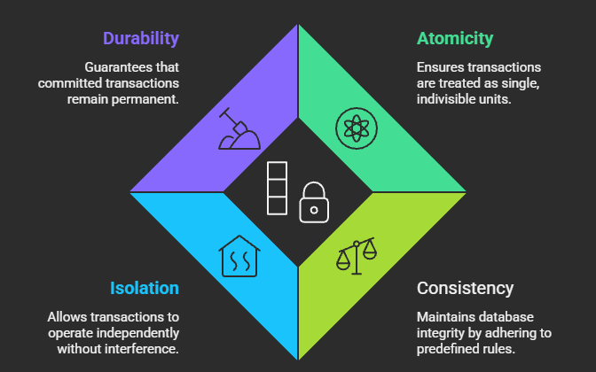
Transactions & ACID Properties

Slide 9

Scaling & Integrity — Connection
Pooling and Referential Checks
Practical considerations for a DB-backed web app: reuse connections,
limit resource contention, and rely on DB-level referential rules.
Connection Pooling
mysql2 pool with connectionLimit: 10 reduces latency and avoids
frequent TCP handshakes. Connections are checked out per
request and released back to the pool.
Referential Integrity
Foreign keys prevent orphaned transactions. The database
enforces that a transaction cannot reference a non-existent
account.
ON DELETE CASCADE
Deleting an account removes dependent transactions
automatically — useful for tests and data lifecycle management,
but requires caution in production.

Slide 10
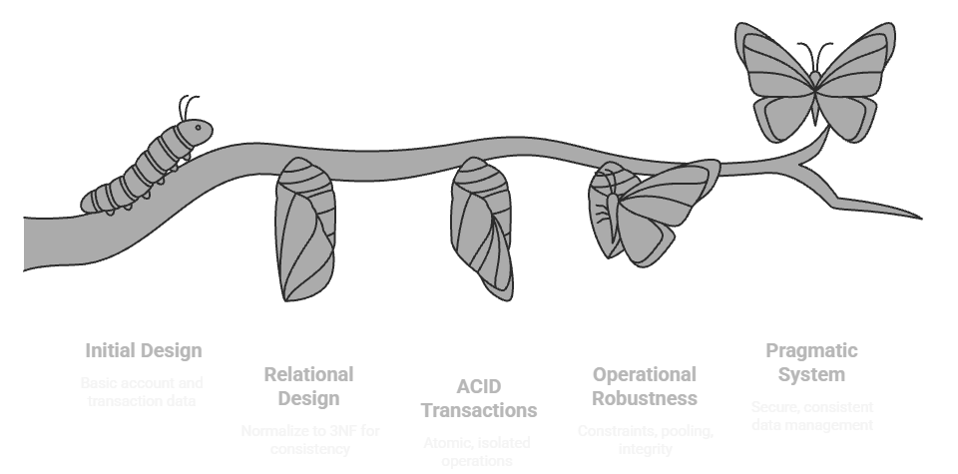
Conclusion — What BMS Teaches

