Slide 1
2D GAMEjj DUNGEONjjjj
Group 3

Slide 2
TEAM MEMBERS
Full Name | Student ID | Declaration of contribution
Đỗ Gia Thụy | ITCSIU21237 | Handle enemy configuration
Nguyễn Thanh Tú | ITITIU21338 | Create overlay screen, make presentation
Đỗ Huỳnh Duy Tiến | ITCSIU22291 | Write report and handle the control of player
Lý Khải Minh | ITITSB22008 | Config canon and projectiles and traps, make presentation
Nguyễn Khánh Vinh | ITDSIU21129 | Create levels for the game

Slide 3
TABLE OF CONTENT
01
ITRODUCTION TO THE GAME
02
GAME STRUCTURE
Content
Explain through sequence diagram
03
REFERENCES

Slide 4
INTRODUCTION TO THE GAME
1

Slide 5

ABOUT THE GAME
Code in Java
Defeat all the enemy is the goal
Link to the game:
Different perspective

Slide 6
Work flow
Vinh
Thuy
Create level for the game
Create and handle control of piggy
Tien
Tu
Minh
Create overlay screen and menu panel
Add canon and trap for the game
Create and handle control of player

Slide 7




HOW TO PLAY
Move right
Move right
Attack
Jump

Slide 8
GAME STRUCTURE
2

Slide 9
Initialization Phase

Slide 10
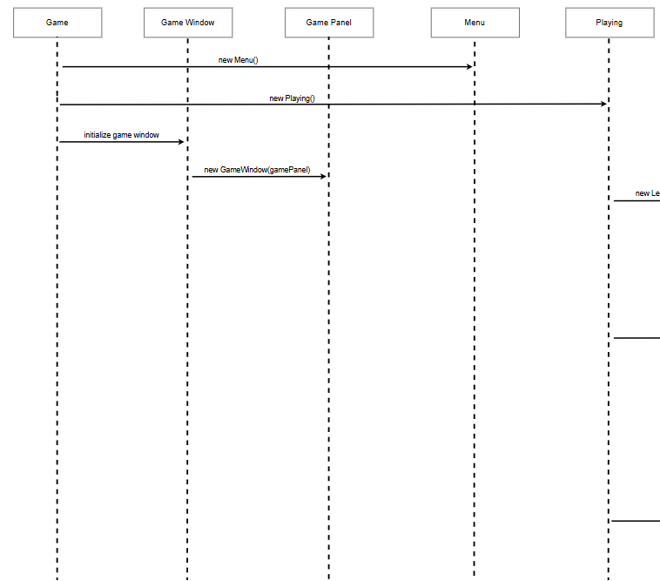

Slide 11
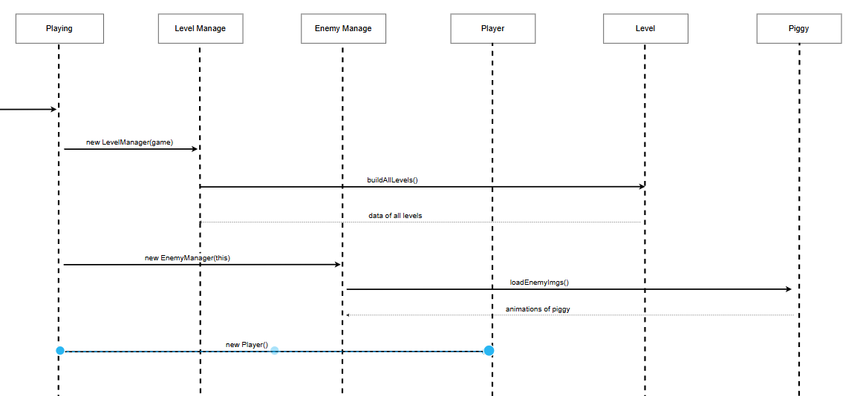

Slide 12
Player Class

Slide 13
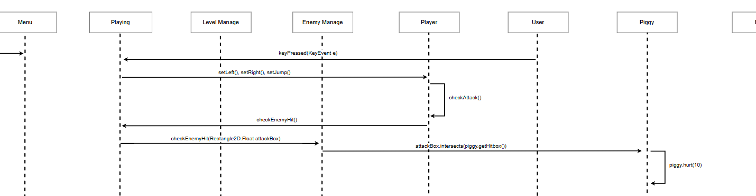
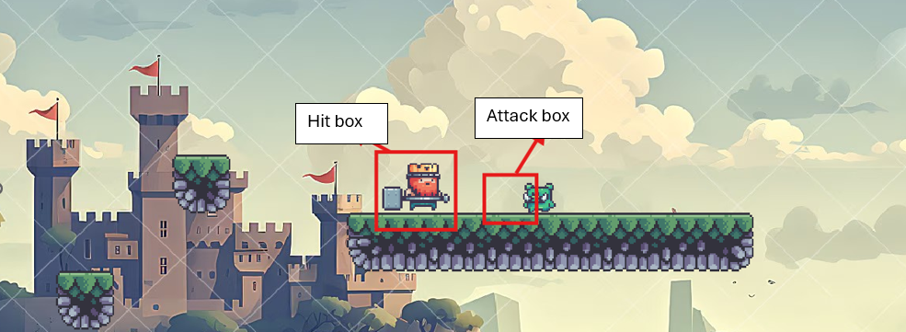

Slide 14
Piggy Enemy Behavior

Slide 15
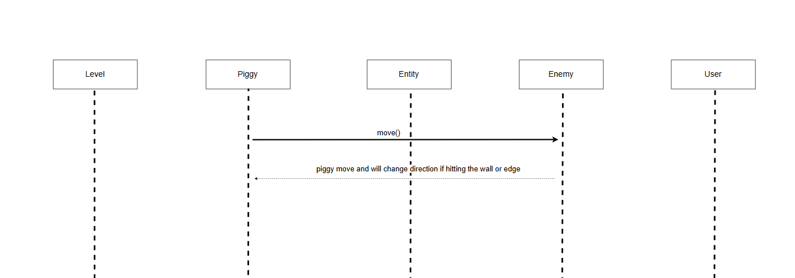
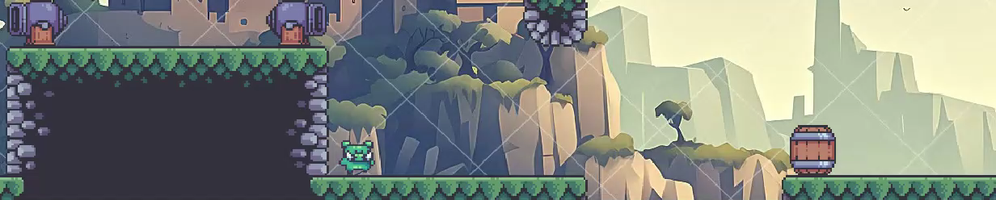

Slide 16
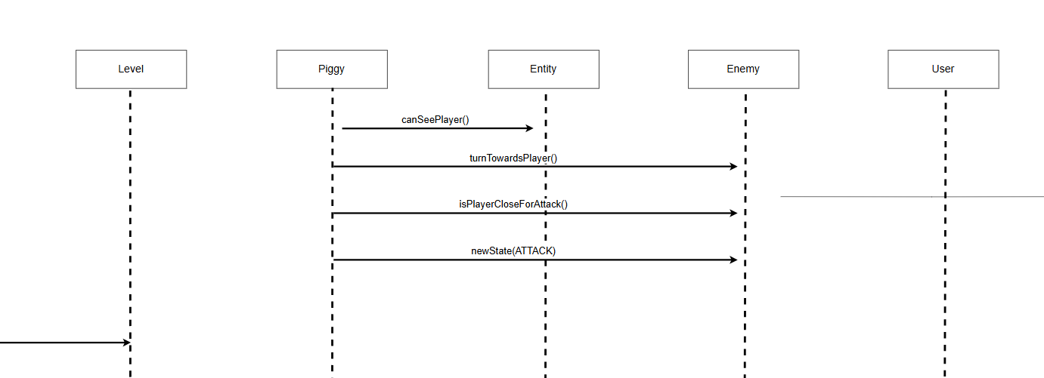
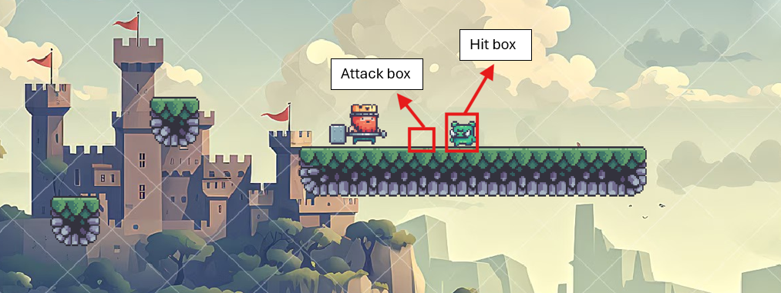

Slide 17
RENDER

Slide 18
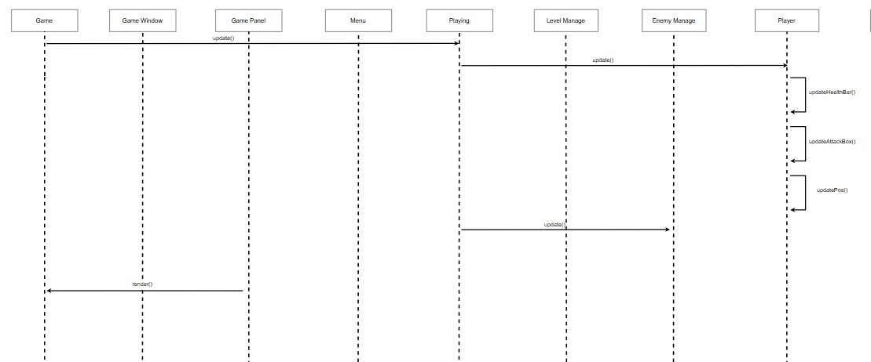

Slide 19
REFERENCES
3

Slide 20
REFERENCES
Images from https://pixelfrog-assets.itch.io/kings-and-pigs
Tutorial 2d platformer game: https://www.youtube.com/@KaarinGaming

Slide 21
THANKS FOR WATCHING

Slide 22
Q&A

