Slide 1
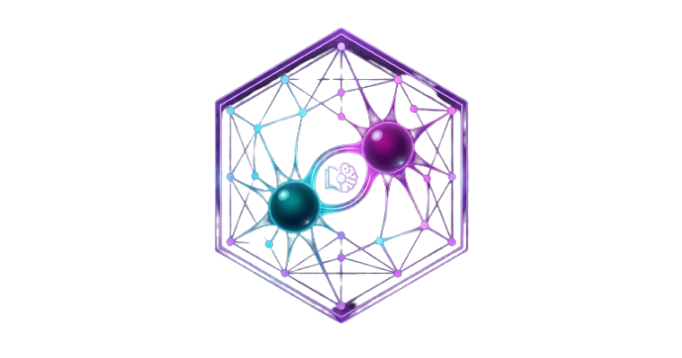
ResearchMind
AI Research Intelligence Platform
"Where knowledge connects."
Teodor Mihailescu
Anastasia Sandu
Selena Hurloi
MPA 2026 · May 2026

Slide 2
THE PROBLEM
Researchers are drowning
in disconnected knowledge.
📄
⏰
🧠
200–400
6 hrs/week
0
papers read per year by a single PhD student
lost searching and cross-referencing literature
tools that connect, synthesise AND critique papers with AI
2 / 10

Slide 3
THE SOLUTION
Three AI agents.
One living knowledge graph.
1
2
3
Agent 1
Agent 2
Agent 3
Paper Analyzer
Synthesis Agent
Paper Critic
Extracts title, concepts, methodology, findings & keywords from any paper in under 10 seconds.
Finds cross-paper themes, surfaces research gaps, and generates novel evidence-backed hypotheses.
Scores each paper's methodology, reproducibility & statistical soundness. Flags weaknesses & suggests improvements.
3 / 10

Slide 4
PRODUCT
ResearchMind in action.
http://localhost:8000
PAPER LIBRARY
AGENT 1 OUTPUT
AGENT 2 OUTPUT
AGENT 3 OUTPUT
Attention Is All You Need
Key Concepts
Hypothesis
Quality Score: 9.1/10
AlphaFold 2
· Transformer architecture
· Combining transformer attention
· Methodology: 9/10
GNN Survey 2024
· Self-attention mechanism
· with protein folding functions
· Reproducibility: 10/10
· Multi-head attention
· may improve binding site
· Novelty: 9/10
· Positional encoding
· prediction by 23%
· Minor: limited ablations
4 / 10

Slide 5
MARKET OPPORTUNITY
A $8.2B market
growing at 12% CAGR.
$8.2B
$2.8B
5M+
12%
Academic research
software market (2025)
AI research assistant
market by 2028
Academic papers
published annually
Market CAGR
2025–2028
Primary target: 3.5M PhD students & postdocs globally · Secondary: 500K academic labs · Tertiary: R&D in pharma & tech companies
5 / 10

Slide 6
BUSINESS MODEL
Freemium SaaS — free tier
drives viral adoption.
POPULAR
Free
Scholar
Lab
University
€0/mo
€29/mo
€99/mo
€499/mo
50 papers
3 agents
Basic graph
Unlimited papers
Full agents
Export & API
Team of 10
Shared library
Priority support
Institutional
All features
SSO + SLA
Target ARR Year 1: €258,480 · Break-even at Month 8 · ROI Year 2: ~767%
6 / 10

Slide 7
COMPETITIVE ADVANTAGE
We are the only platform
with all three agents.
Feature
ResearchMind
ResearchRabbit
Connected Papers
Semantic Scholar
3-Agent AI
✓
✗
✗
✗
Hypothesis Generator
✓
✗
✗
✗
Paper Quality Critic
✓
✗
✗
✗
Chat with Library
✓
✗
✗
✗
Free Tier
✓
✓
✓
✓
7 / 10

Slide 8
TRACTION & ROADMAP
MVP live. Roadmap clear.
CURRENT TRACTION
ROADMAP
✓
3-agent MVP fully implemented & live
v1.0 — NOW
MVP live · 3 agents · Demo mode
✓
Landing page with full funnel & CTA
v1.1 — Q3 2026
✓
FastAPI + Groq backend (700 tok/s)
PDF upload · ChromaDB vector store · Neo4j graph
✓
Demo mode — works without backend
v1.2 — Q4 2026
Team collaboration · EU data residency · SSO
✓
Business foundation & pitch ready
v2.0 — 2027
Institutional licences · API marketplace · 50K users
8 / 10

Slide 9
THE TEAM
Built by researchers,
for researchers.
Teodor Mihailescu
Anastasia Sandu
TM
Full-Stack Dev & AI Engineer
AS
Frontend Dev & UX Designer
FastAPI backend · All 3 Groq agents · DevOps & deployment pipeline
Landing page (Three.js+GSAP) · MVP app UI · Knowledge graph viz
Selena Hurloi
Adelina Danescu
SH
Product Manager & Analyst
AD
Backend Developer & QA
Business foundation · Market research · Pitch deck & risk planning
API testing · QA pipeline · Integration tests · Bug tracking & fixes
9 / 10

Slide 10
JOIN US
Start for free.
No credit card. No limits. Just knowledge.
🌐 Landing Page
⚡ Free Groq Key
📧 Contact Us
researchmind.ai
console.groq.com
hello@researchmind.ai
Open App →
ResearchMind · MPA 2026 · Teodor Mihailescu, Anastasia Sandu, Selena Hurloi, Adelina Danescu
10 / 10

