Slide 1
Urban Technologies Predicting Bike Rentals
Teodor Chiaburu

Slide 2
Table of contents
A look at the dataset
Data preprocessing
Applying predictive models
Multilinear Regression
Random Forest
Time Series
Model comparison

Slide 3
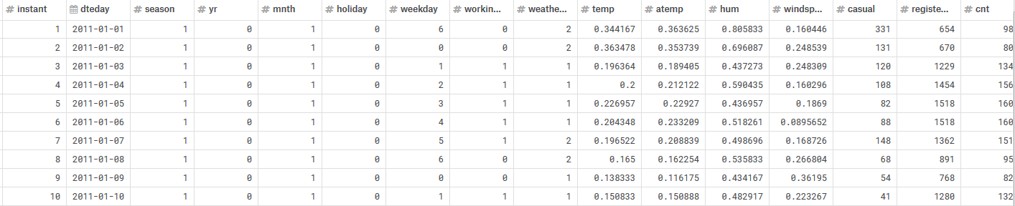
1. A look at the dataset
Daily count of rental bikes between years 2011 and 2012 in Washington, DC with the corresponding weather and seasonal information.

Slide 4
1. A look at the dataset
Metadata (temporal features):
instant: record index
dteday: date
season: astronomical season (1: 21.12-20.03,
2: 21.03-20.06,
3: 21.06-21.09,
4: 22.09-20.12)
yr: year (0: 2011, 1: 2012)
mnth: month (1 to 12)
holiday: whether day is holiday or not (1 or 0)
weekday: day of the week (0 to 6)
workingday: 1, if neither weekend nor holiday,
0, otherwise

Slide 5
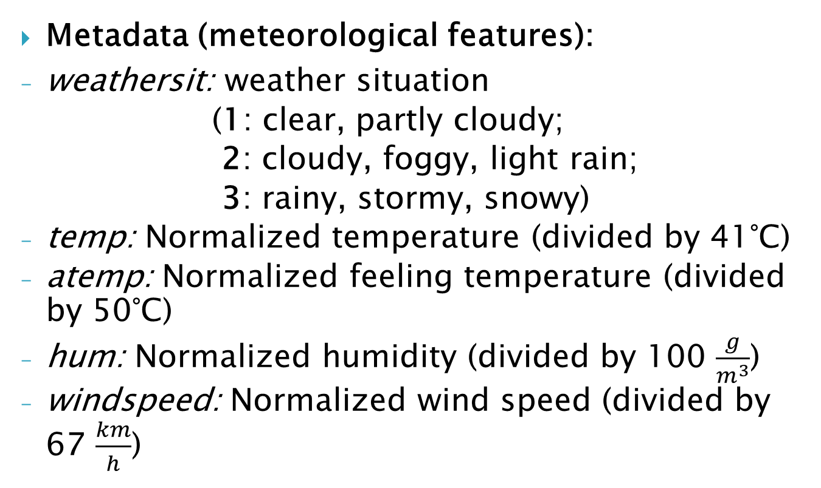
1. A look at the dataset
Metadata (meteorological features):
weathersit: weather situation
(1: clear, partly cloudy;
2: cloudy, foggy, light rain;
3: rainy, stormy, snowy)
temp: Normalized temperature (divided by 41°C)
atemp: Normalized feeling temperature (divided by 50°C)
hum: Normalized humidity (divided by 100 $\frac{g}{m^{3}}$)
windspeed: Normalized wind speed (divided by 67 $\frac{km}{h}$)

Slide 6
1. A look at the dataset
Metadata (dependent variables):
casual: count of casual/one-time users
registered: count of registered/regular users
cnt: count of total rental bikes including both casual and registered

Slide 7
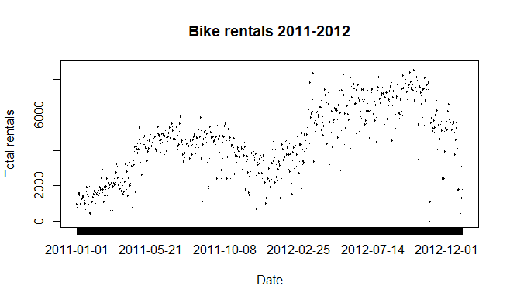
1. A look at the dataset

Slide 8
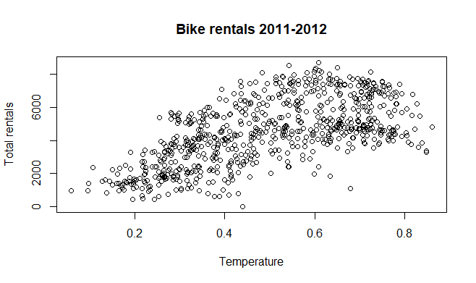
1. A look at the dataset

Slide 9
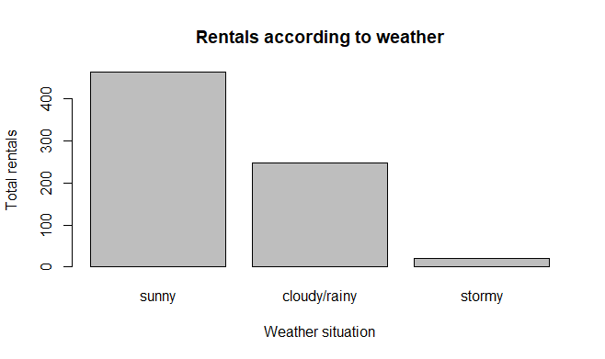
1. A look at the dataset

Slide 10
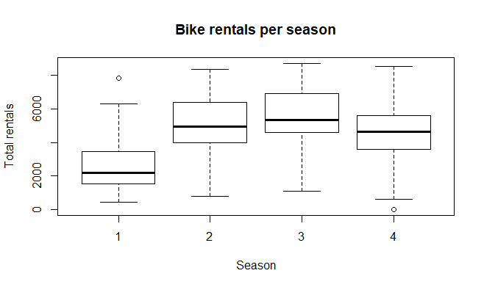
1. A look at the dataset

Slide 11
2. Data preprocessing
Variable selection:
Drop the record index instant (redundant)
Discard casual and registered rentals, keep only total rentals:
total rentals = casual + registered

Slide 12
2. Data preprocessing
Dealing with outliers/anomalies:
only 22 rentals on 29th october 2012
hurricane in Washington -> replace datapoint with mean of the previous 30 days
very few rentals on 26th december 2012
Christmas period -> keep the data point
very few rentals on 29th february 2012
leap year -> keep data point
unusually large interest on 17th march 2012
St. Patrick‘s Day -> keep data point

Slide 13
2. Data preprocessing
Encoding categorical features:
season, year, month, holiday, weekday, workingday, weathersituation -> dummy variables
example: season replaced with season_2, season_3, season_4 (0-1)
season 1 is represented as the tuple (0, 0, 0)
season 2 is represented as the tuple (1, 0, 0)
…

Slide 14
2. Data preprocessing
Splitting the data:
Method 1: at random -> 60-20-20
not realistic (interested in predicting the future, not the past)
Method 2: (chronological) block splitting
last week as test set
30 days before as cv set
rest of data as training set

Slide 15
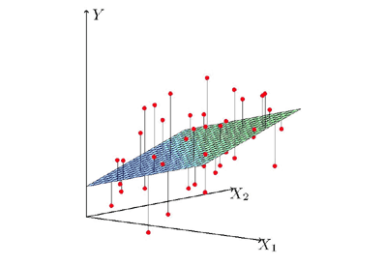
3. Applying predictive models
Multilinear Regression
Random Forest
Time Series

Slide 16
3.1 Multilinear Regression
Fit regressor to the training set using all features
RMSE on CV set: 1073
Can we do better? Look at statistically non-significant (or just little significant) features.
summary() command in R

Slide 17
3.1 Multilinear Regression
workingday non-significant and also NA
drop feature and retrain regressor
RMSE on CV set: 1073
error remains constant
check significance again

Slide 18
3.1 Multilinear Regression
atemp non-significant and also computable from variable temp
drop feature and retrain regressor
RMSE on CV set: 1074
error increases -> keep variable atemp

Slide 19
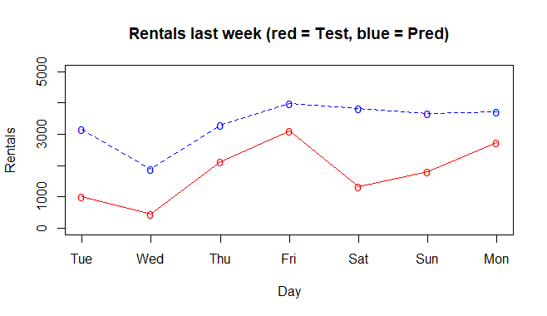
3.1 Multilinear Regression
Predict last week:
RMSE on Test set: 1664

Slide 20

3. Applying predictive models
Multilinear Regression
Random Forest
Time Series

Slide 21
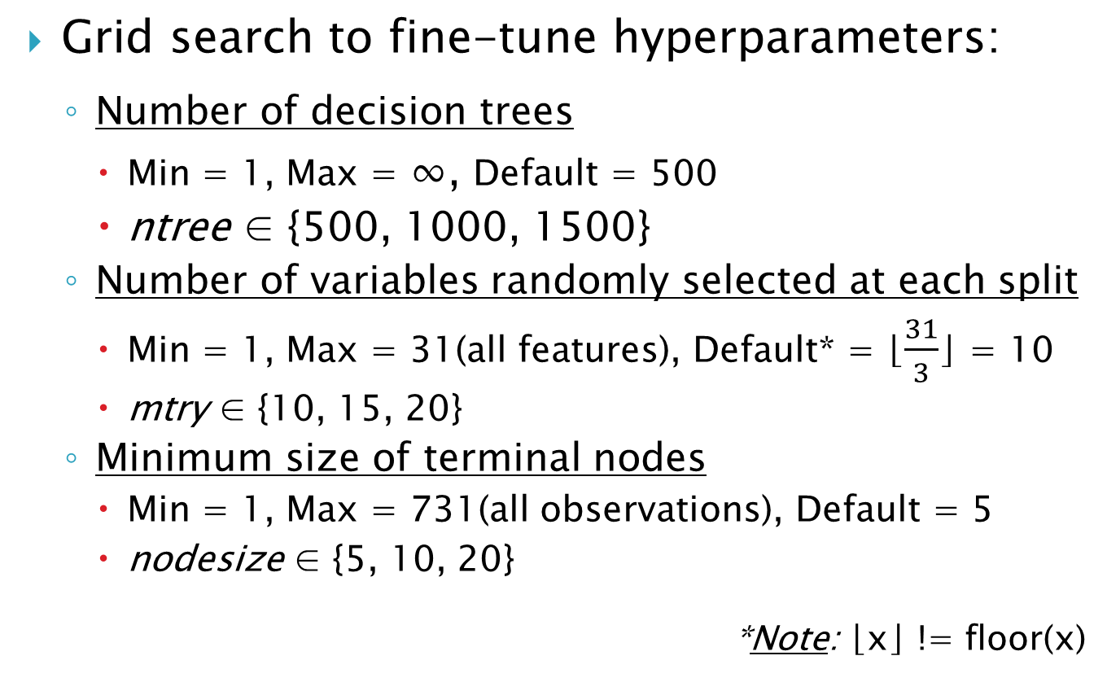
3.2 Random Forest
Grid search to fine-tune hyperparameters:
Number of decision trees
Min = 1, Max = ∞, Default = 500
ntree ∈ {500, 1000, 1500}
Number of variables randomly selected at each split
Min = 1, Max = 31(all features), Default* = ⌊$\frac{31}{3}$⌋ = 10
mtry ∈ {10, 15, 20}
Minimum size of terminal nodes
Min = 1, Max = 731(all observations), Default = 5
nodesize ∈ {5, 10, 20}
*Note: ⌊x⌋ != floor(x)

Slide 22
3.2 Random Forest
Fit regressor to training set for all combinations of hyperparameters and measure performance on CV set
3•3•3 = 27 possibilities
best configuration:
ntree = 1500
mtry = 10
nodesize = 10
RMSE on CV set: 1367

Slide 23
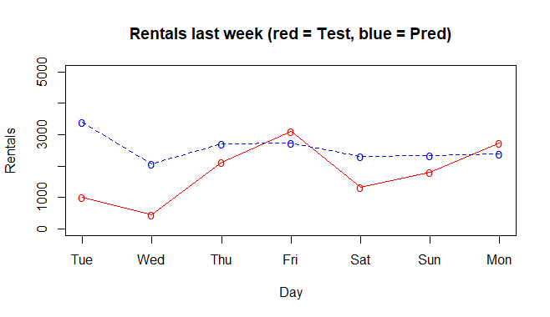
3.2 Random Forest
Predict last week:
RMSE on Test set: 1210

Slide 24

3. Applying predictive models
Multilinear Regression
Random Forest
Time Series

Slide 25


Slide 26
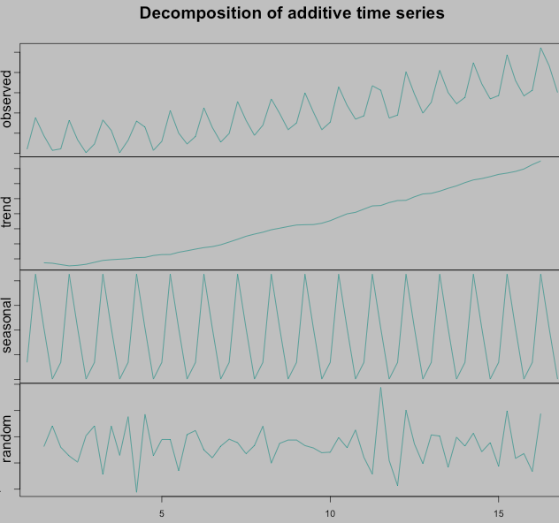
3.3 Time Series

Slide 27

3.3 Time Series
Data needs to be stationary in order to be analyzed with time series.
Stationary time series:
mean, variance and covariance do not depend on time

Slide 28
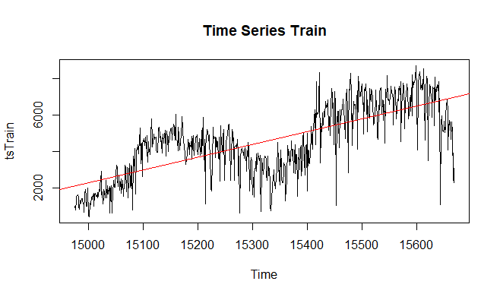
3.3 Time Series

Slide 29
3.3 Time Series
Make the series stationary:
Deal with the increasing variance
apply log-function to smoothen seasonality
Deal with the increasing mean
differentiate to exclude trend

Slide 30
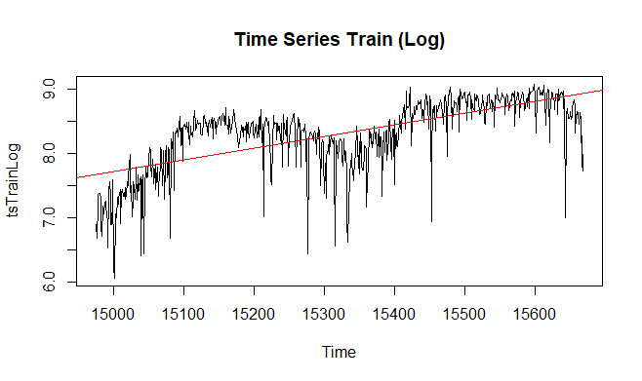
3.3 Time Series

Slide 31
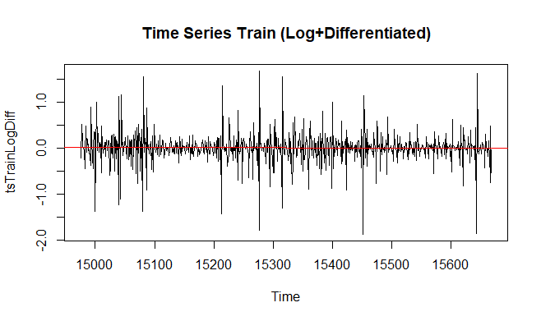
3.3 Time Series

Slide 32
3.3 Time Series
Apply ARIMA Model:
Auto-Regressive (p) -> predict future values based on past values
Integrated (d) -> for differentiated non-stationary series
Moving-Average (q) -> smoothening process by taking averages of subsets over time
Determine parameters p, d, q:
d = 1 (series differentiated only once)
for q and p look at ACF and PACF

Slide 33
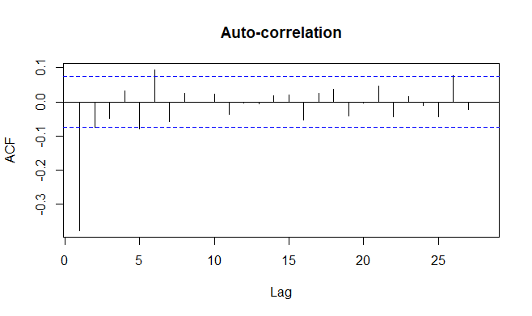
3.3 Time Series
first line reversed
line index = 2 = q

Slide 34
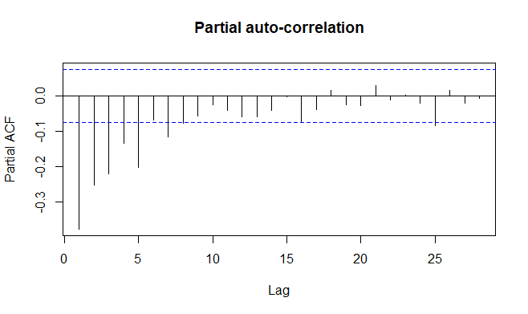
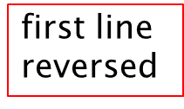
3.3 Time Series
line index = 16 = p

Slide 35
3.3 Time Series
Grid Search to fine-tune hyperparameters:
Fitting method: maximum likelihood (ML) or minimize conditional sum of squares (CSS)
Default: CSS-ML (find starting values with CSS, then use ML)
method ∈ {CSS-ML, ML, CSS}
Whether to transform p and q in order to maintain stationarity
Default: False
transform.pars ∈ {True, False}

Slide 36
3.3 Time Series
Fit regressor to training set for all combinations of hyperparameters and measure performance on CV set
3•2 = 6 possibilities
best configuration:
method = CSS
transform.pars = True
RMSE on CV set: 1468

Slide 37
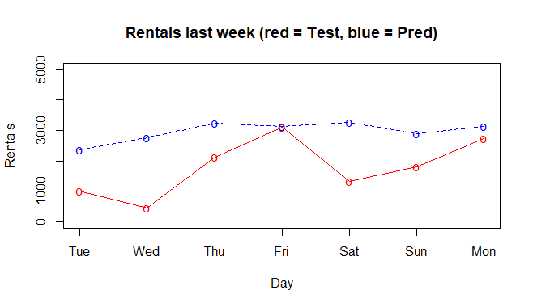
3.3 Time Series
Predict last week:
RMSE on Test set: 1392

Slide 38
4. Model comparison
Model | Full Train Error | CV Error | Test Error
MLR | 745 | 1073 | 1188
RF | 6 | 869 | 1368
TS | - | 1468 | 1392

Slide 39
Resources
https://www.kaggle.com/marklvl/bike-sharing-dataset
https://towardsdatascience.com/the-complete-guide-to-time-series-analysis-and-forecasting-70d476bfe775
https://www.analyticsvidhya.com/blog/2015/12/complete-tutorial-time-series-modeling/
https://machinelearningmastery.com/tune-machine-learning-algorithms-in-r/
https://anomaly.io/seasonal-trend-decomposition-in-r/index.html

