Slide 1
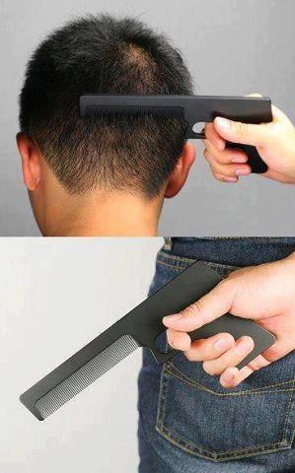

Crazy Gadget Website
Cool website to spent some funny time

Slide 2
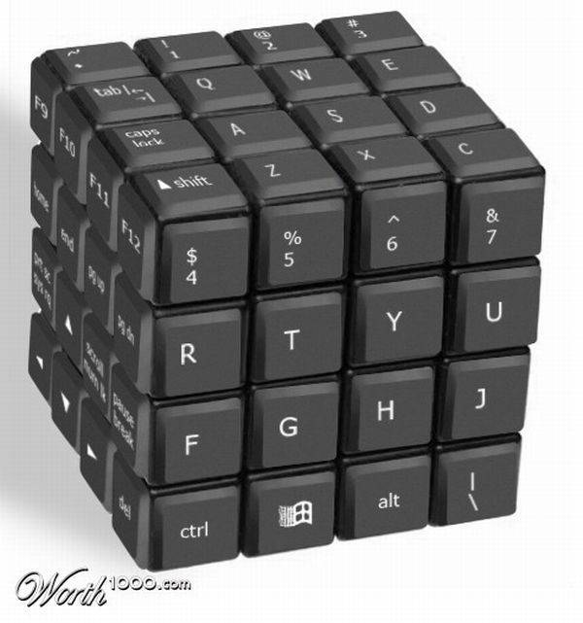

Structure
Home Page
Login Page
Register Page
Gadget Details Page
Simple Admin Panel Page
User Ordered Articles Page

Slide 3
For what about this Site is:
The site represent idea for online shop and place where potential customers could find some funny, and some times really useful stuff to buy from
Full set of functionalities it should provide is not completed at this time
But it provides a good platform to build one interesting website app
To be continued…

Slide 4
Summary
That was all folks
Thank you for your attention.
Best regards from JS Enthusiasts team (P.S renamed to Dark Pink, Pink Floyd, Deep Purple or whatever… ;))

Slide 5
Our Crazy Funny Gadget Website

