Slide 1
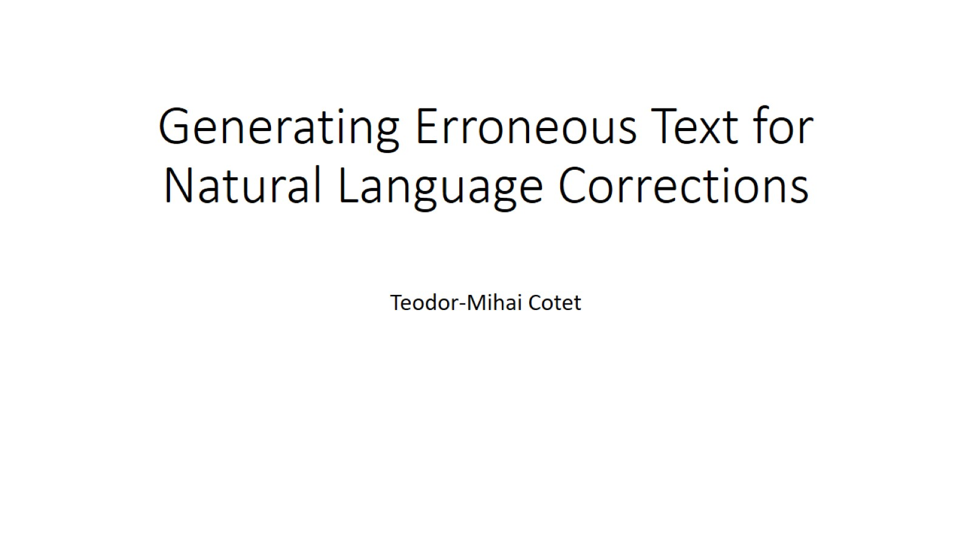
Generating Erroneous Text for Natural Language Corrections
Thesis advisor:
Prof. dr. ing. Mihai Dascălu

Slide 2
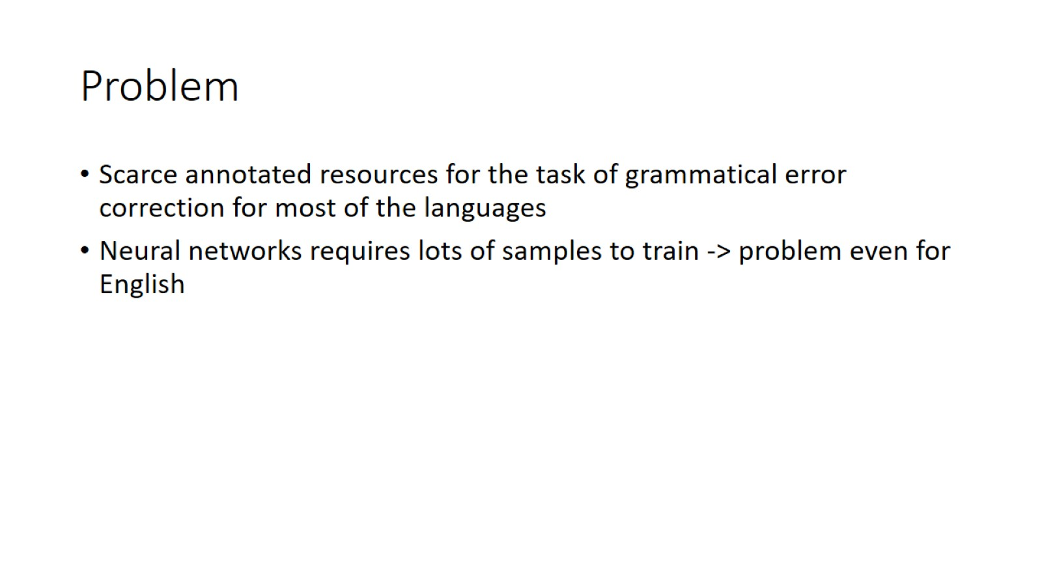
Problem

Slide 3
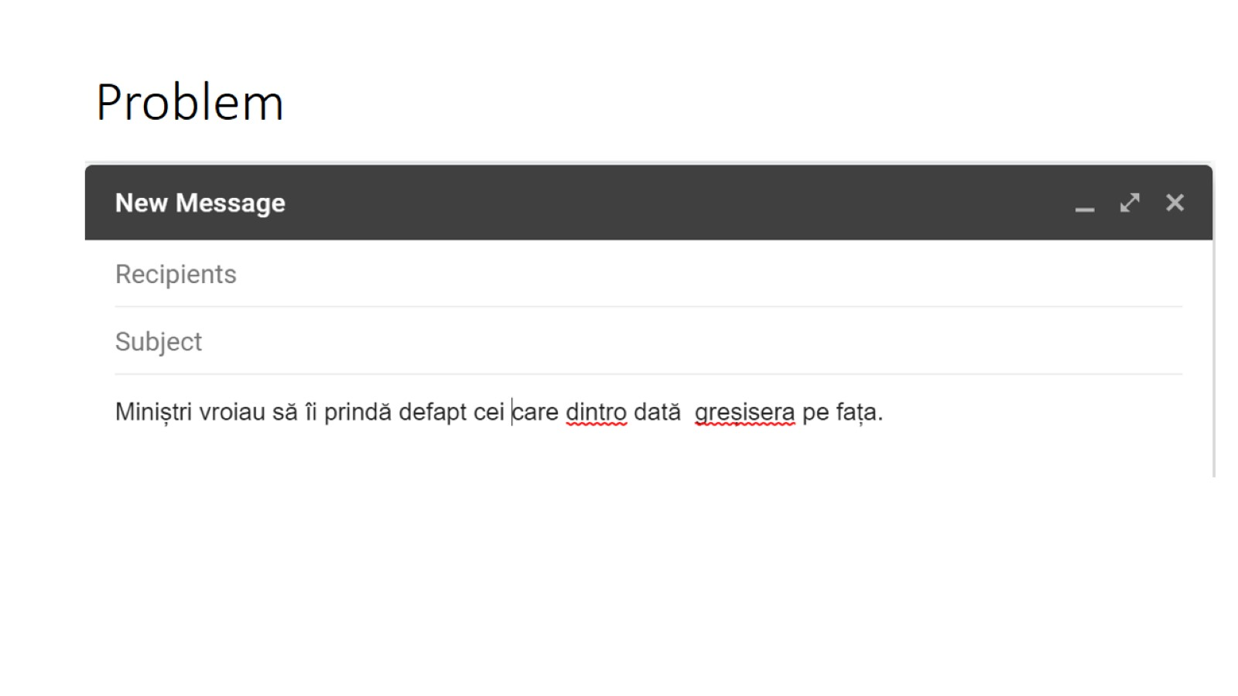
Problem

Slide 4
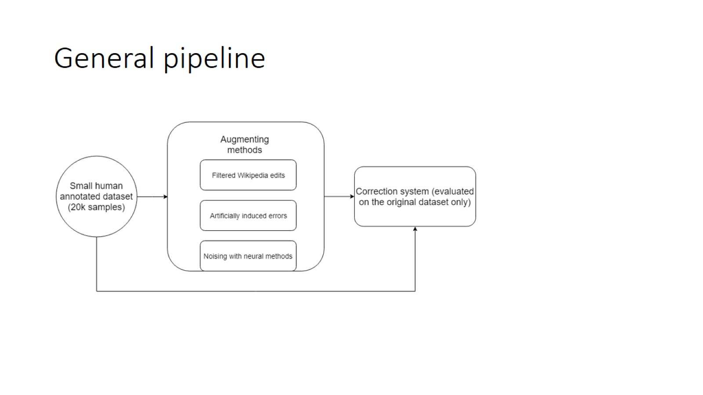
General pipeline

Slide 5
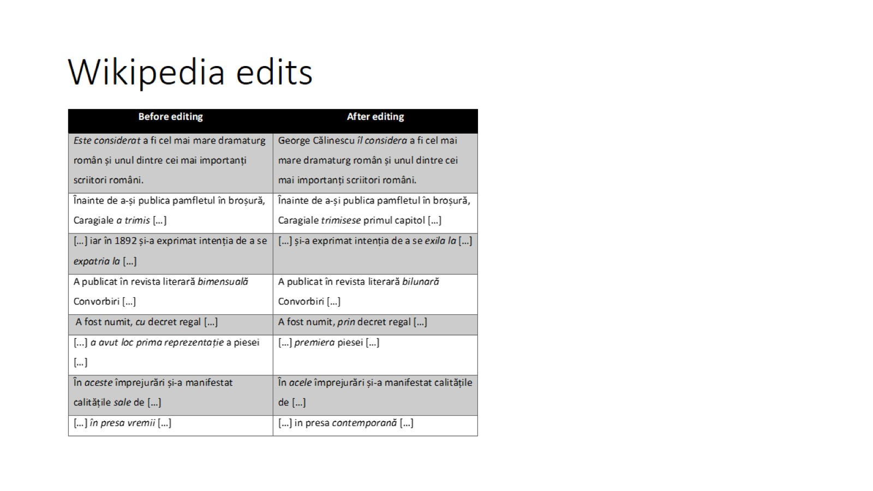
Wikipedia edits

Slide 6
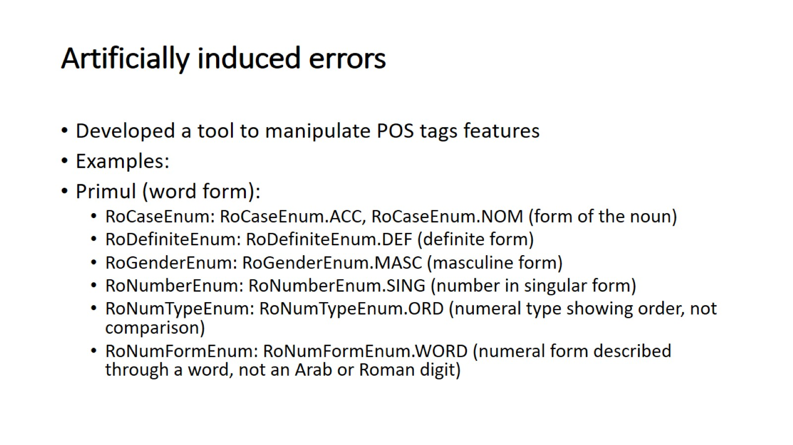
Artificially induced errors

Slide 7
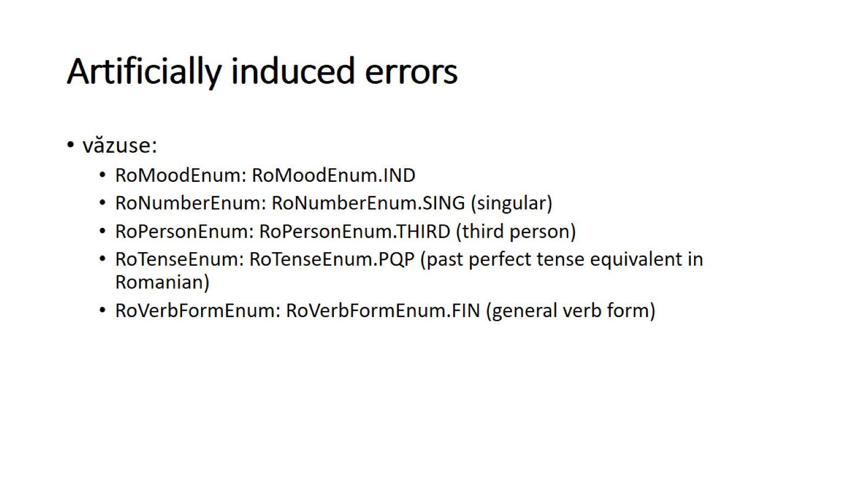
Artificially induced errors

Slide 8
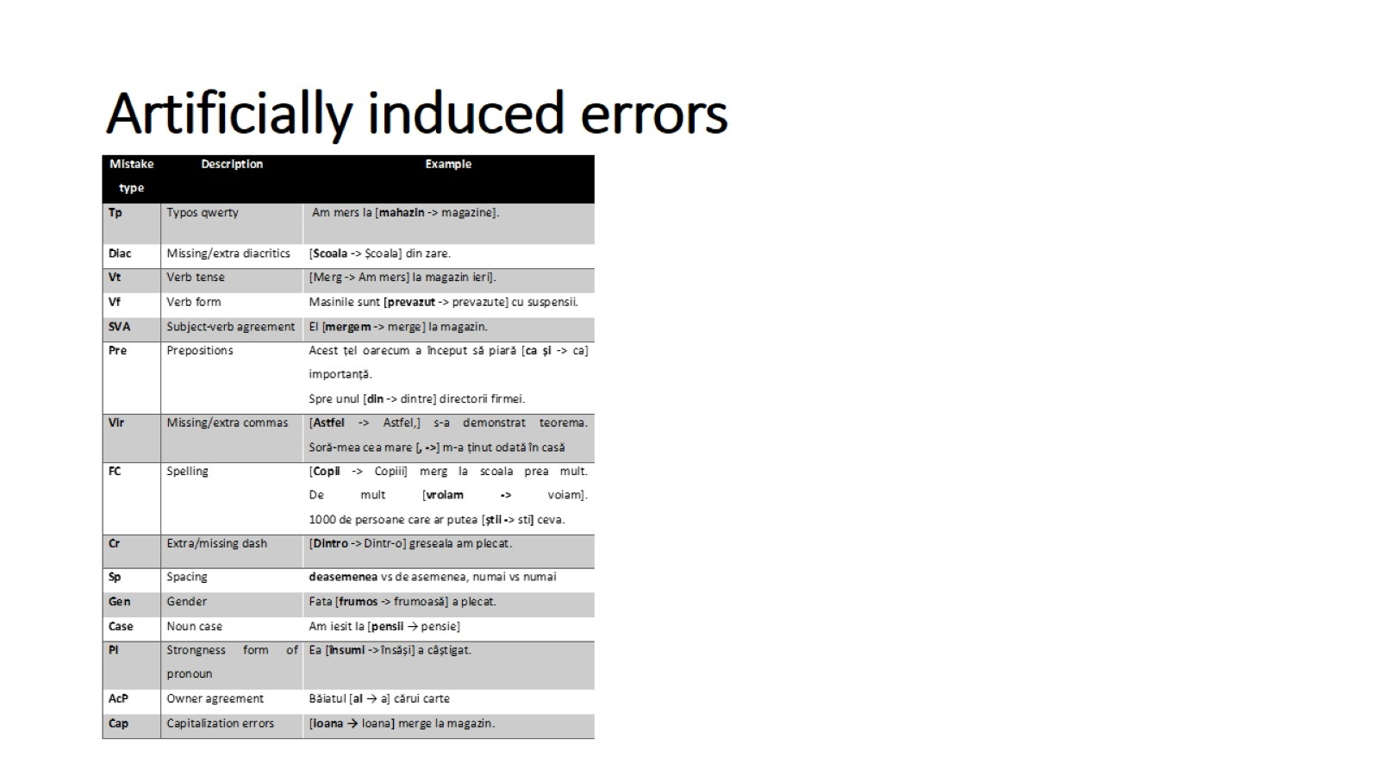
Artificially induced errors

Slide 9
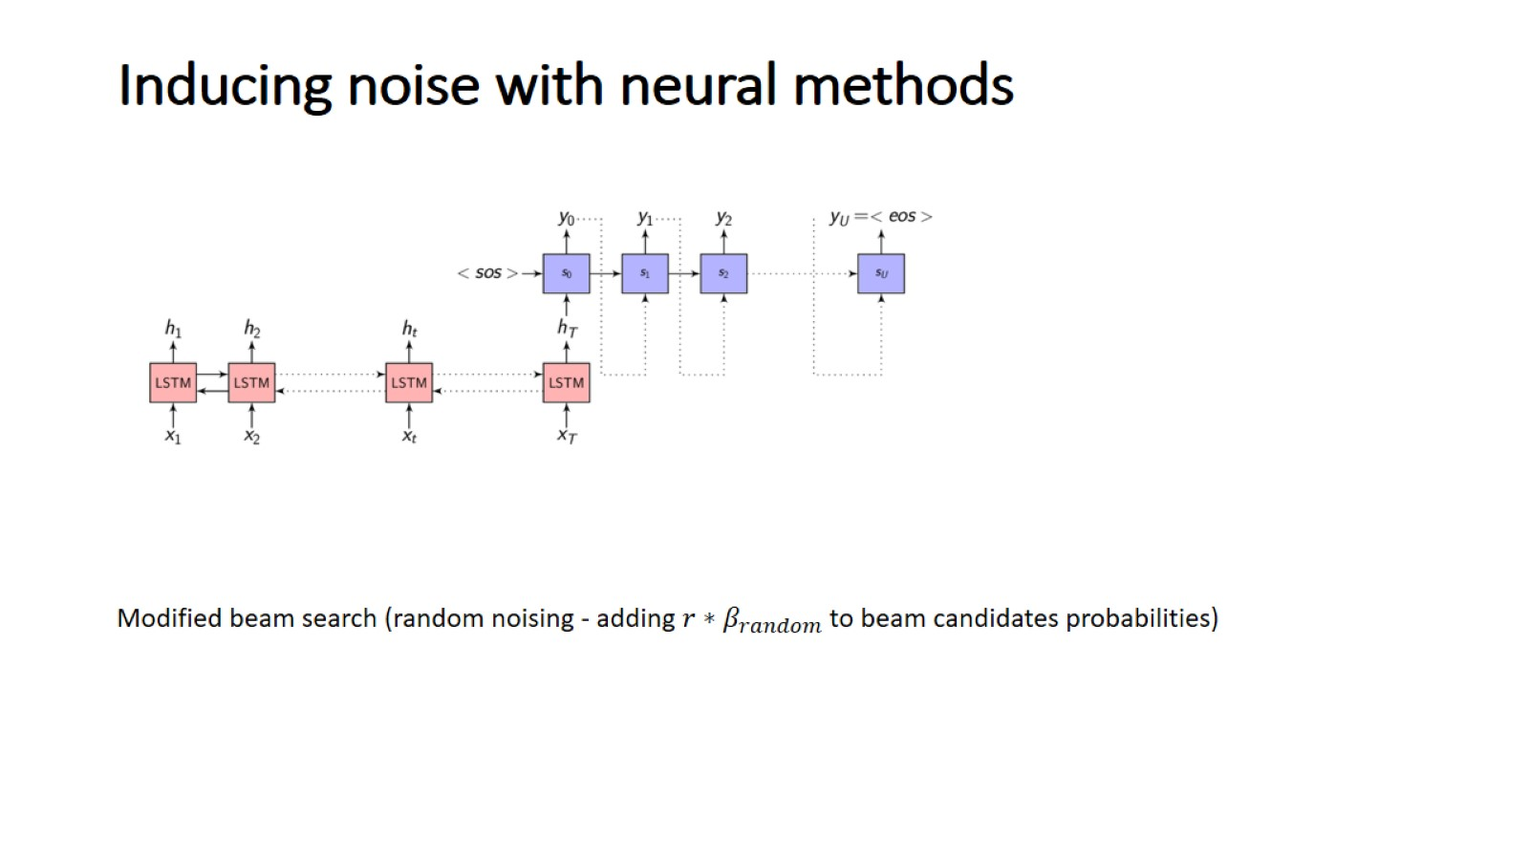
Inducing noise with neural methods

Slide 10
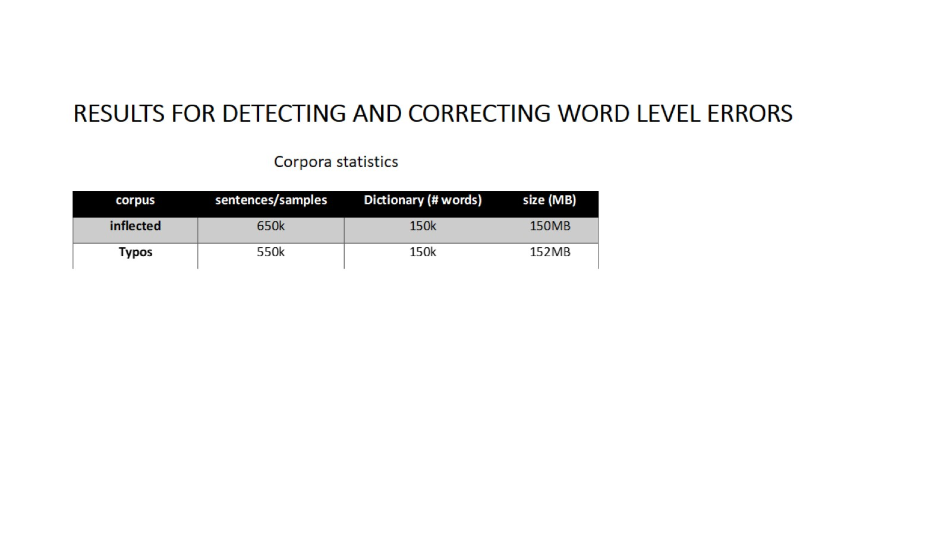
Results for Detecting and Correcting Word Level Errors

Slide 11
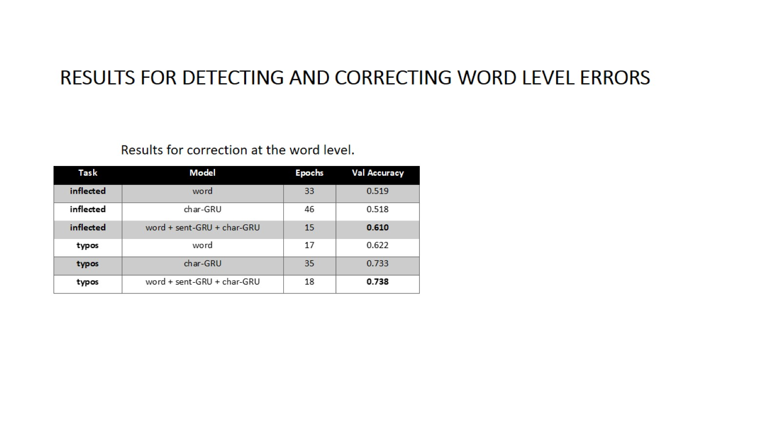
Results for Detecting and Correcting Word Level Errors

Slide 12
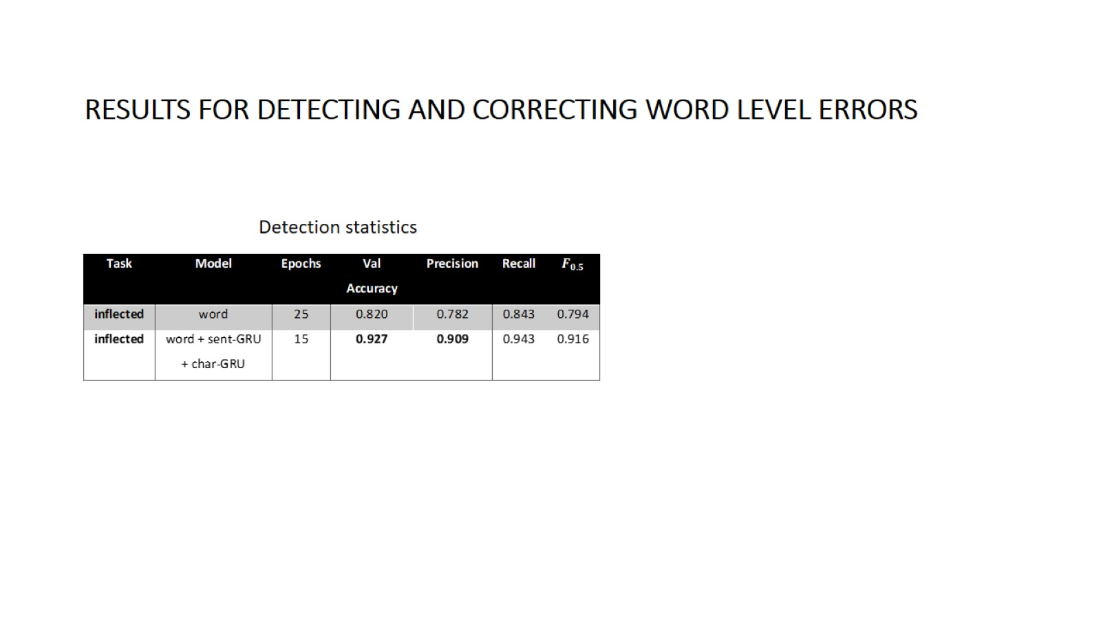
Results for Detecting and Correcting Word Level Errors

Slide 13
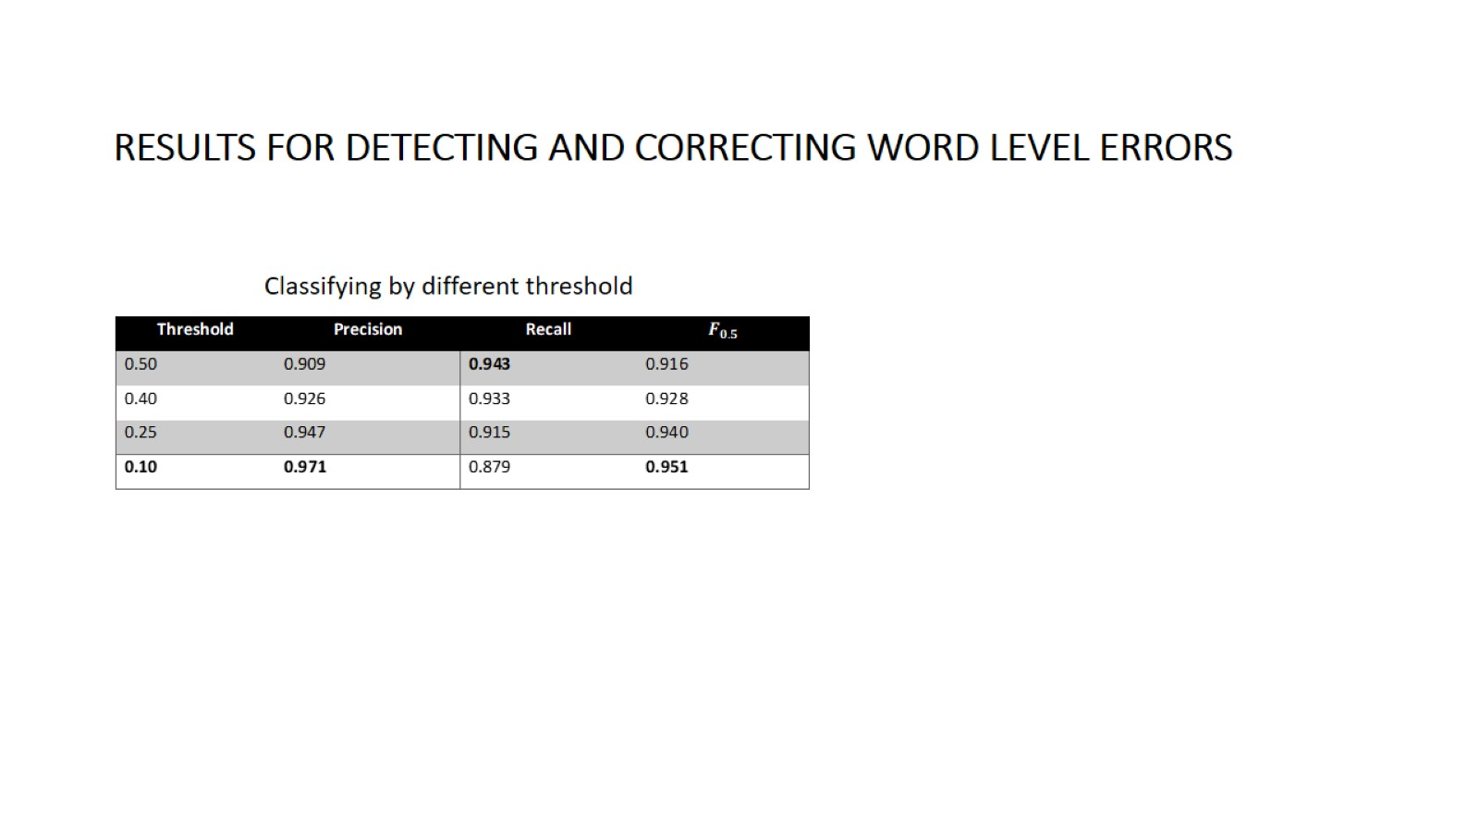
Results for Detecting and Correcting Word Level Errors

Slide 14
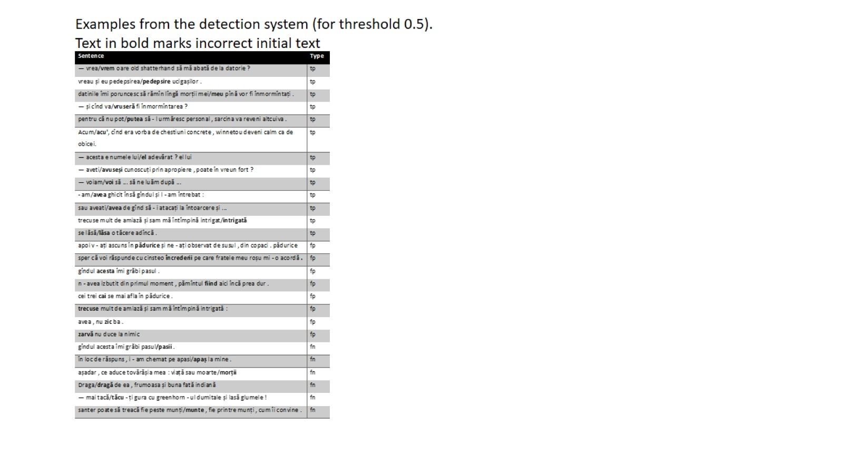

Slide 15
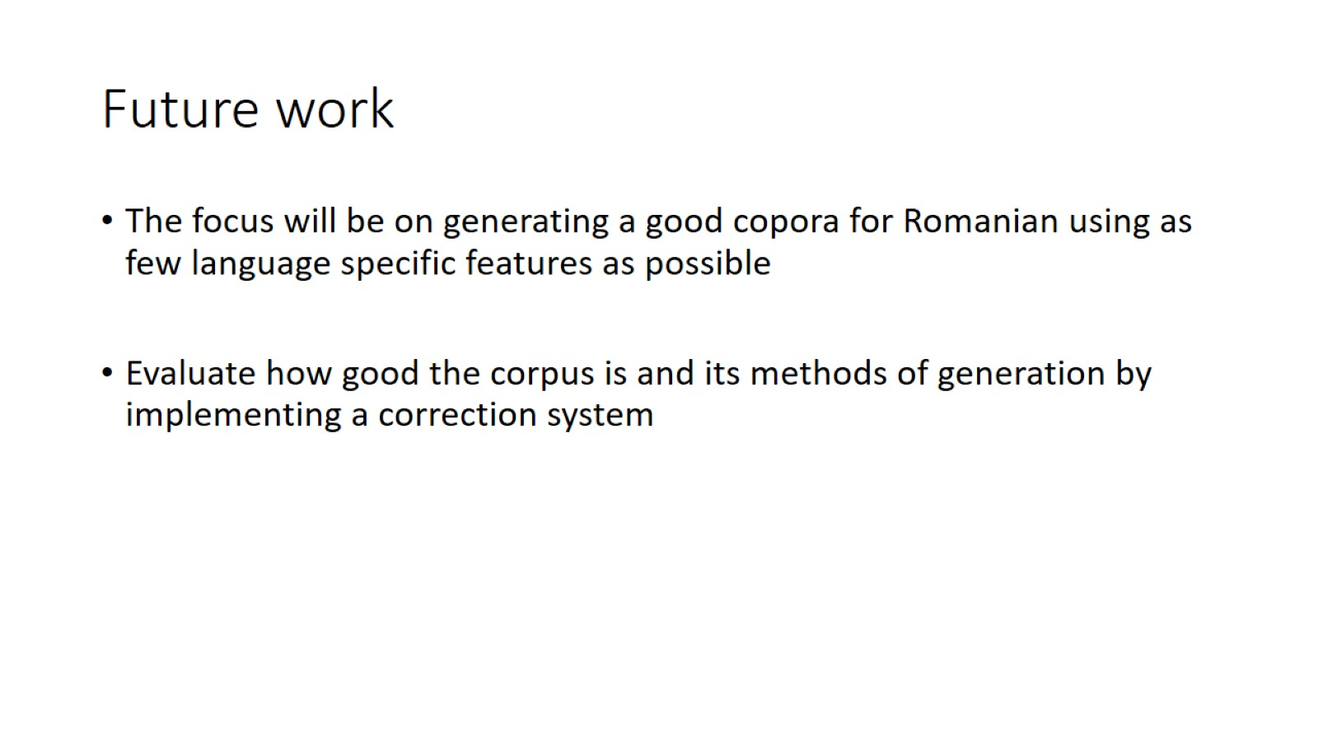
Future work

Slide 16
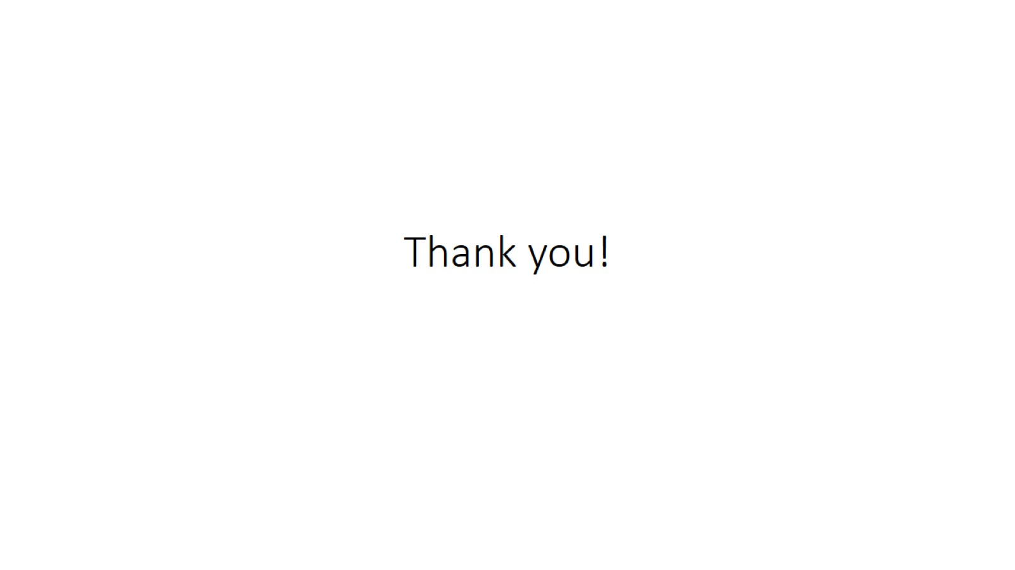
Thank you!

