Slide 1
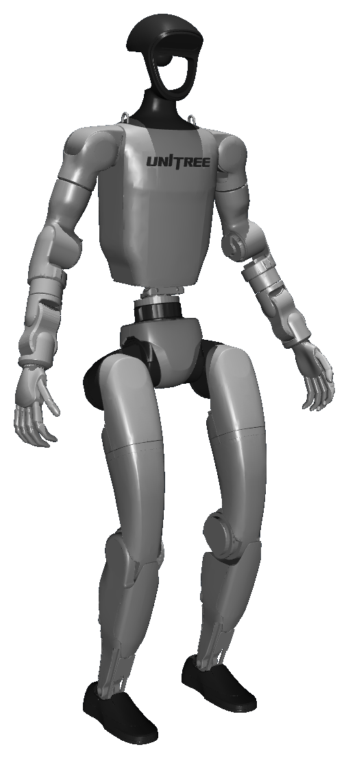

Unitree G1 Humanoid Locomotion
Reward Design and PPO vs. DISC Comparison
Teodor Penchev — KAIST • DRCD Lab • October 2026
Notes:
Today I'll present the G1 humanoid locomotion environment I built in MuJoCo, the PPO baseline it produced, and an experiment comparing PPO with DISC, the algorithm from my previous study.

Slide 2
ENVIRONMENT
G1 Locomotion Environment
Simulator
Unitree G1 (MuJoCo Menagerie), custom Gymnasium env
RL CONTROL LOOP
Policy πθ
MLP 512-256-128
Joints
29 in the model, 23 controlled (legs, waist, arms)
Control
PD position targets at 50 Hz (physics at 200 Hz)
action
23 targets
obs + reward
96-D, rt
Command
Forward velocity 0–1.2 m/s, 30% standing episodes
MuJoCo G1
PD control, contacts
Gait clock
Alternating leg phases, period 1.1 → 0.8 s with speed
Observation
96-D: base velocity, gravity, command, clock, joint states, last action
command v* + gait clock
Objective: natural, stable, velocity-controlled walking, not just forward motion.
Notes:
I built a custom Gymnasium environment around the MuJoCo Menagerie G1 model. The policy runs at 50 Hz and outputs PD position targets for 23 of the 29 joints; the wrists hold their pose. The command is a forward speed between 0 and 1.2 m/s, and 30% of episodes are standing. A gait clock gives each leg a phase so the reward can ask for alternating steps; its period shortens from 1.1 s to 0.8 s as speed increases. The goal was not just forward motion but natural, stable walking that follows the command.

Slide 3
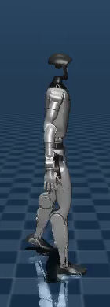
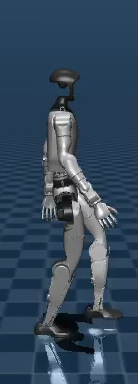
REWARD DESIGN — MAIN ENVIRONMENT CONTRIBUTION
Reward Design for Human-Like Walking
1 Task
Velocity tracking, yaw rate, pelvis and torso heading
KEY ENGINEERING DECISIONS
Gait-gated velocity reward
Velocity reward × gait-quality score: shuffling forward off the clock earns only ~30% of it.
2 Gait
Clock phase matching, foot clearance (9 cm), step length ∝ speed
3 Foot contact
Flat feet, slip, soft landing, foot placement, no crossovers
4 Posture
Bent knees, upright torso, pelvis roll, base height
Bent-knee default pose
Actions are offsets from a bent-knee pose; the straight-legged default led to locked knees.
5 Arms
Clock-driven counter-swing, opposite the same-side leg
6 Smoothness
Action rate and jerk, joint effort
7 Standing
Feet down and still at zero command
straight
bent
~48 reward terms in seven groups; concepts from Isaac Lab / legged_gym, weights tuned for this setup.
Notes:
The reward is my main environment contribution. It has about 48 terms in seven groups, listed here. Two decisions mattered most. First, the velocity reward is multiplied by a running gait-quality score, so a policy that shuffles forward without following the clock earns only about 30% of it. Second, actions are offsets from a bent-knee default pose: with Menagerie's straight-legged keyframe, early policies locked and hyperextended their knees, as in the left image.

Slide 4
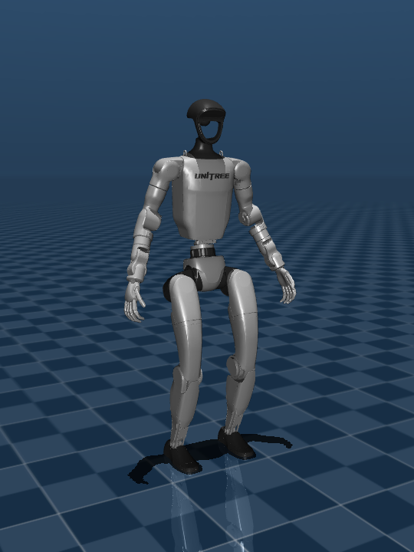
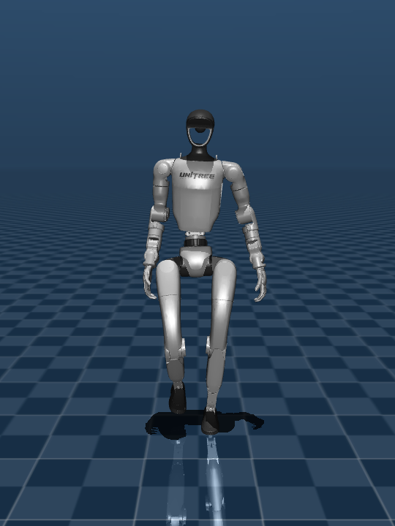
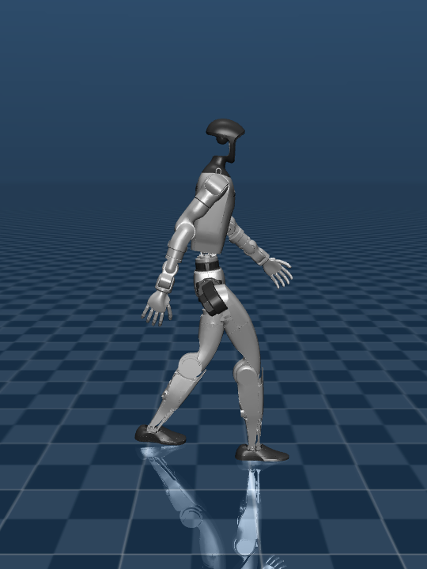
RESULTS — PPO BASELINE (SEED 1, 16M STEPS)
Learned G1 Locomotion
0 m/s · standing
0.5 m/s · front
1.0 m/s · side
0 falls
in 18 benchmark episodes
97–99%
gait phase match
≤ 0.011 m/s
speed tracking error
6.3–6.9 cm
L / R landing offset, 0 crossovers
±16–27°
arm swing, 0.5 → 1.0 m/s
100%
Embedded videos (click to play)
both feet down at 0 m/s
Both seeds learn the same gait; metrics from benchmark_eval.py (3 × 20 s episodes per command).
Notes:
These clips are the PPO baseline after 16M steps, seed 1, at 0, 0.5 and 1.0 m/s. In the benchmark (three 20-second episodes per command, two seeds) it never fell. The legs follow the gait clock 97–99% of the time, speed error is about 0.01 m/s or less, feet land about 6.5 cm from the centreline on both sides with no crossovers, the arms swing opposite the legs, and at 0 m/s it stands with both feet down.

Slide 5
MOTIVATION
Improving Sample Efficiency with DISC
PPO baseline needs ~10M steps before it walks.
PPO clips one joint ratio, r = ∏i ri, over all 23 action dimensions.
In high dimensions this product drifts from 1 more easily; once clipped, the whole sample's gradient is zero.
Our PPO runs: 13–24% of samples per update had zero policy gradient.
CONCEPT: WHICH DIMENSIONS KEEP GRADIENT
PPO
joint ratio clipped
→ no sample gradient
DISC
clip per dimension
→ others still learn
contributes gradient
clipped
Illustrative: one sample, six of 23 action dimensions
DISC (HAN & SUNG, ICML 2019): THREE CHANGES TO PPO
1 Dimension-wise IS clipping
Each action dimension's ratio is clipped separately
2 Adaptive IS regularization
Penalty α_{IS} keeps the update near a target divergence J_{targ}
3 Reuse of selected rollouts
Recent rollouts replayed if per-dimension IS deviation < ε_{b}
Per-dimension clipping keeps gradient from unclipped dimensions; it does not remove clipping altogether.
Notes:
With a working baseline, PPO needed about 10 million steps before the policy walked, so I looked at sample efficiency, using DISC from my previous study. PPO clips a single likelihood ratio, the product of the per-dimension ratios over all 23 action dimensions. In high dimensions that product moves away from 1 more easily, and when it leaves the clip range in the direction of the advantage, the whole sample stops contributing gradient; in our PPO runs that was 13 to 24% of samples per update. DISC clips each dimension separately, so only the out-of-range dimensions lose their gradient. It also adds an adaptive importance-sampling penalty and reuses recent rollouts that are still close to the current policy.

Slide 6
EXPERIMENTAL SETUP
PPO vs. DISC: Experimental Setup
SymmetricPPO ×2 seeds
baseline hyperparameters
Frozen G1 env (v1)
identical for both
16M steps per run
checkpoint every 1M
Same benchmark
benchmark_eval.py
DISC ×2 seeds
same symmetry loss
EVALUATED ON TWO AXES
DISC HYPERPARAMETERS NEEDED TUNING
Sample efficiency: first checkpoint that meets the walking standard
Walking quality: benchmark gait metrics of the final 16M policies
 | Paper settings | Tuned (seed 1 only)
J_{targ} | 1e-4 | 1e-2
Replayed rollouts | 16 | 4
Walks within 16M? | No | Yes
Walking standard: no falls at 0 / 0.5 / 1.0 m/s; speed error ≤ 0.1 m/s, phase match ≥ 95%, heading error ≤ 15°.
Notes:
To keep the comparison fair, both algorithms train on the same frozen environment, version 1. DISC is built on SymmetricPPO, so it has the same mirror-symmetry loss, network, rollout size and learning-rate schedule, and PPO keeps its baseline hyperparameters. Each run is 16 million steps, two seeds per algorithm, with a checkpoint every million steps evaluated by the same benchmark. The paper's DISC settings did not transfer: the IS penalty kept updates to about 1% of PPO's, and DISC had not learned to walk after 16M steps. I tuned it on seed 1 only and kept seed 2 for confirmation. The comparison looks at both sample efficiency and final walking quality.

Slide 7
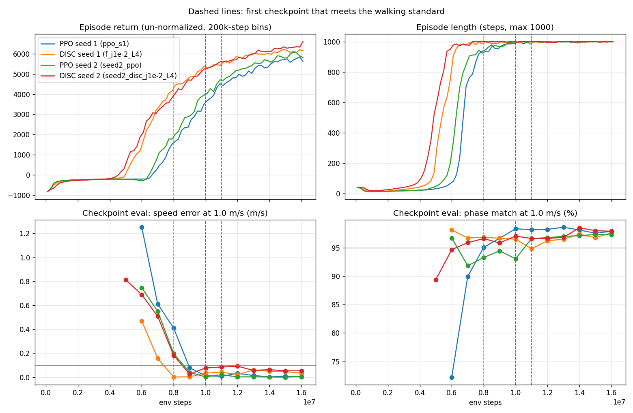
TRAINING RESULTS
DISC Improves Sample Efficiency
FIRST WALKING CHECKPOINT
 | Seed 1 | Seed 2
PPO | 10M | 11M
DISC | 8M | 10M
EPISODE RETURN AT 8M STEPS
 | Seed 1 | Seed 2
PPO | 1306 | 1689
DISC | 4055 | 3682
Top: return and episode length. Bottom: checkpoint eval at 1.0 m/s. Dashed: first walking checkpoint.
DISC reached the walking standard ~1–2M environment steps earlier than PPO on both seeds.
Notes:
These are the actual training curves for both seeds. Top left is episode return, top right episode length; the bottom panels are the checkpoint evaluations at 1.0 m/s. Dashed lines mark the first checkpoint that meets the walking standard. DISC reached it at 8M and 10M steps, PPO at 10M and 11M, so DISC walked 1 to 2 million steps earlier on both seeds, including seed 2, which was not used for tuning. Two seeds is a small sample, so I read this as a consistent trend rather than a statistically established result.

Slide 8
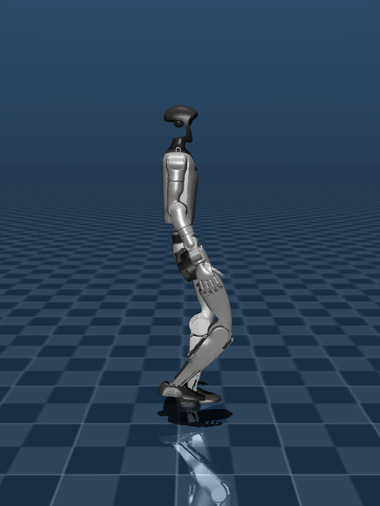
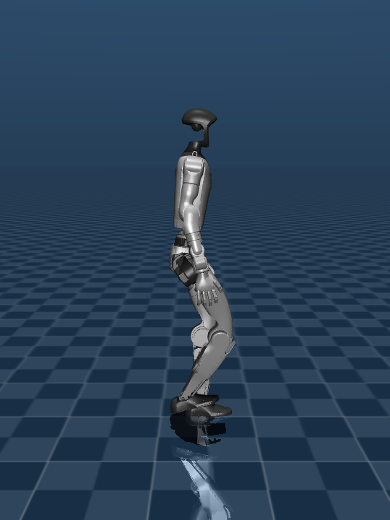
FINAL POLICY QUALITY (16M STEPS)
PPO vs. DISC: Final Walking Quality
PPO
DISC
Seeds 1 / 2 | PPO | DISC
Falls (benchmark) | 0 / 0 | 0 / 0
Speed error (m/s), 1.0 m/s | 0.003 / 0.005 | 0.032 / 0.053
Flat-foot contact, 0.5 m/s | 71% / 72% | 55% / 55%
Pelvis roll range, 0.5 m/s | 4.1° / 4.4° | 9.7° / 8.4°
Touchdowns per cycle, 1.0 m/s | 1.10 / 1.07 | 1.25 / 1.32
Wall-clock, 16M steps | 3.6 / 3.4 h | 4.9 / 4.7 h
Both learn stable walking; DISC learns it earlier.
PPO's gait is smoother and more refined.
DISC needs ~35% more wall-clock time.
Seed 1 at 0.5 m/s, side view (embedded videos)
Trade-off: DISC is more sample-efficient; PPO gives the more refined gait at lower compute cost.
Notes:
At 16 million steps all four policies walk without falling, with the same standing behaviour, phase match and foot placement. But PPO's gait is more refined: it tracks speed about ten times more precisely at 1 m/s, has more flat-footed contact, half the pelvis roll, and cleaner single touchdowns. DISC's action noise also collapsed earlier, which may explain part of this. DISC also took about 35% longer in wall-clock time. So DISC learns from fewer samples, but it is not better overall on this task.

Slide 9
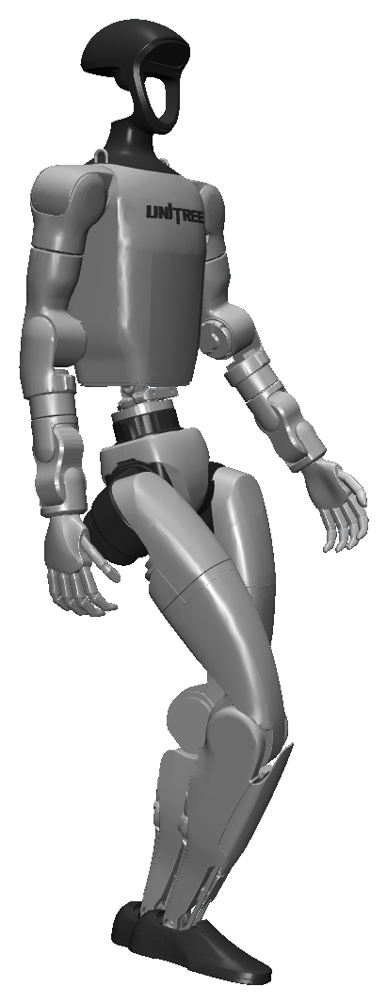
SUMMARY
Conclusions
1
Environment
Reproducible Unitree G1 locomotion environment, with reward design targeting natural walking.
2
PPO baseline
Stable, symmetric PPO baseline with accurate velocity tracking and a coordinated gait.
3
PPO vs. DISC
Tuned DISC improves sample efficiency; PPO achieves better final gait quality at lower computational cost.
I would appreciate suggestions on possible directions for continuing this research.
Notes:
To summarise: I built a reproducible G1 locomotion environment whose reward targets natural walking; a symmetric PPO baseline that tracks speed accurately with a coordinated gait on two seeds; and a comparison showing that tuned DISC improves sample efficiency while PPO keeps the better final gait at lower cost. I'd appreciate your suggestions on where to take this research next.

