Slide 1
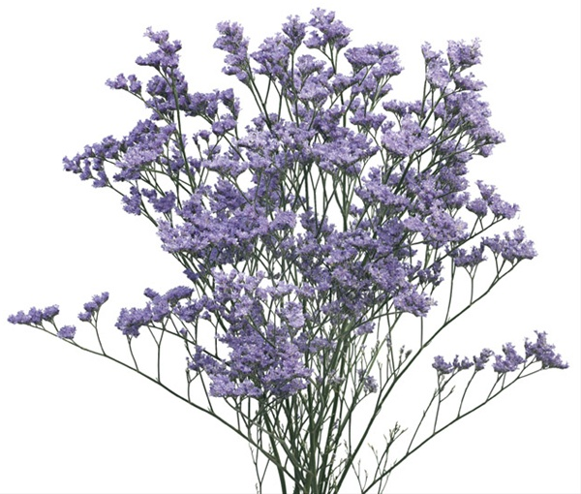
SoftUni memory game
Team "Misty blue Limonium"
-Nicollette Karaivanova
-Lyubomir Viktorov
Svilen Tyutyunev
Teodor Penev

Slide 2
Where to find the game?
https://github.com/TeodorPenev/TEAM-MISTY-BLUE-LIMONIUM-

Slide 3
SoftUni memory – main game idea
You have 12 reversed cards
Flip one by one card till you find match
If it is not correct the 2 card flipover
Try to find all 6 trainers

Slide 4
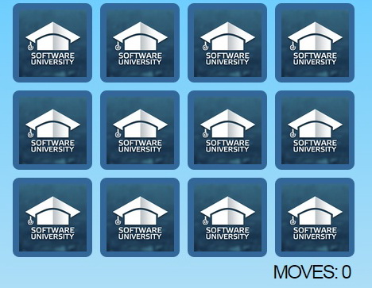
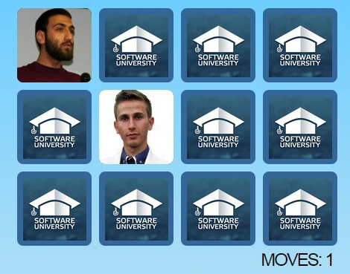
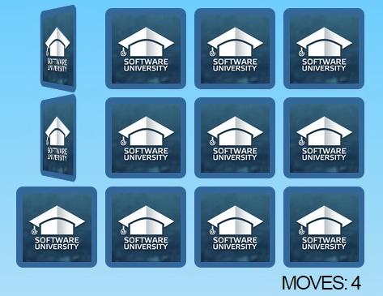
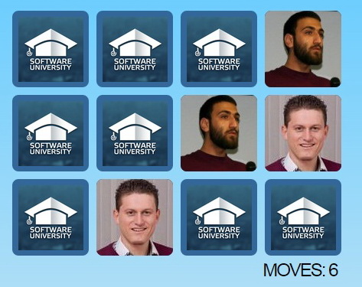
Demo

