Slide 1

JAVA-BASICS
Team Papaya
Teamwork Project
Software University
SoftUniBreaker-the game

Slide 2



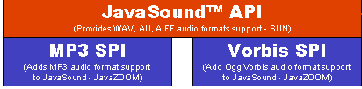

Slide 3
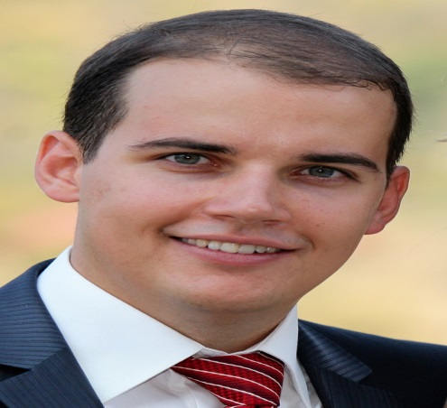
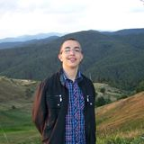
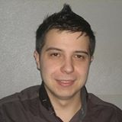
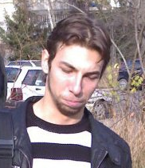
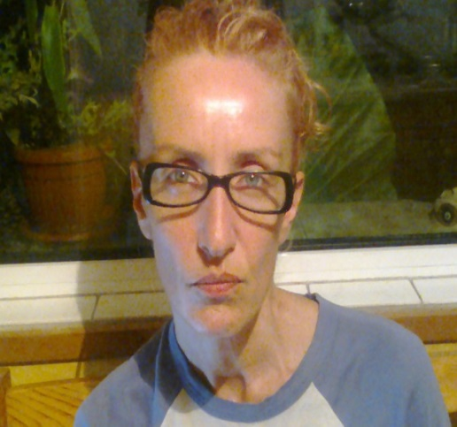
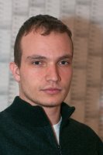

Team PAPAYA
Borislav Totev
Alexandur Seferinkin
Salih Alishov
Teodor Penev
Magdalena Petrova
Stoyan Petrov
KostadinStefanov

Slide 4
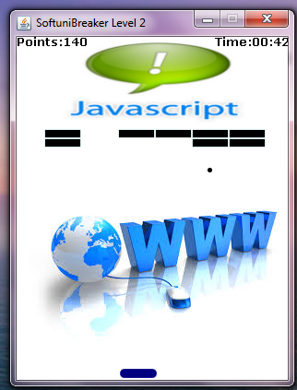
Demo…

Slide 5

Thanks!!!

