Slide 1
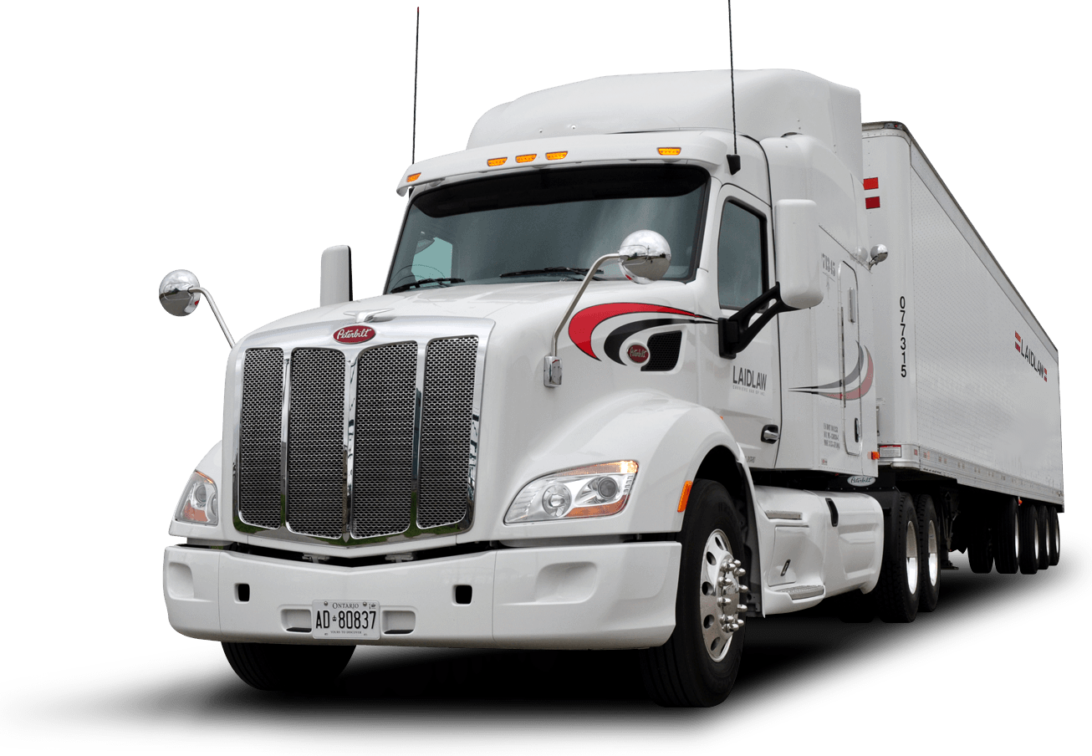
Get My Driver Card (demo)
“Mystique” team
Rayna Pavlova
Teodora Filipova

Slide 2

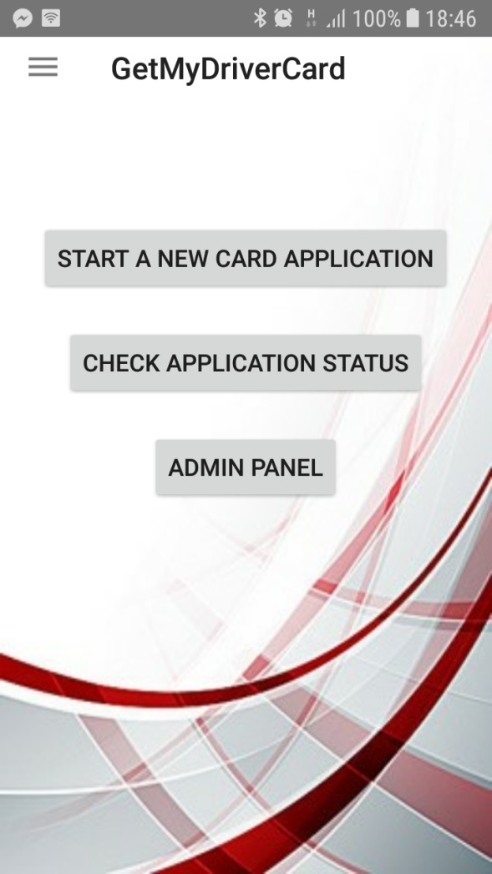
Mystique team – Get My Driver Card Application (demo)
Project purpose
represents business demo application for EU digital tachograph application
includes user application part and administrative part

Slide 3
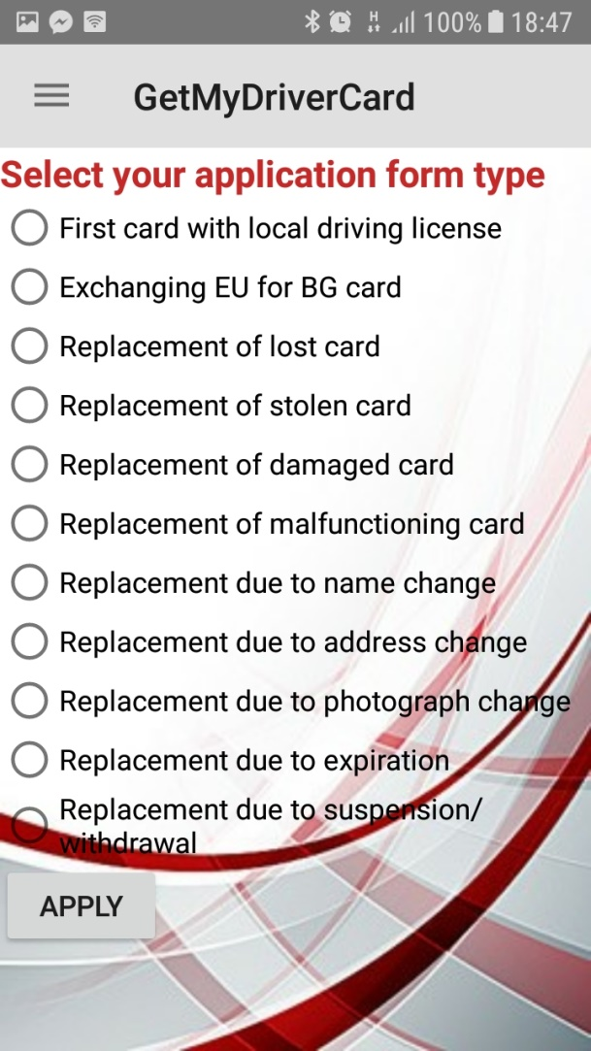
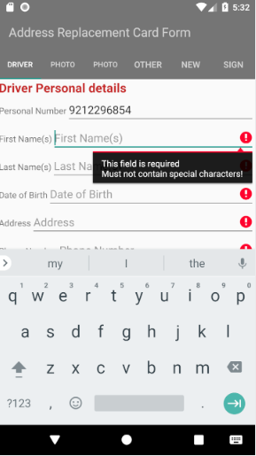
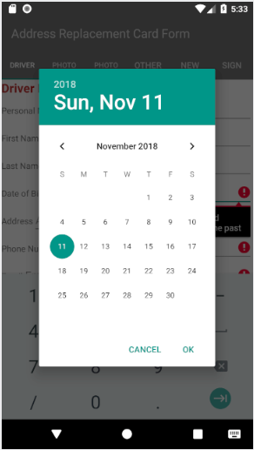
Mystique team Get My Driver Card Application (demo)
User Interface – Start a new card application

Slide 4
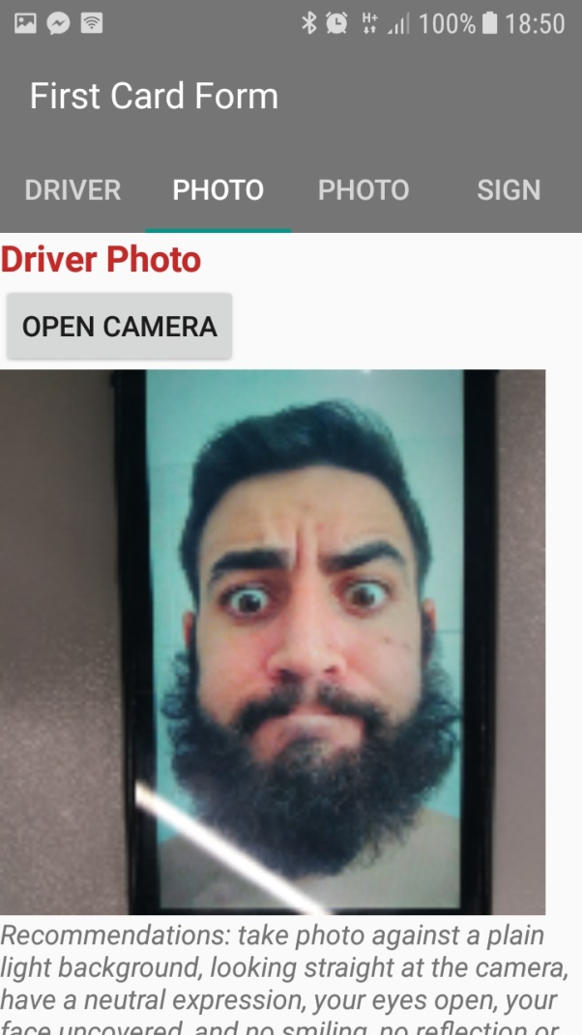
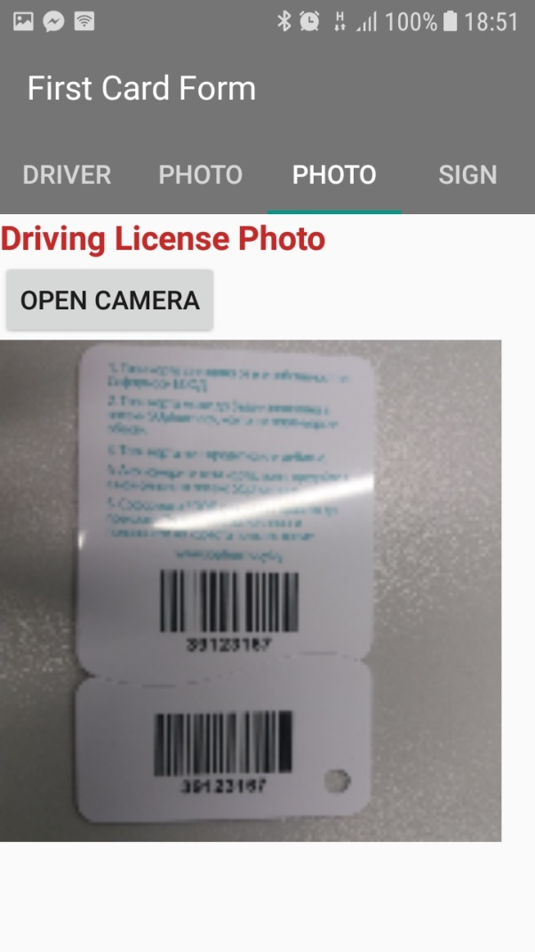
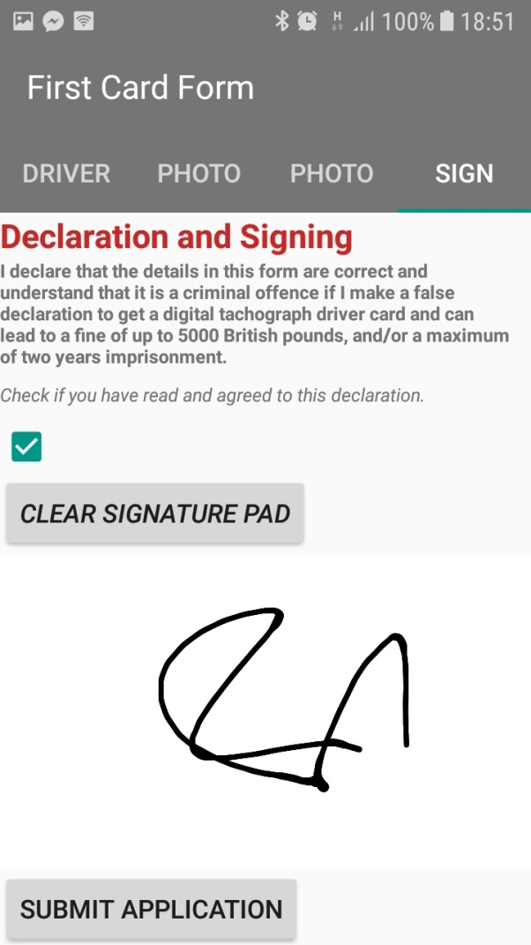
Mystique team Get My Driver Card Application (demo)
User Interface – Start a new card application

Slide 5


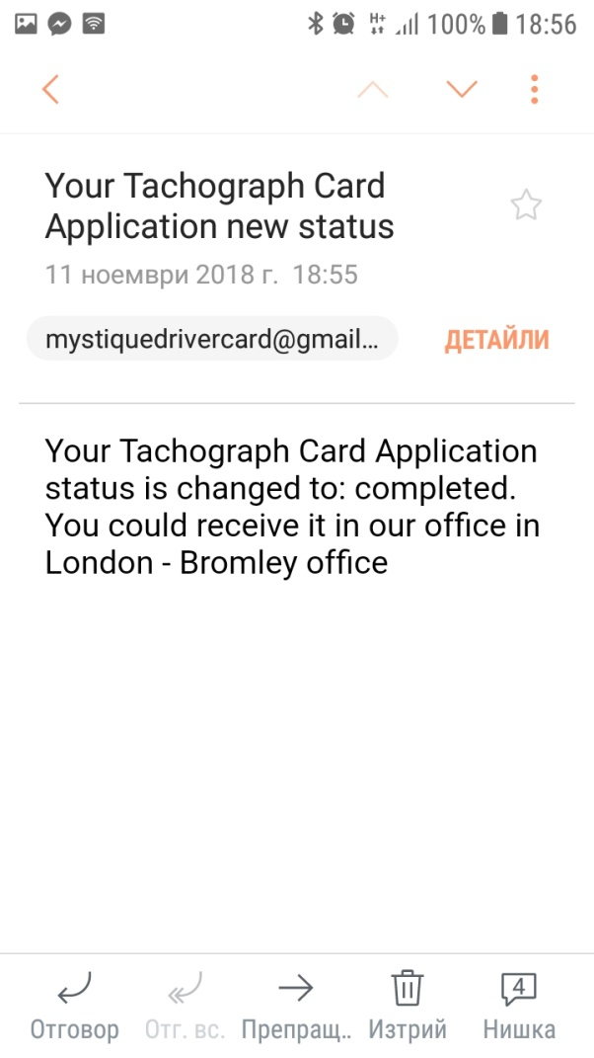
Mystique team Get My Driver Card Application (demo)
User Interface – Start a new card application

Slide 6
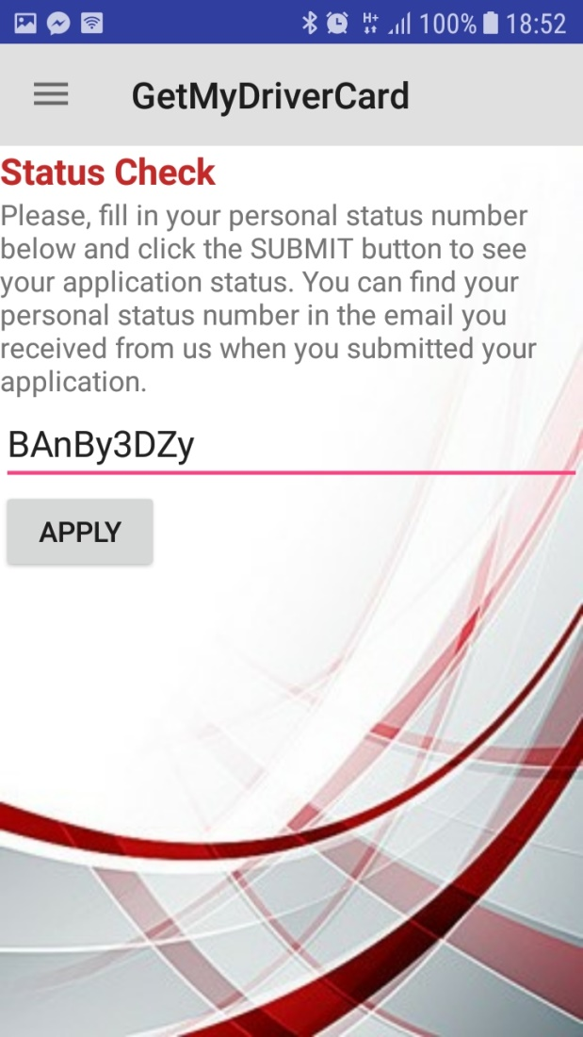
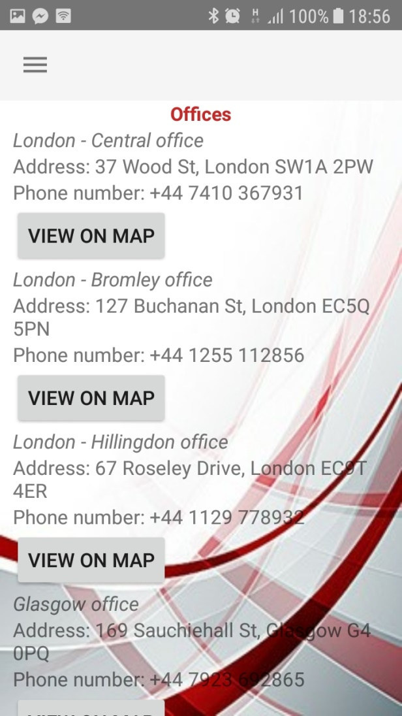
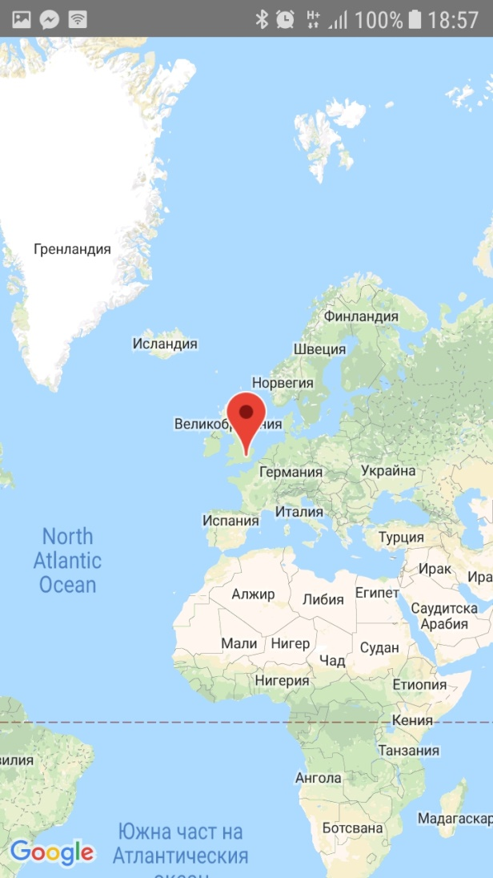
Mystique team Get My Driver Card Application (demo)
User Interface – Start a new card application

Slide 7
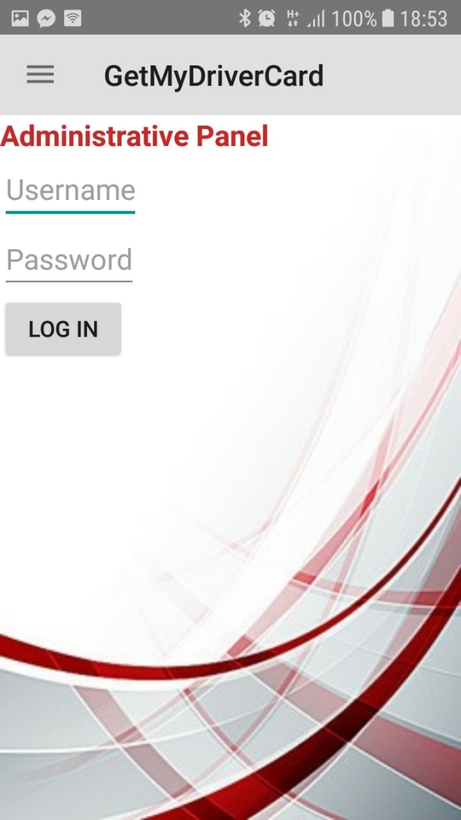
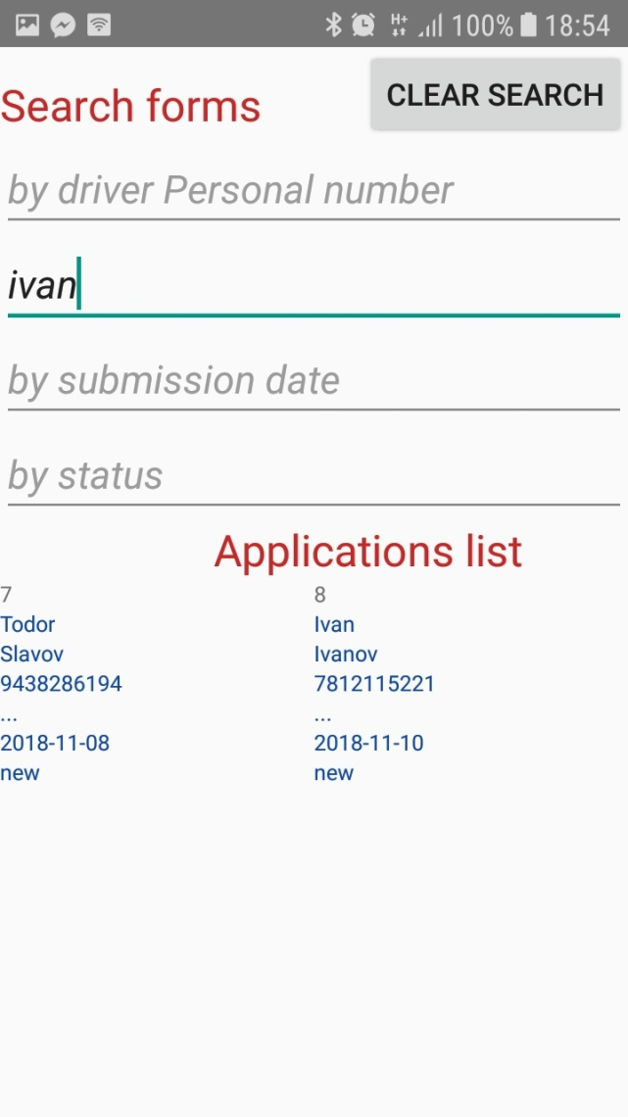
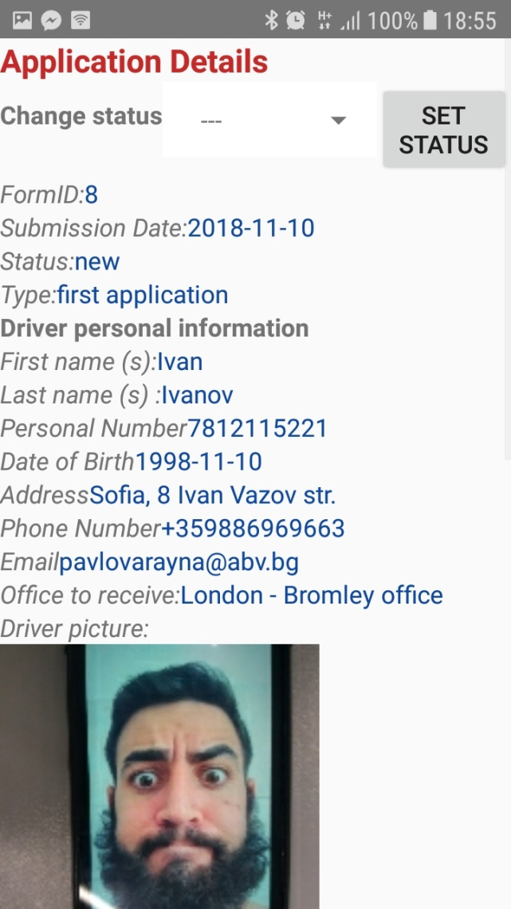
Mystique team Get My Driver Card Application (demo)
Mystique team Get My Driver Card Application (demo)
Administrator Interface - Log in and applicationa list

Slide 8
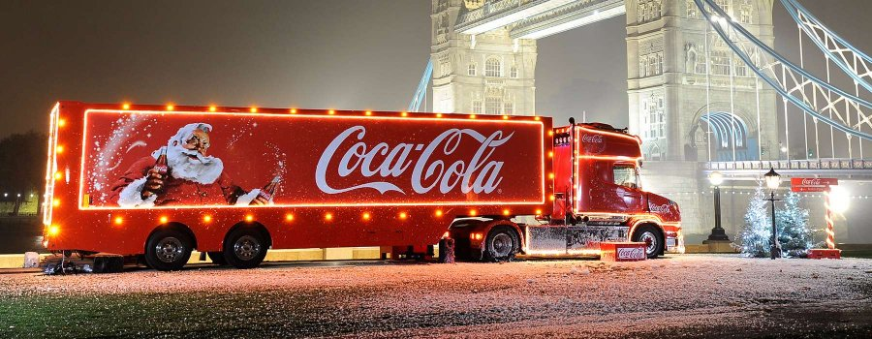
Mystique team Get My Driver Card Application (demo)
Any questions?
Thank you! ☺

