Slide 1
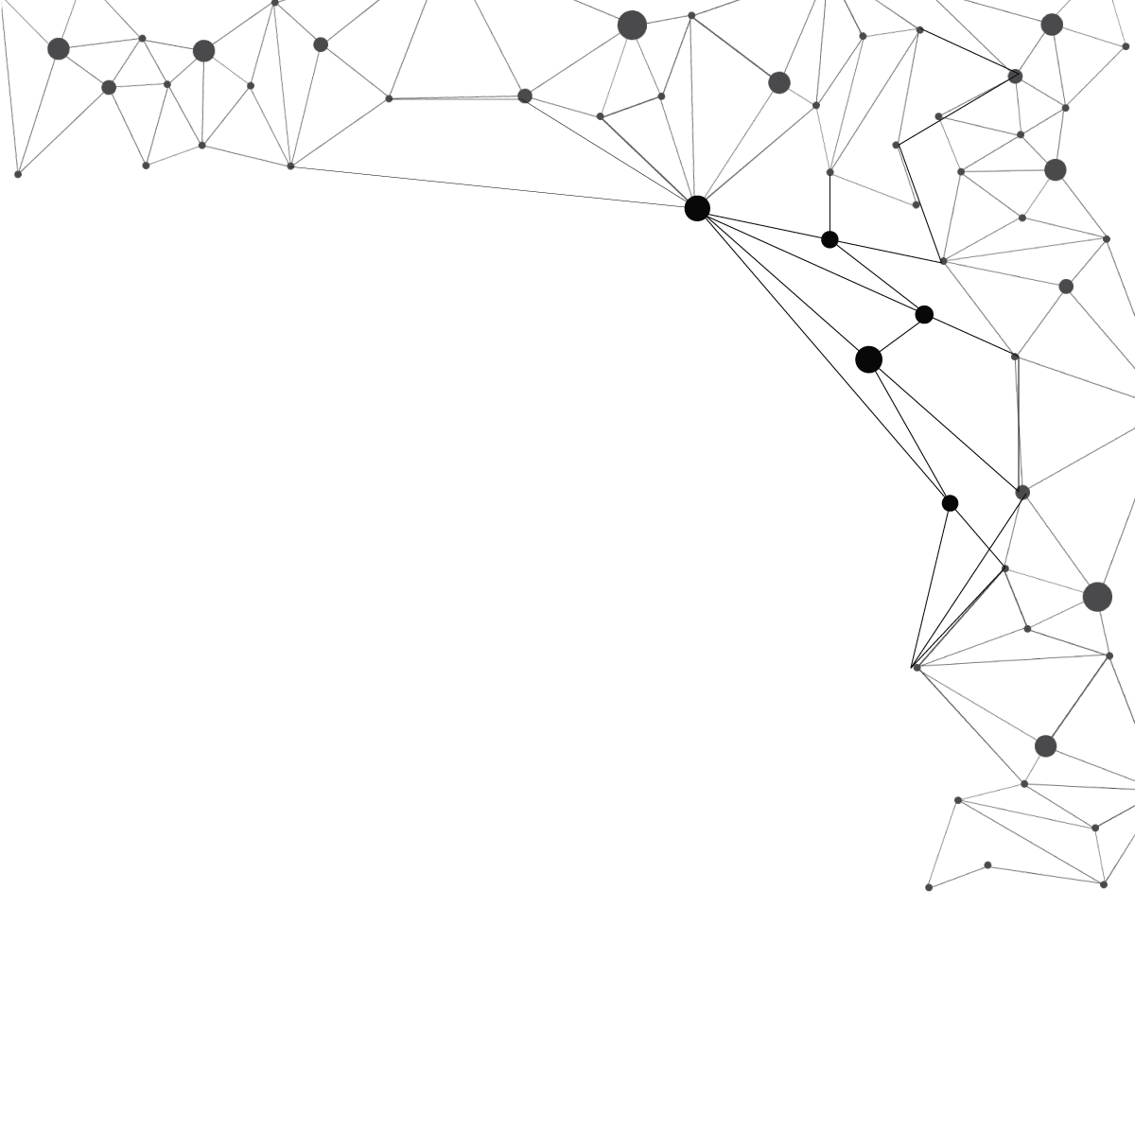
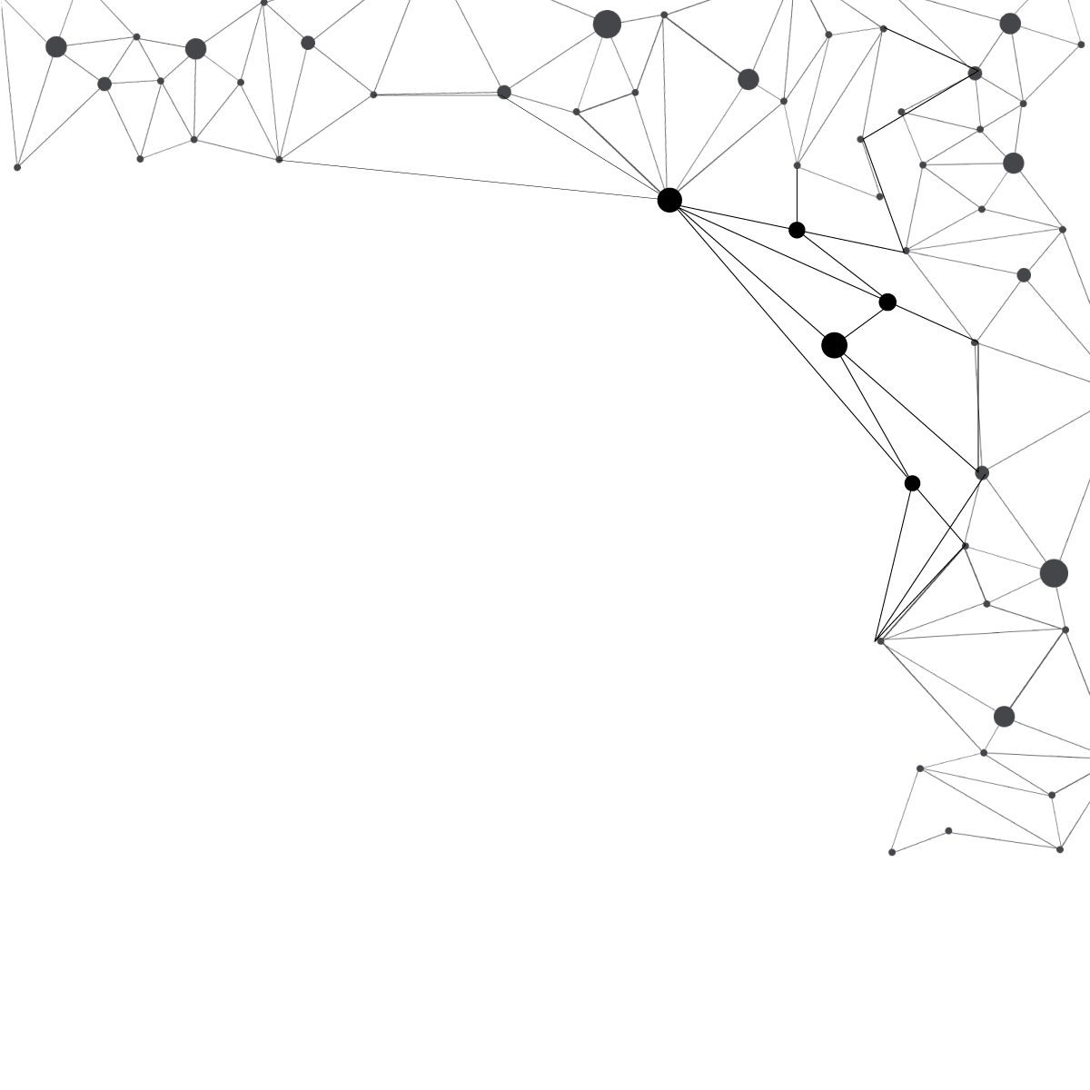
Dot Patterns Perceptual Grouping:
RDG vs K-means

Slide 2
What will we talk about?
Dot Patterns, perception and Gestalt
Clustering and K-means
Algorithm based on the Reduced Delaunay Graph
Comparison: K-means vs RDG
How can the perception of Dot Patterns be modeled?

Slide 3
1. Dot Patterns, perception and Gestalt

Slide 4
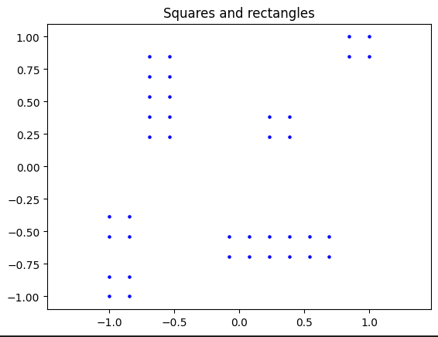
How many groups do we perceive?

Slide 5
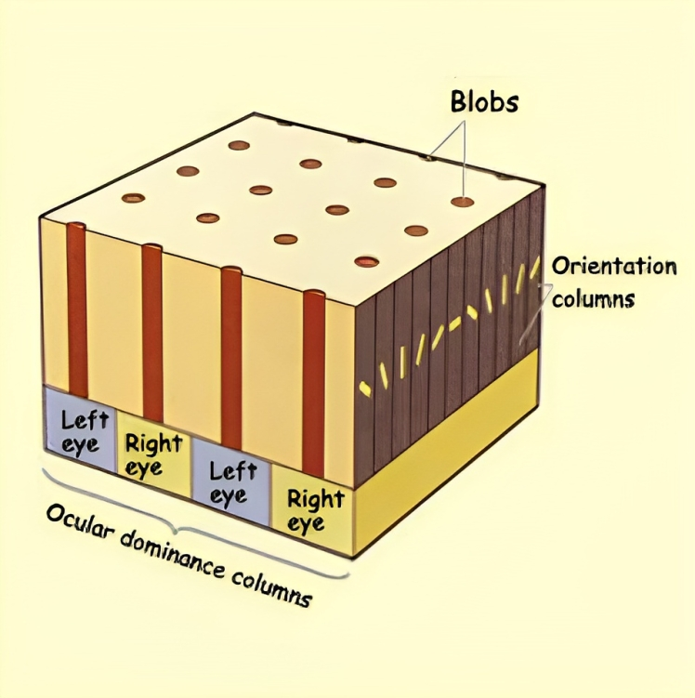
Location and Orientation Columns
Neurons in a location column have close receptive fields.
Inside a location column there are orientation columns with certain preferred orientations.
The orientation columns are grouped in pinwheels alternating with blobs.
The ocular dominance columns receive input from an eye or the other via the Lateral Geniculate Nucleus.

Slide 6
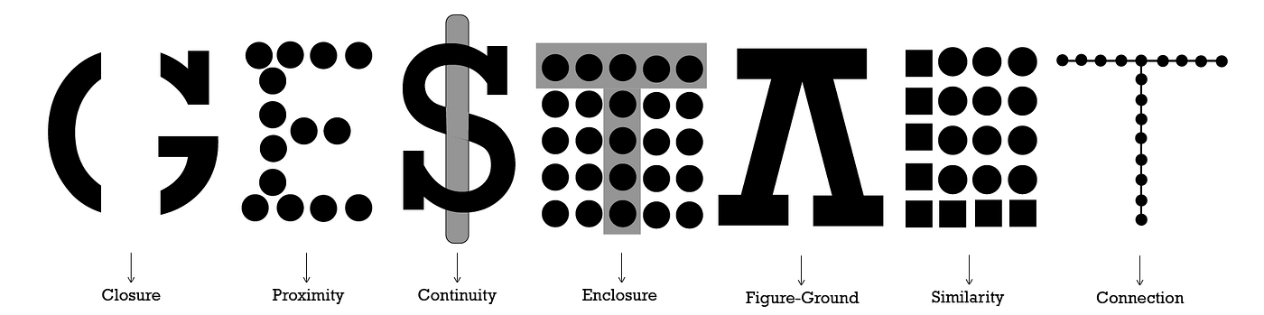
Gestalt Laws
The psychology of Gestalt concerns form and representation in the context of the Human Visual System.
Elements in a group can have properties that emerge from mutual relationships.

Slide 7
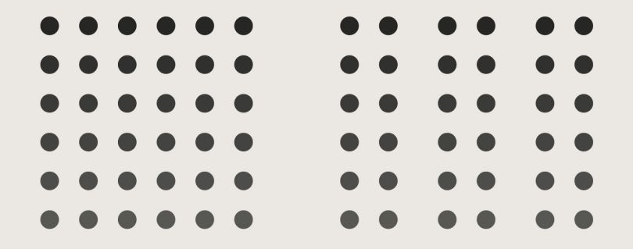
Gestalt Law: proximity
The human eye tends to group nearby elements, separating them from those farther away.

Slide 8
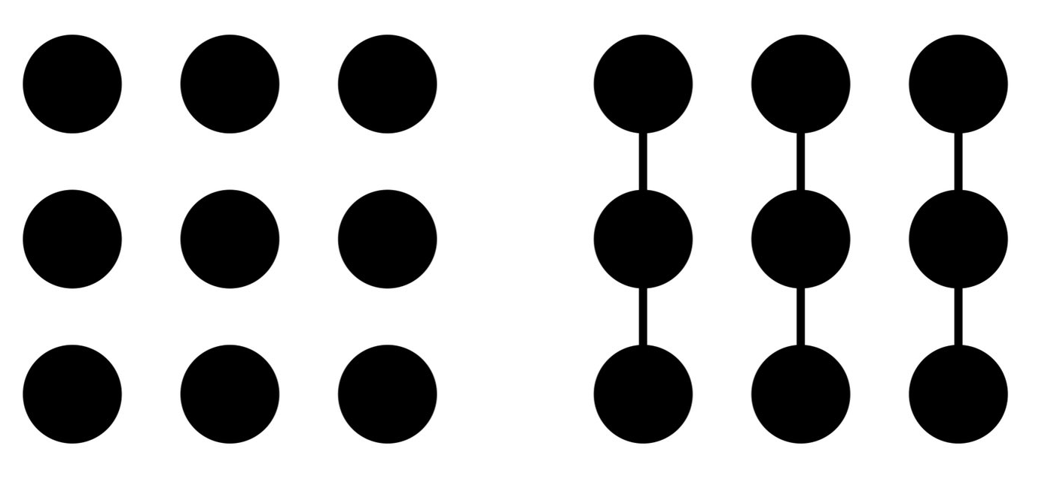
Gestalt Law: connection
The human eye tends to group elements connected by lines.
We want to reproduce this mechanisms algorithmically!

Slide 9
2. Clustering and K-means

Slide 10
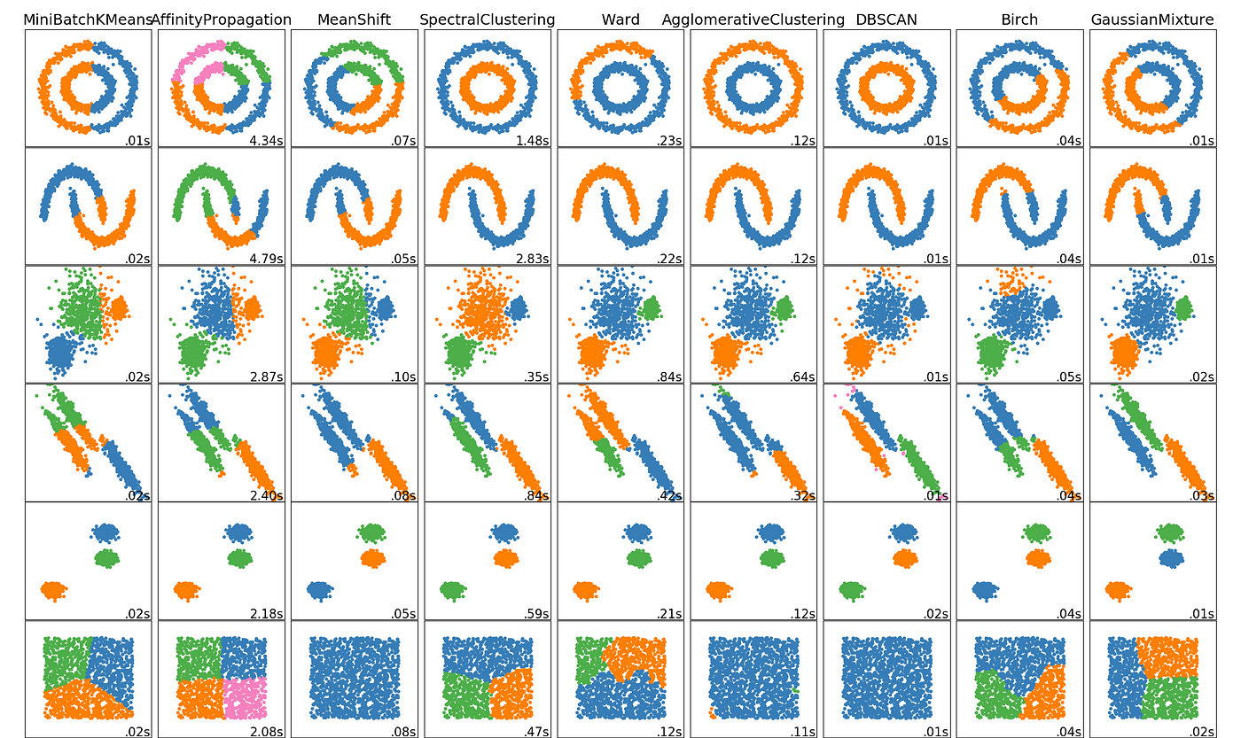
A way to model Gestalt: Clustering
Clustering is a set of unsupervised techniques aimed at selecting and grouping homogeneous elements in a data set.
Tipologie:
Hard clustering: each element is assigned to one and only one cluster.
Soft/fuzzy clustering: an element can belong to multiple clusters with different degrees of membership.
Partitioning clustering (or not hierarchical or k-clustering): group membership is determined by the distance from a representative point. Example: k-means.
Hierarchical clustering: uses a hierarchy of partitions characterized by an increasing or decreasing number of groups.

Slide 11
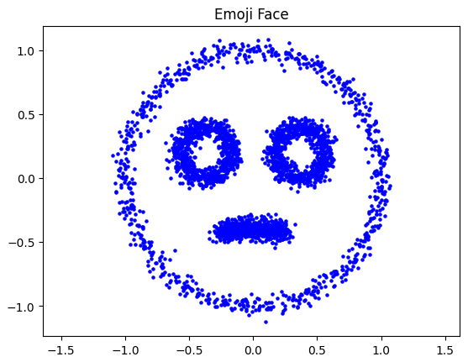
Dot Patterns

Slide 12
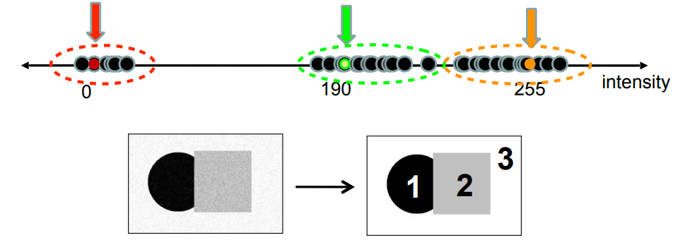
K-means clustering
First idea: using the k-means algorithm.
Group identification → selecting representative centroids that minimize a certain cost function: ∑^{k}_{j=1} E(C_{j})
For example the Sum of Square Distances (SSD): ∑_{cluster i} ∑_{points p in cluster i} ||p - c_{i}||²
Chicken and egg problem with the groups and corresponding centroids!

Slide 13
K-means clustering
Input: an array of points in the plane characterized by a pair of coordinates [x, y] and the number k of clusters.
Output and effects (typically): the coordinates of centroids for each cluster and the assignment of each input point to a cluster.
1. Randomly initialize k centroids c₁, …, c_{k}
2. Given the centroids find points for each cluster:
For each point p find the nearest c_{i}
Put p in cluster i
3. Given the found points in each cluster, find c_{i} and set c_{i} as the mean of the points in cluster i
4. If c_{i} has changed from the current one go back to 2. otherwise terminate

Slide 14
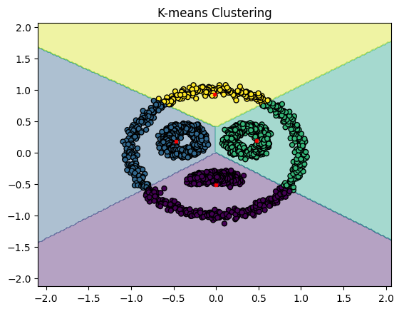
K-means clustering
We want to model perception more accurately!

Slide 15
Voronoi Diagram and Delaunay Triangulation
Given a set S = {p₁, …, p_{N}} of N points in the plane, partition the plane in cells C₁, …, C_{N} so that the points belonging to the cell C_{j}, associated with the point p_{j} ∈ S, are nearer to p_{j} than any other point p_{k} ∈ S, k ≠ j :
q ∈ C_{j} ⇔ d(q,p_{j}) ≤ d(q,p_{k}) ∀q, ∀p_{j},p_{k} ∈ S
The dual of the Voronoi Diagram or Tessellation, called the Delaunay Triangulation or Graph, is obtained by connecting all pairs of points in set S whose Voronoi Diagram cells share a boundary.

Slide 16
3. Algorithm based on the Reduced Delaunay Graph

Slide 17
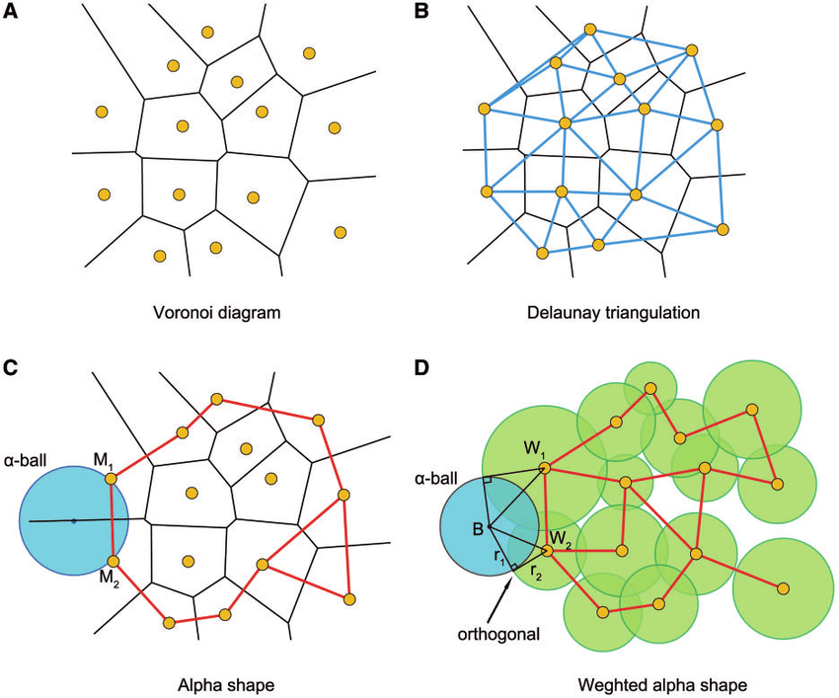
Voronoi Diagram
Delaunay Triangulation

Slide 18
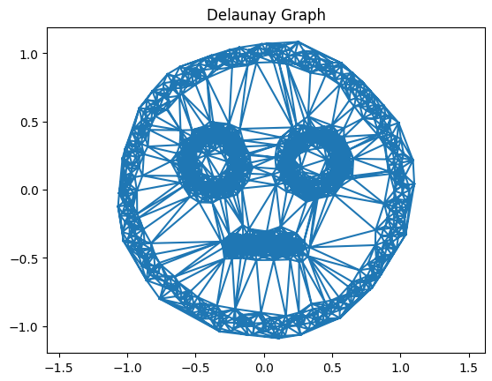
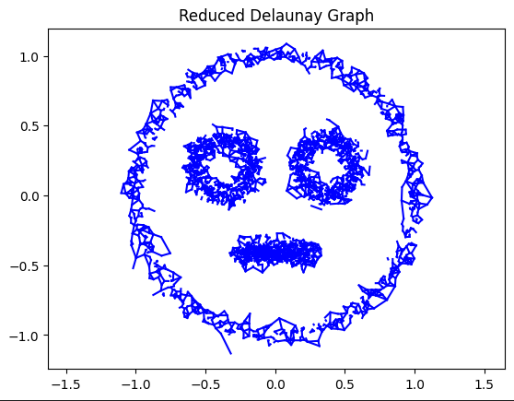
Reduced Delaunay Graph
Idea: keep only some edges so to highlight nearby zones.

Slide 19
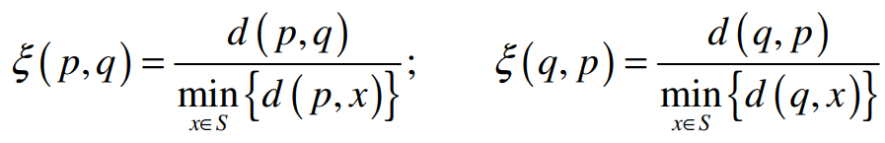
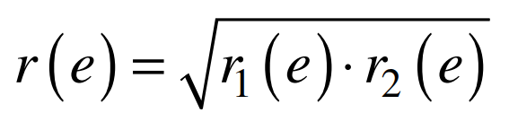

Reduced Delaunay Graph
To select which edges pq to remove, calculate a normalized distance:
In doing so, two ratios r₁(e) = ξ(p, q) and r₂(e) = ξ(q, p) are assigned to each edge in the graph. Then, reduce them to one quantity, their geometric average:
And remove every edge from the graph whose r(e) is greater than a certain threshold r_{T}:

Slide 20
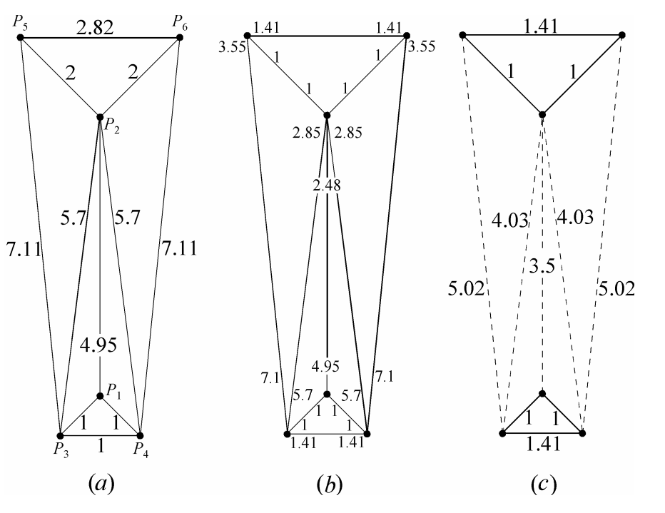
Reduced Delaunay Graph

Slide 21
RDG: Algorithm
Input: an array of points in the plane characterized by a pair of coordinates [x, y].
Output: a reduced array of points which form the RDG when connected with edges.
1. Compute the Delaunay Triangulation on the points given as input
2. For each point, compute the distances to its neighbours
3. Normalize the distances with the minimum of the distances to the neighbours
4. Compute the geometric average between the two ratios found for each edge and assign the result to it
5. Thresholding: remove the edges whose value is greater than a certain threshold

Slide 22
4. Comparison: K-means vs RDG

Slide 23
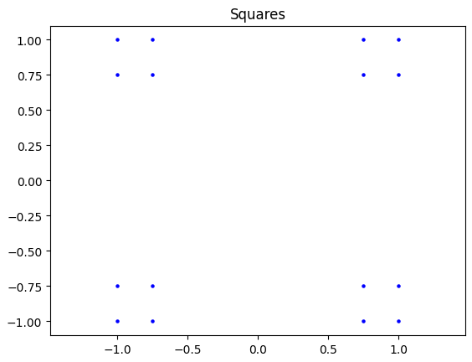
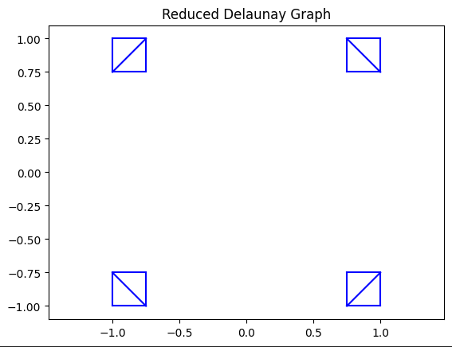
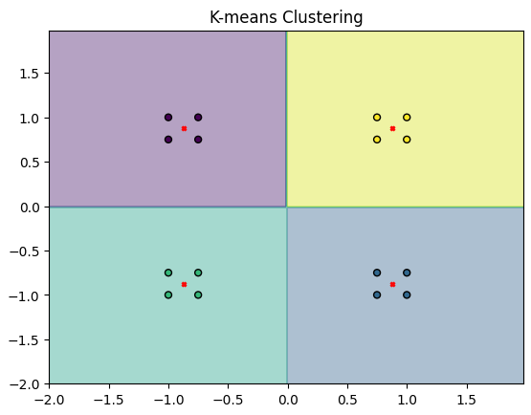
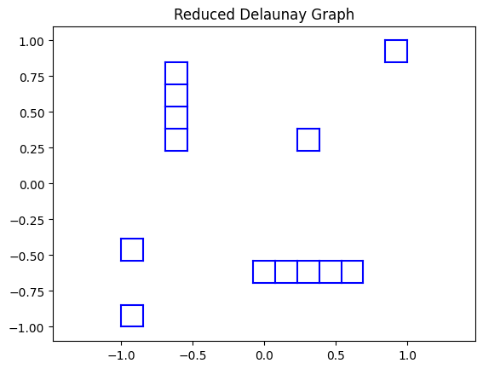
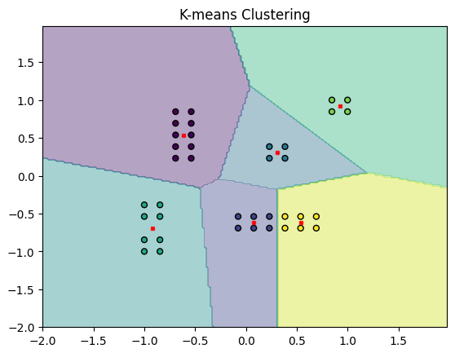
K-means vs RDG

Slide 24
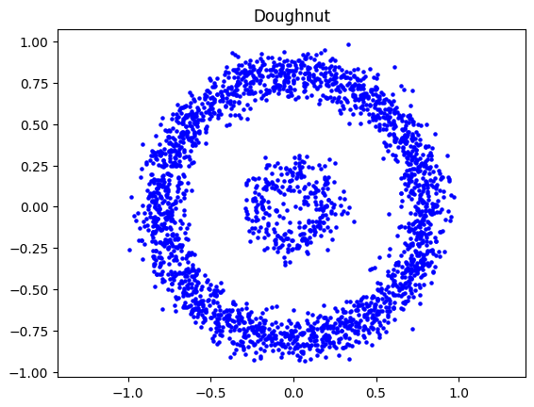
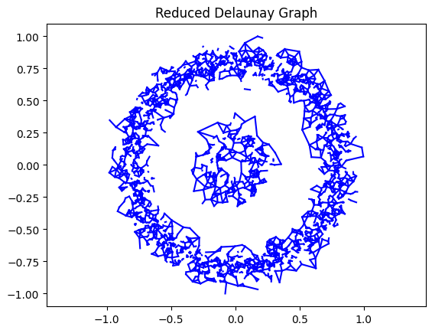
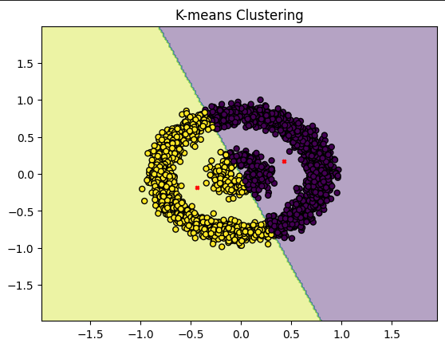
K-means vs RDG

Slide 25
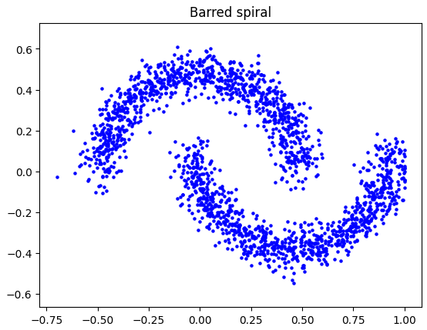
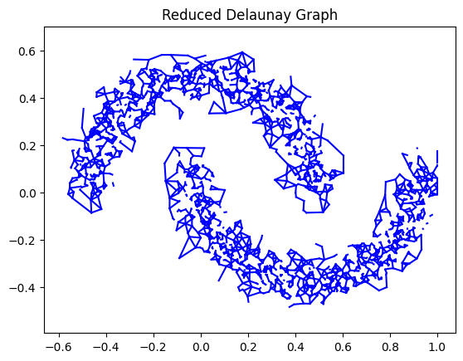
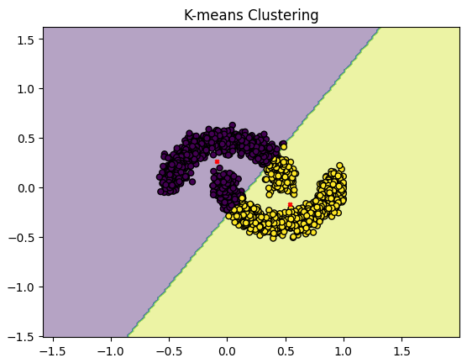
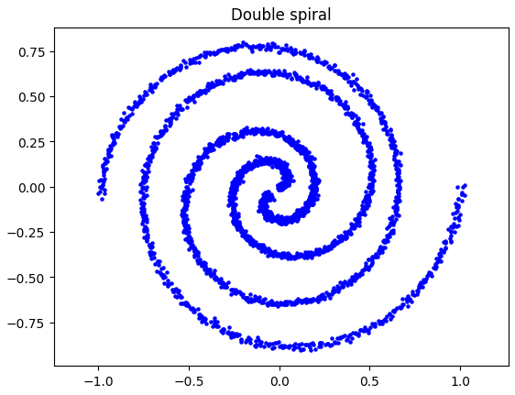
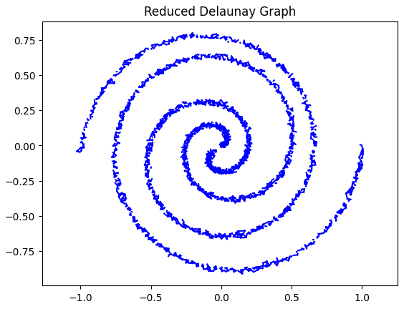
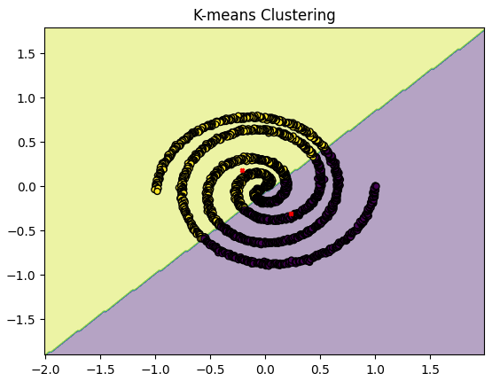
K-means vs RDG

Slide 26
K-means vs RDG
Similarities:
Both are non-supervised algorithms
The tessellation of the plane can be part of their operations or output
Both work well with separated point clouds
Differences:
RDG uses a graph to consider the distances between points
RDG technically doesn’t select representatives for the computed groups
K-means can have elements of randomness

Slide 27
K-means vs RDG
K-means pros:
Simple to implement
Computationally (pretty) efficient
Always converges to a local minimum for each cluster
K-means cons:
Setting k is difficult
Sensitive to random initial centroids and noise
Suited mainly to spherical clusters
Doesn’t model human perception that well
RDG pros:
Models human perception well
Can find groups even in complex shapes
Robust to far away outliers
RDG cons:
Setting the threshold is difficult (especially at different scales)
Computationally heavy

Slide 28
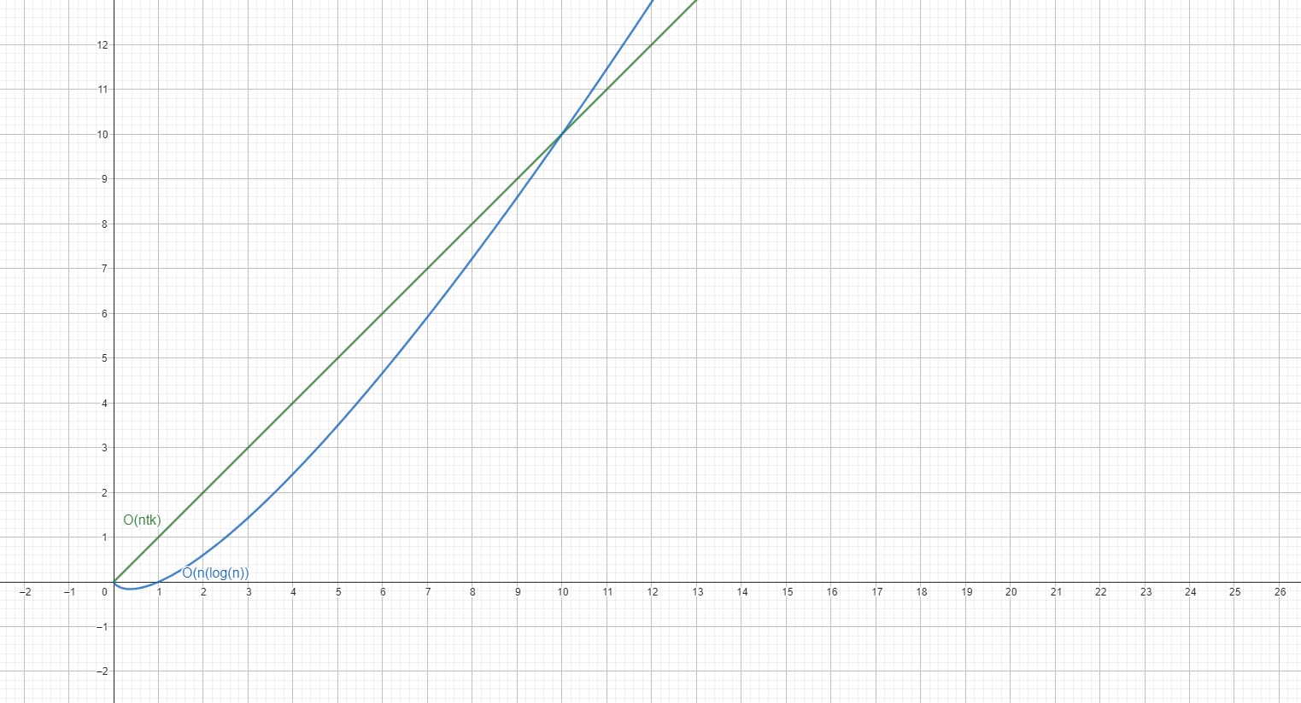
K-means vs RDG: complexity
K-means: O(ntk), with n as number of points, t as number of iterations for converging to a local minimum, k as chosen number of clusters.
RDG: O(nlog(n)), with n as the number of points.
Complexity deducted empirically.

Slide 29
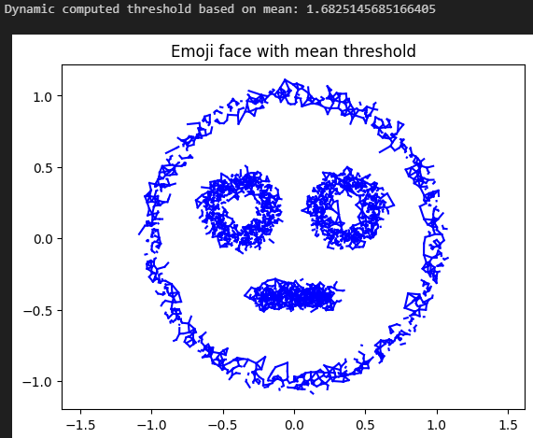
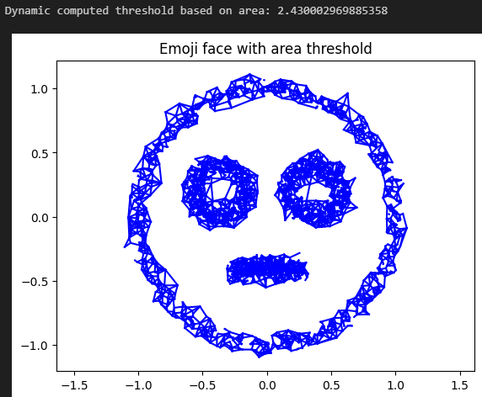
How could it be improved?
One thing we thought about was introducing a dynamic threshold.
Based on the average of the values of each edge.
Based on the area of the minimum bounding circle.

Slide 30
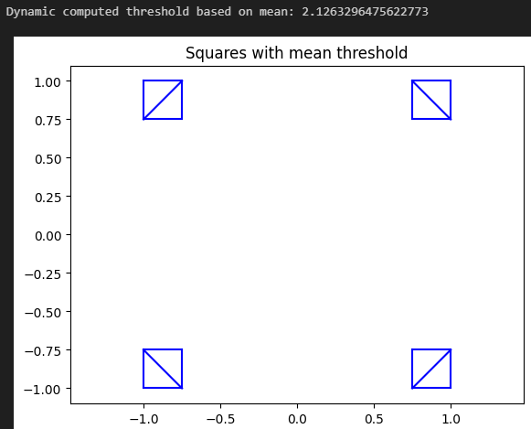
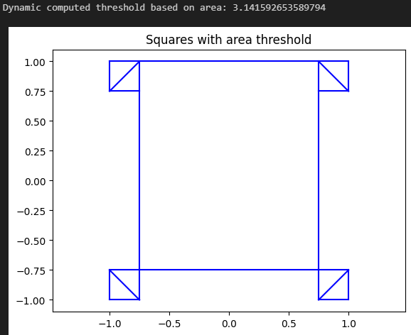
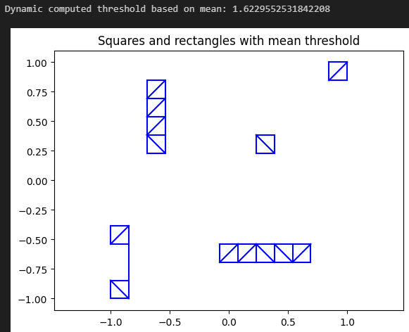
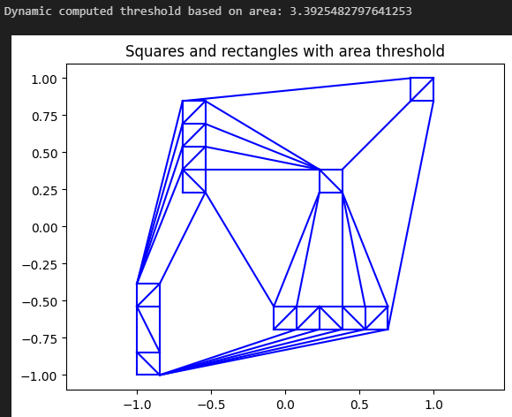
Mean vs Area threshold

Slide 31
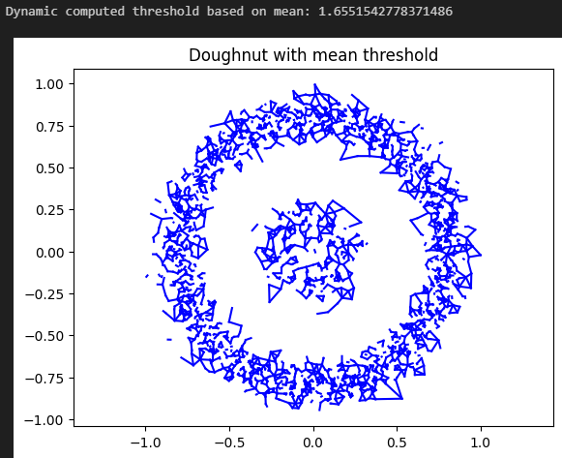
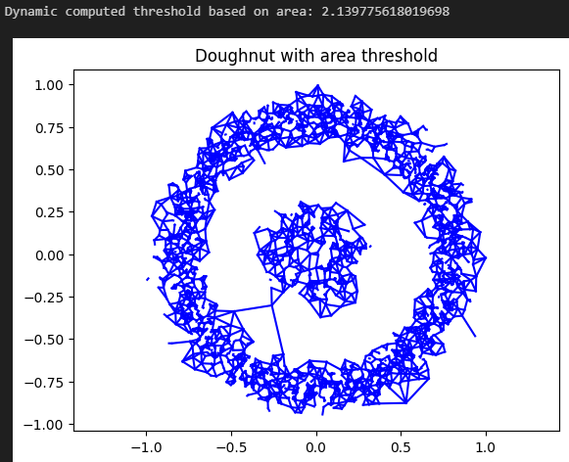
Mean vs Area threshold

Slide 32
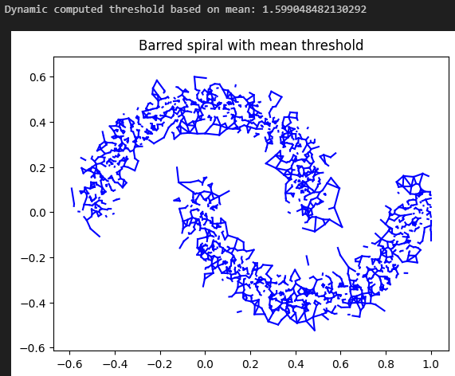
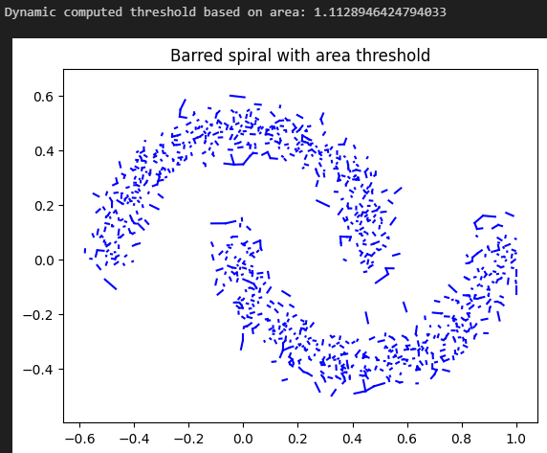
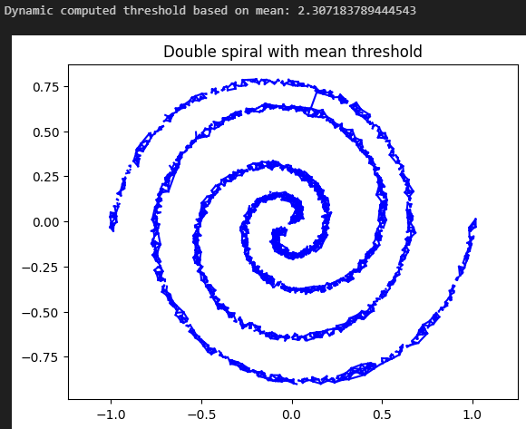
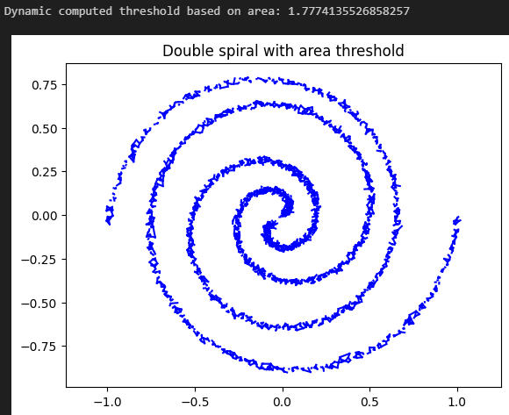
Mean vs Area threshold

Slide 33
External sources
https://pressbooks.umn.edu/sensationandperception/chapter/columns-and-hypercolumns-in-v1
https://www.analytixlabs.co.in/blog/types-of-clustering-algorithms
https://www.cs.rug.nl/~petkov/publications/2005LNCS3704_grouping_dots.pdf

