Slide 1
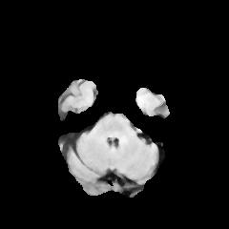

3
16
16
48
64
64
2
240 x 240
240 x 240
240 x 240
240 x 240
240 x 240
240 x 240
240 x 240
Input
Image
16
32
32
64
64
64
Output
Segmentation
Map
120 x 120
120 x 120
120 x 120
120 x 120
120 x 120
120 x 120
32
64
64
128
64
64
60 x 60
60 x 60
60 x 60
60 x 60
60 x 60
60 x 60
64
128
128
Conv 3 x 3, ReLU
Concatenate
Max Pool 2 x 2
30 x 30
30 x 30
30 x 30
Up-Conv 3 x 3
Conv 1 x 1

