Slide 1
Review 2
CSci 474: Operating Systems Concepts
Instructor: Dr. Jun Kong

Slide 2
Chapter 4. Threads
1. Thread VS. process
  Thread: scheduling/executing unit
  Process: resource
  Advantages
    Takes less time to create a new thread than a process
    Less time to terminate a thread than a process
    Less time to switch between two threads within the same process
    Since threads within the same process share memory and files, they can communicate with each other without invoking the kernel
  Suspending/terminating a process involves suspending/terminating all threads of the process

Slide 3
Chapter 4. Threads
2. Thread implementation
  User-Level Threads: the application supports threading through a thread library and the OS isn’t aware of threads.
  Kernel-Level Threads: the operating system supports threads itself.

Slide 4
User-Level Threads
Disadvantages
  Most system calls are blocking for processes. So all threads within a process will be blocked
  The kernel can only assign processes to processors. Two threads within the same process cannot run simultaneously on two processors
Advantages
  Thread switching does not involve the kernel: no mode switching
  Scheduling can be application specific: choose the best algorithm.
  Can run on any OS. Only needs a thread library

Slide 5
Kernel-Level Threads
Advantages
  the kernel can simultaneously schedule many threads of the same process on many processors
  blocking is done on a thread level, so one thread in a process can block while another runs (doesn’t block the entire process)
  kernel routines can be multithreaded
Disadvantages
  thread switching within the same process requires a mode switch to the kernel, which may result in a significant slow down.

Slide 6
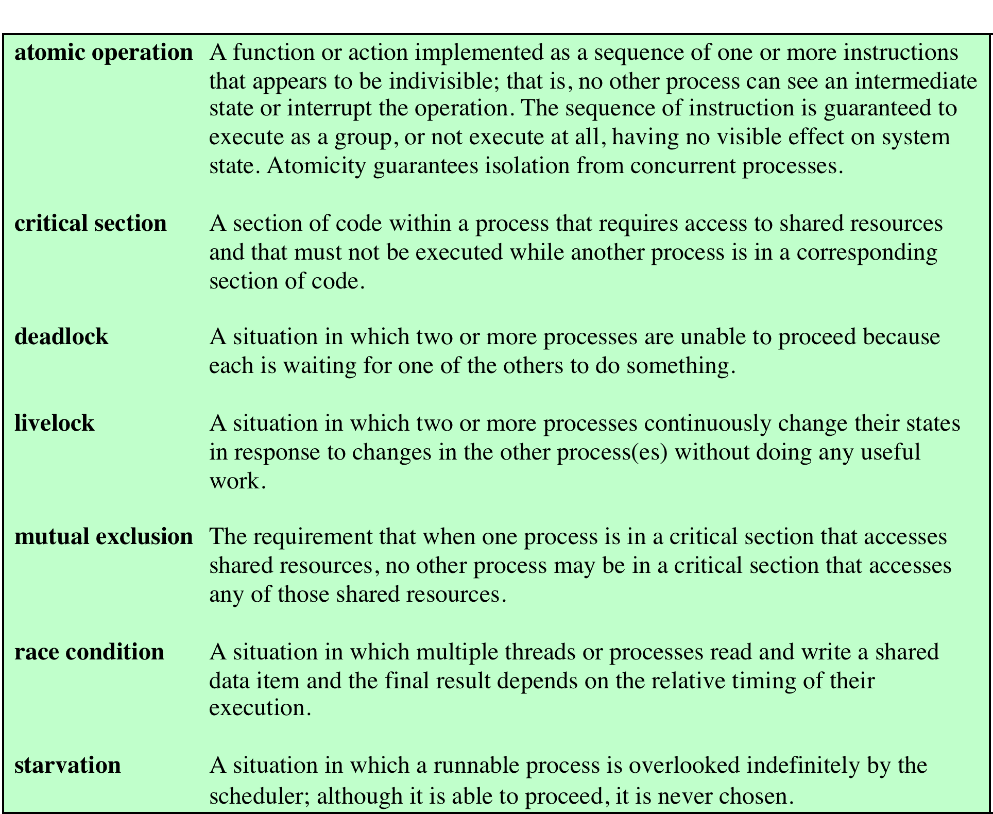
Chapter 5. Mutual Exclusion and Synchronization

Slide 7
Chapter 5. Concurrency: Mutual Exclusion and Synchronization
2. Software solutions:
  Identify the problems in each attempt
  Write down the execution sequence that causes the problem in solutions 2-4

Slide 8
Second Attempt
// process 0
while (flag[1]) // p1 in crit.sec.
// do nothing
flag[0] = true; // I’m in
//… code of critical section
flag[0] = false; // I’m out
// process 1
while (flag[0])
// do nothing
flag[1] = true;
//… code of critical section
flag[1] = false;

Slide 9
Third Attempt
// process 0
flag[0] = true; // I want in
while (flag[1]) // p1 in crit.sec.
// do nothing
//… code of critical section
flag[0] = false; // I’m out
// process 1
flag[1] = true;
while (flag[0])
// do nothing
//… code of critical section
flag[1] = false;

Slide 10
Fourth Attempt
// process 0
flag[0] = true; // I want in
while (flag[1]) // p1 is in
{
flag[0] = false; // defer to p1
// delay
flag[0] = true; // try again
}
//… code of critical section
flag[0] = false; // I’m out
// process 1
flag[1] = true;
while (flag[0])
{
flag[1] = false;
// delay
flag[1] = true;
}
//… code of critical section
flag[1] = false;

Slide 11
Chapter 5. Concurrency: Mutual Exclusion and Synchronization
3. Hardware support:
  Interrupt disabling
    Degrade multitasking performance.
    Doesn’t work on multiprocessor system where multiple processes execute at once regardless of interrupts.

Slide 12
Chapter 5. Concurrency: Mutual Exclusion and Synchronization
3. Hardware support:
  Special machine instruction:
    Busy-waiting is employed:
    Starvation possible since the process that runs next is arbitrary.
    Deadlock is possible if p1 enters the critical section and is interrupted by a higher priority process p2. p2 cannot enter due to p1, and p1 will not be scheduled due to p2.
    Use the “Test and Set” to achieve the mutual exclusion

Slide 13
Chapter 5. Concurrency: Mutual Exclusion and Synchronization
4. Semaphore
  Simulate the execution of semaphores
  Analyze pseudocode
  Use semaphores to solve problems

