Slide 1
Review 1
CSci 474: Operating Systems Concepts
Instructor: Dr. Jun Kong

Slide 2
Chapter 1. Computer System
1. Registers
User-visible registers
Control and status registers (program counter, instruction register, program status word)
2. Instruction cycle: the processing of a single instruction, involving fetch cycle and execute cycle.
The processor fetches the instruction from memory into IR
The instruction in the IR is decoded to determine what the processor should do
After each fetch, the PC is normally incremented so that it is ready to fetch the next instruction.

Slide 3
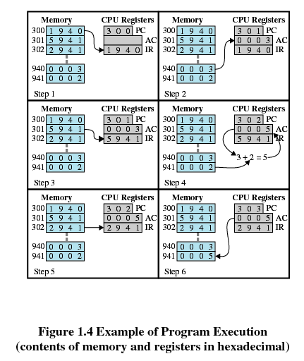
Example of Program Execution
Fetch stage
Execute stage
0x01 = Load AC from Memory
0x02 = Store AC to Memory
0x05 = Add to AC from Memory

Slide 4
Chapter 1. Computer System
3. Interrupt
Notifying the processor of an event VERSUS making the processor wait
Multiple interrupts:
Handle interrupts based on arrival time
Interrupt priority
Program execution sequences with and without interrupts

Slide 5
Chapter 1. Computer System
4. Memory hierarchy
Motivation: great capacity, fast access time and low cost
Locality of reference: program execution of instructions and data occur in cluster

Slide 6
Chapter 2. Operating System Overview
1. Single batch system: introduce the concept of “monitor”
Hardware features
Memory protection: do not overwrite the monitor!
Timer: prevents a job from monopolizing the system
Privileged Instructions: only the monitor can do certain things.
Interrupts: provides better way to handle transfer of control from the monitor to user programs.
Calculate the elapsed time, throughput rate and mean response time.

Slide 7
Chapter 2. Operating System Overview
2. Multiprogrammed batch systems
Calculate the elapsed time, throughput rate and mean response time.
3. Time-sharing system
Processor’s time is split among the set of users
Multiple users simultaneously access the system terminals

Slide 8
Chapter 2. Operating System Overview
4. Symmetric multiprocessing
Multiple processors
There processors share the same main memory and I/O facilities
All processors can perform the same functions

Slide 9
Chapter 2. Operating System Overview
5. Microkernel
Small operating system core and contains only essential core operating systems functions.
6. Distributed OS
Provide the illusion of a single main memory and single secondary memory space for a cluster of separate computers

Slide 10
Chapter 3. Process Description and Control
1. Process
Definition
PCB: process identification, processor state information, process control information
Process image
Trace the execution of processes

Slide 11
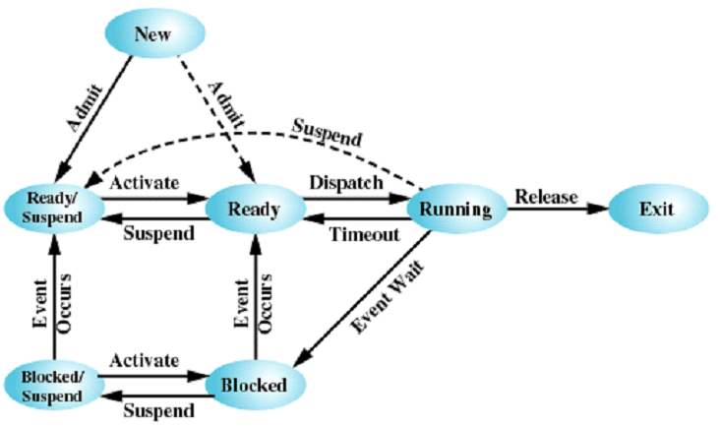
Chapter 3. Process Description and Control
2. Seven state process model

Slide 12
Chapter 3. Process Description and Control
3. Mode of execution
Kernel mode: privileged mode having complete control of system
User mode: running user programs
Mode switch
Switch from process to interrupt handler
Typically, the PSW has a mode bit to indicate the current mode.

Slide 13
Chapter 3. Process Description and Control
4. Process Switch
Save context of processor
Update PCB for process to non-running state.
Move PCB of process to an appropriate queue for the state.
Select another process to run (runs scheduler routine)
Update the PCB of the selected process to the running state.
Update memory-management data structures.
Restore state of newly selected process.

Slide 14
Chapter 3. Process Description and Control
5. Three relations between the kernel and process
Nonprocess Kernel
Execution within User Processes
Process-Based OS

Slide 15
Fork
Use fork/pipe to write pseudocode
Identify the errors in pseudocode

