Slide 1
Assignment #5 作业共11页 1210565
1. Suppose a destination receives the following set of IPv4 fragments in that order. Would it be able to reassemble the original IPv4 datagram? If so, give its length? If not, why not? Answer each of the following cases.
Total length | More fragment | Fragment offset
1020 | 1 | 125
500 | 0 | 375
1020 | 1 | 250
(a)
Total length | More fragment | Fragment offset
1020 | 1 | 125
1020 | 1 | 0
512 | 1 | 250
(b)
Copyright © Xu Jingdong, All right reserved

Slide 2
Answer：
(a) 不能
没有第一个文件片，即没有
offset=0的文件片。
(b) 不能
没有收到最后一个片，即没有
收到标志比特为0的片。
Copyright © Xu Jingdong, All right reserved

Slide 3
Assignment #5
2.Suppose a router has built up the routing table shown below
Where will the router send packets addressed to each of the following destinations? Why?
a) 132.17.97.1
b) 132.17.231.98
c) 196.6.80.10
d) 196.6.80.100
e) 132.17.135.47
Destination Network Address | Network Mask | Next Hop
132.17.128.0 132.17.128.0 196.6.80.0 196.6.0.0 0.0.0.0 | 255.255.128.0 255.255.192.0 255.255.255.192 255.255.0.0 0.0.0.0 | R1 R2 R3 R4 R5
Copyright © Xu Jingdong, All right reserved

Slide 4
Answer：
(a)132.17.97.1
与子网掩码255.255.128.0按位相与得到其网络号为132.17.0.0
与子网掩码255.255.192.0按位相与得到其网络号为132.17.64.0
这两个网络号与132.17.128.0均不匹配，则由缺省路由输出，即发送到R5。
Copyright © Xu Jingdong, All right reserved

Slide 5
(b)132.17.231.98
与子网掩码255.255.128.0按位相与得到其网络号为132.17.128.0，与第一个匹配。
与子网掩码255.255.192.0按位相与得到其网络号为132.17.192.0，与第二个不匹配。
发送到R1。
Copyright © Xu Jingdong, All right reserved

Slide 6
(c)196.6.80.10
与子网掩码255.255.255.192按位相与得到其网络号为196.6.80.0，与第三个匹配。
与子网掩码255.255.0.0按位相与得到其网络号为196.6.0.0，与第四个匹配。
根据最长匹配原则，应与第三个匹配，发送到R3。
Copyright © Xu Jingdong, All right reserved

Slide 7
(d)196.6.80.100
与子网掩码255.255.255.192按位相与得到其网络号为196.6.80.64，与第三个不匹配。
与子网掩码255.255.0.0按位相与得到其网络号为196.6.0.0，与第四个匹配。
发送到R4。
Copyright © Xu Jingdong, All right reserved

Slide 8
(e)132.17.135.47
与子网掩码255.255.128.0按位相与得到其网络号为132.17.128.0，与第一个匹配。
与子网掩码255.255.192.0按位相与得到其网络号为132.17.128.0，与第二个匹配。
根据最长匹配原则，应与第二个匹配，发送到R2。
Copyright © Xu Jingdong, All right reserved

Slide 9
Assignment #5
3. Consider the network shown below where the number on a link between two nodes is the distance between them.
  a) Use Dijkstra’s shortest path algorithm to find the shortest path from A to all other network nodes. Show how the algorithm works by completing the table below the figure.
  b) What is the resulting shortest paths tree and routing table?
2
D
B
2
1
F
7
3
A
2
2
1
1
E
C
2
Copyright © Xu Jingdong, All right reserved

Slide 10
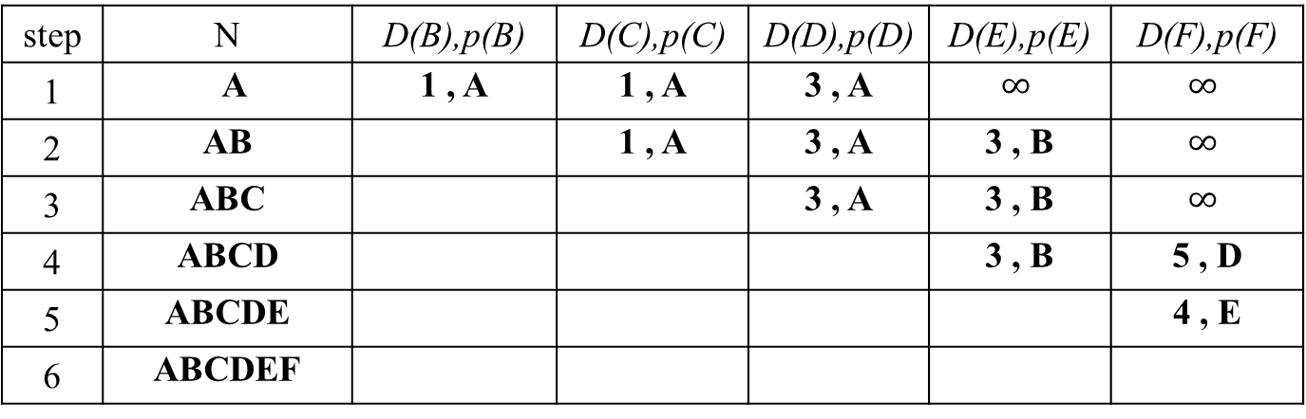
Assignment #5
Answer：
Copyright © Xu Jingdong, All right reserved

Slide 11
(b)the resulting shortest paths tree and routing table
目的网络 | 下一跳
B | B
C | C
D | D
E | B
F | B
D
B
1
F
3
A
2
1
1
E
C
1210565 庄园
2015年5月27日
Copyright © Xu Jingdong, All right reserved

