Slide 1
Assignment #5
1. Suppose a destination receives the following set of IPv4 fragments in that order. Would it be able to reassemble the original IPv4 datagram? If so, give its length? If not, why not? Answer each of the following cases.
Total length | More fragment | Fragment offset
1020 | 1 | 125
500 | 0 | 375
1020 | 1 | 250
(a)
Total length | More fragment | Fragment offset
1020 | 1 | 125
1020 | 1 | 0
512 | 1 | 250
(b)
Copyright © Xu Jingdong, All right reserved

Slide 2
answer：
(a)No,because there isn't a zero in the list of "Fragment offset", and the host has not received the first fragment
(b)No,because there isn't a zero in the list of "More Fragment",and the host has not received the last fragment

Slide 3
Assignment #5
2.Suppose a router has built up the routing table shown below
Where will the router send packets addressed to each of the following destinations? Why?
a) 132.17.97.1
b) 132.17.231.98
c) 196.6.80.10
d) 196.6.80.100
e) 132.17.135.47
Destination Network Address | Network Mask | Next Hop
132.17.128.0 132.17.128.0 196.6.80.0 196.6.0.0 0.0.0.0 | 255.255.128.0 255.255.192.0 255.255.255.192 255.255.0.0 0.0.0.0 | R1 R2 R3 R4 R5
Copyright © Xu Jingdong, All right reserved

Slide 4
answer:
(a) Only match R5 , so send to R5
(b) Match R1 , so send to R1
(c) Match R3 , R4 and R5 , so send to R3
(d) Match R4 and R5 , so send to R4
(e) Match R1 , R2 and R5 , so send to R2

Slide 5
Assignment #5
3. Consider the network shown below where the number on a link between two nodes is the distance between them.
  a) Use Dijkstra’s shortest path algorithm to find the shortest path from A to all other network nodes. Show how the algorithm works by completing the table below the figure.
  b) What is the resulting shortest paths tree and routing table?
2
D
B
2
1
F
7
3
A
2
2
1
1
E
C
2
Copyright © Xu Jingdong, All right reserved

Slide 6
Assignment #5
step | N | D(B),p(B) | D(C),p(C) | D(D),p(D) | D(E),p(E) | D(F),p(F)
1 | A | 1,A | 1,A | 3,A | infinity | infinity
2 | A,B |  | 1,A | 3,A | 3,B | infinity
3 | A,B,C |  |  | 3,B | 3,B | infinity
4 | A,B,C,D |  |  |  | 3,B | 5,D
5 | A,B,C,D,E |  |  |  |  | 4,E
6 | A,B,C,D,E,F
Copyright © Xu Jingdong, All right reserved

Slide 7
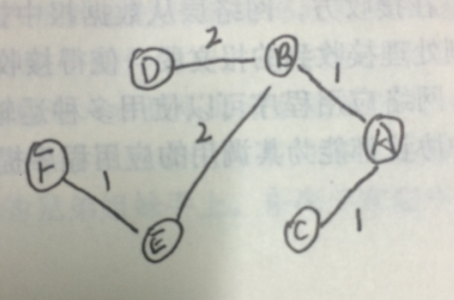
shortest paths tree
routing table
des | next hop | cost
A | --- | 0
B | B | 1
C | C | 1
D | B | 3
E | B | 3
F | B | 4

