Slide 1
Chapter 6
Parallel Processors from Client to Cloud
Notes:
Morgan Kaufmann Publishers
Chapter 7 — Multicores, Multiprocessors, and Clusters

Slide 2
Introduction
§6.1 Introduction
Goal: connecting multiple computers
to get higher performance
  Multiprocessors
  Scalability, availability, power efficiency
Task-level (process-level) parallelism
  High throughput for independent jobs
Parallel processing program
  Single program run on multiple processors
Multicore microprocessors
  Chips with multiple processors (cores)
Chapter 6 — Parallel Processors from Client to Cloud — <number>
Notes:
Morgan Kaufmann Publishers
Chapter 7 — Multicores, Multiprocessors, and Clusters

Slide 3
Hardware and Software
Hardware
  Serial: e.g., Pentium 4
  Parallel: e.g., quad-core Xeon e5345
Software
  Sequential: e.g., matrix multiplication
  Concurrent: e.g., operating system
Sequential/concurrent software can run on serial/parallel hardware
  Challenge: making effective use of parallel hardware
Chapter 6 — Parallel Processors from Client to Cloud — <number>
Notes:
Morgan Kaufmann Publishers
Chapter 7 — Multicores, Multiprocessors, and Clusters

Slide 4
What We’ve Already Covered
§2.11: Parallelism and Instructions
  Synchronization
§3.6: Parallelism and Computer Arithmetic
  Subword Parallelism
§4.10: Parallelism and Advanced Instruction-Level Parallelism
§5.10: Parallelism and Memory Hierarchies
  Cache Coherence
Chapter 6 — Parallel Processors from Client to Cloud — <number>
Notes:
Morgan Kaufmann Publishers
Chapter 7 — Multicores, Multiprocessors, and Clusters

Slide 5
Parallel Programming
Parallel software is the problem
Need to get significant performance improvement
  Otherwise, just use a faster uniprocessor, since it’s easier!
Difficulties
  Partitioning
  Coordination
  Communications overhead
§6.2 The Difficulty of Creating Parallel Processing Programs
Chapter 6 — Parallel Processors from Client to Cloud — <number>
Notes:
Morgan Kaufmann Publishers
Chapter 7 — Multicores, Multiprocessors, and Clusters

Slide 6
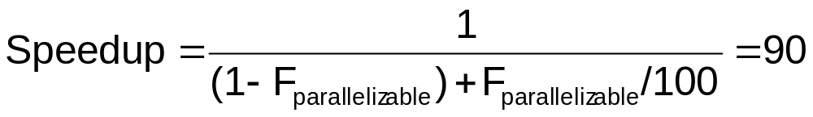
Amdahl’s Law
Sequential part can limit speedup
Example: 100 processors, 90× speedup?
  T_{new} = T_{parallelizable}/100 + T_{sequential}
  Solving: F_{parallelizable} = 0.999
Need sequential part to be 0.1% of original time
Chapter 6 — Parallel Processors from Client to Cloud — <number>
Notes:
Morgan Kaufmann Publishers
Chapter 7 — Multicores, Multiprocessors, and Clusters

Slide 7
Scaling Example
Workload: sum of 10 scalars, and 10 × 10 matrix sum
  Speed up from 10 to 100 processors
Single processor: Time = (10 + 100) × t_{add}
10 processors
  Time = 10 × t_{add} + 100/10 × t_{add} = 20 × t_{add}
  Speedup = 110/20 = 5.5 (55% of potential)
100 processors
  Time = 10 × t_{add} + 100/100 × t_{add} = 11 × t_{add}
  Speedup = 110/11 = 10 (10% of potential)
Assumes load can be balanced across processors
Chapter 6 — Parallel Processors from Client to Cloud — <number>
Notes:
Morgan Kaufmann Publishers
Chapter 7 — Multicores, Multiprocessors, and Clusters

Slide 8
Scaling Example (cont)
What if matrix size is 100 × 100?
Single processor: Time = (10 + 10000) × t_{add}
10 processors
  Time = 10 × t_{add} + 10000/10 × t_{add} = 1010 × t_{add}
  Speedup = 10010/1010 = 9.9 (99% of potential)
100 processors
  Time = 10 × t_{add} + 10000/100 × t_{add} = 110 × t_{add}
  Speedup = 10010/110 = 91 (91% of potential)
Assuming load balanced
Chapter 6 — Parallel Processors from Client to Cloud — <number>
Notes:
Morgan Kaufmann Publishers
Chapter 7 — Multicores, Multiprocessors, and Clusters

Slide 9
Strong vs Weak Scaling
Strong scaling: problem size fixed
  As in example
Weak scaling: problem size proportional to number of processors
  10 processors, 10 × 10 matrix
    Time = 20 × t_{add}
  100 processors, 100 × 100 matrix
    Time = 10 × t_{add} + 1000/100 × t_{add} = 20 × t_{add}
  Constant performance in this example
Chapter 6 — Parallel Processors from Client to Cloud — <number>
Notes:
Morgan Kaufmann Publishers
Chapter 7 — Multicores, Multiprocessors, and Clusters

Slide 10
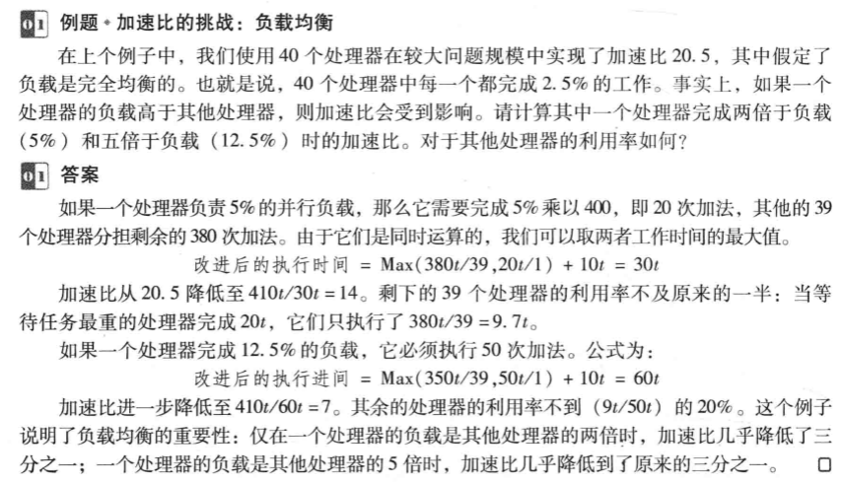
Strong vs Weak Scaling
Chapter 6 — Parallel Processors from Client to Cloud — <number>
Notes:
Morgan Kaufmann Publishers
Chapter 7 — Multicores, Multiprocessors, and Clusters

Slide 11
Instruction and Data Streams
An alternate classification
 |  | Data Streams
 |  | Single | Multiple
Instruction Streams | Single | SISD: Intel Pentium 4 | SIMD: SSE instructions of x86
 | Multiple | MISD: No examples today | MIMD: Intel Xeon e5345
§6.3 SISD, MIMD, SIMD, SPMD, and Vector
SPMD: Single Program Multiple Data
  A parallel program on a MIMD computer
  Conditional code for different processors
Chapter 6 — Parallel Processors from Client to Cloud — <number>
Notes:
Morgan Kaufmann Publishers
Chapter 7 — Multicores, Multiprocessors, and Clusters

Slide 12
Vector Processors
Highly pipelined function units
Stream data from/to vector registers to units
  Data collected from memory into registers
  Results stored from registers to memory
Example: Vector extension to MIPS
  32 × 64-element registers (64-bit elements)
  Vector instructions
    lv, sv: load/store vector
    addv.d: add vectors of double
    addvs.d: add scalar to each element of vector of double
Significantly reduces instruction-fetch bandwidth
Chapter 6 — Parallel Processors from Client to Cloud — <number>
Notes:
Morgan Kaufmann Publishers
Chapter 7 — Multicores, Multiprocessors, and Clusters

Slide 13
Example: DAXPY (Y = a × X + Y)
Conventional MIPS code
l.d $f0,a($sp) ;load scalar a
addiu r4,$s0,#512 ;upper bound of what to load
loop: l.d $f2,0($s0) ;load x(i)
mul.d $f2,$f2,$f0 ;a × x(i)
l.d $f4,0($s1) ;load y(i)
add.d $f4,$f4,$f2 ;a × x(i) + y(i)
s.d $f4,0($s1) ;store into y(i)
addiu $s0,$s0,#8 ;increment index to x
addiu $s1,$s1,#8 ;increment index to y
subu $t0,r4,$s0 ;compute bound
bne $t0,$zero,loop ;check if done
Vector MIPS code
l.d $f0,a($sp) ;load scalar a
lv $v1,0($s0) ;load vector x
mulvs.d $v2,$v1,$f0 ;vector-scalar multiply
lv $v3,0($s1) ;load vector y
addv.d $v4,$v2,$v3 ;add y to product
sv $v4,0($s1) ;store the result
Chapter 6 — Parallel Processors from Client to Cloud — <number>
Notes:
Morgan Kaufmann Publishers
Chapter 7 — Multicores, Multiprocessors, and Clusters

Slide 14
Vector vs. Scalar
Vector architectures and compilers
  Simplify data-parallel programming
  Explicit statement of absence of loop-carried dependences
    Reduced checking in hardware
  Regular access patterns benefit from interleaved and burst memory
  Avoid control hazards by avoiding loops
More general than ad-hoc media extensions (such as MMX, SSE)
  Better match with compiler technology
Chapter 6 — Parallel Processors from Client to Cloud — <number>
Notes:
Morgan Kaufmann Publishers
Chapter 7 — Multicores, Multiprocessors, and Clusters

Slide 15
SIMD
Operate elementwise on vectors of data
  E.g., MMX and SSE instructions in x86
    Multiple data elements in 128-bit wide registers
All processors execute the same instruction at the same time
  Each with different data address, etc.
Simplifies synchronization
Reduced instruction control hardware
Works best for highly data-parallel applications
Chapter 6 — Parallel Processors from Client to Cloud — <number>
Notes:
Morgan Kaufmann Publishers
Chapter 7 — Multicores, Multiprocessors, and Clusters

Slide 16
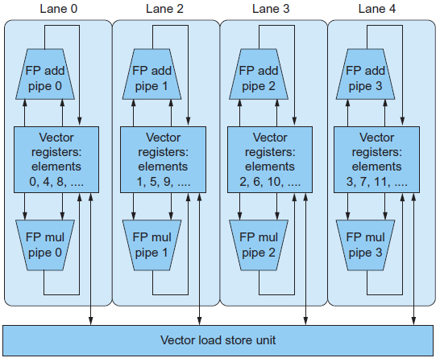
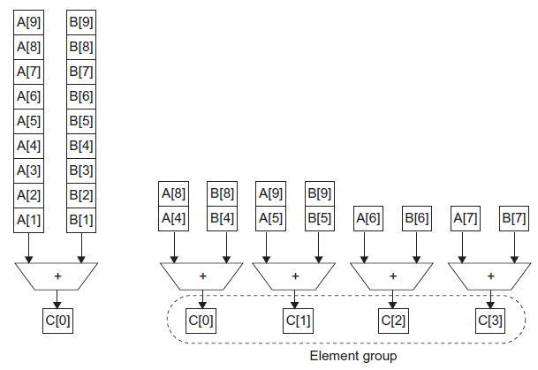
Vector vs. Multimedia Extensions
Vector instructions have a variable vector width, multimedia extensions have a fixed width
Vector instructions support strided access, multimedia extensions do not
Vector units can be combination of pipelined and arrayed functional units:
Chapter 6 — Parallel Processors from Client to Cloud — <number>

Slide 17
Multithreading
Performing multiple threads of execution in parallel
  Replicate registers, PC, etc.
  Fast switching between threads
Fine-grain multithreading
  Switch threads after each cycle
  Interleave instruction execution
  If one thread stalls, others are executed
Coarse-grain multithreading
  Only switch on long stall (e.g., L2-cache miss)
  Simplifies hardware, but doesn’t hide short stalls (eg, data hazards)
§6.4 Hardware Multithreading
Chapter 6 — Parallel Processors from Client to Cloud — <number>
Notes:
Morgan Kaufmann Publishers
Chapter 7 — Multicores, Multiprocessors, and Clusters

Slide 18
Simultaneous Multithreading
In multiple-issue dynamically scheduled processor
  Schedule instructions from multiple threads
  Instructions from independent threads execute when function units are available
  Within threads, dependencies handled by scheduling and register renaming
Example: Intel Pentium-4 HT
  Two threads: duplicated registers, shared function units and caches
Chapter 6 — Parallel Processors from Client to Cloud — <number>
Notes:
Morgan Kaufmann Publishers
Chapter 7 — Multicores, Multiprocessors, and Clusters

Slide 19
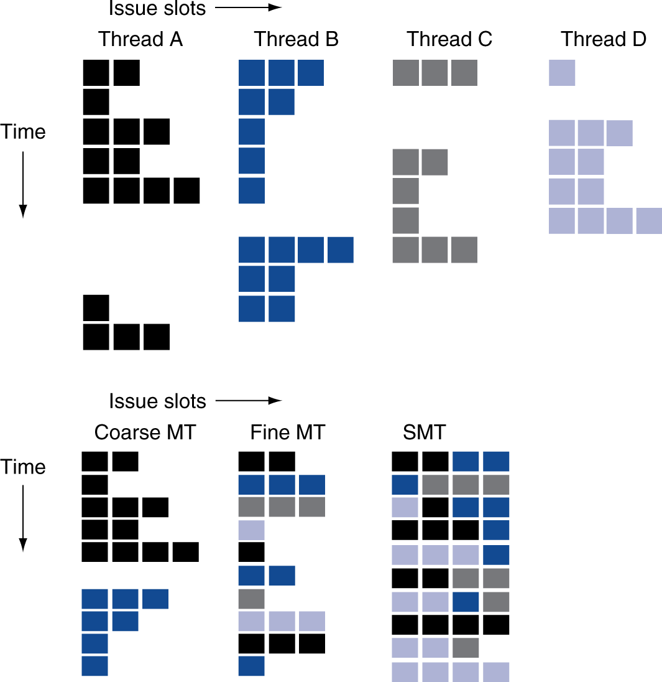
Multithreading Example
Chapter 6 — Parallel Processors from Client to Cloud — <number>
Notes:
Morgan Kaufmann Publishers
Chapter 7 — Multicores, Multiprocessors, and Clusters

Slide 20
Future of Multithreading
Will it survive? In what form?
Power considerations ⇒ simplified microarchitectures
  Simpler forms of multithreading
Tolerating cache-miss latency
  Thread switch may be most effective
Multiple simple cores might share resources more effectively
Chapter 6 — Parallel Processors from Client to Cloud — <number>
Notes:
Morgan Kaufmann Publishers
Chapter 7 — Multicores, Multiprocessors, and Clusters

Slide 21
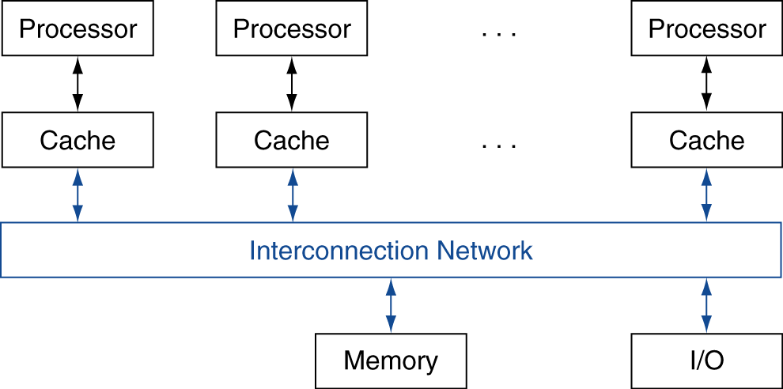
Shared Memory
SMP: shared memory multiprocessor
  Hardware provides single physical
  address space for all processors
  Synchronize shared variables using locks
  Memory access time
    UMA (uniform) vs. NUMA (nonuniform)
§6.5 Multicore and Other Shared Memory Multiprocessors
Chapter 6 — Parallel Processors from Client to Cloud — <number>
Notes:
Morgan Kaufmann Publishers
Chapter 7 — Multicores, Multiprocessors, and Clusters

Slide 22
Example: Sum Reduction
Sum 100,000 numbers on 100 processor UMA
  Each processor has ID: 0 ≤ Pn ≤ 99
  Partition 1000 numbers per processor
  Initial summation on each processor
  sum[Pn] = 0;
  for (i = 1000*Pn;
  i < 1000*(Pn+1); i = i + 1)
  sum[Pn] = sum[Pn] + A[i];
Now need to add these partial sums
  Reduction: divide and conquer
  Half the processors add pairs, then quarter, …
  Need to synchronize between reduction steps
Chapter 6 — Parallel Processors from Client to Cloud — <number>
Notes:
Morgan Kaufmann Publishers
Chapter 7 — Multicores, Multiprocessors, and Clusters

Slide 23
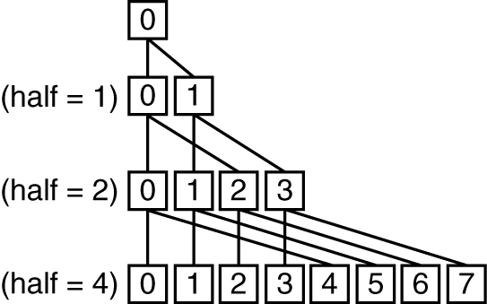
Example: Sum Reduction
half = 100;
repeat
synch();
if (half%2 != 0 && Pn == 0)
sum[0] = sum[0] + sum[half-1];
/* Conditional sum needed when half is odd;
Processor0 gets missing element */
half = half/2; /* dividing line on who sums */
if (Pn < half) sum[Pn] = sum[Pn] + sum[Pn+half];
until (half == 1);
Chapter 6 — Parallel Processors from Client to Cloud — <number>
Notes:
Morgan Kaufmann Publishers
Chapter 7 — Multicores, Multiprocessors, and Clusters

Slide 24
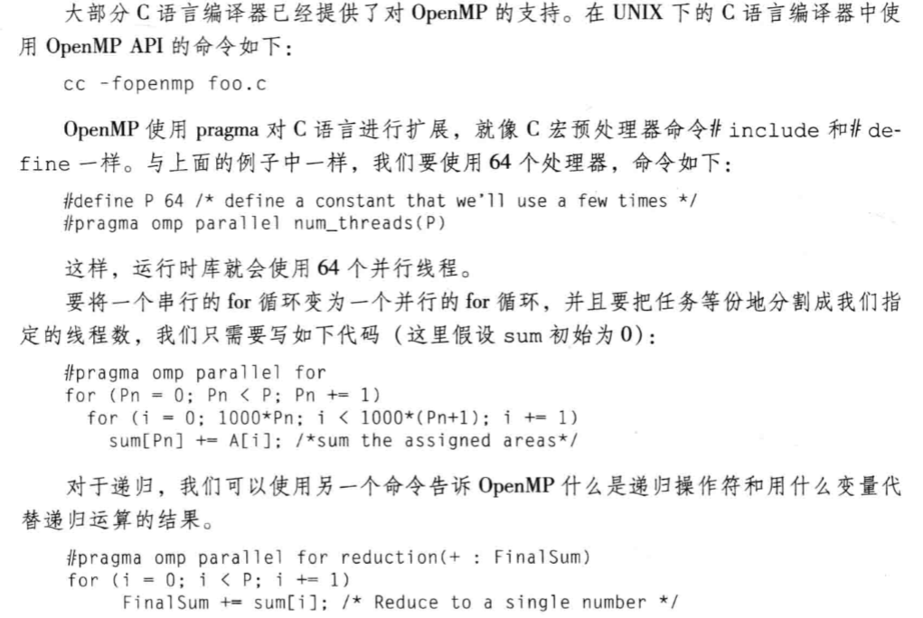
Example: Sum Reduction
Chapter 6 — Parallel Processors from Client to Cloud — <number>
Notes:
Morgan Kaufmann Publishers
Chapter 7 — Multicores, Multiprocessors, and Clusters

Slide 25
History of GPUs
Early video cards
  Frame buffer memory with address generation for video output
3D graphics processing
  Originally high-end computers (e.g., SGI)
  Moore’s Law ⇒ lower cost, higher density
  3D graphics cards for PCs and game consoles
Graphics Processing Units
  Processors oriented to 3D graphics tasks
  Vertex/pixel processing, shading, texture mapping,
  rasterization
§6.6 Introduction to Graphics Processing Units
Chapter 6 — Parallel Processors from Client to Cloud — <number>
Notes:
Morgan Kaufmann Publishers
Chapter 7 — Multicores, Multiprocessors, and Clusters

Slide 26
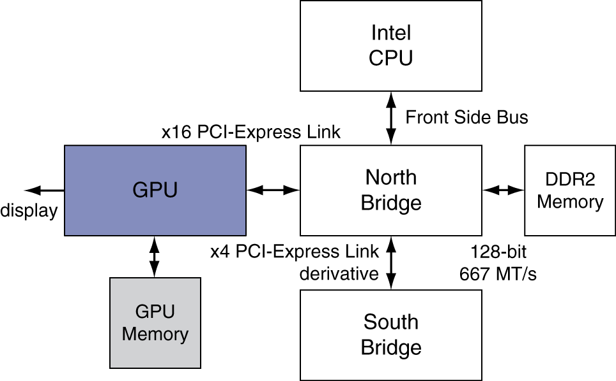
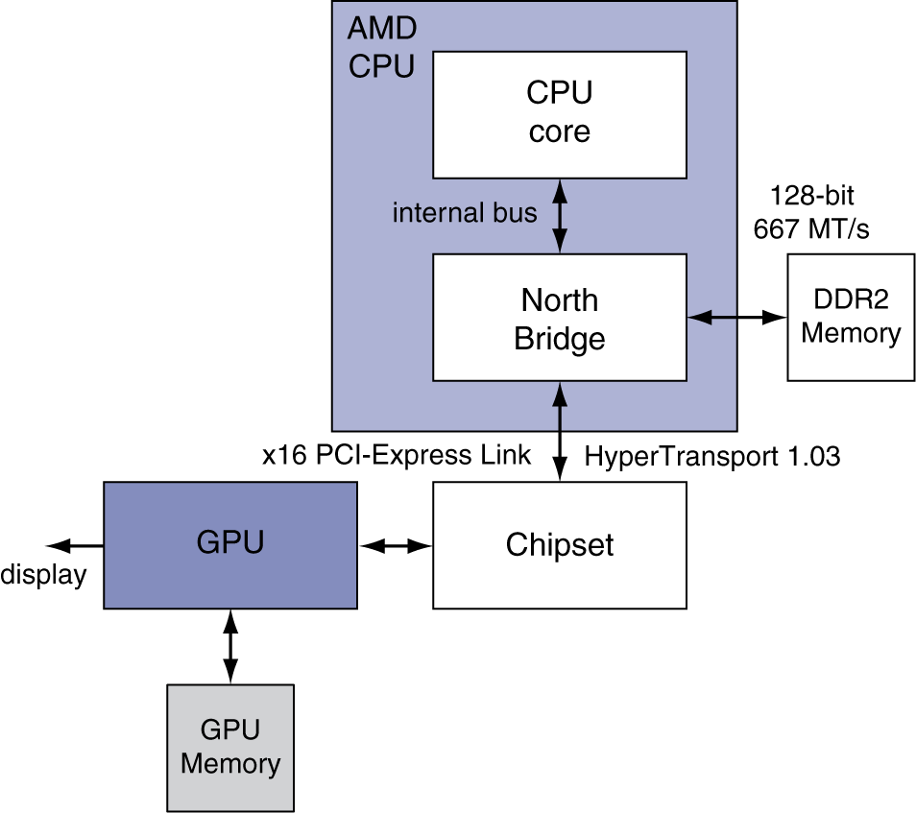
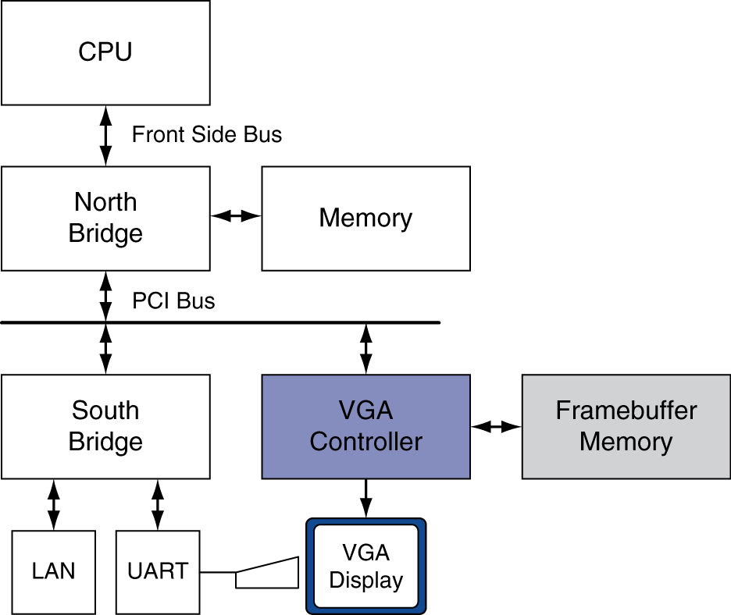
Graphics in the System
Chapter 6 — Parallel Processors from Client to Cloud — <number>
Notes:
Morgan Kaufmann Publishers
Chapter 7 — Multicores, Multiprocessors, and Clusters

Slide 27
GPU Architectures
Processing is highly data-parallel
  GPUs are highly multithreaded
  Use thread switching to hide memory latency
    Less reliance on multi-level caches
  Graphics memory is wide and high-bandwidth
Trend toward general purpose GPUs
  Heterogeneous CPU/GPU systems
  CPU for sequential code, GPU for parallel code
Programming languages/APIs
  DirectX, OpenGL
  C for Graphics (Cg), High Level Shader Language (HLSL)
  Compute Unified Device Architecture (CUDA)
Chapter 6 — Parallel Processors from Client to Cloud — <number>
Notes:
Morgan Kaufmann Publishers
Chapter 7 — Multicores, Multiprocessors, and Clusters

Slide 28
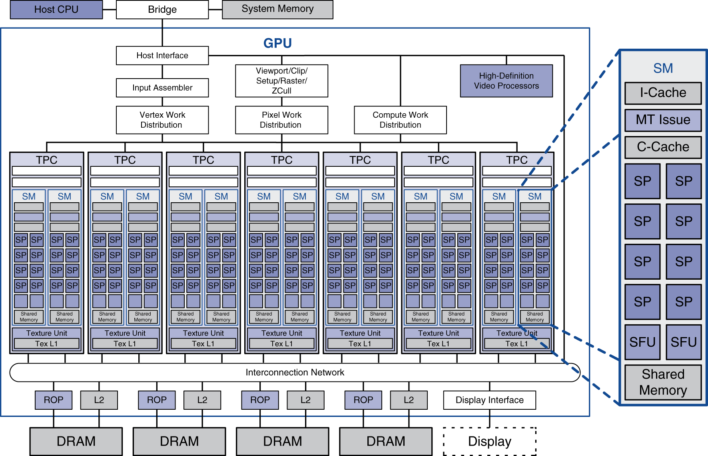
Example: NVIDIA Tesla
Streaming multiprocessor
8 × Streaming
processors
Chapter 6 — Parallel Processors from Client to Cloud — <number>
Notes:
Morgan Kaufmann Publishers
Chapter 7 — Multicores, Multiprocessors, and Clusters

Slide 29
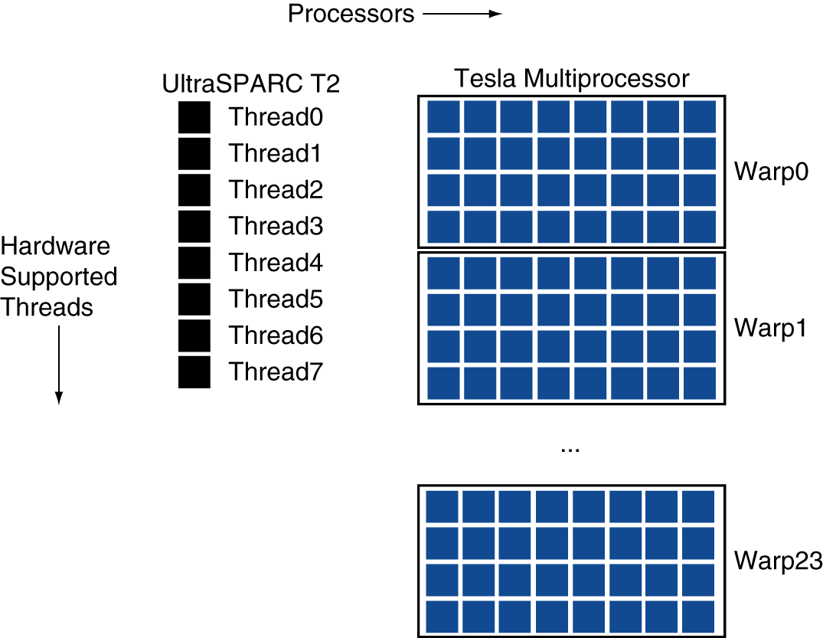
Example: NVIDIA Tesla
Streaming Processors
  Single-precision FP and integer units
  Each SP is fine-grained multithreaded
Warp: group of 32 threads
  Executed in parallel,
  SIMD style
    8 SPs
    × 4 clock cycles
  Hardware contexts
  for 24 warps
    Registers, PCs, …
Chapter 6 — Parallel Processors from Client to Cloud — <number>
Notes:
Morgan Kaufmann Publishers
Chapter 7 — Multicores, Multiprocessors, and Clusters

Slide 30
Classifying GPUs
Don’t fit nicely into SIMD/MIMD model
  Conditional execution in a thread allows an illusion of MIMD
    But with performance degredation
    Need to write general purpose code with care
 | Static: Discovered at Compile Time | Dynamic: Discovered at Runtime
Instruction-Level Parallelism | VLIW | Superscalar
Data-Level Parallelism | SIMD or Vector | Tesla Multiprocessor
Chapter 6 — Parallel Processors from Client to Cloud — <number>
Notes:
Morgan Kaufmann Publishers
Chapter 7 — Multicores, Multiprocessors, and Clusters

Slide 31
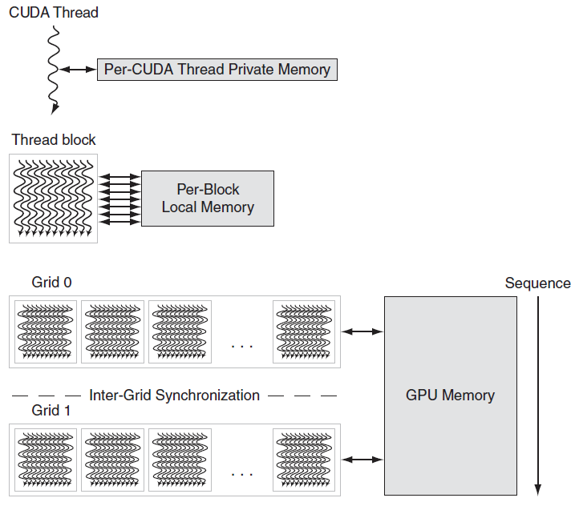
GPU Memory Structures
Chapter 6 — Parallel Processors from Client to Cloud — <number>

Slide 32
Putting GPUs into Perspective
Feature | Multicore with SIMD | GPU
SIMD processors | 4 to 8 | 8 to 16
SIMD lanes/processor | 2 to 4 | 8 to 16
Multithreading hardware support for SIMD threads | 2 to 4 | 16 to 32
Typical ratio of single precision to double-precision performance | 2:1 | 2:1
Largest cache size | 8 MB | 0.75 MB
Size of memory address | 64-bit | 64-bit
Size of main memory | 8 GB to 256 GB | 4 GB to 6 GB
Memory protection at level of page | Yes | Yes
Demand paging | Yes | No
Integrated scalar processor/SIMD processor | Yes | No
Cache coherent | Yes | No
Chapter 6 — Parallel Processors from Client to Cloud — <number>

Slide 33
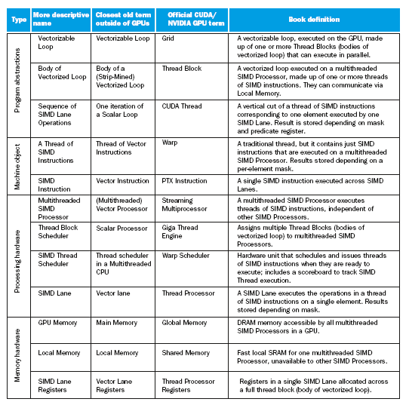
Guide to GPU Terms
Chapter 6 — Parallel Processors from Client to Cloud — <number>

Slide 34
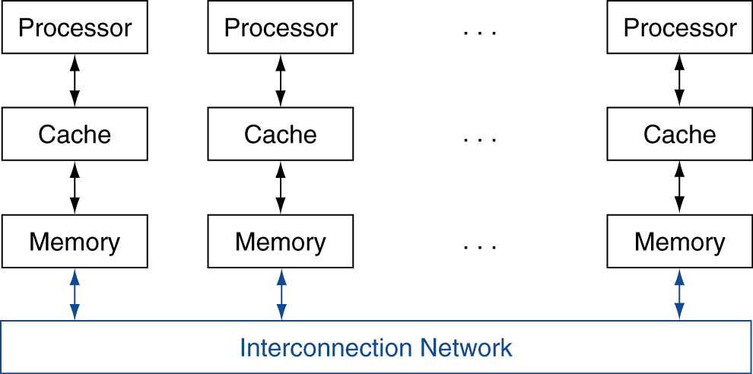
Message Passing
Each processor has private physical address space
Hardware sends/receives messages between processors
§6.7 Clusters, WSC, and Other Message-Passing MPs
Chapter 6 — Parallel Processors from Client to Cloud — <number>
Notes:
Morgan Kaufmann Publishers
Chapter 7 — Multicores, Multiprocessors, and Clusters

Slide 35
Loosely Coupled Clusters
Network of independent computers
  Each has private memory and OS
  Connected using I/O system
    E.g., Ethernet/switch, Internet
Suitable for applications with independent tasks
  Web servers, databases, simulations, …
High availability, scalable, affordable
Problems
  Administration cost (prefer virtual machines)
  Low interconnect bandwidth
    c.f. processor/memory bandwidth on an SMP
Chapter 6 — Parallel Processors from Client to Cloud — <number>
Notes:
Morgan Kaufmann Publishers
Chapter 7 — Multicores, Multiprocessors, and Clusters

Slide 36
Sum Reduction (Again)
Sum 100,000 on 100 processors
First distribute 100 numbers to each
  The do partial sums
  sum = 0;
  for (i = 0; i<1000; i = i + 1)
  sum = sum + AN[i];
Reduction
  Half the processors send, other half receive and add
  The quarter send, quarter receive and add, …
Chapter 6 — Parallel Processors from Client to Cloud — <number>
Notes:
Morgan Kaufmann Publishers
Chapter 7 — Multicores, Multiprocessors, and Clusters

Slide 37
Sum Reduction (Again)
Given send() and receive() operations
  limit = 100; half = 100;/* 100 processors */
  repeat
  half = (half+1)/2; /* send vs. receive
  dividing line */
  if (Pn >= half && Pn < limit)
  send(Pn - half, sum);
  if (Pn < (limit/2))
  sum = sum + receive();
  limit = half; /* upper limit of senders */
  until (half == 1); /* exit with final sum */
  Send/receive also provide synchronization
  Assumes send/receive take similar time to addition
Chapter 6 — Parallel Processors from Client to Cloud — <number>
Notes:
Morgan Kaufmann Publishers
Chapter 7 — Multicores, Multiprocessors, and Clusters

Slide 38
Grid Computing
Separate computers interconnected by long-haul networks
  E.g., Internet connections
  Work units farmed out, results sent back
Can make use of idle time on PCs
  E.g., SETI@home, World Community Grid
Chapter 6 — Parallel Processors from Client to Cloud — <number>
Notes:
Morgan Kaufmann Publishers
Chapter 7 — Multicores, Multiprocessors, and Clusters

Slide 39


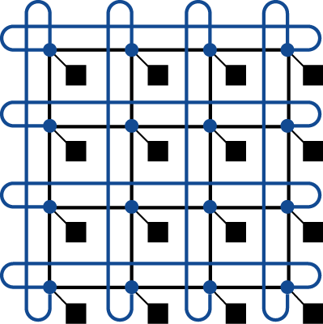

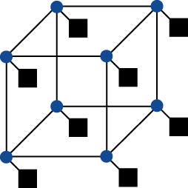
Interconnection Networks
Network topologies
  Arrangements of processors, switches, and links
§6.8 Introduction to Multiprocessor Network Topologies
Bus
Ring
N-cube (N = 3)
2D Mesh
Fully connected
Chapter 6 — Parallel Processors from Client to Cloud — <number>
Notes:
Morgan Kaufmann Publishers
Chapter 7 — Multicores, Multiprocessors, and Clusters

Slide 40
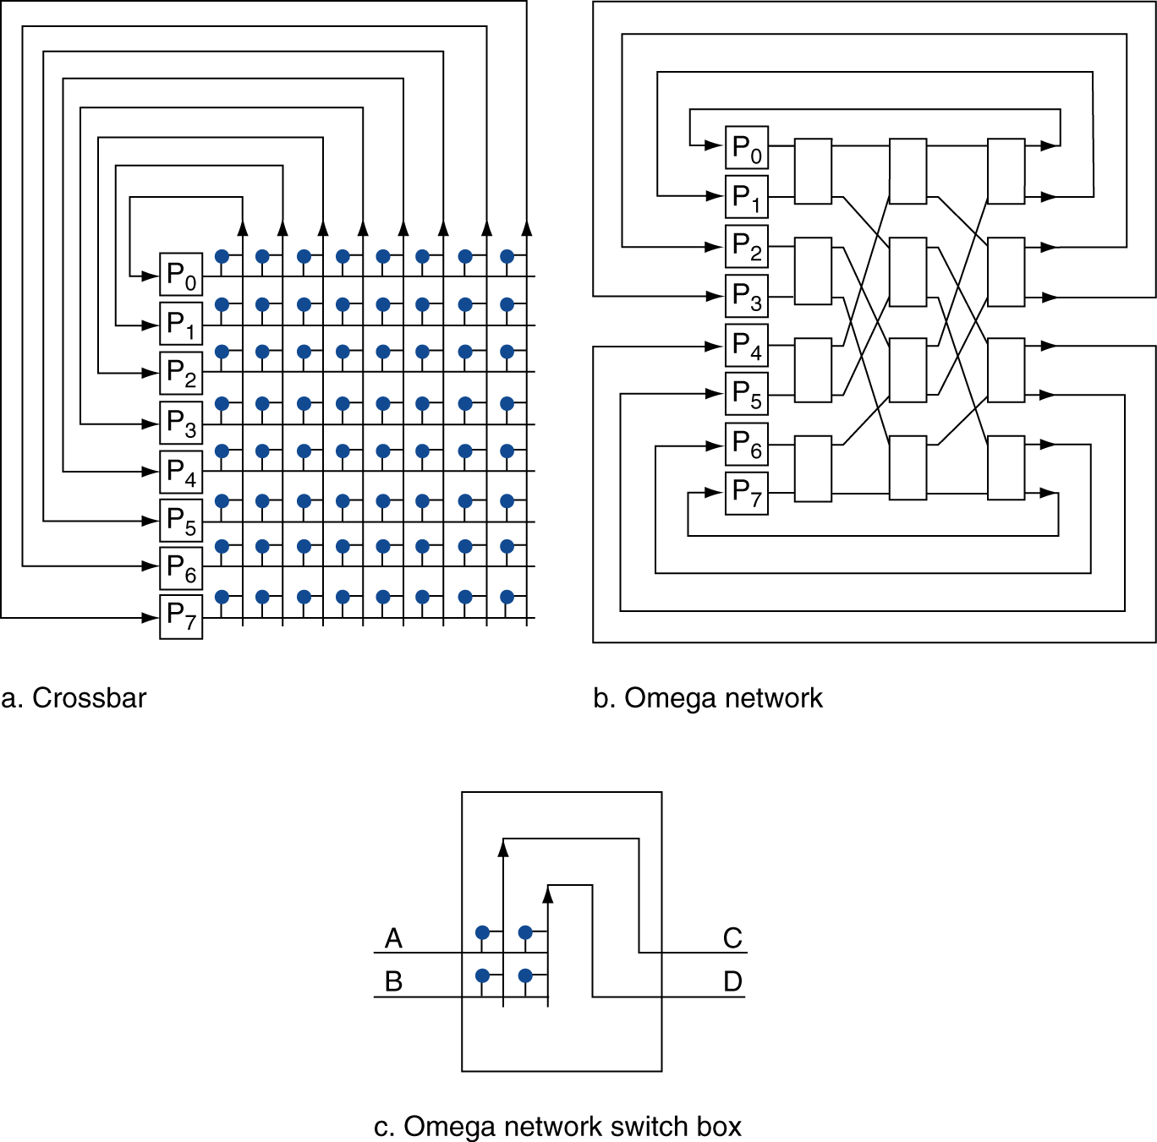
Multistage Networks
Chapter 6 — Parallel Processors from Client to Cloud — <number>
Notes:
Morgan Kaufmann Publishers
Chapter 7 — Multicores, Multiprocessors, and Clusters

Slide 41
Network Characteristics
Performance
  Latency per message (unloaded network)
  Throughput
    Link bandwidth
    Total network bandwidth
    Bisection bandwidth
  Congestion delays (depending on traffic)
Cost
Power
Routability in silicon
Chapter 6 — Parallel Processors from Client to Cloud — <number>
Notes:
Morgan Kaufmann Publishers
Chapter 7 — Multicores, Multiprocessors, and Clusters

Slide 42
Parallel Benchmarks
Linpack: matrix linear algebra
SPECrate: parallel run of SPEC CPU programs
  Job-level parallelism
SPLASH: Stanford Parallel Applications for Shared Memory
  Mix of kernels and applications, strong scaling
NAS (NASA Advanced Supercomputing) suite
  computational fluid dynamics kernels
PARSEC (Princeton Application Repository for Shared Memory Computers) suite
  Multithreaded applications using Pthreads and OpenMP
§6.10 Multiprocessor Benchmarks and Performance Models
Chapter 6 — Parallel Processors from Client to Cloud — <number>
Notes:
Morgan Kaufmann Publishers
Chapter 7 — Multicores, Multiprocessors, and Clusters

Slide 43
Code or Applications?
Traditional benchmarks
  Fixed code and data sets
Parallel programming is evolving
  Should algorithms, programming languages, and tools be part of the system?
  Compare systems, provided they implement a given application
  E.g., Linpack, Berkeley Design Patterns
Would foster innovation in approaches to parallelism
Chapter 6 — Parallel Processors from Client to Cloud — <number>
Notes:
Morgan Kaufmann Publishers
Chapter 7 — Multicores, Multiprocessors, and Clusters

Slide 44
Modeling Performance
Assume performance metric of interest is achievable GFLOPs/sec
  Measured using computational kernels from Berkeley Design Patterns
Arithmetic intensity of a kernel
  FLOPs per byte of memory accessed
For a given computer, determine
  Peak GFLOPS (from data sheet)
  Peak memory bytes/sec (using Stream benchmark)
Chapter 6 — Parallel Processors from Client to Cloud — <number>
Notes:
Morgan Kaufmann Publishers
Chapter 7 — Multicores, Multiprocessors, and Clusters

Slide 45
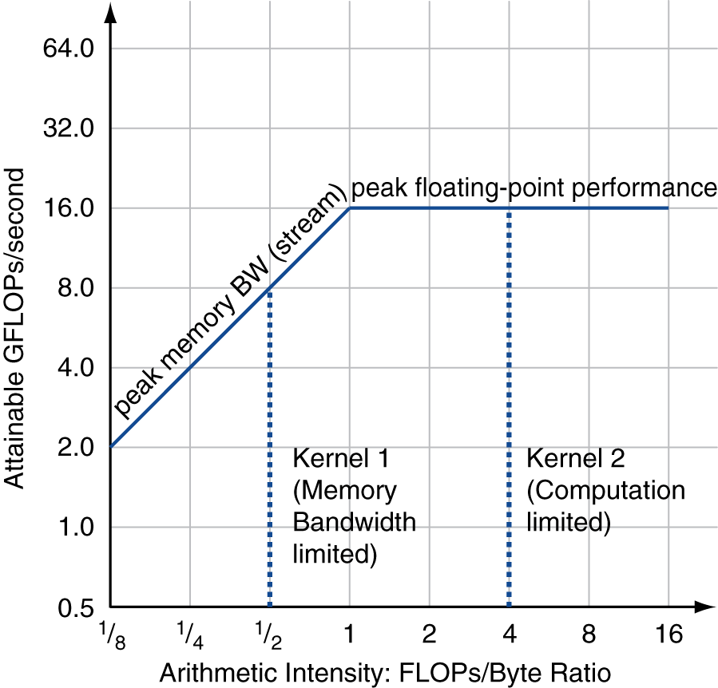
Roofline Diagram
Attainable GPLOPs/sec
= Max ( Peak Memory BW × Arithmetic Intensity, Peak FP Performance )
Chapter 6 — Parallel Processors from Client to Cloud — <number>
Notes:
Morgan Kaufmann Publishers
Chapter 7 — Multicores, Multiprocessors, and Clusters

Slide 46
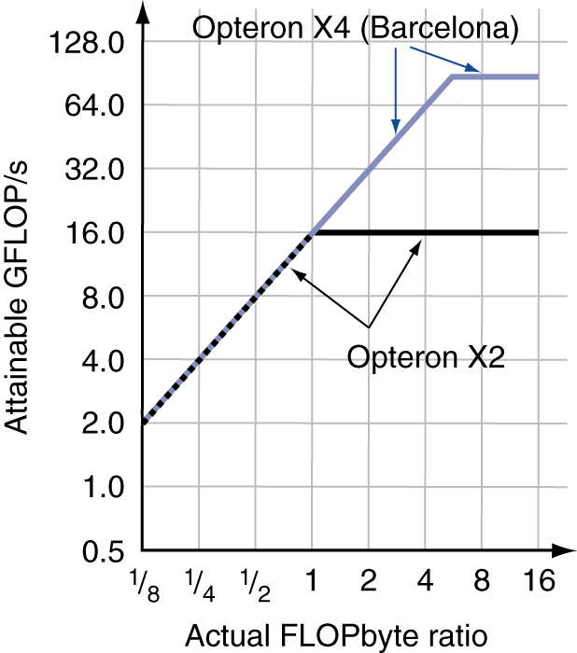
Comparing Systems
Example: Opteron X2 vs. Opteron X4
  2-core vs. 4-core, 2× FP performance/core, 2.2GHz vs. 2.3GHz
  Same memory system
To get higher performance on X4 than X2
  Need high arithmetic intensity
  Or working set must fit in X4’s 2MB L-3 cache
Chapter 6 — Parallel Processors from Client to Cloud — <number>
Notes:
Morgan Kaufmann Publishers
Chapter 7 — Multicores, Multiprocessors, and Clusters

Slide 47
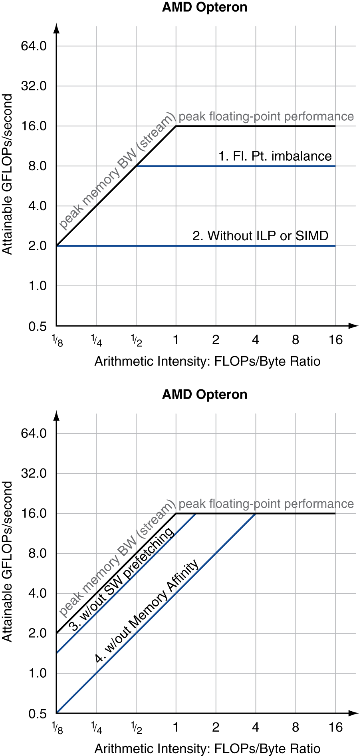
Optimizing Performance
Optimize FP performance
  Balance adds & multiplies
  Improve superscalar ILP and use of SIMD instructions
Optimize memory usage
  Software prefetch
    Avoid load stalls
  Memory affinity
    Avoid non-local data accesses
Chapter 6 — Parallel Processors from Client to Cloud — <number>
Notes:
Morgan Kaufmann Publishers
Chapter 7 — Multicores, Multiprocessors, and Clusters

Slide 48
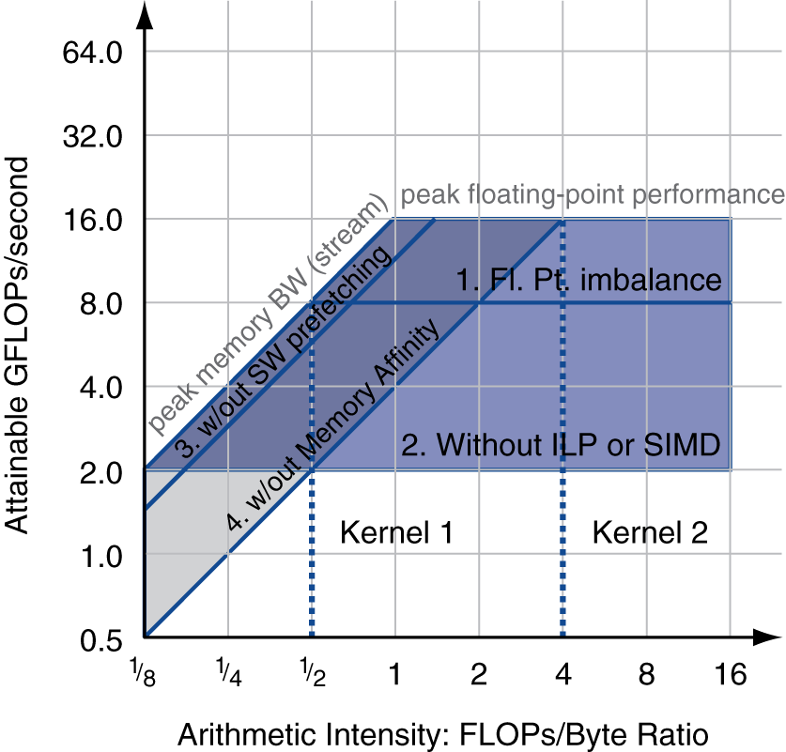
Optimizing Performance
Choice of optimization depends on arithmetic intensity of code
Arithmetic intensity is not always fixed
  May scale with problem size
  Caching reduces memory accesses
    Increases arithmetic intensity
Chapter 6 — Parallel Processors from Client to Cloud — <number>
Notes:
Morgan Kaufmann Publishers
Chapter 7 — Multicores, Multiprocessors, and Clusters

Slide 49
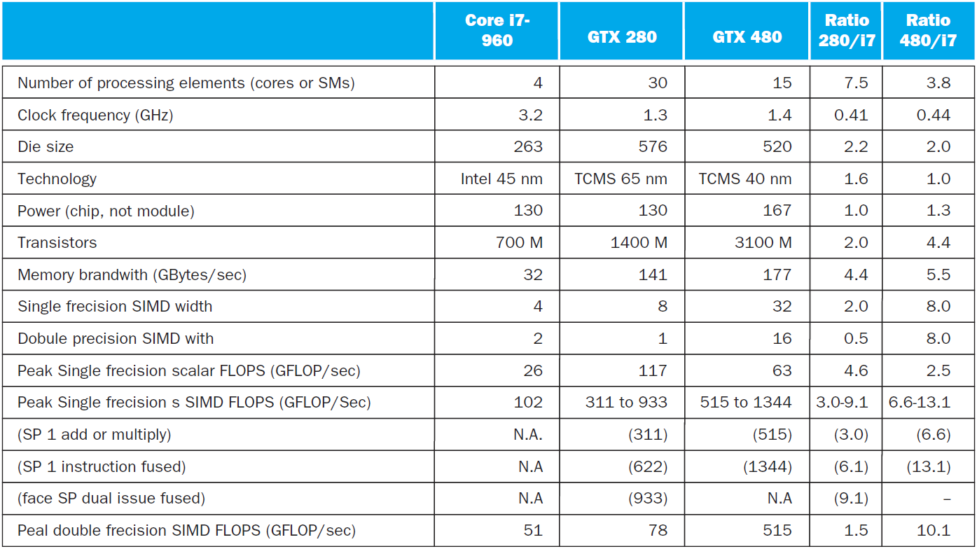
i7-960 vs. NVIDIA Tesla 280/480
§6.11 Real Stuff: Benchmarking and Rooflines i7 vs. Tesla
Chapter 6 — Parallel Processors from Client to Cloud — <number>
Notes:
Morgan Kaufmann Publishers
Chapter 7 — Multicores, Multiprocessors, and Clusters

Slide 50
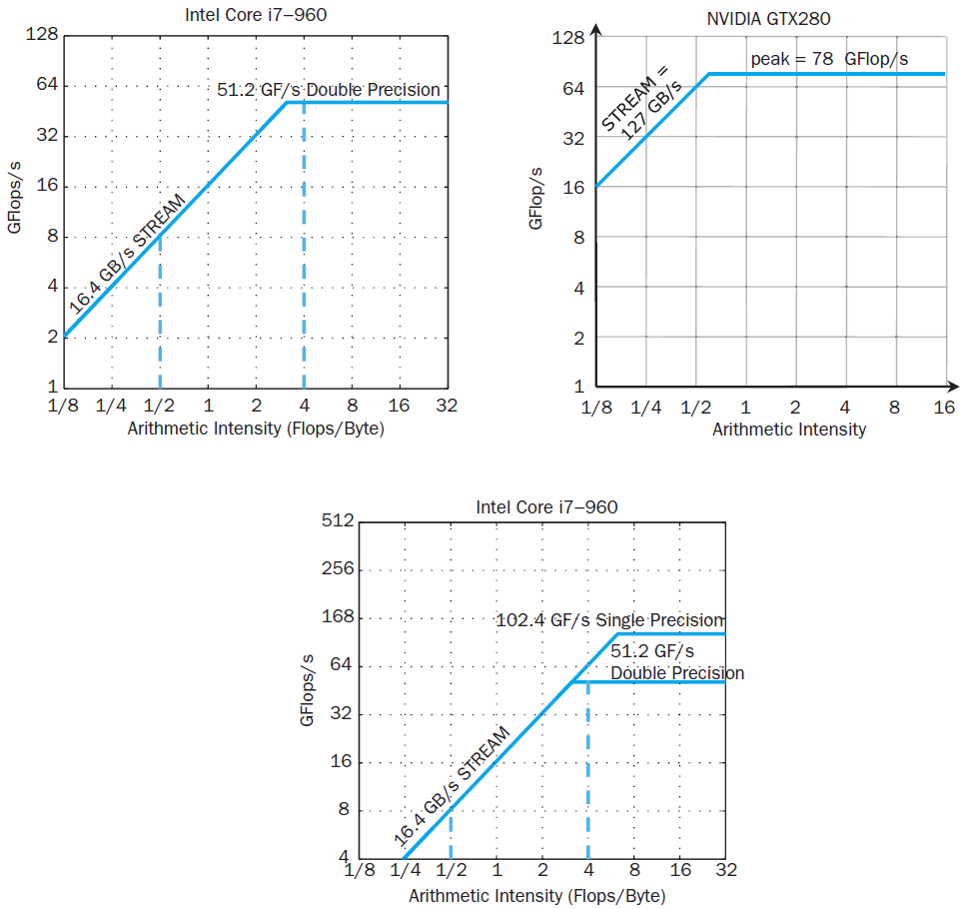
Rooflines
Chapter 6 — Parallel Processors from Client to Cloud — <number>

Slide 51
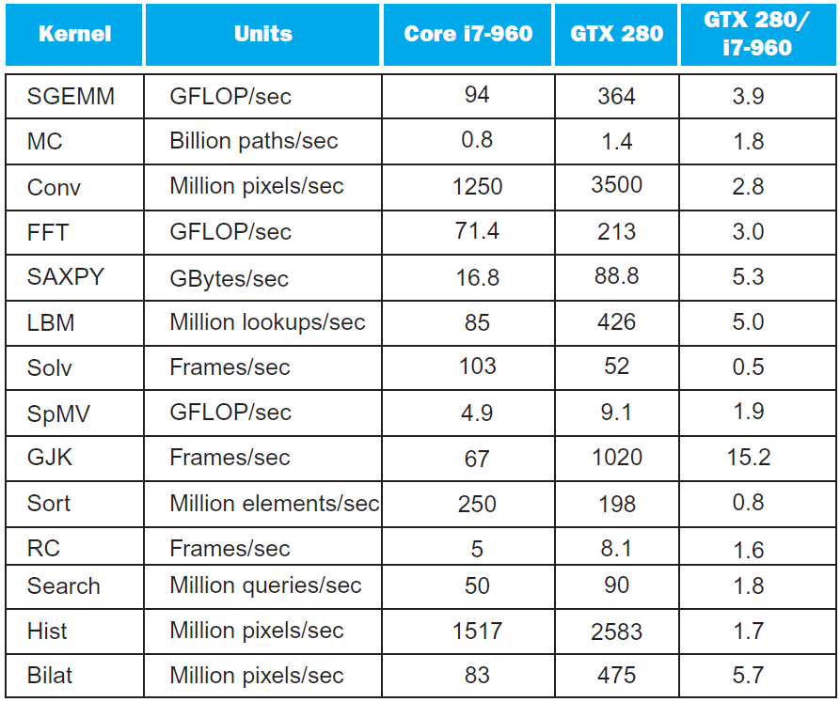
Benchmarks
Chapter 6 — Parallel Processors from Client to Cloud — <number>

Slide 52
Performance Summary
GPU (480) has 4.4 X the memory bandwidth
  Benefits memory bound kernels
GPU has 13.1 X the single precision throughout, 2.5 X the double precision throughput
  Benefits FP compute bound kernels
CPU cache prevents some kernels from becoming memory bound when they otherwise would on GPU
GPUs offer scatter-gather, which assists with kernels with strided data
Lack of synchronization and memory consistency support on GPU limits performance for some kernels
Chapter 6 — Parallel Processors from Client to Cloud — <number>

Slide 53
Multi-threading DGEMM
Use OpenMP:
void dgemm (int n, double* A, double* B, double* C)
{
#pragma omp parallel for
for ( int sj = 0; sj < n; sj += BLOCKSIZE )
for ( int si = 0; si < n; si += BLOCKSIZE )
for ( int sk = 0; sk < n; sk += BLOCKSIZE )
do_block(n, si, sj, sk, A, B, C);
}
§6.12 Going Faster: Multiple Processors and Matrix Multiply
Chapter 6 — Parallel Processors from Client to Cloud — <number>

Slide 54
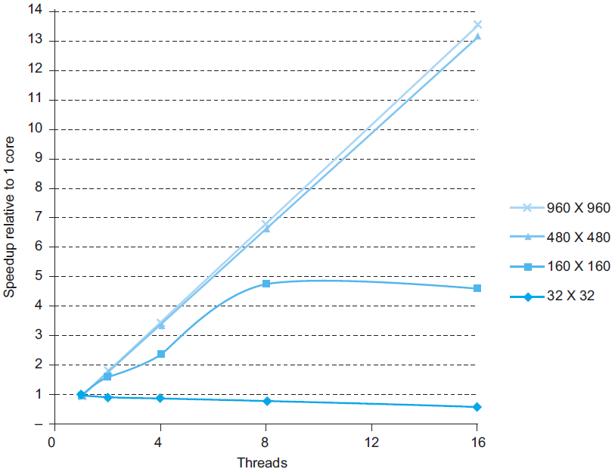
Multithreaded DGEMM
Chapter 6 — Parallel Processors from Client to Cloud — <number>

Slide 55
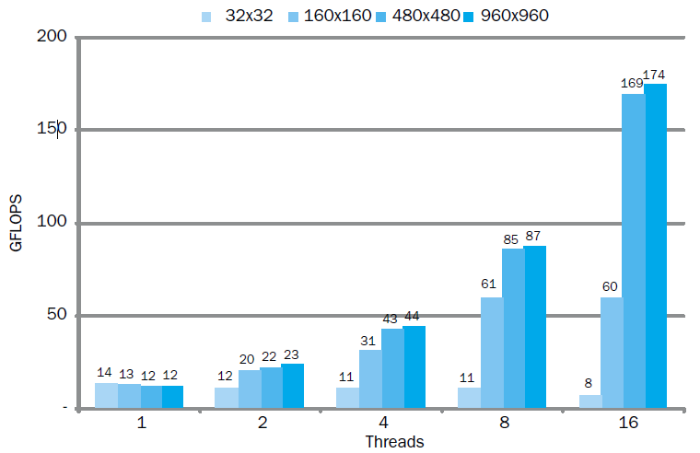
Multithreaded DGEMM
Chapter 6 — Parallel Processors from Client to Cloud — <number>

Slide 56
Fallacies
Amdahl’s Law doesn’t apply to parallel computers
  Since we can achieve linear speedup
  But only on applications with weak scaling
Peak performance tracks observed performance
  Marketers like this approach!
  But compare Xeon with others in example
  Need to be aware of bottlenecks
§6.13 Fallacies and Pitfalls
Chapter 6 — Parallel Processors from Client to Cloud — <number>
Notes:
Morgan Kaufmann Publishers
Chapter 7 — Multicores, Multiprocessors, and Clusters

Slide 57
Pitfalls
Not developing the software to take account of a multiprocessor architecture
  Example: using a single lock for a shared composite resource
    Serializes accesses, even if they could be done in parallel
    Use finer-granularity locking
Chapter 6 — Parallel Processors from Client to Cloud — <number>
Notes:
Morgan Kaufmann Publishers
Chapter 7 — Multicores, Multiprocessors, and Clusters

Slide 58
Concluding Remarks
Goal: higher performance by using multiple processors
Difficulties
  Developing parallel software
  Devising appropriate architectures
SaaS importance is growing and clusters are a good match
Performance per dollar and performance per Joule drive both mobile and WSC
§6.14 Concluding Remarks
Chapter 6 — Parallel Processors from Client to Cloud — <number>
Notes:
Morgan Kaufmann Publishers
Chapter 7 — Multicores, Multiprocessors, and Clusters
(焦耳)

Slide 59
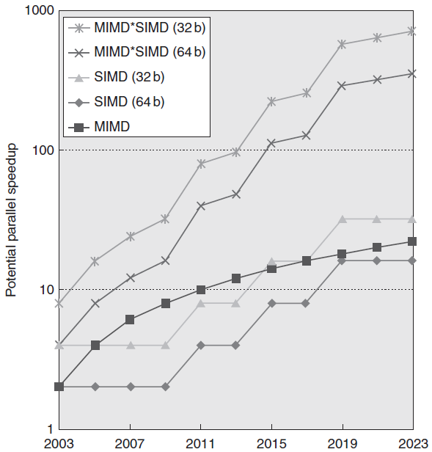
Concluding Remarks (con’t)
SIMD and vector operations match multimedia applications and are easy to program
Chapter 6 — Parallel Processors from Client to Cloud — <number>

Slide 60
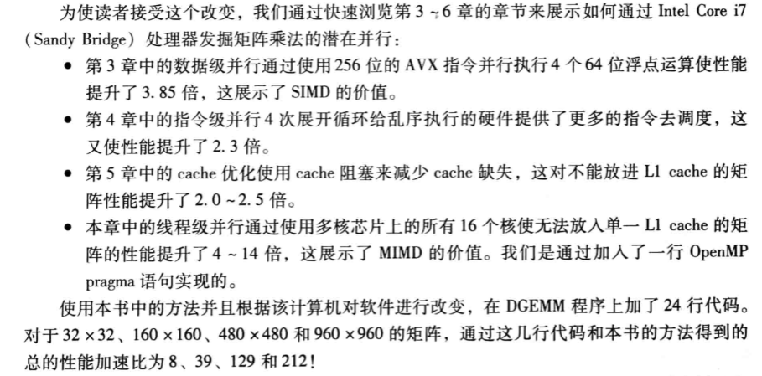
Concluding Remarks (con’t)
Chapter 6 — Parallel Processors from Client to Cloud — <number>

