Slide 1
Operating System
Chapter 2: Basic Concept and Prerequisite knowledge
GuangShun Shi
Department of Computer Science, NanKai University
Email: gsshi@nankai.edu.cn
Web Site: http://202.113.15.72/osteach

Slide 2
Computer Hardware Review
Processors: Architecture and Modes
Memory: Hierarchy of storage systems
I/O Devices: Clock, keyboard, monitor and hard disk
Buses: Organization of computer system
Operating System
CITS, NanKai University

Slide 3
History of Processors
The beginning of microprocessor
  1960s, Intel 4004 & Intel 440
  4bits, 4K address space, 45 instructions, 50KIPS
The beginning of modern microprocessor
  1971, Intel 8008: 8bits, 16K address space, 48 instructions, 50KIPS
  1973, Intel 8080 & 8085: 64K address space, ,246 instructions, 500KIPS
  1973, Motorola MC6800; Zilog Z80
16 bit microprocessor
  1978, Intel 8086; 1979, Intel 8088; 1983, Intel 80286
  16bits, 1MB address space, 20K instructions, 2.5MIPS & 4.0MIPS
32 bit & 64 bit microprocessor
  Intel 80386(1986), Intel 80486(1989), Intel Pentium(1993)
  32bits, 4GB address space, CISC & RISC, xGIPS
  64bits, 64PB address space,
Operating System
CITS, NanKai University

Slide 4
Structure of microprocessor
Execute unit
  Execute the specified instruction
Control unit
  Fetch instruction from memory to registers
  Maintain the status of CPU
  Data transfer between CPU and memory
Register and Cache
Pipeline
Operating System
CITS, NanKai University

Slide 5
Instruction cycle of processor
Fetch instruction from memory
  Program Counter stores the address of next instruction
  Processor fetch the instruction via memory access
Decode instruction
  Store the parameters of the instruction into registers
Execute instruction
  Instruction Register stores current instructions
  Integer, float and Boolean processors
Pipeline
  Sequence of circuit units to execute an instruction
Start
Fetch unit
Decode unit
Execute unit
End
Operating System
CITS, NanKai University

Slide 6
Guide line of processor’s capability
Frequency
  CPU clock speed = CPU socket speed * clock multiplier
  CPU socket speed: the times per second that transfer data from/to CPU, generated by mainboard
  Front side bus speed: the bandwidth that transfer data between “Northbridge” chip and CPU
  Clock multiplier
  Memory clock speed
Instruction set & Coprocessor
  CISC, RISC, EPIC
  Float processor, Boolean processor
Cache
  Level1& Level 2 cache: registers & buffers
Architecture
  Micro-architecture, Superscalar & super-pipeline
Technics
  45 nm: the nearest progress of processor designing
Operating System
CITS, NanKai University

Slide 7
Class examination
Assumption
  CPU word length = 64 bit
  Data transfer speed requirement:800 Mbytes / second
Please calculate the front side bus speed
Answer
  800Mbytes = FSB speed (MHZ) * 64 / 8
  FSB speed = 100MHZ
Chip type | CPU clock | Bits/clock | FSB | Multiplier | Speed
P4 2.4 | 100MHZ | 4 | 400MHZ | 24 | 2.4GHZ
P4 2.4A | 133MHZ | 4 | 533MHZ | 18 | 2.4GHZ
AthlonXp 2400 | 133MHZ | 2 | 266MHZ | 15 | 2.0GHZ
Operating System
CITS, NanKai University

Slide 8
Architecture of processor
CPU
算术
协处理器
CPU1
CPU2
算术
协处理器
8KB
一级高速缓存
16KB
一级高速缓存
80486DX结构
Pentium结构
CPU1
CPU2
CPU3
算术
协处理器
CPU1
CPU2
CPU3
算术
协处理器
16KB
一级高速缓存
32KB
一级高速缓存
256KB
二级高速缓存
512KB
二级高速缓存
Pentium Pro结构
Pentium II结构
Operating System
CITS, NanKai University

Slide 9
Superscalar and super-pipeline
Execute unit
Fetch unit
Decode unit
Holding Buffer
Execute unit
Fetch unit
Decode unit
Execute unit
Operating System
CITS, NanKai University

Slide 10
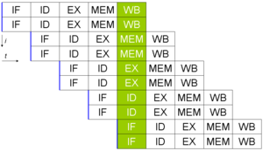
Superscalar pipeline
Operating System
CITS, NanKai University

Slide 11
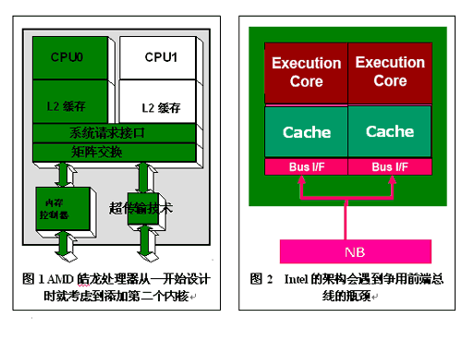
Architecture of processor
Operating System
CITS, NanKai University

Slide 12
Registers in CPU
Address register
  Store the address of data or instruction
Data register
  Store the operand/operator of instruction
Flag register
  Store the flags of operation
Control and status register
  Used by OS for managing CPU
Operating System
CITS, NanKai University

Slide 13
Registers in CPU (privileged)
Program counter
  The register that stores address of next instruction
  Each process has its private PC value
Instruction register
  Stores the instruction to be executed
  Each process has its private IC value
Program status word
  The register that stores flags and conditions of CPU working status
  PSW is the most important part of CPU context
Operating System
CITS, NanKai University

Slide 14
Essential of CPU
Rank of CPU instruction
  R0: privileged instruction only used by OS
  R1: important device driver and I/O routine
  R2: protected program, such as IDE
  R3: user space for common program
Working mode of CPU
  Kernel mode & User mode
“Trap”
  Switch the mode of CPU from “user” mode to “kernel” mode
Operating System
CITS, NanKai University

Slide 15
Essential of CPU
Proc 1
Program counter
Program status word
Instruction register
PU
Proc 2
Program counter
Program status word
Instruction register
Operating System
CITS, NanKai University

Slide 16
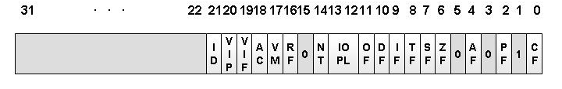
PSW of Intel CPU
标准条件位：
TF：陷阱标志位
IF：中断允许（中断屏蔽）标志位
VIF：虚拟中断标志位
VIP：虚拟中断待决标志位
IOPL：IO特权级别
CF： 进位标志位
ZF： 结果为零标志位
SF： 符号标志位
OF： 溢出标志位
Operating System
CITS, NanKai University

Slide 17
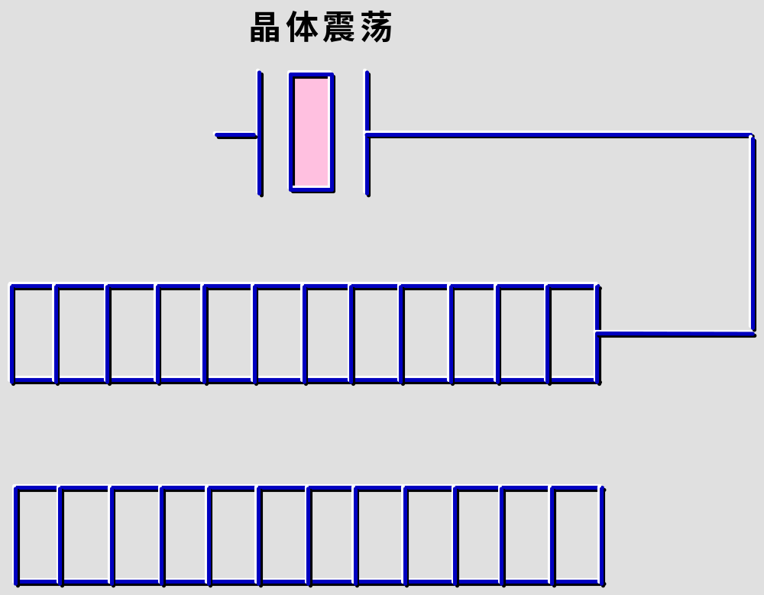
Clock and clock interrupts
每个脉冲使计数器减1，归零则产生时钟中断
用来装入计数器初值
Operating System
CITS, NanKai University

Slide 18
Clock in computer
What dose time means in computer
  The speed of operation and execution
  The criterion of resource management
  The bandwidth of data transfer
  The record of real time
Components of programmable clock
  Crystal oscillator: physical component
  Counter: decremented at each pulse
  Holding register: record the initial value of counter
One-shot clock and square-wave clock
  One-shot clock: controlled by OS software
  Square-wave clock: generate periodic signal
  Clock tick: periodic interrupts
Operating System
CITS, NanKai University

Slide 19
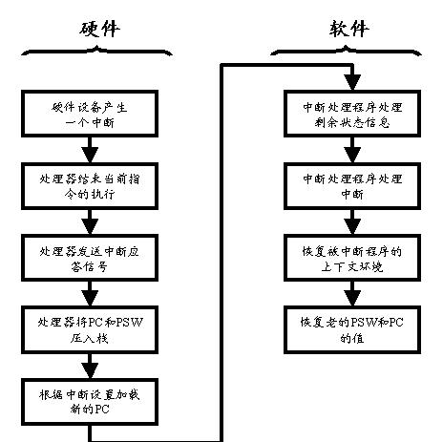
Essential of Interruption
Operating System
CITS, NanKai University

Slide 20
Essential of Interruption
取周期
执行周期
中断周期
不允许中断
取下一条指令
执行指令
检查指令
处理中断
开始
允许
中断
停止
Operating System
CITS, NanKai University

Slide 21
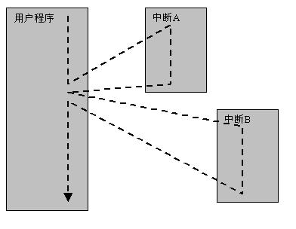
Essential of Interruption (unnested)
Operating System
CITS, NanKai University

Slide 22
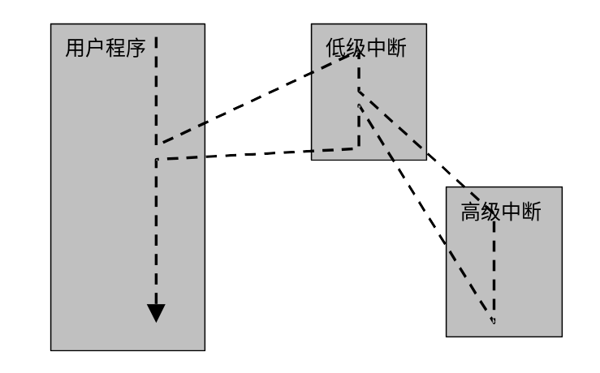
Essential of Interruption (nested)
低优先级中断嵌套高优先级中断的处理流程
Operating System
CITS, NanKai University

Slide 23
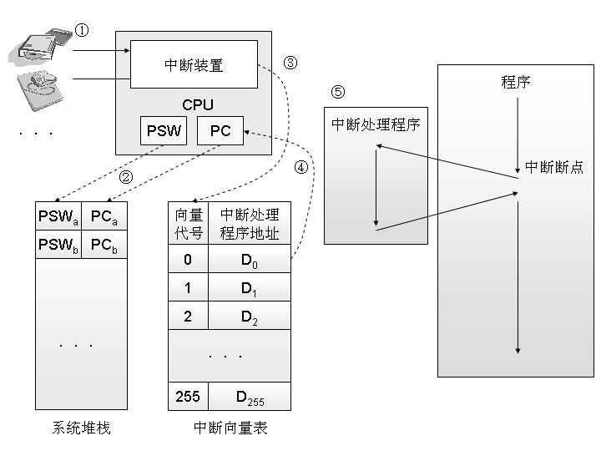
Essential of Interruption
Operating System
CITS, NanKai University

Slide 24
Interrupt, Exception and trap
Exception
  Errors found by hardware, caused by program
  Divide by 0, floating-point underflow, access denied
  The exception will be handled by OS in kernel mode, or informed to the program and handled by user program
Interrupt
  Signal sent from hardware to CPU
  CPU finds and invokes interrupt handler (kernel mode)
  In time-sharing OS, the interrupts are handled in clock interrupt function
System call
  Interface provided by OS to allow programs obtaining some system service
  “Trap” instruction will trap into kernel mode and invoked OS to execute service
Operating System
CITS, NanKai University

Slide 25
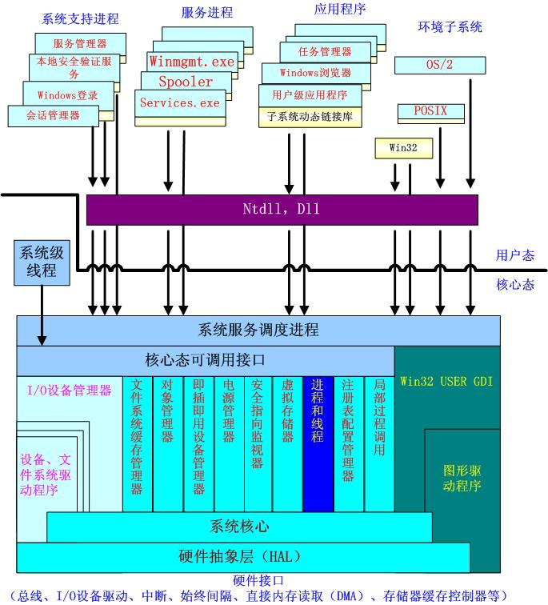
Operating System
CITS, NanKai University

Slide 26
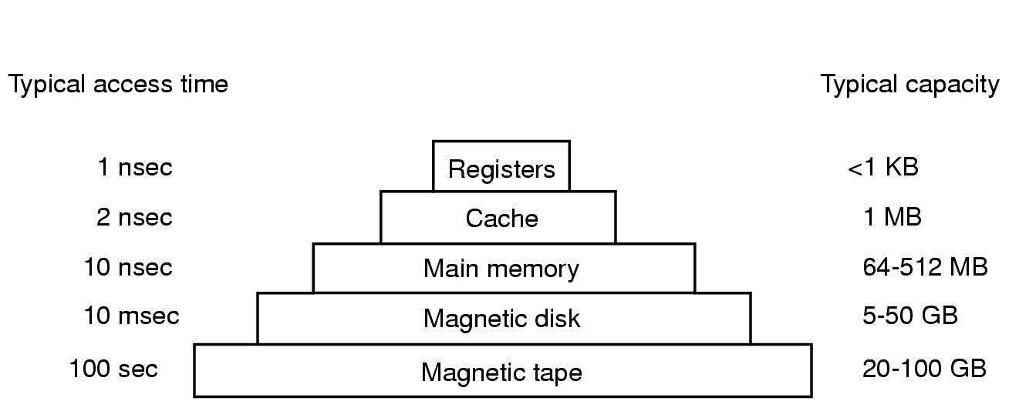
Storage system in computer
Operating System
CITS, NanKai University

Slide 27
Strategy of storage system
Guide lines for storage system
  Speed: should be not slower than CPU speed
  Size: should be enough large that can store everything
  Cost: should not be expensive for most customers
Strategy for a reasonable storage system
  Local optimal principle
  Hierarchy architecture
Various kinds of memory
  Register, RAM, SRAM, DRAM, SDRAM, DDR
  ROM, PROM, EPROM, EEPROM, CMOS
  Flash memory
Operating System
CITS, NanKai University

Slide 28
Local optimal principle
A story about Yangguo and Xiaolongnv
  The answer exists around the question
Local optimal principle in address space
  The address of next instruction should be adjacent to current instruction
Local optimal principle in time sequence
  The instruction used recently should be used again in the near future
Principle of Cache design
  Only stores the instructions that belong to a local region, both in address space and time sequence
  Small size and slow speed, but higher performance and cheap price
Operating System
CITS, NanKai University

Slide 29
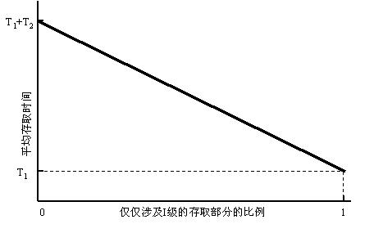
Local optimal principle
Operating System
CITS, NanKai University

Slide 30

Architecture of Computer
Operating System
CITS, NanKai University

Slide 31
North bridge and south bridge
North bridge
  Transfer data between CPU and memory/AGP
  More expensive, faster and complicated
South bridge
  Transfer data between I/O buses and devices
  Cheap, slow and cheap
The communication between I/O and CPU
  CPU don’t access I/O device directly
  Some special mechanisms are designed for the link between north bridge and south bridge (DMA, I/O channel)
  Intel Hub Architecture, SIS Multithread(妙渠)
Operating System
CITS, NanKai University

Slide 32
Thanks for your time!
Questions & Answers
Operating System
CITS, NanKai University

