Slide 1
Vector Space Model

Slide 2
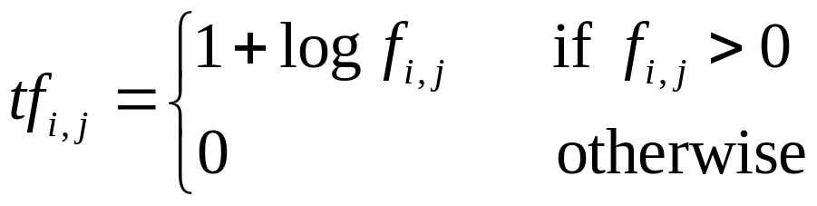
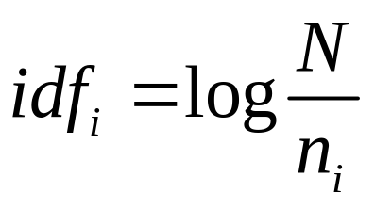
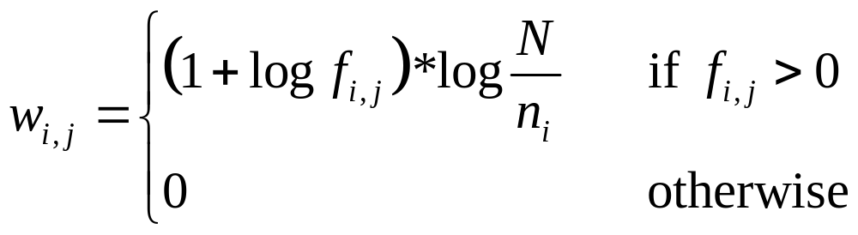
TF-IDF Weighting
Bag of words view of a document
Term Frequency Weights
  tf_{i,j} is the frequency of term k_{i} in document d_{j}
Inverse Document Frequency Weights
TF-IDF Weighting

Slide 3
Example collection
To do is to be.
To be is to do.
To be or not to be.
I am what I am.
d₁
d₂
Do do do, da da da.
Let it be, let it be.
I think therefore I am.
Do be do be do.
d₃
d₄

Slide 4
Term frequencies and log tf weight for the example collection
# | term |  | f_{i,1} | f_{i,2} | f_{i,3} | f_{i,4} |  | tf_{i,1} | tf_{i,2} | tf_{i,3} | tf_{i,4}
1 | to |  | 4 | 2 | - | - |  | 3 | 2 | - | -
2 | do |  | 2 | - | 3 | 3 |  | 2 | - | 2.585 | 2.585
3 | is |  | 2 | - | - | - |  | 2 | - | - | -
4 | be |  | 2 | 2 | 2 | 2 |  | 2 | 2 | 2 | 2
5 | or |  | - | 1 | - | - |  | - | 1 | - | -
6 | not |  | - | 1 | - | - |  | - | 1 | - | -
7 | I |  | - | 2 | 2 | - |  | - | 2 | 2 | -
8 | am |  | - | 2 | 1 | - |  | - | 2 | 1 | -
9 | what |  | - | 1 | - | - |  | - | 1 | - | -
10 | think |  | - | - | 1 | - |  | - | - | 1 | -
11 | therefore |  | - | - | 1 | - |  | - | - | 1 | -
12 | da |  | - | - | - | 3 |  | - | - | - | 2.585
13 | let |  | - | - | - | 3 |  | - | - | - | 2
14 | it |  | - | - | - | 2 |  | - | - | - | 2
Doc Size(# words) |  |  | 10 | 11 | 10 | 12

Slide 5
IDF values for example collection
# | term | n_{i} | IDF_{i}=log(N/n_{i})
1 | to | 2 | 1
2 | do | 3 | 0.415
3 | is | 1 | 2
4 | be | 4 | 0
5 | or | 1 | 2
6 | not | 1 | 2
7 | I | 2 | 1
8 | am | 2 | 1
9 | what | 1 | 2
10 | think | 1 | 2
11 | therefore | 1 | 2
12 | da | 1 | 2
13 | let | 1 | 2
14 | it | 1 | 2

Slide 6
TF-IDF weights for example collection
# | term | d₁ | d₂ | d₃ | d₄
1 | to | 3 | 2 | - | -
2 | do | 0.830 | - | 1.073 | 1.073
3 | is | 4 | - | - | -
4 | be | - | - | - | -
5 | or | - | 2 | - | -
6 | not | - | 2 | - | -
7 | I | - | 2 | 2 | -
8 | am | - | 2 | 1 | -
9 | what | - | 2 | - | -
10 | think | - | - | 2
11 | therefore | - | - | 2 | -
12 | da | - | - | - | 5.170
13 | let | - | - | - | 4
14 | it | - | - | - | 4
Doc Size(vector norms) |  | 5.068 | 4.899 | 3.762 | 7.738

Slide 7
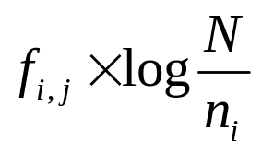
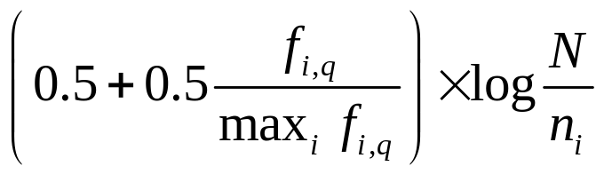
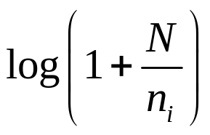

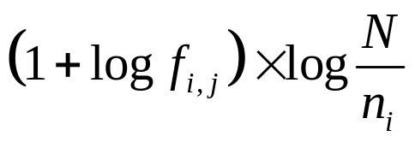

Recommended TF-IDF weighting schemes
weighting scheme | document term weight | query term weight
1
2
3
Scheme 3 is adopted in this slides.

Slide 8
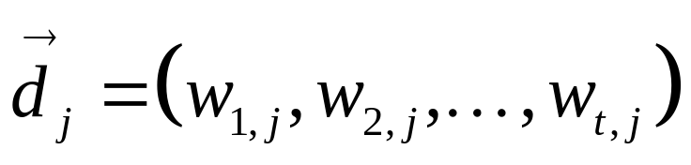
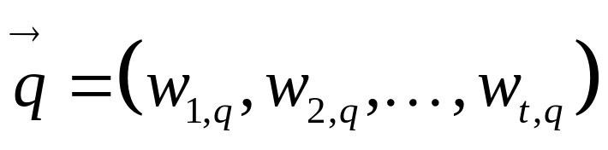
Vector Model
Representations of document d_{j} and query q are t-dimensional vectors given by

Slide 9
Why turn docs into vectors?
First application: Query-by-example
  Given a doc d, find others “like” it.
Now that d is a vector, find vectors (docs) “near” it.

Slide 10
Intuition
t₃
d₂
d₃
d₁
θ
φ
t₁
d₅
t₂
d₄
Postulate: Documents that are “close together”
in the vector space talk about the same things.

Slide 11
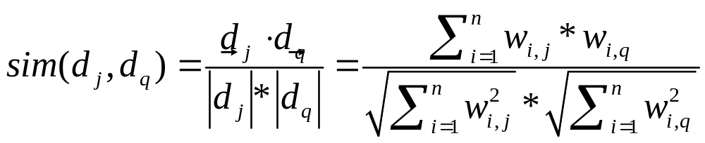
Queries in the vector space model
Central idea: the query as a vector:
Regard the query as short document
Return the documents ranked by the closeness of their vectors to the query, also represented as a vector.
Note that d_{q} is very sparse!
How to compute cosine similarity efficiently?
Omitted while all the query words have almost the same weight.
Preprocess offline. Load into memory to fasten similarity computation when online search.
Omitted because it remains the same value to all documents.

Slide 12
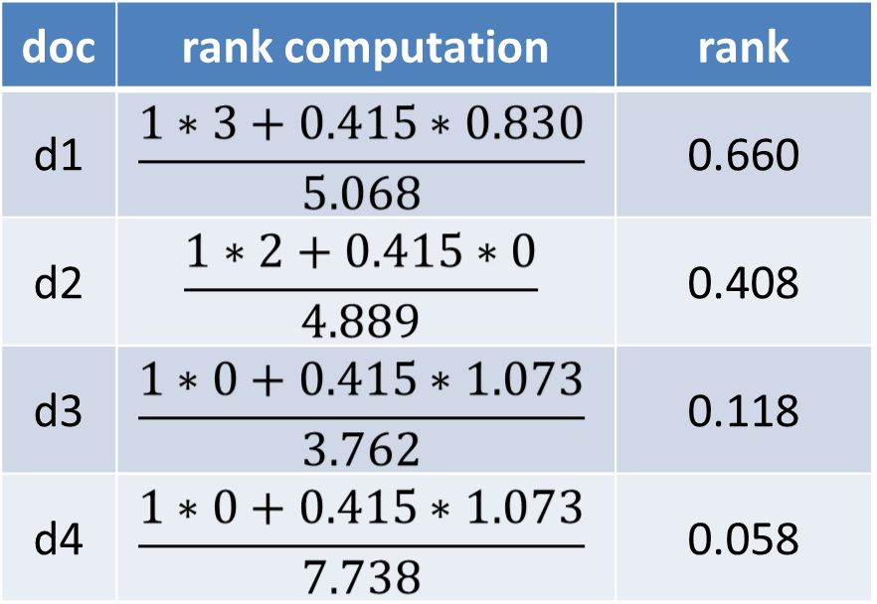
Document ranks example
Document ranks computed by the vector model for the query “to do”
To do is to be.
To be is to do.
d₁
To be or not to be.
I am what I am.
d₂
Do do do, da da da.
Let it be, let it be.
d₃
I think therefore I am.
Do be do be do.
d₄

Slide 13
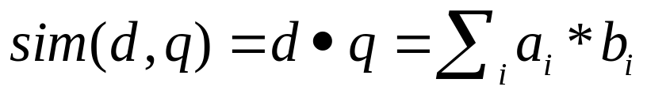
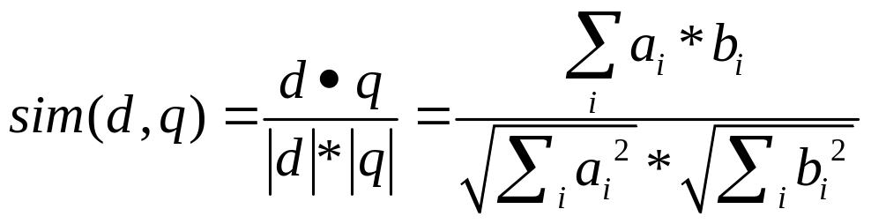
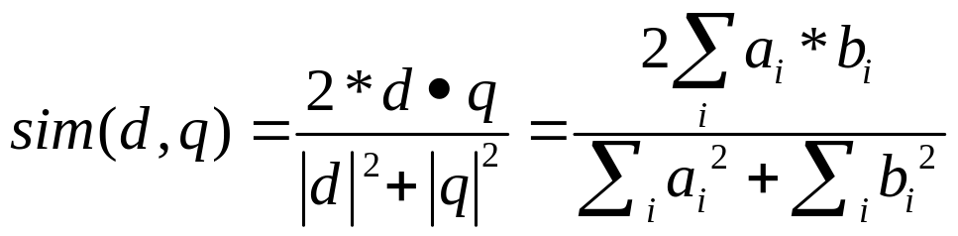
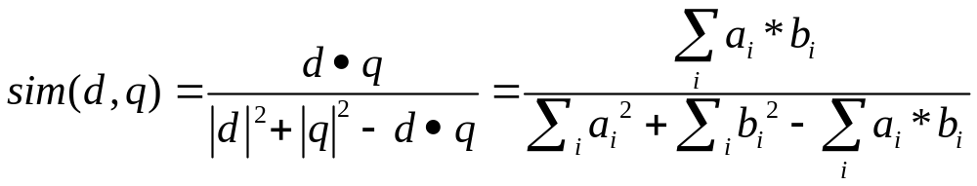
Similarity Computation Methods
Dot product
Cosine
Dice
Jaccard
Cosine similarity is adopted in this slides.

Slide 14
How about VSM?
Effective and Efficient, applied in Text Classification, Bioinformatics, etc
Support partial / approximate match, result ranking
But
Lack of theory support
Term independent assumption, not always true

Slide 15

Computing cosine scores
Sec. 6.3

Slide 16
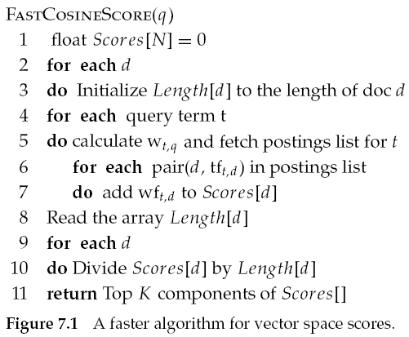
Faster cosine: unweighted query
Sec. 7.1

