Slide 1
Debug Plan Checker Introduction

Slide 2
Scope
It is for pre-action for pattern validation. To find out error in Debug Plan in advance and prevent failure when doing pattern validation.
The error of debug plan will block pattern validation tool, but warning would not.

Slide 3
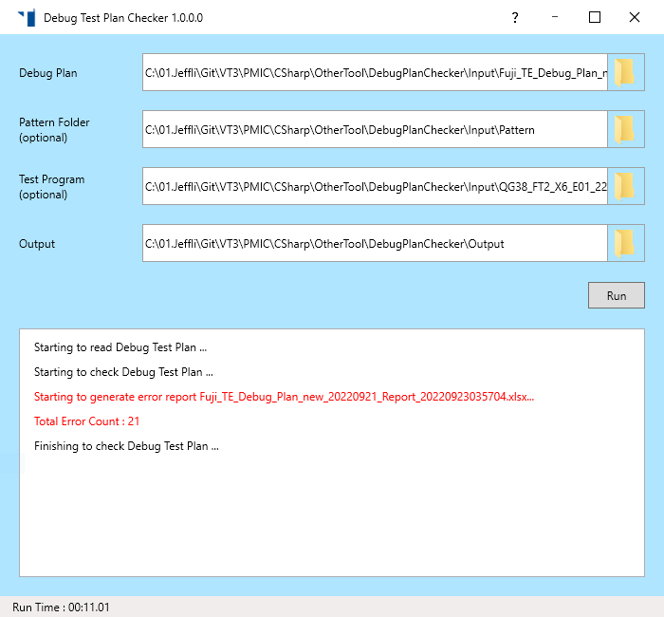
Work Flow in Debug Plan
Step1 : Provide input files (debug plan/Pattern folder/Test program)
Step2 : Setup output folder
Step3 : Click “Run”
Step1
Step2
Step3

Slide 4
Sheet in Debug Plan
Type of Sheet
Pattern Dashboard : That sheet name is “Pattern_dashboard”
Process Condition : That sheet name is “Process_Condition” (On going)
AI Test Plan Sheet
The “A1” cell should be “AITestPlanSheet;version=[#];”, so this sheet can be recognized as AI Test Plan Sheet
.

Slide 5
Format Pattern Dashboard
Header
# : For reference only
Pattern : Generic pattern name
Use/No use : For reference only
Timeset Latest : Provide full file name of TimeSet, that has version
File Versions : Pattern name with version and date

Slide 6
Check for Pattern Dashboard
Check if “File Versions” is in pattern folder (Need assign pattern folder)
Check if “Timeset Latest” is in pattern folder (Need assign pattern folder)

Slide 7
Format of AI Test Plan Sheet
Header
Use/Not Use : Only “Use” can create test instance, other will be ignored
Comment : For reference only
Test instance name : If it is duplicated, pattern validation tool will add “SheeName_Row#” as prefix.
AI type : Only allow “Data log”,”1D”,”2D”
Data logging setting : Only allow “NA”,” DFC (-0.01,-0.02)”,” 512 FC”
Timeset : new timeset name with version
SELSRAM_DSSC : source bites of SELSRAM_DSSC, and starts with “SELSRM”. (Ex. SELSRMSSSSS)
Voltage Category : DC spec in the test program and DC selector (LV/NV/HV)
(Ex. “Sa_GFX_X_X_CSOC LV)
Pattern# : It can generic pattern name in dashboard or pattern name with date.

Slide 8
Format of AI Test Plan Sheet
Header
PIN : It can be pin in pin map or symbol in AC spec
Start/Stop/Step : It can be number or number with unit. (Voltage(V) for pin only and Frequency(Hz) for AC only)
Order :Define the sequence of shmoo. If it is empty, the sequence will follow the left to right. (Ex. VDD_ECPU,VDD_PCPU)
Search : Define the test method of shmoo. (Ex. 2D shmoo => Jump 2;Linear)
Temp. Condition (TBD)
pin

Slide 9
Check for AI Test Plan Sheet
Check Syntax for “Use/Not Use”
Check Syntax for “AI type”

Slide 10
Check for AI Test Plan Sheet
Check Syntax for “Data logging setting”
Check if “Timeset” is in pattern folder or test program (Need assign pattern folder & test program)

Slide 11
Check for AI Test Plan Sheet
Check if “Pattern” is in pattern folder (Need assign pattern folder)
Check if “pin” is pin map or ac spec (Need assign test program)

Slide 12
Check for AI Test Plan Sheet
Check syntax for start/stop/step
Check if the count of “order” match AI Type
Check if syntax for “order’

Slide 13
Check for AI Test Plan Sheet
Check Y shmoo can not be “Jump”
Check if the step of “Jump” exceed total steps
Only 5 step, but jump 6

