Slide 1
Use InputInfo to run Autogen.bat
Kevin Chang

Slide 2
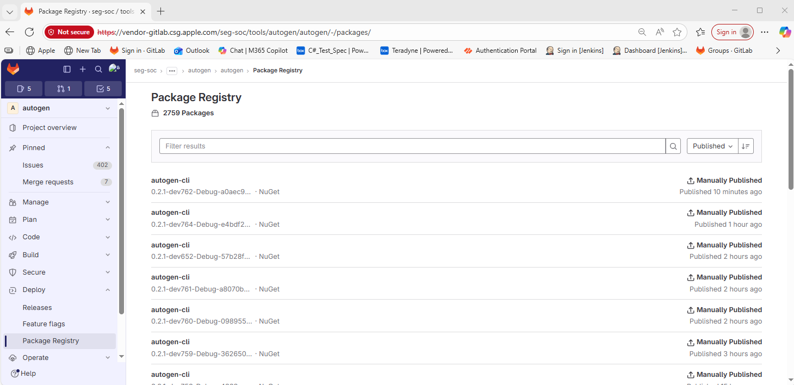
Process Flow
Browse Autogen gitlab page and download the latest version of Autogen Tool

Slide 3
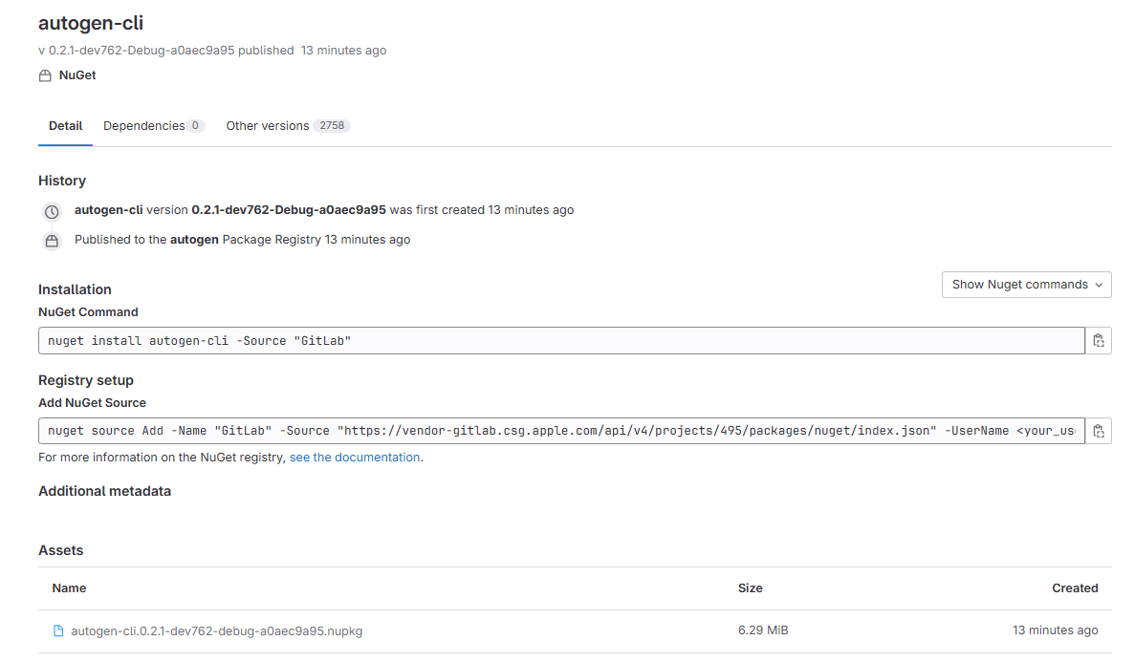
Process Flow
Click and download the Autogen Tool, then change files’ extensions to “.zip”

Slide 4
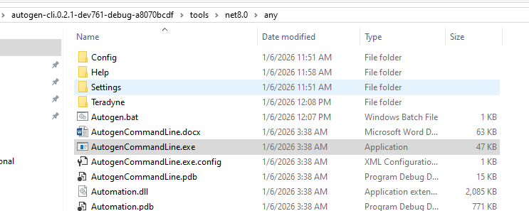
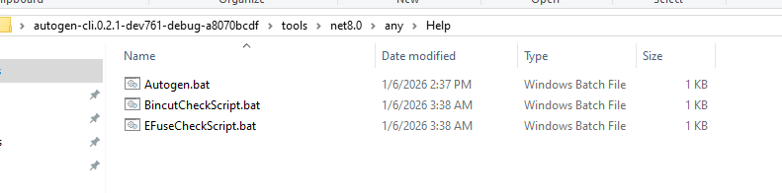
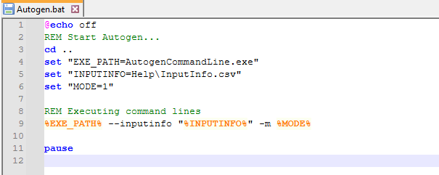
Process Flow
Click the batch file to run Autogen with InputInfo.csv file
Autogen program
Bat file
Modify content in InputInfo.csv file

Slide 5
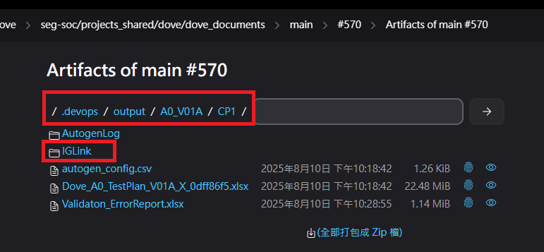
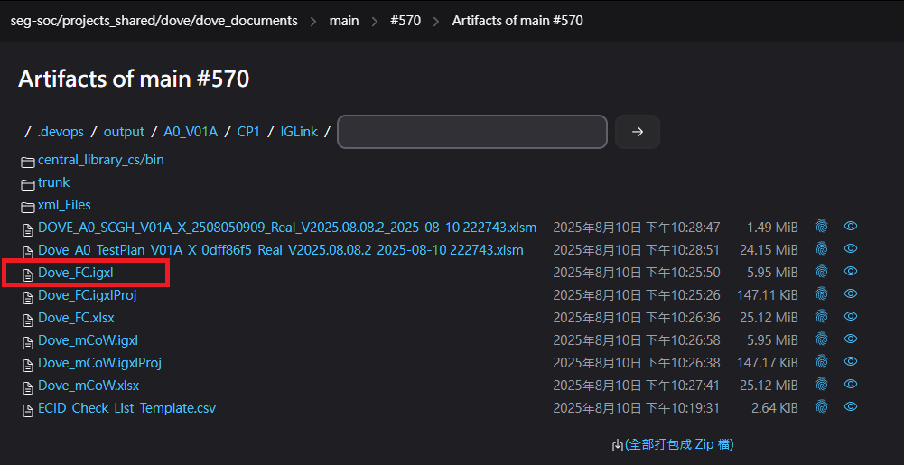
Process Flow
Access to the IGLink folder and download the central lib.
Version of central lib

Slide 6
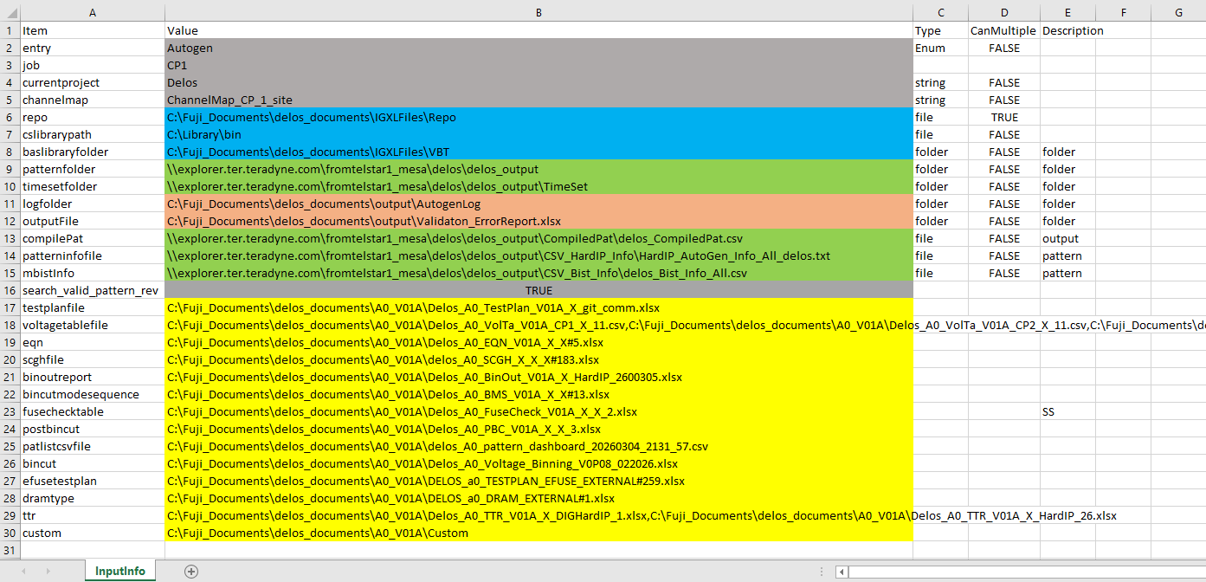
InputInfo content
Please modify all path references in the csv file to use absolute paths on the local PC.
Testplan Document
System Config
Library files
Sync files from Org/Fuji
Log files

Slide 7
Parameters in Testplan Document
Parameter | Description
entry | Autogen Tool
job | Stage
currentproject | Test Chip
channelmap | ChannelMap file
repo | Repo Folder
cslibrarypath | Library Folder
baslibraryfolder | VBT Library Folder
patternfolder | Pattern folder
timesetfolder | Timeset folder
logfolder | Autogen Tool log
outputFile | Validation error report file
compilePat | Compile Pattern File
patterninfofile | HardIP pattern info file
mbistInfo | Mbist info file
search_valid_pattern_rev | Control pattern check by True or False
testplanfile | Testplan file
voltagetablefile | Voltage table files
eqn | EQN file
scghfile | SCGH file
binoutreport | Binout report file
bincutmodesequence | BMS file
fusechecktable | Fusecheck table file
postbincut | PBC file
patlistcsvfile | Pattern dashboard file
bincut | Voltage binning files
efusetestplan | Testplan EFUSE exeternal file
dramtype | DRAM exeternal file
ttr | TTR table files
custom | Custom folder

Slide 8
Thank you

