Slide 1
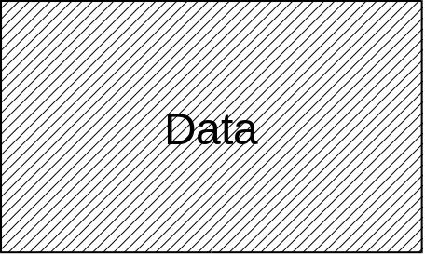
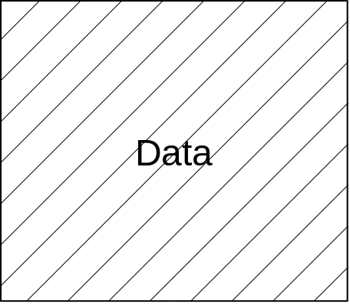
DDE Buffer Management
TComVar cv
InBuffSize(1KB)
HLogBuf pointer
LogBuf pointer
LogPtr
Data time order
LStart
- DDE buffer is a ring buffer style.
- The oldest data is overwritten when
the buffer is no space available.
- Both the log buffer and the DDE buffer
are shared.
- The DCount byte at the offset from
the DStart is available.
- The LStart and DStart is same, and
the LCount and DCount is same
when logging and macro execution
are used at the same time.
LCount
Latest Data
DStart
DCount
DDE buffer space available
InBuffSize(1KB)
HLogBuf pointer
LogBuf pointer
LogPtr
LStart
LCount
Latest Data
DStart
DCount
Data time order
DDE buffer no space available

