Slide 1

Teradata TechBytes
Using Python with Teradata Vantage
Part 1: Introduction - Connections
Alexander Kolovos – Product Engineering, Teradata
Tim Miller – Advanced Analytics Product Management, Teradata
Version 2
May 2021
Notes:
Teradata TechBytes Series: Using R and Python with Teradata Vantage 1.1
Audience: Technical
Hello, and welcome to another edition of Teradata TechBytes. My name’s Tim Miller, and I work in Teradata’s Technology and Innovation Office. Today we’re going to talk about how Teradata’s Vantage platform support the R and Python languages for data science and analytics. This is the first of a five part TechBytes series on this topic which will provide you an overview of all the capabilities in Vantage for R and Python. My co-host for the series is Alexander Kolovos the analytic architect from Teradata’s Product Development organization.

Slide 2


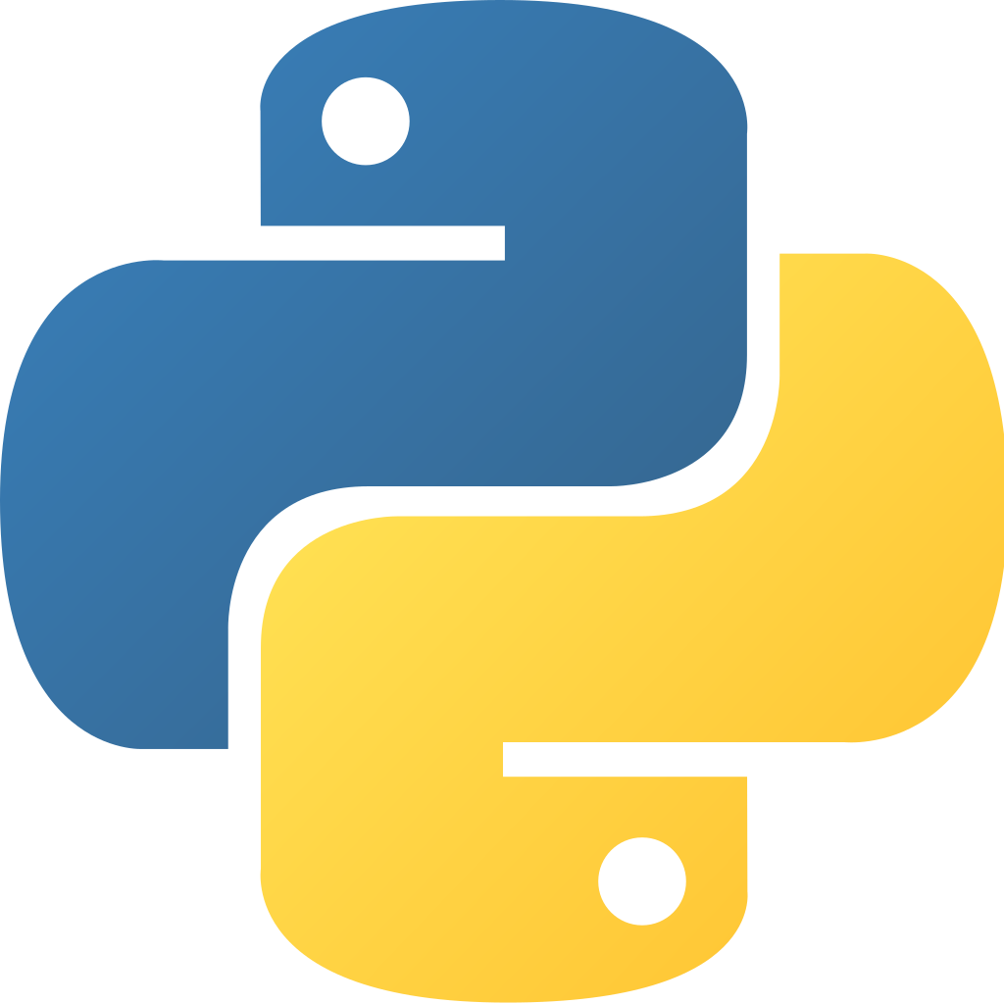
R and Python EcoSystem In Teradata Vantage
Scalability, Performance, Operationalization
R and Python analytics: Prominent position in Vantage. The Vantage parallel architecture
  provides an architectural scaling pathway for the principally single-threaded, memory-bound languages.
  unleashes performant execution of complex analytics on large data sets.
  alleviates the interpretative language overhead.
  facilitates productionization of R and Python workflows.
A pharmaceutical company tried to build a R regression model against 200,000 observations which took 5 hours! The same function was run against 1,200,000 observation and was aborted after 8 hours.
A retailer with 30,000 stores, each with 152 demographic variables encountered a memory error when building a store segmentation model on their existing Python infrastructure.
…many analytic teams rely on tools and approaches that will not scale…These teams lack a repeatable, efficient process for creating and effectively deploying predictive analytic models into production. To succeed they need to operationalize analytics.
- James Taylor, CEO Decision Management Solutions
Notes:
The three most important reasons for using R and Python with Vantage are:
Performance
Scalability
Operationalization
Although adoption of both these languages in the data science community is staggering, they are not without their issues:
R is Single Threaded, Memory Bound
Both R and Python have the overhead of an interpretative language
Complex analytics on large data sets can run slow (or not at all)
As a result, productization of R and Python analytic workflows can be difficult
Teradata has worked with many customers on these concerns. You see two such examples here in retail and pharma that really illustrate the statements made above.
Most importantly, because of these reasons as well as others, many analytics teams struggle with putting these complex workloads into production as eloquently stated by James Taylor.
As a result, often times R and Python are on the outside looking in when it comes to pervasive data intelligence. With the Vantage Platform, Teradata provides the foundation for the performance and scalability you need to operationalize your analytics!

Slide 3
Python In Teradata Vantage
Powerful tools for Python users
The Teradata Package for Python teradataml is the master key for Python analytics in Vantage. Core features include:
  Vantage connectivity through the Advanced SQL Engine Database.
  The teradataml DataFrame object that lends from the pandas DataFrame for efficient data handling.
  Interoperability with the popular SQLAlchemy library for relational databases.
  A broad collection of utility and database management functions for pythonic interaction with Vantage.
  Data manipulation with SQL-like grammar via Python methods and operators.
  Python wrapper functions for a wealth of analytic functions and tools in Vantage, including:
    Advanced SQL Engine and Machine Learning Engine functions.
    Vantage Analytics Library functions.
    SQL functions in the Database via the SQLAlchemy extension.
  Model Cataloging facilities to save, administer, and reuse the models you build on Vantage.
  An interface to the SCRIPT Table Operator Database object to push and run Python scripts natively in-Database, and a Docker-based Sandbox environment to test your scripts on the client in advance.
  Additional features include time series aggregates, map functions for row- and partition-based tasks, etc.
The latest version of the teradataml library is available on the PyPI repository.
Extensive documentation and examples available at docs.teradata.com.
Notes:
First lets talk about the assumptions being made regarding the content of this TechByte as well as the key takeaways we hope all listeners walk away with.
First off, you should have a good understanding of either the R or Python languages – ideally both.
Second, you should understand the Teradata Vantage platform. Please see the TechByte episode “The Next Step in Analytics: Teradata Vantage” from my colleague Rob Armstrong if you have not yet been exposed to Vantage.
Key takeaways from this TechByte include:
Understand the motivation behind Teradata’s Vantage R and Python integration
3 ways to utilize R and Python on Vantage, and the 2 ways Vantage provides performance and scalability to get to a path to production
R or Python can operate externally on directly on the Vantage platform and that there are pros and cons to each.
The Vantage libraries for R and Python leverage the best of open source and Teradata technology.

Slide 4
The Python In Teradata Vantage TechBytes Series
Assumptions, Takeaways, and Overview
Assumptions
  Good understanding of the Python language
  General understanding of the Teradata Vantage platform
    See TechBytes - The Next Step in Analytics: Teradata Vantage
The key takeaway is to illustrate operating with Python on the Vantage platform from your client.
There are 4 parts in the Python In Teradata Vantage TechBytes Series:
  Part 1: Introduction
  Connecting to a Vantage Advanced SQL Engine Database with teradataml
  Basic operations
  Part 2: Data Exploration and Transformations
  Building an Analytic Data Set (ADS)
  Part 3: Modeling with Vantage Analytic Functions
  Model Cataloging
  Part 4: In-Database scripting with the SCRIPT Table Operator
  Map functions
  Each part comprises of a demo that illustrates corresponding features.
Notes:
First lets talk about the assumptions being made regarding the content of this TechByte as well as the key takeaways we hope all listeners walk away with.
First off, you should have a good understanding of either the R or Python languages – ideally both.
Second, you should understand the Teradata Vantage platform. Please see the TechByte episode “The Next Step in Analytics: Teradata Vantage” from my colleague Rob Armstrong if you have not yet been exposed to Vantage.
Key takeaways from this TechByte include:
Understand the motivation behind Teradata’s Vantage R and Python integration
3 ways to utilize R and Python on Vantage, and the 2 ways Vantage provides performance and scalability to get to a path to production
R or Python can operate externally on directly on the Vantage platform and that there are pros and cons to each.
The Vantage libraries for R and Python leverage the best of open source and Teradata technology.

Slide 5
The Python In Teradata Vantage TechBytes Series
Assumptions, Takeaways, and Overview
Assumptions
  Good understanding of the Python language
  General understanding of the Teradata Vantage platform
    See TechBytes - The Next Step in Analytics: Teradata Vantage
The key takeaway is to illustrate operating with Python on the Vantage platform from your client.
There are 4 parts in the Python In Teradata Vantage TechBytes Series:
  Part 1: Introduction
  Connecting to a Vantage Advanced SQL Engine Database with teradataml
  Basic operations
  Part 2: Data Exploration and Transformations
  Building an Analytic Data Set (ADS)
  Part 3: Modeling with Vantage Analytic Functions
  Model Cataloging
  Part 4: In-Database scripting with the SCRIPT Table Operator
  Map functions
  Each part comprises of a demo that illustrates corresponding features.
Notes:
First lets talk about the assumptions being made regarding the content of this TechByte as well as the key takeaways we hope all listeners walk away with.
First off, you should have a good understanding of either the R or Python languages – ideally both.
Second, you should understand the Teradata Vantage platform. Please see the TechByte episode “The Next Step in Analytics: Teradata Vantage” from my colleague Rob Armstrong if you have not yet been exposed to Vantage.
Key takeaways from this TechByte include:
Understand the motivation behind Teradata’s Vantage R and Python integration
3 ways to utilize R and Python on Vantage, and the 2 ways Vantage provides performance and scalability to get to a path to production
R or Python can operate externally on directly on the Vantage platform and that there are pros and cons to each.
The Vantage libraries for R and Python leverage the best of open source and Teradata technology.

Slide 6
Using Python with Teradata
Part 1: Demo

Slide 7
Notes:
This concludes Part 1 of Using R and Python with Teradata Vantage – Overview

