Slide 1

Automated Table Onboarding to Kafka Using Oracle GoldenGate REST APIs
A Step-by-Step API Workflow for Real-Time Data Replication

Slide 2

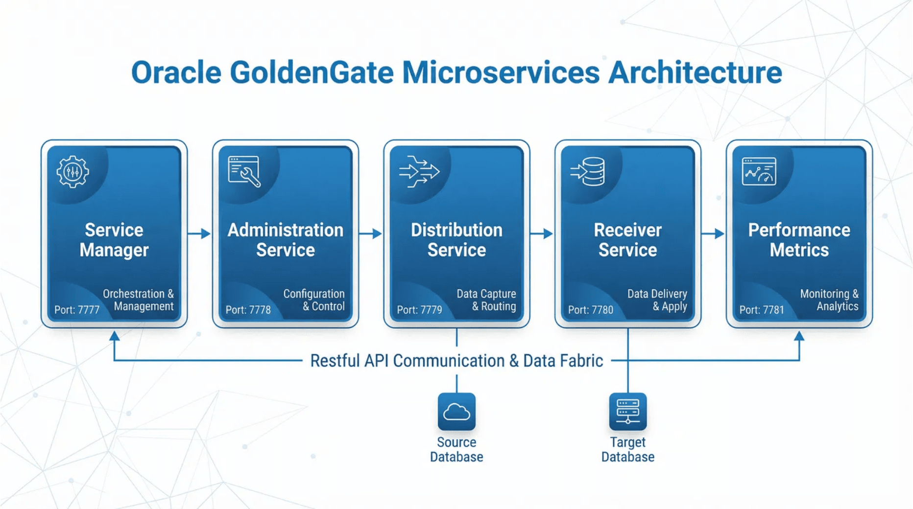
GoldenGate Microservices Architecture
Enabling Full API Automation Across All Services
Service Manager (9100)
Admin Service (10100)
Distribution (10101)
Central orchestration point for all services and deployments.
Manages Extract & Replicat processes via REST API.
Routes trail files from source to target deployments.
Flow: Source DB Deployment → Distribution → Big Data Deployment → Kafka

Slide 3
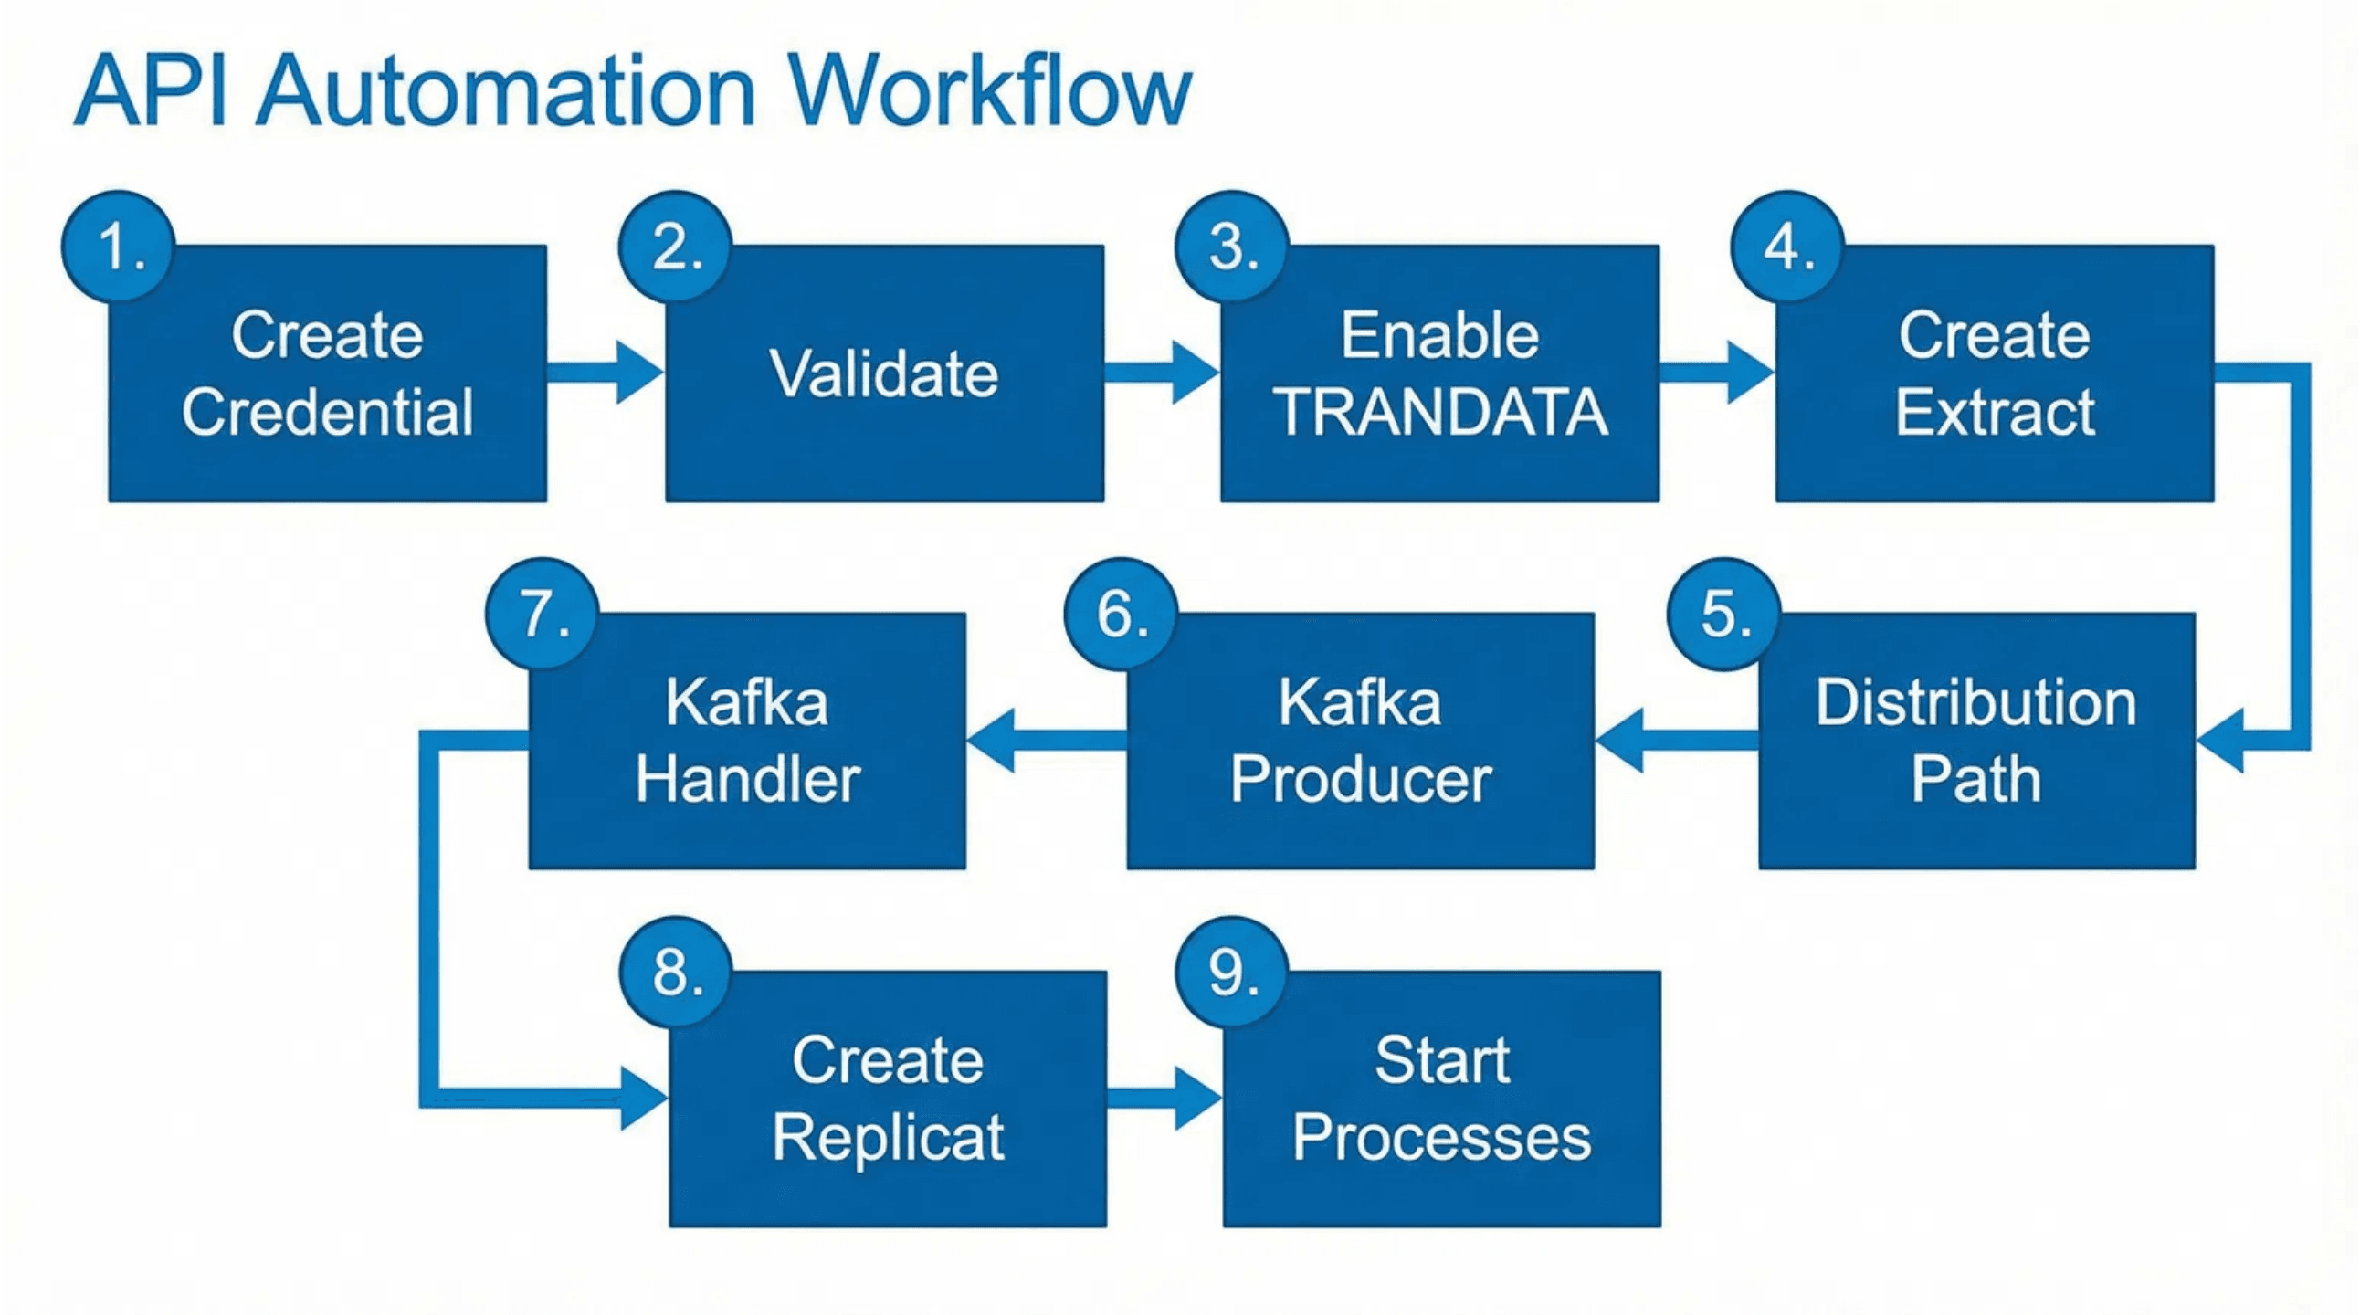
Complete API Workflow
9 Sequential Steps for Automated Table Onboarding
Source Admin Service (10100)
Distribution Service (10101)
Big Data Admin Service (10200)
Steps 1-4: Credential, Validation, TRANDATA, Extract
Step 5: Distribution Path Configuration
Steps 6-8: Kafka Config, Handler, Replicat

Slide 4

Step 1 - Create Database Credential
Administration Service (Source) • Port 10100
POST
/services/v2/credentials/{domain}/{alias}
Parameter
Location
Required
Description
Sample Request Body
{ "userid": "c##ggadmin@ORCLPDB1", "password":
domain
URL Path
Yes
Credential domain (e.g., OracleGoldenGate)
"Welcome#123" }
alias
URL Path
Yes
Unique credential name
Expected Response
HTTP 201 Created
userid
Body
Yes
DB user with connect string
password
Body
Yes
Database password

Slide 5

Step 2 - Validate Database Connection
Verify connectivity before proceeding
GET
/services/v2/credentials/{domain}/{alias}/valid
Service
Request Parameters (URL Path)
Administration Service (Source)
Parameter
Required
Example
Port
domain
Yes
OracleGoldenGate
10100
alias
Yes
OGG_SOURCE
Purpose
Expected Response
Confirms that the credential created in Step 1 can successfully authenticate and connect to the source Oracle database. This step prevents downstream failures.
JSON
{
"valid": true
}

Slide 6

Step 3 - Enable Supplemental Logging
Ensure all column changes are captured for replication
Admin Service (Source): 10100
POST
/services/v2/connections/{connection}/trandata/schema
Parameter
Location
Required
Description
Sample Request Body
connection
URL Path
Yes
Connection name (domain.alias)
{
"operation": "add",
"schemaName": "HR"
}
operation
Body
Yes
Action: 'add' or 'delete'
schemaName
Body
Yes
Target schema name
Why this is needed:
Supplemental logging (TRANDATA) ensures that the database logs the necessary columns to identify rows for updates and deletes, which is critical for data integrity in the target system.
Alternative: Single Table
Endpoint:
.../trandata/table
Body:
{"operation": "add", "tableName": "HR.EMPLOYEES"}

Slide 7

Step 4: Create Extract Process
Administration Service (Source) - Port 10100
Sample Request Payload
POST
{ "config": [ "EXTRACT EXT_ORA", "USERIDALIAS OGG_SOURCE DOMAIN OracleGoldenGate", "EXTTRAIL ex", "TABLE HR.*;" ], "source": "tranlogs", "credentials": { "alias": "OGG_SOURCE" }, "registration": { "containers": ["ORCLPDB1"] }, "begin": "now", "targets": [ { "name": "ex" } ] }
/services/v2/extracts/{extract}
Parameter
Description
extract
Process name (URL Path)
config
Parameter file content
source
Capture type ("tranlogs")
credentials
DB credential alias
registration
PDB containers

Slide 8
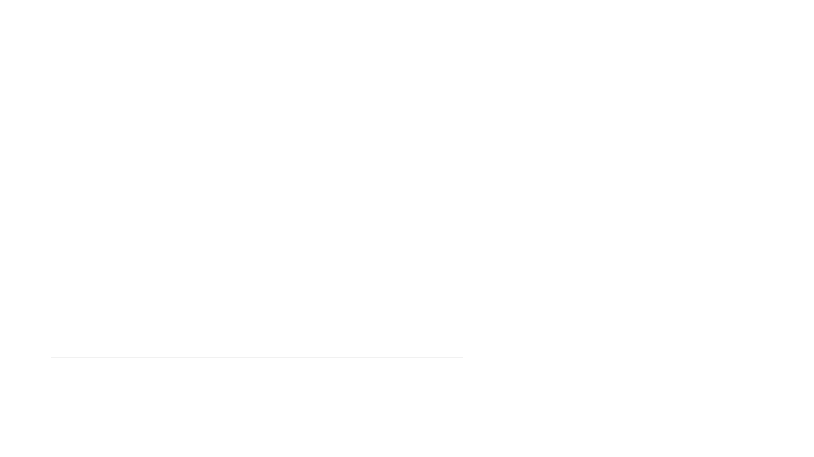

Step 5 - Create Distribution Path
Establish Trail File Transfer to Big Data Deployment
POST
/services/v2/sources/{path}
Distribution Service (Port 10101)
Request Parameters
Sample Request Body
Parameter
Required
Description
Example
{ "name": "DIST_KAFKA", "source": { "uri": "trail://source-host:10101/services/v2/sources?trail=ex" }, "target": { "uri": "ogg://bigdata-host:10202/services/v2/targets?trail=rt" } }
path
Yes (URL)
Name of the distribution path
DIST_KAFKA
name
Yes (Body)
Path name (must match URL)
DIST_KAFKA
source.uri
Yes
Source trail URI protocol
trail://host:10101...
target.uri
Yes
Target receiver URI protocol
ogg://host:10202...

Slide 9
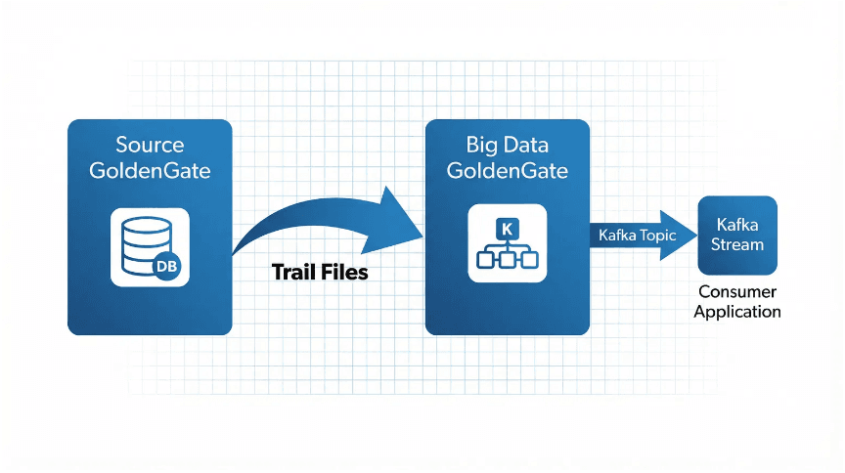
Step 6 - Create Kafka Producer Configuration
Define connection properties for the Kafka Cluster
POST
/services/v2/config/files/kafka_producer.properties
Big Data Admin Service (10200)
Sample Request Payload
{ "lines": [ "bootstrap.servers=kafka-broker1:9092,kafka-broker2:9092", "acks=1", "key.serializer=org.apache.kafka.common.serialization.ByteArraySerializer", "value.serializer=org.apache.kafka.common.serialization.ByteArraySerializer", "batch.size=102400" ] }
Key Configuration Properties
bootstrap.servers
Comma-separated list of Kafka broker host:port pairs.
acks
Acknowledgment level (0, 1, or all) for data durability.
key.serializer
Serializer class for message keys (usually ByteArray).

Slide 10
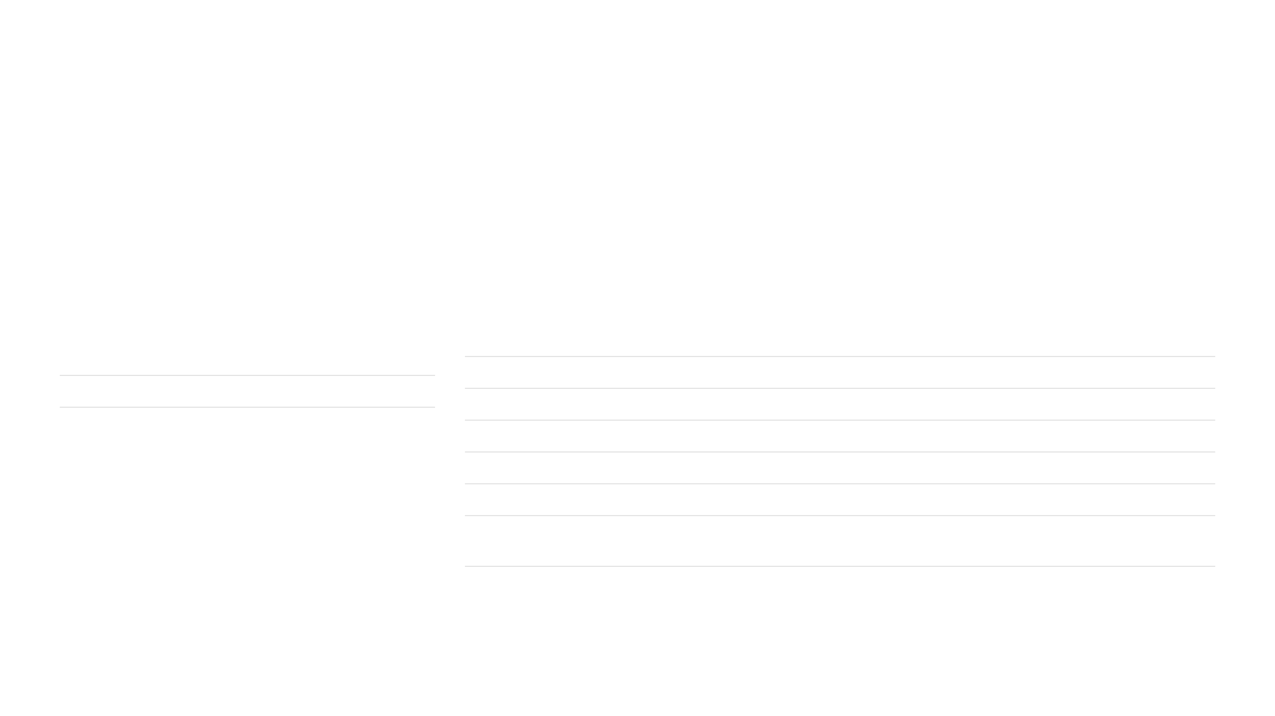

Step 7 - Configure Kafka Handler
Define Custom JSON Format and Topic Mapping
POST
/services/v2/config/files/{filename}
Big Data Admin (Port 10200)
Request Parameters
Key Handler Properties (in 'lines' array)
Parameter
Description
Property
Purpose
Example Value
filename
Config file name (e.g., REP_KAFKA.properties)
gg.handlerlist
Handler Name
kafkahandler
gg.handler.kafkahandler.type
Handler Type
kafka
lines
Array of configuration property strings
gg.handler.kafkahandler.topicMappingTemplate
Topic Naming
${tableName}
gg.handler.kafkahandler.keyMappingTemplate
Message Key
${primaryKeys}
gg.handler.kafkahandler.mode
Op Mode
op
gg.handler.kafkahandler.format
Output Format
json
gg.handler.kafkahandler.format.metaColumnsTemplate
Custom Metadata
${objectname[table]},...

Slide 11

Customizing JSON Output
Using the metaColumnsTemplate Property
Template Syntax
${keyword[alias]}
Defines metadata fields to inject into the JSON payload
Keyword
Description
Example Output
Example Configuration
${objectname[table]}
Source table name
"table": "EMPLOYEES"
# In Kafka Handler Properties File gg.handler.kafkahandler.format.metaColumnsTemplate= ${objectname[table]}, ${optype[op_type]}, ${timestamp[op_ts]}, ${currenttimestamp[current_ts]}, ${position[pos]}, ${primarykeycolumns[pk_cols]}
${optype[op_type]}
Operation (I/U/D/T)
"op_type": "I"
${timestamp[op_ts]}
Commit timestamp
"op_ts": "2026-02-04..."
${position[pos]}
Trail file position
"pos": "0000001234"
${primarykeycolumns[pk]}
Primary Key columns
"pk": ["ID"]
${alltokens[tokens]}
All GoldenGate tokens
"tokens": {...}
Note: The alias inside the brackets [] becomes the key name in your final JSON output.

Slide 12
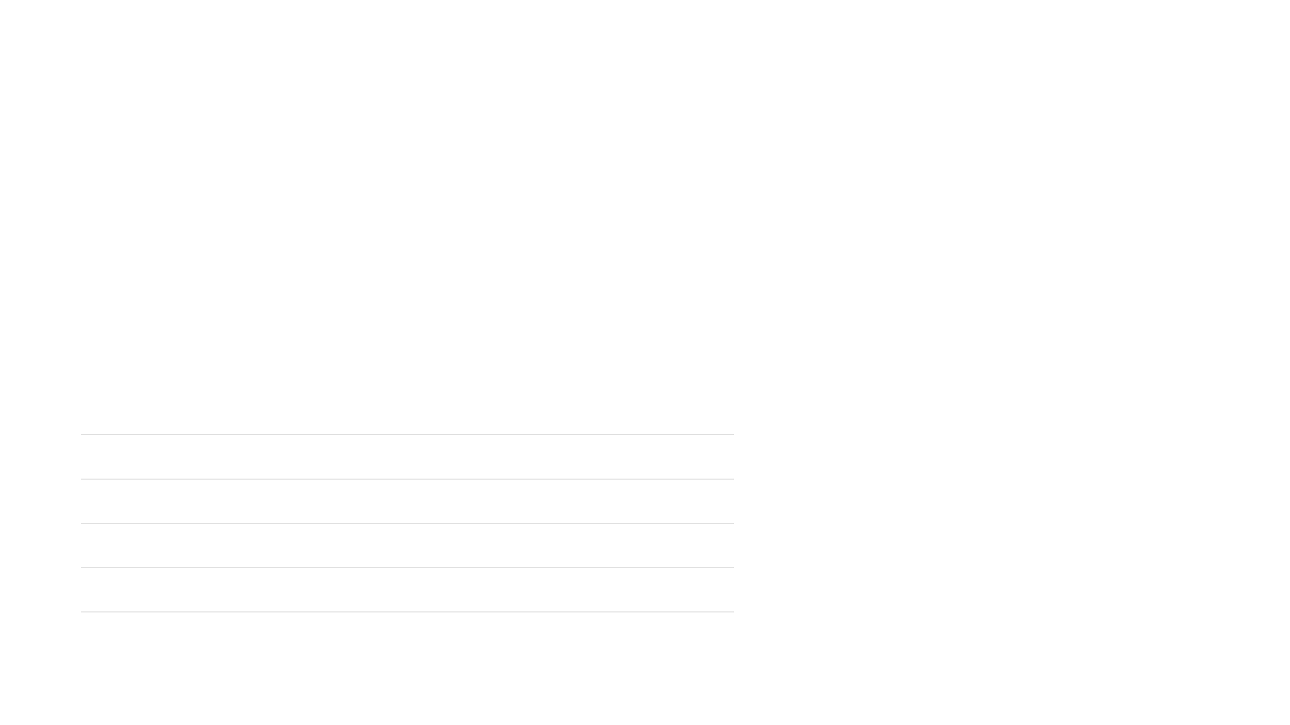
Step 8 - Create Replicat Process
Configure Data Delivery to Kafka Topic
POST
/services/v2/replicats/{replicat}
Big Data Admin (Port 10200)
Request Parameters
Sample Request Body
Parameter
Required
Description
Example
{ "config": [ "REPLICAT REP_KAFKA", "TARGETDB LIBFILE libggjava.so SET property=dirprm/REP_KAFKA.properties", "MAP HR.*, TARGET HR.*;" ], "source": { "name": "rt" }, "mode": { "type": "nonintegrated" }, "registration": "none" }
replicat
Yes (URL)
Replicat process name
REP_KAFKA
config
Yes
Parameter file content
["REPLICAT...", "MAP..."]
source.name
Yes
Source trail file prefix
rt
mode.type
Yes
Process mode
nonintegrated
registration
Yes
DB registration type
none

Slide 13
Step 9 - Start All Processes
Execute startup sequence to begin replication
1
Start Extract
2
Start Distribution
3
Start Replicat
Admin Service (Source)
Distribution Service
Admin Service (Big Data)
POST /services/v2/commands/execute
PATCH /services/v2/sources/DIST_KAFKA
POST /services/v2/commands/execute
{ "name": "start", "processName": "EXT_ORA" }
{ "status": "running" }
{ "name": "start", "processName": "REP_KAFKA" }

Slide 14
Sample JSON Output in Kafka Topic
Structured Data Payloads for Database Operations
INSERT
New Record Created
UPDATE
Existing Record Modified
{
"table": "EMPLOYEES",
"op_type": "I",
"op_ts": "2026-02-04T12:30:45.123",
"pos": "00000000000000001234",
"before": null,
"after": {
"EMPLOYEE_ID": 100,
"FIRST_NAME": "John",
"LAST_NAME": "Smith",
"SALARY": 75000.00,
"DEPT_ID": 10
}
}
{
"table": "EMPLOYEES",
"op_type": "U",
"op_ts": "2026-02-04T12:35:22.456",
"pos": "00000000000000001456",
"before": {
"SALARY": 75000.00
},
"after": {
"SALARY": 80000.00
}
}
Operation Type: Insert
Operation Type: Update
Pre-update values
Full row data
Post-update values

Slide 15

Complete Automation Script Flow
Orchestrating the 9-Step Pipeline
INPUT: Table Name & Schema
Automation Benefits
1. Create / Verify Credential
5. Create Kafka Producer Config
Reduces onboarding time from hours to minutes
2. Enable Supplemental Logging
6. Create Kafka Handler Config
Eliminates manual configuration errors
3. Create Extract Process
7. Create Replicat Process
Enables self-service for application teams
4. Configure Distribution Path
8. Start All Processes
Seamless integration with CI/CD pipelines
OUTPUT: Data Streaming to Kafka
Implementation Strategy
Wrap the REST calls in a short script that accepts the source table name and generates the JSON payloads for each step.

Slide 16

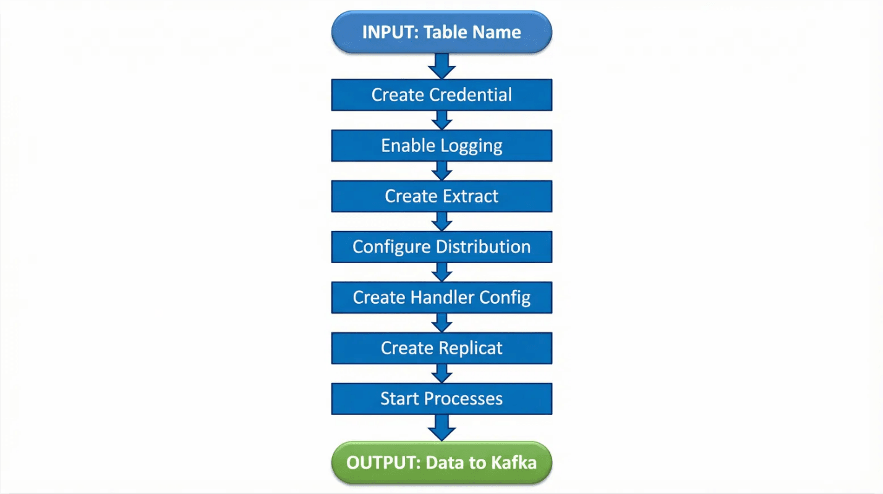
API Quick Reference Summary
Complete Endpoint Checklist for Automation
#
Method
Endpoint URI
Port
Purpose
1
POST
/services/v2/credentials/{domain}/{alias}
10100
Create DB Credential
2
GET
/services/v2/credentials/.../valid
10100
Validate Connection
3
POST
/services/v2/connections/.../trandata
10100
Enable Logging
4
POST
/services/v2/extracts/{name}
10100
Create Extract
5
POST
/services/v2/sources/{path}
10101
Create Distribution
6
POST
/services/v2/config/files/{file}
10200
Kafka Producer Config
7
POST
/services/v2/config/files/{file}
10200
Kafka Handler Config
8
POST
/services/v2/replicats/{name}
10200
Create Replicat
Full Automation Pipeline
9
POST
/services/v2/commands/execute
All
Start Processes

Slide 17








Key Takeaways for Implementation
Summary and Strategic Next Steps
Executive Summary
Action Plan
Full API Coverage
GoldenGate Microservices exposes 100% of configuration capabilities via REST, eliminating manual console work.
Script the 9-step workflow
Integrate with CI/CD (Jenkins/GitLab)
9-Step Sequential Workflow
A defined, repeatable process from credential creation to process startup ensures consistency.
Define JSON schema standards
Configure monitoring dashboards
Custom JSON Formatting
The metaColumnsTemplate property provides granular control over the JSON output structure.
Automation Ready
The stateless nature of the REST API makes it ideal for integration into CI/CD pipelines and self-service portals.
"Automation is not just about speed; it's about reliability and scale."

