Slide 1
Outlier Discovery/Anomaly Detection

Slide 2
Anomaly/Outlier Detection
What are anomalies/outliers?
  The set of data points that are considerably different than the remainder of the data
Variants of Anomaly/Outlier Detection Problems
  Given a database D, find all the data points x ∈ D with anomaly scores greater than some threshold t
  Given a database D, find all the data points x ∈ D having the top-n largest anomaly scores f(x)
  Given a database D, containing mostly normal (but unlabeled) data points, and a test point x, compute the anomaly score of x with respect to D

Slide 3
Applications
  Credit card fraud detection
  telecommunication fraud detection
  network intrusion detection
  fault detection
  many more

Slide 4
Anomaly Detection
Challenges
  How many outliers are there in the data?
  Method is unsupervised
    Validation can be quite challenging (just like for clustering)
  Finding needle in a haystack
Working assumption:
  There are considerably more “normal” observations than “abnormal” observations (outliers/anomalies) in the data

Slide 5
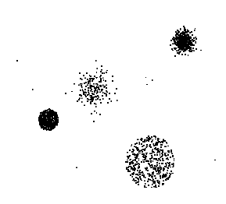
Anomaly Detection Schemes
General Steps
  Build a profile of the “normal” behavior
    Profile can be patterns or summary statistics for the overall population
  Use the “normal” profile to detect anomalies
    Anomalies are observations whose characteristics
    differ significantly from the normal profile
Types of anomaly detection
schemes
  Graphical & Statistical-based
  Distance-based
  Model-based

Slide 6
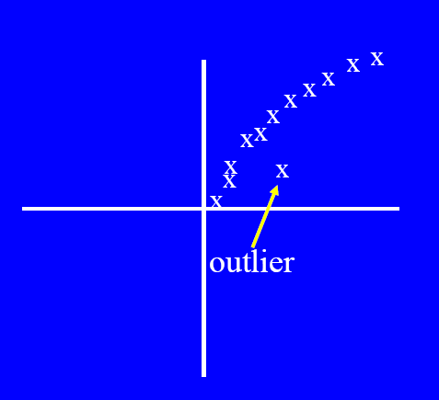
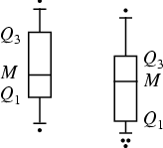
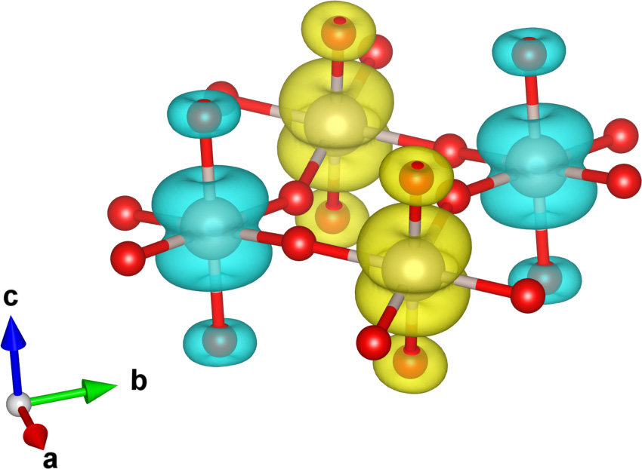
Graphical Approaches
Boxplot (1-D), Scatter plot (2-D), Spin plot (3-D)
Limitations
  Time consuming
  Subjective

Slide 7
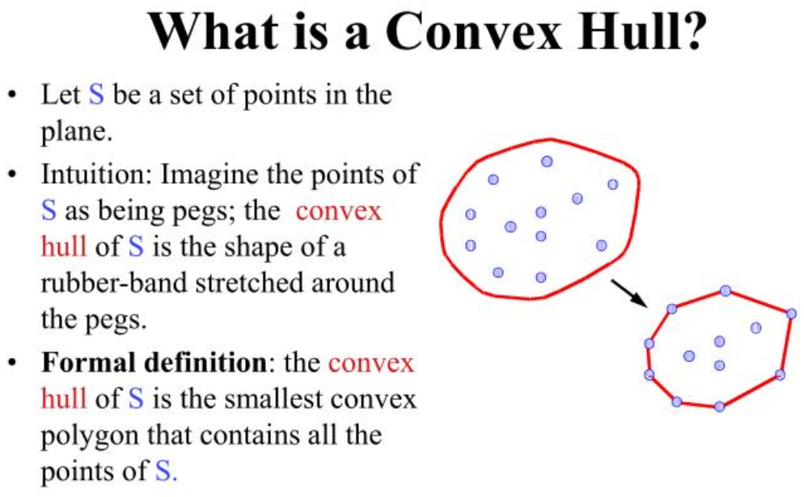
Convex Hull Method

Slide 8
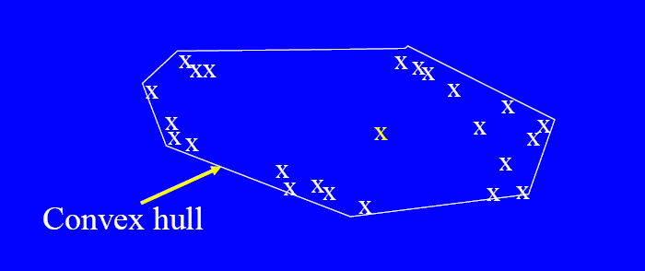
Convex Hull Method
Extreme points are assumed to be outliers
What if the outlier occurs in the middle of the data?

Slide 9
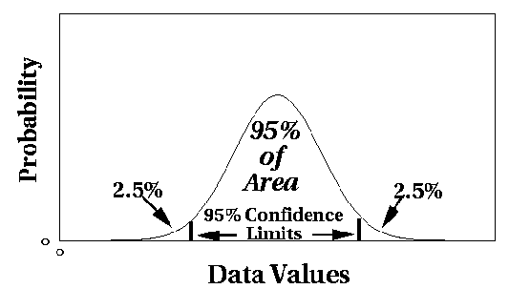
Statistical Approaches
Assume a parametric model describing the distribution of the data (e.g., normal distribution)
Apply a statistical test that depends on
  Data distribution
  Parameter of distribution (e.g., mean, variance)
  Number of expected outliers (confidence limit)

Slide 10
Grubbs’ Test
Detect outliers in univariate data
Assume data comes from normal distribution
Detects one outlier at a time, remove the outlier, and repeat
  H₀: There is no outlier in data
  H_{A}: There is at least one outlier
Grubbs’ test statistic:
Reject H₀ if:

Slide 11
Limitations of Statistical Approaches
Most of the tests are for a single attribute
In many cases, data distribution may not be known
For multi-dimensional data, it may be difficult to estimate the true distribution

Slide 12
Distance-based Approaches
Data is represented as a vector of features
Three major approaches
  Nearest-neighbor based
  Density based
  Clustering based

Slide 13
Nearest-Neighbor Based Approach
Approach:
  Compute the distance between every pair of data points
  There are various ways to define outliers:
    Data points for which there are fewer than p neighboring points within a distance D
    The top n data points whose distance to the kth nearest neighbor is greatest
    The top n data points whose average distance to the k nearest neighbors is greatest

Slide 14
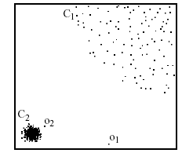
Density-based: LOF approach
For each point, compute the density of its local neighborhood
Compute local outlier factor (LOF) of a sample p as the average of the ratios of the density of sample p and the density of its nearest neighbors
Outliers are points with largest LOF value
In the NN approach, p₂ is not considered as outlier, while LOF approach find both p₁ and p₂ as outliers
p₂
×
p₁
×

Slide 15
LOF
The local outlier factor LOF, is defined as follows:
where N_{k}(p) is the set of k-nearest neighbors to p
and

Slide 16
Clustering-Based
Basic idea:
  Cluster the data into groups of different density
  Choose points in small cluster as candidate outliers
  Compute the distance between candidate points and non-candidate clusters.
    If candidate points are far from all other non-candidate points, they are outliers

