Slide 1
1. Data upload to Linux server 2. Data import into MySQL
Lee, Tzong-Yi

Slide 2
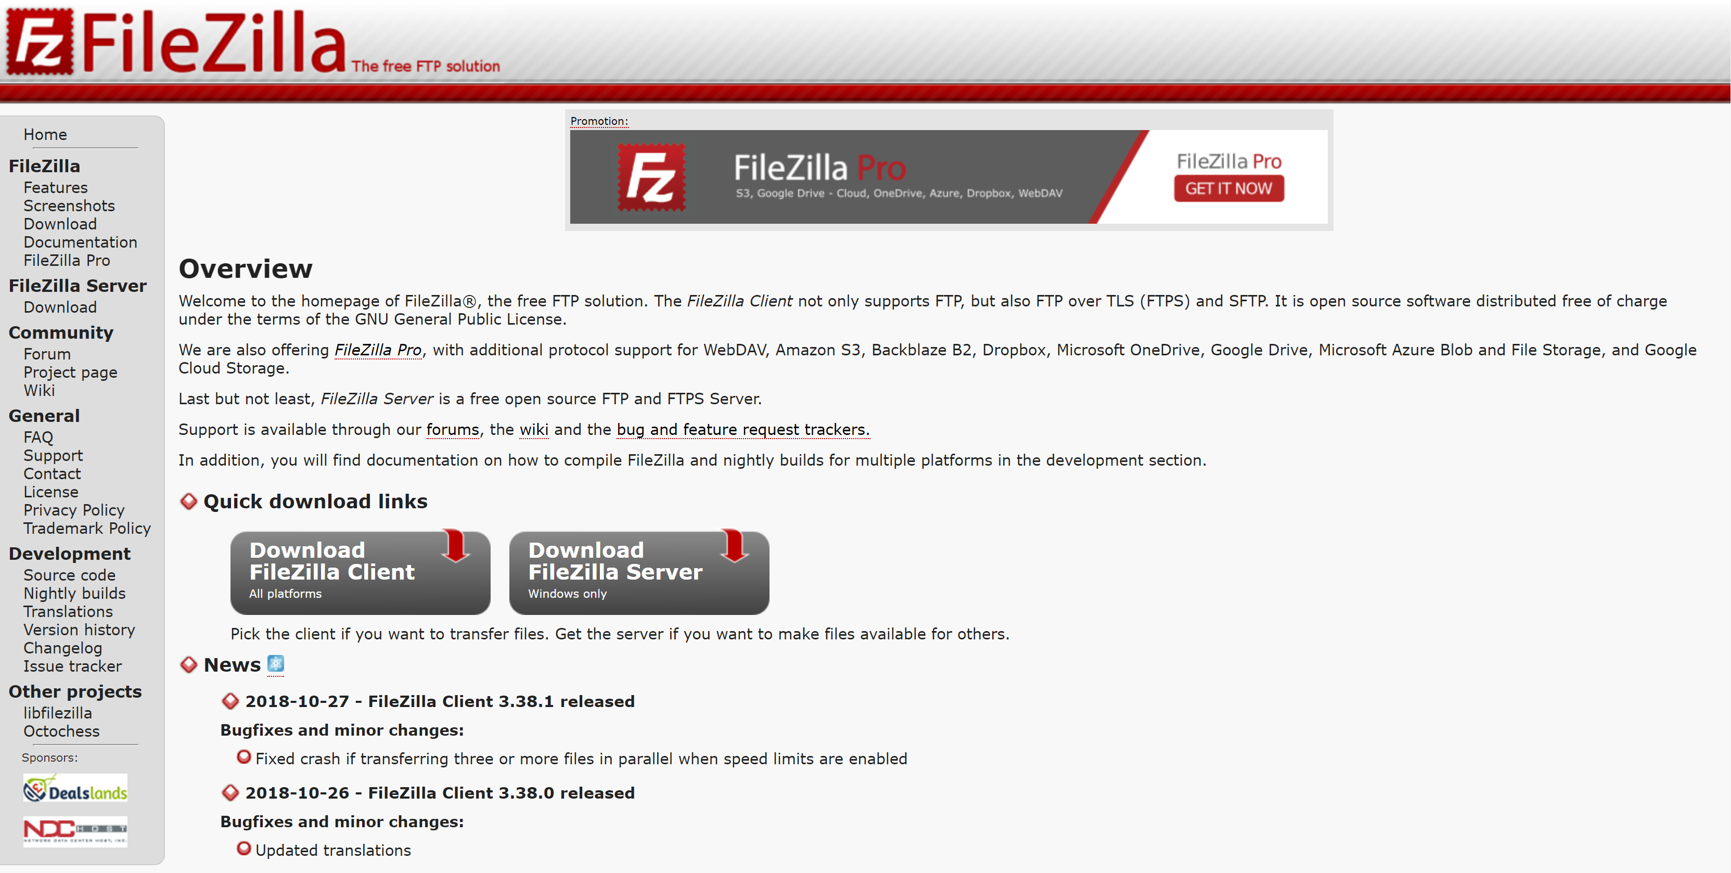

Download FileZilla Client
https://filezilla-project.org/ (Please don’t download the server version !!)

Slide 3
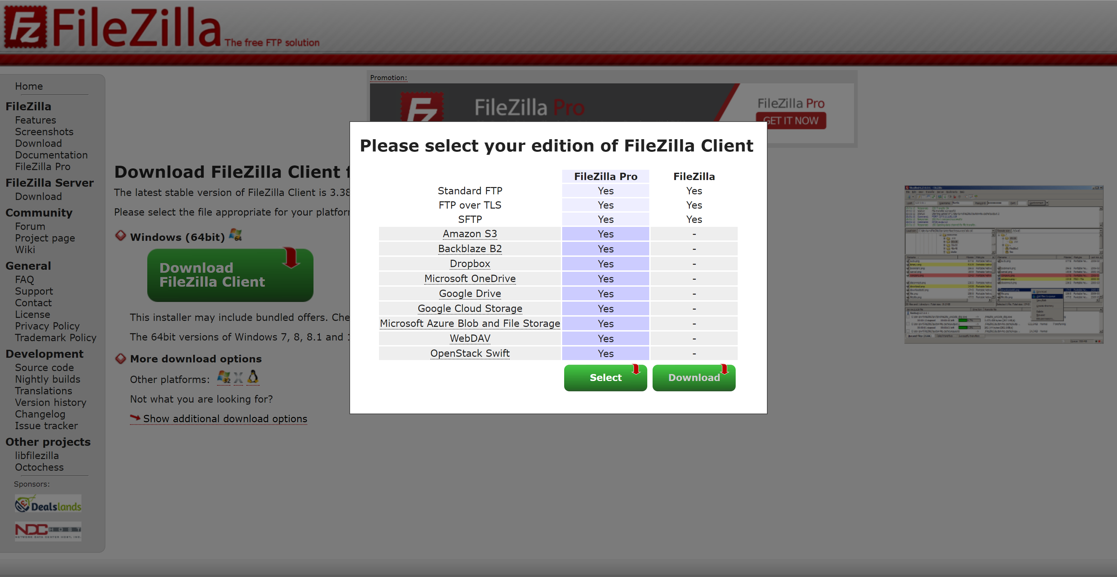
Download FileZilla Client
Please select the FileZilla for free instead of FileZilla Pro.

Slide 4
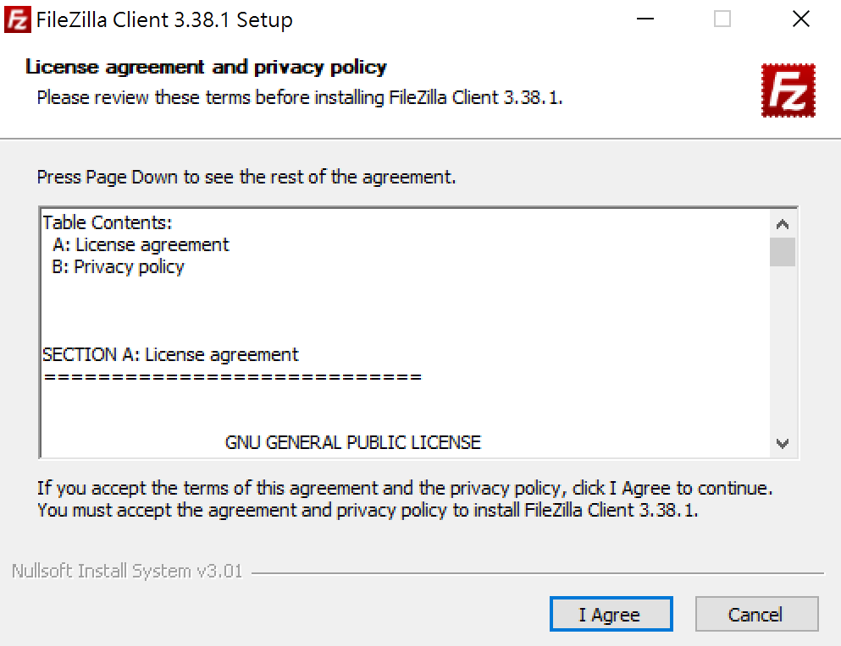
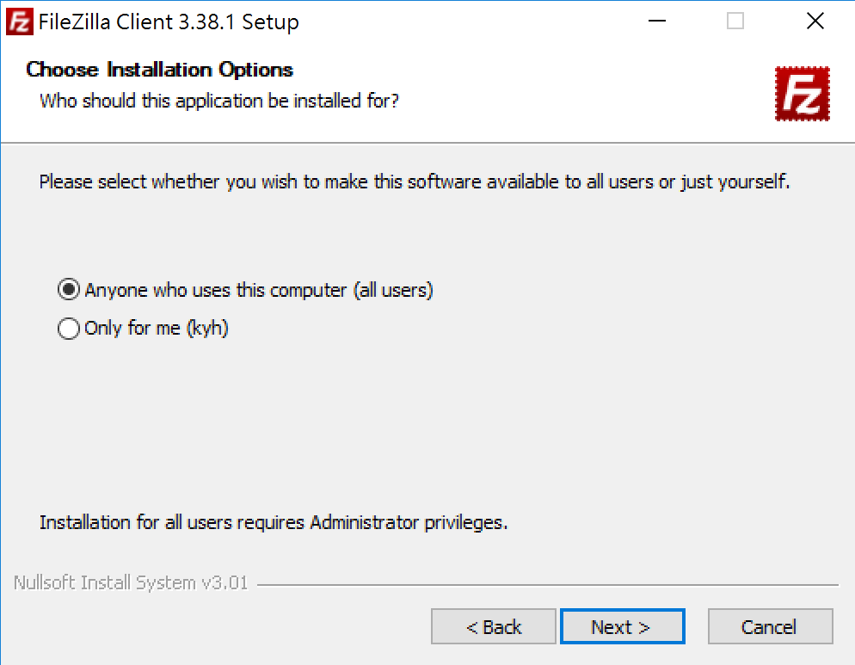
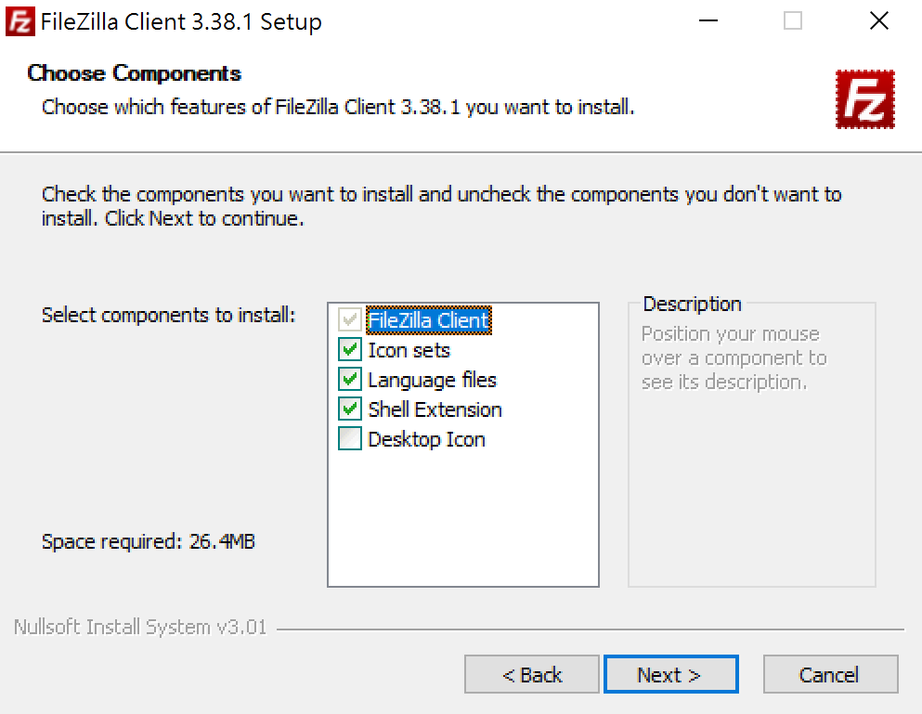

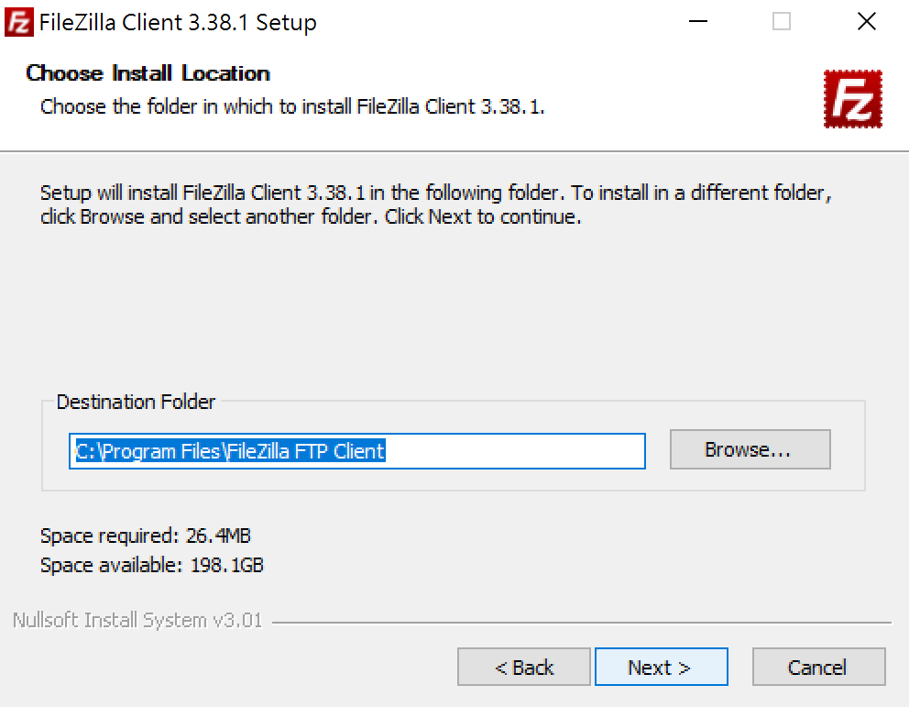
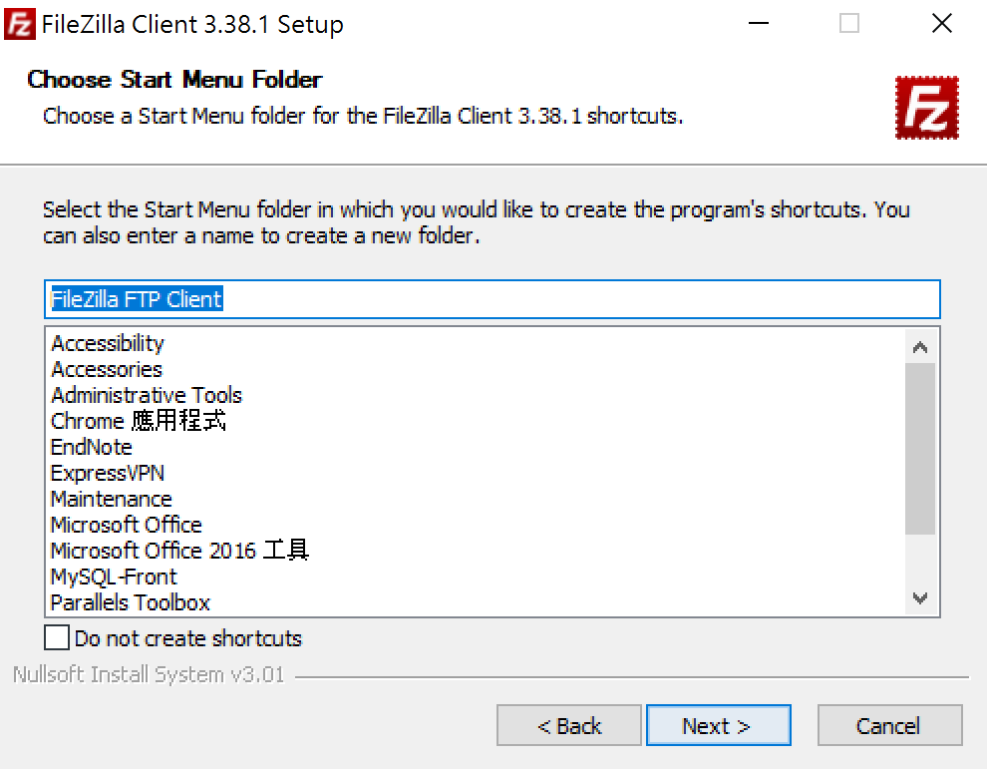
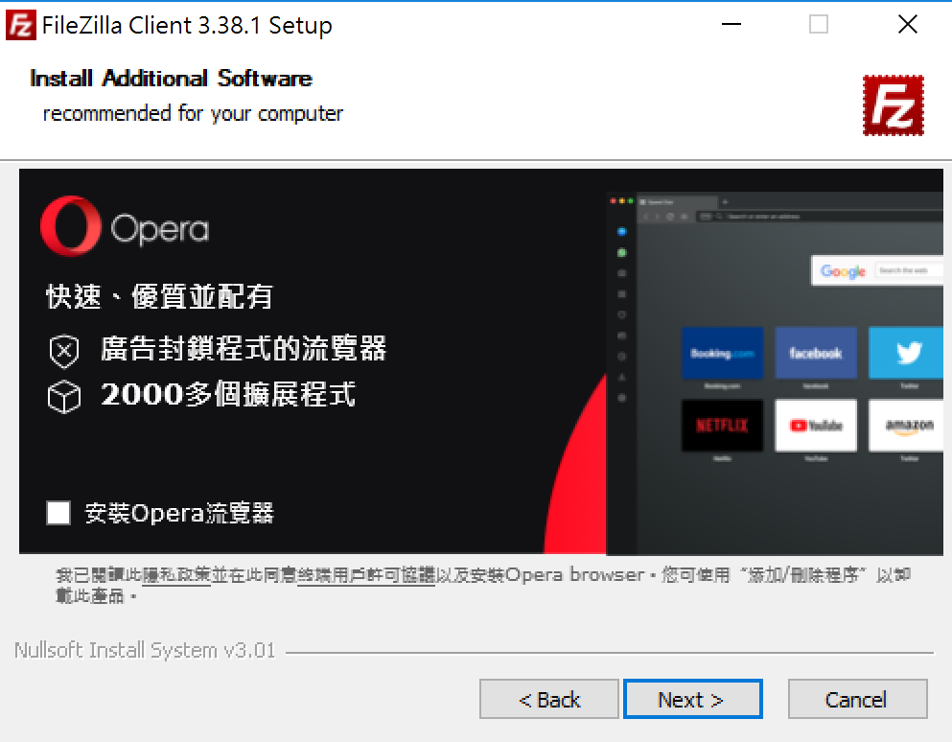
Installation
1. Agree the License.
2. Software available to all users.
3. Default components to install.
4. Choose install location.
5. Name of start menu folder.
6. Additional software (up to you).

Slide 5
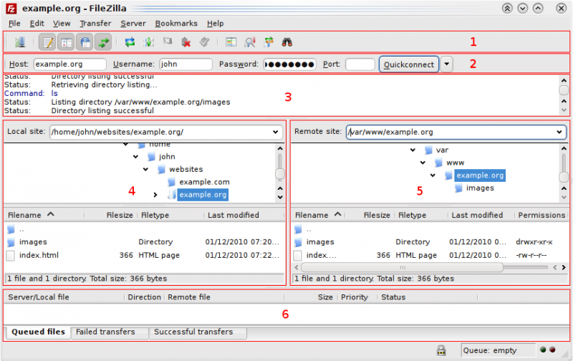
Usage
(1) Toolbar (2) Quick connect bar (3) Message log
(4) Displays the local files and directories.
(5) Displays the files and directories on the server.
(6) Transfer queue lists the to-be-transferred and already transferred files.

Slide 6
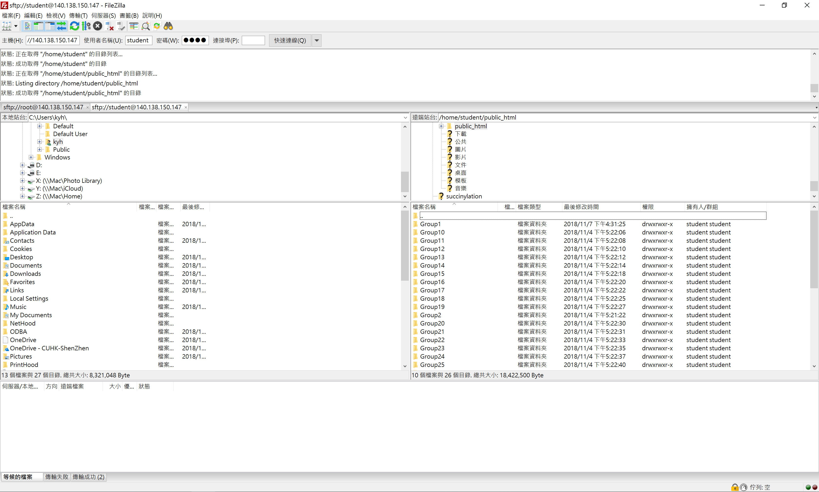
Connect to the Server
Host: sftp://140.113.118.199
Username: NYCU-BiOmicsLab
Password: biomics317@nycu
Port: 22
(or leaving it blank, default port: 22)
Input the host IP, username, password and port.

Slide 7
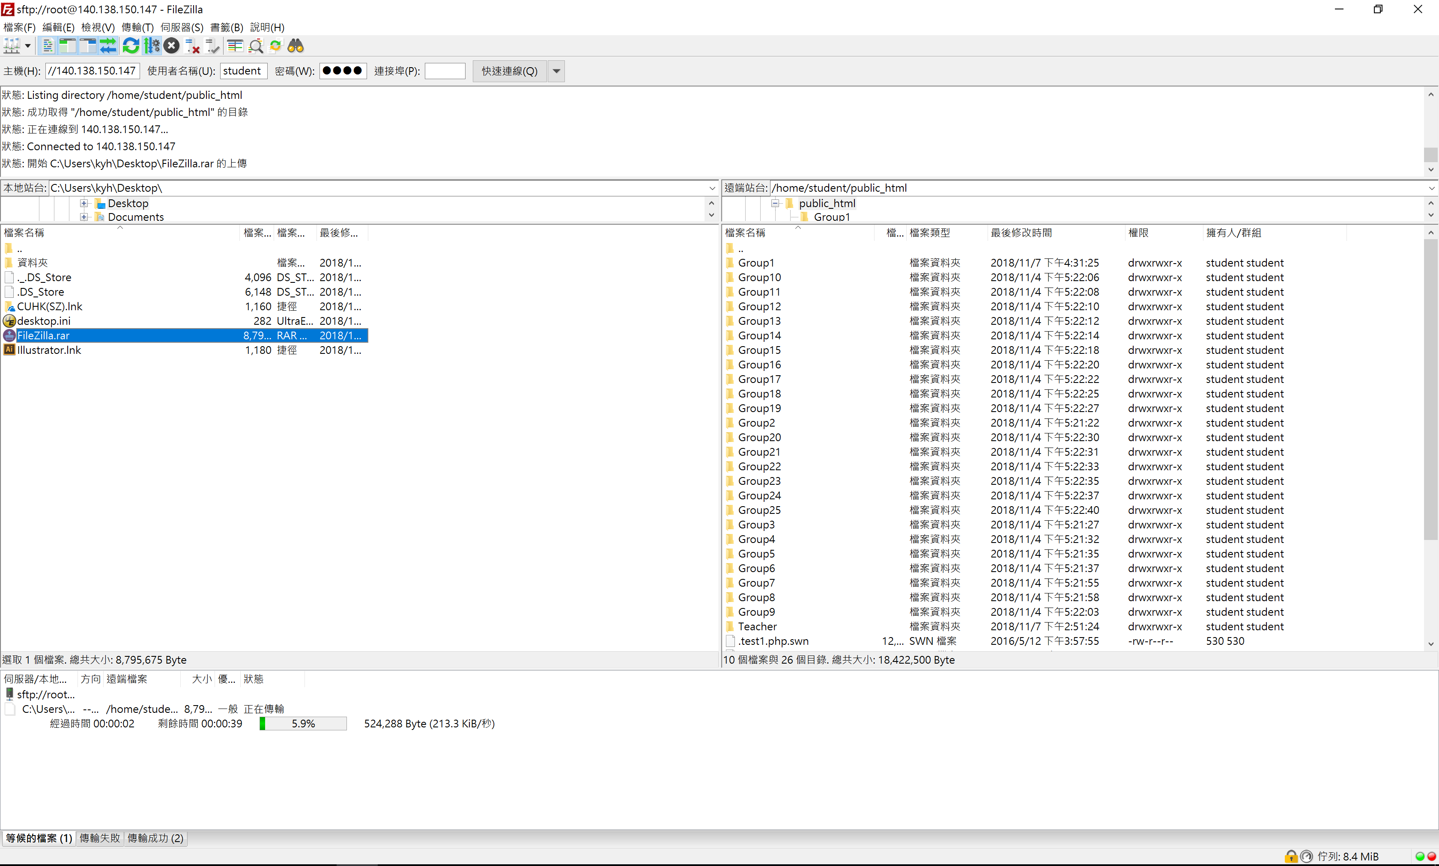
Copy the Local File(s) to Server
Select the local file …
Uploading the file to server …

Slide 8
Import Data to MySQL
(1) Create a new MySQL database
# create database [DB_NAME];
(2) Use the database
# use [DB_NAME];
(3) Create a table
# create table [TABLE_NAME] (column1 value_type, column2 value_type, column3 value_type, column4 value_type);
For example:
# create table Pets (Name VARCHAR(20), Breed VARCHAR(30), Sex CHAR(1), Birthday DATE);
(4) Import a text file to MySQL database
# mysqlimport -u [USER] -p [DB_NAME] [TEXT_FILE] (TEXT_FILE = TABLE_NAME)
For example:
# mysqlimport -u student -p MyDB Pets.txt
-u: user name
-p: password validation

Slide 9
Import Data to MySQL
The other way to import data to MySQL …
Import the database with “SQL description” to MySQL
# mysql -h [HOST_IP] -u [USER] -p [DB_NAME] < C:\Database.sql
< : Import data
-h: host IP or domain name
-u: user name
-p: password validation

Slide 10
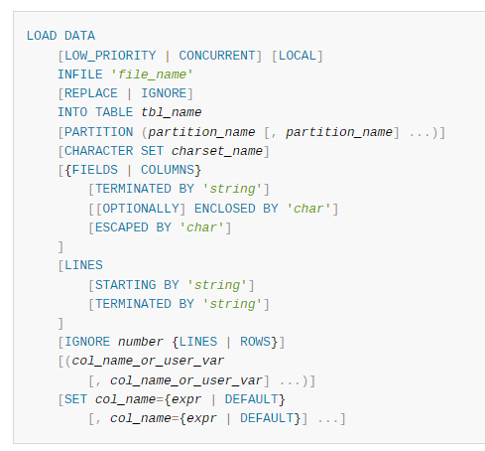
Load Data into MySQL
The other way to load datafile into MySQL …
mysql> load data infile ‘/file path/file name’ into table table_name

Slide 11
Export Data from MySQL (MySQL dump)
Backup a database
# mysqldump -h [HOST_IP] -u [USER] -p [DB_NAME] > BACKUP1.sql;
Backup the multi-databases
# mysqldump -u [USER] -p --databases [DB1_NAME] [DB2_NAME] > BACKUP2.sql;
Backup a table in the database
# mysqldump -u [USER] -p [DB_NAME] [TABLE1] > BACKUP3.sql;
Backup the multi-tables in the database
# mysqldump -u [USER] -p [DB_NAME] [TABLE1] [TABLE2] > BACKUP4.sql;
Backup all of databases in MySQL
# mysqldump -u [USER] -p --all-databases > BACKUP5.sql;
> : Export data
-h: host IP or domain name
-u: user name
-d: table structure without data
-p: password validation

