Slide 1
Progress Report
Chen, Yi Jie
2023.09.27

Slide 2
Outline
Single Cell Analysis: Overview
Single Cell Analysis: Bio-tools
Single Cell Analysis: Database
Familiar Tools
Future Work

Slide 3
Single Cell Analysis Map
Analysis SOP
scRNA-seq
scATAC-seq
scDNA-seq
scProteomics-seq
scDNA Methylation-seq
scTCR-seq?
scCUT&Tag?
scNTT-seq?
QC
Normalization
Feature selection
Dimensionality Reduction
Clustering
Differential Analysis
Functional Annotation
Notes:
針對單細胞分析的趨勢分析 https://www.toolsbiotech.com/news_detail.php?id=320
scDNA: https://www.nature.com/articles/s41467-019-11857-8；https://genomebiology.biomedcentral.com/articles/10.1186/s13059-021-02583-w
NEW scDNA sequencing method (MPT/WES): https://www.sciencedirect.com/science/article/pii/S2666979X22001689
scMetabolism
差異分析：基因表達、染色質開放度、轉錄因子活性等
Functional Annotation
基因注釋（Gene Annotation）：將單細胞數據中的基因與已知的功能性資訊進行關聯。這可以包括確定每個基因的功能、參與的生物學通路、細胞功能等。這通常倚賴基因註釋資料庫，如Gene Ontology (GO)、KEGG Pathways、Reactome等。
通路分析（Pathway Analysis）：將單細胞中的基因表達數據映射到生物學通路，以了解哪些通路在特定細胞或細胞群中活躍。通路分析可以幫助確定細胞的生物學功能和參與的生物過程。
網絡分析（Network Analysis）：建立基因調控網絡，以揭示基因之間的調控關係。這可以幫助理解哪些基因在調控細胞的功能和狀態中起著關鍵作用。
功能預測（Functional Prediction）：根據基因表達模式和功能註釋資訊，對單細胞的功能狀態進行預測。這可能包括預測細胞的分化狀態、細胞類型、調控因子的活性等。

Slide 4
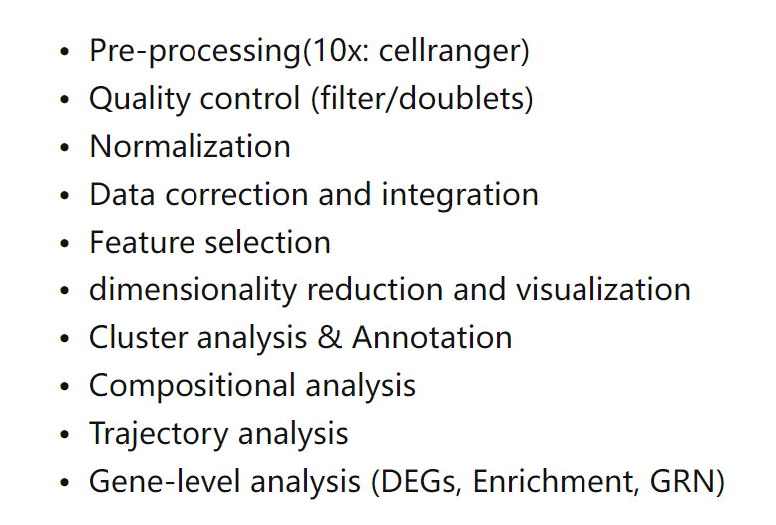
Single Cell RNA Guideline
https://www.embopress.org/doi/full/10.15252/msb.20188746
Notes:
推薦閱讀：https://zhuanlan.zhihu.com/p/544443428
https://www.embopress.org/doi/full/10.15252/msb.20188746

Slide 5
Single Cell Analysis
scRNA-seq: gene expression/regulation, cell type/subtype
Cell Ranger: raw data-> matrix,…
Seurat®: QC, normalization, dimensionality reduction, clustering etc.
Scanpy : Seurat in py
scATAC-seq: epigenetic states, TF binding sites
SnapATAC: QC, counting, dimensionality reduction, clustering etc.
(Cicero ®: Covariance analysis and gene regulation via HMM)
ArchR®: Same work, and providing integration interfaces to Seurat、Signac etc.
Signac®:Same like above
Notes:
Cell Ranger: raw data-> matrix (for alignment, filtering, counting, and clustering )
Seurat: QC, normalization, dimensionality reduction, clustering, and differential expression analysis SnapATAC：這是一個基於 Python 語言的軟體，可以對單細胞染色質可及區域測序數據進行品質控制、計數、降維、聚類、差異分析和可視化等，並提供了一種新的數據格式（SNAP）來存儲和處理大規模的數據。

Slide 6
Single Cell Analysis
scDNA-seq: gene variation, CNVs, methylation etc.
Ginkgo: CNVs detection and visualization
Monovar: SNV detection
Sccaller®: SNV detection
scProteomics-seq: proteins, phosphorylated a.a.
CITE-seq-Count: raw data -> matrix
CATALYST®
SAVER-X®
Ginkgo: https://www.ncbi.nlm.nih.gov/pmc/articles/PMC4775251/
Notes:
Ginkgo：https://www.ncbi.nlm.nih.gov/pmc/articles/PMC4775251/
Monovar：這是一個基於 Python 語言的軟體，可以對單細胞DNA測序數據進行單核苷酸變異（SNV）的偵測和分析，並考慮了數據中的深度不均勻性和假陽性率等問題5。
SCcaller：這是一個基於 R 語言的軟體，也可以對單細胞DNA測序數據進行SNV的偵測和分析，並利用了貝氏統計模型來估計每個變異位點的後驗機率6。

Slide 7
DB for scData
Single Cell Portal (SCP)
Single Cell Expression Atlas (SCEA)
For scRNA Data
scRNASeqDB
PanglaoDB
The Human Cell Atlas Data Portal
Notes:
Single Cell DB.csv: https://docs.google.com/spreadsheets/d/1En7-UV0k0laDiIfjFkdn7dggyR7jIk3WH8QgXaMOZF0/edit?pli=1#gid=0
Single cell genomic center (non-DB): https://scgc.bigelow.org/

Slide 8
DB for specific type data
scProteomics-seq
ProteomicsDB
PRIDE: MS data
scDNA Methylation-seq
scMethBank
scTCR-seq
JingleBells
scRNA-seq
TISCH2: tumor
HCL: human
SCPortalen2: human/mouse
scATAC-seq
No specific DB, only tools
scDNA-seq
No specific DB
scMethBank: https://academic.oup.com/nar/article/50/D1/D380/6376025
Notes:
scMethBank: https://academic.oup.com/nar/article/50/D1/D380/6376025
SCPortalen2: https://pubmed.ncbi.nlm.nih.gov/29045713/

Slide 9
Relatively Familiar
Seurat
Monocle3
Velocyto
SingleR
SCENIC
Cicero

Slide 10
Future Work
Try running different types of analysis tools (scDNA, scMethylation etc.)
Building a pipeline (Database A + Biotools B)
Take others pipeline as a reference
(Our own DB for single cell data?)

Slide 11
Conclusion
DB 先不用 build
可以先從跑完整的 scRNA, scATAC 開始，然後學習去說明每個圖的意義，或表現值高高低低之類的東西。
下一次進度報告。可以報一下scRNA+TCGA這篇論文。

Slide 12
Not important, but can discuss?
- Courses Loading
- Some interesting ideas
- Combine Spatial Transcriptome?
- with GWAS or TCGA

