Slide 1
Multi-Omics Database for Single Cell Survey
2024.01.08

Slide 2
Outline
scRNA / scATAC Database
scMethylation Database
sc Spatial Transcriptomics Database
Public Dataset Analysis -> Research Ideas

Slide 3
1. scRNA / scATAC

Slide 4
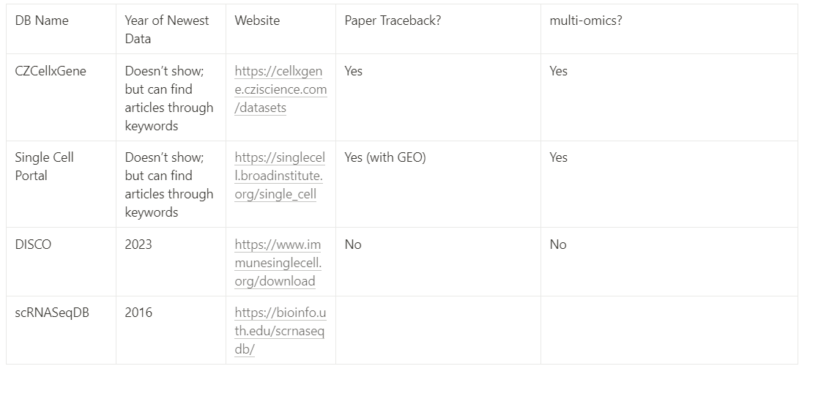
Database Overview

Slide 5
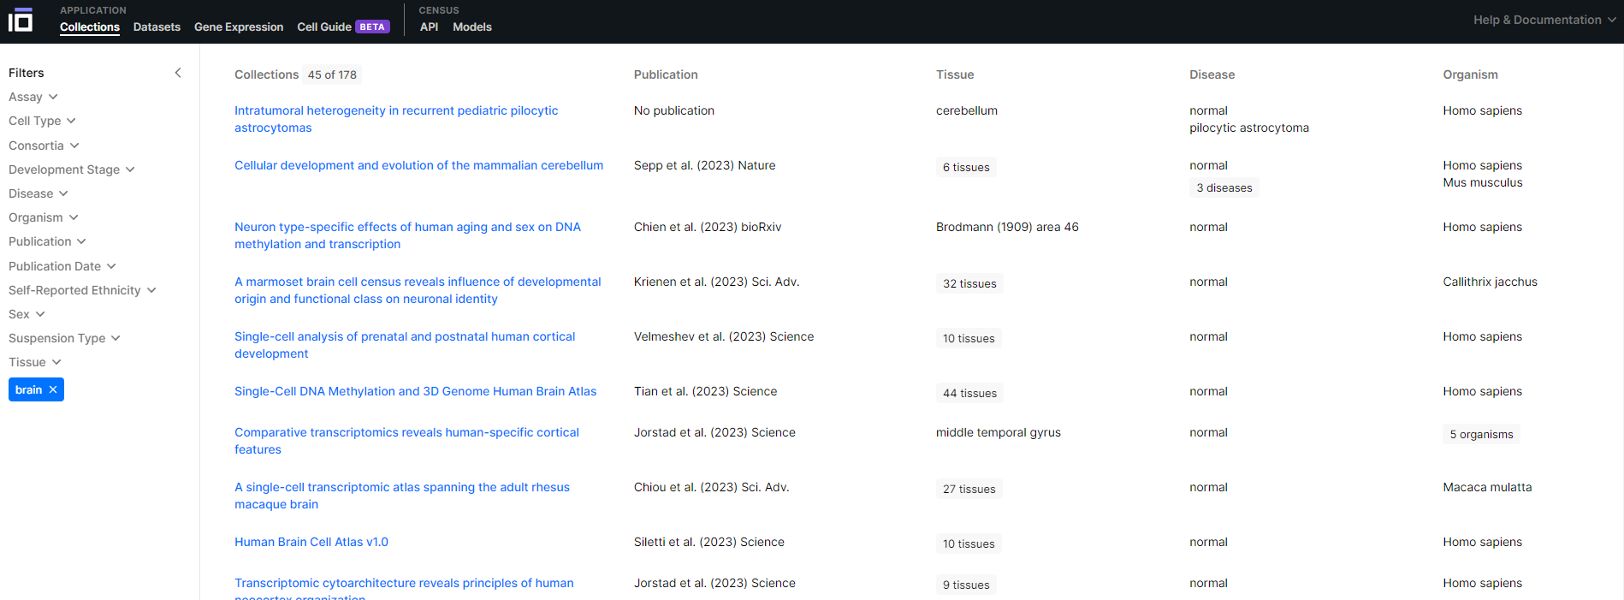
CellxGene
https://cellxgene.cziscience.com/collections

Slide 6
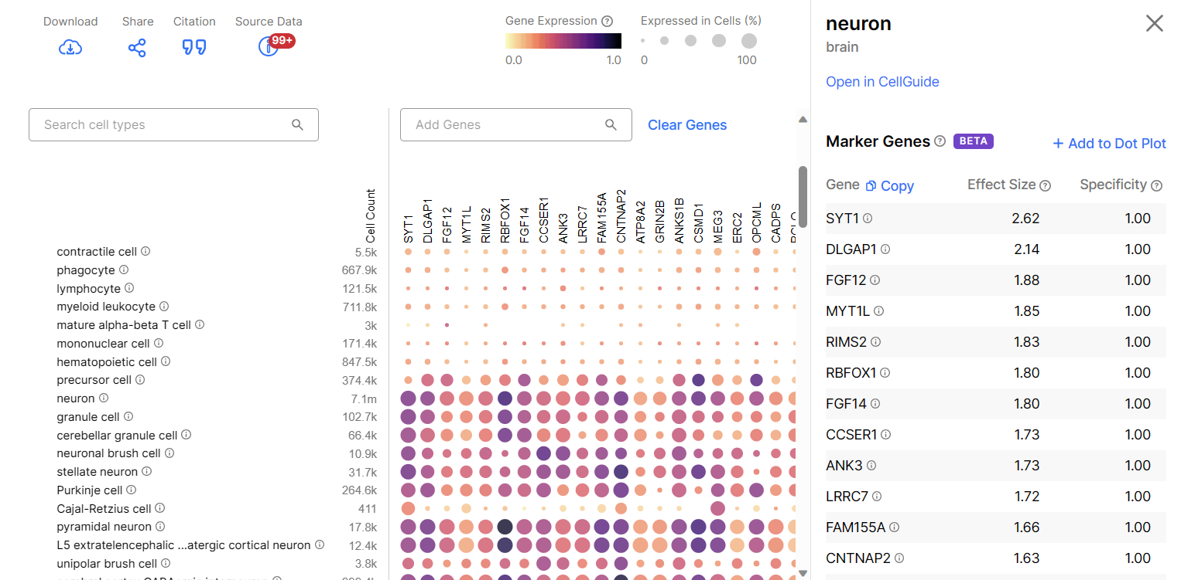
CellxGene

Slide 7
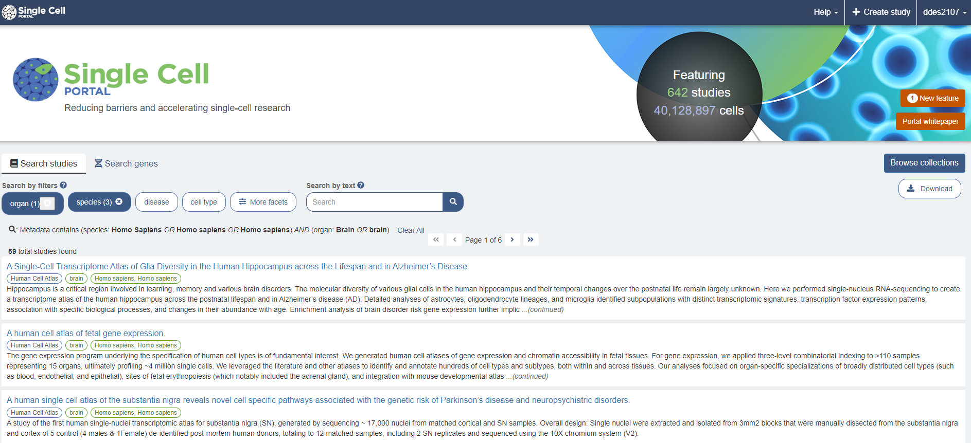
Single Cell Portal
https://singlecell.broadinstitute.org/single_cell

Slide 8
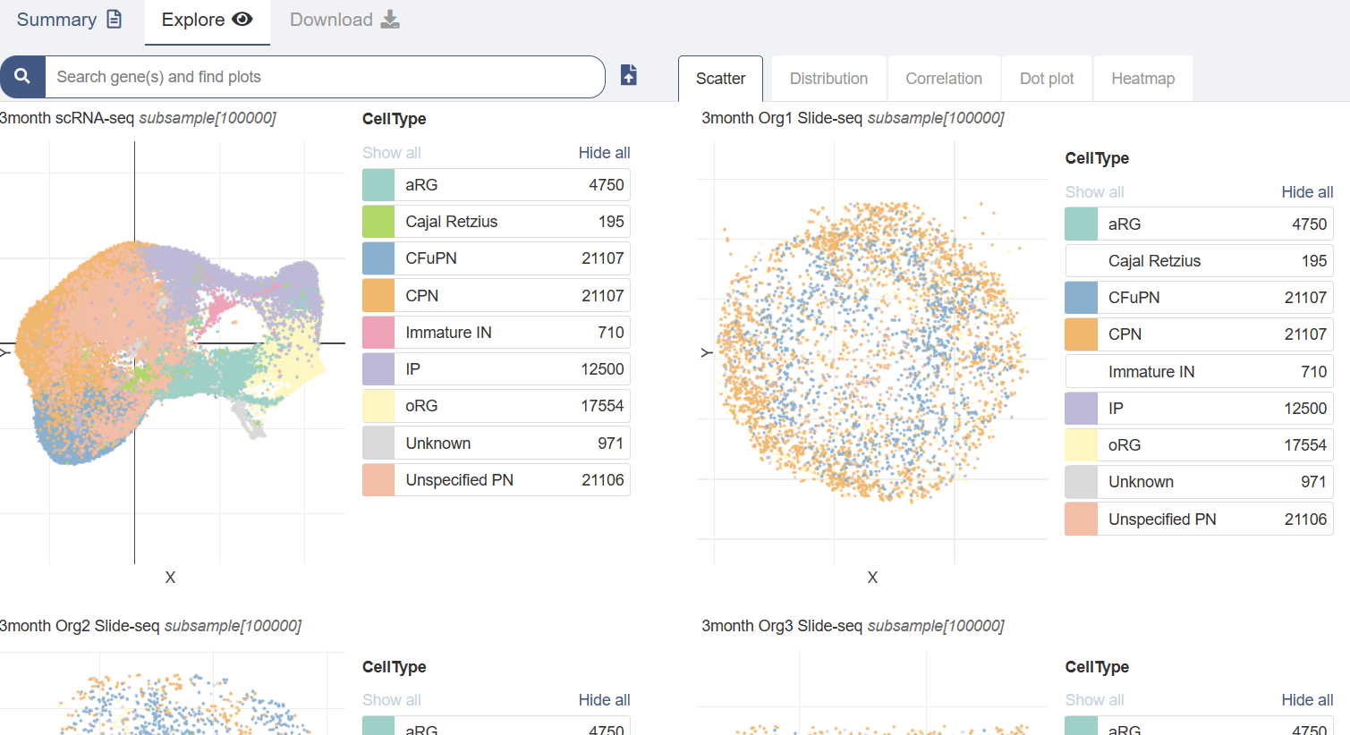
Single Cell Portal

Slide 9
DISCO
- DISCO（Deeply Integrated Single-Cell Omics）是一個公開可用的數據庫，專門收集和整合人類單細胞轉錄組數據
- 使用一個控制詞彙和本體系統來標準化相關的元數據，並且為了實現大規模單細胞數據的整合，開發了FastIntegration（快速整合工具）和CELLiD（自動細胞類型識別工具）。此外，DISCO提供了三個在線工具：Online FastIntegration、Online CELLiD、和CellMapper，讓用戶可以整合、標記並將上傳的單細胞RNA序列數據投影到選定的圖譜上。

Slide 10
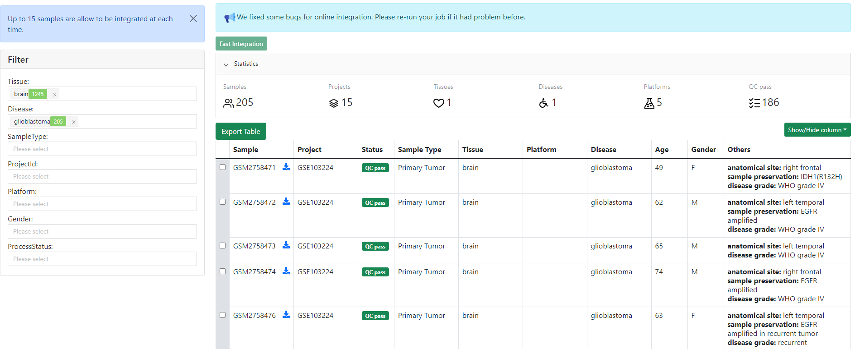
DISCO
https://www.immunesinglecell.org/repository

Slide 11
2. scMethylation

Slide 12
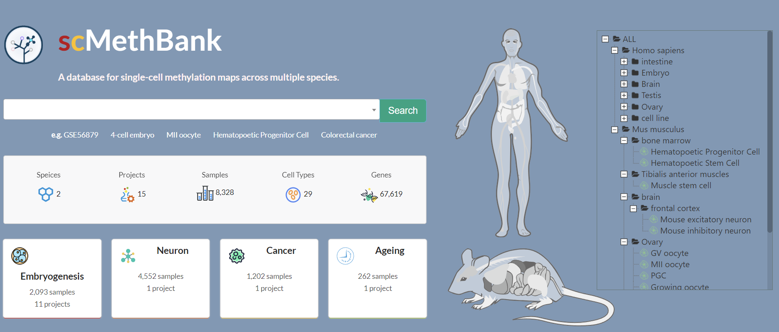
scMethBank
https://ngdc.cncb.ac.cn/methbank/scm/

Slide 13
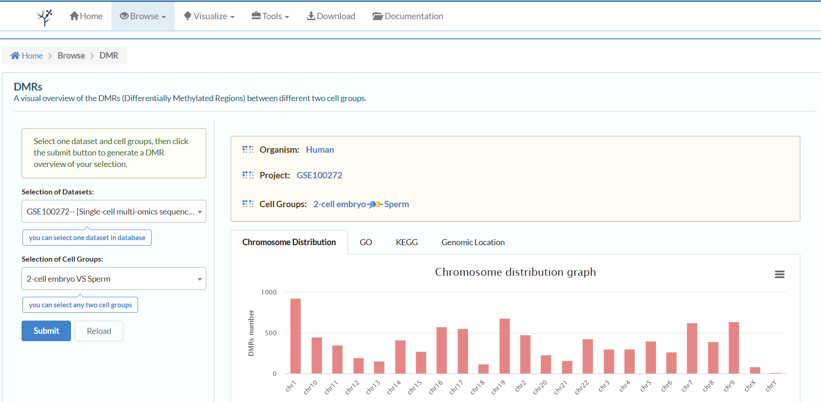
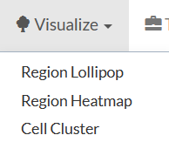
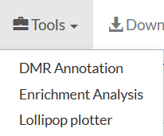
scMethBank

Slide 14
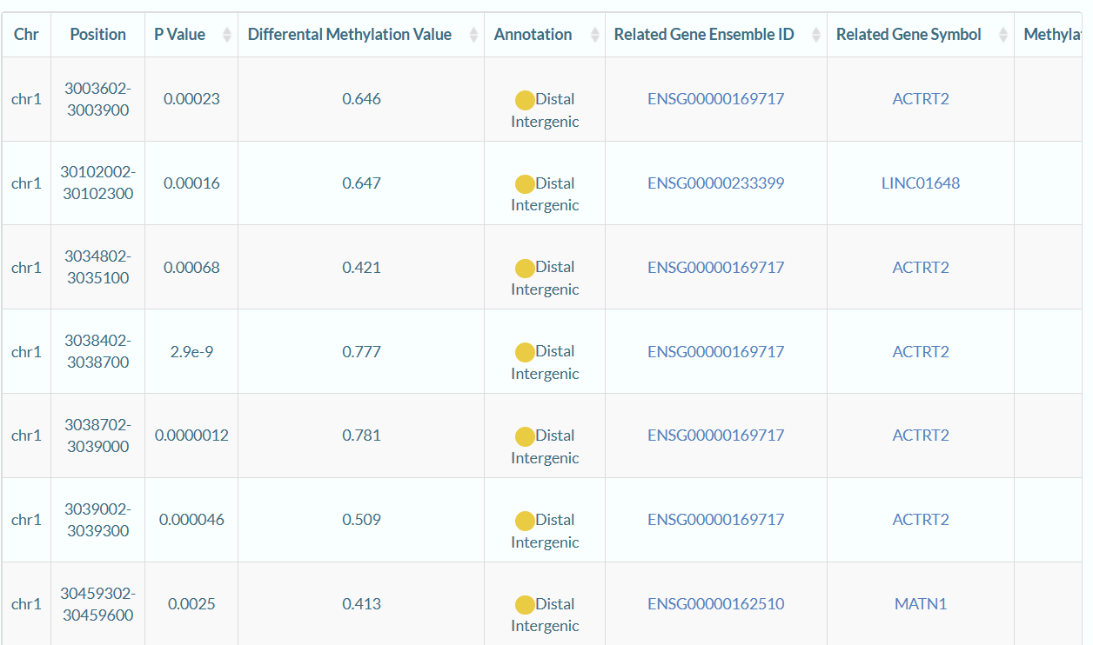

Slide 15
3. sc Spatial Transcriptomics

Slide 16
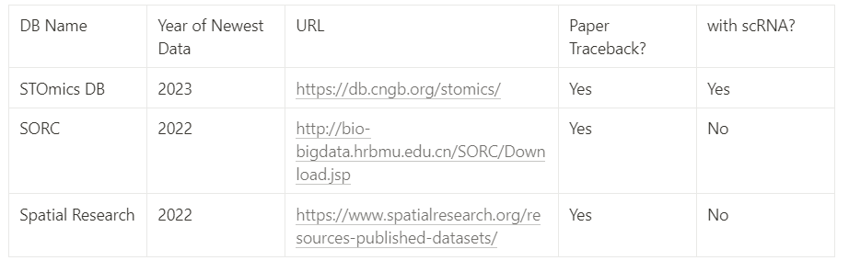
Database Overview

Slide 17
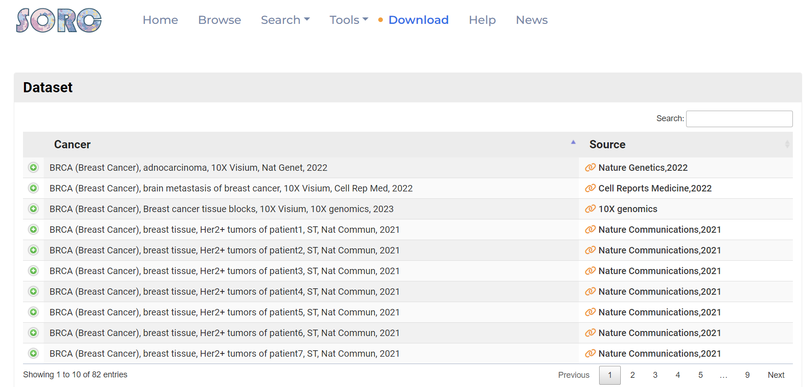
SORC
http://bio-bigdata.hrbmu.edu.cn/SORC/Download.jsp

Slide 18
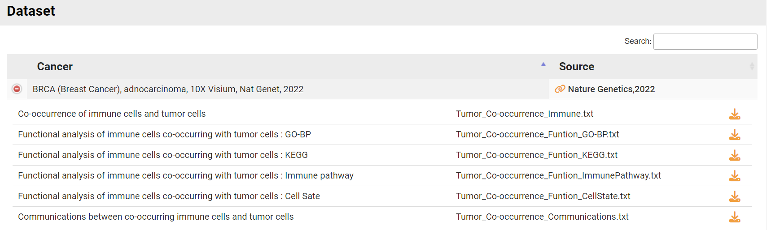
SORC
http://bio-bigdata.hrbmu.edu.cn/SORC/Download.jsp

Slide 19
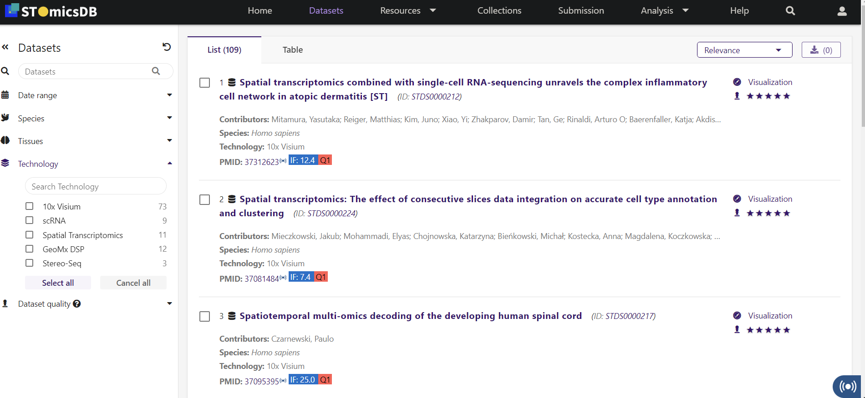
STOmicsDB
https://db.cngb.org/stomics/

Slide 20
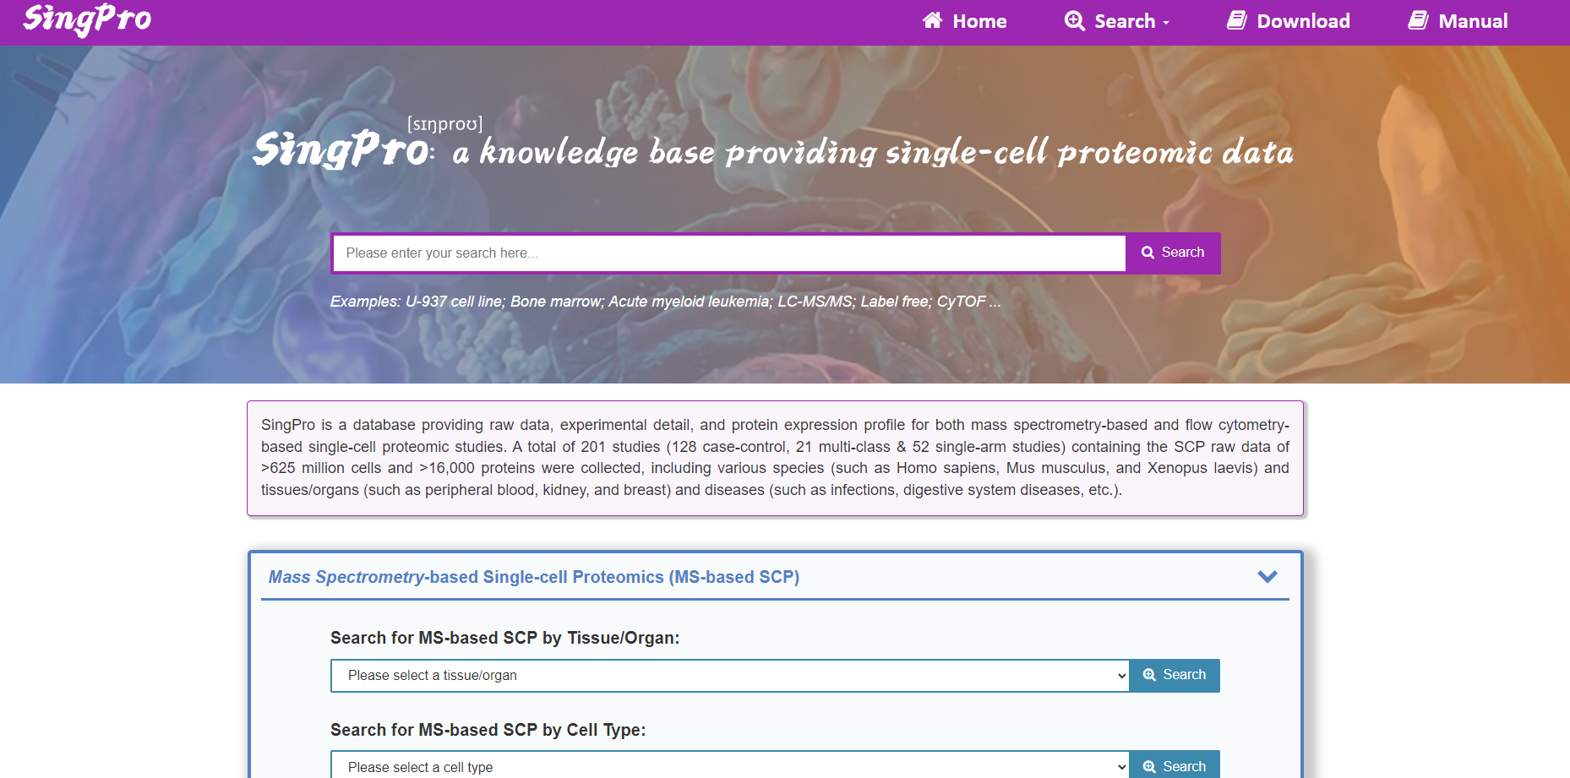
SingPro
http://singpro.idrblab.net/data/ms/details/SCP43381

Slide 21
4. Research Ideas
↓ Public Datasets ↓

Slide 22
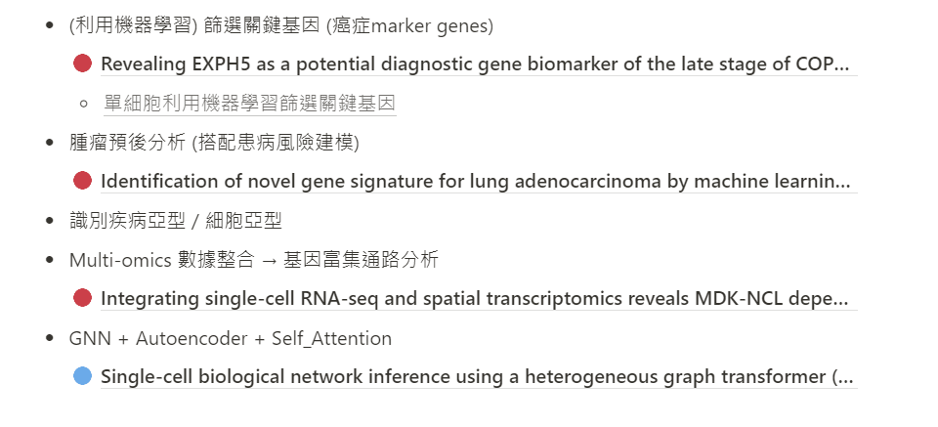
Research Ideas
Notion
表觀遺傳調控網路的建模

Slide 23
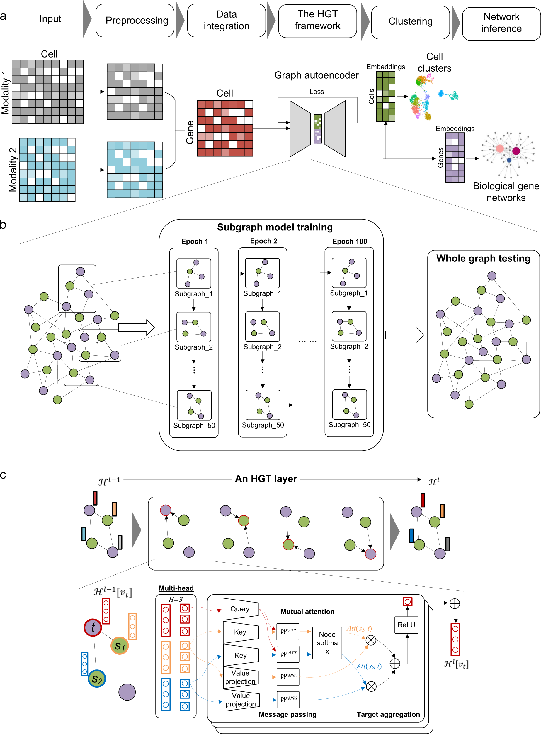
Workflow of DeepMAPS

Slide 24
HGT Layer

Slide 25
From “Methods”
scGNN: cell-cell interactions and signal transduction pathways
scRNN: identify cell types / states
scGCN: cell-cell interactions and signal transduction pathways
scGPT
LSTM: cell differentiation
Xvolustion : Convolution + Self-attention

