Slide 1
Single Cell Analysis of LUAD in Different Stages(I)
2024/02/01
Yi Jie, Chen

Slide 2
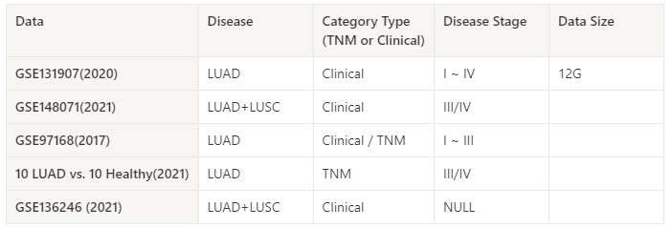
Data Collection
Clinical Records are detailed
Comprehensive and clear

Slide 3
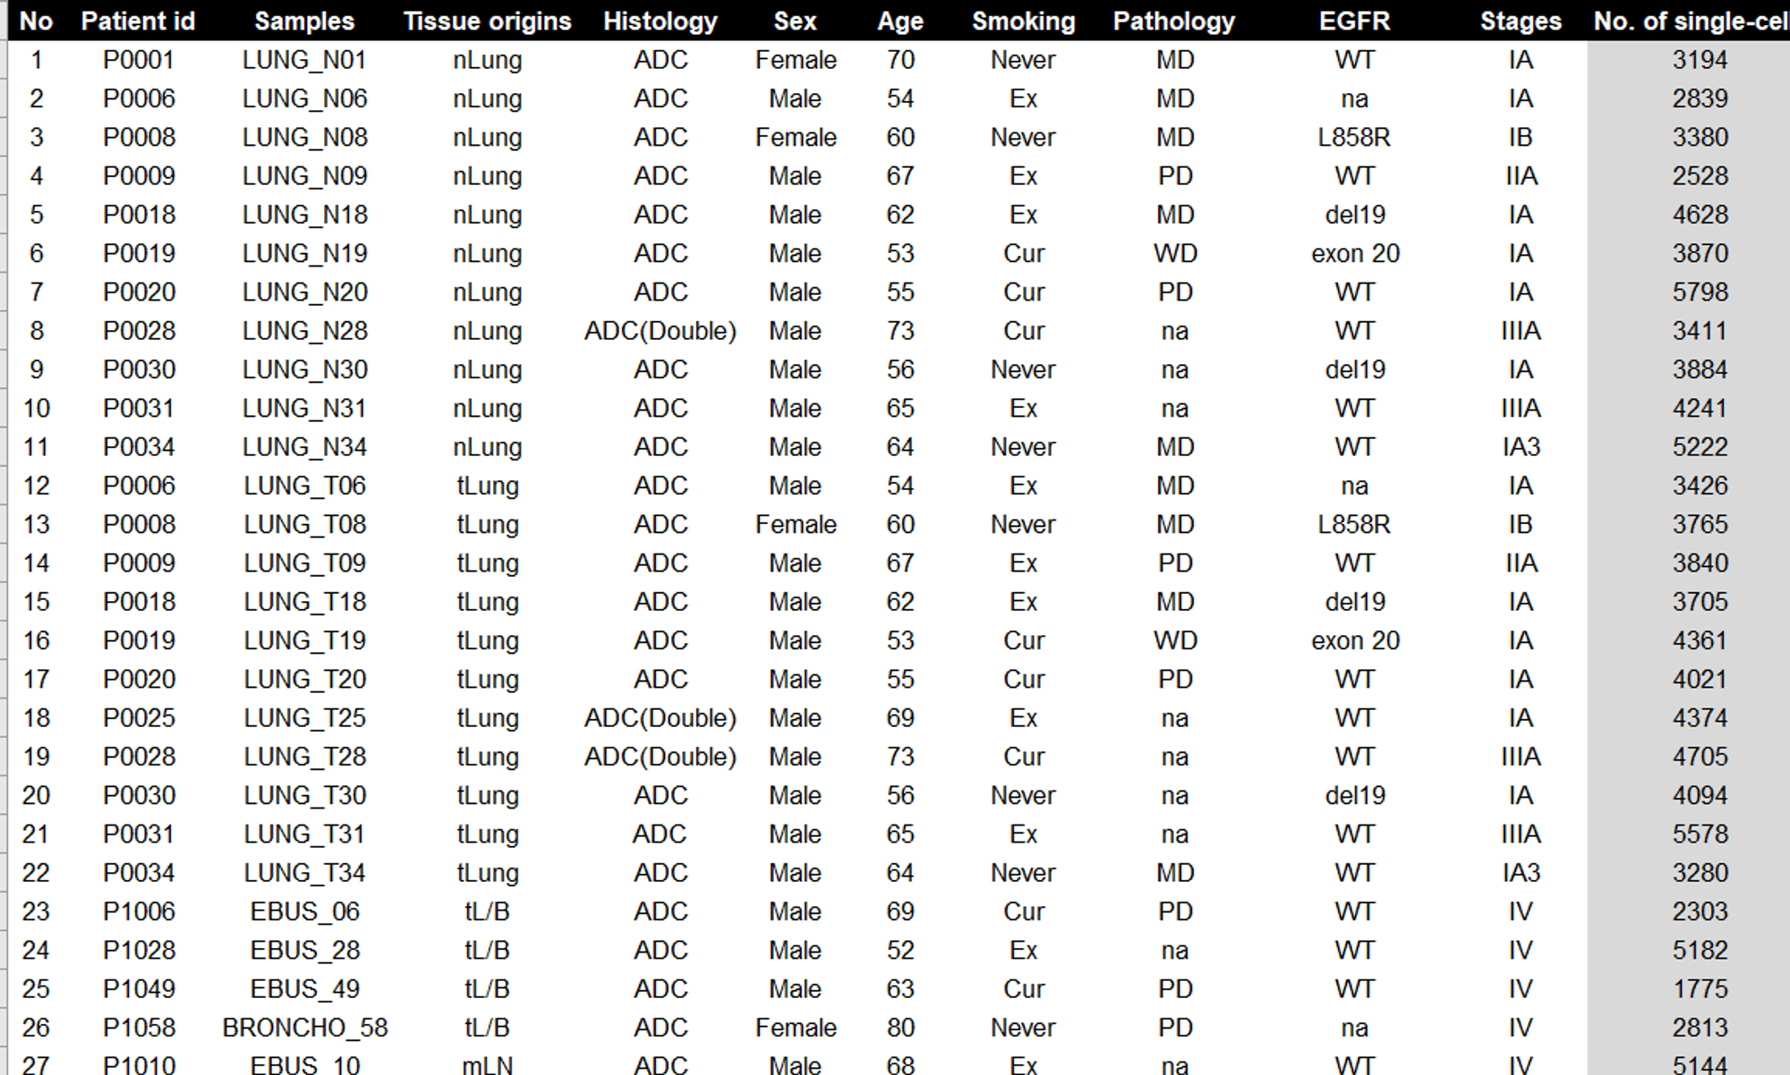
Data Format (GSE131907)
Stages
Notes:
Samples: LUNG(樣本直接來自肺部)；EBUS (Endobronchial Ultrasound，一種內窺鏡超聲波引導下的支氣管穿刺技術，用於取得肺部或周圍結構（通常是淋巴結）的樣本)；BRONCHO (Bronchoscopy，通過支氣管鏡進行肺部樣本採集)
Histology: ADC (Adenocarcinoma)；Double 可能意味著在臨床實踐中，一個患者有兩個原發性腫瘤 (或者腫瘤有兩種不同的組織學特徵)

Slide 4
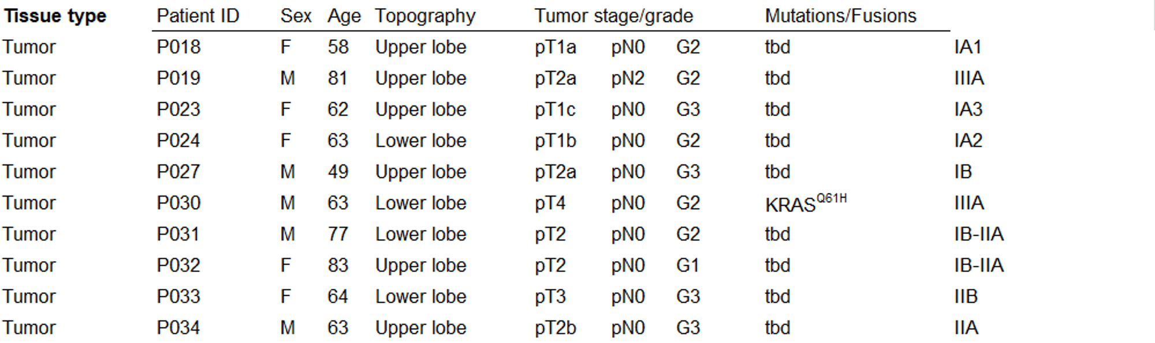
Data Transformation (10LUAD vs. 10Healthy)
Notes:
Upper Lobe: 腫瘤位在肺的上葉
Lower Lobe: 腫瘤位在肺的下葉

Slide 5
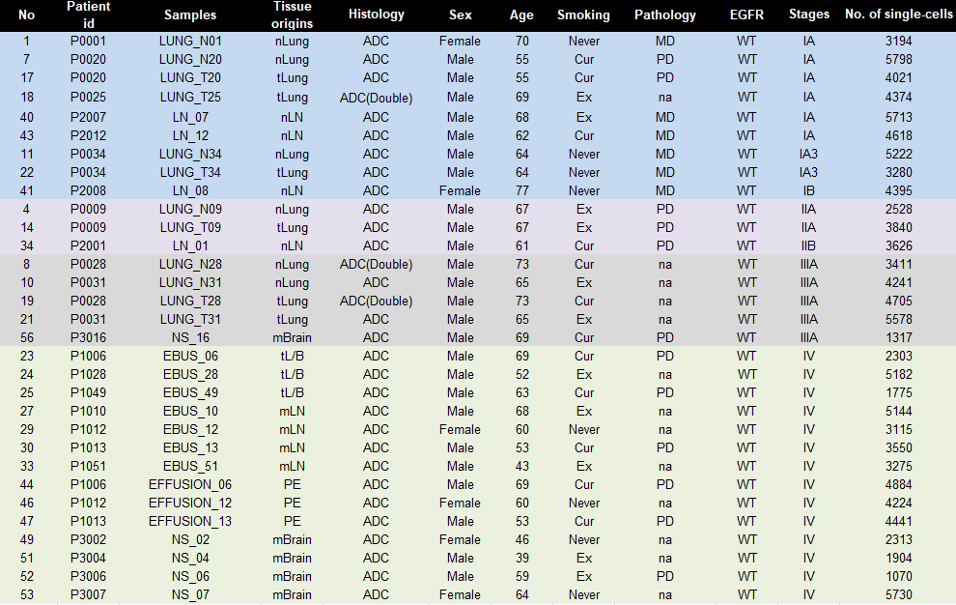
Data Extraction
Mutation is fixed
Colored by Stage
I
II
III
IV

Slide 6
Marker genes and Cell type

Slide 7
Patients in different stages
LUAD I: LUNG_N01 / LUNG_N20 / LUNG_T20
LUAD II: LUNG_N09
LUAD III: LUNG_N28
LUAD IV: EBUS_28

Slide 8
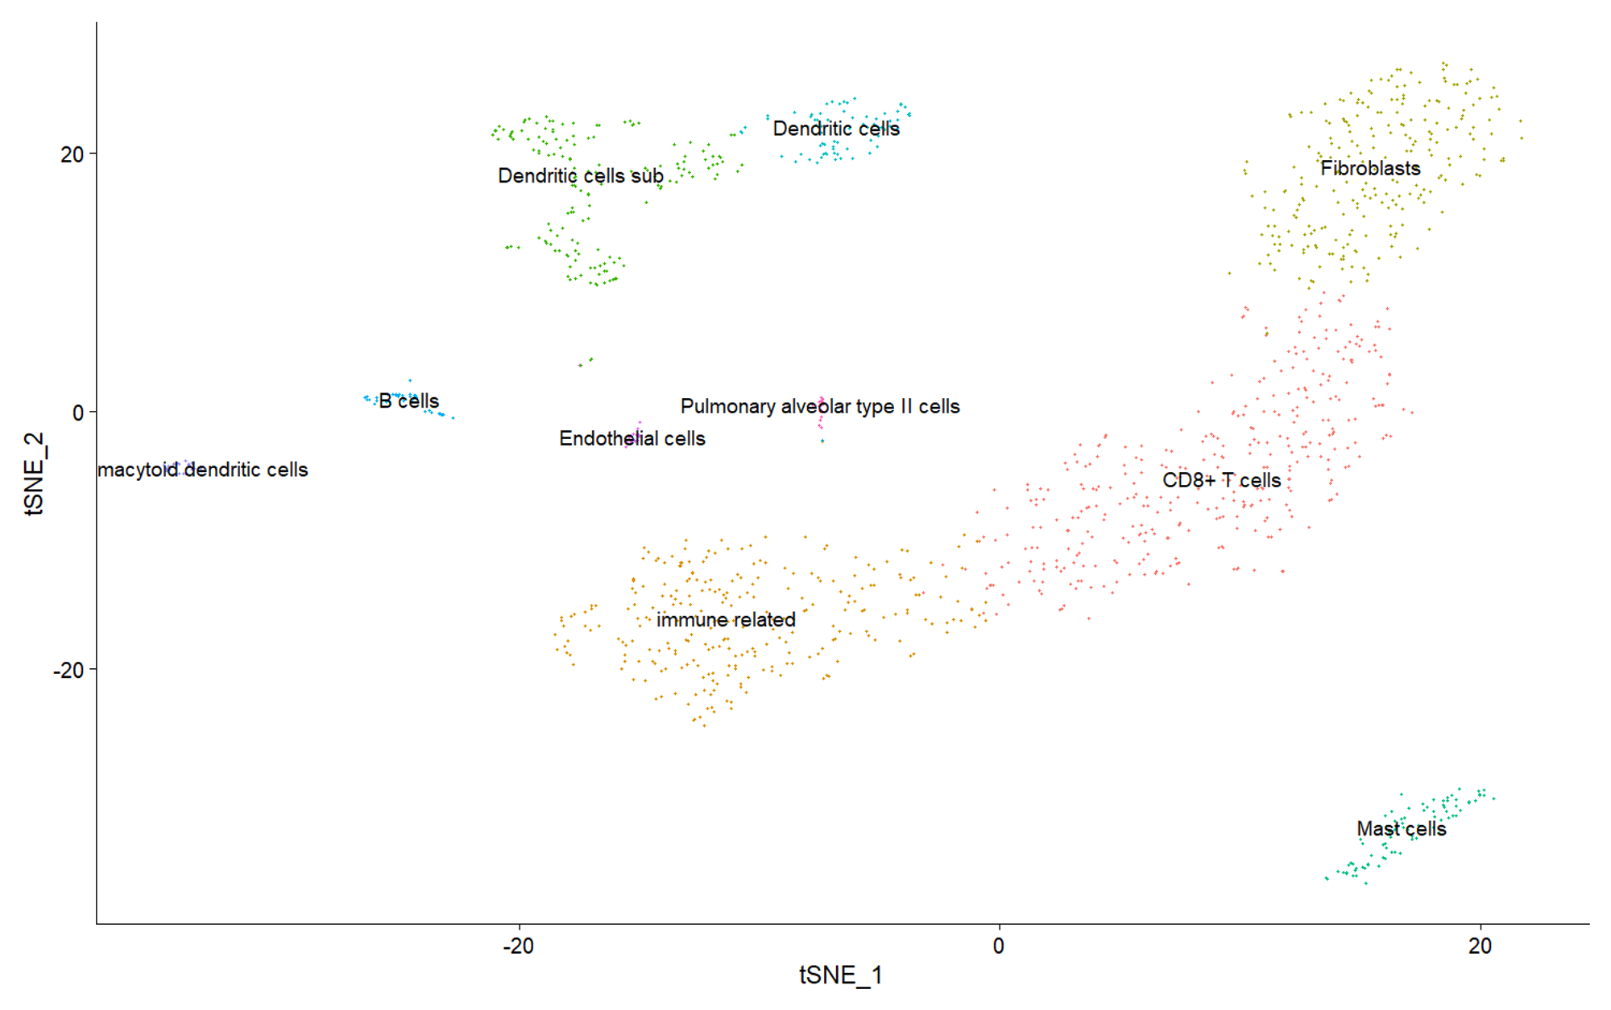
LUAD I
10 clusters
CD8+ T cell
Immune-related
Fibroblasts
Dendritic cells sub
Mast cells
Dendritic cells
B cells
Plasmacytoid dendritic cells
Endothelial cells
Pulmonary alveolar type II cells

Slide 9
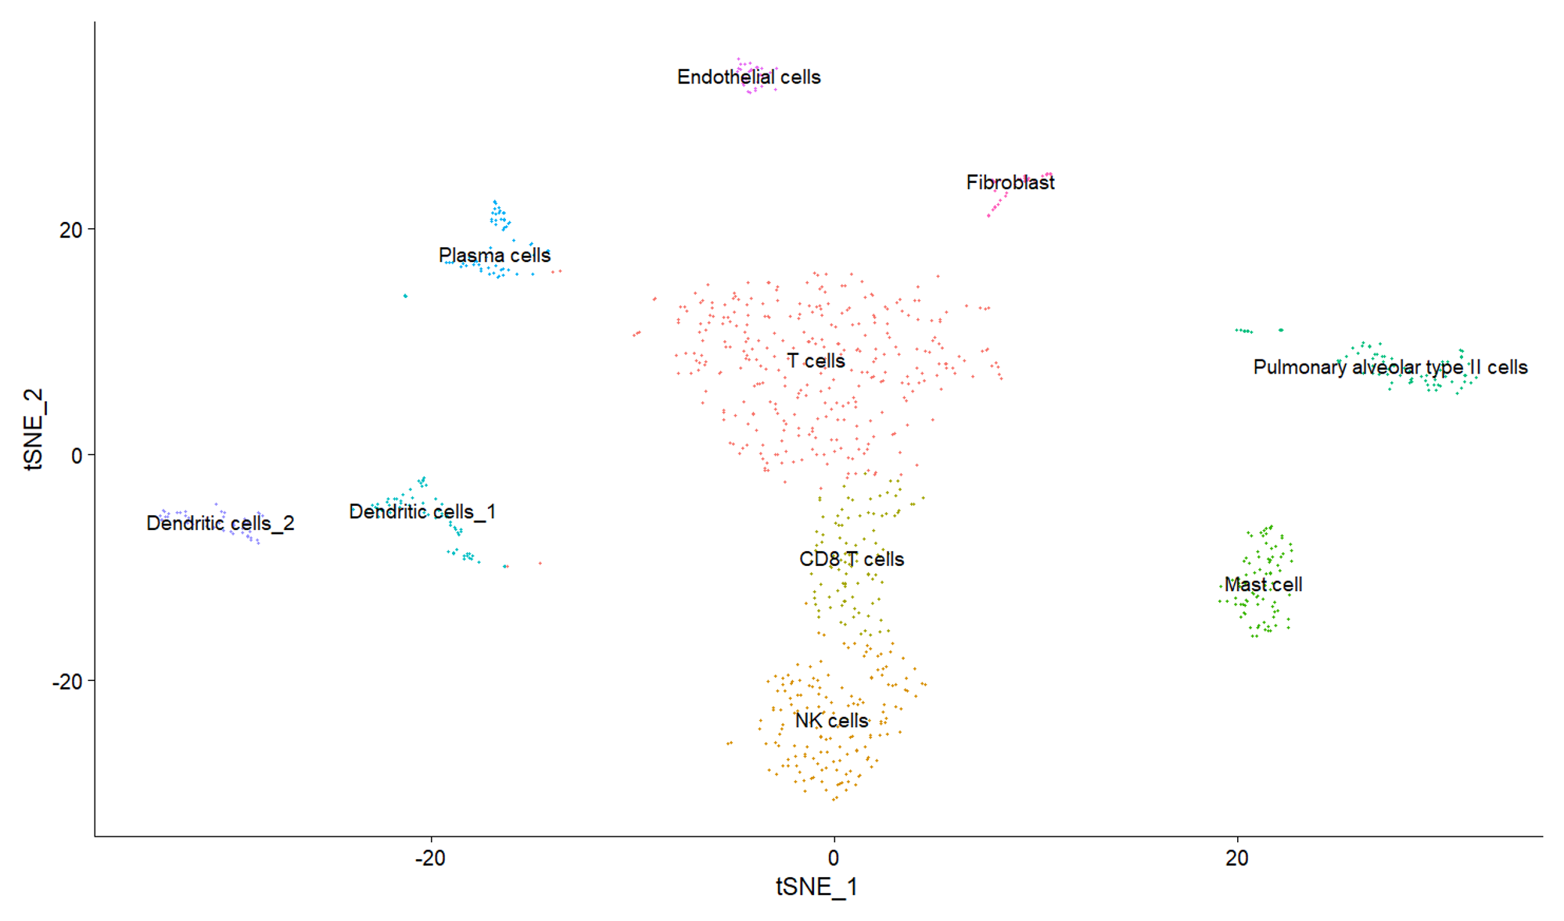
LUAD II
10 clusters
CD8+ T cell
NK cells
T cells
Fibroblasts
Mast cells
Dendritic cells 1
Dendritic cells 2
Plasma cells
Endothelial cells
Pulmonary alveolar type II cells

Slide 10
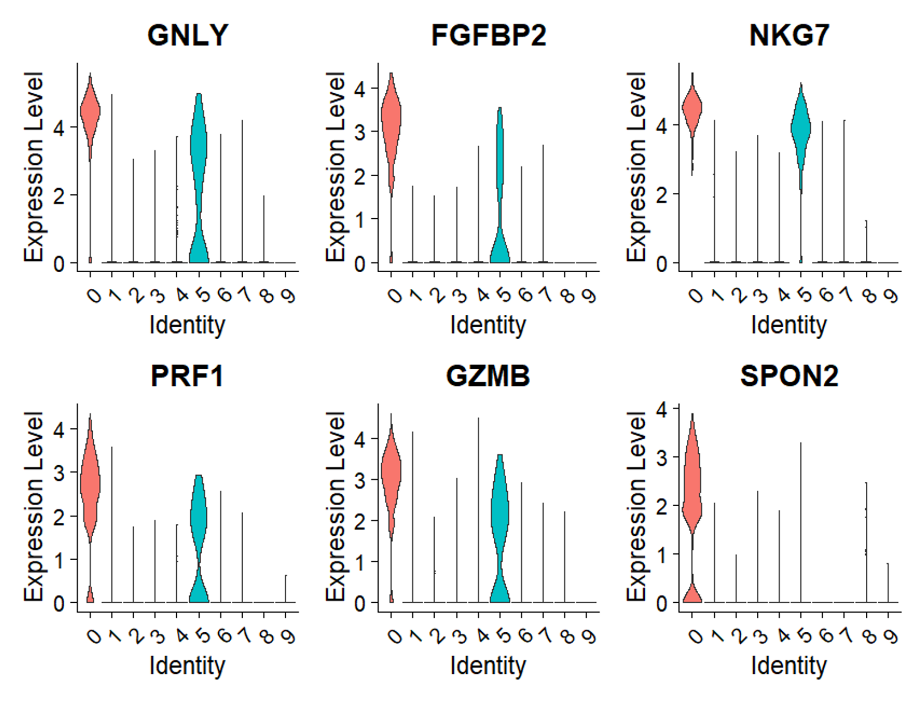
LUNG_N20 (LUNG_N01)
Gene Marker is Specified
Cell type Annotation is harder than Stage II
Stage I

Slide 11
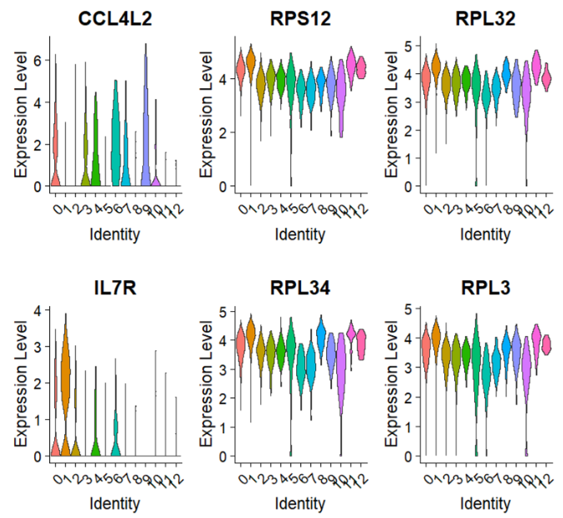
LUNG_T20
1) Immune-related Genes ↑
2) Multiple Markers
Stage I

Slide 12
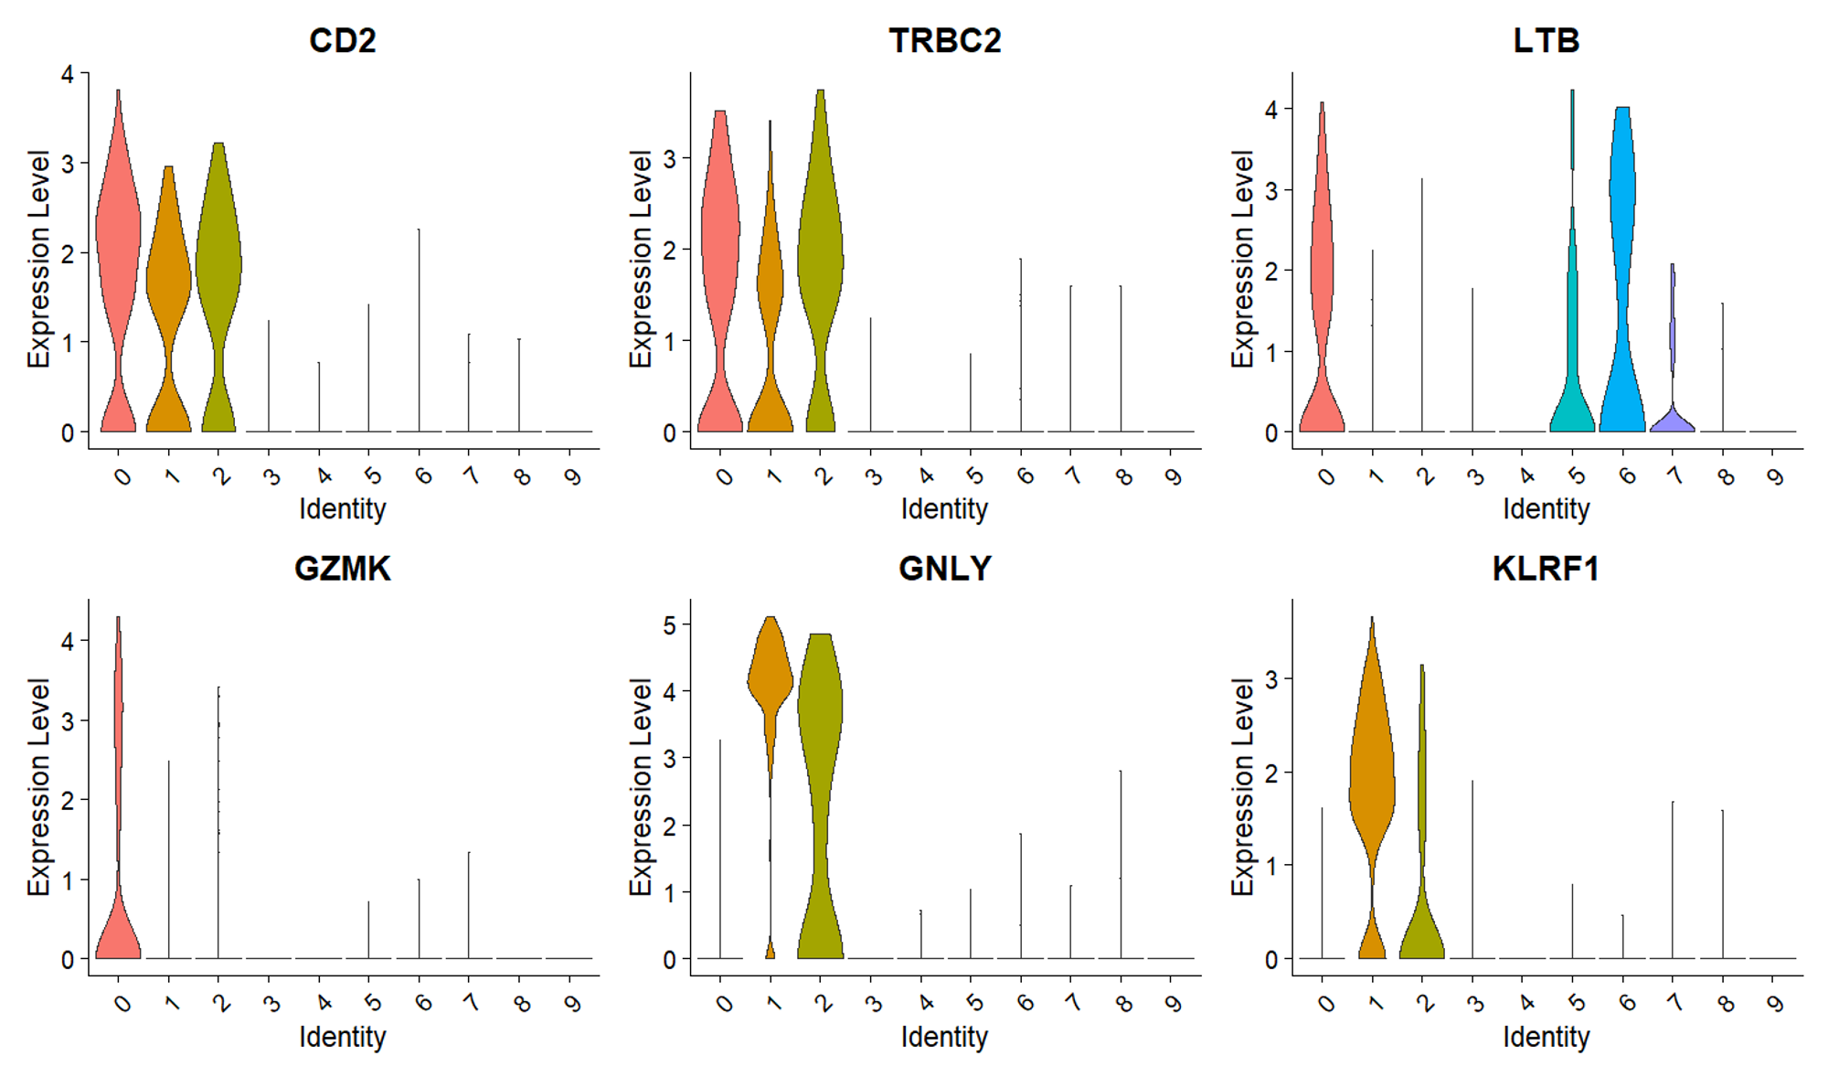
LUNG_N09
Compare to stage I,
Easier to do the
“Cell Annotation”
Stage II

Slide 13
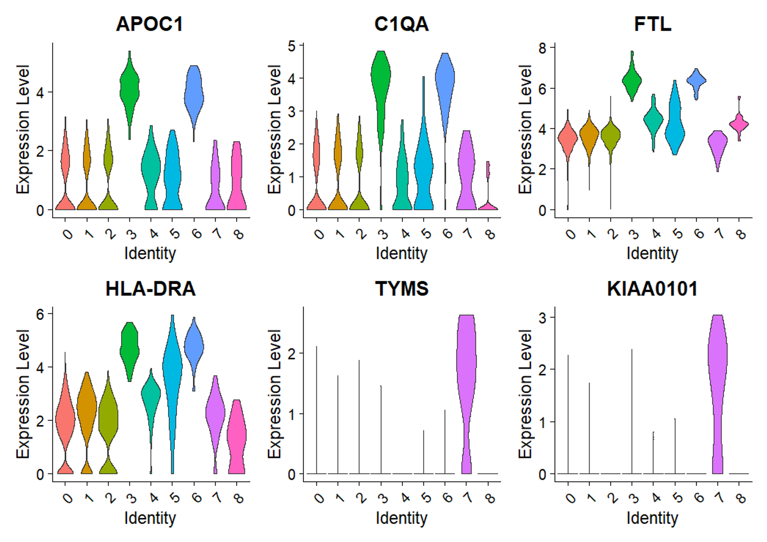
LUNG_N28
Stage III
Notes:
APOC1 和脂蛋白有關

Slide 14
Exhausted Genes Analysis

Slide 15
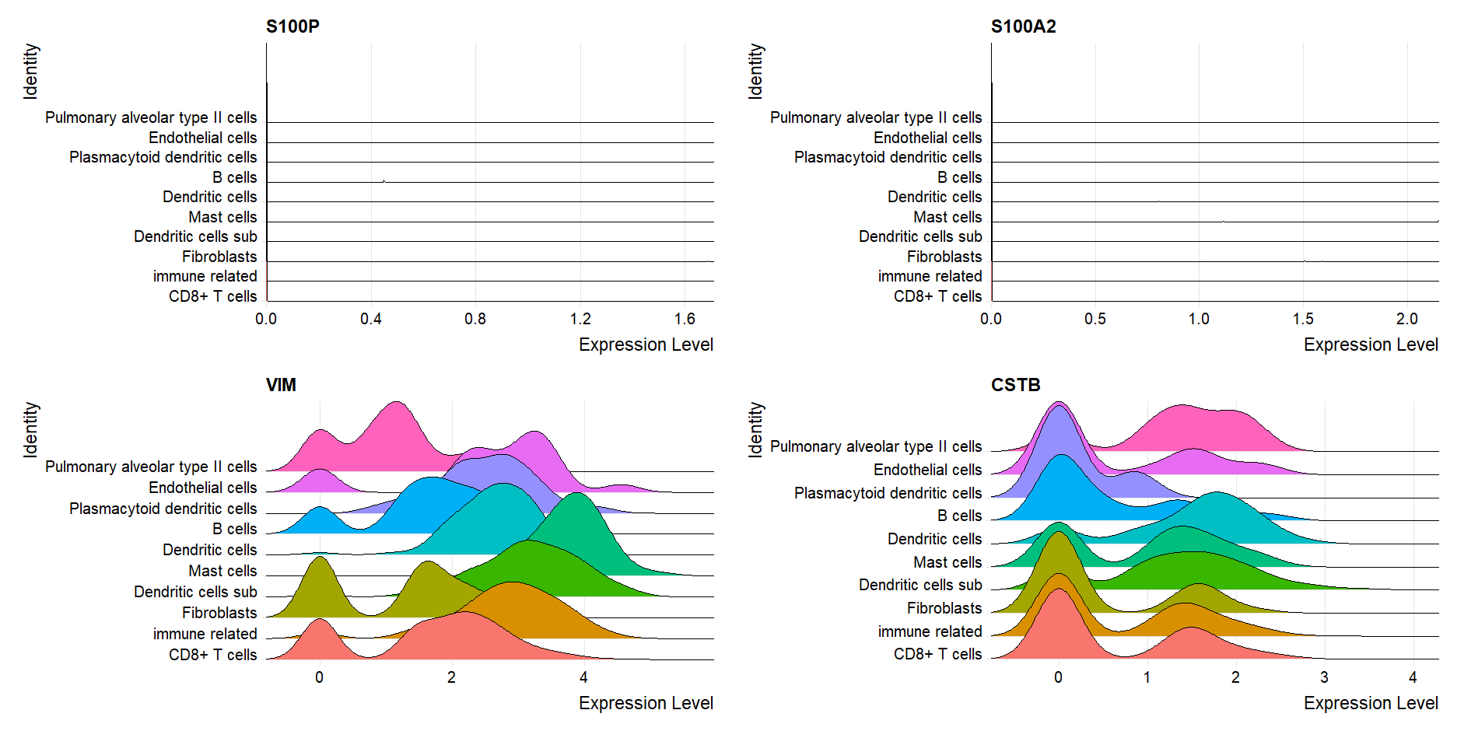
LUNG_N01
Stage I

Slide 16
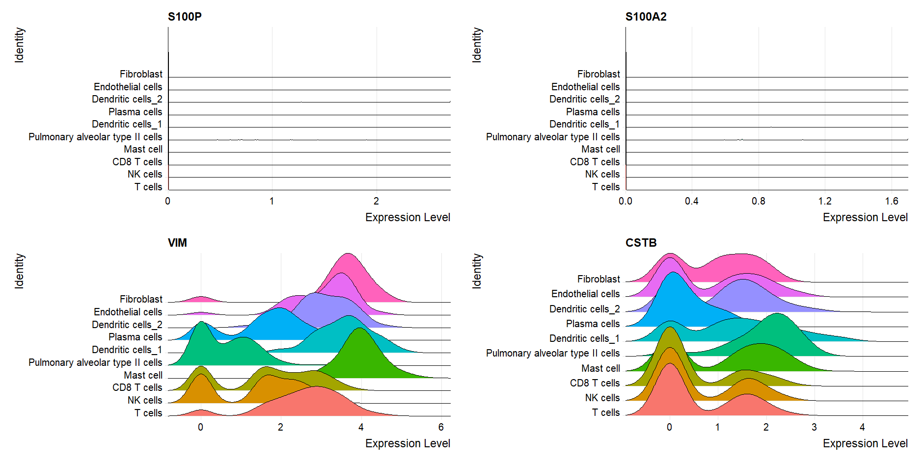
LUNG_N09
Stage II
Notes:
APOC1 和脂蛋白有關

Slide 17
LUNG_N28
Stage III

Slide 18
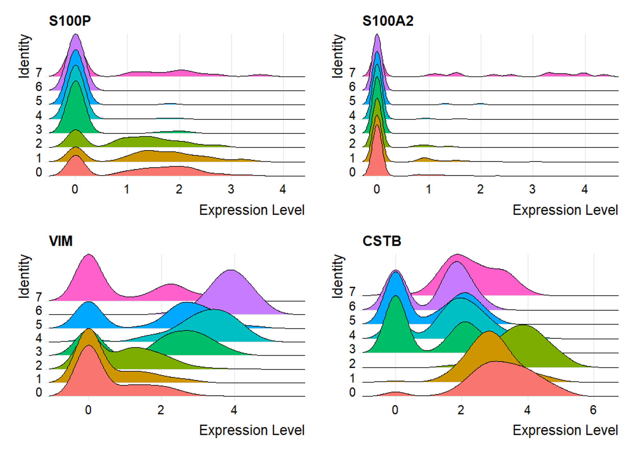
EBUS_28
Stage IV
Notes:
本研究也發現S100P大量表現在非小型肺腺癌的病患的腫瘤組織中。由此研究證實，S100P在肺癌轉移上可當作是一個標靶基因，也可以當作預後的生物指標
https://www.airitilibrary.com/Article/Detail/U0011-1807201416474700

Slide 19
Trajectory Analysis

Slide 20
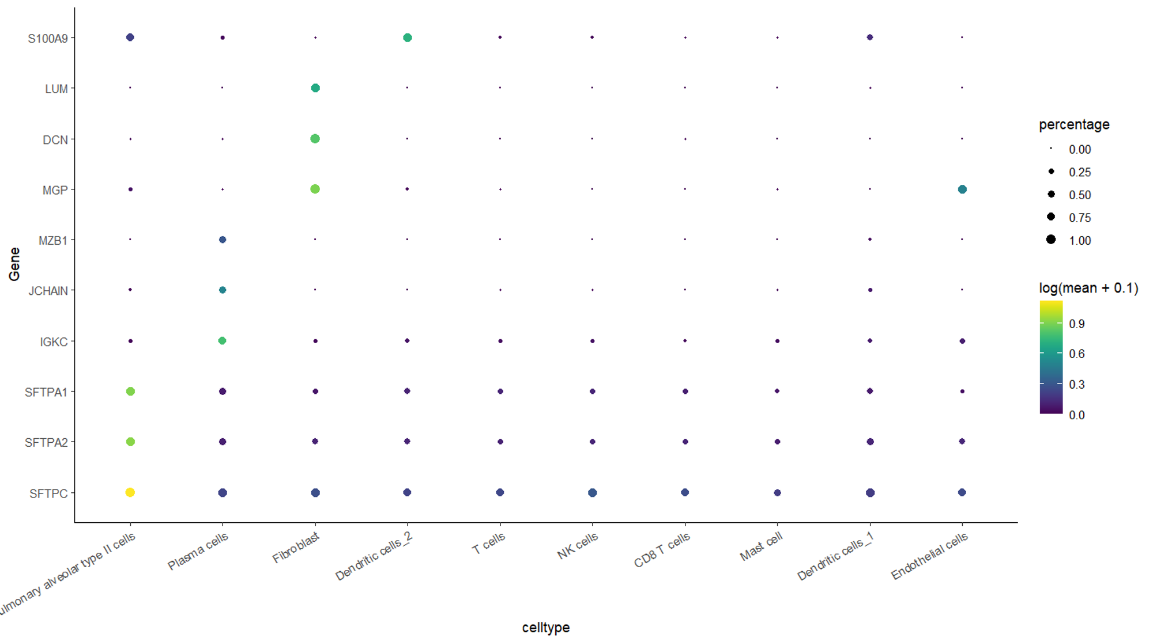

Slide 21
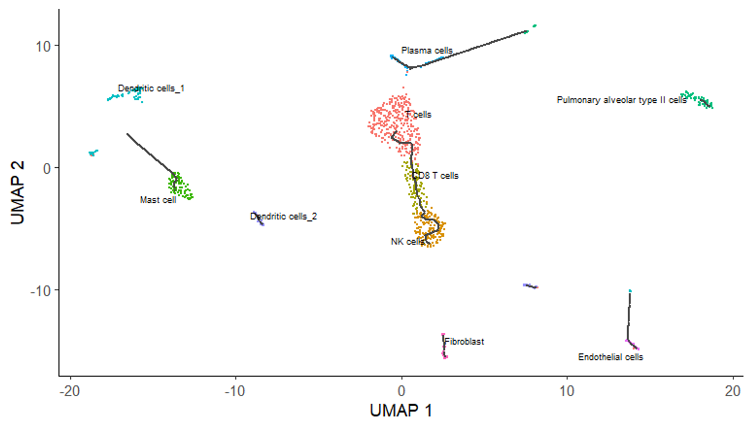

Slide 22
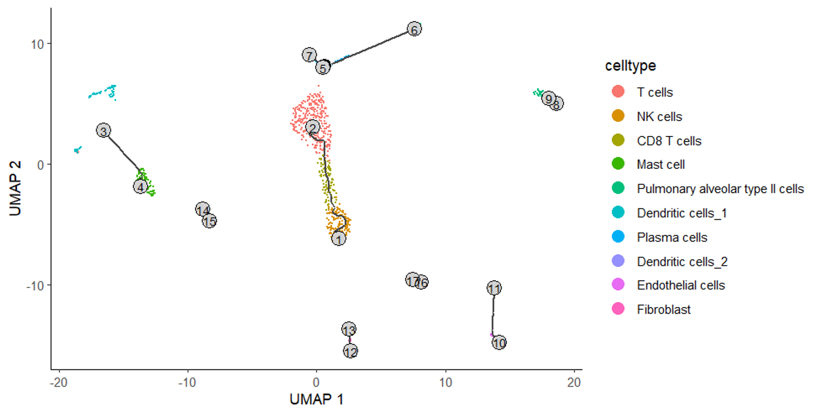

Slide 23
