Slide 1
Retrospect and Prospect
2024.01.05
Chen, Yi-Jie

Slide 2
Reflecting on 2023...
Learning curve is too smooth
Attitude
| Meeting the requirements, instead of achieving perfection
Course Assignments / Exams
Research Topics
七月
八月
九月
十月
十一月
十二月
Online Courses
Seurat
Monocle3
SIMBA
scover
Signac
| SEACells
| ArchR

Slide 3
Prospect of 2024
Hard to ask some valuable questions, but give it a try
~ March
Get the Direction of Research Topics
The Application of Tools Seurat、Monocles、SIMBA、Signac、scover、SEACells、ArchR
~ June
Analysis of Research Topics
Assess the applicability of specific analysis methods
~ September
Assay Script : Preprocessing, Analysis, Visualization
~ December
Assay Revise

Slide 4
Progress Report
Chen, Yi Jie
2024.01.05

Slide 5
Outline
Two Questions about scover
Scover preprocessing -- SEACells
Notes:
Monlcle3 和 Monocle2 可以視為兩個不同的工具

Slide 6
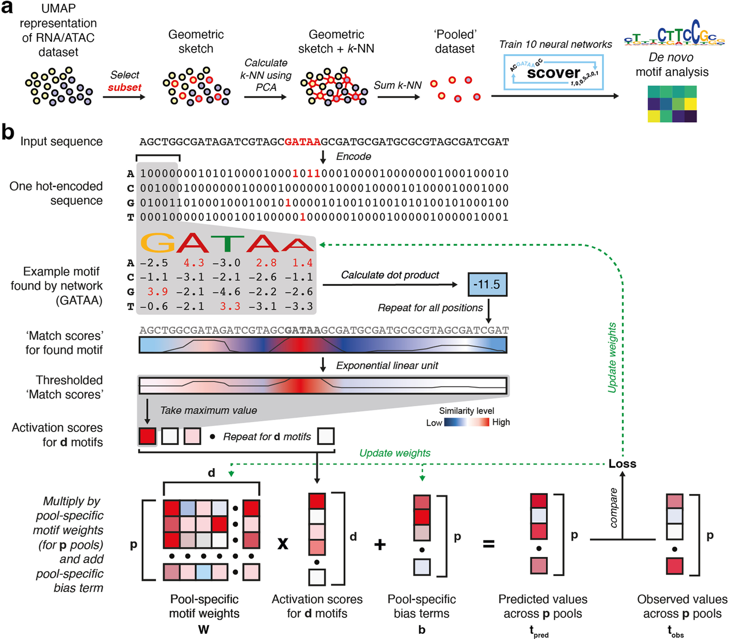

Slide 7

Ten Neural Networks

Slide 8
De Novo?
Notes:
模式重複性：新基序如果在多個細胞或實驗條件下出現，且具有統計顯著性，他可能會被識別為一個有效的 motif
保守性：新發現的基序是否具有一定程度的保守性，即是否在不同細胞類型或不同生物體中都存在相似的模式
與基因表達的相關性：通過計算 Spearman，對 motif cluster c中基序的總影響得分與所有 pool 中 TF t的表達水平之間的關係進行排序。 (motif 與特定TF結合的關聯程度)

Slide 9
Preprocessing - SEACells

Slide 10
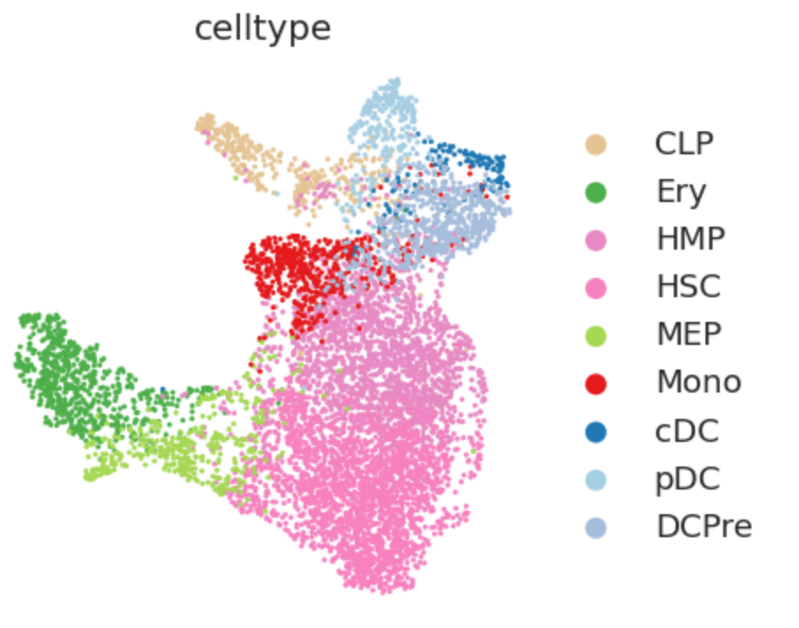
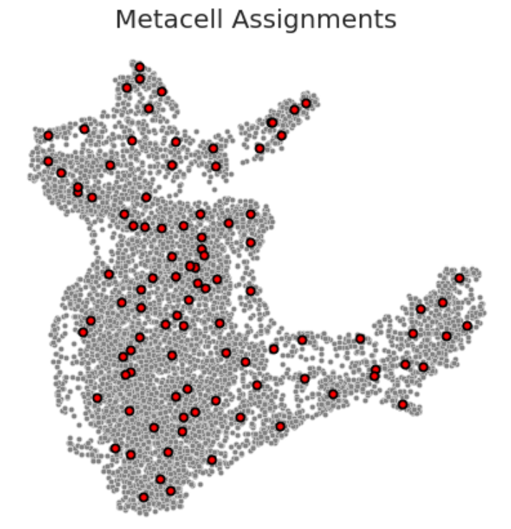
To Solve Sparse Matrix Problem
Pseudo-Bulk RNA
MetaCell

Slide 11
Five Steps for SEACells Algorithm
1. Construct k-NN Graph
Euclidean Distance
2. Derive an affinity matrix of cell-to-cell similarities using k-NN graph
Adaptive Gaussian Kernel
3. Use the kernel matrix as the input for archetypal analysis
archetype matrix
membership matrix
4. Derive a metacell-by-feature count matrix
5. Normalize count matrices

Slide 12
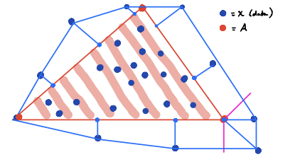


Archetype Analysis
DEFINITION
An unsupervised learning method used to identify extreme patterns or "archetypes" from data
PURPOSE
Find representative points for extreme behaviors in the data
FORMULA
FOR SINGLE CELL
Understanding Heterogeneity
Revealing Hidden Patterns: Identify less observable or rare phenomena
S
Notes:
A 是每個數據點在每個典型點上的權重
S 是典型點的集合
B^(T) 是將典型點重新組合回原始數據空間的轉置矩陣。也就是我們可以通過這些典型點來近似重建原始數據集
最小化數據點和他們投影之間的距離

Slide 13
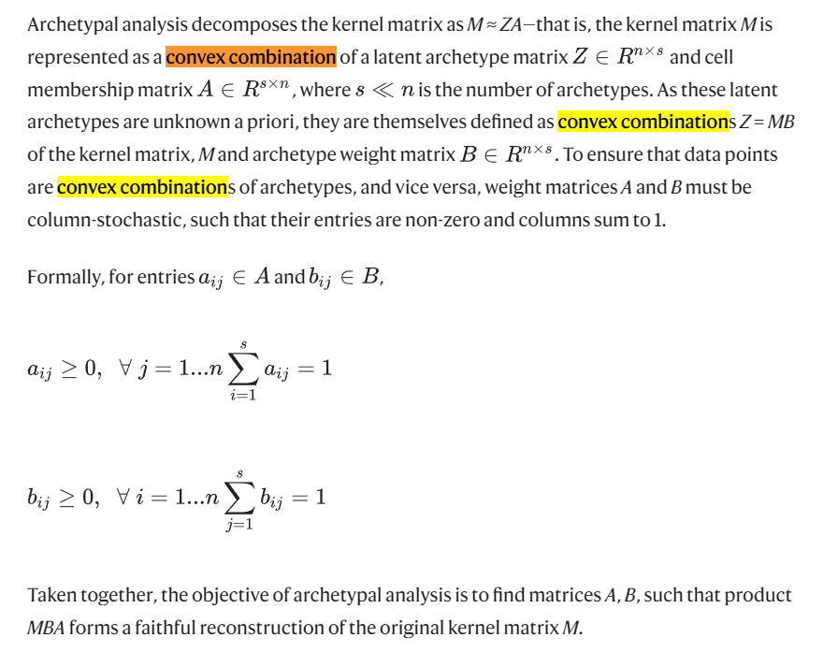

Slide 14
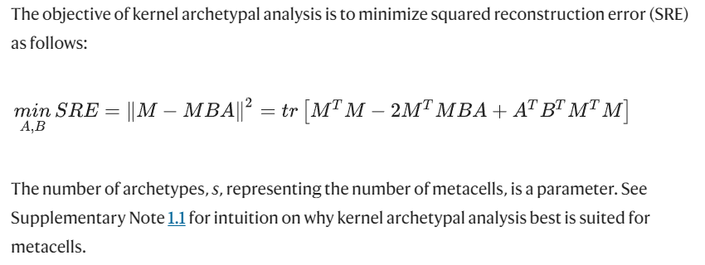

Slide 15
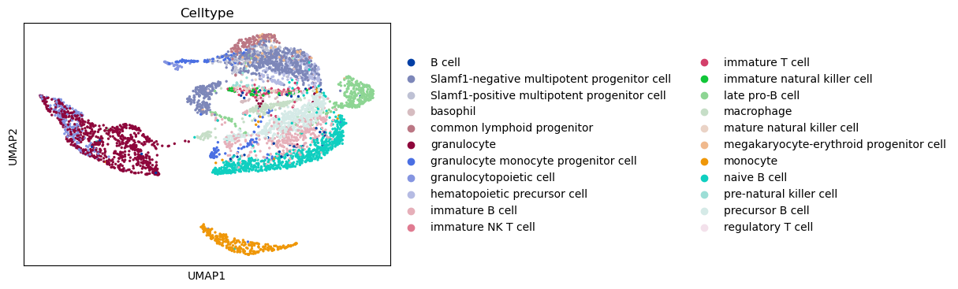
(Original) UMAP

Slide 16
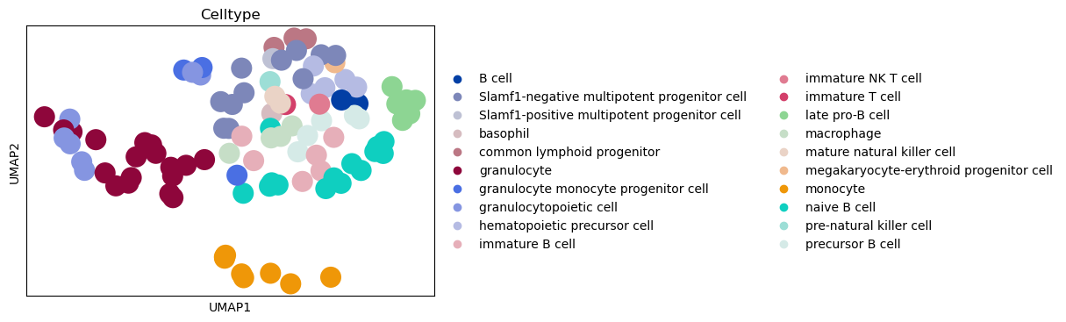
(Sketch) UMAP
N_seeds = 100
sketch_index = gs(adata.obsm['X_umap'], N_seeds, replace=False)
sketch_index[0:10]
ad_sketch = adata[sketch_index,:]
ad_sketch.obsm["X_pca"] = adata.obsm['X_pca'][sketch_index,:]
ad_sketch.obsm["X_umap"] = adata.obsm['X_umap'][sketch_index,:]
Notes:
Dataset 分的不好的。Biomarker/ methylation
Collect Single Cell Cancer Data / ATAC + Cell Specific Network (疾病 / Dataset)
要先 focus 在什麼疾病，然後有沒有相關的 dataset
Single cell kinase?? / phosphorylation
多種維度，思考 single cell 怎麼去做 modeling

Slide 17
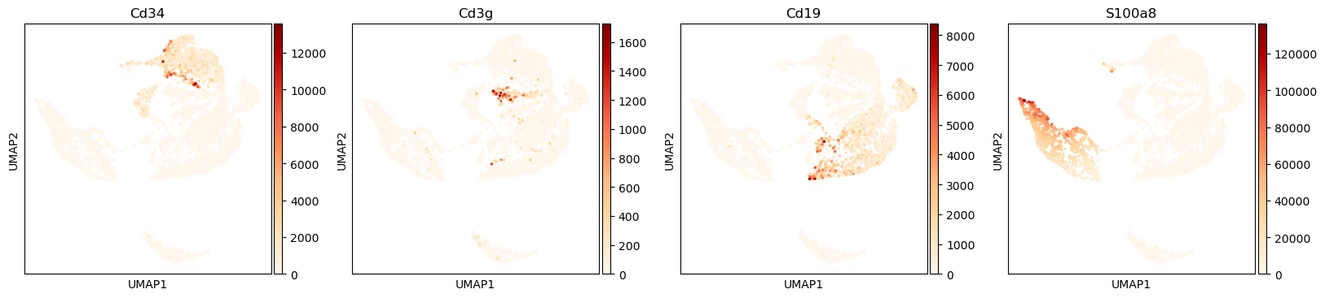
Original Dataset

Slide 18
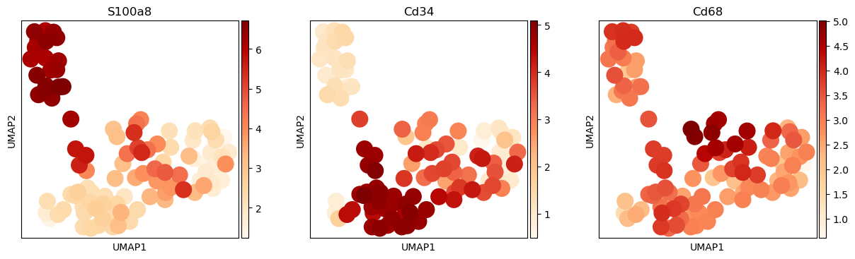
Pooled Dataset

