Slide 1
SIMBA: single-cell embedding along with features
Huidong Chen, Jayoung Ryu, Michael E. Vinyard, Adam Lerer & Luca Pinello (2023)
Nature Methods
Speaker: Chen, Yi-Jie
Advisor : Lee, Tzong-Yi
Notes:
Hello everyone, my name is 陳怡婕。 today I want to introduce a biotools – SIMBA, this biotools is used on single cell analysis. And the paper is published in Nature Methods.
The topic is related to my own research, that’s why I choose it.

Slide 2
Presentation 方向和問題
一張Result的圖究竟要不要拆開成多張？
Method 是否要搭配 Result 說？先後順序呢？
怎麼去定義 Cluster 好不好這件事？(SIMBA vs. Seurat)

Slide 3
Method + Result 一起講
Method1(scRNA)+ Method2(scATAC) 一起講

Slide 4
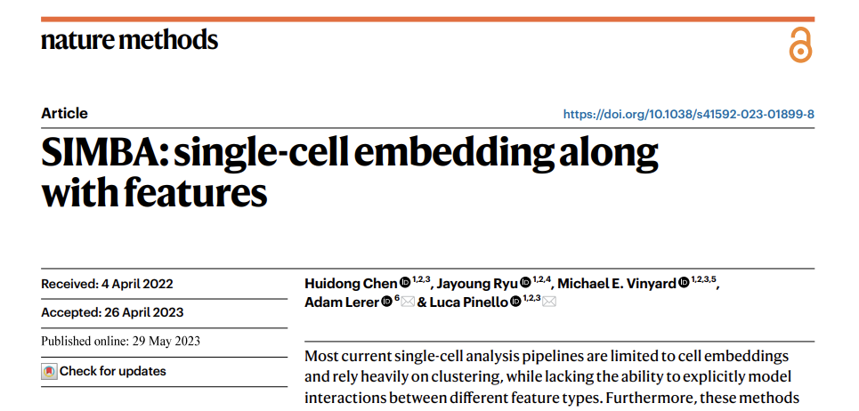
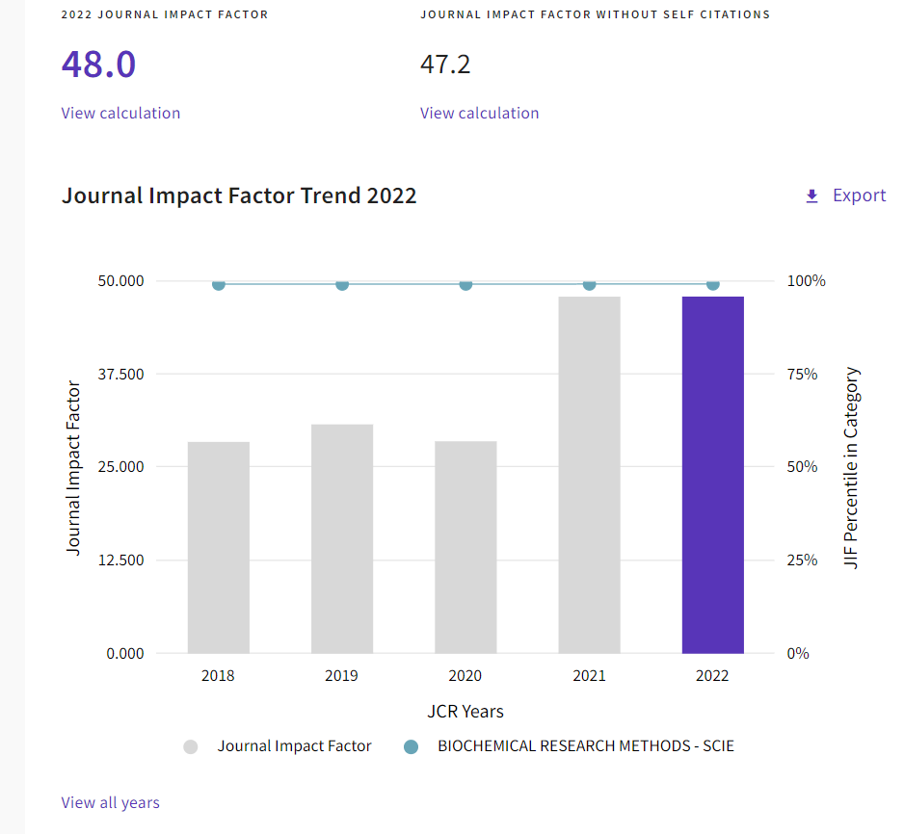
https://jcr.clarivate.com/jcr-jp/journal-profile?journal=NAT%20METHODS&year=2022&fromPage=%2Fjcr%2Fsearch-results
Notes:
And many of us know, papers published in 'Nature Methods' are based on methodologies, so their citation numbers are naturally higher, leading to very high impact factors.

Slide 5
Background
Most current single-cell analysis pipelines rely heavily on clustering
False Discovery (just because they are clustered by similar characteristics)
Lots of single-cell computational methods are developed for the analysis of one modality
….these are also our obstacles
Notes:
But before introducing SIMBA. I would like to first discuss the current challenges in single-cell analysis.
The first one is “Most current single-cell analysis pipelines rely heavily on clustering”, it may lead to False Discovery.
What is false discovery? It is like you group two genes together based on some similar characteristics, for example, high expression level.
However, this can be a random error. It is possible that two genes are not related.
The similarity you see might just be a coincidence, rather than the reason you explained.
The second challenge is many computational methods nowadays in single-cell analysis are developed for one modality.
One modality means there is only one data type. For example, the computational method is only suitable for RNA data, or for proteomics data, or for methylation data.
So actually, we don’t have suitable methods to analyze multiple different types of data simultaneously.

Slide 6
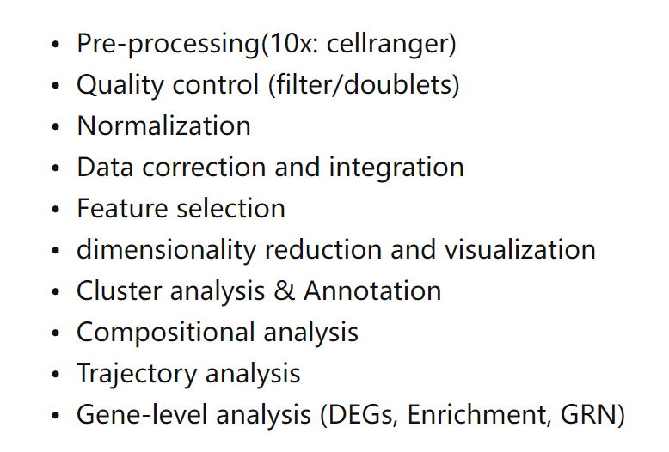
General Workflow for scRNA Analysis
https://www.embopress.org/doi/full/10.15252/msb.20188746
Notes:
This is a picture captured by a paper which summarizes the steps of mainstream scRNA analysis currently in use.
You can clearly see that the cluster analysis is right above.
You can regard clustering as an important step for scRNA alaysis.

Slide 7
The Limitation of Clustering
Presumed Number of Groups
Non-linear Structures and Continuous Variation
Sensitivity to Noise and Outliers

Slide 8
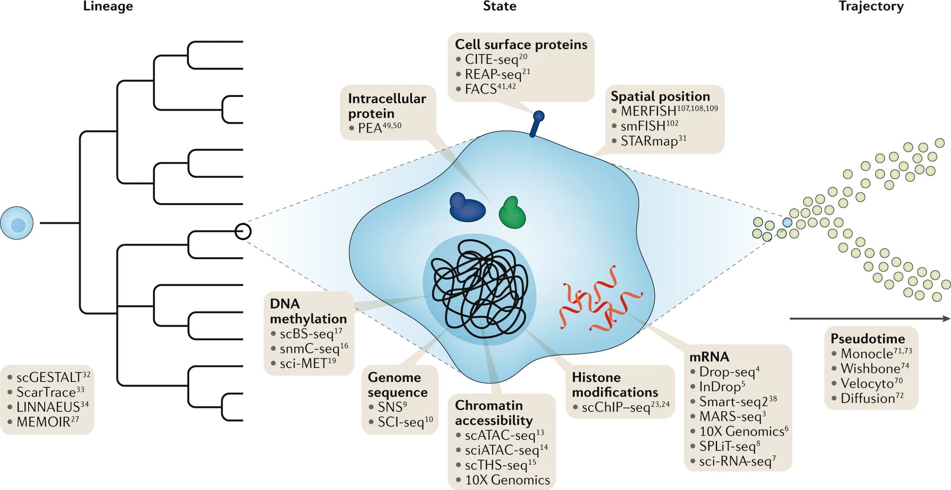
Notes:
Here we can see there are so many information in single cell. For instance, (methylation, genome sequence, chromatin accessibility and also mRNA.)

Slide 9
This is what SIMBA want to ACHIEVE
An clustering-free approach
Building the model considering interactions between different feature
A graph embedding method

Slide 10
This is what SIMBA want to ACHIEVE
A graph embedding method
a common latent space
Cell
mRNA (scRNA)
Chromatin Accessibility (scATAC)
TF motif
DNA sequence
Notes:
When we collect multiple different types of data, we regard them as a feature. And we input this feature, embedding them on a 2D graph.
We employ some techniques and computational methods to identify the relationships between these features, and then we connect these features, these nodes together.

Slide 11
Overview

Slide 12
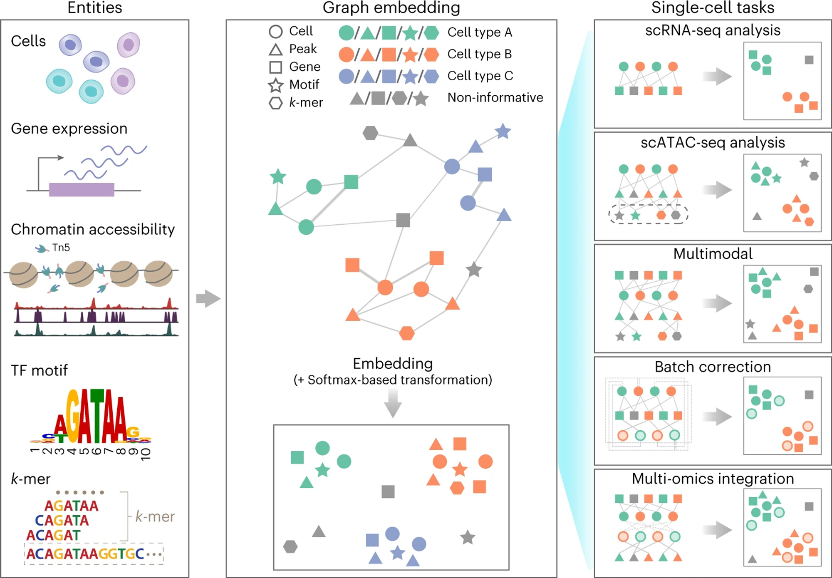
Notes:
In the analysis workflow of SIMBA, five types of data are collected.
Let me spend a little time to explain these data format. I think you guys are familiar with cells and gene expression, but maybe not that familiar with these three types.
Let’s explain TF motif first, TF refers to “Transcription Factor”, transcription factors are specialized proteins that play a crucial role in turning genes on or off.
They do so by recognizing and binding to specific short sequences of DNA, referred to as "TF motifs“, a specific sequence of DNA that can be bound by transcription factors
Chromatin accessibility, reveals which regions of the DNA within a cell are accessible to transcription factors. If there is a high peak, means the region is accessible for transcription factors.
k-mer, ummm….k refers to number, so "k-mer" refers to a substring of DNA that is "k" nucleotides long. Basically, k-mer can let us know the frequency, how many times these fragments had shown up.
And knowing this we can assess the similarities between sequences.
These Data will be transformed to different signature, which means these nodes. Then be placed onto a graph, and certain computational methods are utilized to find associations, then connecting these nodes. We call this process “Embedding”. After Embedding, we employ softmax transformation, we are able to identify the relationship between these cells, genes, chromatin accessibility, TF motif, and k-mer. Dividing different cells and features to different groups based on their association.
And this kind of embedding, or this kind of method. Could be used to multiple single-cell tasks. RNA, ATAC, multimodal, batch correction and multi-omics integration.

Slide 13
Results
Notes:
After explaining so much, let’s move to result.

Slide 14
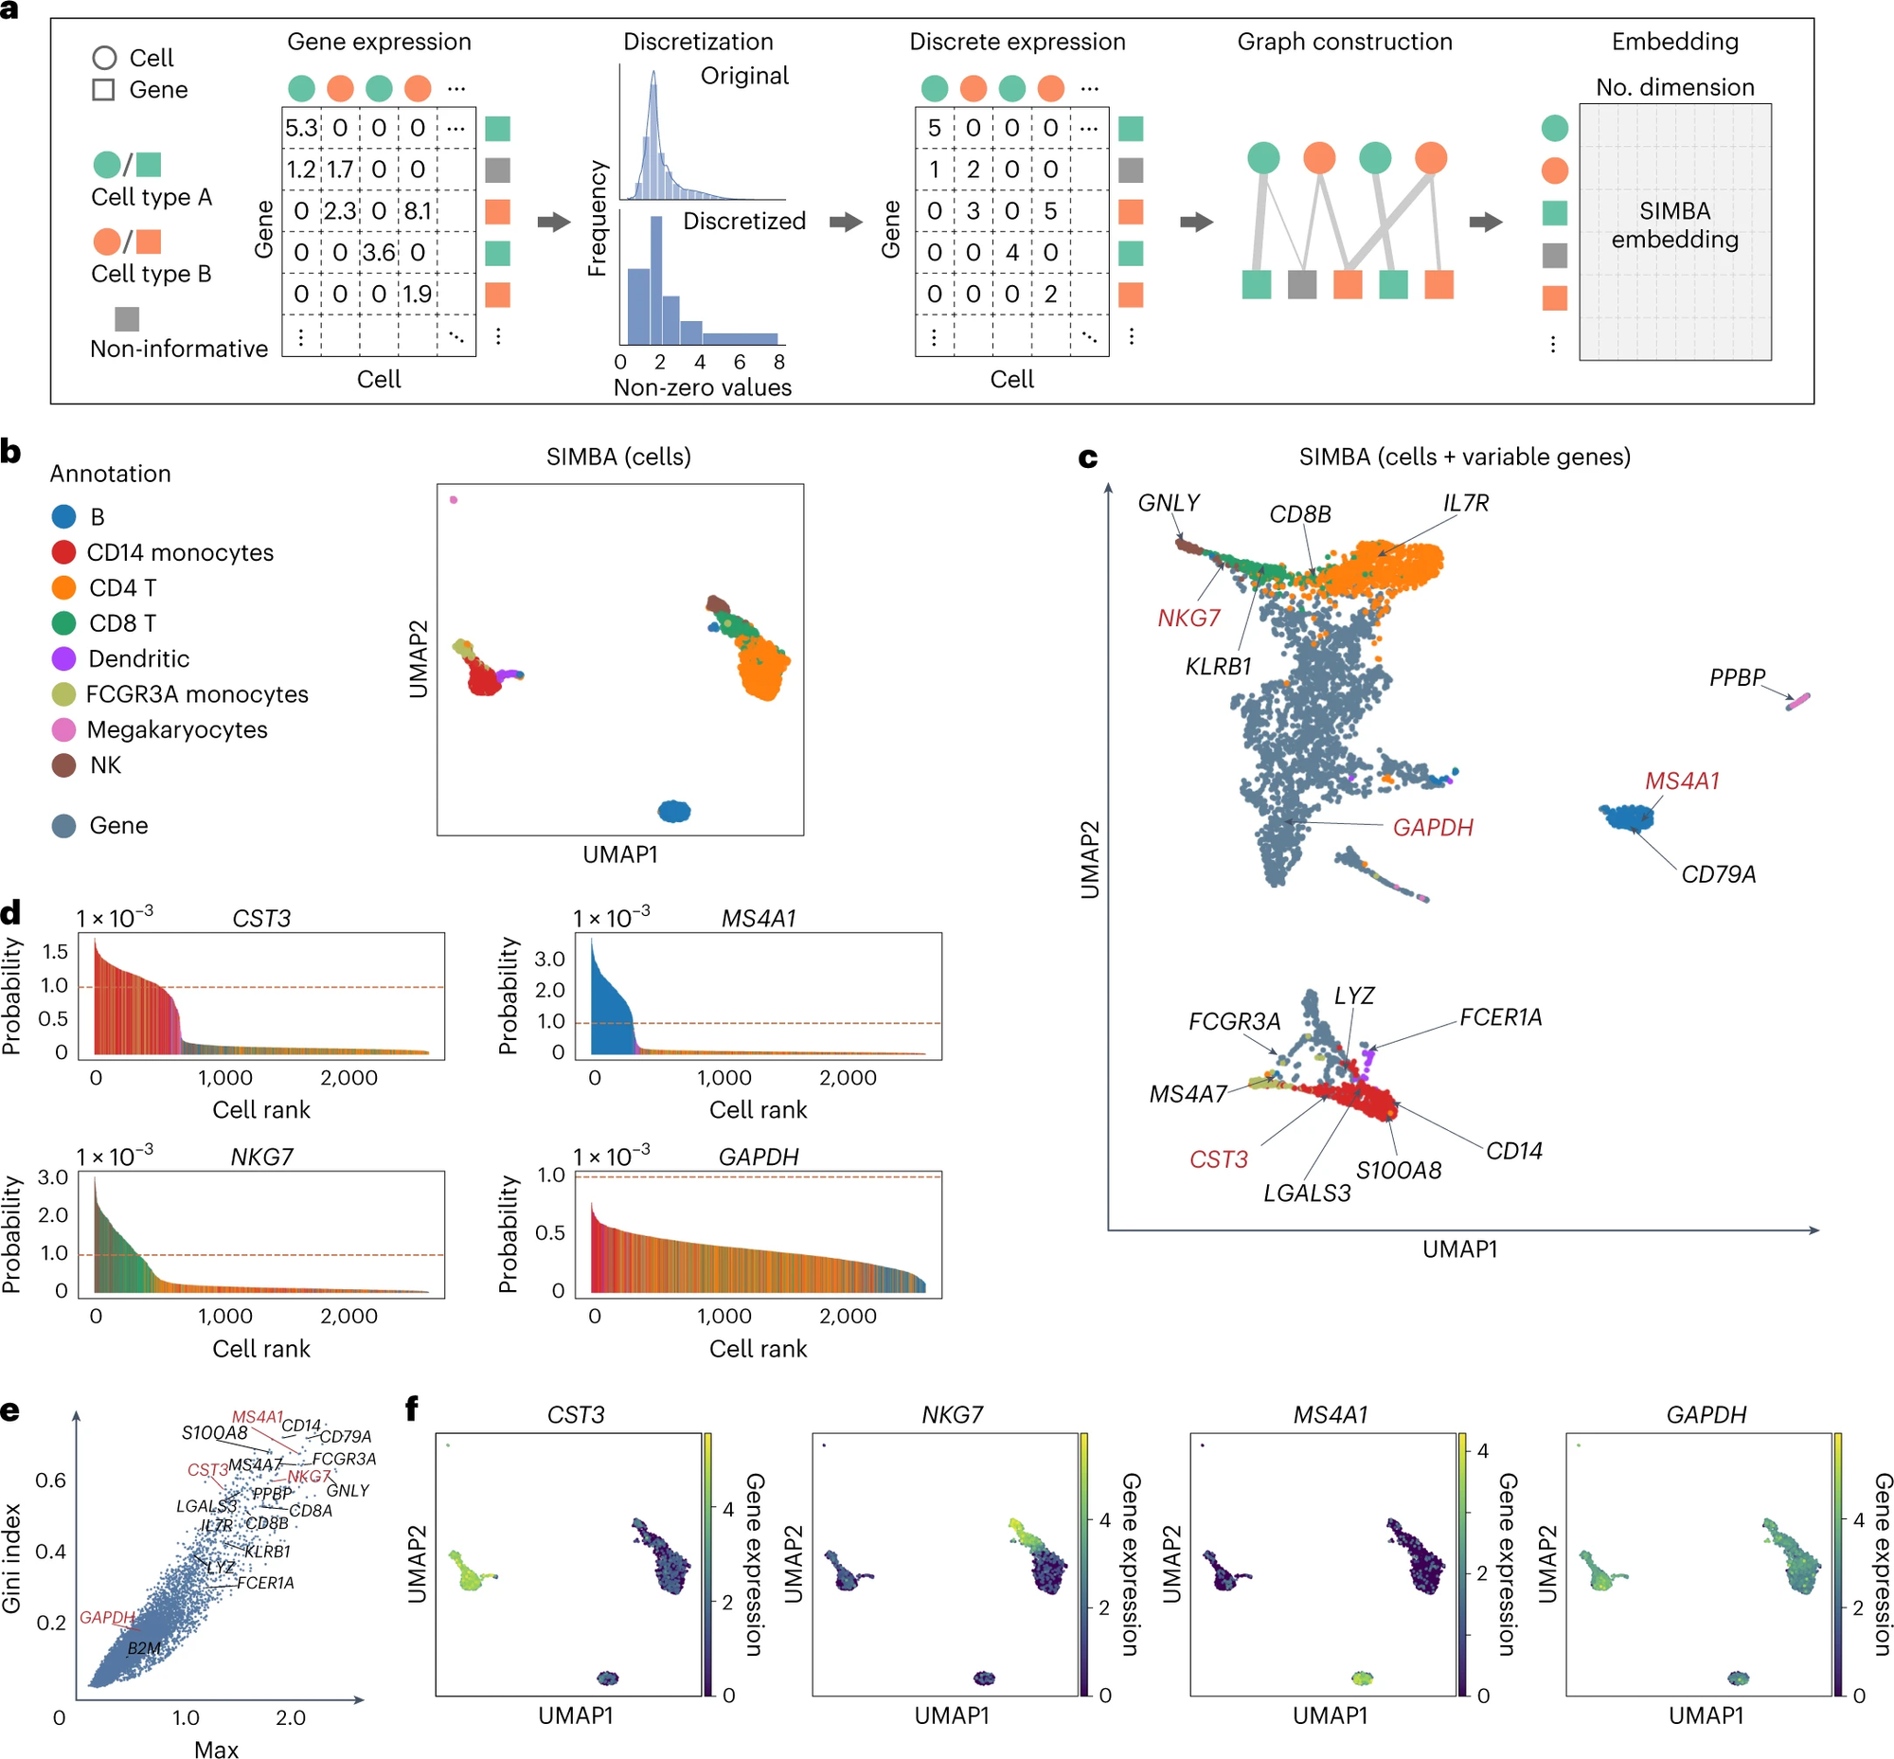
Single-cell
RNA-seq
analysis
Dataset: 10x Genomics PBMCs
Notes:
In fact, for SIMBA, I think result may not be the most important. Because comparing to result, the methodology, method is somewhat more important. Therefore, I won't spend too much time on the results.
This is an example of SIMBA being used for single-cell RNA-seq analysis.

Slide 15
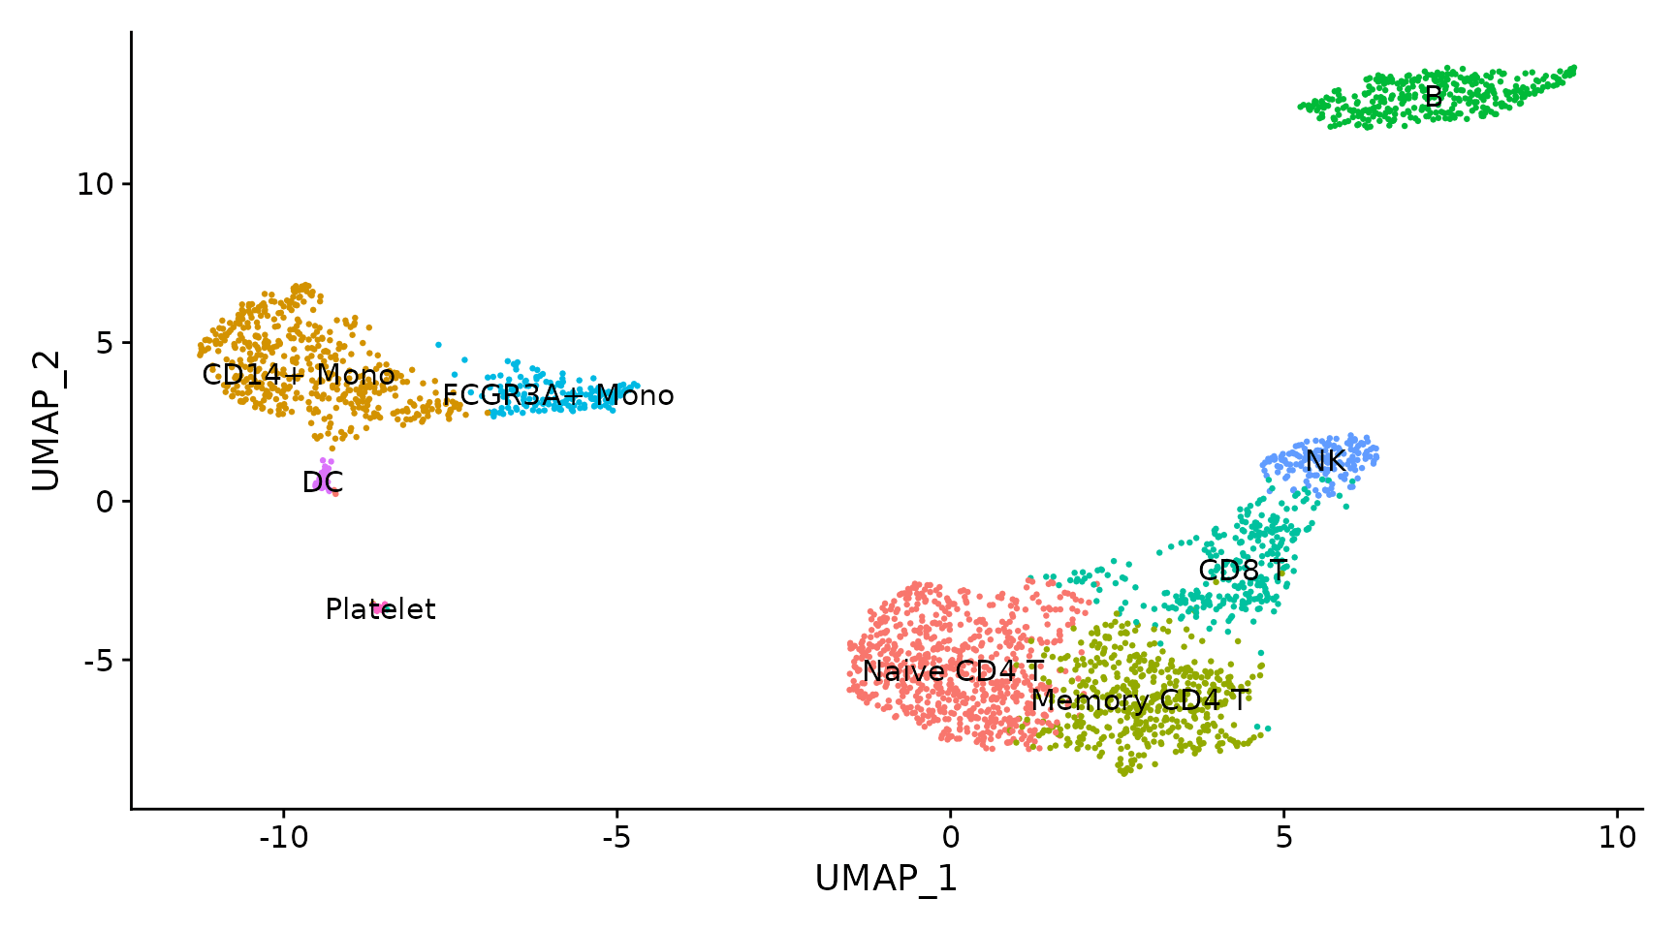
SIMBA can do great work on “cell type”
Seurat
https://satijalab.org/seurat/articles/pbmc3k_tutorial.html
Notes:
First, let's take a look at the clustering results.
The following graph shows the clustering results produced by Seurat. It is a tools widely recognized in the filed of single-cell RNA analysis.
The two graphs tell us that the plots generated by SIMBA and Seurat are very similar.

Slide 16
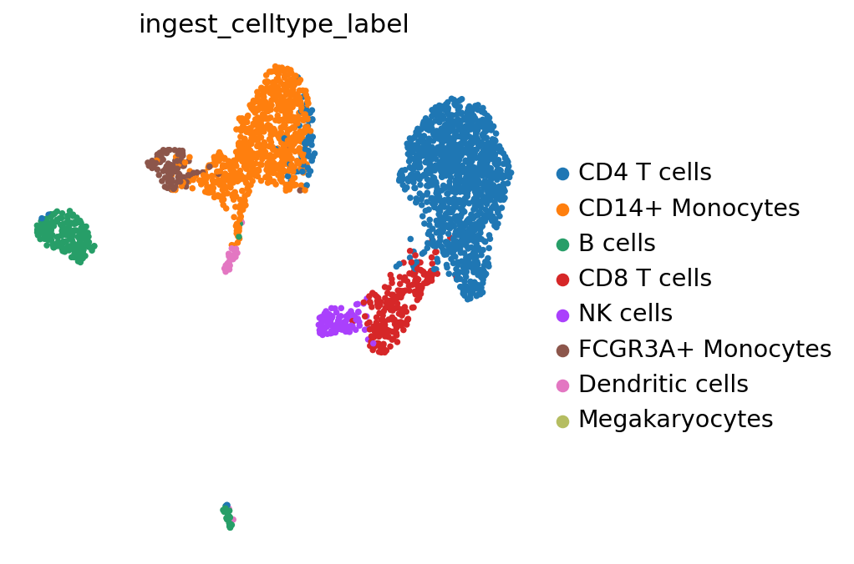
SIMBA can do great work on “cell type”
SCENIC
https://scenicplus.readthedocs.io/en/latest/pbmc_multiome_tutorial.html#Cell-type-annotation

Slide 17
barcode plots
Notes:
If you want to know how many cells express a particular gene, you can also use a barcode plot to observe this.
Here, each line represents a single cell.
We can also use umap to examine gene expression in specific cells
d. The x-axis displays the ranking of cells, based on the probability of each cell being associated with a given gene; the y-axis represents the probability value
e. SIMBA ranking of genes based on the Gini index and max score.

Slide 18
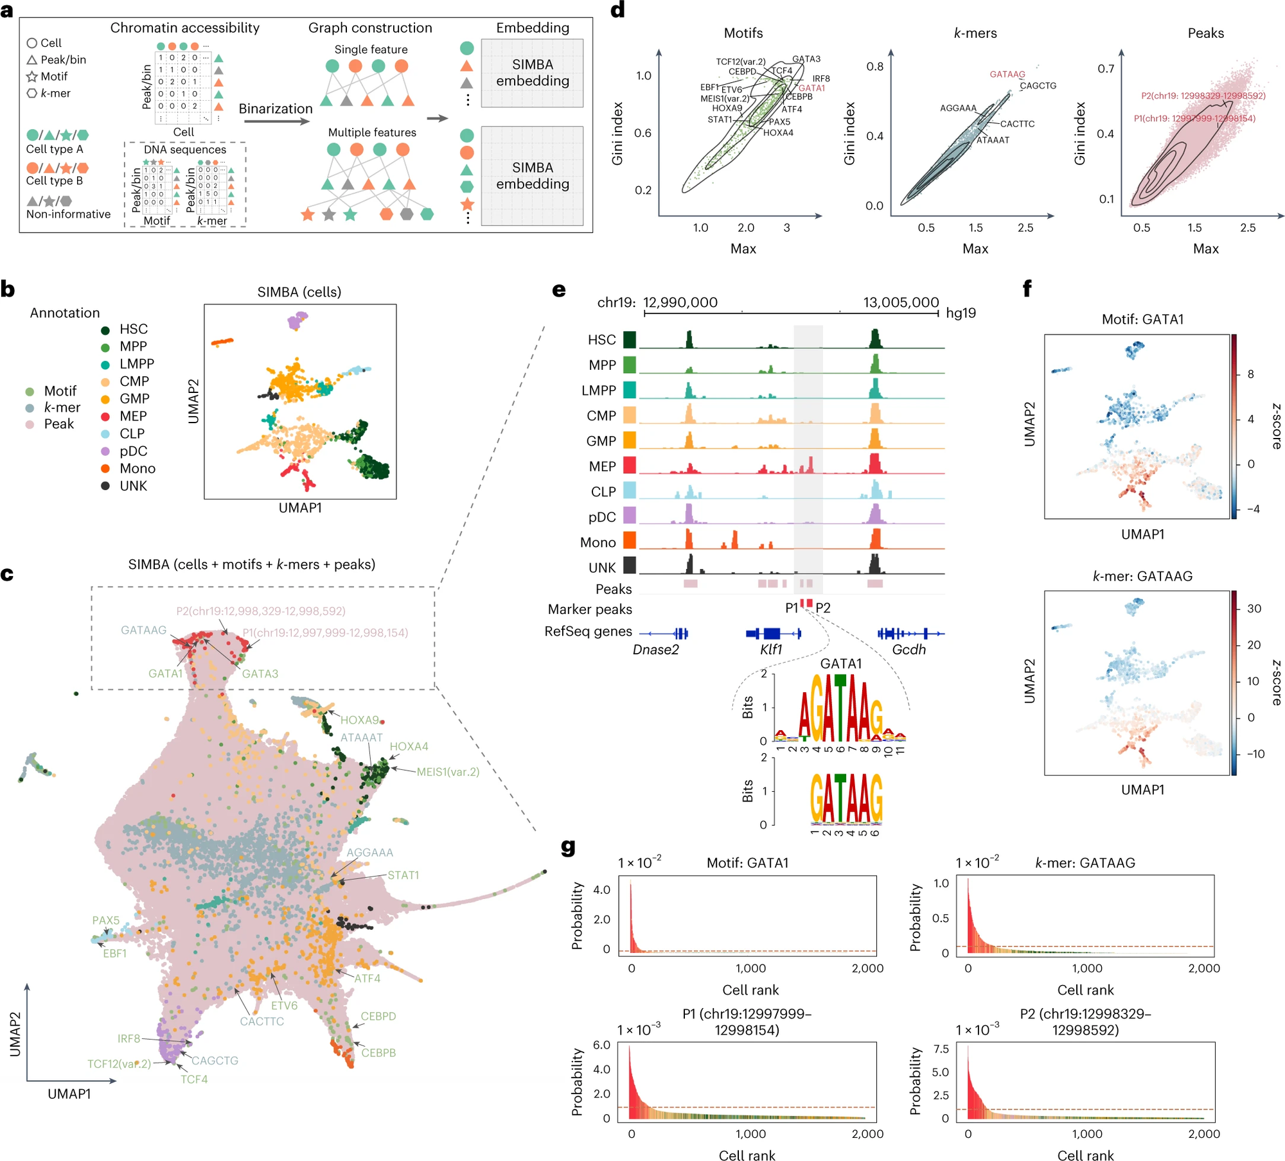
Single-cell ATAC-seq analysis
Dataset:
human hematopoiesis
Notes:
The next application is single-cell ATAC-seq analysis.
Uhh..ATAC-seq is a sequencing method which can provides insights into the chromatin accessibility landscape of individual cells.

Slide 19
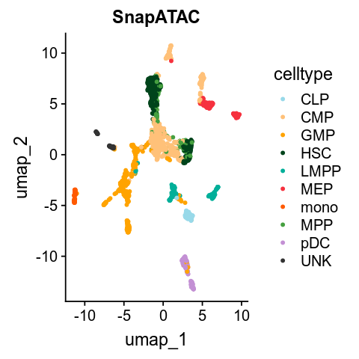
Dataset:
human hematopoiesis
Notes:
As usual, we first use SIMBA to generate a cell annotation plot, and then compare it with a plot generated by another common tool used for ATAC data.
And…actually the result is not bad, right?

Slide 20
Notes:
And now, graph e shows, from a small region on a chromosome, we notice that there is only MEP cell has a peak at this location. And we also found, the DNA sequence GATAAG is the sequence present in this region; GATAAG matches the binding motif of GATA1, GATA1 is a transcription factor, and it is also the master regulator in the production of red blood cells.
Similarly, we can use UMAP to observe the expression of transcription factors and k-mers across different cells.

Slide 21
SIMBA 指標（最大值和Gini指數得分）
Dataset: human hematopoiesis

Slide 22
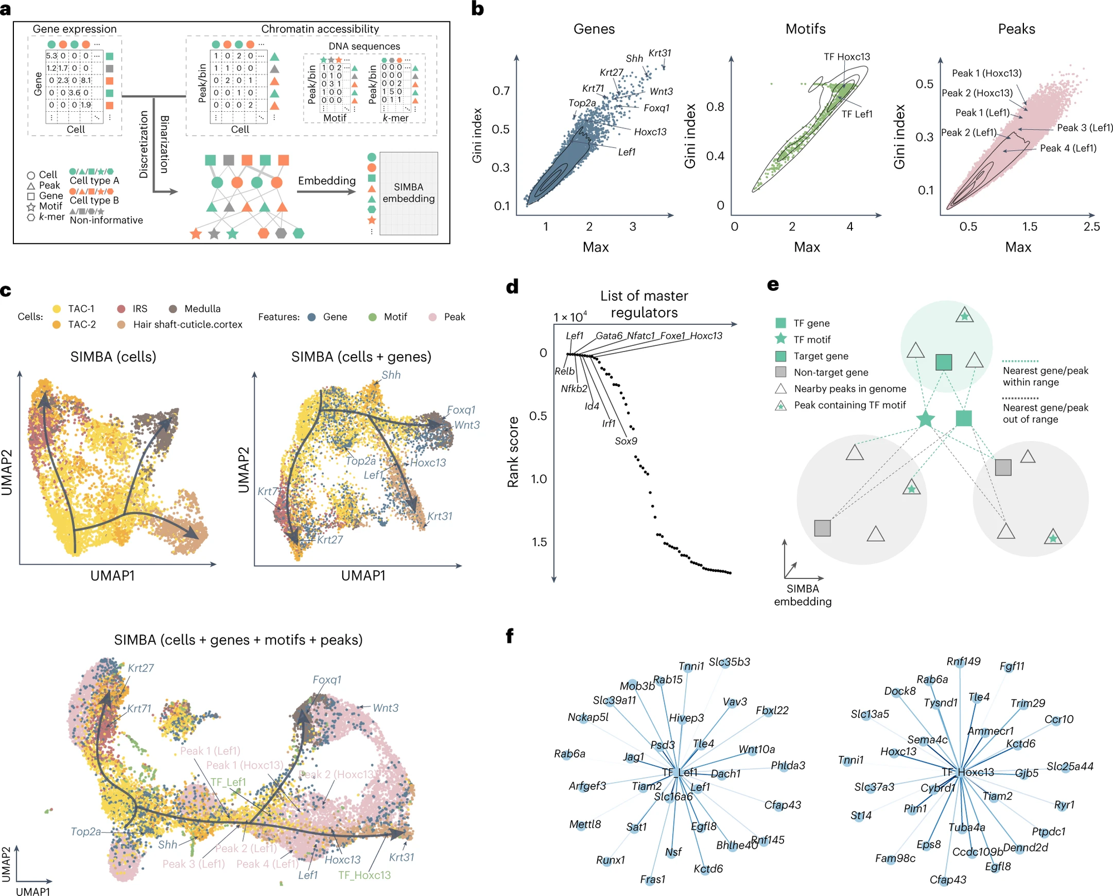
Multimodal analysis
Dataset: SHARE-seq hair follicle
Notes:
The third application of SIMBA, is Multimodal analysis, which means considering more than one data type in single cell analysis.
For instance, you can consider both Single-cell RNA and ATAC sequencing data, incorporating them into a unified analytical framework."
*SHARE-seq enables simultaneous measurement of the RNA data and ATAC data in single cells.

Slide 23
Notes:
Because the sample used here is hair follicles, so …
Through cell annotation and marker gene, we can get the differentiation information from hair follicle

Slide 24
Notes:
And you can consider not only RNA data. ATAC, TF motifs can be included as well.
You can add more information you had already gotten before

Slide 25
Notes:
Uhhh….This is the ranking of a given transcription factor gene based on the distance.
We believe if TF want to bind to the target sequence, then the region of the TF gene may be near to the target sequence.
Therefore, for those transcription factor binding sites that are closer to the target sequences, we will assign higher scores, or you can say, greater weights on it
And through the score, we can find their relationship more easily. Then we line these nodes up.
And…SIMBA also inferred the top 30 target genes of the transcription factor

Slide 26
SIMBA指標（最大值和Gini指數得分）
Dataset: SHARE-seq hair follicle

Slide 27
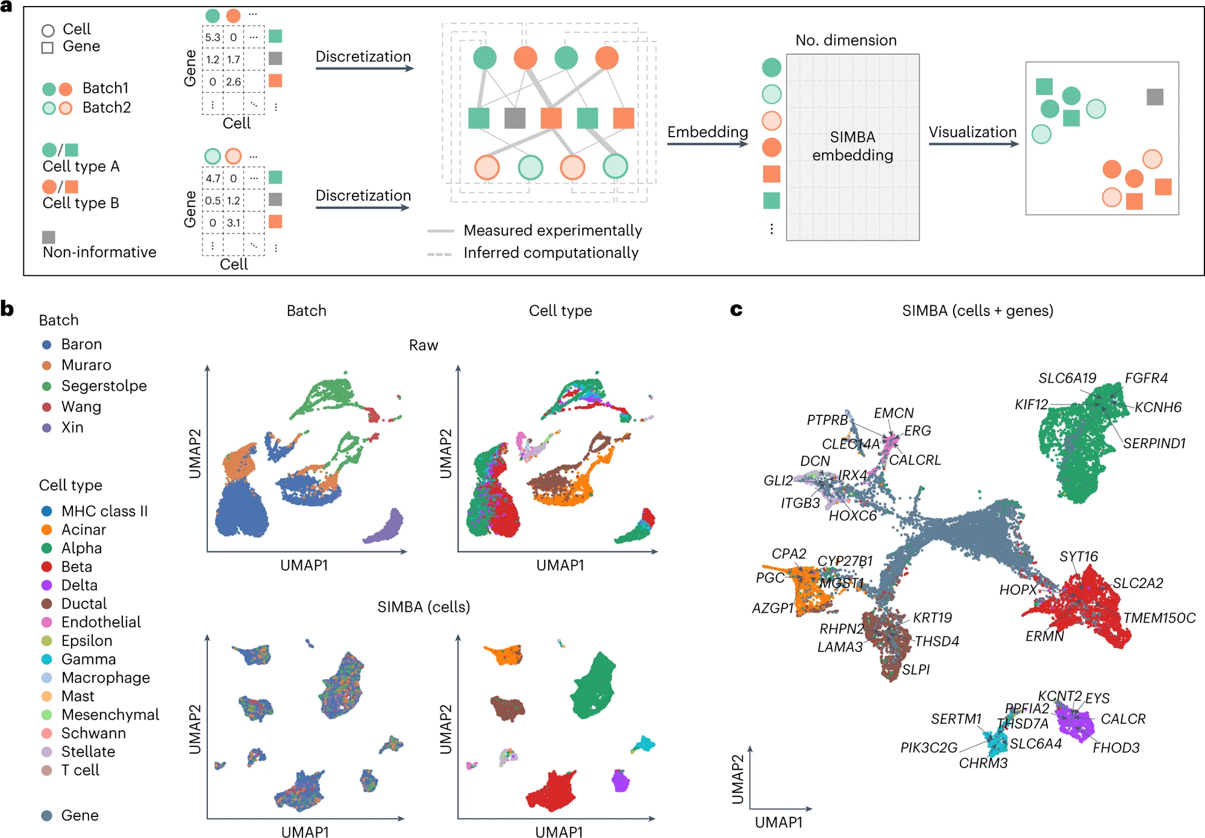
Batch correction analysis
Dataset: scRNA-seq data
Notes:
Okay, so we move to Batch correction analysis.
The top figure presents the UMAP visualization before batch correction.
The bottom figure displays the UMAP visualization after batch correction using SIMBA.

Slide 28
Batch correction analysis
Dataset: scRNA-seq data
Notes:
And here we have known marker genes highlighted.

Slide 29
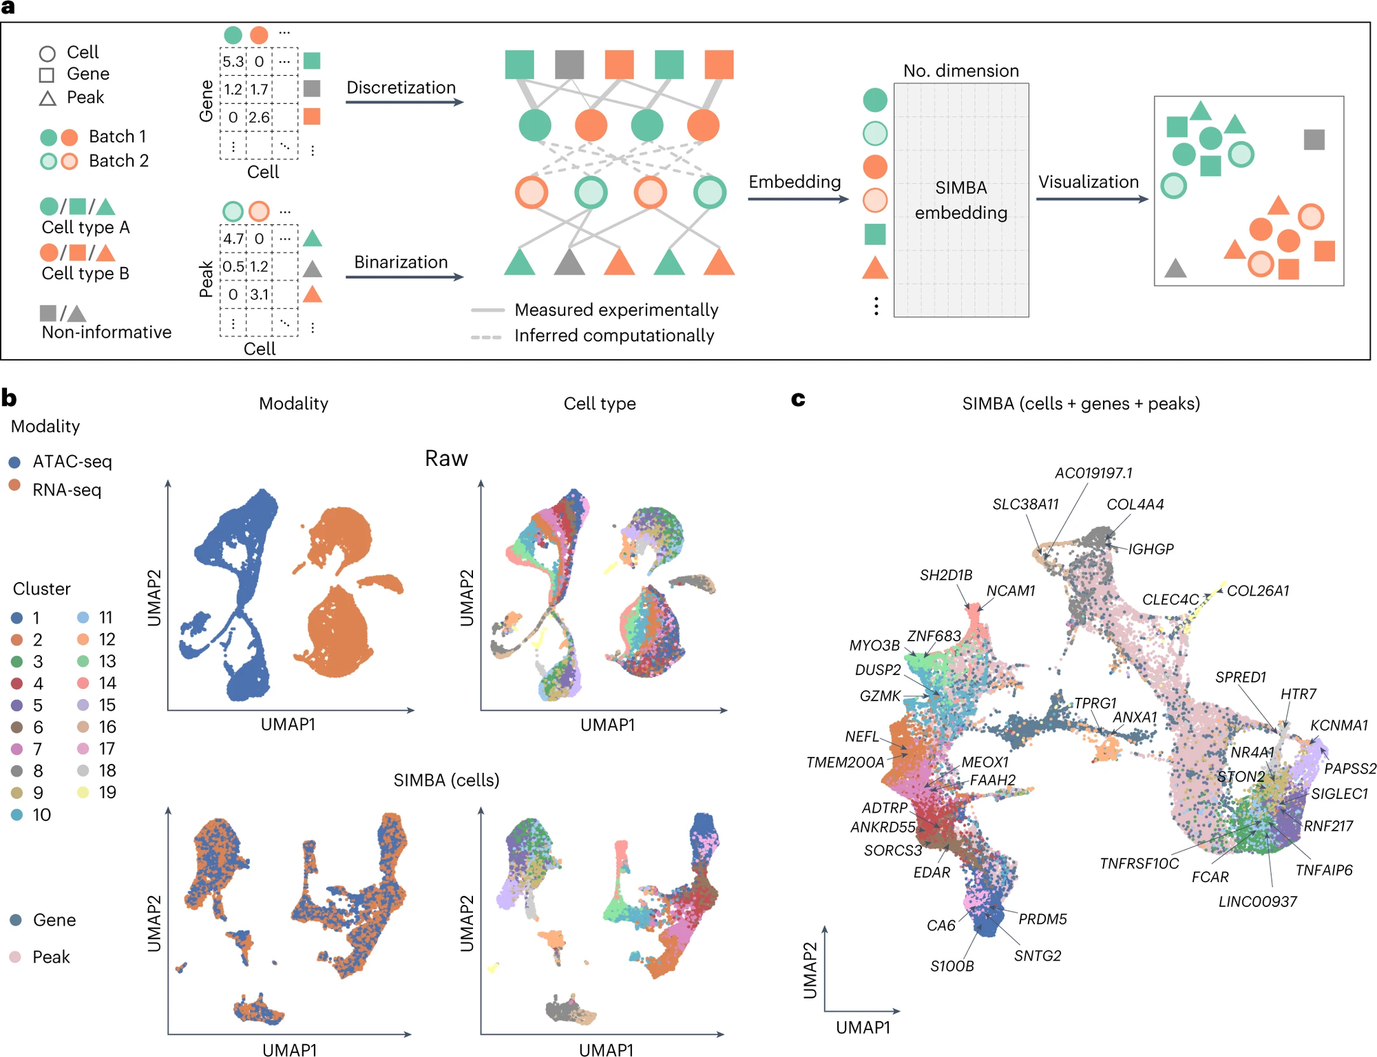
Multi-omics integration
Notes:
The last, is Multi-omics integration.
The top figure presents the UMAP visualization before integration.
The bottom figure displays the UMAP visualization after integration using SIMBA.

Slide 30
Methods
1. Preprocessing
2. Graph Construction
3. SIMBA Embedding
Notes:
We have finally arrived at the highlight of this paper.
In summary, it is divided into three steps

Slide 31
Methods
1. Preprocessing
2. Graph Construction
3. SIMBA Embedding
Notes:
I will discuss the first and second steps together, as the first and second steps in the five applications are very similar.

Slide 32
Single-cell RNA seq Analysis
K-means
Preprocessing
Graph Construction
Embedding
Filtering
Normalization
Variable gene selection
Notes:
Here, You can always see three steps. – Preprocessing, Graph Construction, and Embedding.
Preprocessing is simple, ehen we obtain the gene expression levels of cells, we tend to transform them into a gene expression matrix. You can see that, on this gene expression matrix, the values are continuous and include decimal points.
To simplify, we will transform these continuous values through a discrete conversion. We divide these values into five groups.
Each group here implies that the gene expression levels within the same group are relatively similar
After completing the conversion of discrete values, we can do the graph construction.
Graph construction is very easy, you put cells and genes on a graph. Circles represent Cells, and Squares represent Genes.
You know their relationship, you know which genes expressed in which cells, and you also know the value, the value is their expression level.
So based on their association, you can line them up. And this, is graph construction!
We will discuss SIMBA embedding later.

Slide 33
Single-cell ATAC-seq analysis
Preprocessing
Graph Construction
Embedding
Filtering
Peak selection
Notes:
It's quite clever that, as we just mentioned, the first five applications we discussed all follow a similar process.
If we now take another look at the ATAC data, they also conducted data preprocessing beforehand.
However, the conversion of values here is a bit different. They performed binarization.
Because they only wanted to categorize chromatin accessibility as either 'open' or 'closed.
And Here, you can do the same thing to TF motif data and k-mer. After transformation, You can perform graph construction similar to the previous one.
Peak selection (truncated-SVD) 包括 find main peak (elbow plot，前k個Pcs)、pick peak (knee point detection algorithm)、combine peak (variable peaks)
truncated-SVD：只保留具有信息的peak
PCs selection(elbow): 降維，把主幹挑出來，同時達到去噪
peak pick (knee point detection algo.)
Variable peaks combination

Slide 34
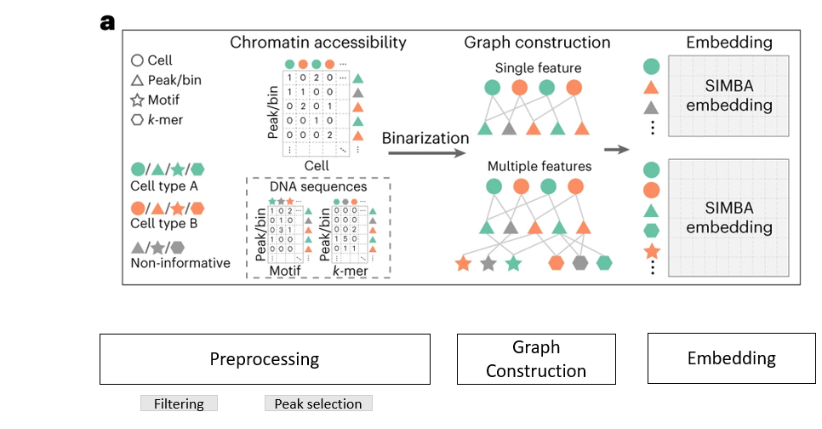
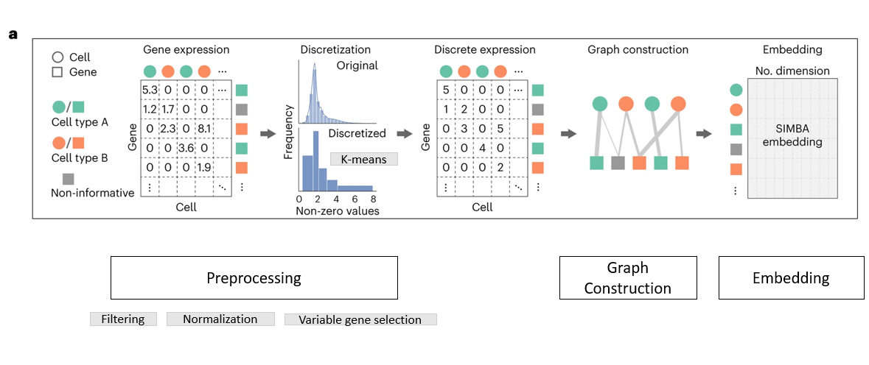
Multimodal Analysis
Single-cell ATAC-seq analysis
Single-cell RNA seq Analysis
Notes:
The concept of multimodal analysis is essentially the combination of the two previous approaches.

Slide 35
Multimodal Analysis
Preprocessing
Graph Construction
Embedding
Notes:
On the left, we have the approach for processing RNA data, while on the right, we have the approach for processing ATAC data

Slide 36
Batch correction analysis
Preprocessing
Graph Construction
for every batch
Embedding
Notes:
Batch correction analysis is essentially the same, but it involves constructing different graphs for different batches
So, here you can see many graphs
* truncated randomized SVD

Slide 37
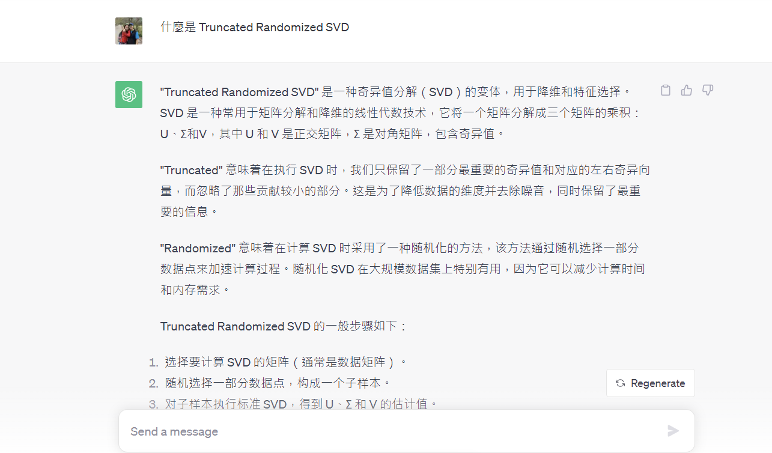
About Truncated Randomized SVD…
Notes:
Truncated-SVD based vs. Truncated randomized SVD
Truncated-SVD based：用于降维和特征选择的方法。在这种情况下，Truncated-SVD用于选择和保留最重要的峰（peak）或箱子（bin），以加速分析并减少维度
Truncated randomized SVD：用于整合不同批次（batch）之间的单细胞RNA-seq数据。目的是通过分析共享特征来推断不同批次之间细胞之间的关系

Slide 38
Multi-omics Integration
Graph Construction
(scRNA and scATAC data)
Graph Construction
Embedding
Notes:
Let’s not go into further about Multi-omics Integration; it's the same concept.
* Gene activity calculation
* truncated randomized SVD

Slide 39
Methods
1. Preprocessing
2. Graph Construction
3. SIMBA Embedding
Notes:
In fact, the most important part of this paper is the SIMBA embedding.
You may want to ask, how is the data normalized across different batches?
How do you integrate different datasets together?
or Why does using SIMBA embedding enable the construction of a world that lining up different features together?

Slide 40

Vector
destination entity
edge = (u, v)
source entity
a common latent space
Calculate “edge score” based on the connection
Calculate “loss” to evaluate the score
Find the overall best score
Notes:
Ok, so for SIMBA embedding…
First, we need to create a vector. Vectors are our input for SIMBA embedding.
We represent each edge existing in this space with a set of vectors.
An edge connects a starting position to an ending position. We call the node at starting position as “source entity”, and we call the node at ending position as “destination entity”
And then, we calculate an edge score for each edge. The score is related to the two nodes connected by the edge. This score reflects our aim to find a method to effectively capture the connectivity relationships between points.
Then we calculate the loss. Loss is a method used to assess whether these scores are sufficiently good. It is an evaluation for these scores.
Find the overall best score means, we will adjust our score and seeing if these scores become increasingly better, meaning they approach the true connectivity relationships more closely.

Slide 41
Negative Sampling
Create the wrong edge
a common latent space
Notes:
And the next step we need to do is to create some wrong edges, It means those edges that shouldn't exist in the reality at all.
But why do we need to do this?

Slide 42


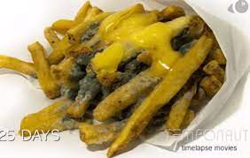
Negative Sampling
Yummy
Yummy
Notes:
Imagine you have a lot of food today. You want to teach your robot to distinguish whether food is tasty or not.
But if, during the teaching process, you only tell it that these are tasty foods without informing it that some foods are actually inedible, they are rotten, no one should eat it.
It will still perceive these as tasty foods.

Slide 43
Negative Sampling
rotten food is not good
Yummy
Disgusting
Notes:
So, it's crucial to inform it that some foods are inedible, they are disgusting.

Slide 44
Negative Sampling
Create the wrong edge
a common latent space
Calculate the weight of each edge
Calculate the score
Notes:
This is the key point of negative sampling, not only creating incorrect connections to indicate which connections should not exist. For points with stronger associations, we should also assign higher weights to reflect their strong relevance. Finally, based on the strength or absence of these relationships, compute the corresponding scores.

Slide 45
Evaluation
Model Training
Notes:
Let's now talk about how to determine if this machine is good or not

Slide 46
Can our model predict precisely?
In this case….
The connection of the edges and nodes
a common latent space
MRR（Mean Reciprocal Rank）
R1: the frequency of the correct answer is ranked first
R10: same above, but range is wider to 10%
R50: same above, but range is wider to 50%
AUC（Area Under the Curve）
Notes:
We might all wonder, how do we know if what this machine says is correct? Is it accurate enough to predict the connections between different features?
Therefore, SIMBA adopts five metrics to evaluate the goodness of a model.
The first one is “Mean Reciprocal Rank”.
Because I want to be simple. So Imagine this, you search for a question on Google, and Google provides you with a bunch of answers. The correct answer might be the first one, or the second one, or possibly further down the list. MRR is a method that measures, on average, how many answers you need to look at before finding the correct one.
The "R1" focuses specifically on the first item in that list. Each time you seek the correct answer, how high is the probability that the correct answer is the first one?
Same as R10 and R50, how high high is the probability that the correct answers shows within 10% or 50%
AUC, most of us are familiar with this. An important metric used to evaluate the performance of classification models. Judging an edge to truly exist in the world, and that edge does indeed exist, results in a high AUC.
On the contrary, predict wronly, indicate that the model does not classify well, resulting in a low AUC

Slide 47
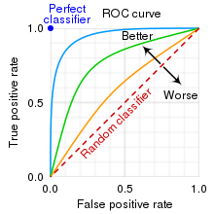
Can our model predict precisely?
How good is the model?
AUC can tell us
https://en.wikipedia.org/wiki/Receiver_operating_characteristic

Slide 48
Evaluation
How do you know the embedding is right?

Slide 49
Softmax Transformation
Comparable?

Slide 50
Evaluation
cell-type specificity

Slide 51




Metrics to assess cell-type specificity
Cells and Features…
How to evaluate that they are related?
Max Score
Gini Index
Standard Deviation
Entropy
Association
Specificity
Variance
Degree of Disorder
The evenness of Distribution

Slide 52

Metrics to assess cell-type specificity
The similarity normalization function:

Slide 53

Discussion
SIMBA
https://zh.wikipedia.org/zh-tw/%E8%BE%9B%E5%B7%B4
Notes:
Before we dive into the discussion, I'd like to make a declaration. Due to time constraints, there are many mathematical concepts and details behind SIMBA that I have not mentioned. If anyone is interested, you can just come to seek me out for further discussion

Slide 54
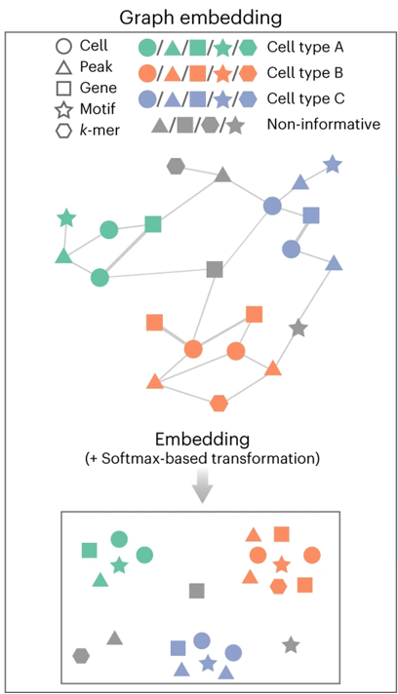
The Great Idea of SIMBA
a common latent space

Slide 55

SIMBA！To do more？
cellular heterogeneity
time points
Perturbations
regulatory mechanisms
https://www.timesofisrael.com/israeli-photographers-real-life-lion-king-photo-grabs-headlines/
Notes:
In the discussion, SIMBA believes it has successfully accomplished two things. First, through SIMBA, we can clearly differentiate various cell types. Secondly, it allows us to understand the regulatory mechanisms among genes, transcription, and chromatin factors within a single cell.
However, is there a chance to incorporate more variables in the future?
For instance, time points, or some interfering factors？
Indeed, with each additional variable, we are essentially adding another dimension to the data, which may complicate the analysis significantly. However, it‘s a matter worth considering for everyone.

Slide 56

Thank you
https://en.wikipedia.org/wiki/Simba
Notes:
Thanks for your listening, this is the end of my presentation. Do you guys have any question?

