Slide 1
SIMBA: single-cell embedding along with features
Huidong Chen, Jayoung Ryu, Michael E. Vinyard, Adam Lerer & Luca Pinello (2023)
Nature Methods
Chen, Yi-Jie
2023/11/20
Notes:
Good morning everyone, 我是生資所碩一的陳怡婕，today I am going to introducr SIMBA: single-cell embedding along with features

Slide 2
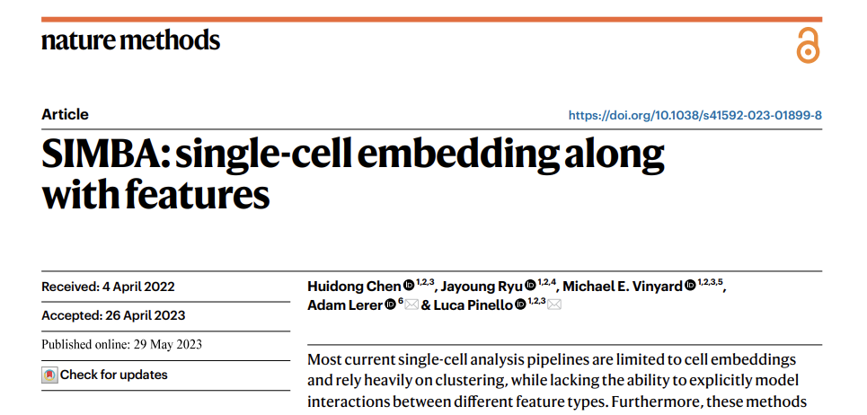
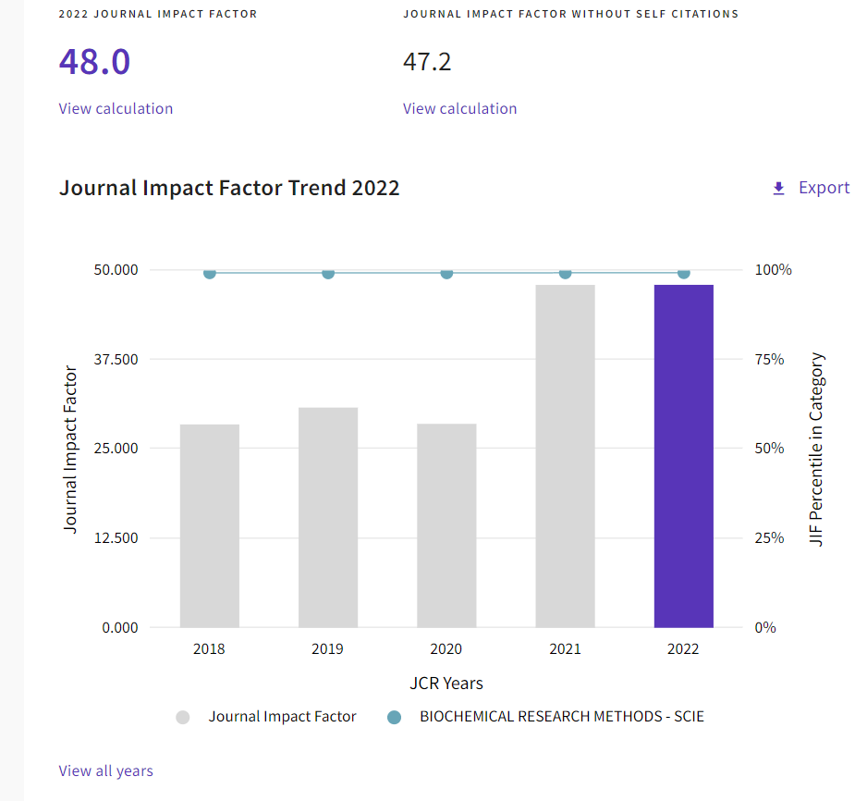
https://jcr.clarivate.com/jcr-jp/journal-profile?journal=NAT%20METHODS&year=2022&fromPage=%2Fjcr%2Fsearch-results
Notes:
正式開始之前，我先簡短summarize這篇paper。
SIMBA 是今年發於 Nature Method 的文章，由於 Method 類的 citation 通常都比較高，所以他的 impact factors 也相對比較高。
SIMBA是一款用於單細胞數據分析的工具。可以整合多模態的數據，比如單細胞轉錄組學（scRNA-seq）和表觀遺傳學數據（比如scATAC-seq）。他的主要方法是使用 graph embedding (圖嵌入技術)，透過對數據中的細胞和分子特徵進行圖形嵌入，使用深度學習的框架，去捕捉細胞和不同特徵之間的關聯性。
它不僅能夠識別存在的連接，還能夠從數據中識別出不存在的潛在連接，這對於理解細胞的內在機制非常有幫助。
此外，SIMBA利用Softmax函數轉換不同類型的實體嵌入，以便在進行批次校正或多模態整合時，可以在相同的度量標準下進行比較。

Slide 3
Outline
Background
What is the challenge of Single Cell Analysis nowadays?
Method
How does SIMBA solve the challenge?
Result
Does SIMBA good enough to use?
Discussion
What else can we do in Single Cell Analysis?
Notes:
And this is the outline. I will start from the background, and then discuss the method, then the result , and last the discussion

Slide 4
Background
Most current single-cell analysis pipelines rely heavily on clustering
False Discovery (just because they are clustered by similar characteristics)
Lots of single-cell computational methods are developed for the analysis of one modality
….these are also our obstacles
Notes:
First, I would like to talks about some challenges that single cell analysis are facing.
The first one is “Most current single-cell analysis pipelines rely heavily on clustering”, it may lead to False Discovery.
What is false discovery? Let me give you an example, imagine now you have many fruits in a box, and you are trying to classify these fruits.
You put apples and tomatoes together, because they are all red. And you put green apples and green grapes together, because they are all green.
Clearly it is not right, right? This is the false discovery, apples should be put together instead of tomatoes or green grapes.
The second challenge is many computational methods nowadays in single-cell analysis are developed for one modality.
One modality means there is only one data type. sometimes the computational method is only suitable for RNA data, or for proteomics data, or for methylation data.
So actually, we don’t have suitable methods to analyze multiple different types of data simultaneously.

Slide 5
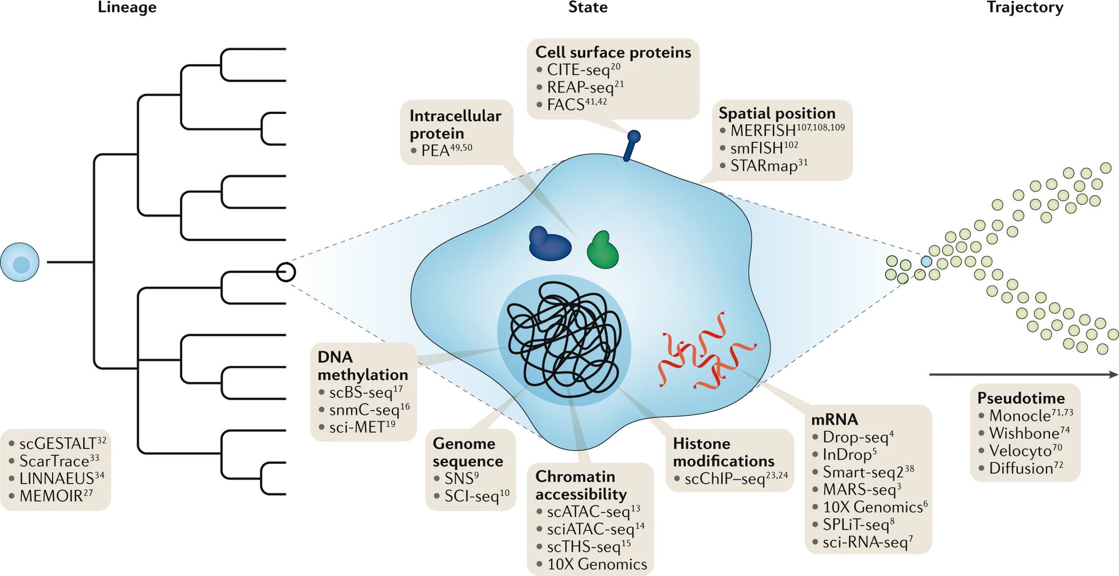
Notes:
The picture shows that there are so many information in one cell. Like (methylation, genome sequence, chromatin accessibility and also mRNA.)

Slide 6
This is what SIMBA want to ACHIEVE
An clustering-free approach
A model considering interactions between different features
A graph embedding method

Slide 7
A Graph Embedding Method
a common latent space
Cell
mRNA (scRNA)
Chromatin Accessibility (scATAC)
TF motif
DNA sequence
Notes:
When we collect multiple different types of data, we regard them as a feature. And we input this feature, embedding them on a graph.
We employ some techniques and computational methods to identify the relationships between these features, and then we connect these features, like if the node is the cell, and the RNA data is related to the cell, two nodes will be lined up; and if the chromatin accessibility region is related to the cell, they will be lined up

Slide 8
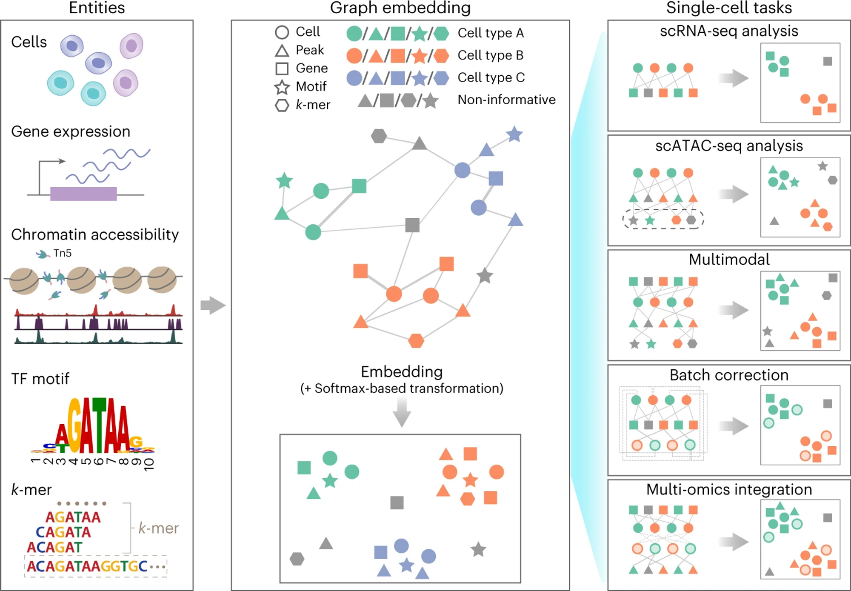
Notes:
In the analysis workflow of SIMBA, five types of data are collected.
Let me spend a little time to explain these data format. I think most of us are familiar with cells and gene expression.
So lets start with TF. TF refers to “Transcription Factor”, which are specialized proteins that play a crucial role in turning genes on or off.
They do so by recognizing and binding to specific short sequences of DNA, referred to as "TF motifs“, a specific sequence of DNA that can be bound by transcription factors
Chromatin accessibility, reveals which regions of the DNA within a cell are accessible to transcription factors. If there is a high peak, means the region is accessible for transcription factors.
k-mer, ummm….k refers to number, so "k-mer" refers to a substring of DNA that is "k" nucleotides long. Basically, it just represent the DNA sequence.
These Data will be transformed to different signature, like circle represent cells, triangle represent chromatin accessibility, and then square, stars etc. Then these signatures will be placed onto a graph, and certain computational methods are utilized to find associations, then connecting these nodes. We call this process “Embedding”. After Embedding, we employ softmax transformation, we are able to identify the relationship between these cells, genes, chromatin accessibility, TF motif, and k-mer. Dividing different cells and features to different groups based on their association.
And this kind of embedding, or this kind of method. Could be used to multiple single-cell tasks. RNA, ATAC, multimodal, batch correction and multi-omics integration.
And due to the time constraint, I would only discuss the top three tasks in today’s presentation

Slide 9
Methods
How does SIMBA solve the challenge?
Notes:
Okay, so let’s talks about method

Slide 10
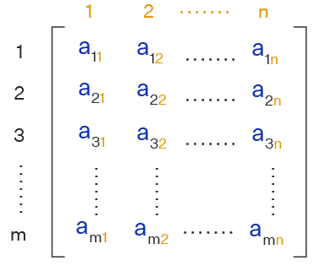
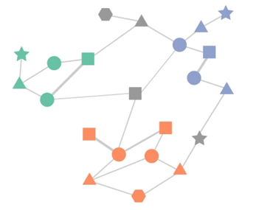
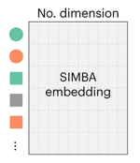
In General, Three Steps
Data Preprocessing
Graph Construction
Embedding
Notes:
In general , it is divided into three steps

Slide 11
1st: Data Preprocessing
Data Preprocessing
Graph Construction
Embedding
Notes:
And we start with Data Preprocessing

Slide 12
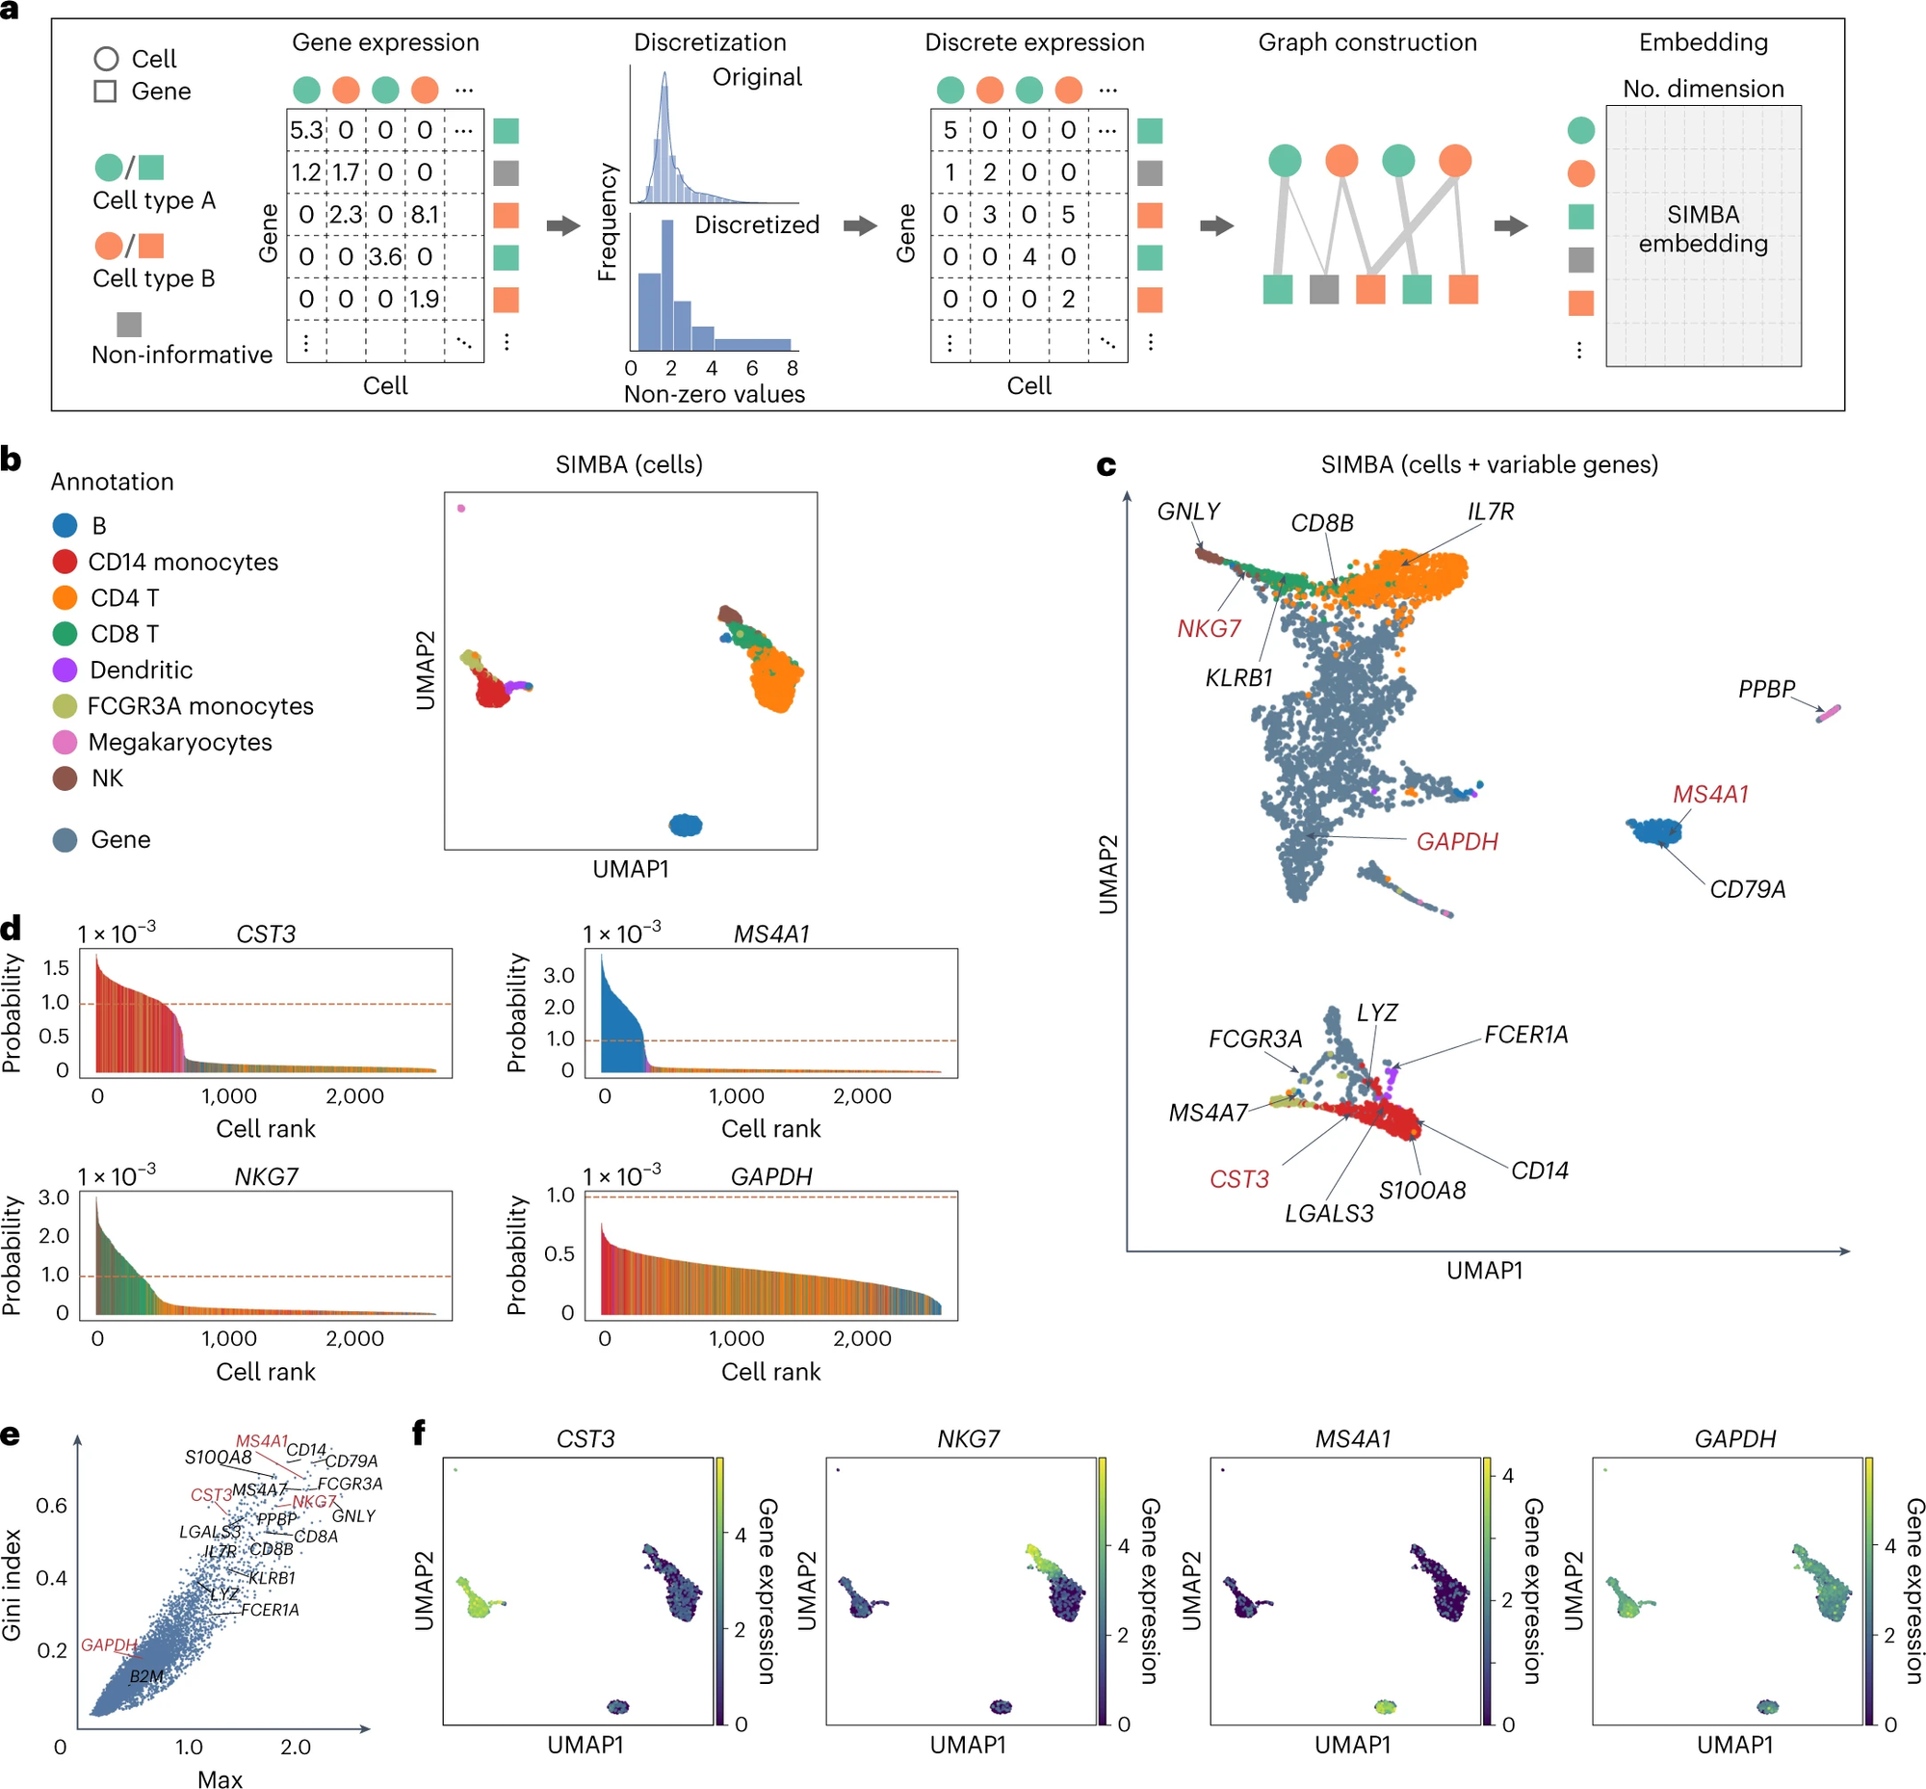
Single cell RNA
Notes:
At first, when we obtain the gene expression levels of cells, we tend to transform them into the gene expression matrix. You can see that, on this gene expression matrix, the values are continuous and include decimal points.
To simplify, we will transform these continuous values through a discrete conversion. We divide these values into five groups.
Each group here implies that the gene expression levels within the same group are relatively similar.
And so you can now see there are only integers in the discrete expression matrix.

Slide 13
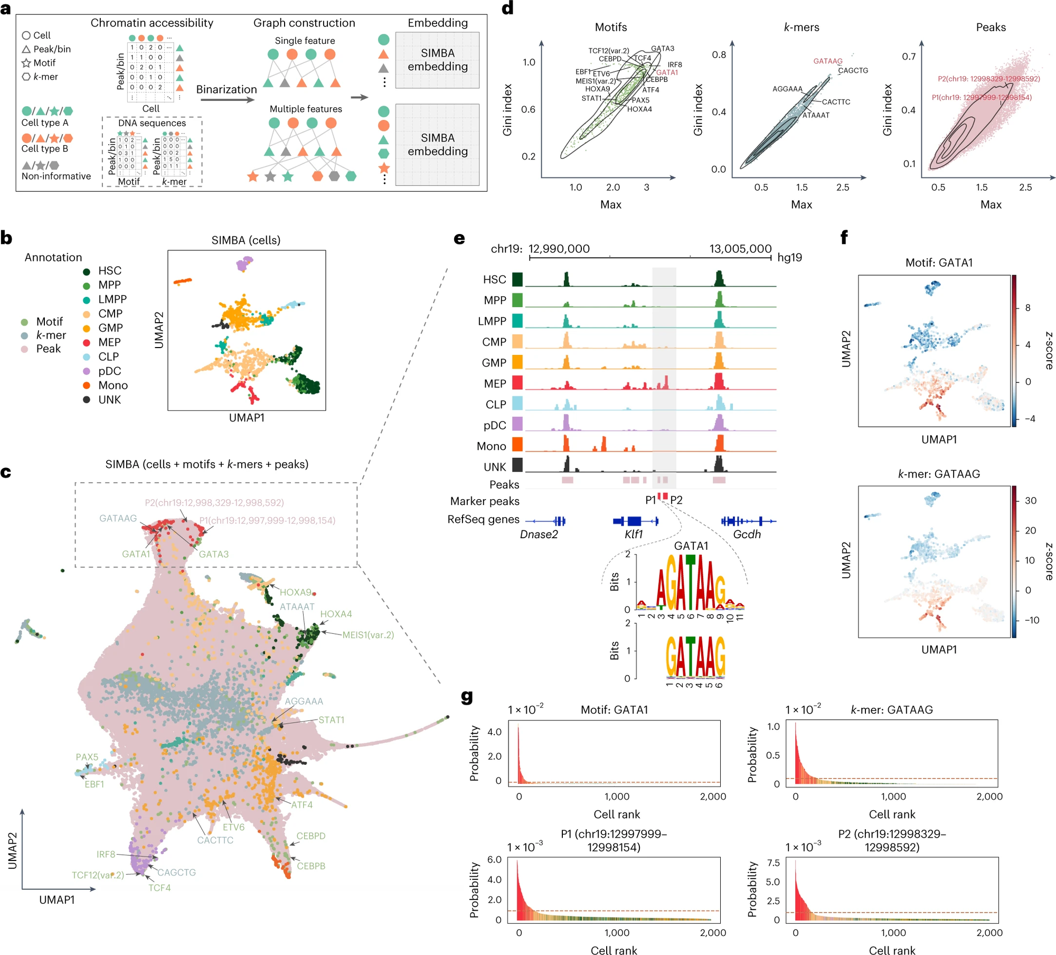
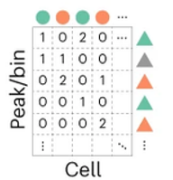

Single cell ATAC
Notes:
we have the same thing for ATAC data
But the conversion of values here is a bit different. They performed binarization.
Because they only wanted to categorize chromatin accessibility as either 'open' or 'closed. So we only get 1 or 0 in the matrix

Slide 14
2nd：Graph Construction
Data Preprocessing
Graph Construction
Embedding
Notes:
The second step is Graph construction. Graph construction is a process to transform matrix into a graph
在將數據矩陣轉換為圖結構（graph construction）的過程中，SIMBA 使用了一個特定的算法來建立圖。從矩陣到圖結構的轉換通常包括以下步驟：
節點表示（Node Representation）：在圖中，每個節點代表矩陣中的一個實體，如單個細胞或基因。這取決於研究的數據類型（例如，單細胞轉錄組數據或染色質可及性數據）。
邊的建立（Edge Construction）：圖中的邊代表節點之間的關係。在SIMBA中，這些邊可能基於數據中的不同相互作用，例如基因表達模式的相似性或細胞間的功能關聯。具體方法可能包括計算節點間的相似度或距離，並根據這些計算來建立邊。
加權（Weighting）：圖的邊可能會被賦予不同的權重，這表示節點間關聯的強度或信任度。權重的確定可能基於節點間相似度的度量，例如皮爾森相關性或其他統計方法。
圖的優化（Graph Optimization）：最後，可能會對圖進行一些優化，以增強其表達數據特徵的能力。這可能包括調整節點或邊的參數，或者應用特定的圖算法來提取有用的信息。
具體到SIMBA，它的特色在於能夠共同嵌入（co-embedding）細胞和特徵（如基因或染色質區域），從而在相同的空間中表示這些不同類型的實體

Slide 15
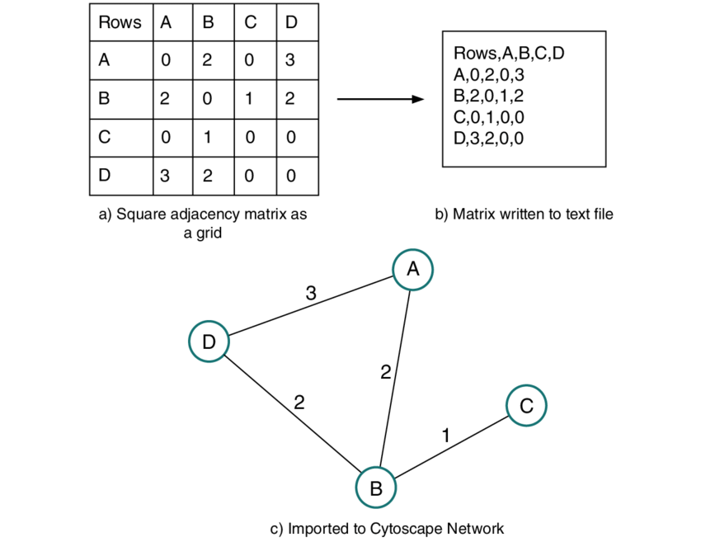
Adjacency Matrix
Graph
https://www.researchgate.net/publication/326959557/figure/fig1/AS:658714340098048@1534061145513/Converting-a-square-adjacency-matrix-into-an-undirected-network-a-In-Excel-Python.png
Notes:
Now we have a matrix, and we usually call it adjacency matrix, how to transform the matrix into a graph?
Take a look at rows A and columns B, there is a value, means the two nodes have some connection.
So there is a edge between them. And you know, some nodes they have very strong interaction, so will give the edge a higher weight.
But actually in SIMBA’s case, we use the thick line to represent the edge with higher weight. Thinner lines represent the edge with lower weight.

Slide 16
Single cell RNA Analysis
Notes:
Here we can see how to transform the matrix.

Slide 17

Single cell ATAC Analysis
Notes:
And we do the same thing for single cell ATAC. But if you have more datatype, these datatypes could also be added into the graph

Slide 18
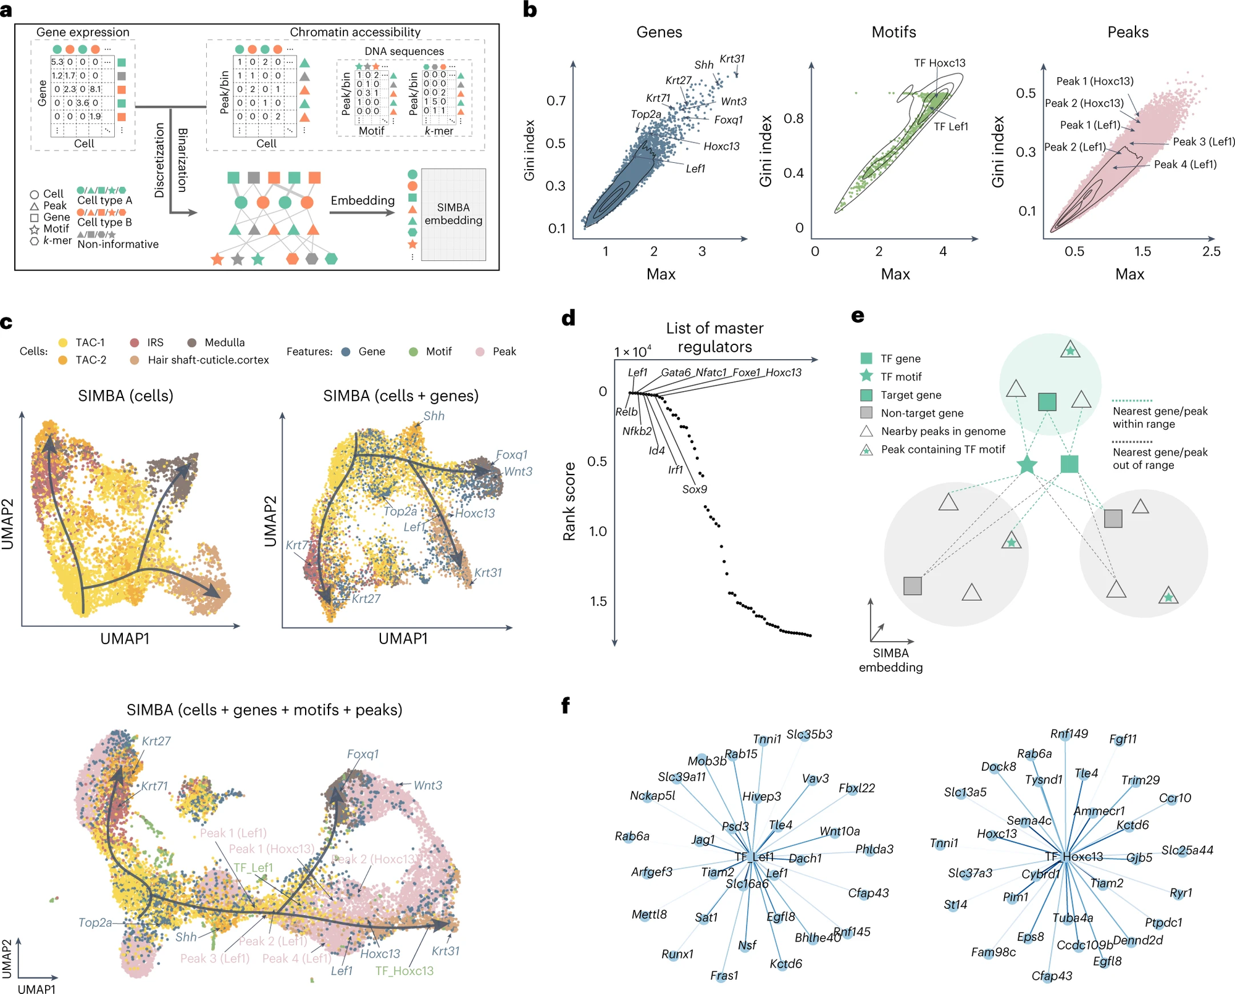
Multimodal Analysis
Notes:
And for multimodal analysis, actually we just combine the two process.
left, we have the approach for processing RNA data, while the right, we have the approach for processing ATAC data

Slide 19
3rd：Embedding
Data Preprocessing
Graph Construction
Embedding

Slide 20

Vector
destination entity
Edge = (u, v)
u
v
source entity
Calculate “edge score” based on the connection
Calculate “loss” to evaluate the score
Find the overall best score
Notes:
Ok, so for SIMBA embedding…
First, we need to create a vector. Vectors are our input for SIMBA embedding.
We represent each edge existing in this space with a set of vectors.
An edge connects a starting position to an ending position. We call the node at starting position as “source entity”, and we call the node at ending position as “destination entity”
And then, we calculate an edge score for each edge. The score is related to the two nodes connected by the edge. This score reflects our aim to find a method to effectively capture the connectivity relationships between points.
Then we calculate the loss. Loss is a method used to assess whether the prediction is close to the true value. You can regard the loss function as a method to calculate if these scores are sufficiently good.
Find the overall best score means, we will adjust our score and seeing if these scores become increasingly better, meaning they approach the true connectivity relationships more closely.
And here simba use pytorch-biggraph to train the graphs.

Slide 21

What is theta?
fembedding​ 是嵌入函數
包含 weight 和 bias，然後可能會有一個激活函數
但在 SIMBA 中，並沒有詳細解釋該嵌入函數的算法

Slide 22

Loss Function
Notes:
Le​ 表示损失函数，用于量化模型预测和实际数据之间的差异
se​ 是模型对边 e 的预测得分
exp(se​) 是 e 的预测得分的指数，这样做可以确保所有得分都是正的，并且放大差异
N N 是一个通过损坏边 e 生成的负采样候选边集合(e‘)。负采样是一种常用的训练数据增强方法，通过引入不正确的例子（例如，不存在的边），帮助模型更好地学习区分正例（实际存在的边）和负例（不存在的边）。
∑e′∈N​exp(se′​) 是所有可能边的预测得分的指数和，用于归一化，以便每个得分变成一个概率
exp(se​)​ / ∑e′∈N​exp(se′​) 计算了边 e 的预测得分占所有得分的比例，这实际上是softmax函数，将原始得分转换成概率。

Slide 23


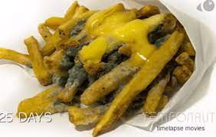
Negative Sampling
Create the wrong edge
Yummy
a common latent space
Yummy
https://www.liyofu.com.tw/blog/%E7%82%BA%E4%BB%80%E9%BA%BC%E4%BD%A0%E8%A9%B2%E5%A4%9A%E5%90%83%E9%A3%9F%E7%89%A9%E5%B0%91%E5%90%83%E9%A3%9F%E5%93%81
Notes:
And there is an important step before simba embedding, which is create the wrong edge. But why do we need to do this?
Imagine you have a lot of food today. You want to teach your robot to distinguish whether food is tasty or not.
But if, during the teaching process, you only tell it that these are tasty foods without informing it that some foods are actually inedible, they are rotten, no one should eat it.
It will still perceive these as tasty foods.

Slide 24
Negative Sampling
Create the wrong edge
Yummy
a common latent space
Disgusting
rotten food = disgusting
https://www.liyofu.com.tw/blog/%E7%82%BA%E4%BB%80%E9%BA%BC%E4%BD%A0%E8%A9%B2%E5%A4%9A%E5%90%83%E9%A3%9F%E7%89%A9%E5%B0%91%E5%90%83%E9%A3%9F%E5%93%81
Notes:
So, it's crucial to inform it that some foods are inedible, they are disgusting.
So the model could know that some edge should not exist in reality

Slide 25
Evaluation
Model Training
Notes:
Let's now talk about how to determine if this machine is good or not

Slide 26
Can our model predict precisely?
In this case….
The connection of the edges and nodes
a common latent space
MRR（Mean Reciprocal Rank）
R1: the frequency of the correct answer is ranked first
R10: same above, but range is wider to 10%
R50: same above, but range is wider to 50%
AUC（Area Under the Curve）
Notes:
We might all wonder, how do we know if what this machine says is correct? Is it accurate enough to predict the connections between different features?
Therefore, SIMBA adopts five metrics to evaluate the goodness of a model.
The first one is “Mean Reciprocal Rank”.
Because I want to be simple. So Imagine this, you search for a question on Google, and Google provides you with a bunch of answers. The correct answer might be the first one, or the second one, or possibly further down the list. MRR is a method that measures, on average, how many answers you need to look at before finding the correct one.
The "R1" focuses specifically on the first item in that list. Each time you seek the correct answer, how high is the probability that the correct answer is the first one?
Same as R10 and R50, how high is the probability that the correct answers shows within 10% or 50%
AUC, most of us are familiar with this. An important metric used to evaluate the performance of classification models. Judging an edge to truly exist in the world, and that edge does indeed exist, results in a high AUC.
On the contrary, predict wronly, indicate that the model does not classify well, resulting in a low AUC
在PyTorch-BigGraph的訓練過程中，預設保留了一小部分的邊（預設情況下，評估比例設置為5%）來監控過擬合情況並評估最終模型。在保留的邊集上計算了五個指標，包括平均倒數排名（MRR，所有正例排名的倒數的平均值）、R1（正例中排名優於所有負例的比例，即排名為1的比例）、R10（正例中排名在所有負例的前10位的比例）、R50（正例中排名在所有負例的前50位的比例）和AUC（曲線下面積）。預設情況下，我們顯示MRR，以及訓練損失和驗證損失，而其他指標也可以在SIMBA套件中找到（附圖1a）。驗證損失和這些指標的學習曲線可以用來確定訓練是否已經完成。訓練損失和驗證損失的相對值，以及這些評估指標，可以用來識別訓練中的問題（欠擬合還是過擬合），並適當調整超參數的權重衰減、嵌入維度和訓練時期的數量。 例如，在附圖1a中，一旦驗證損失達到平穩狀態，訓練可以停止。然而，對於大多數數據集，默認參數不需要調整（請參閱附註9）

Slide 27
Results
Does SIMBA good enough to use?
Notes:
After explaining so much, let’s move to result.

Slide 28
Single-cell
RNA-seq
analysis
Dataset: 10x Genomics PBMCs
Notes:
B shows the cell annotation result of simba, and C shows the Cell Annotation with variable genes.
D is the barcode plot of gene CST3, MS4A1, NKG7, x axis is the rank of cell, according to the probability of cells and related genes. Y axis is probability.
E is the rank notify the gene expression of specificity, the higher the gini index and Max value, the specificity of the gene is higher.
F is the UMAP of single gene, which helps you to visualize the gene expression level in different cell type.
b. Cell Annotation
c. Cell Annotation with variable genes
d. The barcode plot of gene CST3, MS4A1, NKG7 (x軸表示細胞的排序，根據每個細胞與給定基因相關的概率進行排名。y軸描述概率。所有細胞的概率總和為1) 每個細胞都是一個長條，根據b中定義的細胞類型進行著色。橙色虛線表示概率分數為1 × 10 ^{–3} 。
e. The rank notify the gene expression of specificity (Max（x轴）：Max通常代表特征在单个细胞中的最大表达水平)

Slide 29
Single-cell ATAC-seq analysis
Dataset:
human hematopoiesis
Notes:
As for ATAC-seq analysis, B also shows the umap of cell annotation
C shows the umap with cell and features.
E shows the Genomic tracks of aligned scATAC-seq fragments, they are colored by cell type. Two marker peaks P1 and P2 in red are shown here. Within the peak P1, k-mer GATAAG and its resembling GATA1 motif logo are highlighted.
F shows the UMAP visualization of SIMBA embeddings of cells colored by TF activity scores of the GATA1 motif and k-mer GATAAG enrichment
G shows the SIMBA barcode plots of the GATA1 motif, the k-mer GATAAG and the two peaks P1 and P2. Cells are colored according to cell type labels described above.
b. Umap with call annotation (cell type)
c. Umap with cell and features
e. 根據細胞類型分離並著色的對齊scATAC-seq片段的基因組軌跡。對齊下方顯示了兩個標記峰值P1和P2。在峰值P1內，k-mer GATAAG及其相似的GATA1模式標誌被突出顯示。
f、以GATA1模式和k-mer GATAAG富集的TF活性分數為顏色的SIMBA嵌入的UMAP可視化。
g、GATA1模式、k-mer GATAAG和兩個峰值P1和P2的SIMBA條形碼圖
首先，作者觀察到與GATA1轉錄因子動機相似的序列（k-mers）和開放的基因組位置（peaks），這些特徵在MEP細胞中高度豐富，部分在CMP細胞中也存在，這說明了SIMBA在識別細胞類型特異性特徵方面的能力。
為了評估SIMBA在基於scATAC-seq數據集的細胞類型聚類能力，作者將SIMBA與其他專門為這個任務設計的方法進行了比較。SIMBA能夠使用單一特徵（peaks）或多個特徵（peaks和這些peaks內的DNA序列）一致地將細胞嵌入到圖中，這一比較在不同的scATAC-seq數據集（包括不同的分析技術和生物體）上進行了。為了公平比較，使用了與其他方法相同的特徵集（即peaks）。SIMBA的性能與包括SnapATAC、Cusanovich2018和cisTopic在內的三種主要方法相比較，基於UMAP視覺化質性比較以及基於聚類性能的量化比較，結果顯示SIMBA的性能不亞於或者優於這些方法。
在質性觀察方面，SIMBA生成的嵌入結果與是否將序列作為輸入特徵一起考慮相比，差異可以忽略不計。量化比較中，應用了一個作者此前開發的聚類評估框架，該框架評估SIMBA生成的細胞嵌入的優度。在使用peaks或peaks和序列作為輸入時，將這個評估框架應用於SIMBA生成的嵌入，並將其與真實的scATAC-seq數據集進行比較。然後，作者使用了層次聚類、K均值聚類和Louvain聚類三種常見的聚類方法，並使用調整Rand指數（ARI）、調整互信息（AMI）和同質性指標來評估與真實標籤相比的聚類質量。在所有數據集和評估指標上，只觀察到最小的或不一致的差異，表明在SIMBA生成的嵌入中加入序列作為附加特徵對結果的影響可以忽略。

Slide 30
Multimodal analysis
Dataset: SHARE-seq hair follicle
Notes:
C also shows the UMAP visualization of SIMBA embeddings of cells (top left), cells and genes (top right) and cells along with genes, TF motifs and peaks (bottom)
D shows the Rank of master regulators identified by SIMBA. The rank score indicates the rank of a given TF gene among all genes (including non-TFs) on the basis of the distance from the genes to the selected TF motif in the SIMBA embedding space
E shows how simba identify target genes when given a master regulator. The master regulator is represented by a TF motif, which is the star, and TF gene, which is the square
F shows the top 30 target genes of TFs Lef1 and Hoxc13, it is inferred by SIMBA.
c. SIMBA能够根据(1) cell annotation (2)基因表达模式区分出不同的细胞阶段，如转运增殖细胞（TACs）、内根鞘（IRS）、髓质和角质和皮质等
d. SIMBA識別的排名主調節因子。排名分數表示給定轉錄因子基因在所有基因（包括非轉錄因子）中的排名，該排名基於基因到SIMBA嵌入空間中所選轉錄因子模式的距離。 (横轴（x轴）代表调控因子的列表，这些因子根据其影响力或在特定生物学过程中的重要性进行排名。纵轴（y轴）显示的是它们的排名分数，这个分数可能是基于某种统计方法或计算模型，如SIMBA分析工具计算的分数。分数越低表示调控因子的重要性或相关性越高。)
在这张图中，我们可以看到如Lef1、Gata6、Nfatc1、Foxe1和Hoxc13等调控因子位于排名的顶部，这表明它们在分化过程中可能扮演着主要调控者的角色。而其他如Relb、Nkx2-2、Ide和Sox9等则排名较低，这可能表明它们在分化过程中的作用较小，或者在特定的细胞类型或状态中不是主要的调控因子。 F. 为了推断给定主调控因子的目标基因，我们假设在共享的SIMBA嵌入空间中，（1）目标基因靠近转录因子基序和转录因子基因；（2）靠近目标基因位点的可访问区域（峰值）必须靠近转录因子基序和目标转录因子基因。基于这些顺式调控动力学的假设（图4e和方法），SIMBA推断出主调控因子的目标基因，如Lef1和Hoxc13（图4f，补充图12e和补充表4）。 值得注意的是，SIMBA恢复了原始研究中报告的目标基因 ²⁴ ，包括由转录因子Lef1调控的基因Lef1、Jag1、Hoxc13和Gtf2ird1，以及由转录因子Hoxc13调控的基因Cybrd1、Hoxc13和St14。
【Identification of master regulators】
為了識別主控調節因子，我們考慮了每對轉錄因子模式和轉錄因子基因的細胞類型特異性以及它們之間的距離。具體而言，對於每個轉錄因子模式，首先在SIMBA嵌入空間中計算它與所有基因的距離（默認使用歐氏距離）。然後，計算該轉錄因子基因在所有這些基因中的排名。此外，我們還使用SIMBA指標（默認使用最大值和基尼指數）評估該對的細胞類型特異性。

Slide 31
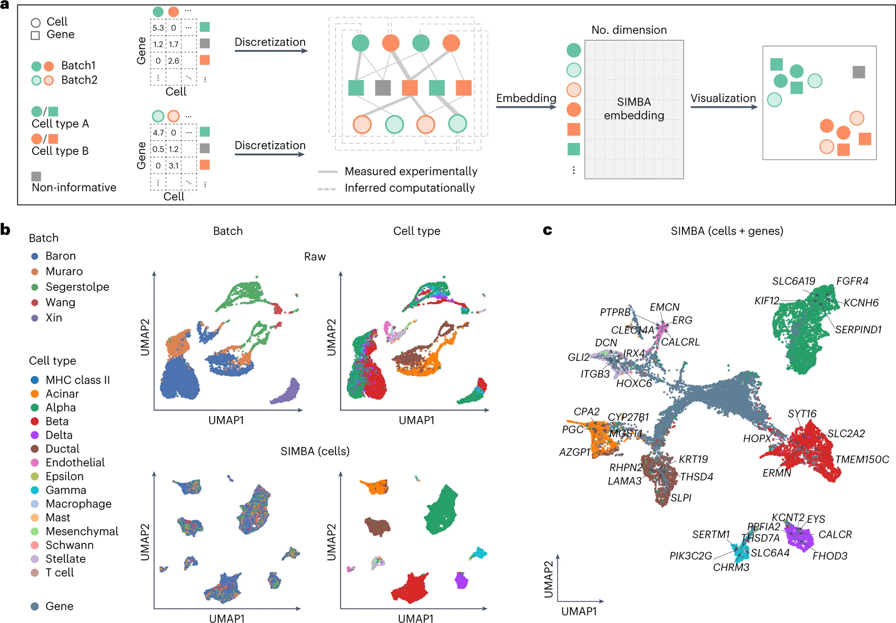
Batch correction analysis
Dataset: scRNA-seq data
Notes:
兩個批次的小鼠組織圖譜數據集 (小鼠組織圖譜數據集包含來自不同测序平台的共享細胞類型的兩個單細胞RNA序列數據集)+
五個批次的人類胰臟數據集 (人類胰臟數據集包含從五個來源中使用四種测序技術混合的五個樣本)

Slide 32
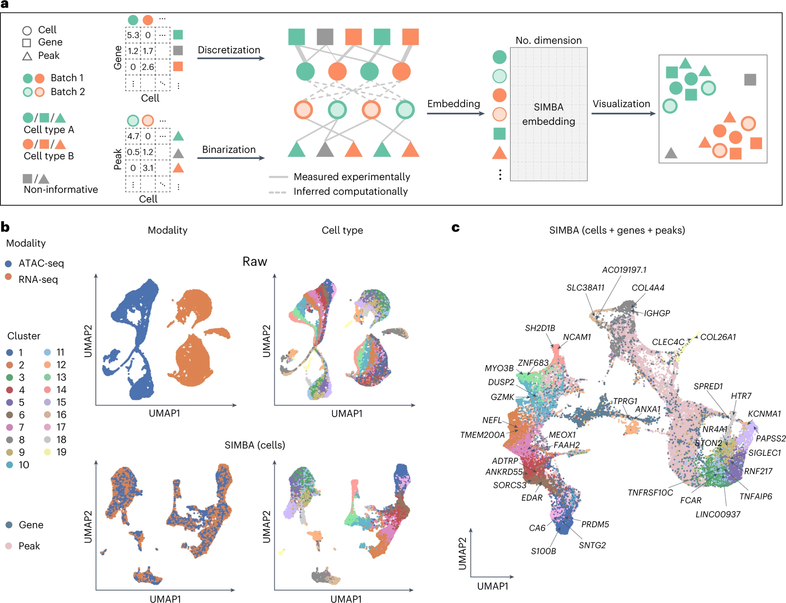
Multi-omics integration
Notes:
The last, is Multi-omics integration.
The top figure presents the UMAP visualization before integration.
The bottom figure displays the UMAP visualization after integration using SIMBA.

Slide 33

Discussion
SIMBA
https://zh.wikipedia.org/zh-tw/%E8%BE%9B%E5%B7%B4
Notes:
Before we dive into the discussion, I'd like to make a declaration. Due to time constraints, there are many mathematical concepts and details behind SIMBA that I have not mentioned. If anyone is interested, you can just come to seek me out for further discussion

Slide 34

SIMBA！To do more？
cellular heterogeneity
time points
Perturbations
regulatory mechanisms
https://www.timesofisrael.com/israeli-photographers-real-life-lion-king-photo-grabs-headlines/
Notes:
In the discussion, SIMBA believes it has successfully accomplished two things. First, through SIMBA, we can clearly differentiate various cell types. Secondly, it allows us to understand the regulatory mechanisms among genes, transcription, and chromatin factors within a single cell.
However, is there a chance to incorporate more variables in the future?
For instance, time points, or some interfering factors？
Indeed, with each additional variable, we are essentially adding another dimension to the data, which may complicate the analysis significantly. However, it‘s a matter worth considering for everyone.

Slide 35
Thanks for your attention Q&A Time
https://en.wikipedia.org/wiki/Simba
Notes:
Thanks for your listening, this is the end of my presentation. Do you guys have any question?

Slide 36
Supplementary

Slide 37
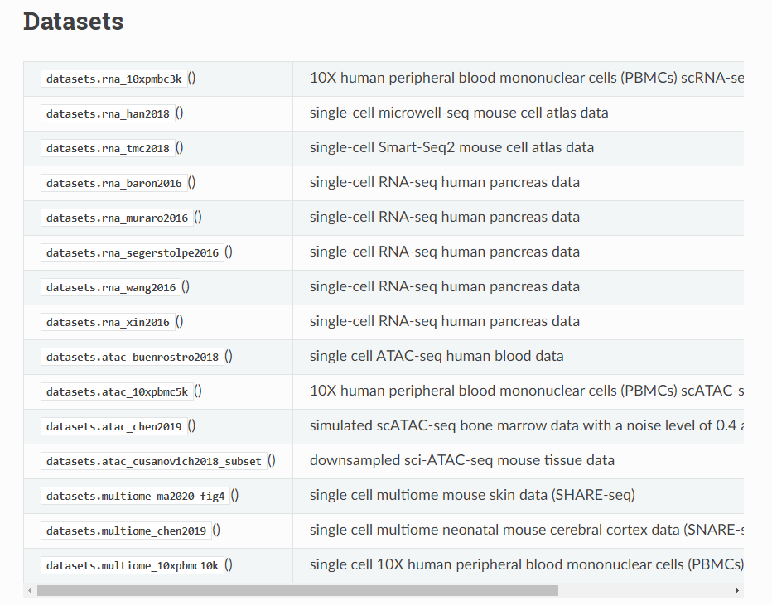
Dataset
Notes:
八個單細胞RNA序列數據集、四個單細胞ATAC序列數據集和三個雙組學數據集

Slide 38
SIMBA’s Innovation
(1) SIMBA does not require node featurization nor ad-hoc transformations.
(2) The co-embedding of cells and features in a common space generated by SIMBA enables an intuitive interface for inferring biologically meaningful information.
(3) Perform better or comparably well than existing state-of-the-art methods that are dedicated to respective tasks.
Notes:
無需節點特徵化：SIMBA不需要節點特徵化或任何特定的轉換。
共嵌入：SIMBA能夠將細胞和特徵共同嵌入到一個空間中，從而提供一個直觀的界面，用於推斷生物學上有意義的信息，例如標誌基因、調節因子或細胞回路。
通用性：雖然SIMBA不是專門針對任何特定的單細胞分析任務而設計，但它在性能上可以比肩或超越專門為特定任務設計的現有最先進的方法。
易於使用的 Python 包：SIMBA 已經作為一個高品質、全面且有良好文檔的 Python 包實現，它建立在 Anndata 結構之上，與 Scanpy 兼容，後者是最廣泛使用的基於Python的單細胞分析框架。這使得SIMBA容易被廣泛的用戶所使用
GLUE：用於未配對的單細胞多組學數據整合，採用變分自編碼器（VAE）將細胞嵌入到低維空間。但是，GLUE的嵌入結果不具可比性，且只適用於特定的多模態分析。
Metacell：一種 scRNA-seq 分析方法，通過k近鄰（kNN）圖和節點特徵化將相似細胞合併成“超細胞”。這種方法僅適用於scRNA-seq數據，嵌入結果也僅包含細胞。
scETM：一個生成主題模型，用於整合 scRNA-seq 數據的分析。它通過 VAE 學習細胞和基因的嵌入，但其結果同樣不具可比性，且只適用於 scRNA-seq 數據。
CellSpace：基於 TagSpace 的 scATAC-seq 數據嵌入方法，將採樣的DNA序列表示為句子，k-mer作為單詞，細胞表示為標籤。它專為 scATAC-seq 數據設計，嵌入結果包含細胞和單一類型的特徵（即DNA序列）。
MIRA：一種多模態分析方法，它也使用 VAE 來學習細胞的嵌入，通過結合來自 scRNA-seq 和 scATAC-seq 數據的細胞的低維表徵。MIRA 專門針對單細胞多模態數據設計，嵌入結果也只包含細胞。

Slide 39
SIMBA and Scanpy
Top 600 marker genes identified by SIMBA
max value
Gini index
Scanpy
z-score calculated from the two-sided Wilcoxon rank-sum test with a Benjamini-Hochberg p-value correction
Notes:
SIMBA識別的前600個標誌基因是基於最大值和基尼指數來選擇的，而Scanpy則是使用基於Wilcoxon秩和測試的z分數（並經過Benjamini-Hochberg p值校正）來識別標誌基因，這是Scanpy教程中推薦的統計測試之一。
研究發現，SIMBA發現的標誌基因與Scanpy識別的標誌基因有近一半重疊。不過，在檢視不重疊的頂尖標誌基因時，他們發現SIMBA識別的基因只在特定細胞群體中富集，而Scanpy識別但SIMBA沒有的包括了B2M這樣的管家基因和多個在所有細胞類型中普遍表達的核糖體蛋白基因（例如RPS3和RPS6）。
此外，要恢復只由SIMBA識別出的基因，需要結合Scanpy中提出的不同統計測試。例如，IL7R只能通過t檢測來識別，而FCER1A只能通過Wilcoxon秩和測試來識別。這在Scanpy的教程中也有提及。與此同時，SIMBA使用單一流程並且不需要對細胞進行聚類，就成功識別了IL7R和FCER1A這兩個有信息量的基因。

Slide 40
Benchmarking scATAC-seq computational methods
k-means clustering
hierarchical clustering
Louvain clustering
Notes:
為了比較SIMBA與其他scATAC-seq計算方法（包括SnapATAC、Cusanovich和cisTopic），我們使用了之前由Chen等人開發的基準測試框架（附錄表2）。該框架根據方法區分細胞類型的能力來評估不同的方法。我們對每種方法所得到的特徵矩陣應用了三種聚類算法：k-means聚類、層次聚類和Louvain
這三種聚類算法的目的是基於特徵矩陣將細胞分組，並看看哪種方法最能區分不同的細胞類型
- k-means: 這是一種經典的群集算法，它將數據點分為K個群集，使得每個點屬於與其最近的群集中心。算法從隨機選取的中心點開始，逐步調整群集中心，直到達到最優或達到迭代次數上限。K-means適合於大數據集，但其性能依賴於K值的選擇和初始中心點的設定。
- 層次聚類：基於層次結構進行群集的方法，可以分為聚合（自下而上）和分裂（自上而下）兩種。在聚合群集中，每個數據點最初被視為一個獨立的群集，然後逐漸將最相似的群集合併，直到達到預定的群集數量或滿足某些停止標準。層次群集算法不需要預先指定群集數量，但計算複雜度較高
- Louvain算法：常常應用於網絡數據的群集分析。它是基於模塊度優化的，通過局部最優化來檢測網絡中的社區結構。算法從小的社區開始，逐步合併可以增加模塊度的社區，直到無法再增加模塊度為止。Louvain算法運行速度快，適合於大型網絡，但其結果可能受到初始化條件的影響
【如何評估一些具有已知標籤（即“真實”分類）的數據集的聚類效果】
標籤可能基於FACS排序或已知的組織標籤。為了評估不同方法的效果，他們使用了三個指標：調整後的Rand指數 (ARI)、調整後的互信息 (AMI) 和同質性
調整後的Rand指數 (ARI)：這是一種衡量兩個聚類解決方案之間相似性的指標。在這裡，它用於比較預測的聚類解決方案和真實的細胞/組織標籤。具體來說，它通過比較在預測的聚類解決方案和真實標籤中被指定為匹配或不同聚類的樣本對來計算相似性。
調整後的互信息 (AMI)：互信息描述了兩個變量之間的共同出現的觀察頻率與期望的共同出現頻率之間的比較。它告訴我們這兩個變量之間的相互依賴性或關聯強度。在這裡，它用於評估預測的聚類解決方案和真實的細胞/組織標籤之間的一致性。
同質性：這個指標衡量一個聚類算法是否在對屬於單一類別的樣本進行聚類時保留了聚類分配。簡單地說，如果同一類的所有樣本都被分到了同一個聚類中，則同質性會很高
ARI：想像一下你有一堆水果，你把它們隨機分成兩組。然後你又隨機地再分一次。現在，你想知道這兩次分組是否相似。你可能會想：「嘿，這兩次分組中，這兩顆蘋果都沒在同一組！」這看起來像是一個相似之處，對吧？但實際上，這只是隨機的結果，並不真正表示這兩次分組相似
5. AMI：想像你有一個特殊的眼鏡，這個眼鏡可以看到兩人間的共同話題不只是真正的共同興趣，還包括那些偶然、巧合談起的話題。現在，當 Alice 和 Bob 一起談話時，這個眼鏡可能會告訴你，他們的共同話題比你原先想像的要多。但其中有些可能只是偶然的、無意義的共通點，例如他們都剛好在同一天買了咖啡，或都剛好看了同一部電影。
這時，你會想知道，去掉這些巧合和隨機的話題後，Alice 和 Bob 真正的共同話題有多少。這就是AMI的作用。AMI會修正那些可能的隨機性，給你一個更真實、更清楚的畫面，告訴你 Alice 和 Bob 之間真正的、有意義的共同話題有多少。

Slide 41
Benchmarking single-cell batch correction methods
Average Silhouette width (ASW)
Adjusted Rand index (ARI)
Local inverse Simpson’s index (LISI)
Notes:
SIMBA的批次校正性能與Seurat3（參考文獻 ¹² ）、LIGER ¹¹ 和Harmony ¹⁰ 在兩個基準數據集上進行了比較。
ASW：ASW 值介於-1到+1之間，其中較高的值表明群集內部緊密且與其他群集清晰分離。ASW是通過比較每個點與其自身群集中其他點的平均距離（凝聚度）和與最近群集中的點的平均距離（分離度）來計算的。如果ASW值接近+1，則表示數據點很好地匹配到其群集，並且群集之間分隔明顯
ARI：ARI 是一種衡量群集結果與某些預定群集（通常是真實標籤或已知結果）之間相似性的指標。它的值介於0到1之間，其中1表示完美的群集一致性，0表示群集結果與隨機分配沒有顯著差異。ARI是Rand指數的一個調整版本，用於校正隨機性。
LISI：LISI 用於衡量群集中的多樣性和均勻性，特別是在考慮批次效應時。它通過考慮每個點周圍鄰居的標籤分佈來計算。LISI的值越高，表示局部區域的多樣性越高。這對於評估批次整合時的數據均勻混合程度非常有用

Slide 42
Benchmarking single cell multi-omics integration methods
Anchoring distance
Anchoring distance rank
Silhouette index
Cluster agreement
Notes:
數據集：研究人員手動從兩個雙模態數據集中拆分出兩對 scRNA-seq 和 scATAC-seq 數據集。這兩個雙模態數據集分別是 SHARE-seq 的老鼠皮膚數據集和 10x PBMCs 數據集。
方法的參數設置：
對於 Seurat3 和 LIGER，他們按照相應的文檔中所描述的方式設置參數和進行數據預處理。
當使用 LIGER 分析 SHARE-seq 的老鼠皮膚數據集時，他們設置了參數 ‘lambda’ 為 30，並將 ‘ref_dataset’ 設置為 scATAC-seq，以獲得更好的對齊效果。
原始結果：他們使用 Seurat3 構建了 scATAC-seq 的活性矩陣，然後使用 scRNA-seq 計數矩陣和活性矩陣的前20主成分(PCs)進行比較。
評估指標：每種方法生成的整合結果都使用四個指標進行評估，這四個指標是錨定距離、錨定距離排名、輪廓指數和群集一致性。具體的詳細信息可以在補充說明8中找到
- 錨定距離（Anchoring Distance）：這個指標用於衡量scRNA-seq和scATAC-seq數據集中相匹配的細胞對之間的距離。錨定距離越小，表示兩種數據集中相對應的細胞在整合後的空間中越接近，這意味著數據整合的質量較高。
- 錨定距離排名（Anchoring Distance Rank）：這個指標是基於錨定距離的一個變體，它不僅考慮了匹配細胞對之間的距離，還考慮了這些距離在所有細胞對中的相對排名。排名越高，表示匹配細胞之間的相似度越高，從而表明數據整合效果較好。
- 輪廓指數（Silhouette Index）：輪廓指數是一種評估群集質量的指標，它測量每個細胞與其群集內其他細胞的相似度與最近的其他群集的細胞的相似度之間的差異。輪廓指數範圍通常在-1到1之間，值越高表示群集內的一致性和群集間的區分度越高。
- 群集一致性（Cluster Agreement）：這個指標評估不同方法生成的群集結果之間的一致性。高群集一致性意味著不同方法識別出相似的群集結構，這表明這些方法對數據的解釋具有一定的共識

Slide 43
Single-cell RNA seq Analysis
K-means
Preprocessing
Graph Construction
Embedding
Filtering
Normalization
Variable gene selection
Notes:
Here, You can always see three steps. – Preprocessing, Graph Construction, and Embedding.
Preprocessing is simple, ehen we obtain the gene expression levels of cells, we tend to transform them into a gene expression matrix. You can see that, on this gene expression matrix, the values are continuous and include decimal points.
To simplify, we will transform these continuous values through a discrete conversion. We divide these values into five groups.
Each group here implies that the gene expression levels within the same group are relatively similar
After completing the conversion of discrete values, we can do the graph construction.
Graph construction is very easy, you put cells and genes on a graph. Circles represent Cells, and Squares represent Genes.
You know their relationship, you know which genes expressed in which cells, and you also know the value, the value is their expression level.
So based on their association, you can line them up. And this, is graph construction!
We will discuss SIMBA embedding later.

Slide 44
Single-cell ATAC-seq Analysis
Preprocessing
Graph Construction
Embedding
Filtering
Peak selection
Notes:
Peak selection (truncated-SVD) 包括 find main peak (elbow plot，前k個Pcs)、pick peak (knee point detection algorithm)、combine peak (variable peaks)
truncated-SVD：只保留具有信息的peak
PCs selection(elbow): 降維，把主幹挑出來，同時達到去噪
peak pick (knee point detection algo.)
Variable peaks combination
過濾掉出現在少於三個單元格中的峰值。可選擇性地，我們實施了一個可擴展的截斷奇異值分解（SVD）程序，以選擇變量峰值作為初步步驟，進一步過濾非信息性的峰值並加快訓練過程。首先，根據方差比例的拐點圖，選擇了前k個主成分（PCs），其中k的選擇基於拐點圖。然後，對於每個前k個PC，根據加載使用的膝點檢測算法自動選擇峰值，該算法由“kneed”實現。最後，將每個PC選擇的峰值結合起來，稱為“變量峰值”。與scRNA-seq數據觀察到的情況類似，選擇變量峰值的可選步驟對結果的單元嵌入影響微乎其微。儘管對結果的嵌入影響很小，但這個特徵選擇步驟在減少訓練過程時間方面具有顯著的實際優勢。

Slide 45
Batch Correction
Notes:
Batch correction analysis is essentially the same, but it involves constructing different graphs for different batches
So, here you can see many graphs
truncated randomized SVD：U、Σ、V
L2 归一化：矩阵U和矩阵V都被进行了L2归一化操作，以确保它们的向量表示在单位长度上。
寻找最近邻：然后，在U和V之间的每个细胞中，搜索了k个最近邻细胞（默认k=20）。也就是说，对于U中的每个细胞，找到了在V中距离最近的k个细胞
保留共同最近邻：最后，只有在U和V中互为最近邻的细胞被保留为推断的边缘（edges）表示不同批次之间的细胞之间的连接

Slide 46
Multi-omics Integration
Notes:
Let’s not go into further about Multi-omics Integration; it's the same concept.
* Gene activity calculation
* truncated randomized SVD

Slide 47




Metrics to assess cell-type specificity
Cells and Features…
How to evaluate that they are related?
Max Score
Gini Index
Standard Deviation
Entropy
Association
Specificity
Variance
Degree of Disorder
The evenness of Distribution
Notes:
最大分數 ⁴⁶ 是對前50個細胞的標準化概率進行平均，用作對細胞類型分配的信心度指標，並有助於過濾噪音特徵（較高的值表示較高的細胞類型特異性）
基尼指數 ⁴⁶ 是從經過Softmax轉換的概率分佈計算出來，用於評估與完全均勻分佈的偏差，因此顯示出不平衡分佈（即細胞類型特異性）的特徵被賦予較高的基尼指數值（較高的值表示較高的細胞類型特異性）
標準差（s.d.）衡量概率分佈中的變異量，較高的值表示細胞內的偏差較大（即細胞類型特異性較高）（較高的值表示較高的細胞類型特異性）
熵度量信息内容并捕捉细胞在经过Softmax转换的概率分布中的分散程度；较低的熵值表示分布几乎集中在一个细胞子集上（即细胞类型特异性较高）（较低的值表示细胞类型特异性较高）

Slide 48
Two desirable properties of generating graph
First-order similarity
for two entity types T₁ and T₂ with a relation between them, edges with high likelihood should have higher dot product
Second-order similarity
within a single entity type, entities that have ‘similar contexts,’ that is, a similar distribution of edge probabilities, should have similar embeddings.

Slide 49
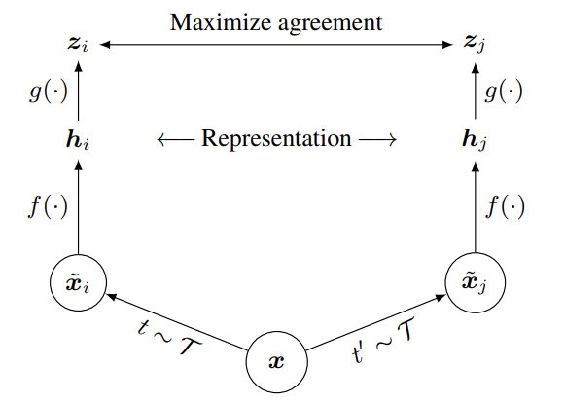

Slide 50
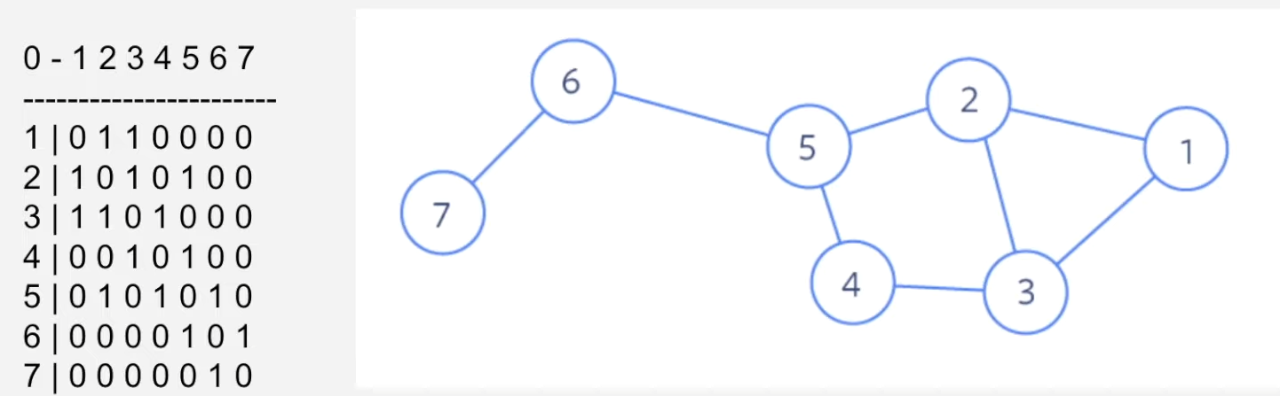

Slide 51
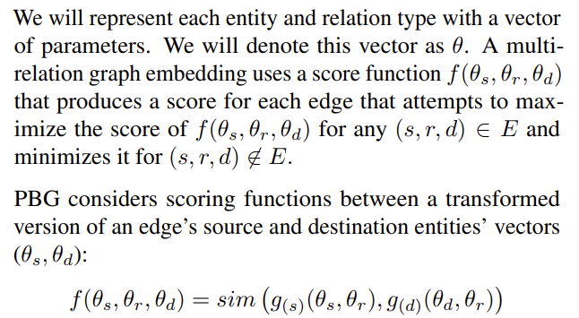

Slide 52
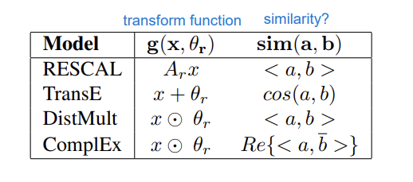

Slide 53
Algorithm Novelty in PBG – Training at Scale
Block Decomposition of the Adjacency Matrix
Distributed Execution Model
Efficient Negative Sampling
Per-Relation Configuration Operations
Notes:
區塊分解的鄰接矩陣（Block Decomposition of the Adjacency Matrix）：
這通常指的是將一個大的鄰接矩陣（在圖形理論中用來表示節點或頂點之間的連接關係）分解成多個較小的區塊或子矩陣。這樣做可以提高處理效率，尤其是在分佈式系統中，每個區塊可以獨立處理。
分佈式執行模型（Distributed Execution Model）：
在分佈式計算中，計算任務被分散到多個計算機節點上執行。分佈式執行模型允許系統橫向擴展，提高大規模數據處理的能力。
高效的負採樣（Efficient Negative Sampling）：
負採樣是一種在訓練機器學習模型，特別是在處理大量未標記數據的情境下使用的技術。它選擇一些負例本來幫助模型更好地學習區分正例本和負例本。高效的負採樣意味著這一過程在計算資源和時間上被最佳化。
每個關係配置操作（Per-Relation Configuration Operations）：
在圖形處理和關係型數據庫中，這可能指的是對於數據集中的每種類型的關係或連接，都可以進行個別的配置或操作。這允許更細粒度的控制，可以對不同類型的關係實施不同的策略或參數設定

Slide 54
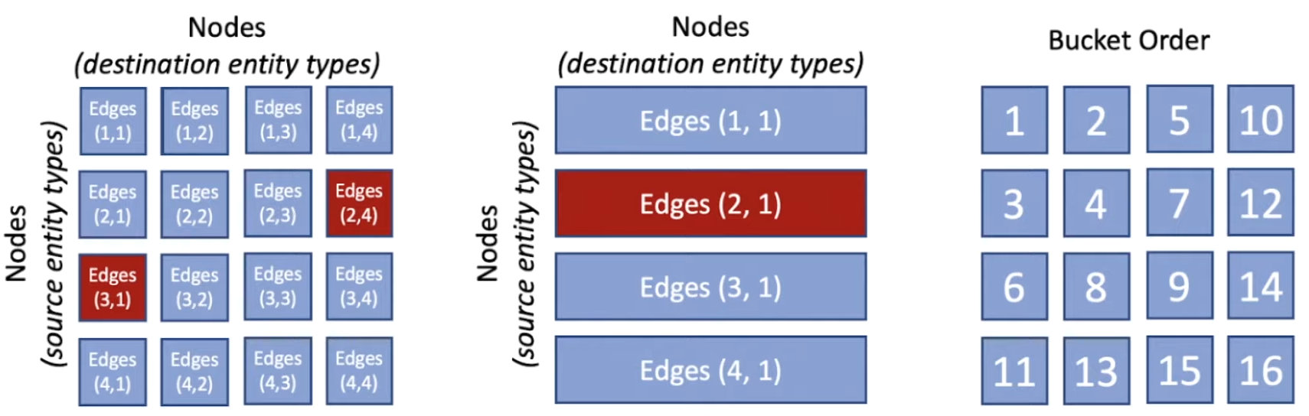
Block Partitioning
Notes:
block partitioning是这样工作的：
将图的节点划分成多个块（block）。
根据这些块划分边，使得每个边连接的节点要么在同一个块中，要么在不同块的对应位置。
在训练过程中，每个块可以独立地加载到内存中，模型可以在这个子图上进行训练，而不需要整个图全部加载到内存中。
这样的方法允许处理大型图数据，因为它减少了同时需要在内存中的数据量，并允许在多台机器上并行处理数据

