Slide 1
Finding the Distance
A single microphone cannot measure how far away a sound is. Two can. What it takes to make that work, where it stops working, and the one measurement that decides between the two.
Distance Report · 11–18 August 2026 | Steven Ha 夏國保

Slide 2
Where we started
Direction was solved to a few degrees. Distance returned 3.00 m on every take, whatever the true distance was.
Widen the search to 10 m and it returned 10.0 m. The number was not a measurement at all — it was the edge of the search grid.
Nine mechanisms were tried and all nine failed for one shared reason: a quiet source nearby and a loud source far away produce very nearly the same signal at one microphone. Nothing in that recording breaks the tie.
Breaking it needs an EXTERNAL REFERENCE. There are only four — a second viewpoint, a known emission time, a known source level, or a known reflector.
Two were actually recordable here: a second microphone at a measured distance, and the floor as a reflector. Both were recorded and both were settled by measurement.
This deck reports both, plus five later takes that push the winning method until it breaks — and one assumption that had to be corrected along the way.

Slide 3
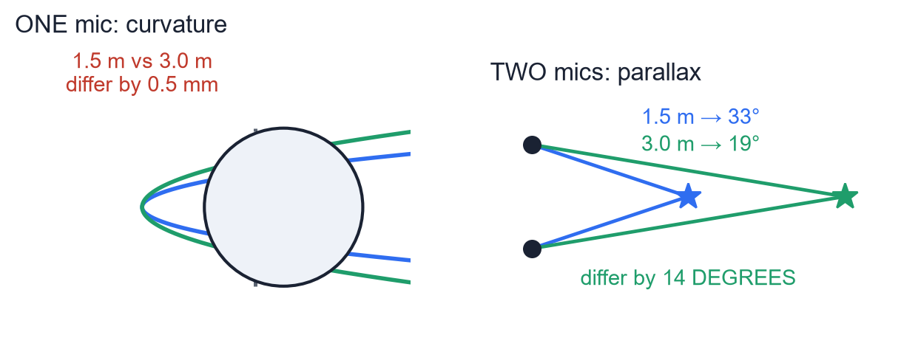
The fix: two viewpoints
Each microphone reports a direction. The source is where the two lines cross. Exactly how two eyes judge depth.
One mic must resolve 0.5 mm of wavefront bulge across an 11 cm sphere. Any 0.5 dB capsule mismatch swamps it.
Two mics must resolve a 14° change in angle — and both mics already measure angle to within a few degrees.
The same physical fact, made roughly ten thousand times easier to see.
It needs no curvature, no reverberation model, no time sync between the two recorders, and it works in any room or outdoors.

Slide 4
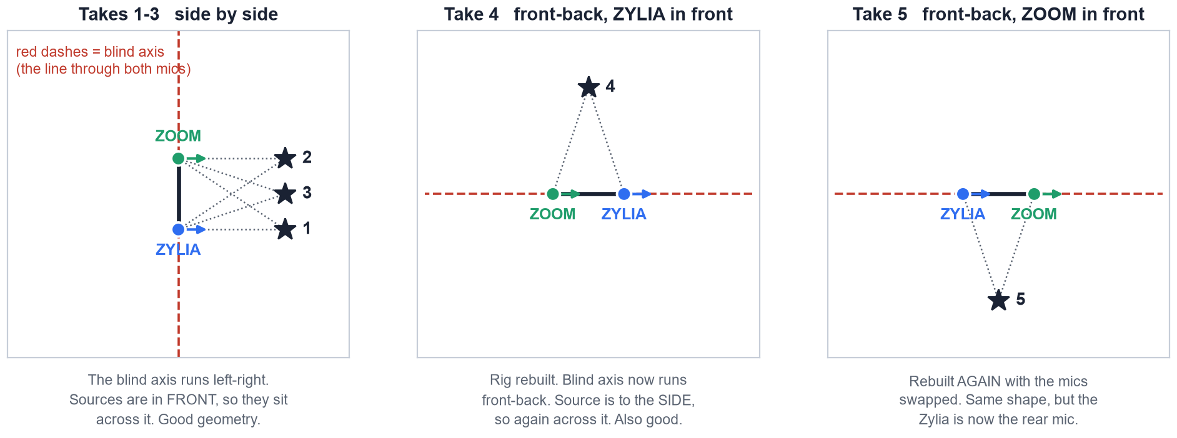
What was recorded
Seven takes over two sessions. The mics were physically rearranged between them — which matters more than it looks.
The blind axis is the line through both microphones. A source ON it gives both mics the identical bearing at every range, so the recording carries no distance at all. Every take here sits safely across it — including the two that failed.

Slide 5
Every take, scored
Direction holds up everywhere. Distance splits cleanly on one thing: whether the rotation between the two mics had been measured.
take | rig | azimuth | distance | vs truth | verdict
11 Aug front clap | side by side | –5.0° | 2.78 m | +85% | passed, wrong
11 Aug back clap | side by side | +0.7° | 1.56 m | +4% | trusted
17 Aug in front of Zylia | side by side | –0.7° | 1.52 m | –4% | trusted
17 Aug in front of Zoom | side by side | –2.7° | 1.62 m | +3% | trusted
17 Aug centre, elevated | side by side | –0.7° | 1.66 m | +6% | trusted
17 Aug left | front-back, Zylia front | +6.2° | 3.14 m | +109% | rejected
17 Aug right | front-back, Zoom front | +2.4° | 2.40 m | +60% | passed, wrong
Where the twist was known: –4, +3, +6 and +4 per cent.
Where it was not: +60, +85 and +109 per cent. That is the entire split — same method, same geometry, one missing number.

Slide 6
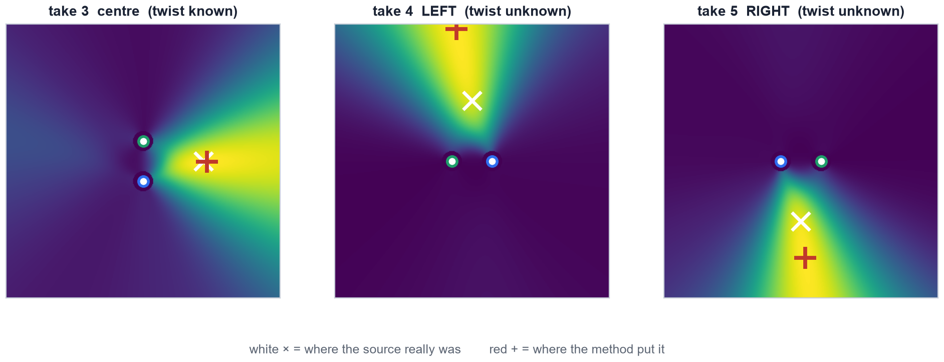
How the answer is actually formed
Not by crossing two single bearings — by asking every point in the room how well BOTH microphones agree with it.
Each mic contributes a whole power map, accumulated over every usable frame; the two are multiplied across the room. Crossing two peak bearings instead would put the answer metres away, because two peaks each a few degrees off do not average out.

Slide 7
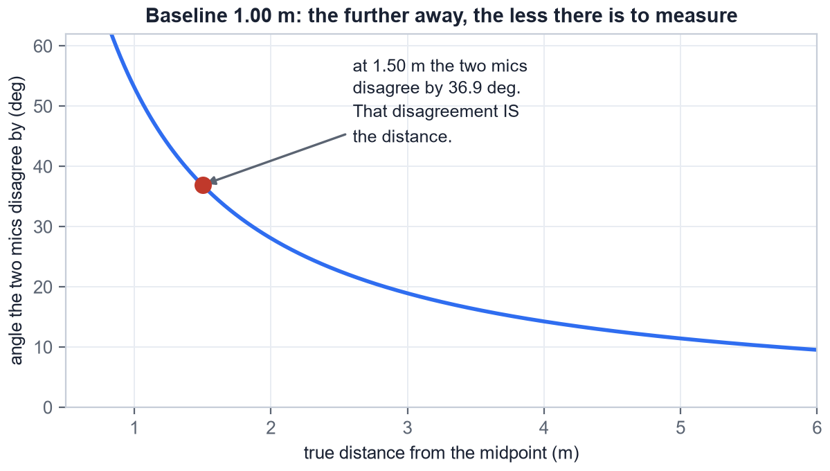
What a distance is made of, and the one rule
The angle the two microphones disagree by IS the distance information. There is nothing else in the recording.
At 1.50 m on a 1 m baseline the two mics disagree by 36.9°.
Further away there is less of it. 18.9° at 3 m, 11.4° at 5 m.
THE RULE: σ(r)/r ≈ (r/B) × σ(θ). Past r/B = 3 the two rays are too close to parallel and the answer stops meaning anything.
So the baseline grows with the range: 1 m to measure 1.5 m; 3–5 m to measure 5 m. Unlike curvature there is no ceiling — only a baseline you have to grow.

Slide 8
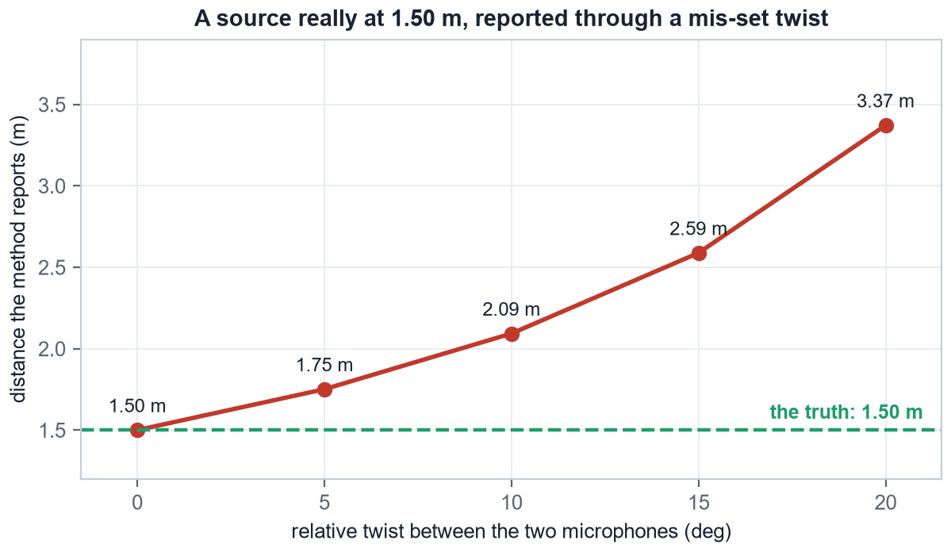
The twist: one unmeasured angle, and the distance doubles
If the two microphones are rotated relative to each other and nobody measured by how much, one of the two lines is drawn at the wrong angle.
A source really at 1.50 m, reported through a twist nobody measured:
5° → 1.75 m
10° → 2.09 m
15° → 2.59 m
20° → 3.37 m
Why it bites so hard: the whole measurement is only 36.9° wide. Spend 15° of it on an unknown rotation and 40% of the signal is gone.
This is the single reason three of the seven takes are wrong.

Slide 9
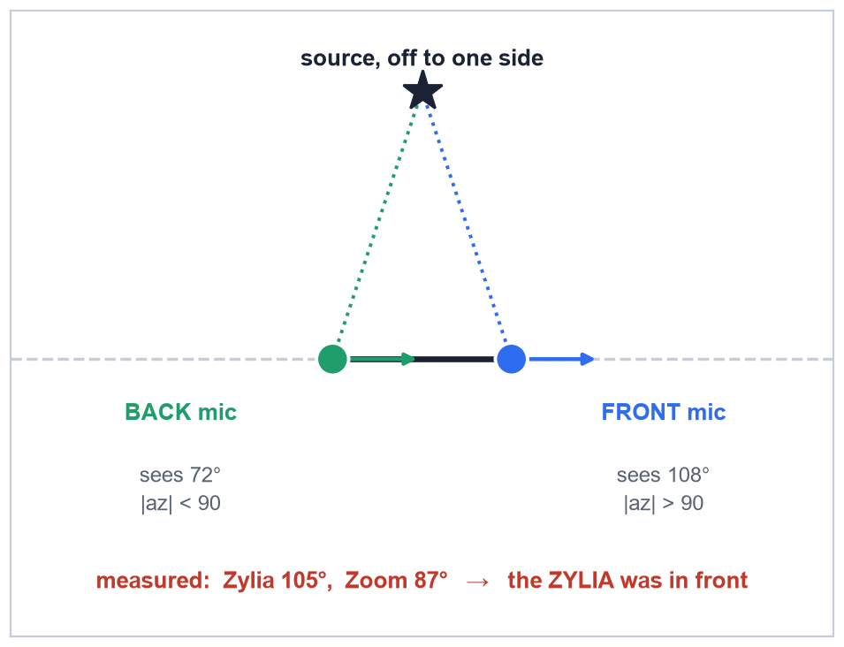
The correction: the rig was rebuilt between takes
An earlier version of this report called the two side takes physically impossible. They were not. Worth recording how the error was made.
The claim was that the source stood on the blind axis, so no distance existed in the recording. True for a side-by-side rig — which is what we assumed the rig was.
The evidence against it was already there. On a front-back rig the FRONT mic must read |az| > 90° and the BACK mic |az| < 90°. The Zylia read 105° in one take and –76° in the other.
The wrong conclusion: “no rig explains both, so the bearings are corrupt.”
The right one: no SINGLE rig does. The mics were physically swapped between the two recordings.
The lesson: when two measurements are each internally consistent but jointly impossible, suspect the apparatus before the data.

Slide 10
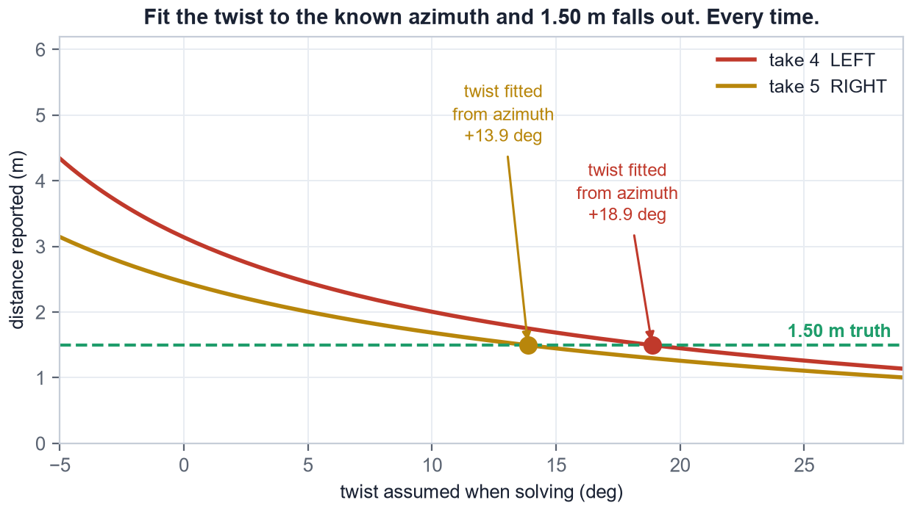
The trap: do not fit the twist to the answer
The twist for the two side takes can be recovered from their azimuth error against the known source direction. It is tempting, and worthless.
Fit it that way and the distance comes back at exactly 1.50 m. Both takes. Every time.
That is not a confirmation. What is left after the fit is a rotation COMMON to both rays, and a common rotation swings the answer around the midpoint without changing its RANGE.
So 1.50 m falls out by construction — it would do so even if the true distance were 3 m.
Contrast the front takes, where the twist came from three takes at once and was then checked against a distance nobody had used to derive it. That is what an independent confirmation looks like.

Slide 11
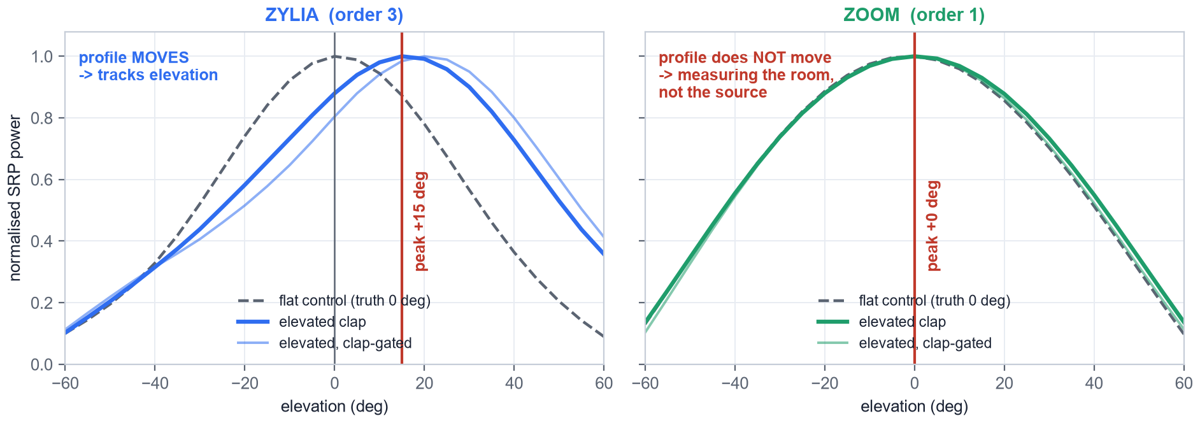
Direction: azimuth everywhere, elevation on the Zylia only
Neither depends on the twist, which is why both survived every take that distance did not.
Azimuth is inside 6.2° on all seven takes, on all three rig arrangements.
Elevation was there all along. The elevated clap reads +15.6° against roughly +16° measured three independent ways.
The Zoom contributes nothing. Its vertical map peaks at exactly 0.0° in every take, elevated or flat — at 1st order the vertical beam is too broad to beat the room, so it measures the diffuse field. Its hardware is fine; this is an estimator limit.
Fixed: elevation now comes from the Zylia's map, not the mean of both.

Slide 12
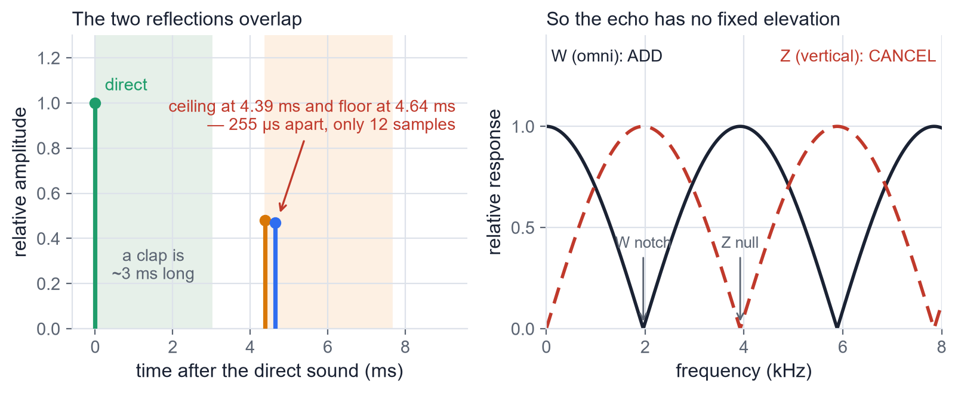
The other reference: the floor, and why it is closed
A floor reflection is sound from an image source as far below the floor as the real one is above it. One mic, two arrivals, and the delay fixes the range.
It failed, and not for the reason expected. The floor is bare hardwood and returns about 96% of the pressure — absorption was never the problem.
The CEILING echo lands 0.25 ms from the floor echo. Twelve samples at 48 kHz, against a clap roughly 3 ms long. They do not merely overlap — they comb-filter, and the blend has no fixed direction.
It is a HEIGHT problem, not a room problem. The two echoes collide when the mic sits at (ceiling − source height). A standing talker at 1.55 m under a 2.70 m ceiling collides at 1.15 m — where a normal stand puts it.
The fix is one tripod adjustment: drop the mic to 0.35 m and the two arrive 4 ms apart.

Slide 13
Recording protocol
Every item here exists because something in this report went wrong without it.
1. Record a FRONT take and a BACK take every setup. check_mic_yaw.m measures the twist from those two alone, with no ground truth. One extra minute. This is the single highest-value item on the list — it is the difference between 4% and 85%.
2. Tape the floor and label which mic is FRONT. The two front-back arrangements give completely different distances and cannot be told apart from the audio afterwards.
3. Never rebuild the rig mid-session without re-measuring. The twist does not survive a teardown, and nothing downstream can detect that it changed.
4. Tape-measure the baseline and write it down. Distance scales linearly with it and it cannot be recovered from the audio.
5. Keep the source broadside and r/B under 3. Grow the baseline with the distance you want to measure.
6. Watch the Zoom's level — it clipped on every clap in both sessions — and write down the mic, source and ceiling heights.

Slide 14
Where it stands
Distance is solved by supplying the second viewpoint a single microphone can never have. Four takes land within 6% of a tape measure, against a railed and meaningless 3.00 m from every single-microphone method tried.
It fails on exactly one thing: an unmeasured rotation between the two mics. That is a recording-time problem with a one-minute fix, not a limitation of the method.
Direction was never modified and never failed — azimuth inside 6.2° on every take, elevation recovered on the Zylia.
The floor-bounce alternative is closed for these recordings, by measurement rather than assumption, and the way to reopen it is known.
Two microphones have one blind axis and you choose where to point it. Covering front and side at once needs a third microphone off the line.
What remains is one session with a tape-measured baseline at three or four known distances, with a front/back pair at each. That turns correct answers into a calibration curve.

