Slide 1
Pushing It Until It Breaks
Five recordings that map the working envelope of the two-microphone method — and the bookkeeping error that made two of them look physically impossible.
Limit-Test Report · revised 18 August 2026 | Steven Ha 夏國保

Slide 2
Why these five takes
The method was confirmed on 11 August from ONE source position: straight in front. That proves it can work, not where it stops working.
The question: azimuth, elevation and distance all come out of one pair of recordings. Which of the three survive when the source is not in the easy place?
Four ways to be awkward: stand directly in front of one microphone so it sees you head-on; raise the source above the mics; and go out to the left and right edges.
One constant: every take at 1.50 m, tape-measured, on the same 1 m baseline, in one session.
A clap in every take gives a sharp shared transient for alignment and a clean direct-path measurement.
What actually came out of it was not the failure mode we expected. Two takes looked impossible; they were not. The rig had been rebuilt between them and nobody wrote it down.
Zylia ZM-1 (3rd order, 19 capsules) + Zoom H3-VR (1st order, AmbiX). All 19 Zylia capsules healthy in all five takes.

Slide 3
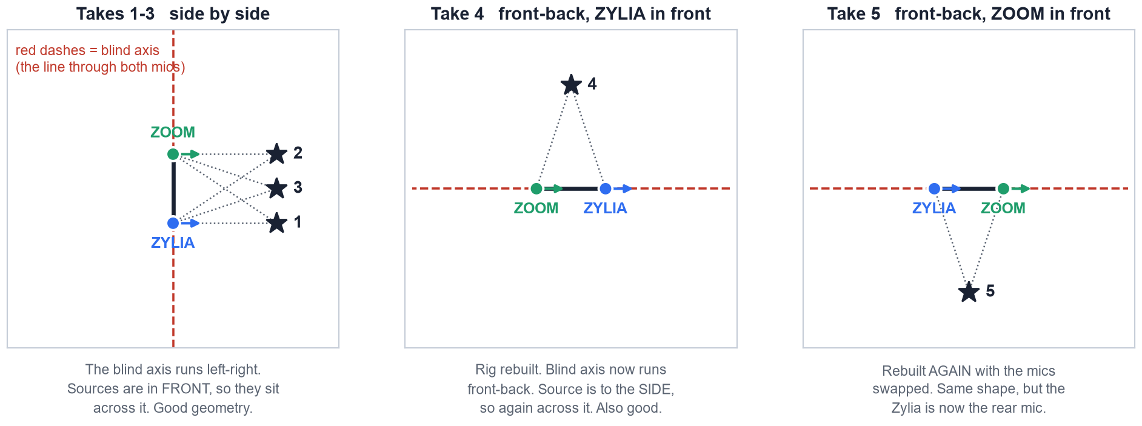
One method, three different rigs
The mics were physically rearranged between takes. Every take is still broadside — the blind axis just points somewhere different each time.
The blind axis is the line through both microphones. A source ON it gives both mics the identical bearing at every range, so the recording carries no distance at all. All five sources sit safely across it.

Slide 4
Scoreboard
Azimuth and elevation hold up everywhere. Distance splits cleanly into the takes whose rig alignment was known and the two whose was not.
take | rig | Zylia bearing | elevation | distance | vs truth | verdict
1 in front of Zylia | side by side | 0.0° | 0° ok | 1.52 m | –4% | trusted
2 in front of Zoom | side by side | –1.7° | 0° ok | 1.62 m | +3% | trusted
3 centre, elevated | side by side | –1.4° | 15.6° | 1.66 m | +6% | trusted
4 left | front-back, Zylia front | –3.4° | 0° ok | 3.14 m | +109% | rejected
5 right | front-back, Zoom front | –4.4° | 0° ok | 2.40 m | +60% | wrong
Every bearing is inside 4.4°. Direction never failed, in any take, on either rig.
Distance is 3 to 6% wrong where the rig alignment was known, and 60 to 109% wrong where it was not. That is the entire split.
“rejected” means the built-in guards refused to report the number. Take 5 is the dangerous one: wrong, and it passed.

Slide 5
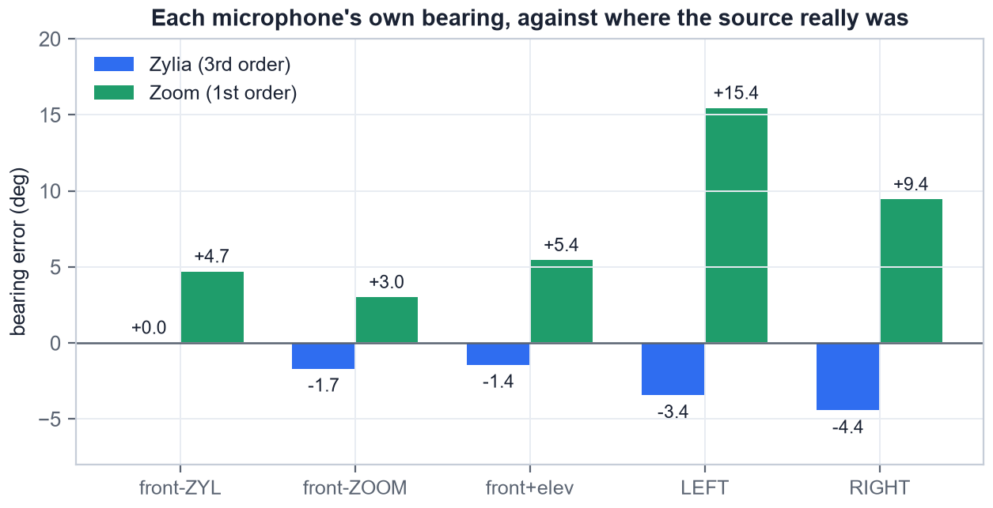
Azimuth: the robust one
Each microphone's own bearing, measured against where the source really was. The Zylia never exceeds 4.4° on any take.
The Zylia is the reliable mic. 3rd order, 19 capsules, no clipping.
The Zoom is consistently biased and by different amounts on different rigs: +4.7, +3.0, +5.4 on the side-by-side takes, then +15.4 and +9.4 on the two front-back ones.
That difference is the whole story. It is not noise — it is the physical rotation between the two mics, and it changed when the rig was taken apart and rebuilt.
Bearing error is measured per microphone, in that microphone's own frame — not the fused source azimuth.

Slide 6
A ground-truth-free azimuth check, for free
Takes 1 and 2 exist for a reason beyond limit-testing: they calibrate azimuth without a protractor.
Stand directly in front of one microphone and that microphone's true azimuth is exactly 0°, whatever the distance. No tape measure, no angle to estimate.
The Zylia read 0.00°. Dead on.
But it is a poor calibration for the TWIST. At 1.5 m, one centimetre of sideways standing error is 0.38°, so this pins the rotation to no better than about ±4°.
Also worth noting: standing 1.50 m in front of a mic that sits 0.50 m off centre puts you 18.43° off the array axis, not “a couple of degrees”. The reported azimuths were –19.1° and +15.8°, which is correct, not a failure to notice the offset.
atan(0.50 / 1.50) = 18.43°. Ratios that look small in metres are large in degrees.

Slide 7
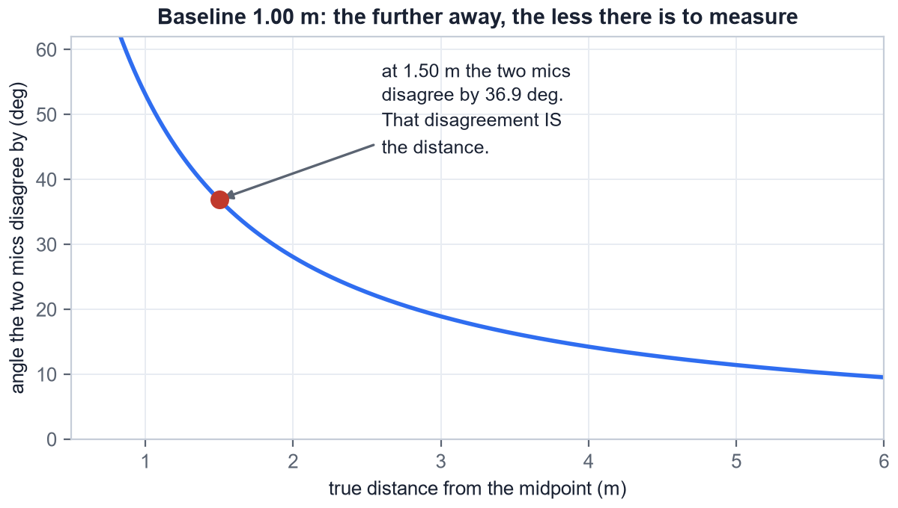
What a distance is actually made of
Each mic reports a direction. Draw a line out of each. Where they cross is the source. That is the entire method.
The two lines only cross usefully if they arrive at meaningfully different angles.
At 1.50 m on a 1 m baseline the two mics disagree by 36.9°. That disagreement IS the distance information — there is nothing else.
Further away, there is less of it. At 3 m it is 18.9°; at 5 m only 11.4°. Hence the rule: make the baseline roughly the distance you want to measure.

Slide 8
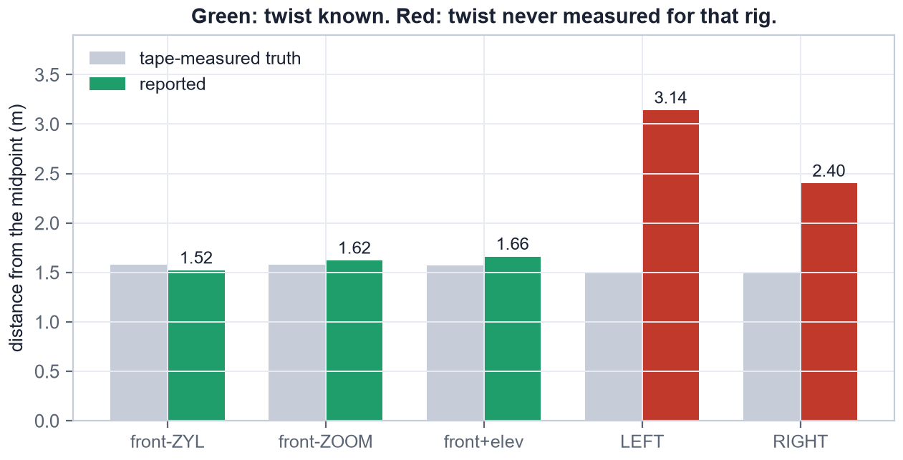
Distance: 3 to 6% where the rig alignment was known
Green bars are takes where the twist between the two microphones had been measured. Red bars are takes where it had not.
1.52, 1.62, 1.66 m against 1.58, 1.58, 1.57 m truth.
The two red bars are not a different kind of failure. Same method, same geometry quality, one missing number.
Compare the old single-microphone attempts, which railed to a meaningless 3.00 m from every curvature-based estimate regardless of where the source was.
Distance is measured from the midpoint between the two mics, so a source 1.50 m in front of ONE mic is 1.5811 m from the midpoint.

Slide 9
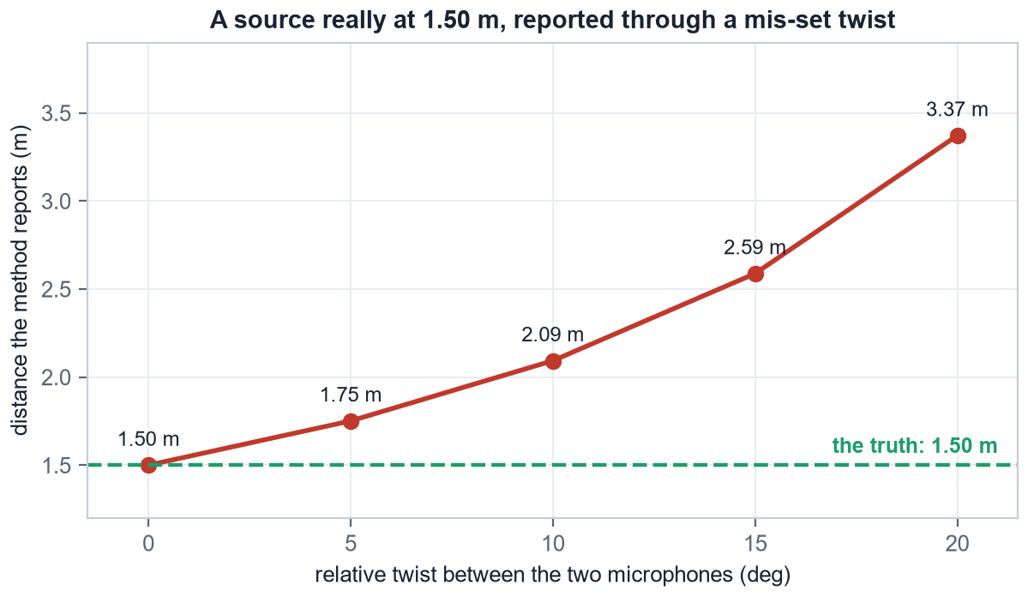
The twist: one unmeasured angle, and the distance doubles
If the two microphones are rotated relative to each other and you do not know by how much, you draw one of the two lines at the wrong angle.
A source really at 1.50 m, reported through a twist nobody measured:
5° twist → 1.75 m
10° twist → 2.09 m
15° twist → 2.59 m
20° twist → 3.37 m
Why it bites so hard: the whole measurement is 36.9° wide. Spend 15° of that on an unknown rotation and you have thrown away 40% of your signal.

Slide 10
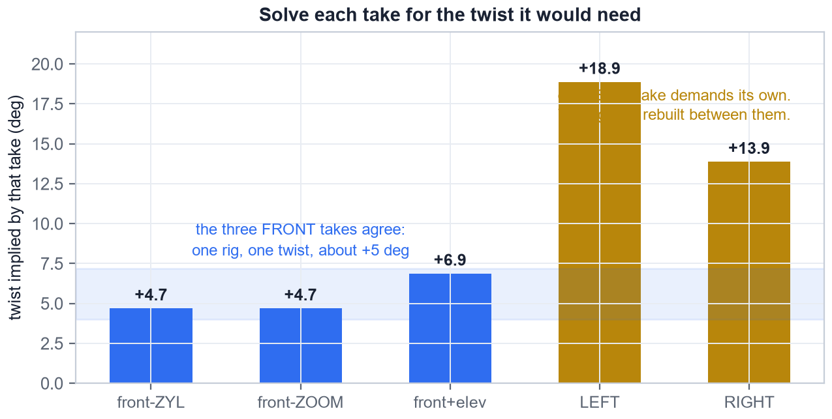
Solve each take for the twist it would need
Every take can be asked: what relative rotation would make YOUR two bearings agree with where the source actually was?
The three front takes answer +4.7, +4.7 and +6.9°. One rig, never touched, one twist — about +5°, which is the value already in the code.
The two side takes answer +18.9° and +13.9°. Not each other's, and not the front takes'.
Three takes agreeing is a measurement. Two takes disagreeing is the signature of a rig that was rebuilt between them — which is exactly what happened.

Slide 11
What this report got wrong the first time
The first version of this deck claimed takes 4 and 5 were physically impossible. They were not. Worth recording how the error was made.
The claim was: the source stood on the blind axis, both mics saw the identical bearing, so no distance existed in the recording. For a SIDE-BY-SIDE rig that is true — and it is what we assumed the rig was.
The evidence against it was already in the data. On a front-back rig the FRONT mic must read |az| > 90° and the BACK mic |az| < 90°. The Zylia read 105° in one take and –76° in the other: front mic in one, back mic in the other.
The wrong conclusion drawn from it: “no rig explains both takes, so the bearings must be corrupt.”
The right one: no SINGLE rig explains both. The mics were physically swapped between the two recordings.
The lesson worth keeping: when two measurements are each internally consistent but jointly impossible, suspect the apparatus changed before you suspect the data.

Slide 12
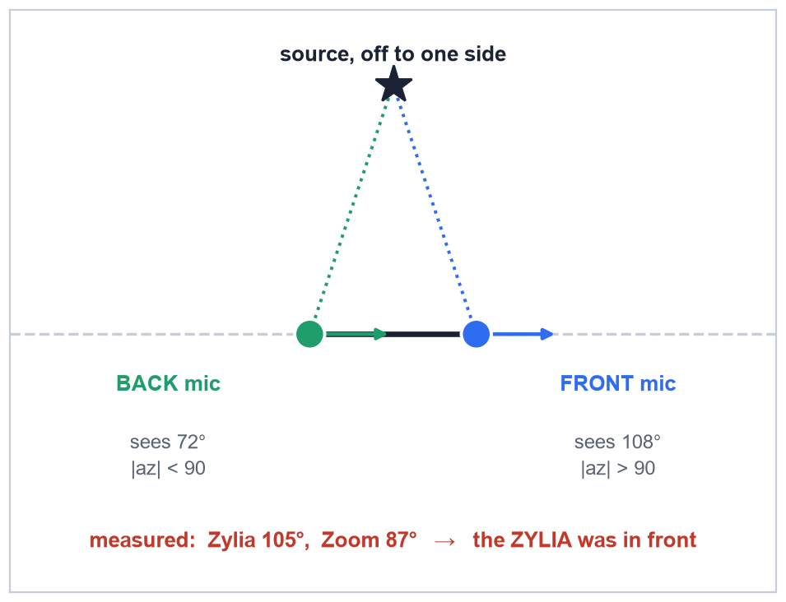
Which microphone was in front? The bearings say so.
This needs no tape measure, no ground truth and no second take — only the two numbers the script already prints.
On a front-back rig with the source off to one side, the geometry forces it:
The FRONT mic sees the source behind its shoulder — |az| > 90°
The BACK mic sees it ahead of its shoulder — |az| < 90°
Take 4: Zylia 105°, Zoom 87° → Zylia in front
Take 5: Zylia –76°, Zoom –99° → Zoom in front
Read this off every side take before trusting a distance from it.

Slide 13
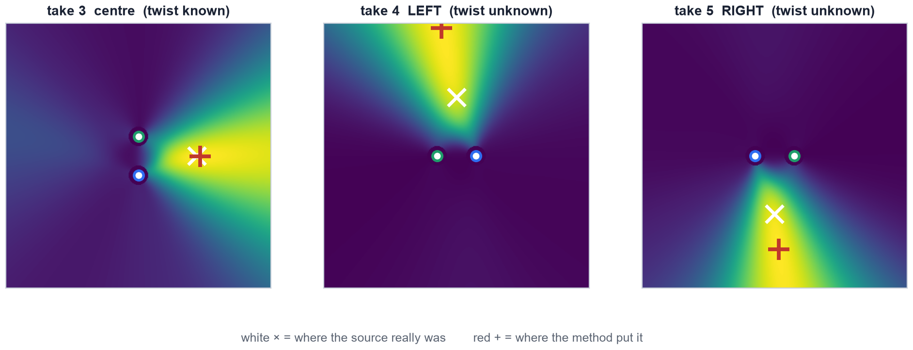
What the solver actually saw
The two microphones' full power maps, multiplied over the room. The peak of the product is the reported source.
All three ridges point in the right DIRECTION — azimuth is fine everywhere. On takes 4 and 5 the peak slides along the ridge, because where it settles is set by the twist, and the twist was wrong.

Slide 14
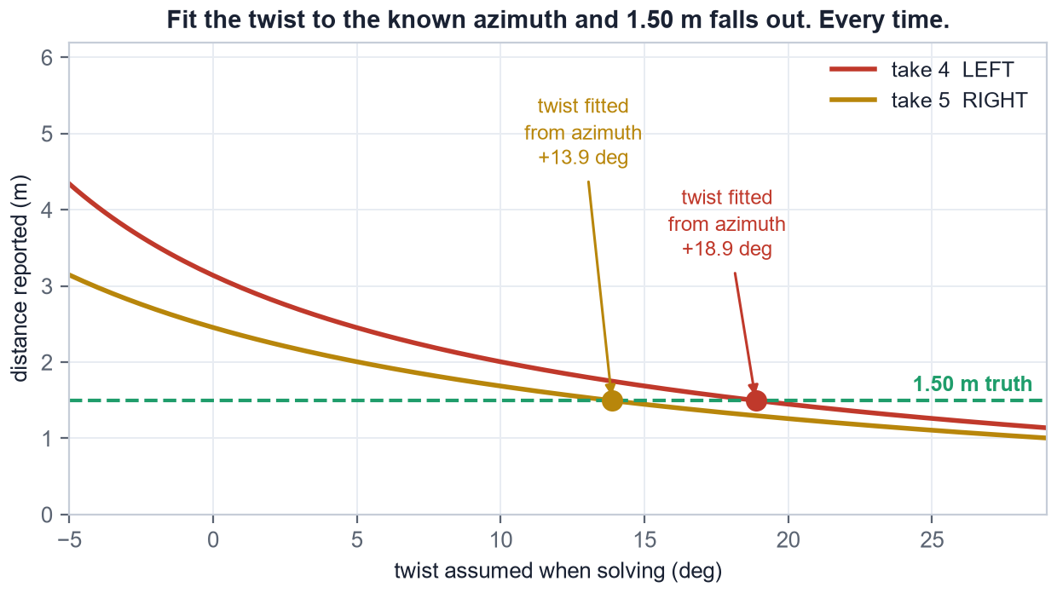
The trap: do not fit the twist to the answer
The twist for takes 4 and 5 can be recovered from the azimuth error against the known source direction. It is tempting, and it is worthless.
Fit it that way and the distance comes back at exactly 1.50 m. Both takes. Every time.
That is not a confirmation. What is left after the fit is a rotation COMMON to both rays, and a common rotation swings the answer around the midpoint without changing its RANGE.
So 1.50 m falls out by construction — it would do so even if the true distance were 3 m. It is arithmetic, not evidence.
Contrast the front takes, where the twist came from three takes at once and was then checked against a distance nobody had used to derive it.

Slide 15
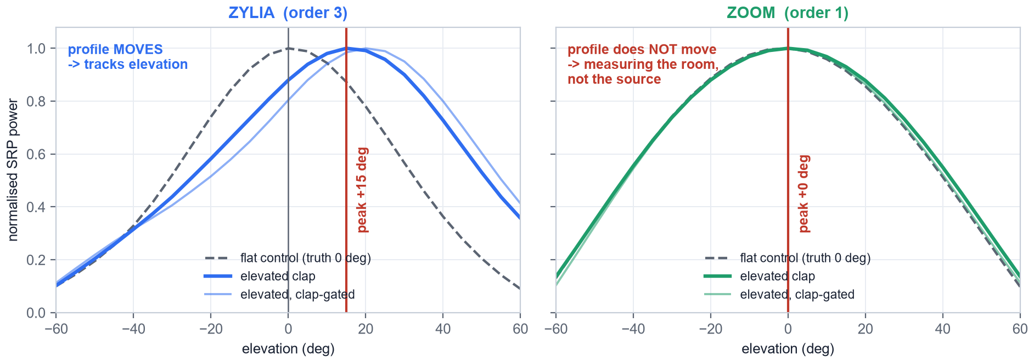
Elevation: it works, and the pipeline was losing it
Take 3 clapped above head height. Three independent measurements put the source at about +16°. The pipeline reported 2.6°.
Zylia SRP map +15° (+20° on claps only)
Zylia direct path +16.9° ± 4.6
Zoom direct path +14.7° ± 2.9
The elevation was always there. It was being averaged away.
Fixed: elevation now comes from the Zylia's accumulated map. Reads 0.0° on all four flat takes and +15.6° on this one.
+16.9° at 1.5 m means the clap was 0.46 m above the mic. The real clap and mic heights were never tape-measured.

Slide 16
Why the Zoom contributes no elevation at all
Its vertical SRP peaks at exactly 0.0° in all five takes — including the elevated one.
The profile is symmetric to two decimals and essentially identical between the elevated take and the flat control. It is not measuring the source; it is measuring the room.
At 1st order the vertical beam is too broad to beat the reverberant field, and a diffuse field is symmetric about the horizontal plane. So it peaks at 0°, always.
The hardware is fine. The Z channel sits at –3.2 dB relative to W, and direct-path pseudo-intensity on the Zoom's own claps returned +14.7°. This is an estimator limit, not a broken microphone.
Why it mattered: the old code averaged the two mics' elevations. Averaging a correct +16° against a stuck 0° halves it.
A first-order microphone can tell you which way something is in the horizontal plane. It cannot tell you how high it is, in a real room.

Slide 17
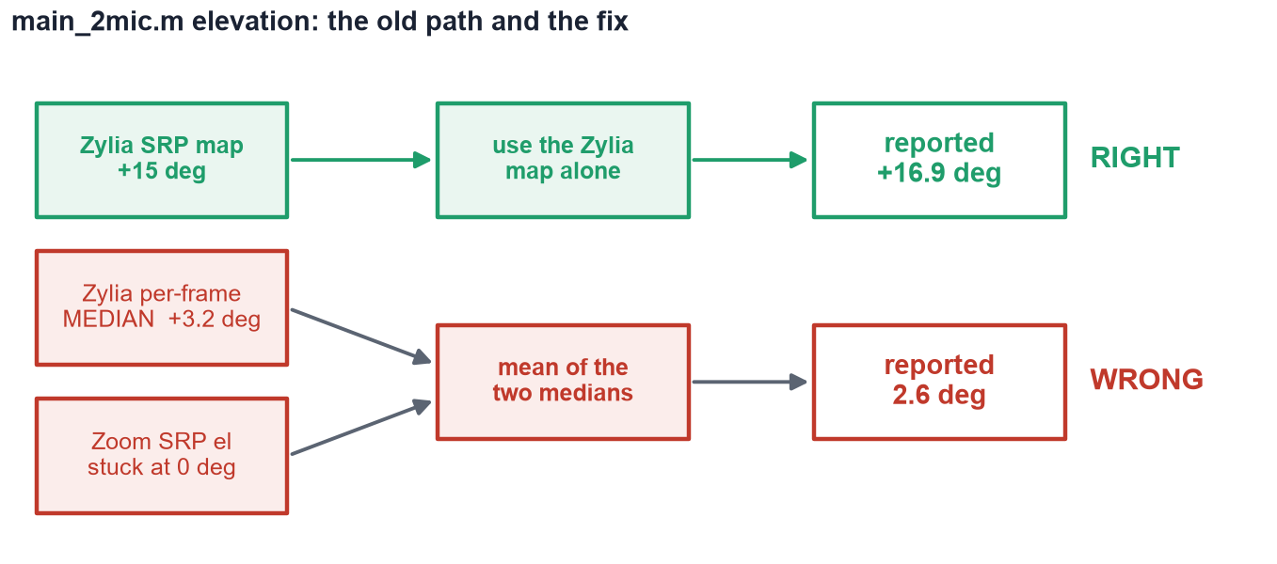
Two faults stacked to turn +17° into 2.6°
Neither fault alone would have been obvious: the Zoom's stuck zero halves the answer, and the per-frame median on clap material collapses the rest. Together they buried a real +17°.

Slide 18
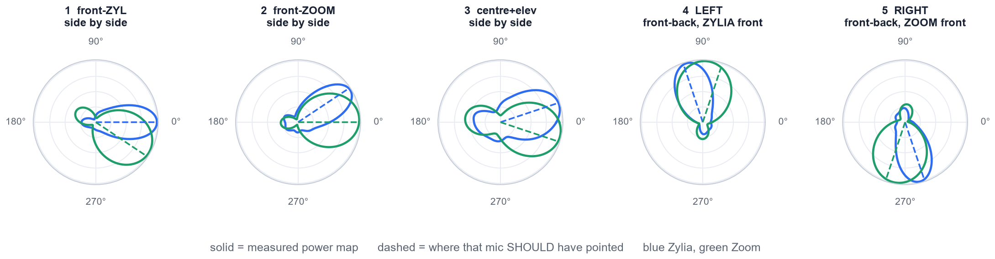
The raw evidence, per microphone
Accumulated steered-response power against azimuth, every usable frame, for all five takes.
On every take, including both side takes, each mic's lobe sits on the bearing it should. Direction was never the problem — the two lobes separate cleanly even where the reported distance was 60% out.

Slide 19
What the guards catch, and what they never will
Three tests now run on every take. One take in this set is still wrong and still passes all three.
guard | what it catches | caught here
r / B < 3 | source too far for the baseline | take 4
parallax > 10° | bearings too close to parallel | —
rays cross in front (new) | geometry inconsistent with both bearings | take 4
unmeasured twist | nothing. No guard can see it. | take 5, +60%
A rotated rig is invisible by construction. It produces two perfectly self-consistent bearings that simply cross in the wrong place. Nothing in the audio contradicts them.
The 11 August front take does the same thing — reports 2.78 m against 1.50 m truth, +85%, and passes everything.
Only check_mic_yaw.m catches it, and it needs a front take and a back take from the same setup.
“Trusted” means the geometry is self-consistent. It has never meant “correct”.

Slide 20
Recording protocol, updated
1. Tape the floor and label which mic is FRONT. The two front-back arrangements give completely different distances and cannot be told apart from the audio afterwards. This one line would have saved both side takes.
2. Record a front take AND a back take, without moving the mics. check_mic_yaw.m measures the twist from those two alone, with no ground truth. One extra minute, and the twist stops being a free parameter.
3. Keep the source broadside — within about 60° of the perpendicular bisector. Aim the blind axis away from where the source will be.
4. Never rebuild the rig mid-session without re-measuring. The twist does not survive a teardown, and nothing downstream can detect that it changed.
5. Drop the H3-VR input gain about 12 dB. It clipped on every clap in all five takes — 2400 to 5600 samples — which cost most of its direct-path evidence.
6. Tape-measure the mic and clap heights. The +16.9° elevation is inferred from audio and has never been checked against a ruler.

Slide 21
What changed in the code
layout is now a per-take setting. 'LR' side by side, 'FB' Zylia in front, 'BF' Zoom in front. Mic positions are no longer hard-coded, so a rebuilt rig is expressible instead of silently mis-modelled.
Degrees off broadside is reported above the answer, with the expected parallax next to the measured one. It says whether a distance was possible before you read what it was.
triangulate.m gained a forward-crossing test. It asks whether any point in front of both mics is consistent with both bearings. When it fails it now also reports which rig orientations WOULD have worked.
Elevation comes from the Zylia's map instead of the mean of two per-frame medians. run_doa.m itself is untouched.
test_all_takes.m reruns every take on record after any code change and prints one scoreboard. It rebuilds main_2mic.m rather than reimplementing it, so it cannot drift from what the real script does.
main_2mic.m is unchanged in how it is used — one take at a time.

Slide 22
Where the method now stands
Azimuth is solid. Inside 4.4° on every take, on both rig arrangements, including the two that failed on distance.
Elevation works on the Zylia and not on the Zoom. +15.6° recovered against roughly +16° measured three independent ways.
Distance works to 3-6% when the relative rotation of the two mics is known, and fails completely when it is not. There is no middle ground and no way to recover it after the fact.
The two “impossible” takes were not impossible. Both were recorded broadside, on a sound rig, with usable bearings. One missing measurement — the twist — was the whole difference.
Two microphones have one blind axis and you choose where to point it. Covering front AND side at once needs a third microphone off the line.
Still open: the 11 August front take reads +85% and passes every guard; elevation ground truth is inferred from audio, not measured.

