Slide 1
Estimating the Direction of a Sound Source from Ambisonic Microphone Recordings
Progress Presentation
Steven Ha 夏國保

Slide 2
What this project does
Goal: given a sound recorded by a spherical "ambisonic" microphone, automatically estimate where the sound came from
One microphone, not an array. A single ambisonic mic captures a full-sphere sound field in a handful of channels, so one device replaces a spread-out array of mics
How: scan every candidate direction on a grid, synthesise what the mic “should” hear from that direction, and keep the direction whose prediction best matches the real recording (Steered-Response Power)
Two microphones tested: Zoom H3-VR (1st-order, 4-ch) and Zylia ZM-1 (3rd-order, 16-ch)

Slide 3
Spherical-audio toolboxes
These are open-source MATLAB files (github.com/polarch) that I took inspiration from for this project:
getSH.m
Spherical-Harmonic-Transform
How to evaluate real spherical harmonics on a set of directions, the reference for my real_sh_matrix.m (N3D, ACN ordering, Condon–Shortley phase)
grid2dirs.m
Spherical-Harmonic-Transform
How to lay out a regular azimuth/elevation grid of directions, the idea behind my candidate grid in build_steering_matrix.m
sphMUSIC.m
Spherical-Array-Processing
Steering the array over a direction grid and scoring each direction, the concept of my SRP loop in run_doa.m
sphMVDR.m / sphNullformer_pwd.m
Spherical-Array-Processing
Beamforming in the spherical-harmonic domain (W^H·x style scoring). Confirmed how to combine channels per direction and per frequency

Slide 4
The pipeline
main_doa_estimation
config + ground truth + plots
run_doa
STFT · energy gate · SRP · peak
build_steering_matrix
grid → steering templates
real_sh_matrix
spherical-harmonic shapes
convert_to_acn_n3d
FuMa/SN3D → ACN/N3D
sph_hankel2
near-field radial term

Slide 5
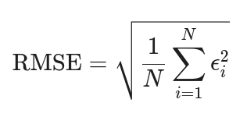

main_doa_estimation.m
Picks the mic: order = 1 (Zoom) or 3 (Zylia), and micRadius, which sets the physics
Sets the analysis band (fBand) and the search grid (azimuth 0-355°, elevation ±40°, distance 0.5–3 m)
Defines ground truth (the measured true angle) so error can be computed
Calls res = run_doa(cfg), everything else happens in there
Reports median estimate vs truth and RMSE, then draws the per-frame plots and the SRP map

Slide 6
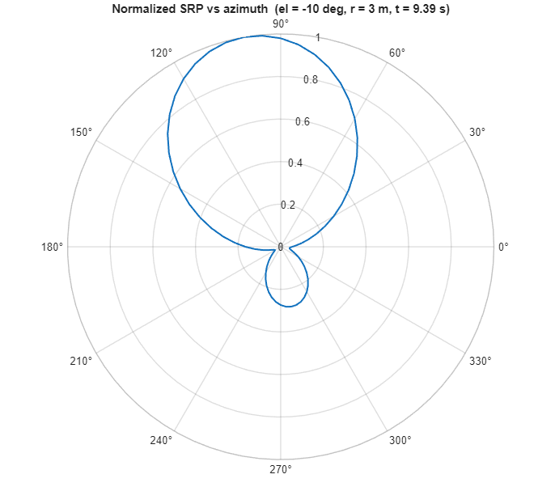
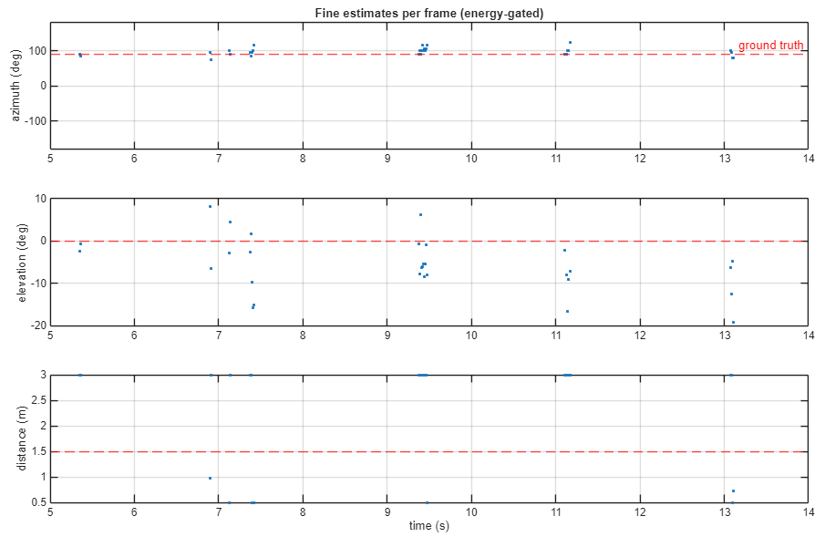

Slide 7
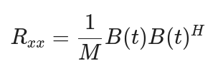

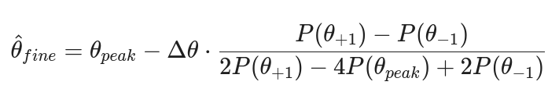
run_doa.m
Load & convert: reads the .wav and calls convert_to_acn_n3d to get ACN/N3D signal
Frame the audio: 1024-sample Hann windows, 50% overlap (~21 ms hops) → short-time FFT
Pick frequency bins inside the analysis band (up to 60 bins)
Energy gate: frames quieter than −9 dB below the loudest are skipped, so silence isn’t “localised”
SRP score: for each grid direction, project the frame onto its steering template and sum power over frequency: P = Σ |Wᴴ·B|²
Reshape the score vector into a 3D azimuth×elevation×distance map and take its maximum
Parabolic interpolation: fit a parabola across the peak and its two neighbours → sub-grid resolution (finer than the 5° grid)
Keeps the strongest frame to display as the representative SRP map
Returns per-frame azimuth, elevation, and distance

Slide 8

convert_to_acn_n3d.m
AmbiX input is already ACN/SN3D → just rescale SN3D→N3D
FuMa input (old B-format) → reorders WXYZ and restores the -3 dB on the W channel
SN3D → N3D: multiplies each order-n channel by √(2n+1), the scaling the steering matrix assumes

Slide 9
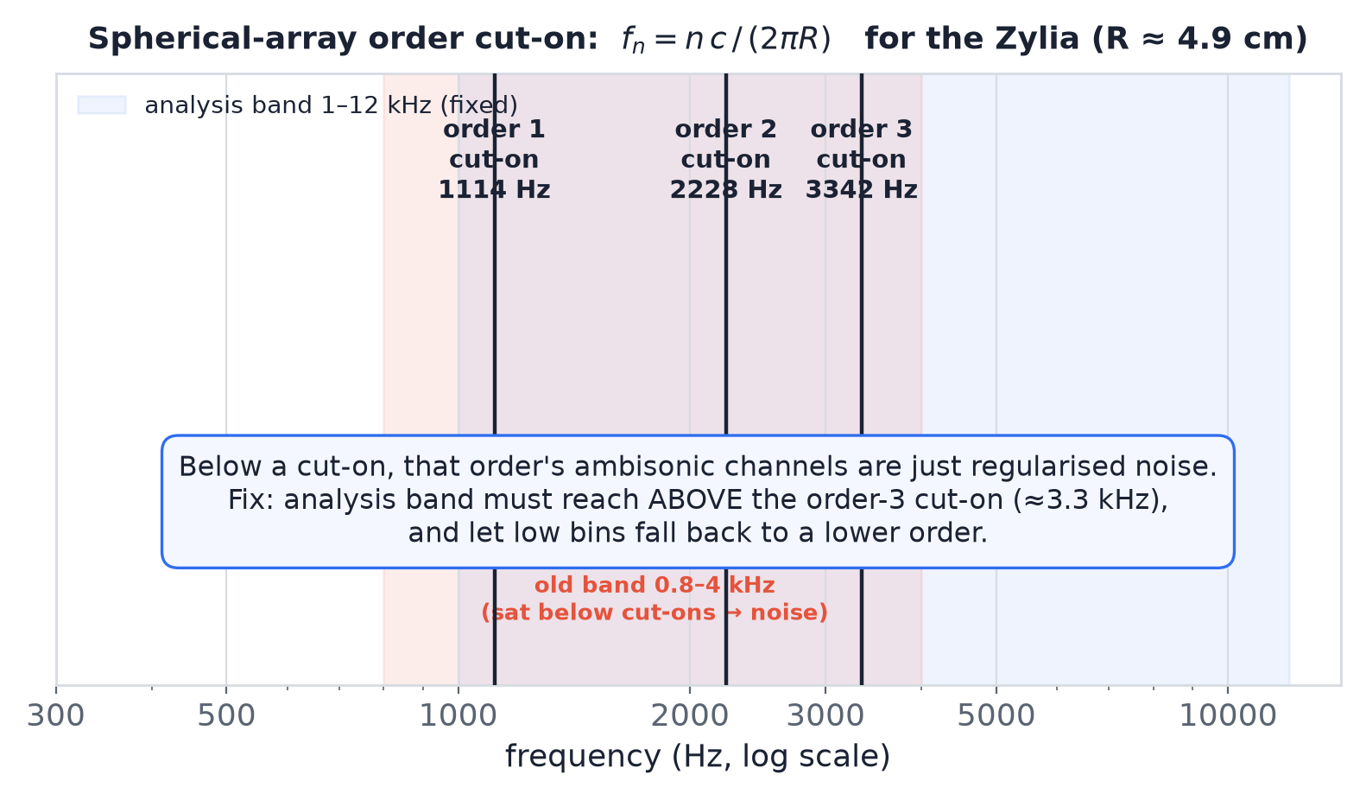

build_steering_matrix.m
Pre-computes the theoretical Ambisonic response for every candidate source position
Generates a steering template for every azimuth, elevation and distance
For each grid direction it multiplies the: angular information from (real_sh_matrix) by radial near-field correction from (sph_hankel2)
Frequency-dependent order: a small sphere only carries order-n info above a cut-on frequency fₙ = n·c / (2πR)
Below that cut-on an order’s channels are pure regularisation noise, so those bins fall back to a lower order
The graph shows which frequencies actually carry each ambisonic order's information for the Zylia, and why my original analysis band was in the wrong place

Slide 10
real_sh_matrix.m (Direction)
Computes the real spherical harmonic basis functions that describe directional sensitivity
Input: an order and a list of directions (azimuth, elevation)
Output: a matrix of real spherical harmonic values, one row per ambisonic channel, one column per direction
Uses MATLAB’s legendre() for the associated Legendre polynomials, then applies the N3D normalisation and sin/cos of azimuth
Handles conventions like ACN channel ordering, N3D normalisation, and removes the Condon-Shortley phase (to prevent sign error)
Spherical harmonics define the angular component of every steering vector, determining how the microphone responds to sounds arriving from different directions

Slide 11
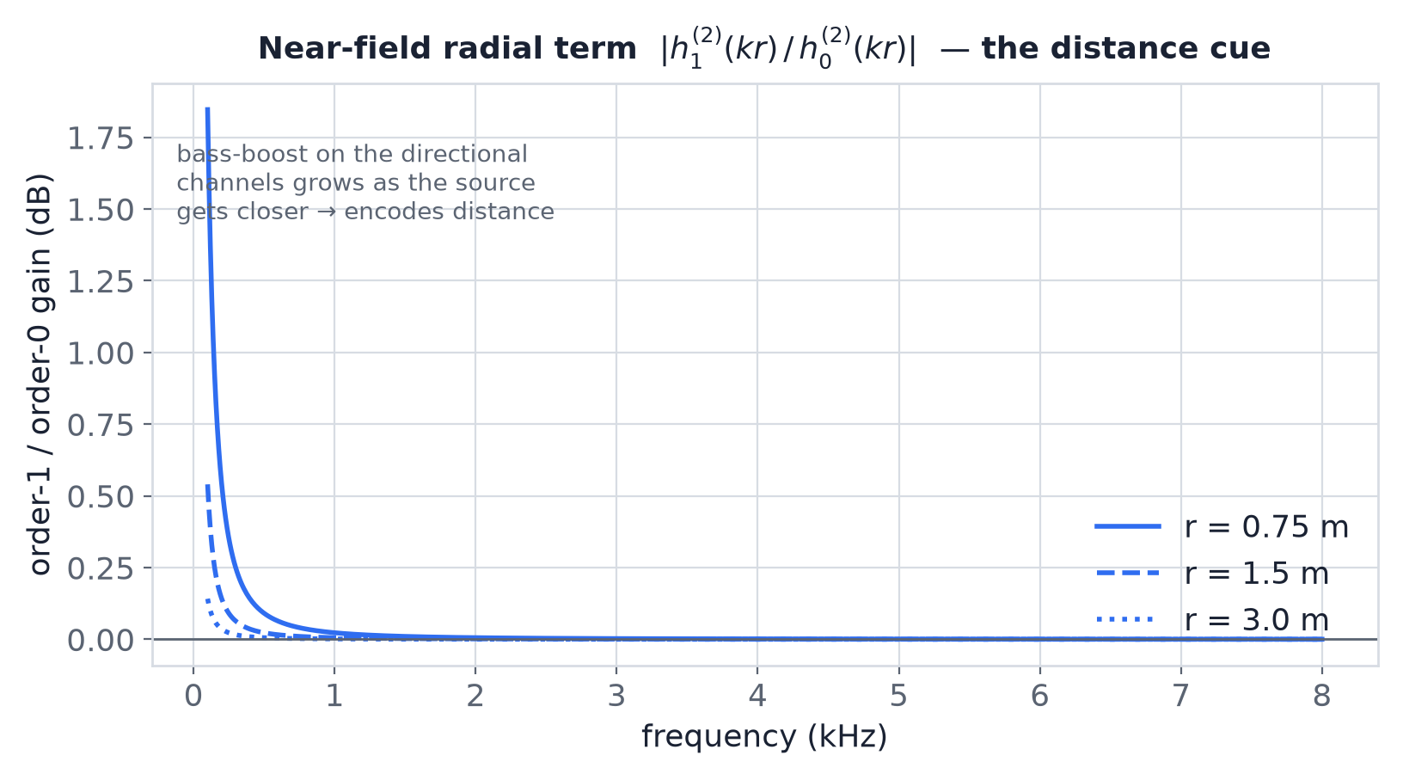
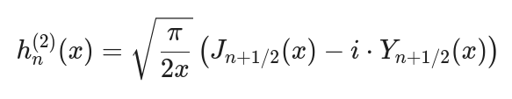
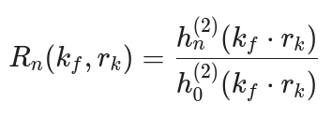
sph_hankel2.m (Distance)
Models spherical wave propagation for nearby sound sources
Computes the spherical Hankel function of the 2nd kind from standard Bessel functions
The ratio hₙ(kr)/h₀(kr) produces the near-field radial correction used inside the steering matrix
A close source boosts the directional channels’ low end (curved wavefront); while, a far source looks like a flat plane wave
That difference is the only cue for distance, the plot shows how it shrinks with range
Unlike far-field plane waves, nearby sources produce curved wavefronts. The radial correction models this curvature, allowing the steering vectors to encode distance as well as direction
Closer source → stronger low-frequency boost on the directional channels.

Slide 12
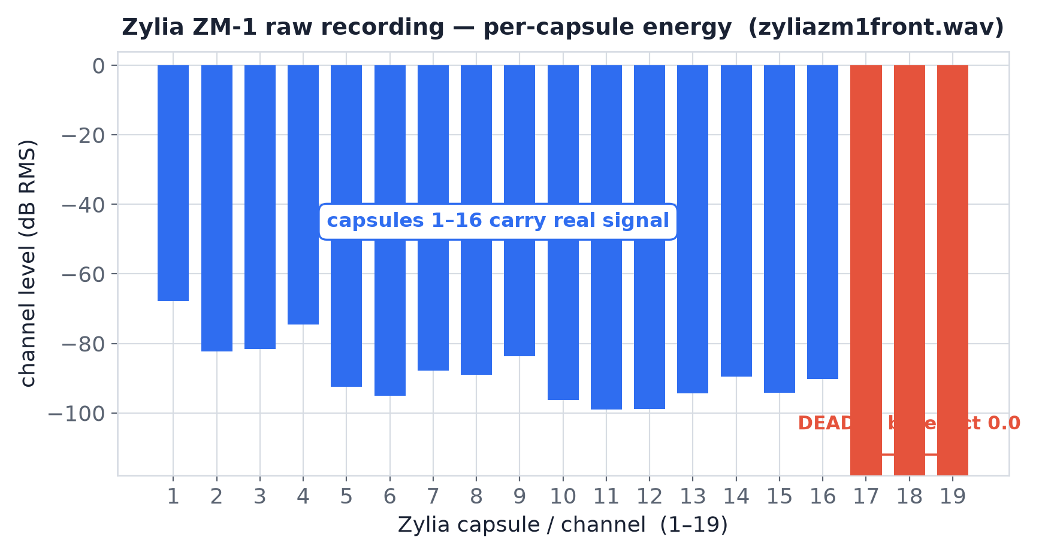
The last 3 channels are always dead
The Zoom always works, but on the Zylia the estimates are wrong
In every single raw Zylia recording, capsules 17, 18 and 19 are bit-exact 0
It’s always the LAST three, never a random capsule, and it’s identical across every take I’ve made
3rd-order ambisonics needs all capsules to reconstruct the 16 channels; 3 dead capsules corrupt the higher-order channels the Zylia depends on
Real data: my own recording zyliazm1front.wav (19 raw capsules).

Slide 13
A possible USB bottleneck
The mic streams all 19 capsules in each USB frame. If the link can’t move a full frame in time, the tail capsules (17/18/19) get starved and written as zero
Zylia’s own log confirms it: it records “Found drop … from microphone 17/18/19” every ~30 seconds, in every session
Possible cause: the USB link trained at USB 2.0 High-Speed instead of USB 3.0 SuperSpeed. At USB-2 bandwidth it can’t carry all 19 capsules
Ruled out: a dead capsule (survives on other conditions), and power management (re-tested with battery-saver off, selective-suspend off)

Slide 14
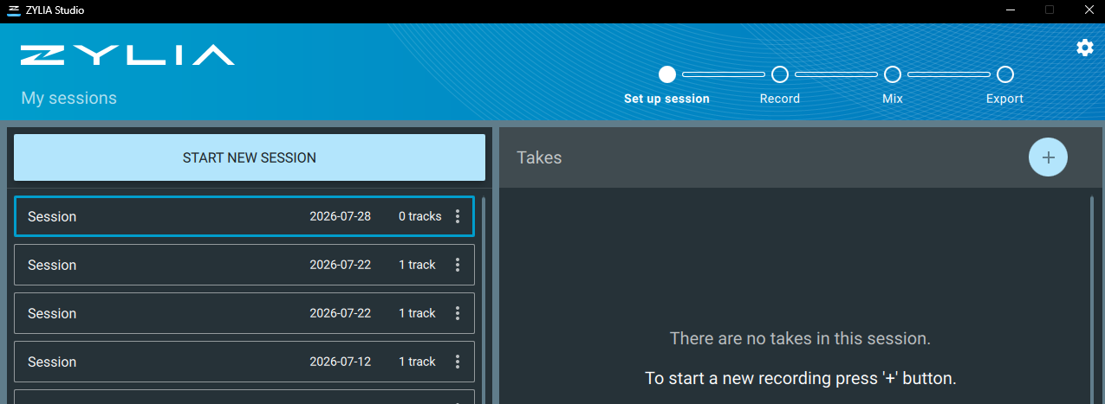
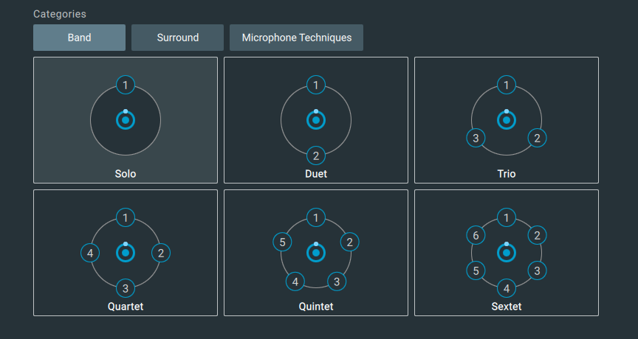
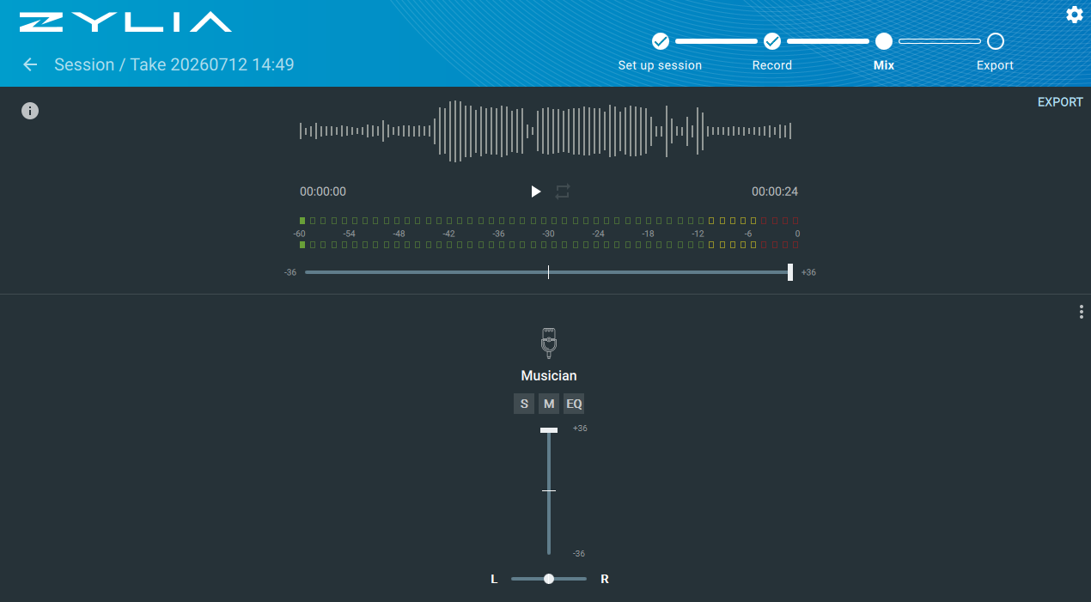
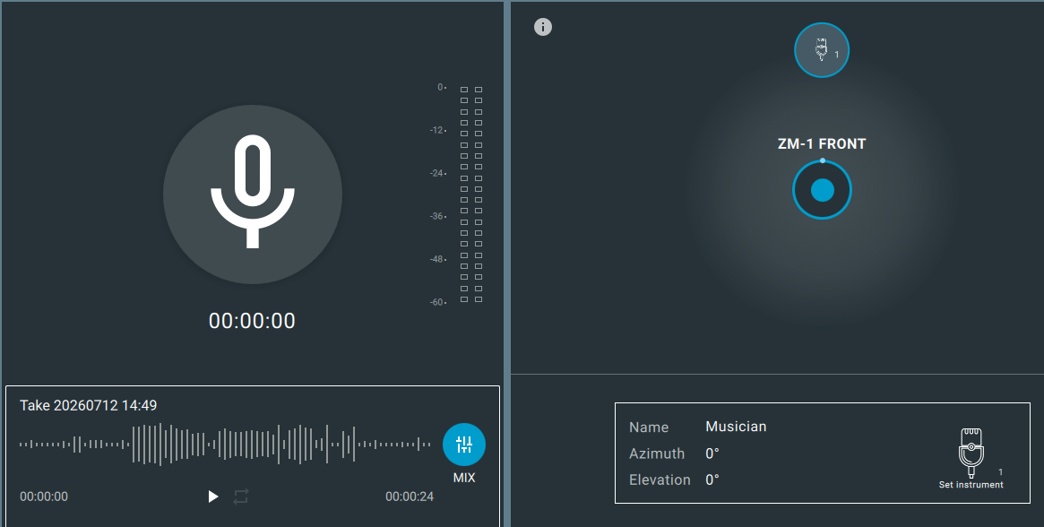

Slide 15
