Slide 1
Pseudocode, Logic and Design
UNCLASSIFIED//FOUO

Slide 2
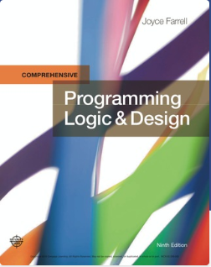
RESOURCE:
Programming Logic & Design, Comprehensive , 9th Edition
Joyce Farrell ISBN-10: 1-337-10207-5 ISBN-13: 978-1-337-10207-0

Slide 3
Programming Logic and Design
Lesson 1
An Overview of Computers and
Programming

Slide 4
Objectives
In this chapter, you will learn about:
Computer systems
Simple program logic
The steps involved in the program development cycle
Pseudocode statements and flowchart symbols
Using a sentinel value to end a program
Programming and user environments
The evolution of programming models

Slide 5
Understanding Computer Systems
Computer system
Combination of all the components required to process and store data using a computer
Hardware
Equipment associated with a computer
Software
Computer instructions that tells the hardware what to do
Programs
Instructions written by programmers
Programming
Writing software instructions

Slide 6
Understanding Computer Systems (continued -1)
Application software such as word processing, spreadsheets, payroll and inventory, even games, app
System software such as operating systems like Windows, Linux, or UNIX, Google Android and Apple IOS
Computer hardware and software accomplish three major operations
Input
Data items such as text, numbers, images, and sound
Processing
Calculations and comparisons performed by the central processing unit (CPU)

Slide 7
Understanding Computer Systems (continued -2)
Output
Resulting information that is sent to a printer, a monitor, or storage devices after processing
A cloud based device is accessed through the Internet
Programming language
Used to write computer instructions called program code
Writing instructions is called coding the program
Examples
Visual Basic, C#, C++, or Java
Syntax
Rules governing word usage and punctuation
Mistakes in a language’s usage are syntax errors

Slide 8
Understanding Computer Systems (continued -3)
Computer memory
Computer’s temporary, internal storage – random access memory (RAM)
Volatile memory – lost when the power is off
Permanent storage devices
Nonvolatile memory
Compiler or interpreter
Translates source code into machine language (binary language) statements called object code
Checks for syntax errors
Program executes or runs
Input will be accepted, some processing will occur, and results will be output

Slide 9
Understanding Simple Program Logic
Programs with syntax errors cannot execute
Logical errors
Errors in program logic produce incorrect output
Logic of the computer program
Sequence of specific instructions in specific order
Variable
Named memory location whose value can vary

Slide 10
Understanding the Program Development Cycle
Program development cycle
Understand the problem
Plan the logic
Code the program
Use software (a compiler or interpreter) to translate the program into machine language
Test the program
Put the program into production
Maintain the program

Slide 11
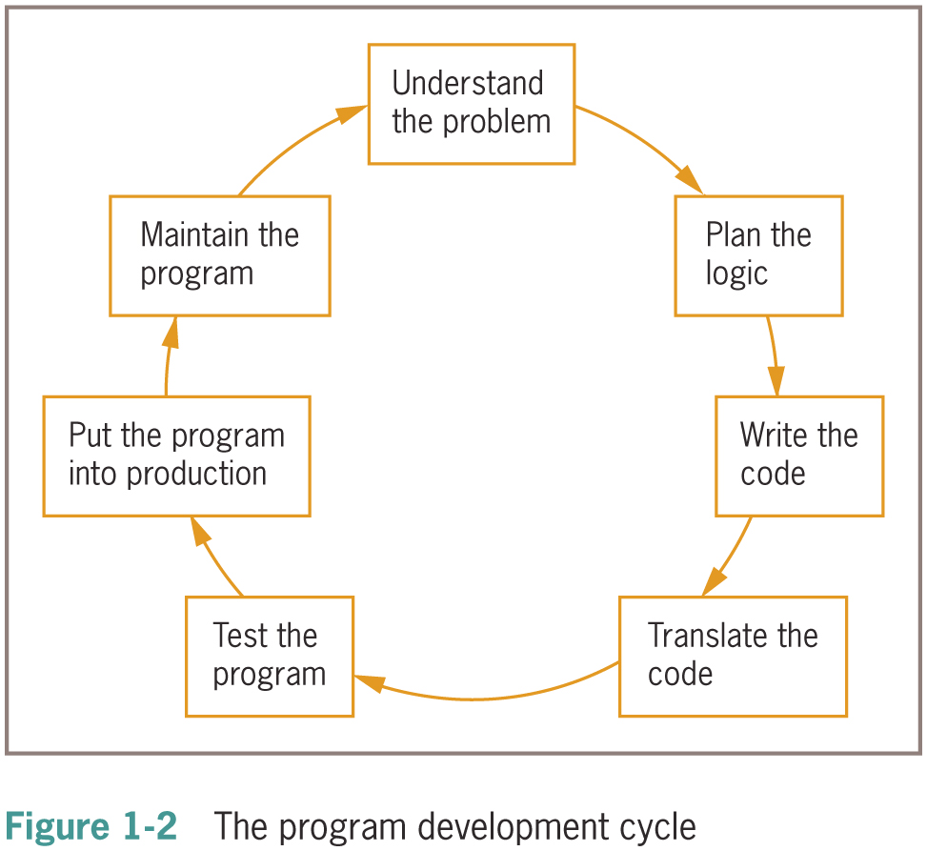
Understanding the Program Development Cycle (continued -1)

Slide 12
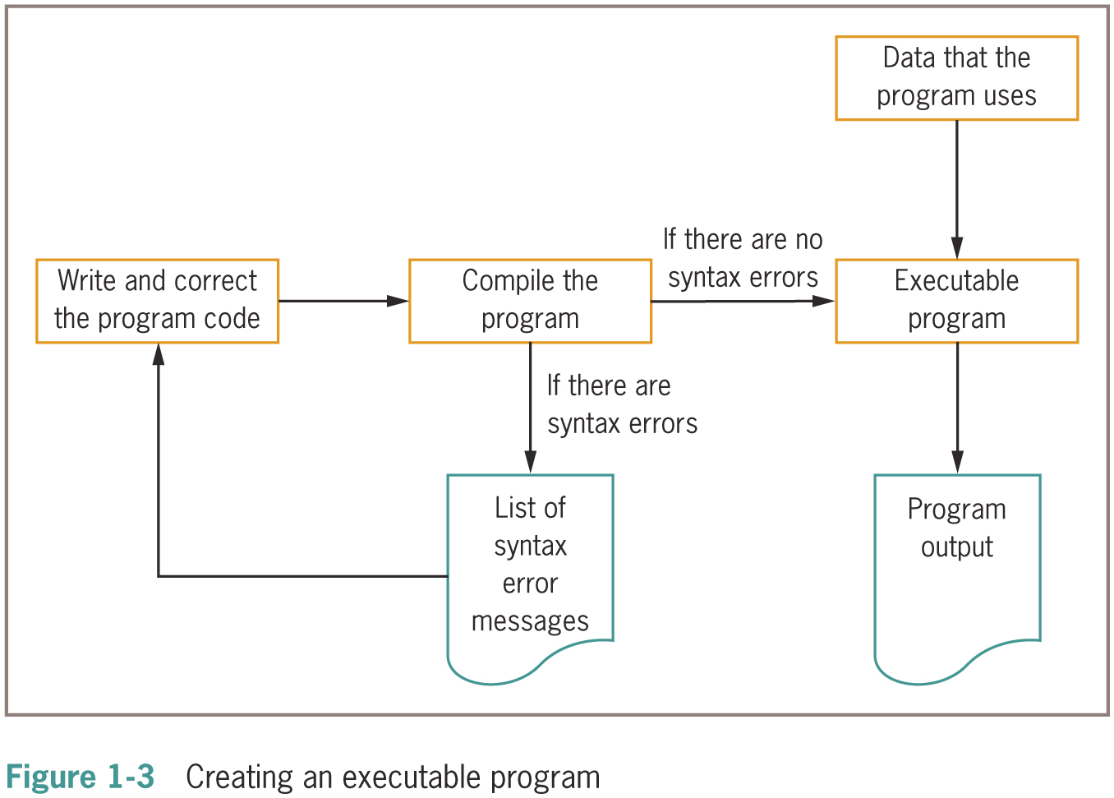
Using Software to Translate the Program into Machine Language (continued -1)

Slide 13
Using Pseudocode Statements and Flowchart Symbols
Pseudocode
English-like representation of the logical steps it takes to solve a problem
Flowchart
Pictorial representation of the logical steps it takes to solve a problem

Slide 14
Writing Pseudocode
Pseudocode representation of a number-doubling problem
start
input myNumber
set myAnswer = myNumber * 2
output myAnswer
stop

Slide 15
Pseudocode Standards
Programs begin with the word start and end with the word stop; these two words are always aligned
Whenever a module name is used, it is followed by a set of parentheses
Modules begin with the module name and end with return. The module name and return are always aligned
Each program statement performs one action—for example, input, processing, or output

Slide 16
Pseudocode Standards (continued -1)
Program statements are indented a few spaces more than the word start or the module name
Each program statement appears on a single line if possible. When this is not possible, continuation lines are indented
Program statements begin with lowercase letters
No punctuation is used to end statements

Slide 17
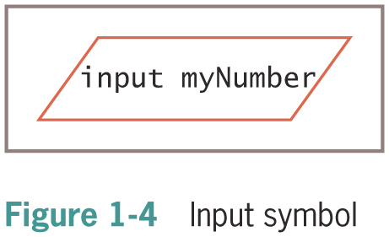
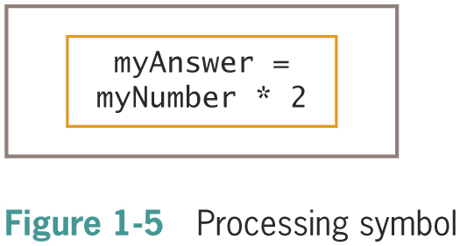
Drawing Flowcharts
Create a flowchart
Draw geometric shapes that contain the individual statements
Connect shapes with arrows
Input symbol
Indicates input operation
Parallelogram
Processing symbol
Contains processing statements such as arithmetic
Rectangle

Slide 18
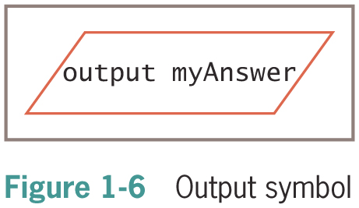


Drawing Flowcharts (continued -1)
Output symbol
Represents output statements
Parallelogram
Flowlines
Arrows that connect steps
Terminal symbols
Start/stop symbols
Shaped like a racetrack
Also called lozenges

Slide 19
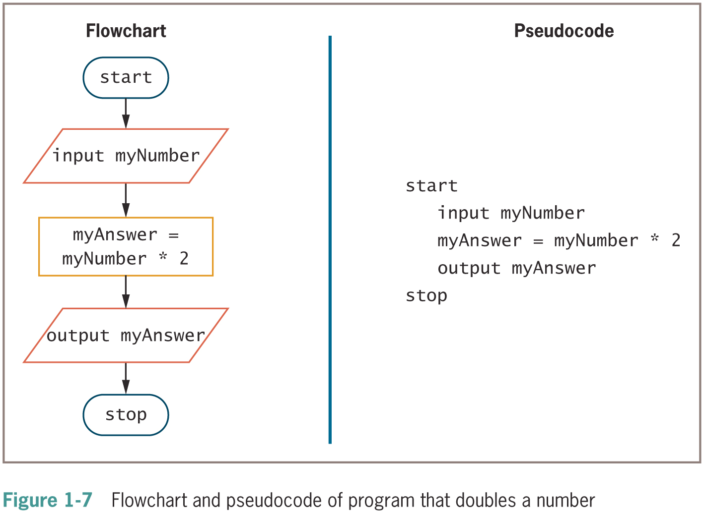
Drawing Flowcharts (continued -2)

Slide 20
Using a Sentinel Value to End a Program
Making a decision
Testing a value
Decision symbol
Diamond shape
Dummy value
Data-entry value that the user will never need
Sentinel value
eof (“end of file”)
Marker at the end of a file that automatically acts as a sentinel

Slide 21
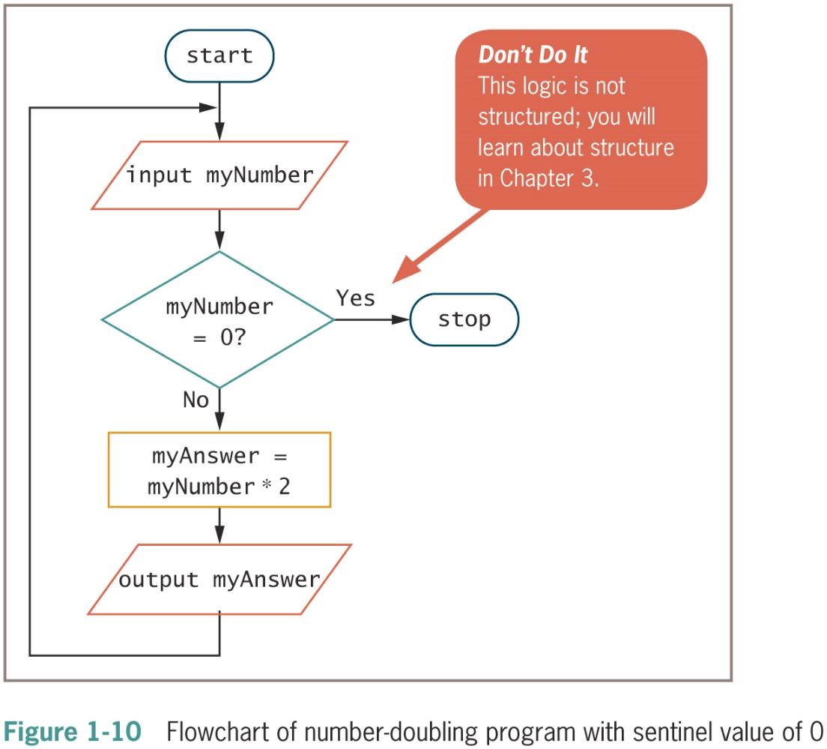
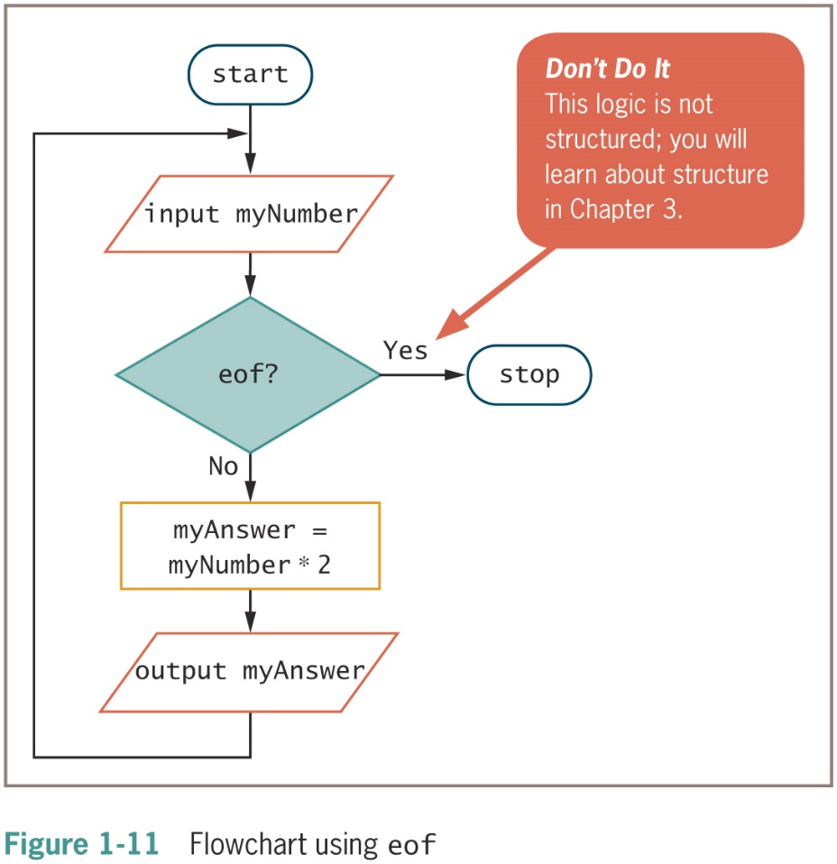
Using a Sentinel Value to End a Program (continued -1)

Slide 22
Summary
Hardware and software accomplish input, processing, and output
Logic must be developed correctly
Logical errors are much more difficult to locate than syntax errors
Use flowcharts and pseudocode to plan the logic
Avoid infinite loops by testing for a sentinel value
Use a text editor or an IDE to enter your program statements

