Slide 1
Pseudocode, Logic and Design
UNCLASSIFIED//FOUO

Slide 2
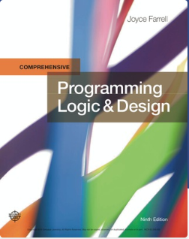
RESOURCE:
Programming Logic & Design, Comprehensive , 9th Edition
Joyce Farrell ISBN-10: 1-337-10207-5 ISBN-13: 978-1-337-10207-0

Slide 3
Programming Logic and Design
Lesson 2
Pseudocode

Slide 4
Objectives
In this chapter, you will learn about:
Declaring and using variables and constants
Performing arithmetic operations
The advantages of modularization
Modularizing a program
Hierarchy charts
Features of good program design

Slide 5
Declaring and Using Variables and Constants
Understanding Data Types
Data type describes:
What values can be held by the item
How the item is stored in memory
What operations can be performed on the item
All programming languages support these data types:
Numeric consists of numbers that can be used in math
String is anything not used in math

Slide 6
Understanding Unnamed, Literal Constants
There are two types of constants
Numeric constant (or literal numeric constant)
Contains numbers only
Number does not change
String constant (or literal string constant)
Also known as Alphanumeric values
Can contain both alphabetic characters and numbers
Strings are enclosed in quotation marks

Slide 7
Working with Variables
Variable are named memory locations
Contents can vary or differ over time
Declaration is a statement that provides a variable's:
Data type
Identifier (variable’s name)
Optionally, an initial value

Slide 8
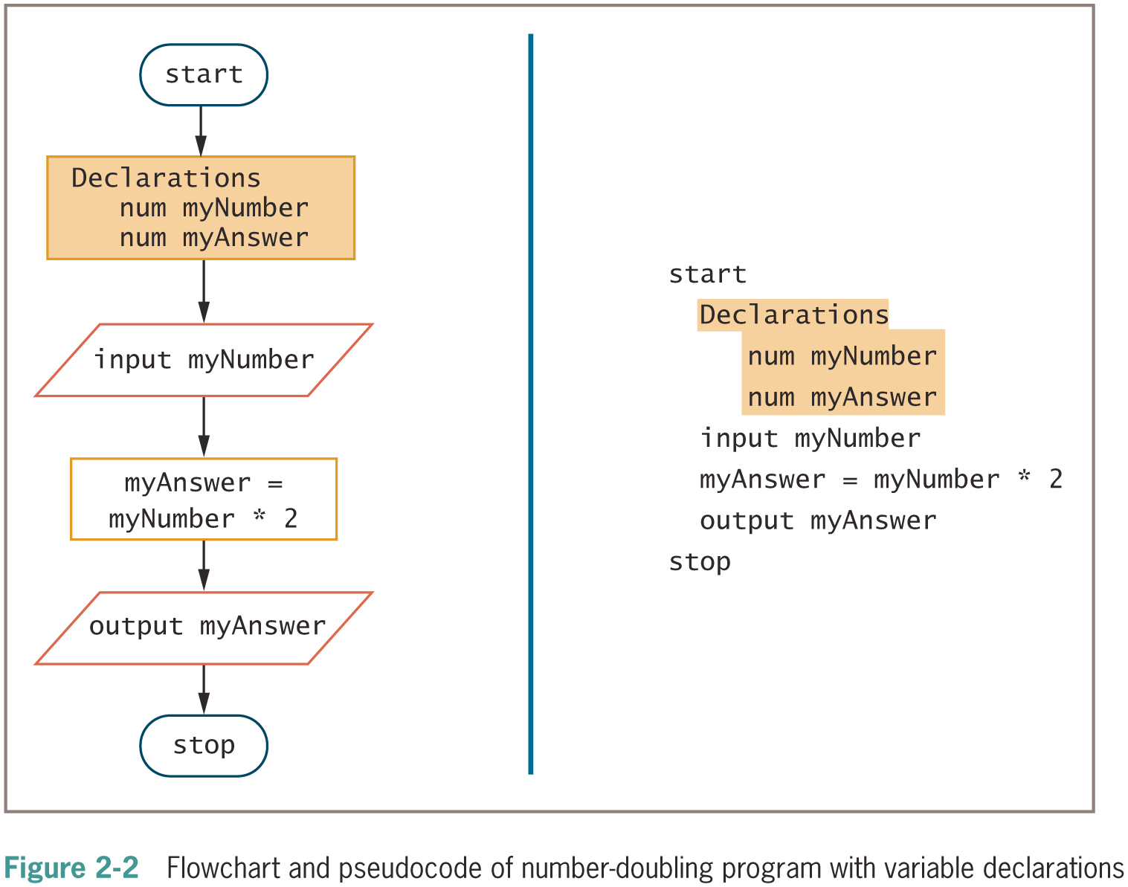
Working with Variables (continued)

Slide 9

Understanding a Declaration’s Identifier (continued -2)

Slide 10
Variable Naming Conventions
Camel casing
Variable names have a “hump” in the middle such as hourlyWage
Pascal casing
Variable names have the first letter in each word in uppercase such as HourlyWage
Hungarian notation
A form of camel casing in which the data type is part of the name such as numHourlyWage

Slide 11
Variable Naming Conventions (continued)
Snake casing
Parts of variable names are separated by underscores such as hourly_wage
Mixed case with underscores
Similar to snake casing, but new words start with a uppercase letter such as Hourly_Wage
Kebob case
Parts of variable names are separated by dashes such as hourly-wage

Slide 12
Assigning Values to Variables
Assignment statement
set myAnswer = myNumber * 2
Assignment operator
Equal sign
A binary operator, meaning it requires two operands—one on each side
Always operates from right to left, which means that it has right-associativity or right-to-left associativity
The result to the left of an assignment operator is called an lvalue

Slide 13
Initializing a Variable
Initializing the variable - declare a starting value
num yourSalary = 14.55
string yourName = “Janita”
Garbage – a variable’s unknown value
Variables must be declared before they are used in the program

Slide 14
Declaring Named Constants
Named constant
Similar to a variable
Can be assigned a value only once
Assign a useful name to a value that will never be changed during a program’s execution
Magic number
Unnamed constant
Use taxAmount = price * SALES_TAX_AMOUNT instead of taxAmount = price * .06

Slide 15
Performing Arithmetic Operations
Standard arithmetic operators:
+ (plus sign)—addition
− (minus sign)—subtraction
* (asterisk)—multiplication
/ (slash)—division

Slide 16
Performing Arithmetic Operations (continued -1)
Rules of precedence
Also called the order of operations
Dictate the order in which operations in the same statement are carried out
Expressions within parentheses are evaluated first
All the arithmetic operators have left-to-right associativity
Multiplication and division are evaluated next
From left to right
Addition and subtraction are evaluated next
From left to right

Slide 17
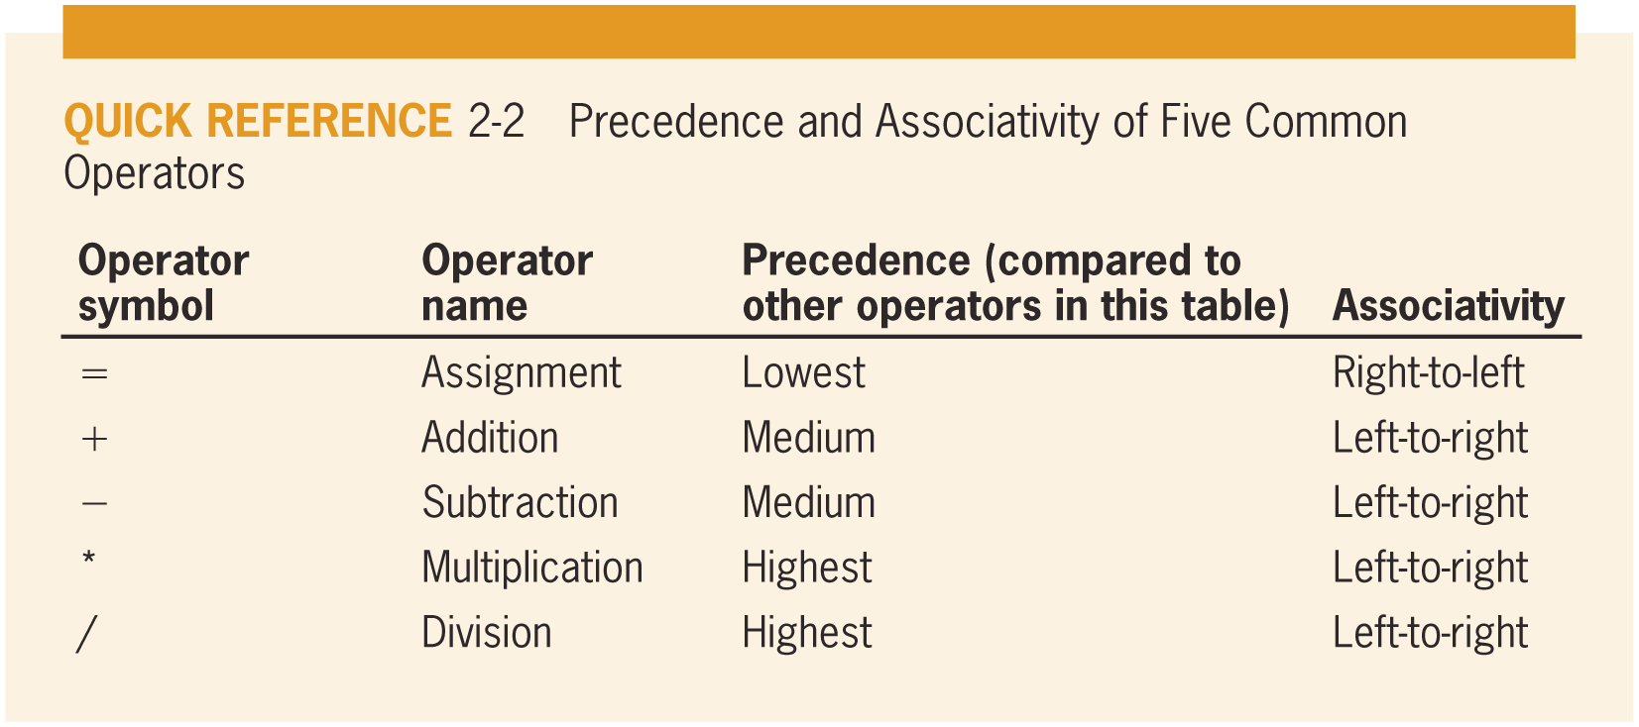
Performing Arithmetic Operations (continued -2)

Slide 18
Creating Hierarchy Charts
Hierarchy chart
Shows the overall picture of how modules are related to one another
Tells you which modules exist within a program and which modules call others
Specific module may be called from several locations within a program
Planning tool
Develop the overall relationship of program modules before you write them
Documentation tool

Slide 19
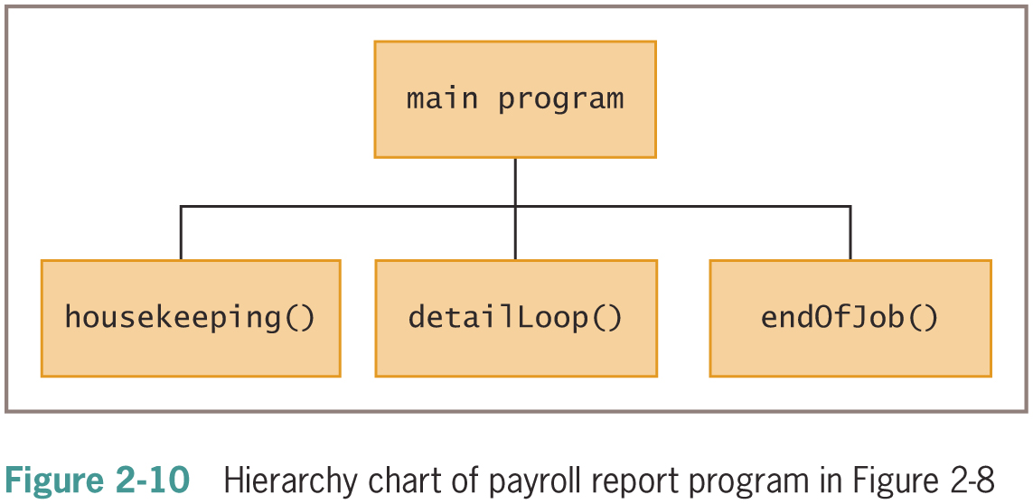
Creating Hierarchy Charts (continued -1)

Slide 20
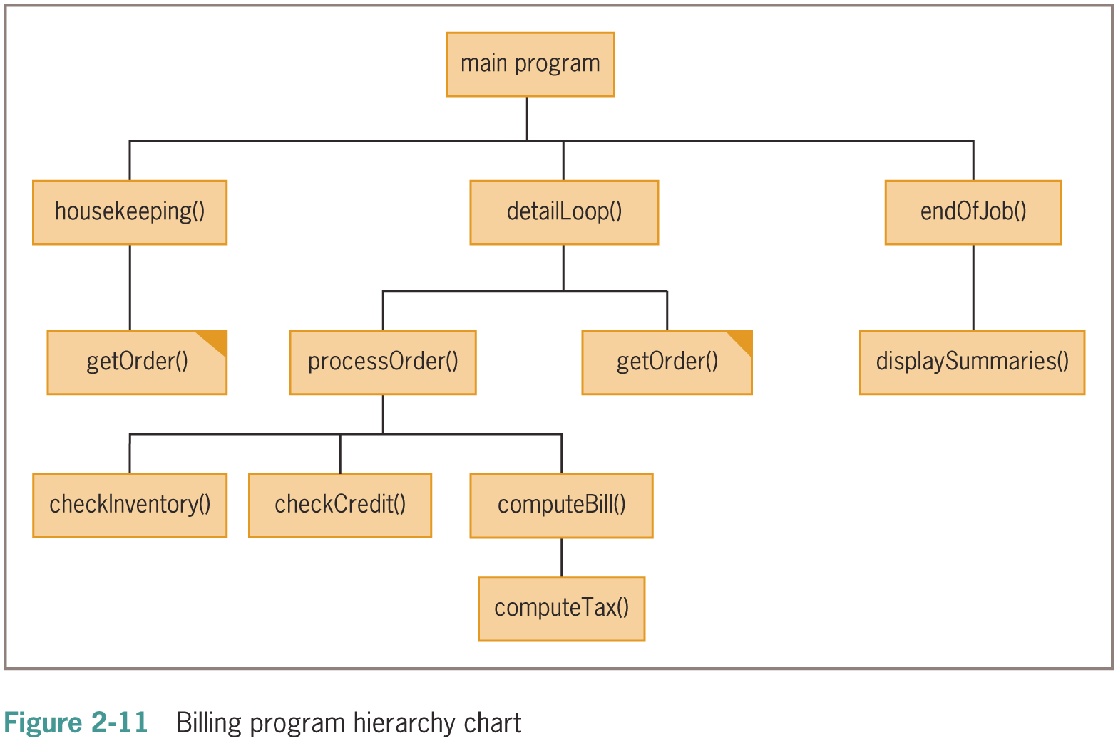
Creating Hierarchy Charts (continued -2)

Slide 21
Features of Good Program Design
Use program comments where appropriate
Identifiers should be chosen carefully
Strive to design clear statements within your programs and modules
Write clear prompts and echo input
Continue to maintain good programming habits as you develop your programming skills

Slide 22
Maintaining Good Programming Habits
Every program you write will be better if you:
Plan before you code
Maintain the habit of first drawing flowcharts or writing pseudocode
Desk-check your program logic on paper
Think carefully about the variable and module names you use
Design your program statements to be easy to read and use

Slide 23
Summary
Programs contain literals, variables, and named constants
Arithmetic follows rules of precedence
Break down programming problems into modules
Include a header, a body, and a return statement
Hierarchy charts show relationship among modules
As programs become more complicated:
Need for good planning and design increases

