Slide 1
Quadair
Our newest solution to make your dream car into reality

Slide 2
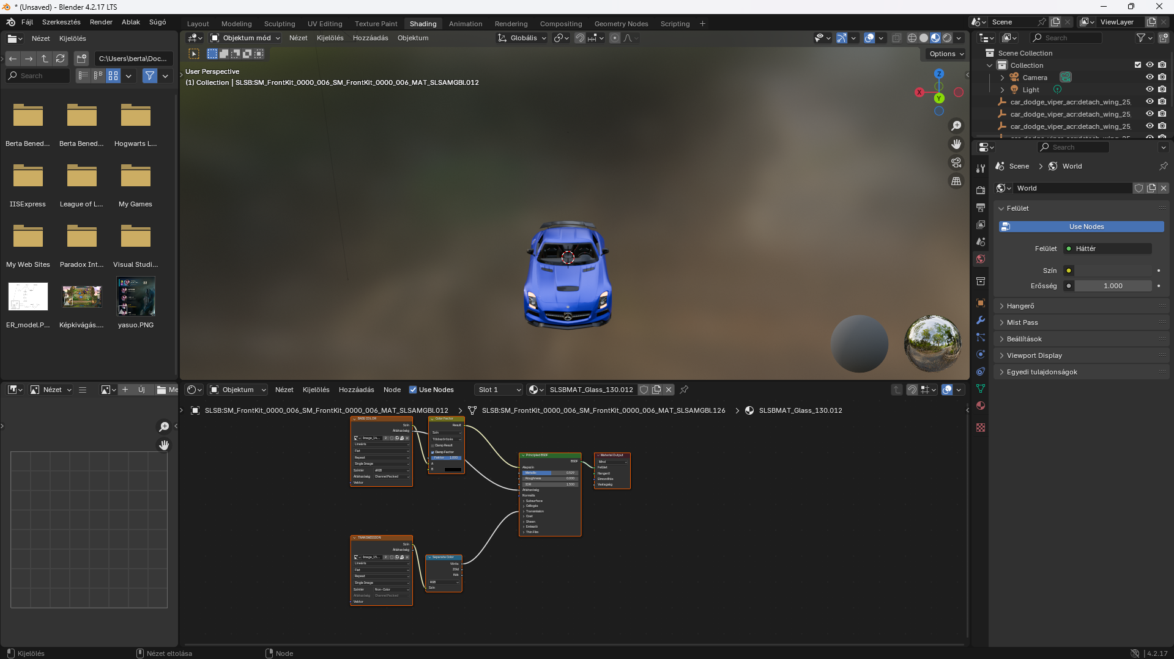
How our models are made
Our models are made with open-source software
The base of the models are open sourced, however any changes to the models (lights, windows, etc…) are made by our team

Slide 3
Engines
Diesel engines use compression ignition, while gasoline engines use spark ignition.
A diesel engine: compresses air much more injects fuel into very hot compressed air usually gives higher torque and better fuel efficiency
A gasoline engine: mixes air and fuel earlier uses a spark plug to ignite it usually gives higher RPM, smoother response, and quieter operation
So briefly: Diesel = more torque, more efficient Gasoline = smoother, revs higher, usually more sporty

Slide 4
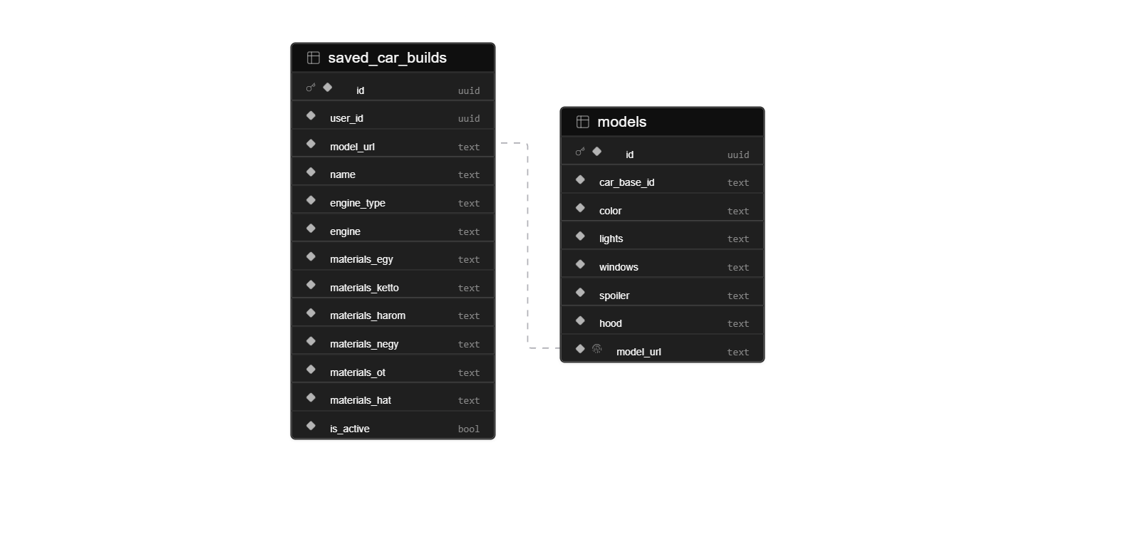
Garage
The models are stored in the models table, and if the user saves a car that car goes into the saved_car_builds table. In both instances we store the models url so load times can be faster and more efficient. The user can only access their builds, customize them or delete them.

Slide 5
How do we store users and their data
The only personal information that we store is that their email.
Their password is stored with Supabase’s encryption. No other personal information is stored.
Every user gets a randomly generated uid which can be used to store their build with their uid so only they can access it.

Slide 6
Technology used
Frontend: NextJS, shadcnUI, Three.js (for the 3d models)
Backend: Supabase, postgreSQL
Hosted on Vercel

