Slide 1

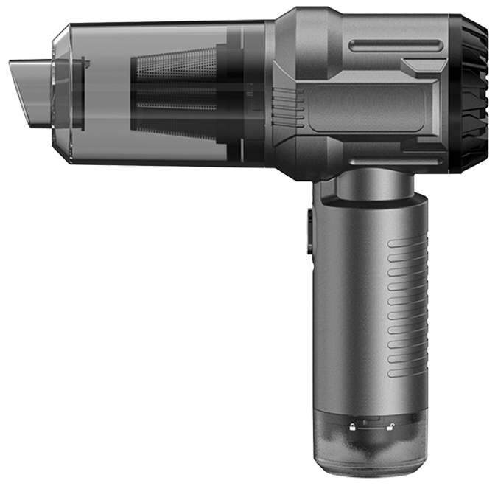
Preliminary Quote Sheet (PQS)
Product Name: BLDC ResQVac w safety hammer and blade
Date: 24 Febuary 2025 (Quote Valid for 2 Months)
Model Number: TS_50378
Specification / Features:
Brushless Motor (45) for high efficiency Dual-Layer Filter (P7-P8) for better dust filtration Vacuum Power: 7000Pa (low), 12000Pa (high) Material & Color: ABS, Gray-Blue Power: 75W Battery: 7.4V/2000mAh (2000mAh*2 in series) Charging: 3 hours Runtime: 16-17 min (high mode) Noise Level: 70dB Dust Bin Capacity: 150ml Current: 10A Power Cord: USB/Type-C booster cable Indicator: Charge/discharge light
Product Class: I
Unit Size: 180*180*65mm
Unit Weight: 0.355kgs
Colour box size: 250*200*80mm
Colour box weight: 0.55kgs
Export Carton Size: 40*41.6*51.6
Export Carton Weight: 11kgs
Quantity per Carton: 20
Quantity per 20'/40'/40HQ: 6500/13000/15500
HS Code: 85081100
Certificates: CE/ROHS
Unit Price in USD: 9.80
Extra Cost for BS & South African Plug: usd0.6
FOB Port: NINGBO
MOQ: 3000.0
Delivery Days: 50 Days
Product Status: Ready for Production
Product Video Link: https://youtu.be/DW6f6cyCOc0
Payment Terms: 30% Deposit, Balance against B/L copy

Slide 2
