Slide 1

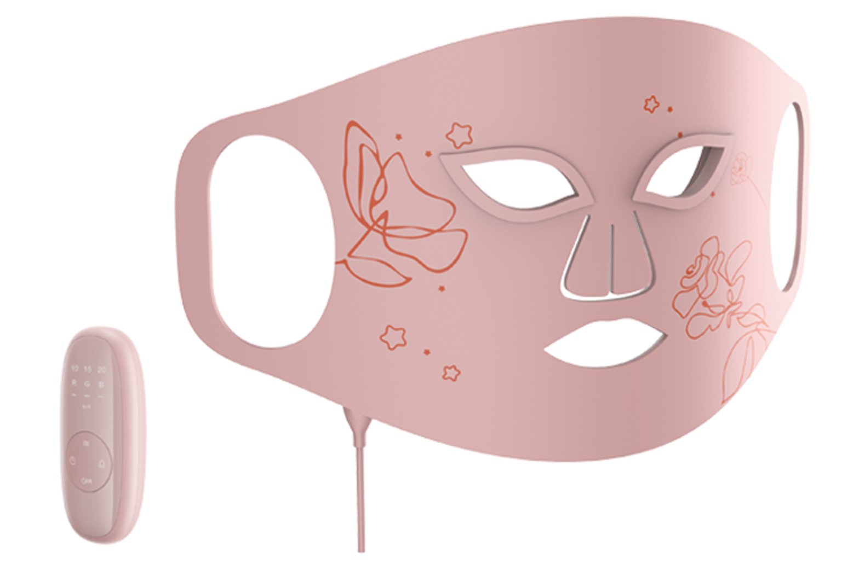
Preliminary Quote Sheet (PQS)
Product Name: LED Face Mask
Date: 18 April 2025 (Quote Valid for 2 Months)
Model Number: TS_51011
Specification / Features:
The LED light is absorbed by the deeper layers of the skin. This triggers cellular activity, which helps to renew skin cells and repair aging tissue. 1.Using 60pcs 99% purity infra LED chips with no UV； 2.Made from food-grade flexible silicone material, fits and wraps you face skin perfectly- meaning the light can penetrate more deeply and evenly, and suitable for different size face； 3.Lightweight design, the mask weighs only 206g, 3mm ultra-thin ; 4.Wireless ease, built-in rechargable large capacity Lithium battery for long time use; 5.Remote controller for convience operation; 6.IPX6 waterproof; 7.Timmer function:5minutes, 10minutes, 15minutes; 8.Light energy 3 levels adjustable; 9.Treat your skin with 7 different LED colors; each color tackles a different skin concern. 10.Elgent Design: admire the blend of technology and design
Product Class: I
Unit Size: 402*199*3mm
Unit Weight: 0.1925g
Colour box size: 41.6*23.6*5.7cm
Colour box weight: 0.92kgs
Export Carton Size: 60cm*43.3cm*48.5cm
Export Carton Weight: 20kgs
Quantity per Carton: 20
Quantity per 20'/40'/40HQ: 4,500/9,200/10,000
HS Code: 8543709990
Certificates: CE/RoHS/FCC
Unit Price in USD: 18
FOB Port: Shenzhen
MOQ: 5000
Delivery Days: 30 Days
Product Status: Ready for Production
Payment Terms: 30% Deposit, Balance against B/L copy

