Slide 1

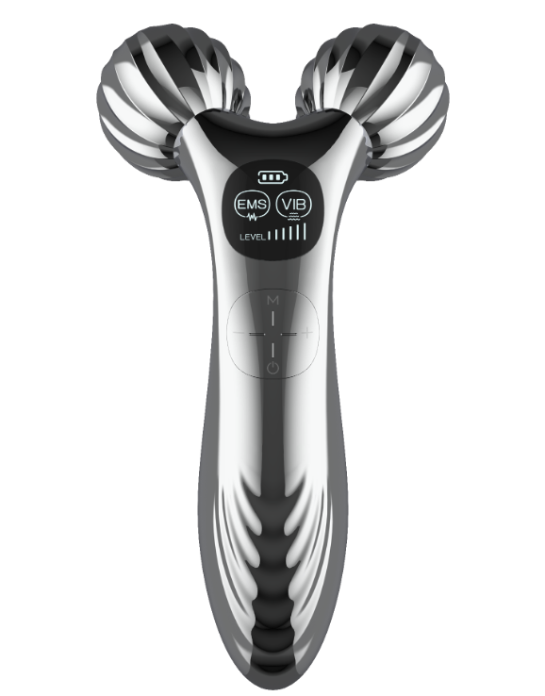
Preliminary Quote Sheet (PQS)
Product Name: EMS Massager
Date: 18 April 2025 (Quote Valid for 2 Months)
Model Number: TS_51016
Specification / Features:
EMS activates skin cell and stimulates colleagen regeration, makes stronger muscles and more elastic skin. Vibrating massage for blood circulation Facial and body uplifting and reshaping Six working intensities adjustable. LCD on the handle shows functions and operations clearly. Swirl marks design on rollers improves massage comfort and promotes skin texture circulation. Special ripple appearance on handle
Product Class: I
Unit Size: 160*85*53mm
Unit Weight: 0.141kgs
Colour box size: 198*121*65mm
Colour box weight: 0.276kgs
Export Carton Size: 40.2x37.2x36.2cm
Export Carton Weight: 13.8kgs
Quantity per Carton: 50
Quantity per 20'/40'/40HQ: 25,000/53,000/62,000
HS Code: 8543709990
Certificates: CE/RoHS/FCC
Unit Price in USD: 12.95
FOB Port: Shenzhen
MOQ: 5000
Delivery Days: 30 Days
Product Status: Ready for Production
Payment Terms: 30% Deposit, Balance against B/L copy

