Slide 1
Simulation of World’s Highest Jumping Robot
Junlin Chen
Sanskar Nalkande

Slide 2
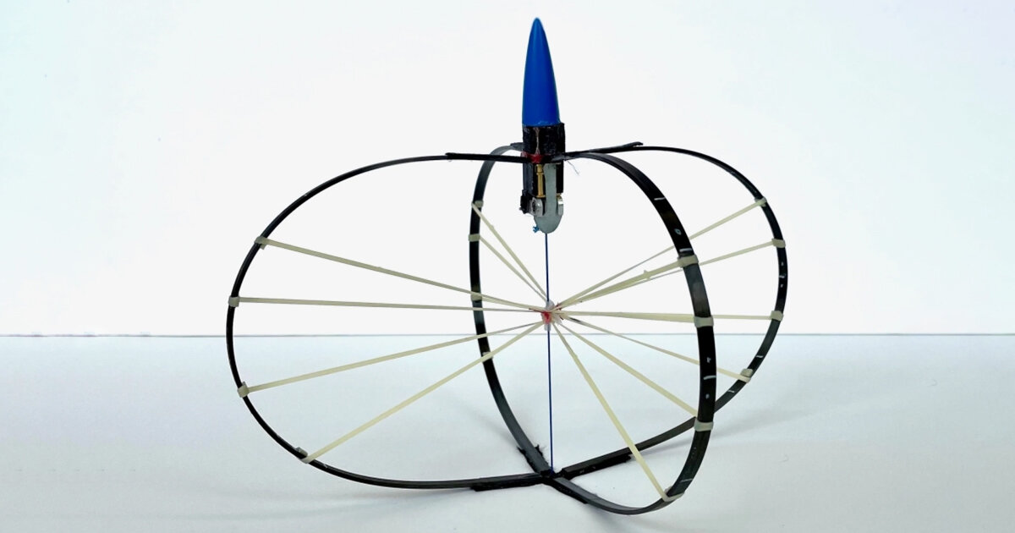
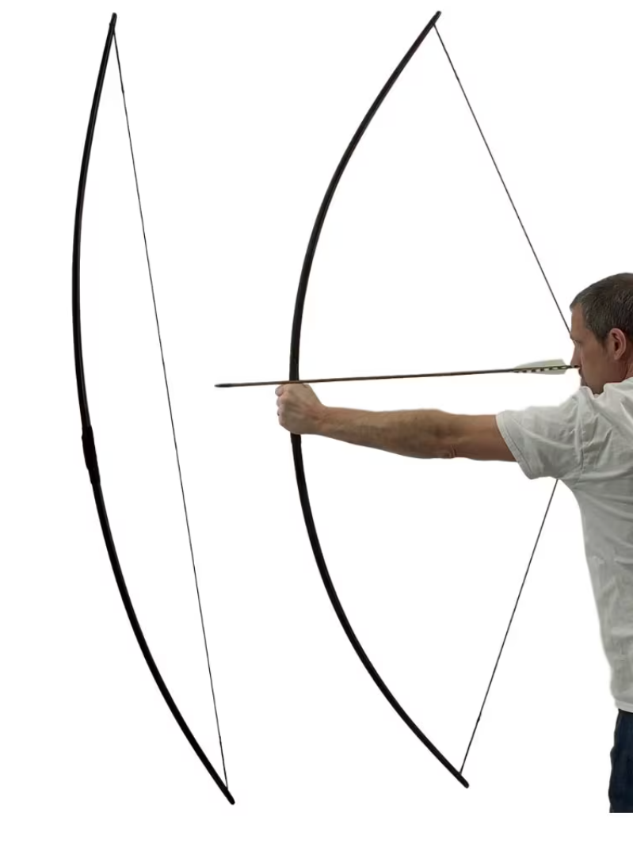
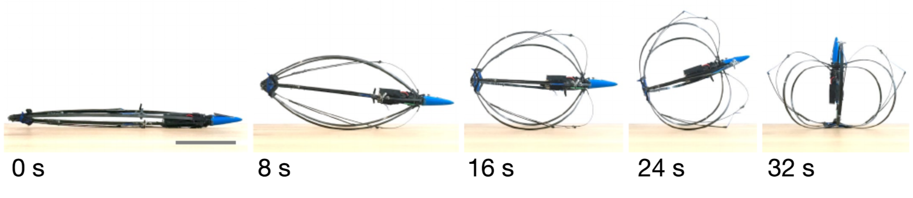
The Jumping Robot
Hybrid Tension-Compression Jumping Robot
Methodology:
-DisMech DER Simulation
Goal:
-Simulation matches real motion -Easy change of parameters and geometry

Slide 3
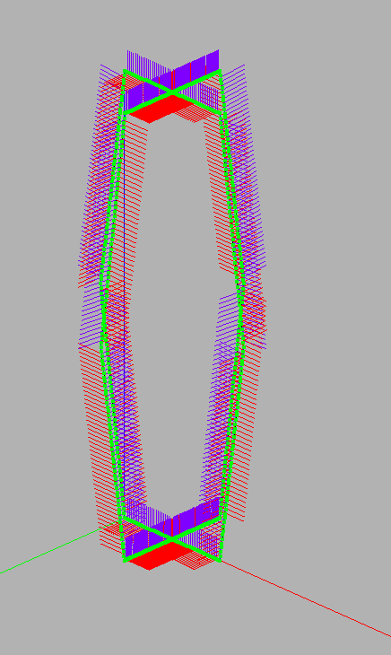
Limb and Joint Construction
Dismech rod simulation in 3D
D = 1.45mm, E = 131GPa[2]
9 limbs and 9 joints(more to add)
Joint as single elastic body
0.03x0.03x0.3m in size[1]

Slide 4
Force Application and Fixtures
Center edge of bottom cross is fixed
Force in the downward z direction uniformly distributed at top cross
Expected a constant application of force throughout time

Slide 5


Slide 6
Work in Progress & Challenges
Z component force issue
Elastic bands(30.5x2mm)[1] addition
Ground contact rather than fixtures
Realistic way to apply force
Compute the total elastic energy stored[3]
Actuation?
Ground

Slide 7
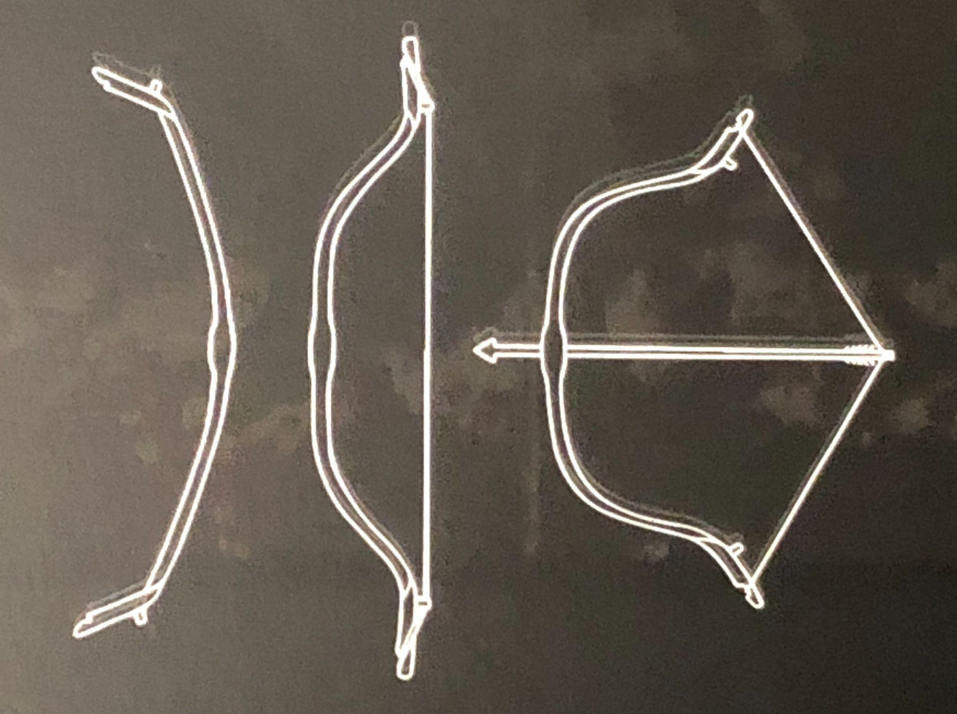
Possible Future Improvements
Recurve vs. normal bow
Higher specific elastic energy
Need to build from vertices rather than limbs
Change natural curvature in DisMech

Slide 8
Sources:
[1] E. W. Hawkes et al., "Engineered Jumpers Overcome Biological Limits via Work Multiplication," Nature News, Apr. 27, 2022.
[2] ACP Composites, "Solid Carbon Rod All Series PDS," No.49881, Oct.2019.
[3] M. Khalid Jawed, Class Lecture, Topic: "Networks of Beams." Module 17, University of California, Los Angeles. Oct, 2023.
[4] K. McLaughlin, A. Titus, “Elasticity of Thera-Band Resistance Band,” High Point University., High Point N.C., 2014.

Slide 9
Thank you
Q&A Time

